Slide 1



Coastal Satellite-Assisted Governance (tools, techniques, models) for Erosion
Coastal SAGE
Dr Ing. Gianluca Valentino (PI), Dr Sebastiano D’Amico
University of Malta

Slide 2
Outline
Introduction and motivation
Earth Observation (EO) for coastal erosion - why and how
The Coastal SAGE project outcomes
Study areas around the Maltese Islands

Slide 3
Outline
Introduction and motivation
Earth Observation (EO) for coastal erosion - why and how
The Coastal SAGE project outcomes
Study areas around the Maltese Islands

Slide 4
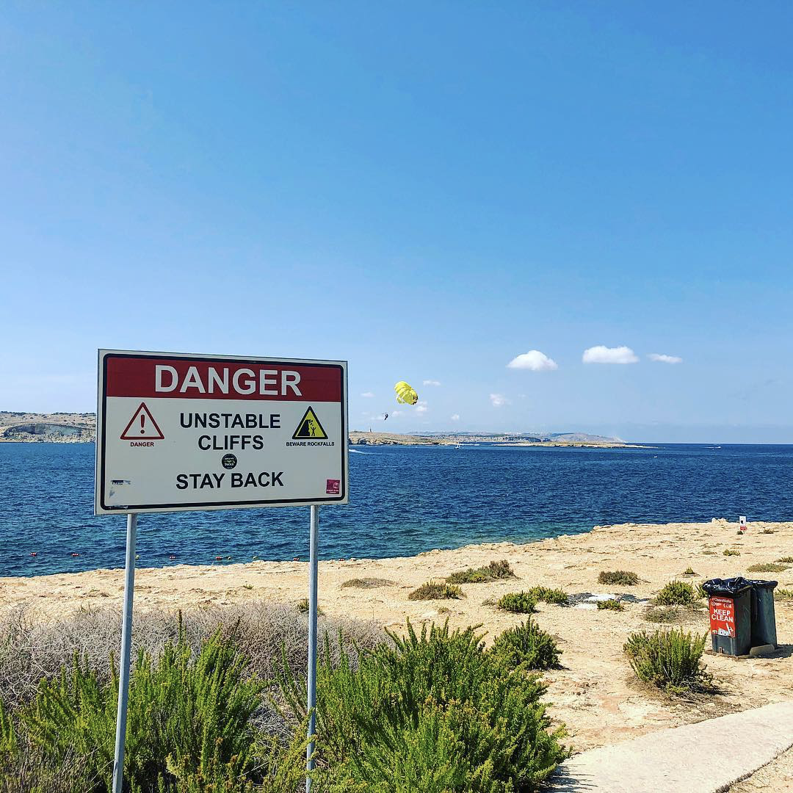
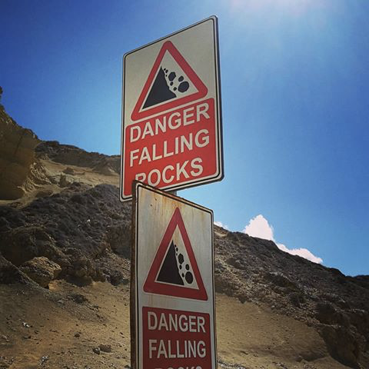
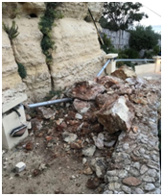
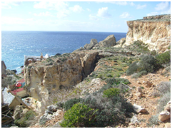
Introduction and motivation
Coastal erosion is of importance to the Maltese Islands as the coast is one of the most intensely-used and visited areas.
Erosion along the rocky shoreline poses hazards to life, infrastructure and cultural heritage.
Current response to this issue is mostly reactive and driven by visual site inspections.
The Coastal SAGE project will use satellite data and related image processing and AI techniques to better monitor the phenomenon of erosion.

Slide 5
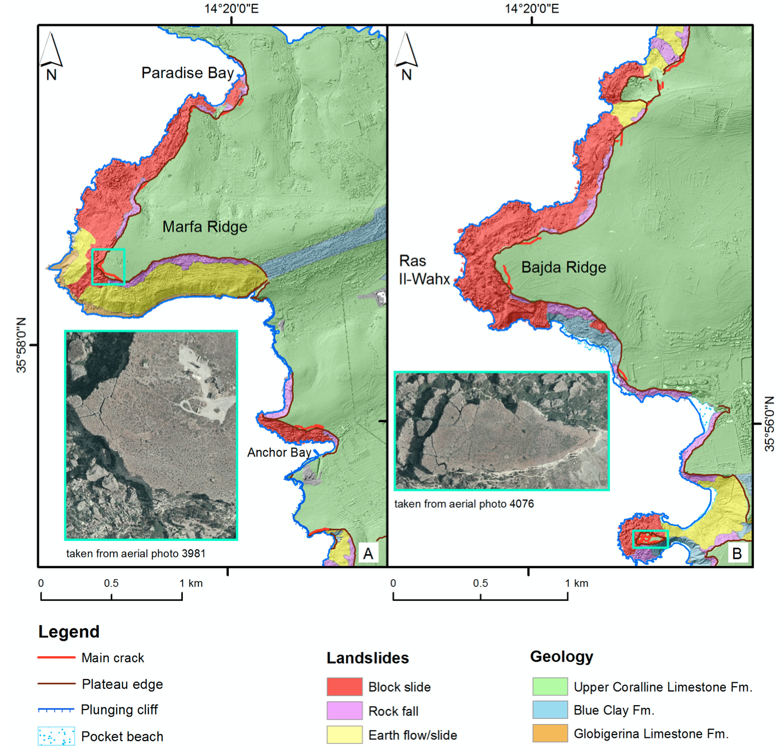
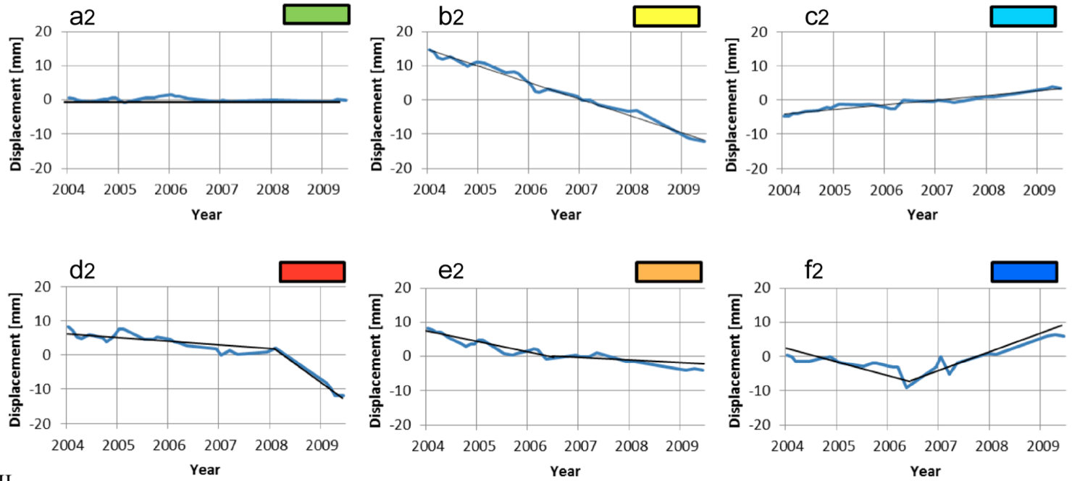
Introduction and motivation
A team from CNR/UNIMORE has already studied slow-moving landslides along the NW coastline using SAR satellite data and Persistent Scatterer Interferometry techniques.
Collaboration envisaged for the Coastal SAGE project.
Mantovani et al., Remote Sens. 2016

Slide 6
Outline
Introduction and motivation
Earth Observation (EO) for coastal erosion - why and how
The Coastal SAGE project outcomes
Study areas around the Maltese Islands

Slide 7

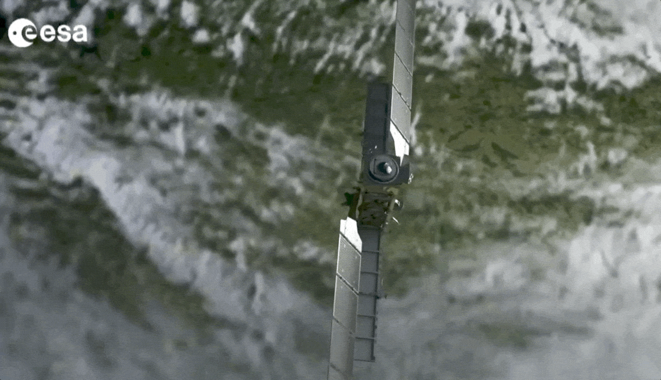
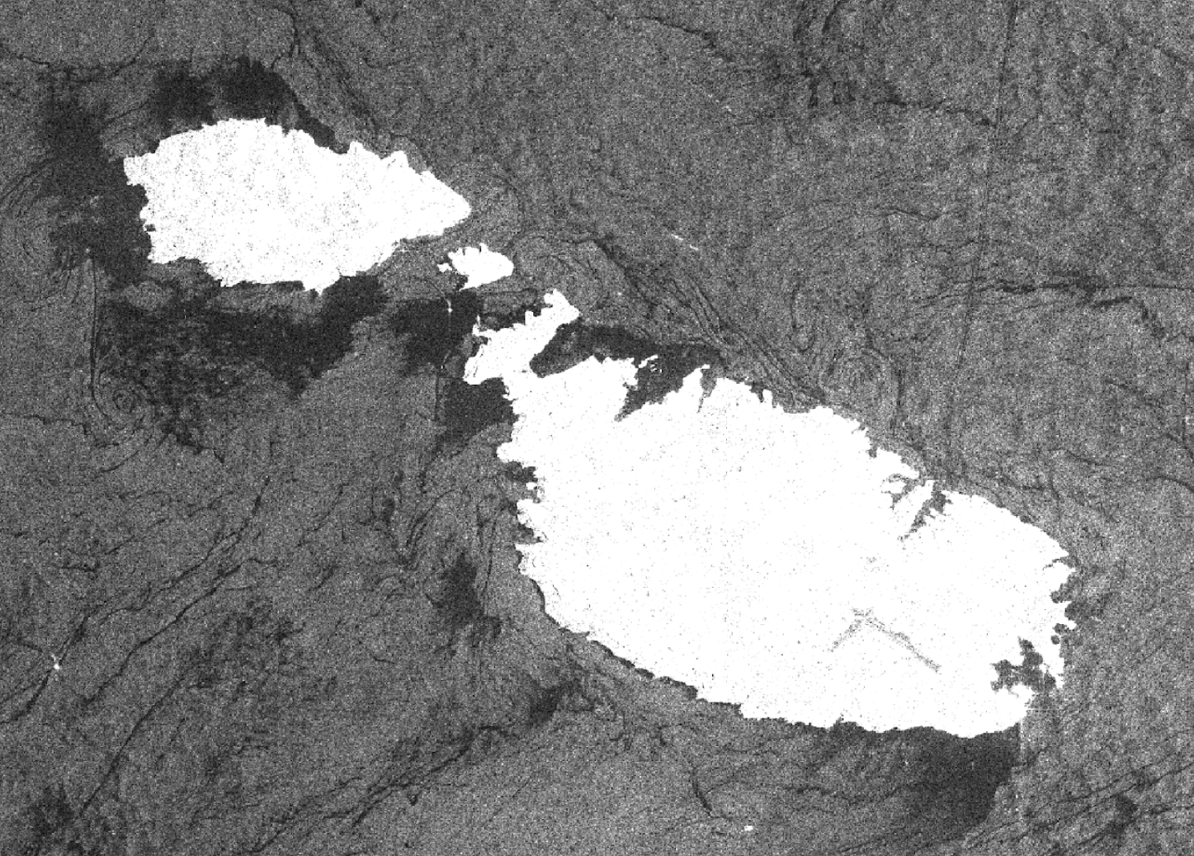
Synthetic Aperture Radar
The European Space Agency’s Sentinel-1 satellites were launched in 2014-2016.
Their Synthetic Aperture Radar (SAR) instrument monitors changes on Earth with millimetric precision.
Spatial resolution: 5 x 20 metres
Applications: land surface deformation, urbanization, agriculture, forestry, oceanography and glaciology.
SAR amplitude image of the Maltese Islands

Slide 8
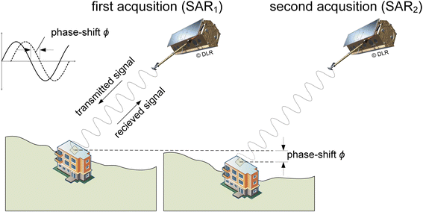
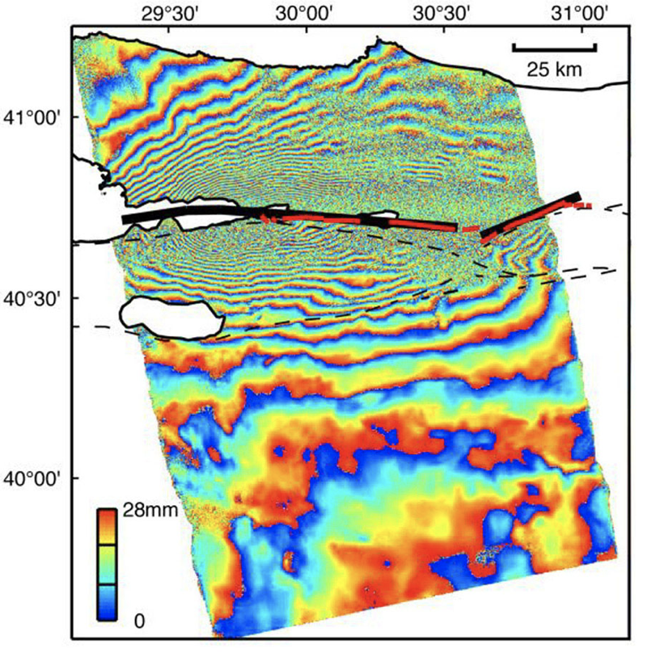
Interferometric SAR
Changes in the Earth’s surface can be estimated from the change in phase of the received signal over time.
Interferogram showing land deformation in Izmit (Turkey) after earthquake.
Red lines = location of fault

Slide 9
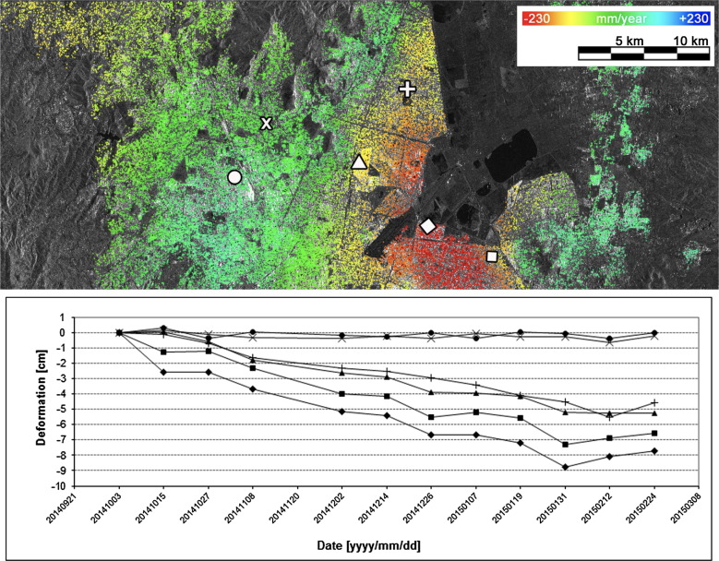
Persistent Scatterer Interferometry
Certain pixels in a scene may be coherent over a sequence of interferograms.
  i.e. they reflect the signal roughly in the same way each time the satellite passes over.
These pixels are known as persistent scatterers.
Therefore, they are very useful in estimating slow deformation over time with high precision (mm).

Slide 10
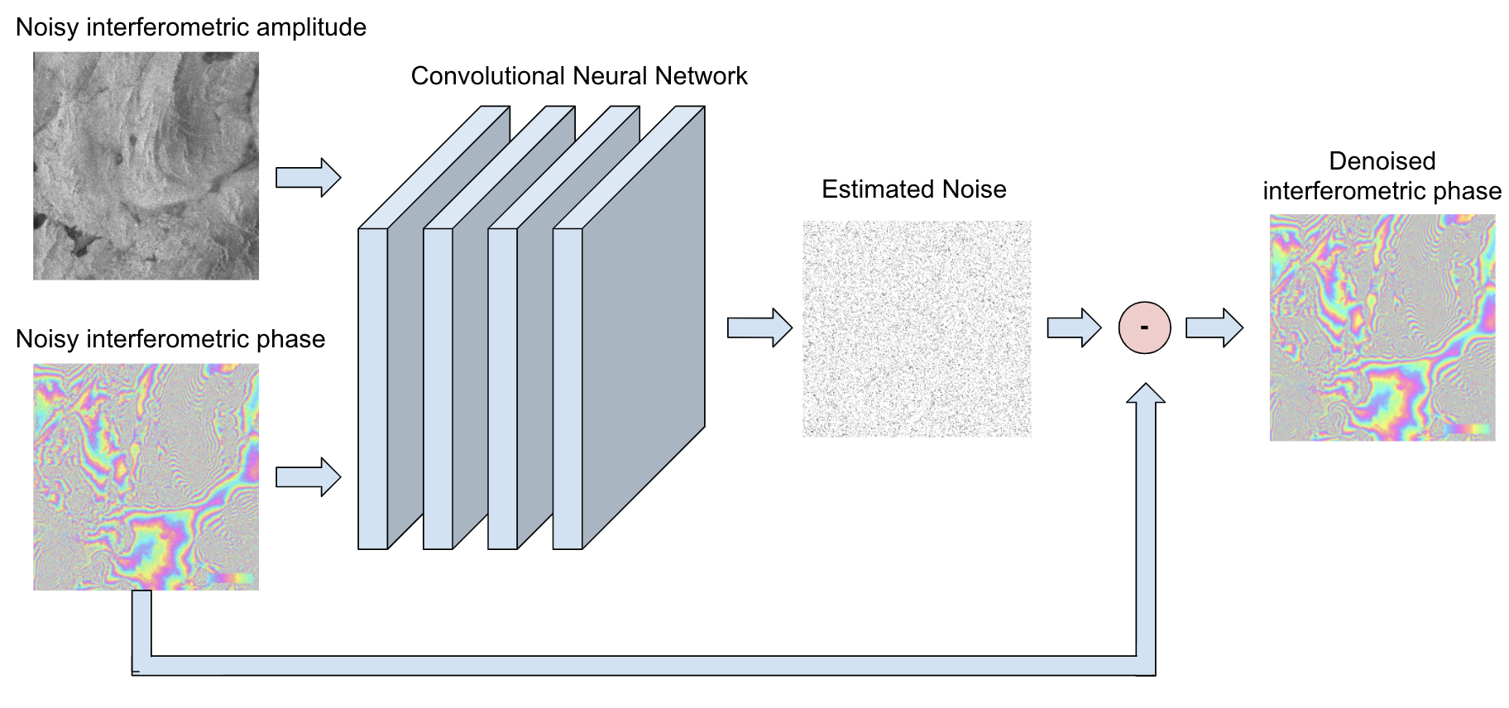
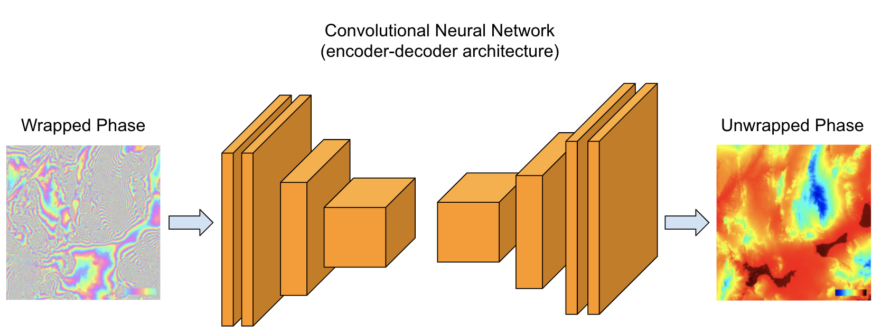
Persistent Scatterer Interferometry
Our planned research contribution is to use Artificial Intelligence (AI) techniques to improve the PSI pipeline:
Improved SAR interferometric phase denoising:
Improve the phase unwrapping procedure:

Slide 11
Outline
Introduction and motivation
Earth Observation (EO) for coastal erosion - why and how
The Coastal SAGE project outcomes
Study areas around the Maltese Islands

Slide 12
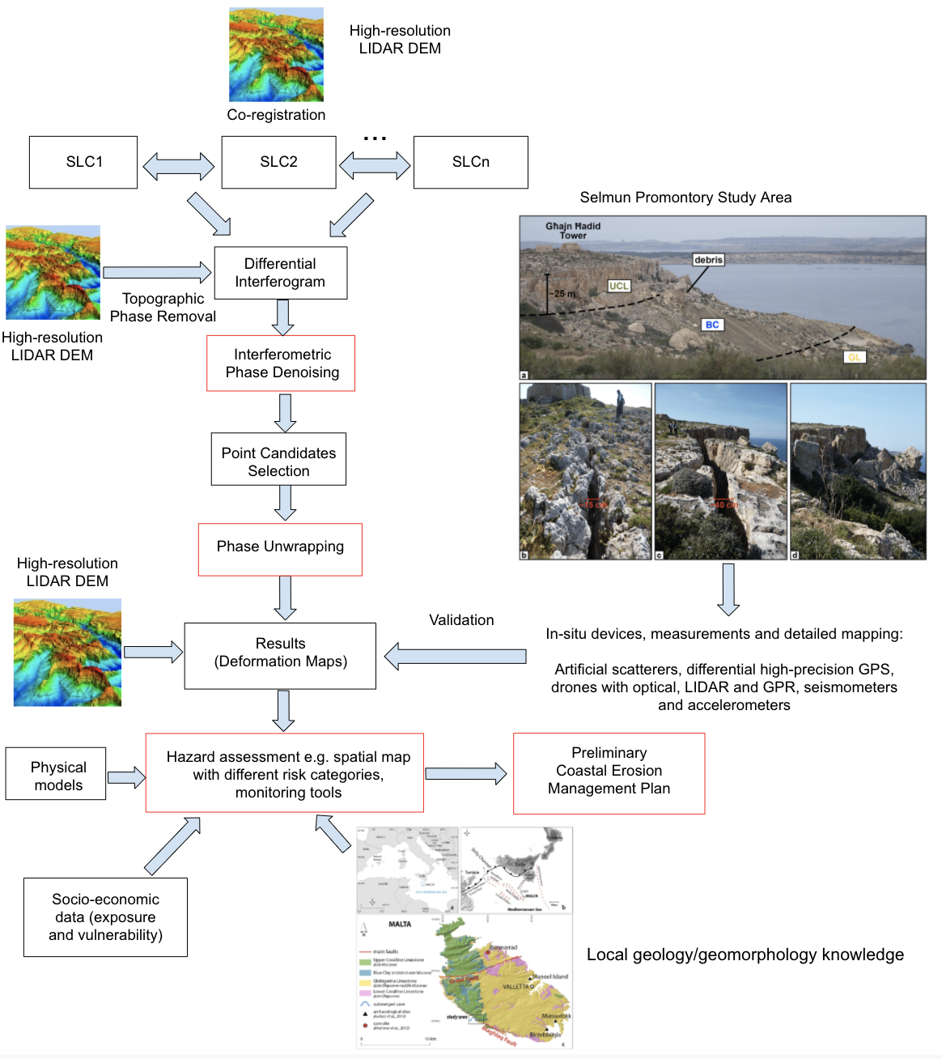
Coastal SAGE project outcomes
Project outcomes:
  Improving the EO data processing pipeline
  Development of a risk assessment and monitoring tool
  Capacity building
  Stakeholder engagement and participation
  Preliminary Coastal Erosion Management Plan

Slide 13
Outline
Introduction and motivation
Earth Observation (EO) for coastal erosion - why and how
The Coastal SAGE project outcomes
Study areas around the Maltese Islands

Slide 14
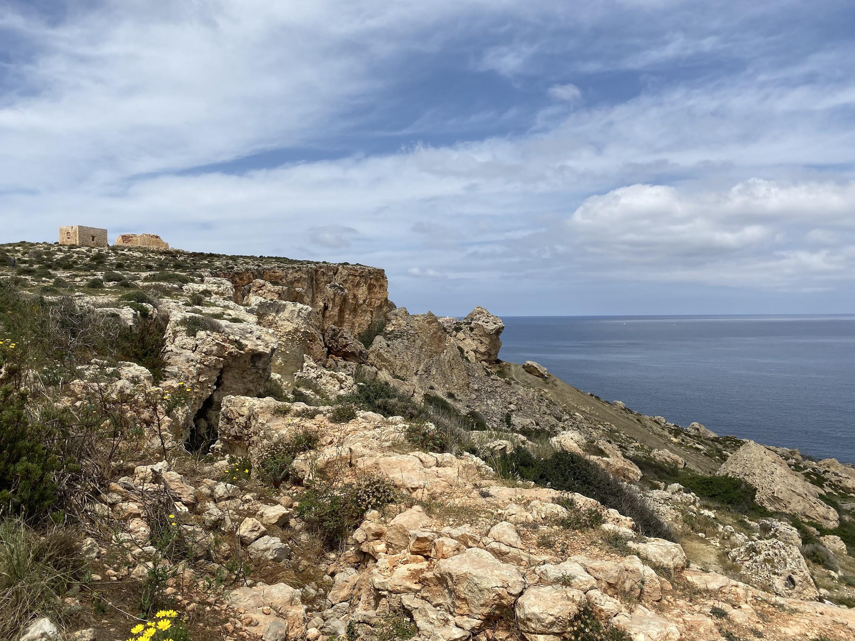
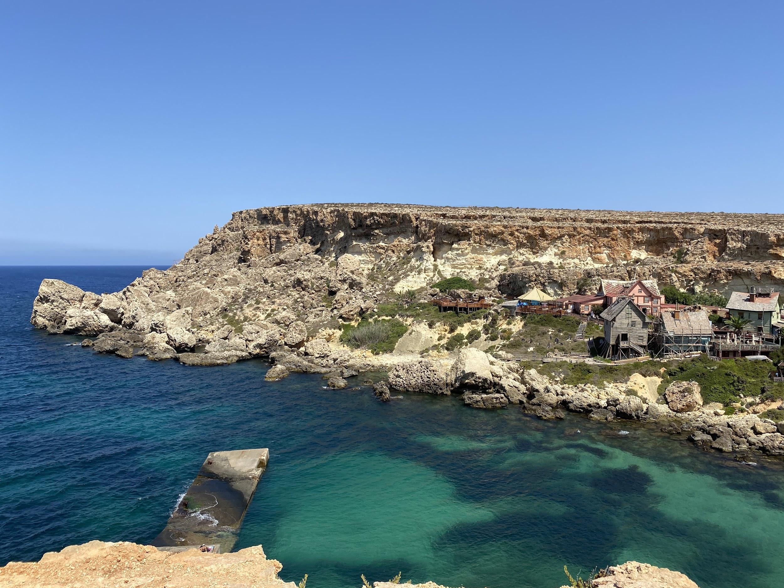
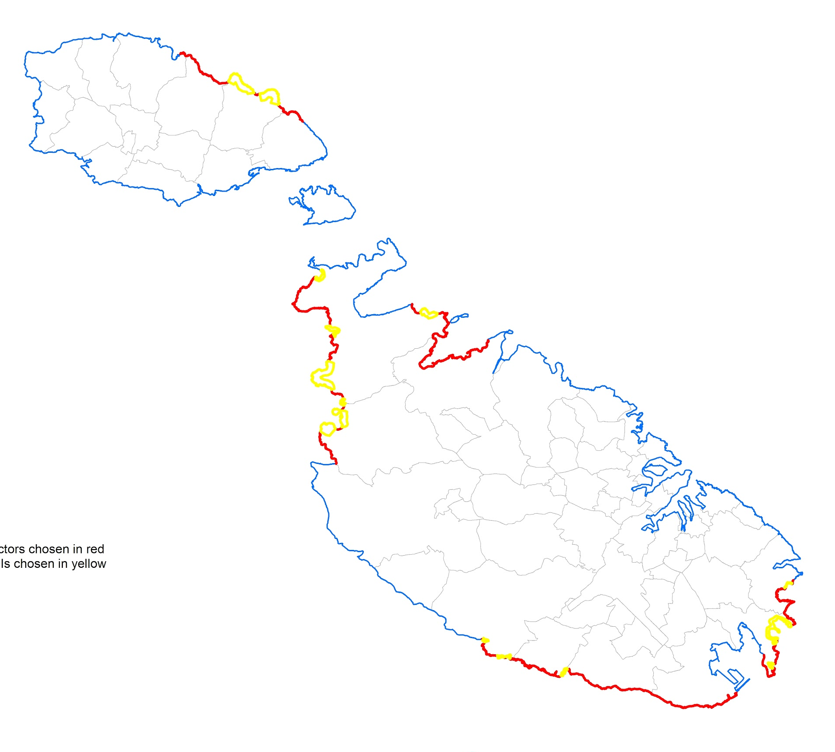
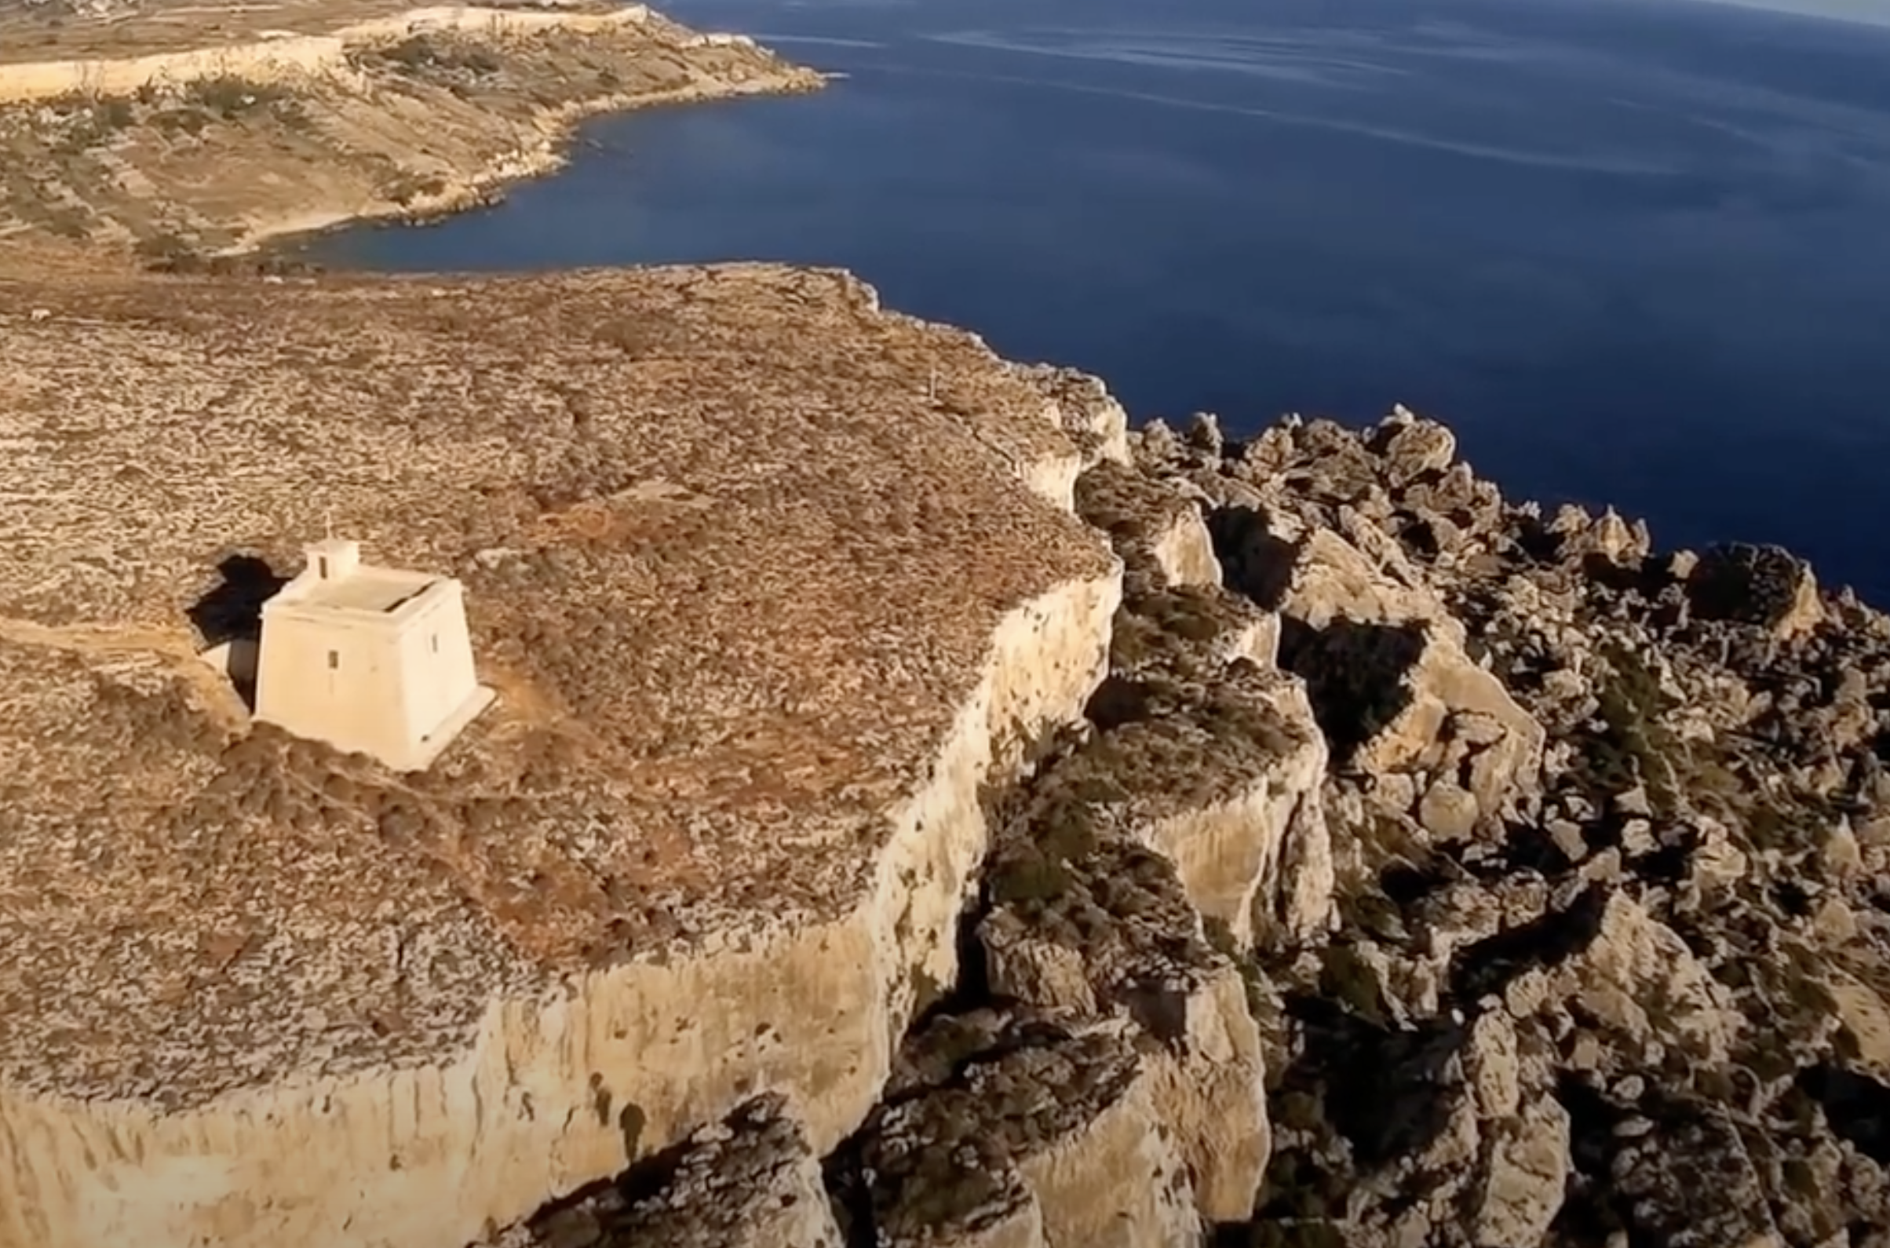
6 Study Areas around the Maltese Islands

Slide 15
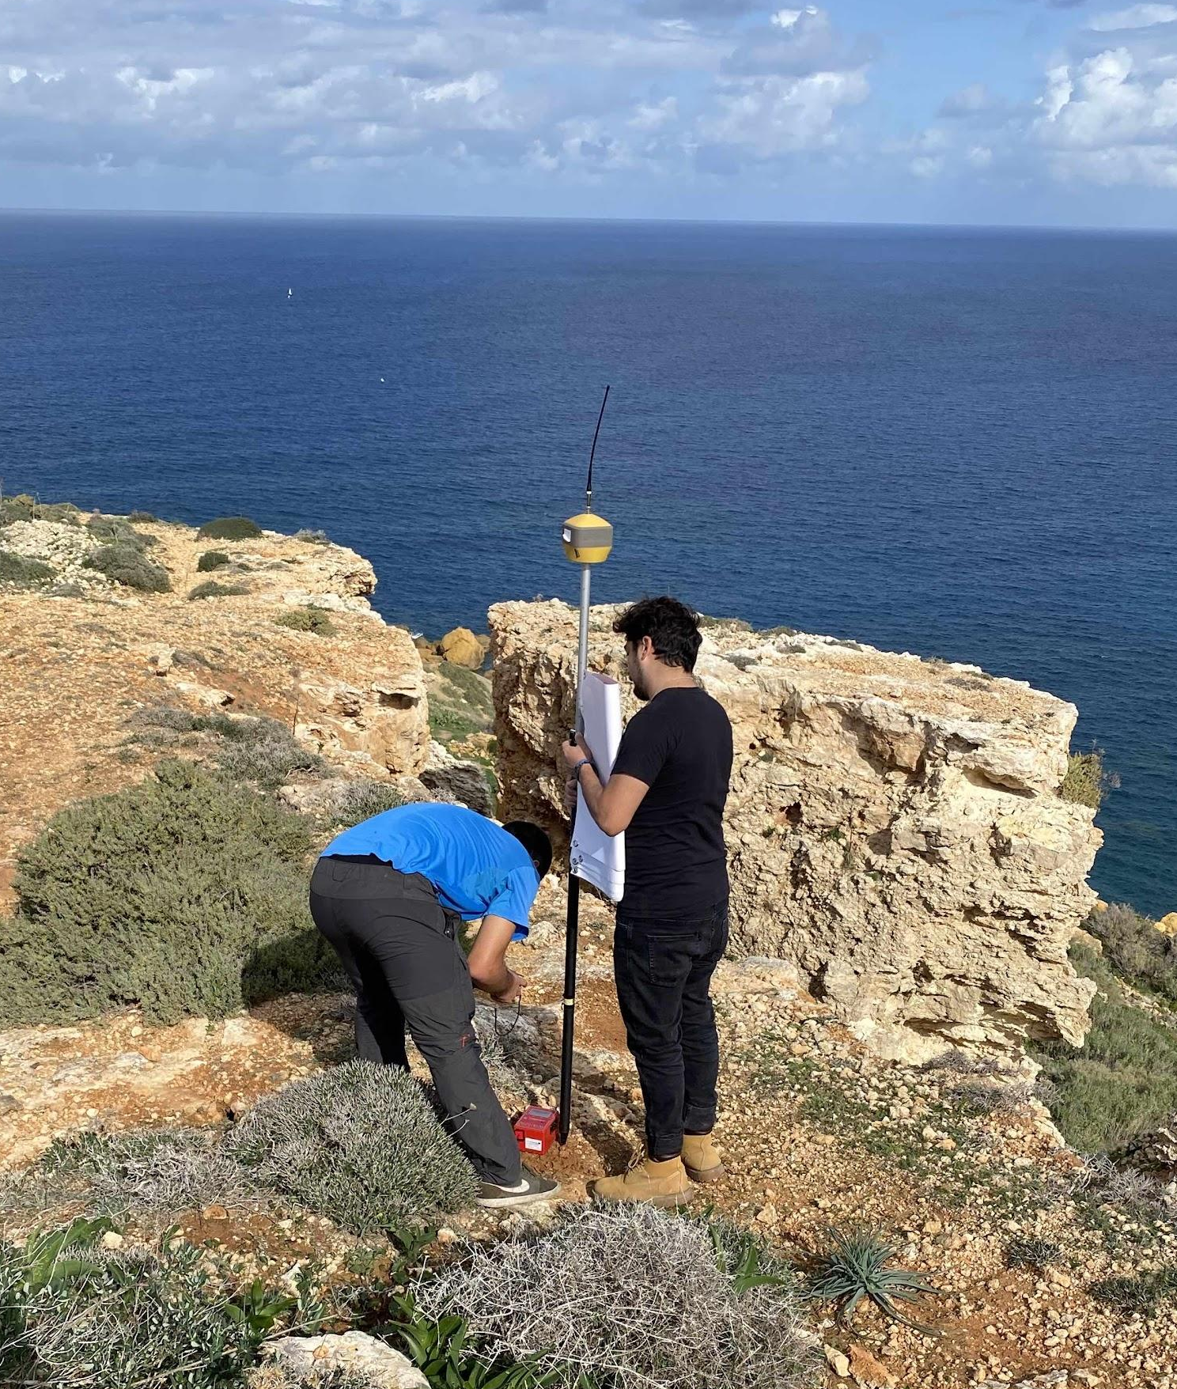
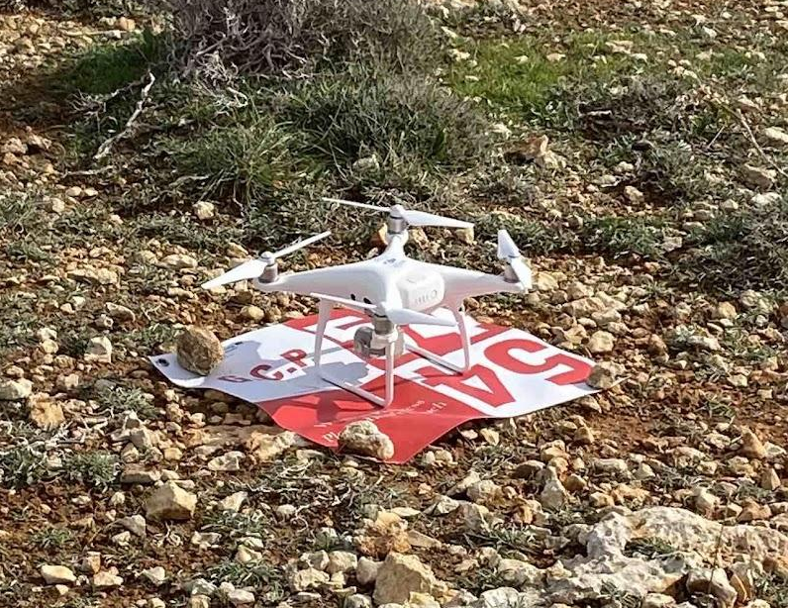
In-situ measurements
In each of the above 6 Study areas, we are conducting in-situ measurement campaigns in specific test sites:
  UAV missions will be flown to obtain LIDAR cloud points to construct Digital Elevation Models
  Differential high-precision GPS for topographic campaigns
  Fixed GPS sensors for long-term monitoring
  Tiltmeters
  Accelerometers
  Artificial scatterers deployed to improve the SAR response.

Slide 16
Risk assessment and monitoring tool
Gather socio-economic data
  E.g. bathing frequency, maritime traffic, presence of infrastructure
Develop a risk assessment matrix
  Hazard = geologically induced situations estimated through PSI techniques
  Exposure = socio-economic aspects
Using the risk assessment tool, potential mitigation strategies for areas deemed to be at high risk will be postulated
  Managerial e.g. use-zonation
  Engineered e.g. reducing flow velocity at cliff faces
End result: preliminary Coastal Erosion Management Plan

Slide 17
Conclusions
The Coastal SAGE project kicked-off in September 2020 with the aim of providing the Maltese authorities with an EO data-driven solution to develop a proactive response to the problem of coastal erosion.
Main project goals:
  Improving the EO data processing pipeline
  Development of a risk assessment and monitoring tool
  Capacity building
  Stakeholder engagement and participation
  Preliminary Coastal Erosion Management Plan
For further updates throughout the project: https://www.um.edu.mt/projects/coastal-sage/index.html

Slide 18
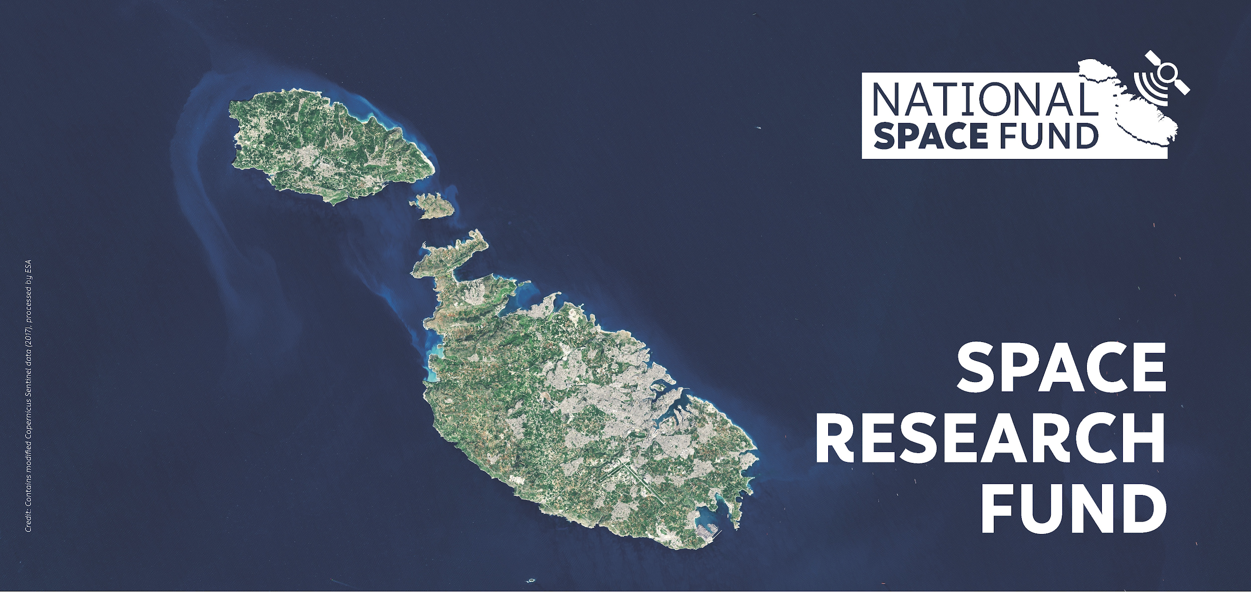

Acknowledgements
Project Coastal SAGE financed by the Malta Council for Science and Technology, for and on behalf of the Foundation for Science and Technology, through the Space Research Fund.

