Slide 1
EUSPA and the EU Space Programme
18/07/2023
Rodrigo da Costa, Executive Director

Slide 2



A new EU Space Programme
EU space activities under one umbrella
…
SSA
Space Situational Awareness (SSA)
Others
EGNOS
Galileo
Copernicus
GOVSATCOM
EGNOS “Makes navigation signals more accurate and trustable for Safety-critical applications”
Operational in 400+ airports & helipads in 23 countries
Global satellite navigation and positioning system (GNSS)
More than 3 billion Galileo receivers worldwide
Earth Observation (EO) and monitoring based on satellite & non-space data
Nr.1 world provider of space data and information (>20TB/day)
Secure satellite communications for EU governmental actors
Rapid support over crisis areas
Space Surveillance and Tracking (SST)
Space Weather Events (SWE)
Near-Earth Objects (NEO)
Access to Space
Research & Innovation
Entrepreneurship
Certification & standardisation
Capacity Building

Slide 3
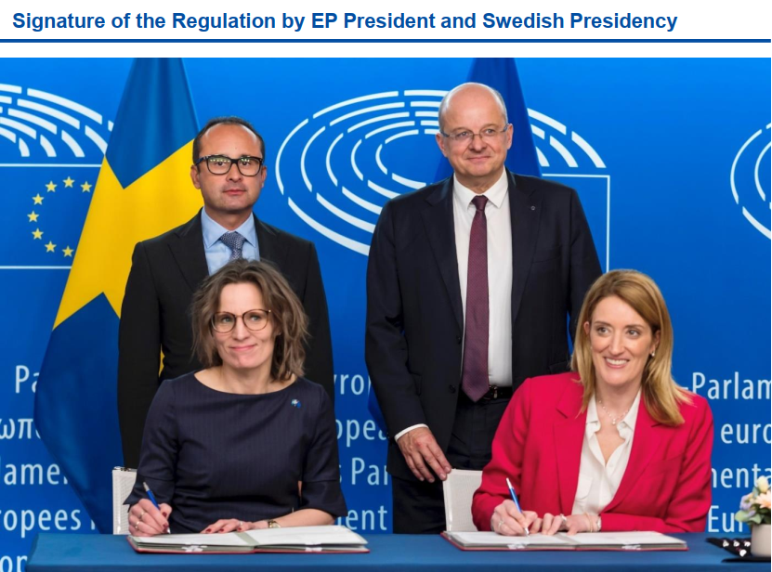
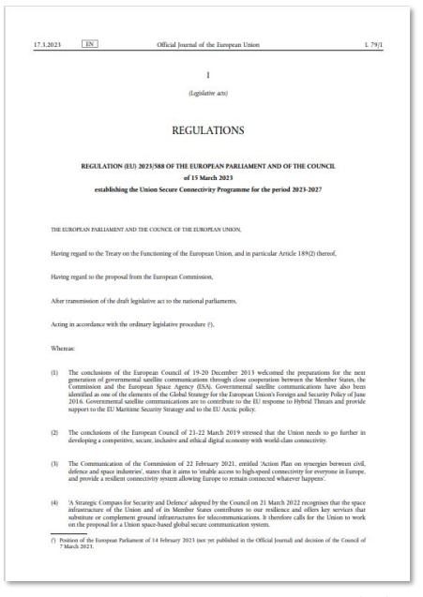
IRIS²
Infrastructure for Resilience, Interconnectivity and Security by Satellite
Regulation 2023/588 in force since 20 March 2023

Slide 4
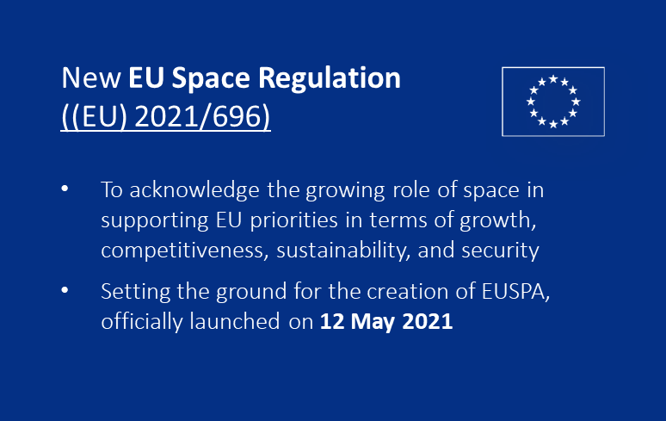


EUSPA’s mission
Exploitation
Security
Market development, communications, user uptake, applications, innovation

Slide 5
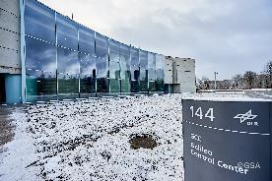
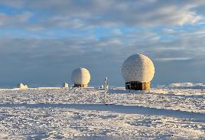
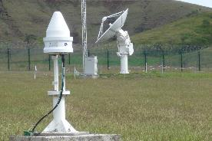
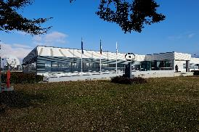
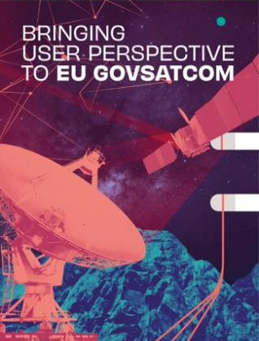
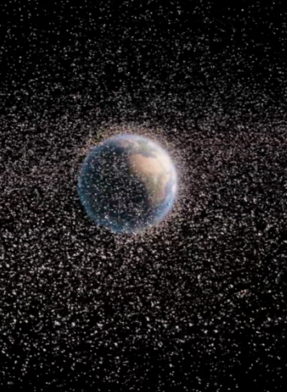
Exploitation
Galileo and EGNOS services provision and 24/7 operations
  including management, operation, maintenance, improvement, evolution & protection of infrastructure
GOVSATCOM hub and IRIS2 preparation
Space Surveillance and Tracking (SST) Front Desk as of July 2023

Slide 6


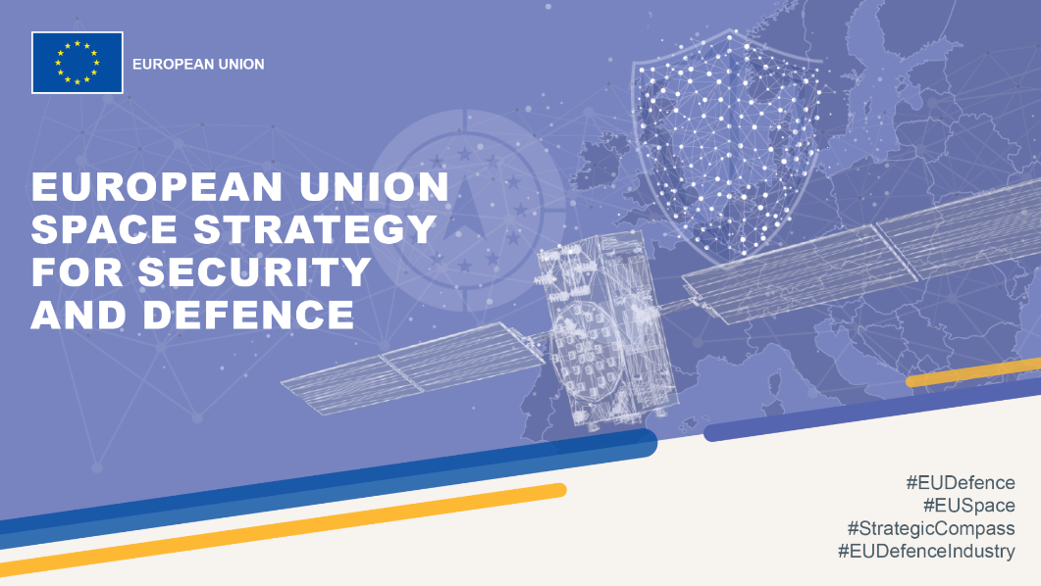
Security
Security Accreditation
Security Monitoring Center operations
Governmental Service Provision
Security Engineering
Key contributor for the implementation EU Space Strategy for Security and Defence

Slide 7
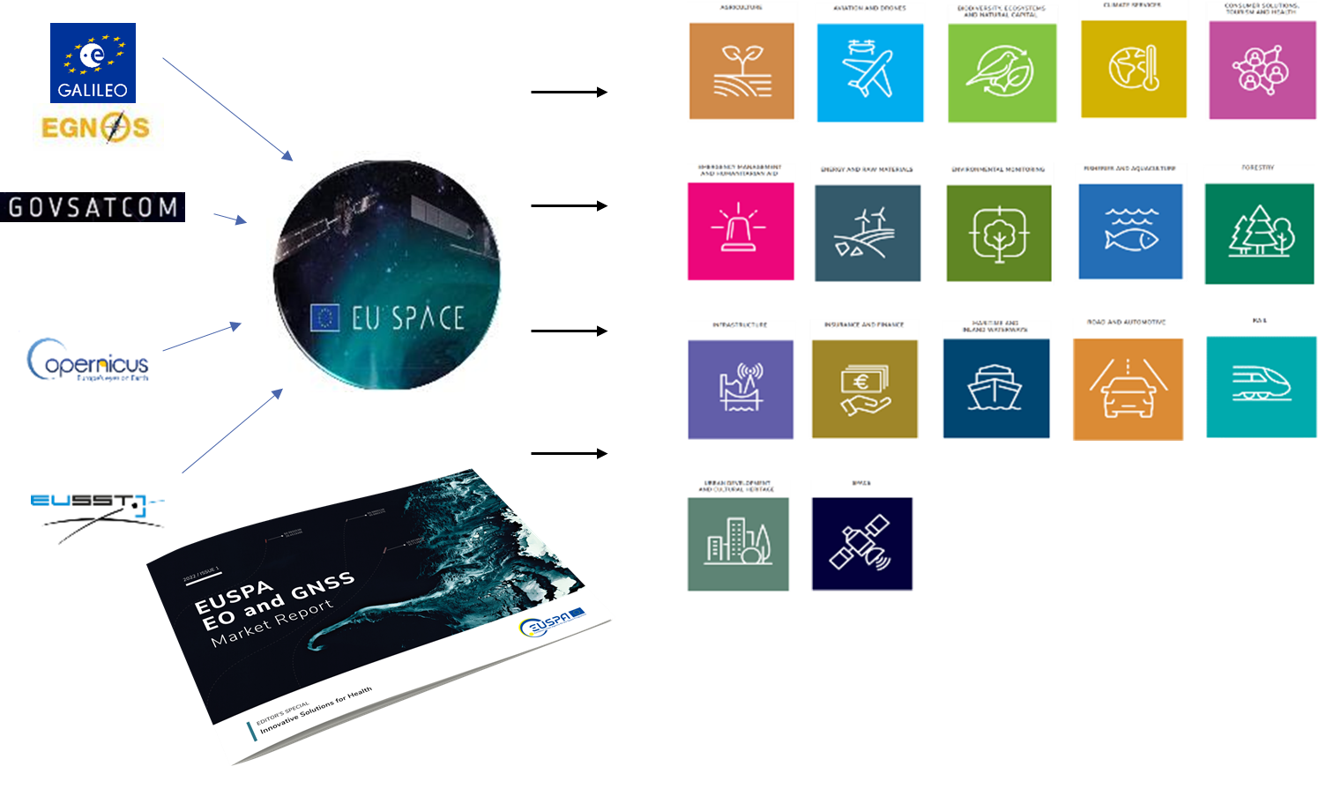
Utilization
Market development, communications, user uptake, applications, innovation
For Galileo, EGNOS, commercial use of Copernicus, GOVSATCOM - and soon IRIS²

Slide 8
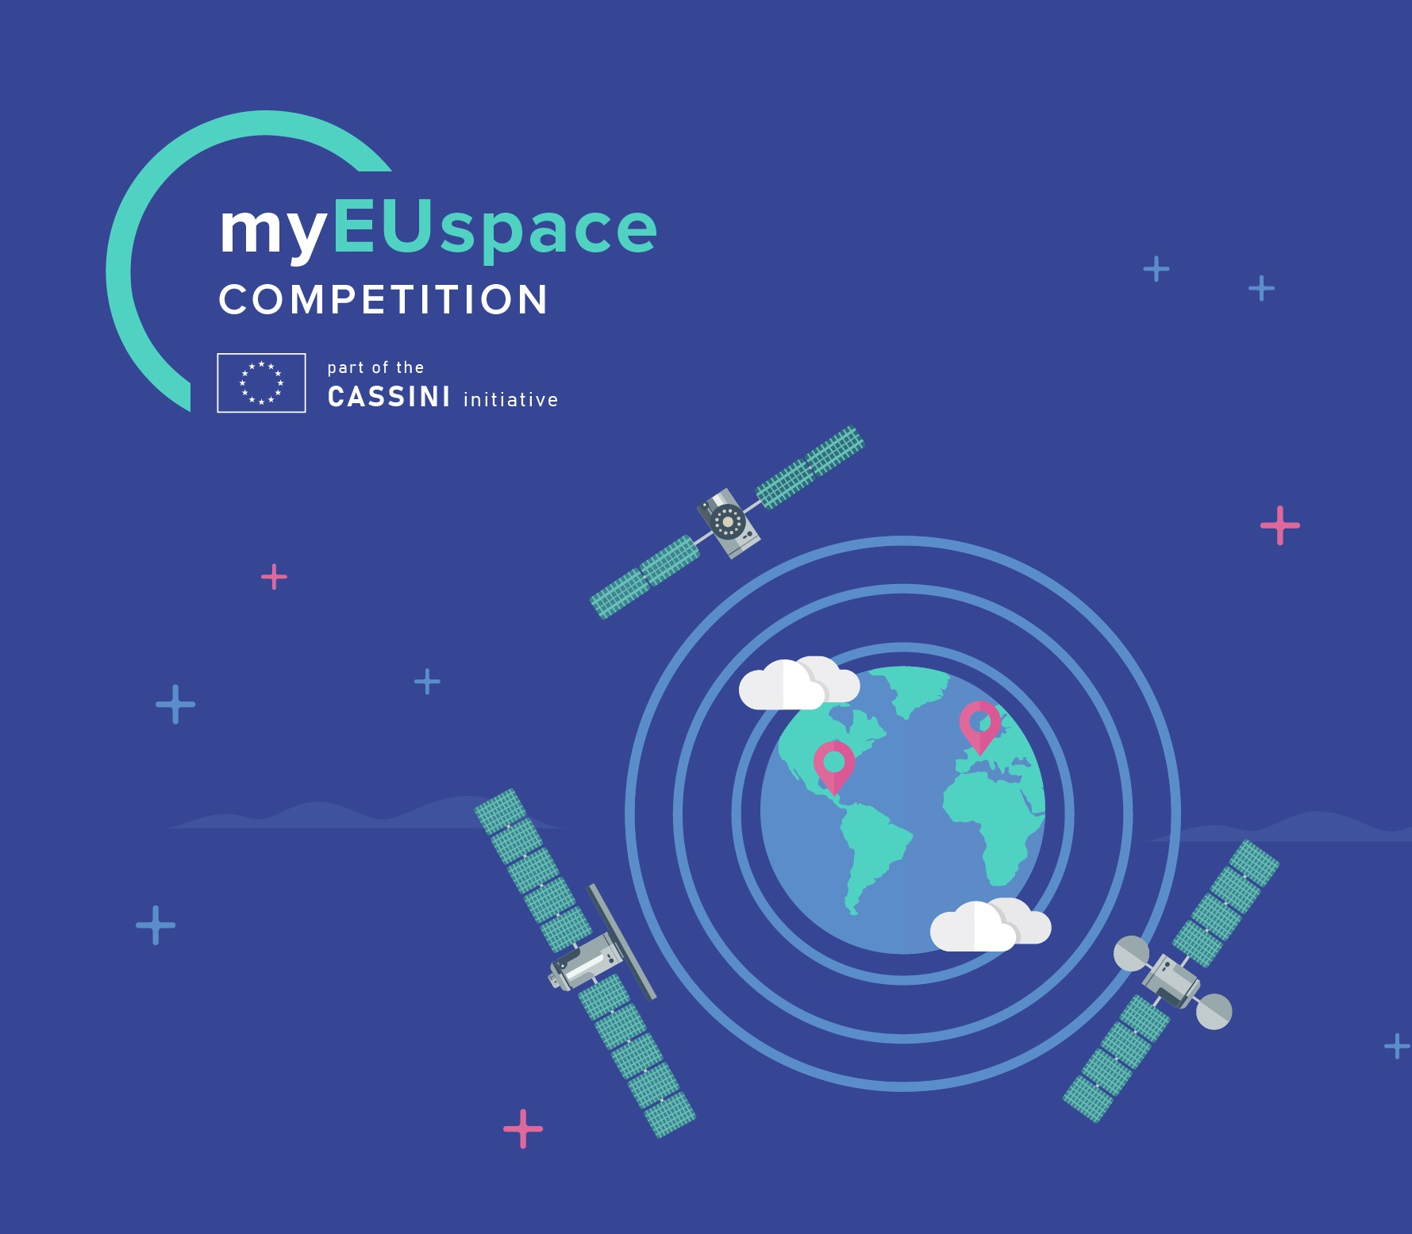
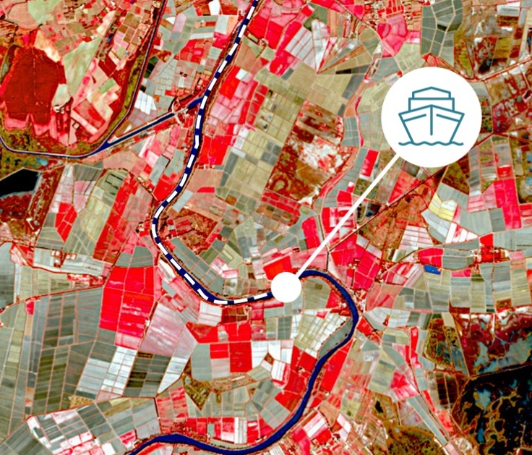


EUSPA funding tools stimulating innovation and fostering EU aerospace ecosystem, incl. start-ups & SMEs
  CASSINI and Entrepreneurship
  Galileo/EGNOS research (Fundamental Elements)
  Aviation Grant Programme
  Horizon Europe
Foster EU’s innovative spirit to deliver applications and services
Stimulate innovation and entrepreneurship in the aerospace ecosystem
Foster adoption of Galileo, EGNOS and Copernicus via application development
Support the integration of services into devices and their commercialisation
Foster the development of innovative Galileo and EGNOS-enabled receivers, antennas and chipsets
Increase EU industry competitiveness
Foster EGNOS operational implementation for civil aviation
Maximise EGNOS adoption all over EU

Slide 9
EUSPA contributes to the EU Agenda
  Stronger Europe
  Strategic autonomy and non-dependence of Europe in space
  Green Deal
  EU-space-based applications for transport, agriculture, energy, smart cities…
  Digital
  Security of EU space, uninterrupted high capacity connectivity everywhere, IoT
  Resilience
  Innovative downstream space sector
Notes:
The user-oriented operational Agency of the EU Space Programme, contributing to sustainable growth, security and safety of the EU
Stronger Europe: strategic autonomy of Europe in space
Green deal: EU-space-based applications for transport, agriculture, energy, smart cities…
Digital: security of EU space, uninterrupted high capacity connectivity everywhere, IoT
Resilience: innovative downstream space sector

Slide 10
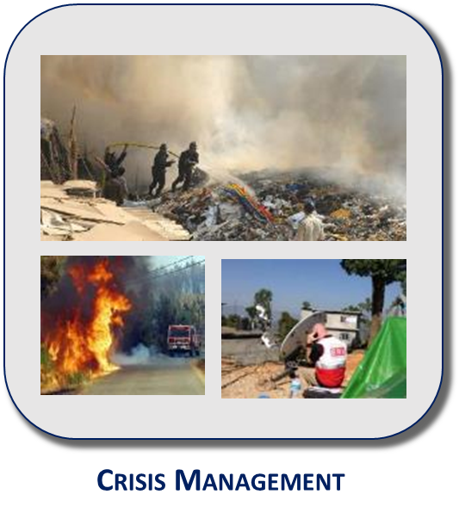
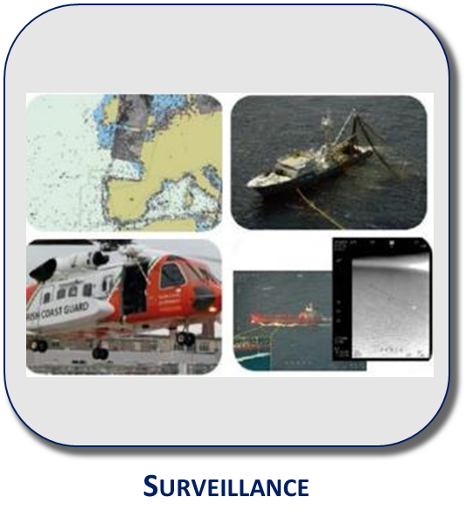
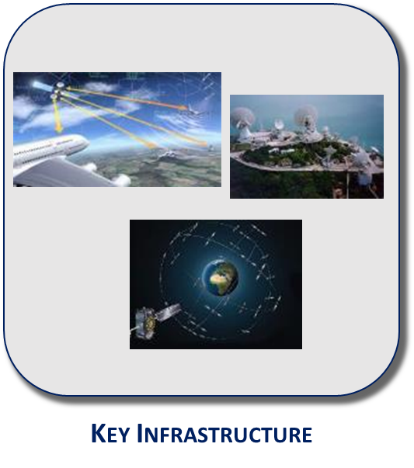
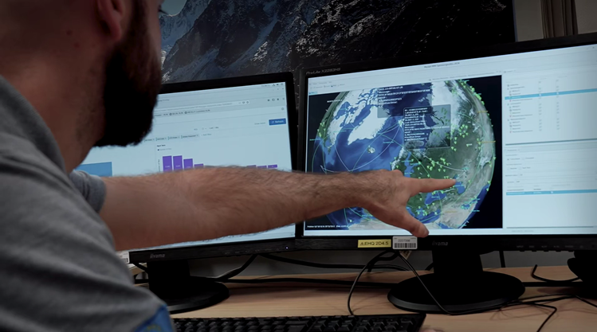
Crisis Management and Surveillance
Galileo Search and Rescue
  Below 2km localization in less than 10’
  SAR beacons with Galileo for maritime, aviation and personal use available in the market
  SAR/Galileo Return Link Service operational since January 2020
  Earth observation and Copernicus Emergency Services
  On-demand Mapping (all disaster management cycle phases)
  Early Warning and Monitoring Service (floods, wildfires, droughts)
  Exposure Mapping (different indicators for exposure)
  EU Space Surveillance and Tracking Front Desk
  As of 1 July EUSPA responsible for the EU SST Front Desk
  Information provided to authorities (e.g. aviation)

