Slide 1
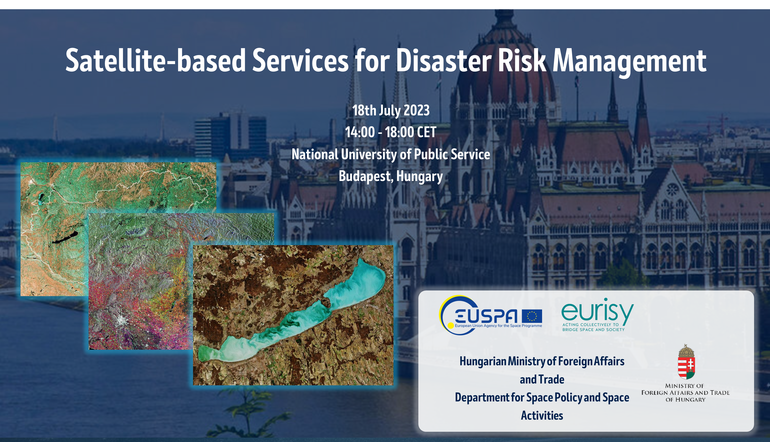

Slide 2

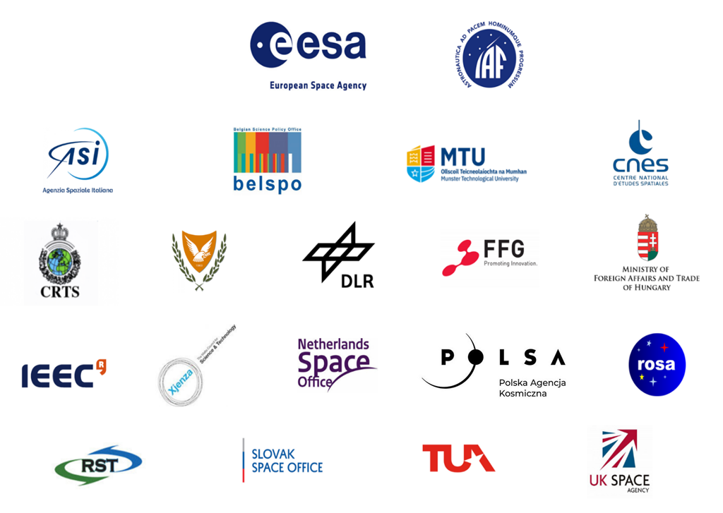


Members

Slide 3

Mission
Eurisy has been mandated by its Members to create networks to bridge space and society.

Slide 4
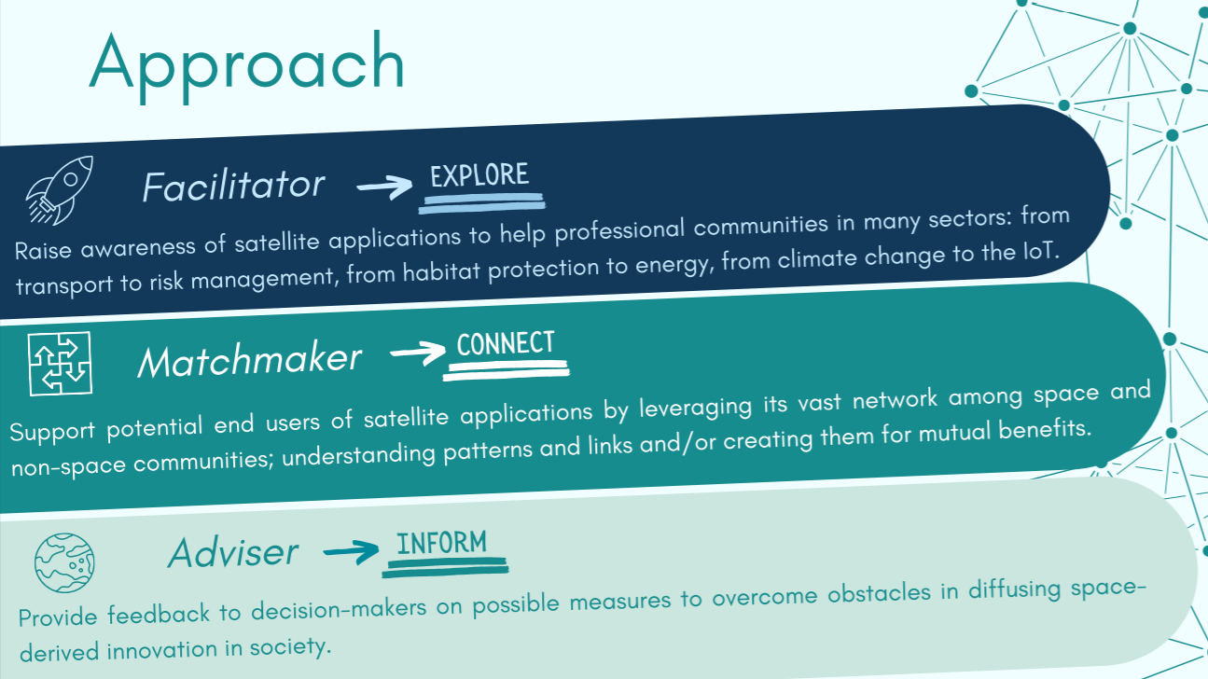
Agenda

Slide 5

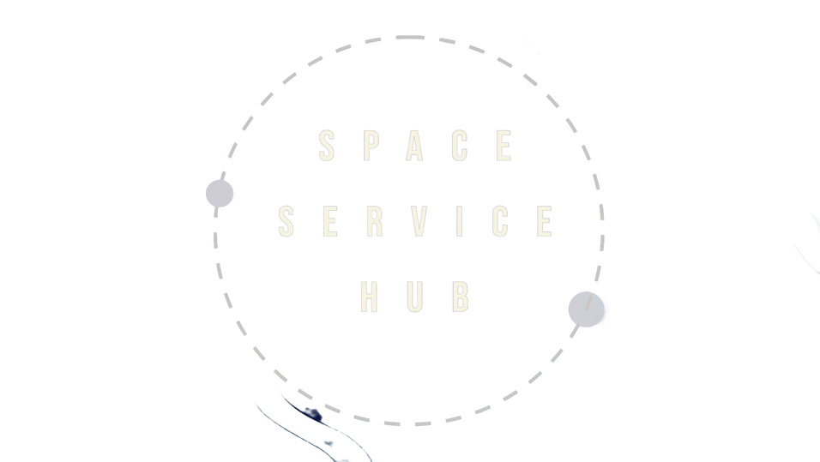
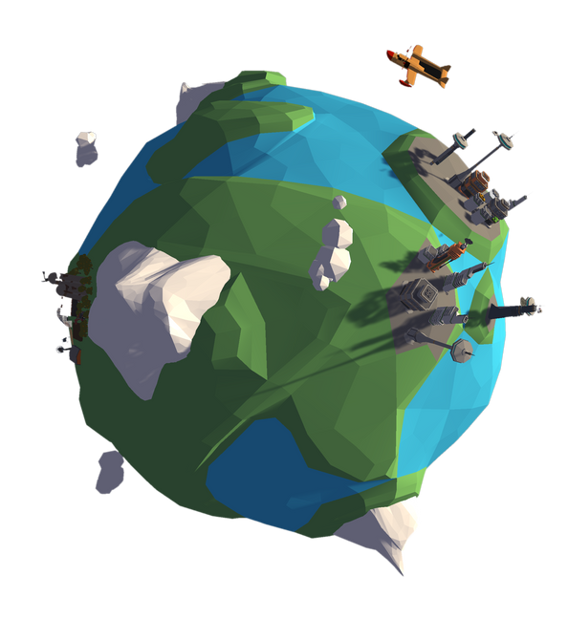

SPACE SERVICE HUB
CONNECT WITH USER COMMUNITIES ON A WHOLE NEW LEVEL

Slide 6
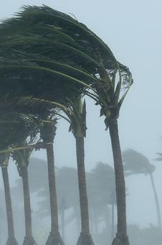
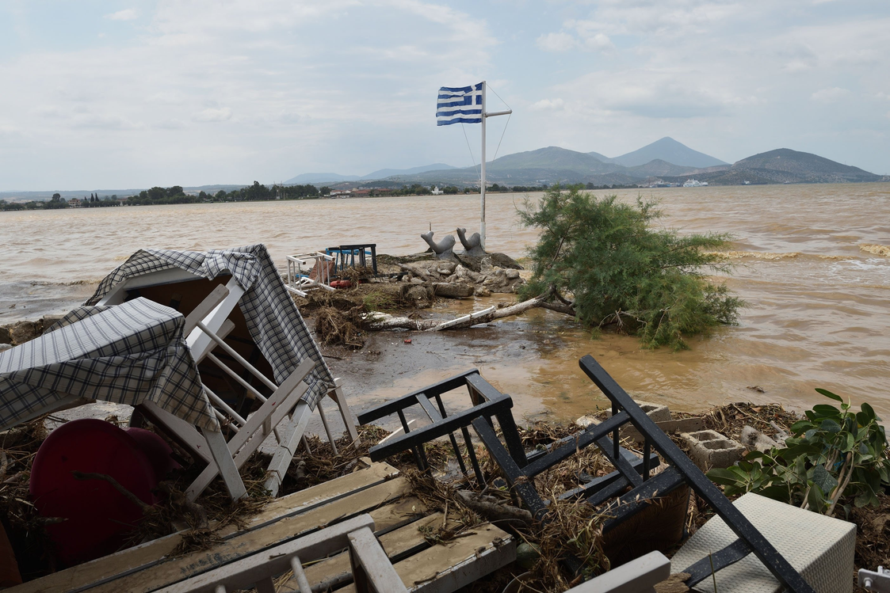
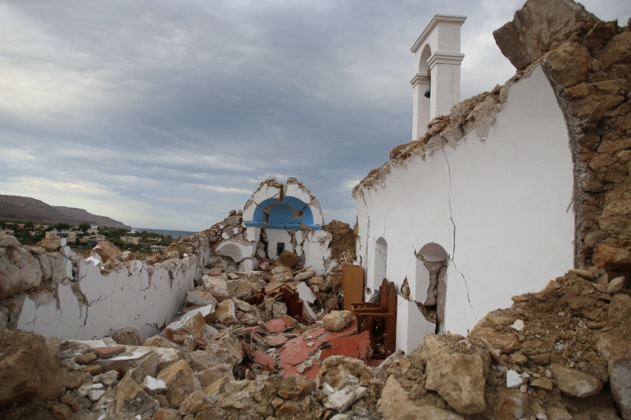
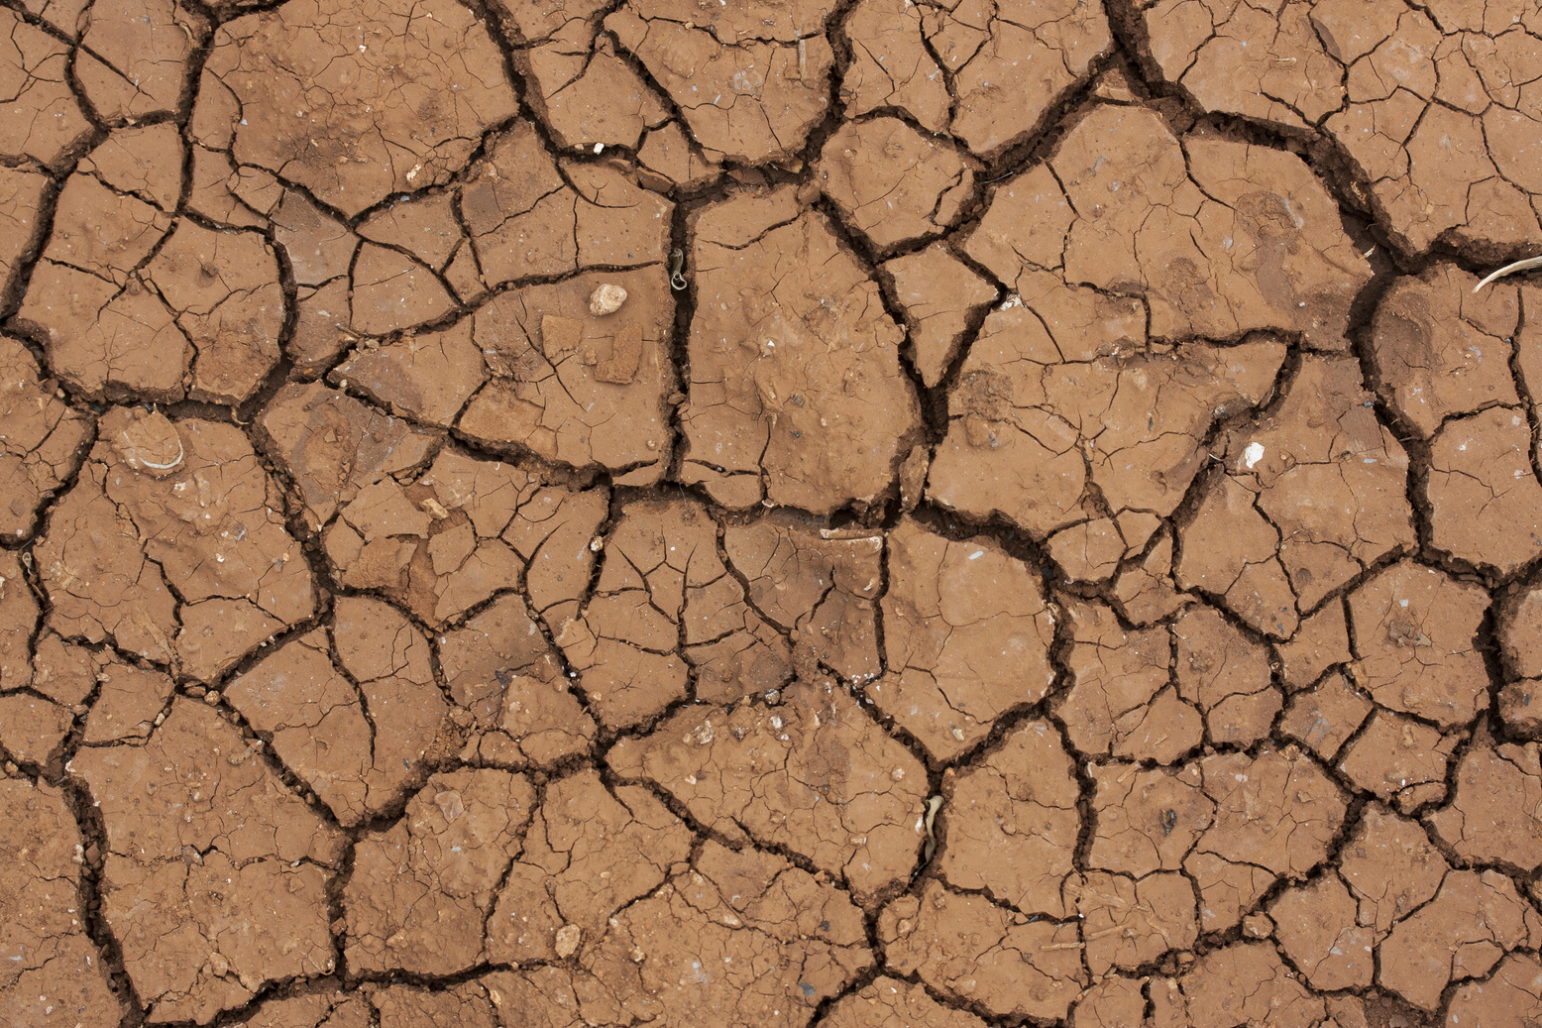
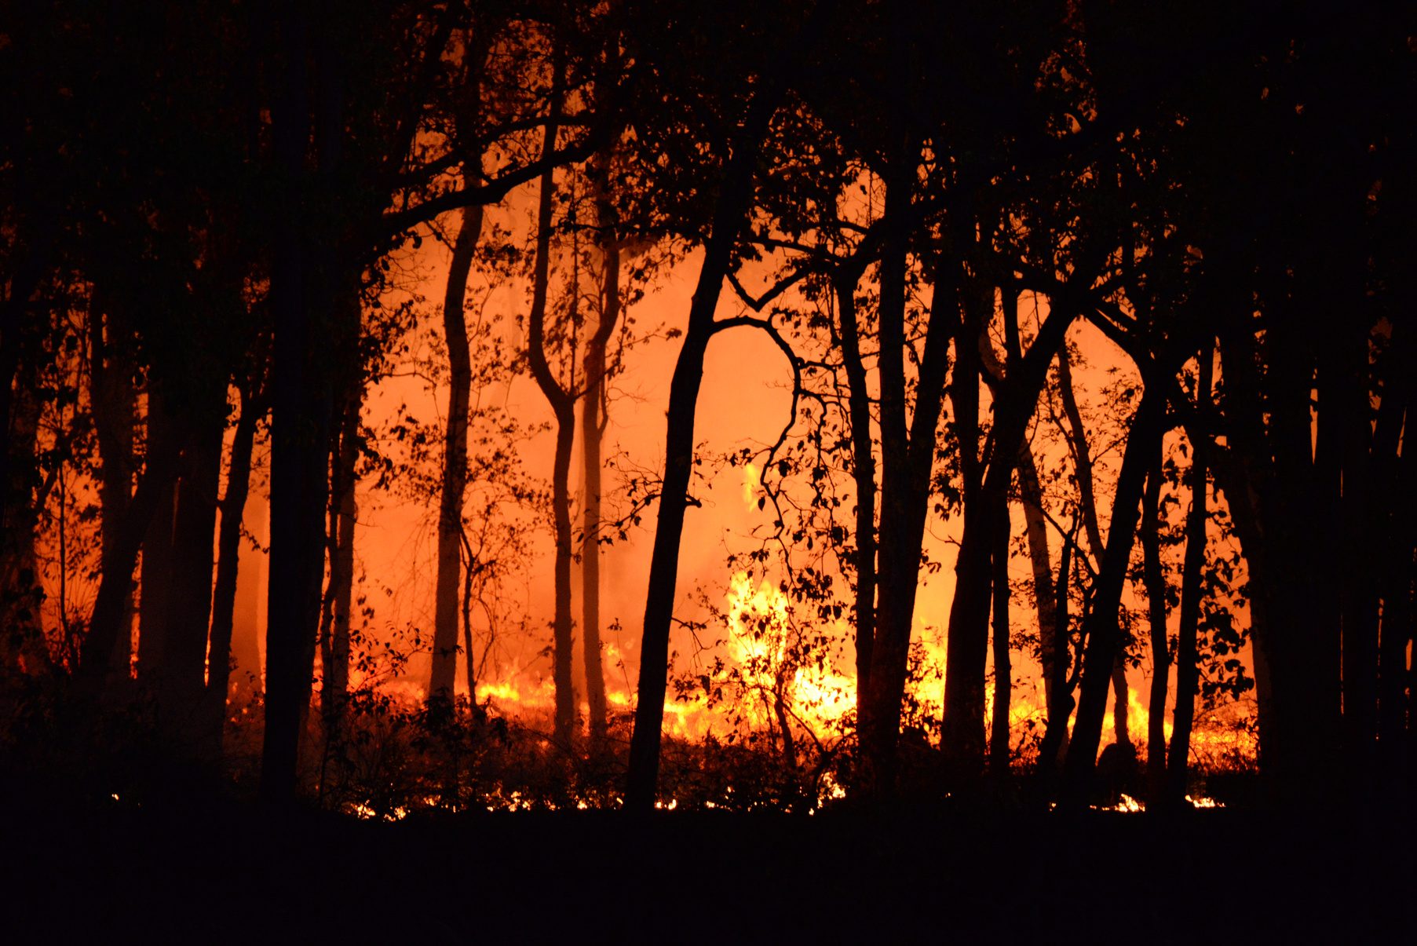






Human cost of disasters: an overview of the last 20 years – UNDRR Report
Climate challenges
1980
1999
1.63
trillion
145
1389
44
263
163
2043
3254
552
338
238
47%
$1.39 trillion
2000
2019
2.97
trillion
22%
$651 billion
21%
$636 billion
4%
3%
$636 billion
$93 billion

Slide 7
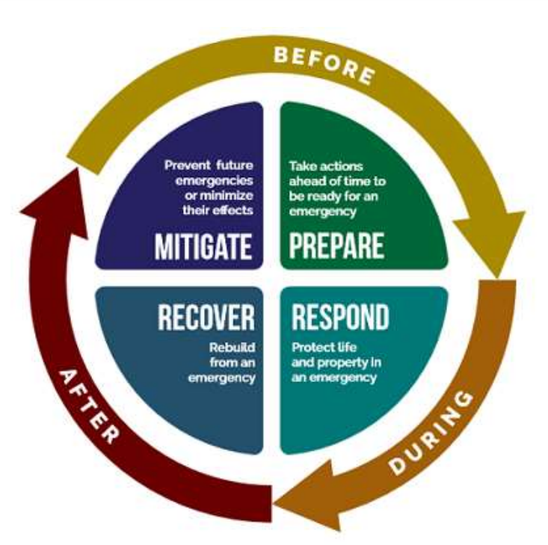
Disaster risk management
Key information & observation needs:
Forecasts & early warnings: pre-disaster information
Need for assistance: post-disaster maps; human displacement
Key information & observation needs:
Hazards: Past events; adverse phenomena; geographic settings
Vulnerability: physical and socio-economic vulnerability assessment
Exposure: inventory of assets
Prevent future emergencies or minimising the effects
PREVENTION
Take action ahead
of time to effectively manage a crisis
PREPARADNESS
RECOVERY
Restoring human activities and services
RESPONSE
Saving lives and minimizing losses
Key information & observation needs:
Losses and damages: post-disaster maps
Recovery and risk: changes of risks and hazards
Key information & observation needs:
→ Disaster scenarios: pre-disaster information

Slide 8


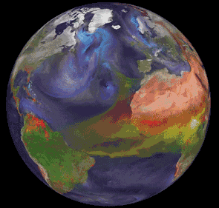

Why Space Applications?
Satellite Communication
Earth Observation
Satellite Navigation

Slide 9







Disaster risk management

Slide 10
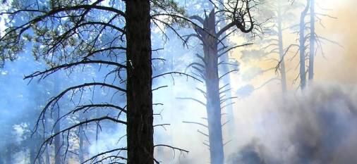

FireHUB: early-warning service relying on meteorological and EO data
The user:
GREEK MINISTRY OF ENVIRONMENT
The challenge:
Droughts, high winds, and the sprawl of land development in the proximity of forests cause several wildfires every year. Monitoring these large areas can be very costly and time-consuming.
The solution:
Through a dedicated web-GIS application operators monitor wildfires and forecast smoke dispersion. The service also generates burnt scar maps during and after wildfires during the last 30 years
The benefit:
Provides timely fire detection data, enabling authorities to get a Situation Awareness Picture and to effectively deploy available resources. Maps of the burnt areas are also useful for damage and deforestation assessment

Slide 11
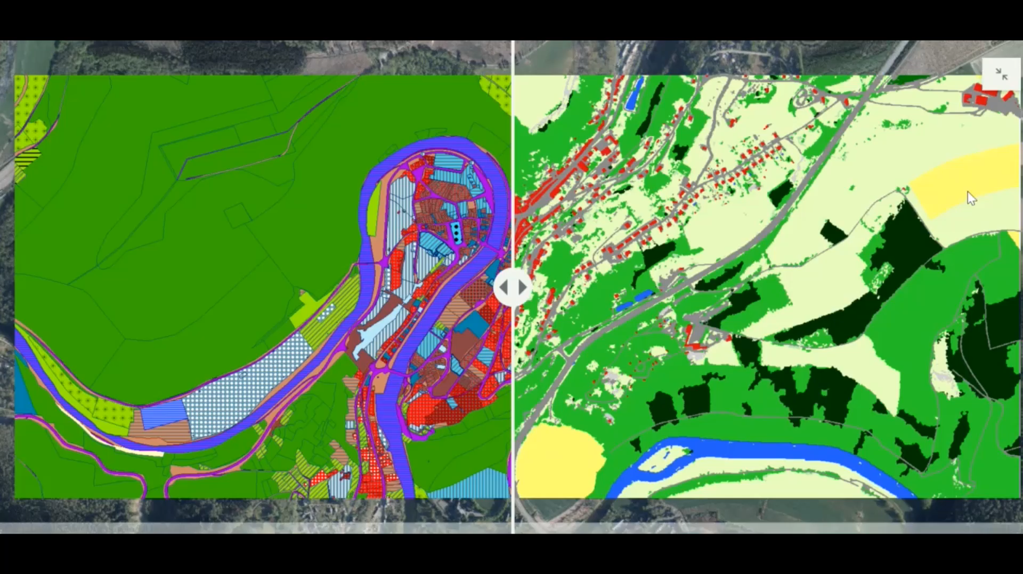

The Public Service of Wallonia (Belgium) relies on satellite imagery for a comprehensive view of land cover and use
The user:
The Public Service of Wallonia
The challenge:
Acquisition of precise, accurate and easily updatable information, on land cover (LC) and land use (LU) to comply with EU INSPIRE Legislation
The satellite solution:
WALOUS maps’ integrate the latest georeferenced data on the whole Walloon territory
The benefit:
the Department of Agriculture, Natural Resources and Environment of the PSW uses the map to support farmers in making their declarations

Slide 12
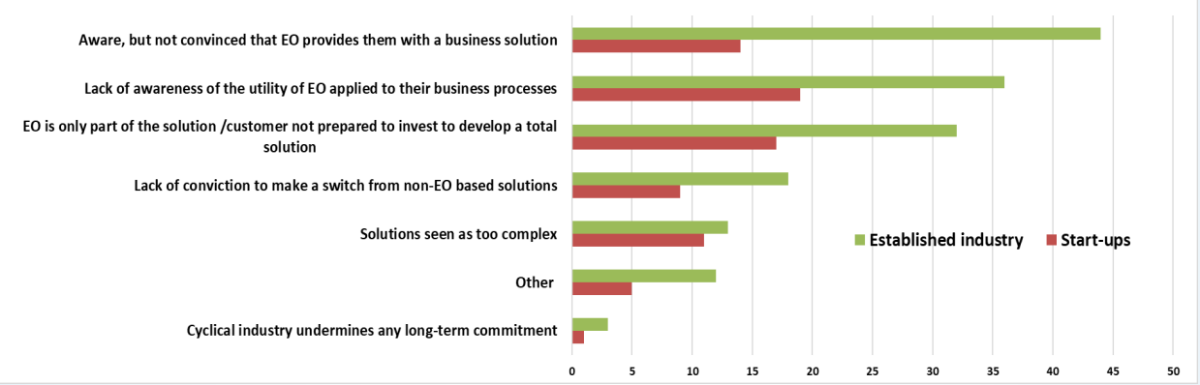
Copernicus and EO market perspectives
Most significant barriers to growth that your company faces:
1. The biggest obstacle for both established companies (45%) and start ups (18%) is market user acceptance;
2. The second is for both finding new customers (38% EC; 16% Sus)
Most significant barriers related to customer uptake
EARSC 2021 Industry survey
Notes:
Companies were asked to consider the most significant barriers to their growth. These results are consistent with our previous survey. The most important barriers are related to three main issues: market/user acceptance, finding new customers and lack of development funding.
According to our survey’s respondents, the difficulty for customers to be convinced that EO provides them with a business solution is the most important barrier. The lack of awareness of the utility of EO applied to their business processes also represent an important barrier

Slide 13
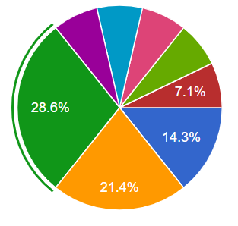
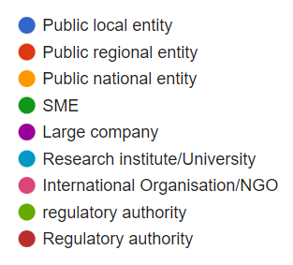
Local Users perspectives: sample
In what type of organisation do you work?
In which field do you operate:
50% Environmental protection/DRM
35.7% Buildings/Infrastructure
28.6% Climate/Energy
21.4% Agriculture
In which kind of data would you need to improve your daily work?
High resolution images, especially SAR
Equipment, including cloud-based processing solutions and labs

Slide 14
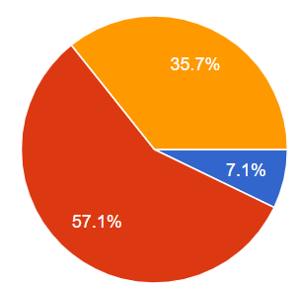
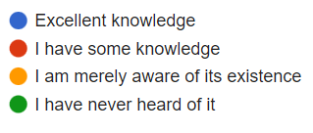
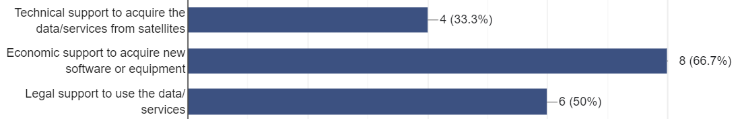
Local Users perspectives: sample
How familiar are you with Copernicus Emergency Management Service CEMS?
Which kind of support would you need to integrate satellite-based solutions?

Slide 15
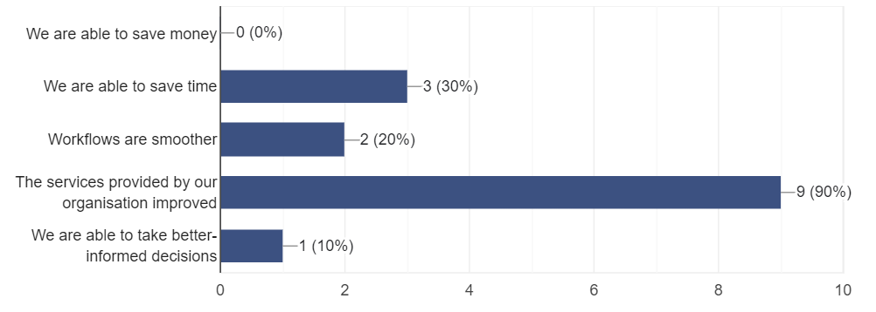
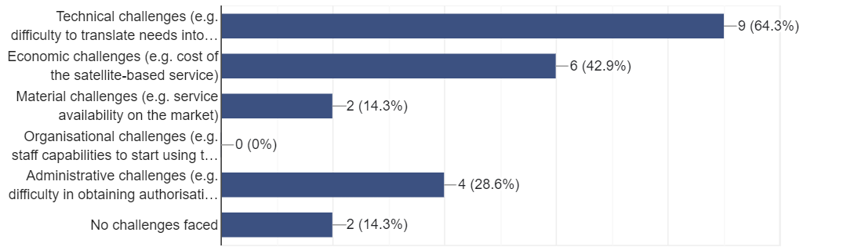
Local Users perspectives: sample
BENEFITS
CHALLENGES

Slide 16
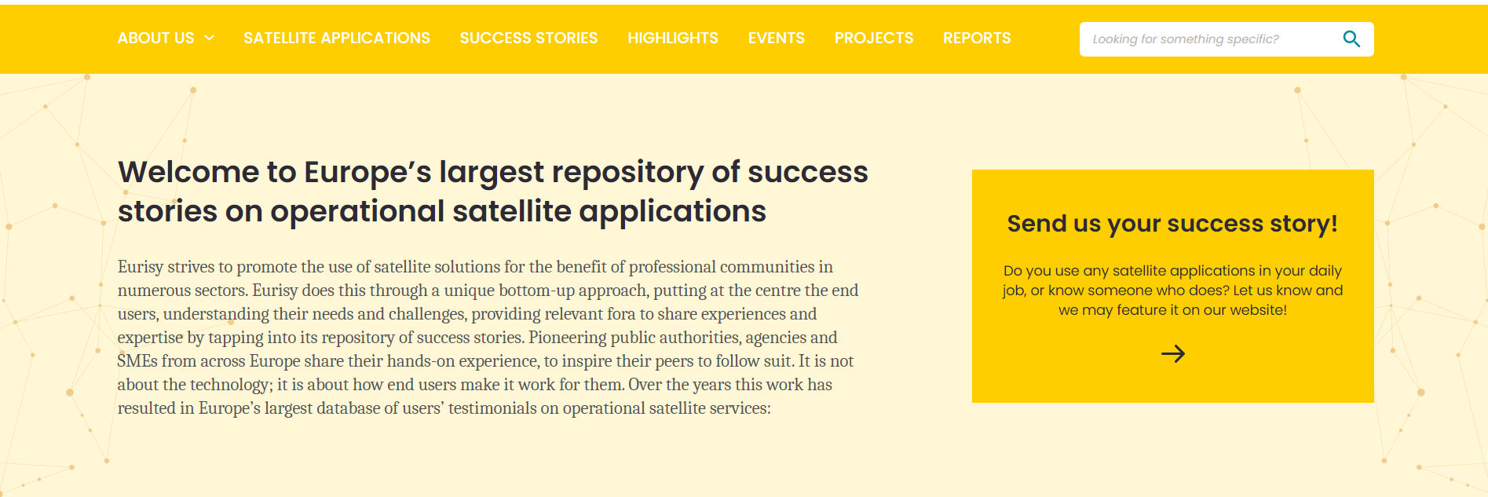
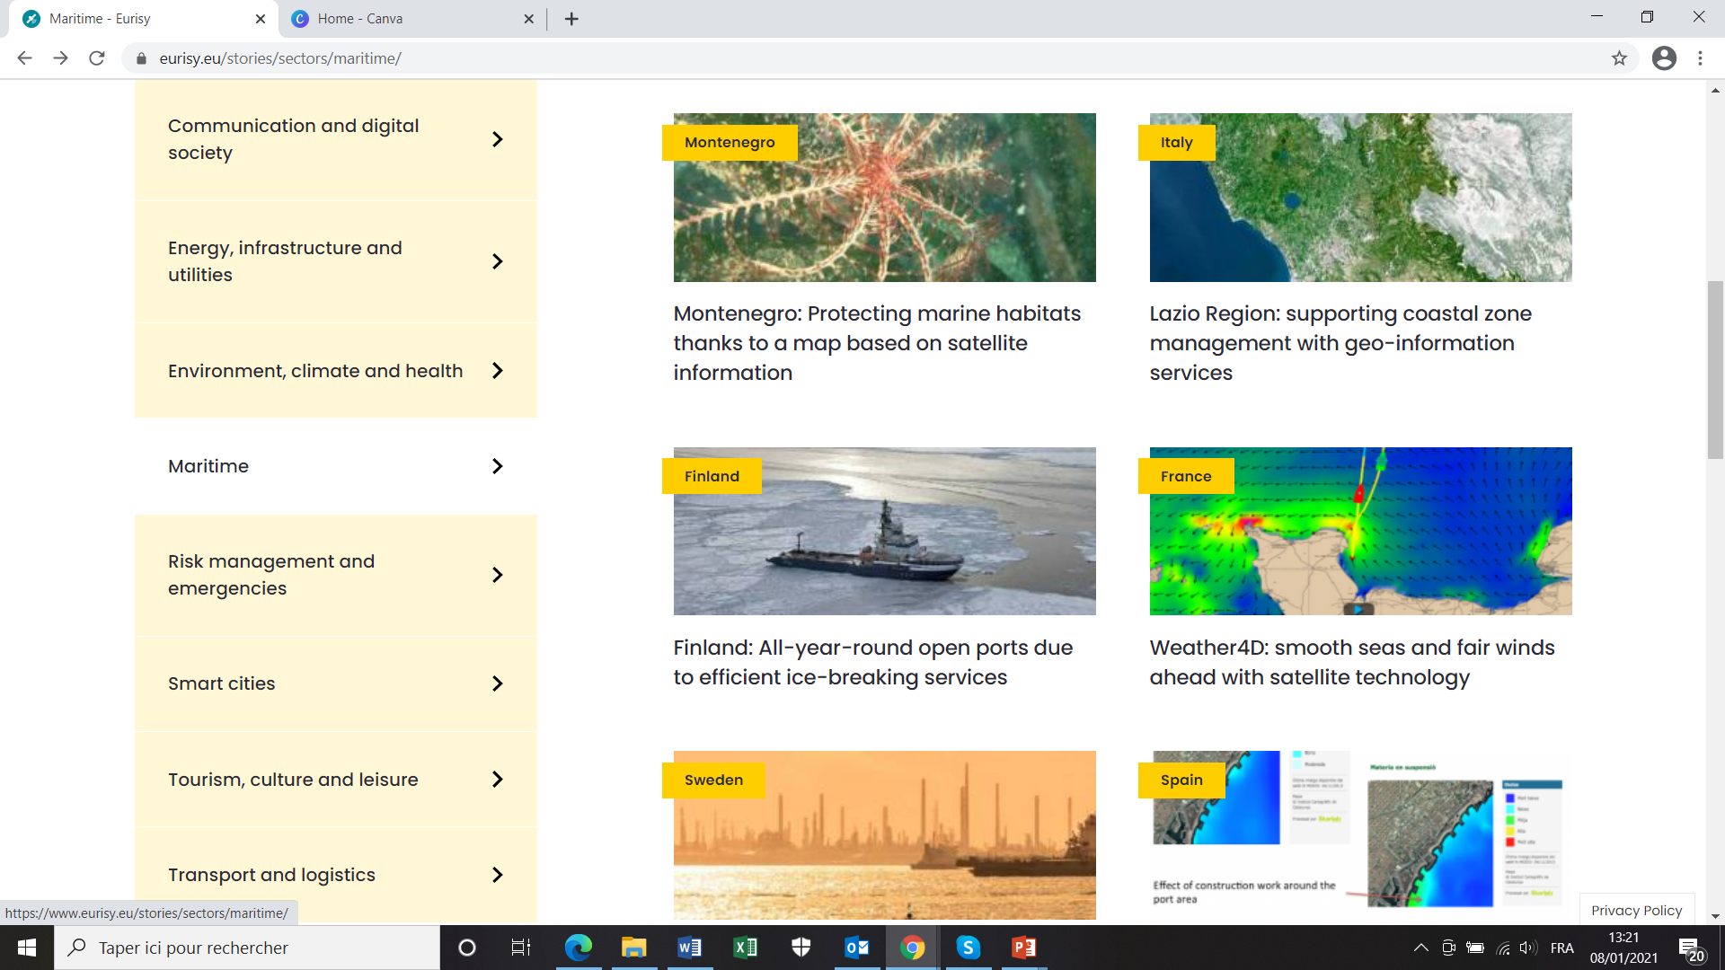
Success stories database
Success stories will favour the dissemination of case studies and help connecting service providers and end users.
The Success Stories aim at addressing communities outside the space sector to express their needs and to present their challenges.
Objective is to favour the integration of satellite-based solutions in their workflow.

Slide 17
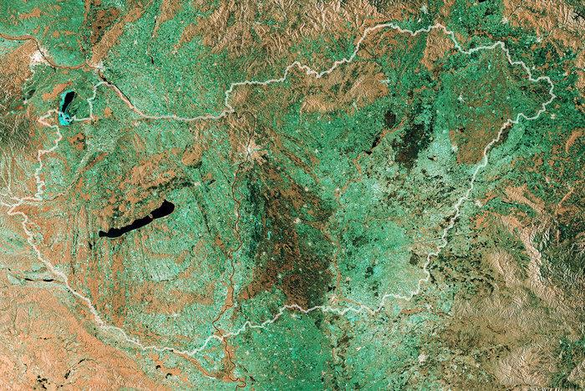






Thank you!
For more, take the survey
Follow us:
eurisy1
@Eurisy1
Eurisy

