Slide 1
European Union Agency for the Space Programme
Rodrigo da Costa

Slide 2
The EU Space Programme
The Space Programme Regulation, space data and services at the heart
of a technological revolution

Slide 3




EU Space Programme 2021-2027
EU Space activities under one umbrella
GOVSATCOM
IRIS²
IRIS²
Infrastructure for Resilience, Interconnection &
Security by Satellites
EGNOS
Galileo
Copernicus
GOVSATCOM
Space Situational Awareness (SSA)
EGNOS “Makes navigation signals more accurate and trustable for Safety-critical applications”
Operational in 480+ airports & helipads in 26 countries
97% of new tractors with GNSS in Europe equipped with EGNOS
Global satellite navigation and positioning system (GNSS)
More than 4 billion Galileo receivers worldwide
Earth Observation (EO) and monitoring based on satellite & non-space data
Nr. 1 world provider of space data and information (16TB/day)
Secure satellite communications for EU governmental actors
Rapid support over crisis areas
Space Surveillance and Tracking (SST)
Space Weather Events (SWE)
Near-Earth Objects (NEO)
Sovereign multi-orbit constellation
Cutting-edge technologies focused on government service

Slide 4


EUSPA’s mission
Exploitation
Security
Utilization

Slide 5
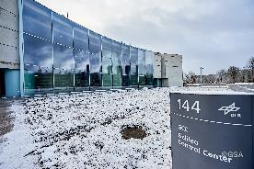
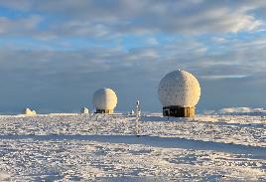
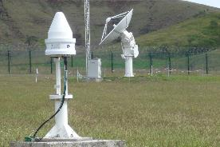
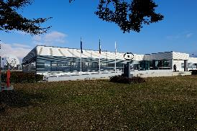
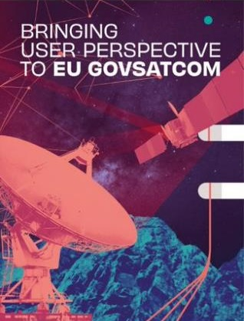
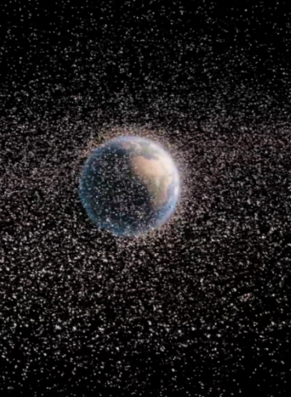
Exploitation
Galileo and EGNOS services provision and 24/7 operations
  including management, operation, maintenance, improvement, evolution & protection of infrastructure
GOVSATCOM hub
Support to IRIS2 preparation
Space Surveillance and Tracking (SST) Front Desk

Slide 6
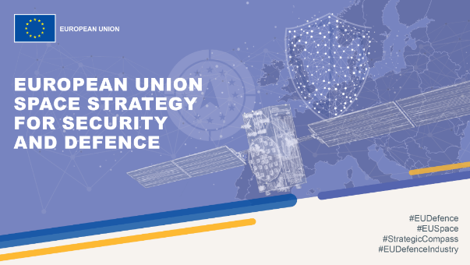
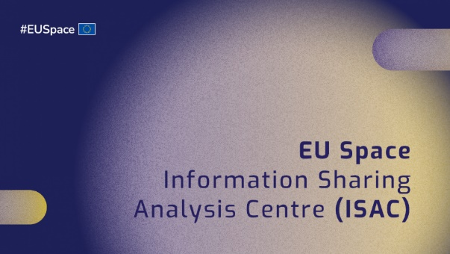
EU Space Security at EUSPA
  Security
  Governance
  Security
  Operations
  Security Accreditation Board (SAB)
Operational security (including cryptography and cybersecurity), security risks and threat analysis
24/7 monitoring operations
Action regarding security threats and alerts
Governmental service provision with competent authorities in EU Member States
Security Accreditation Authority for all components of the EU Space Programme
Including tasks assigned under Decision No 1104/2011 (PRS access) and Council Decision 2021/CSFP/698
Key contributor in the implementation of the EU Space Strategy for Security and Defence
Together with EC, EUSPA is spearheading the formation of the EU Space ISAC

Slide 7
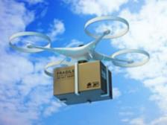
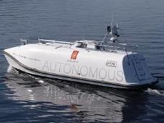
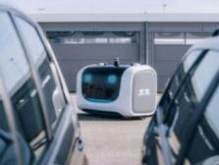


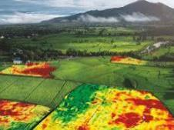


EU Space
Downstream Ecosystem
Market intelligence
Creating, supporting, and scaling up a new generation of SMEs, start-ups, and innovators in the EU
Fostering the EU Space Downstream industry competitiveness
Promoting synergies among different components of the EU Space Programme

Slide 8
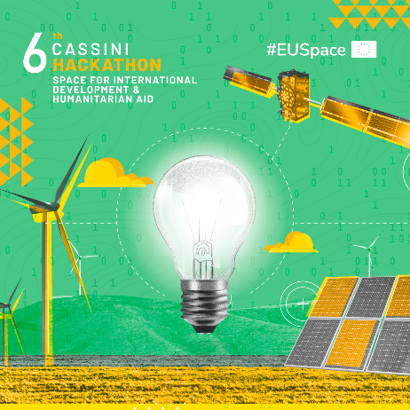
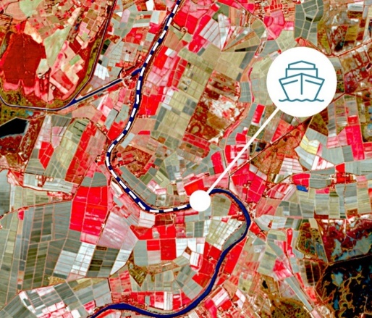


EUSPA Funding Opportunities
  Fundamental Elements
  EGNOS adoption in transport
  CASSINI
  Horizon Europe
Stimulating innovation and entrepreneurship in the aerospace ecosystem
R&D for Galileo, EGNOS and Copernicus applications
Supporting the integration of services into devices and their commercialisation
Fostering the development of innovative Galileo and EGNOS-enabled receivers, antennas and chipsets
Fostering EGNOS operational implementation in aviation & drones, maritime and rail
Maximising EGNOS adoption all over EU

Slide 9
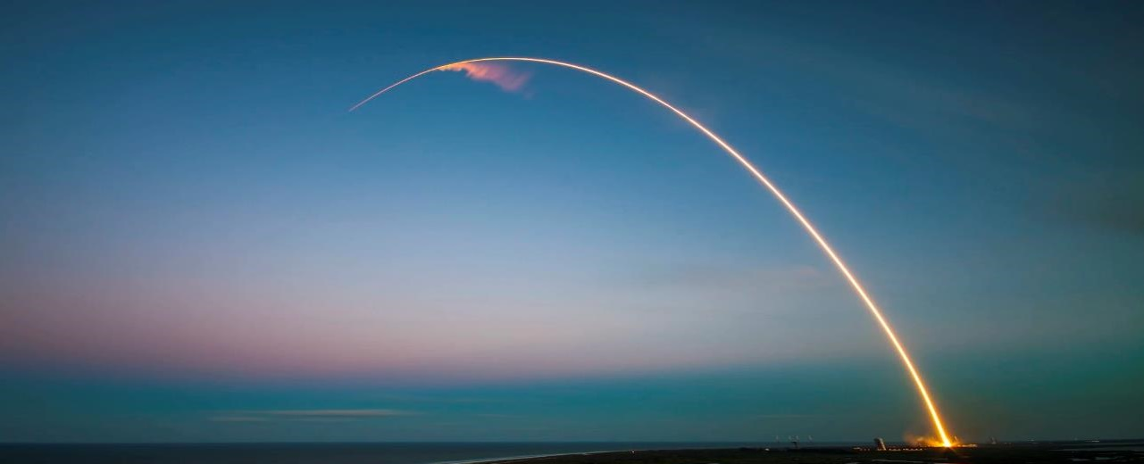
CASSINI 2021-2027 overview
THE ROAD TO NEW SPACE
Clear vision for European space businesses and markets
New industry setup
New entrants
New private investment
New markets
New solutions
MATCHMAKING
CASSINI Matchmaking with Investors CASSINI Industrial Partnering
€4.0 million for 2021-27
BUSINESS GROWTH
CASSINI Business Accelerator
€30.0 million for 2021-27
INVESTMENT
CASSINI Seed and Growth Funding Facility (InvestEU)
INNOVATION COMPETITIONS
CASSINI Prizes
€30.0 million for 2021-27
www.cassini.eu
PROMOTION
CASSINI Hackathons & Mentoring
€10.0 million for 2021-27

Slide 10
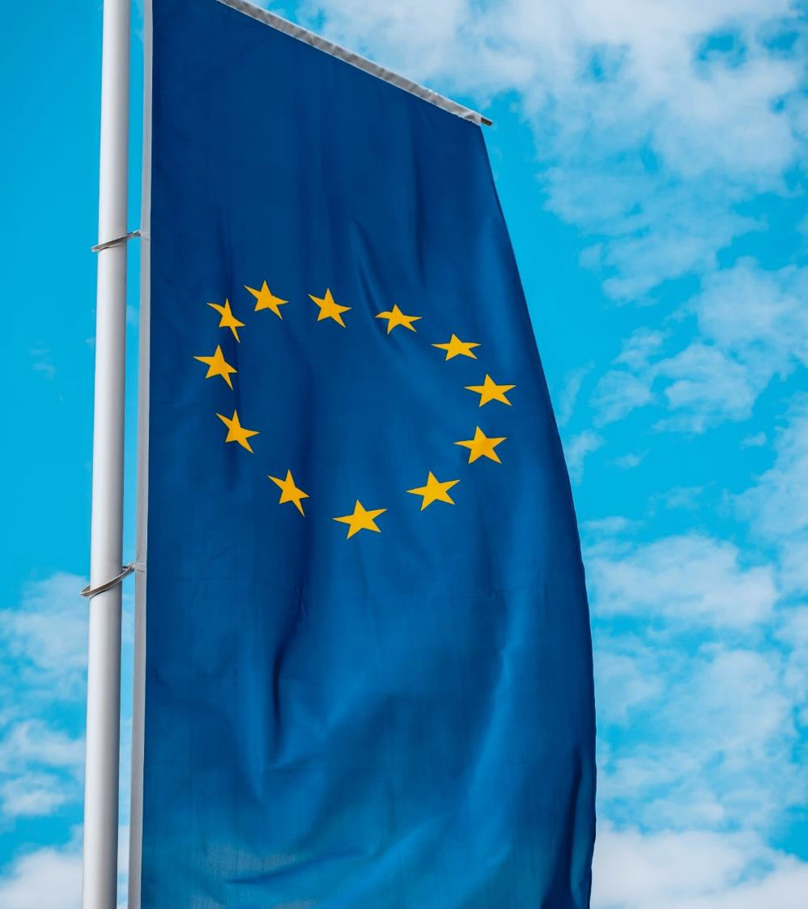
EUSPA contributes to the EU Agenda
  Stronger Europe
  Strategic autonomy and non-dependence of Europe in space
  Green Deal
  EU-space-based applications for sustainable economy, transport, agriculture, biodiversity, energy, smart cities, etc.
  Digital
  Security of EU Space, uninterrupted high capacity connectivity everywhere, IoT
  Resilience
  Innovative space downstream sector

Slide 11
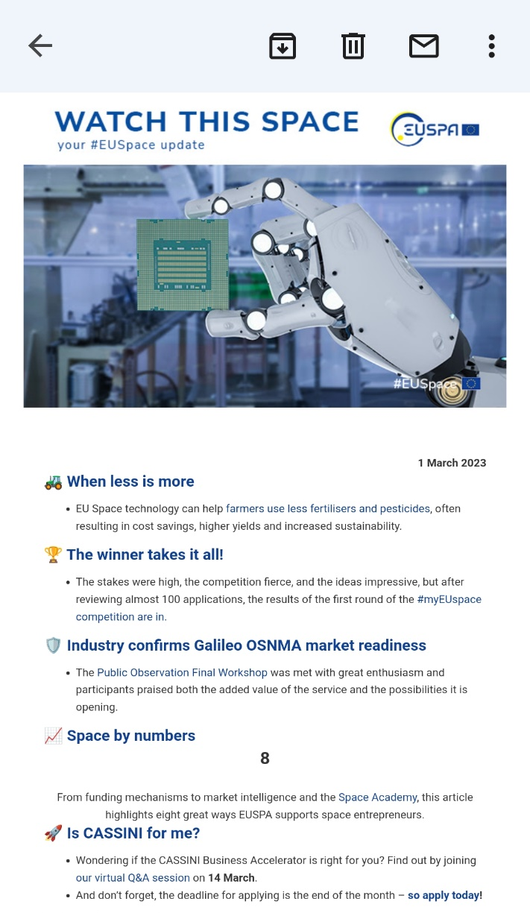
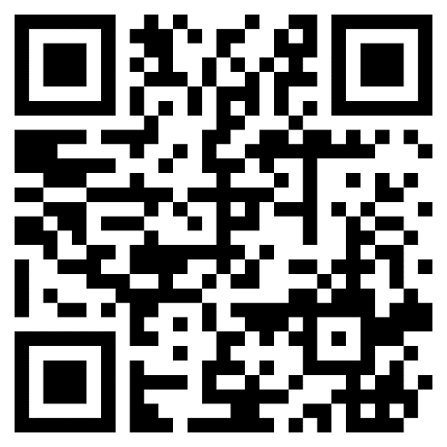
Subscribe to our newsletter Watch This Space
… and receive the latest #EUSpace news every week in your mailbox.
To subscribe, scan the QR code below:

