Slide 1
Providing EO services for public administrations:
Challenges and experience-based solutions
Dr. Benjamin Palmaerts
& the ISSeP/CTG Team
Notes:
I’m BP from ISSeP
I’m going to present you some of our experience in providing EO services for public administrations nd authorities

Slide 2
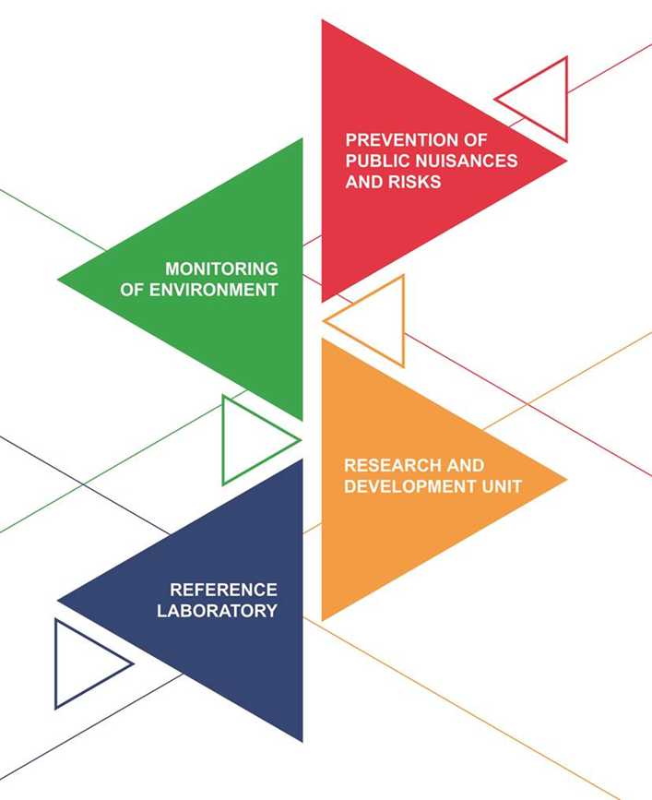
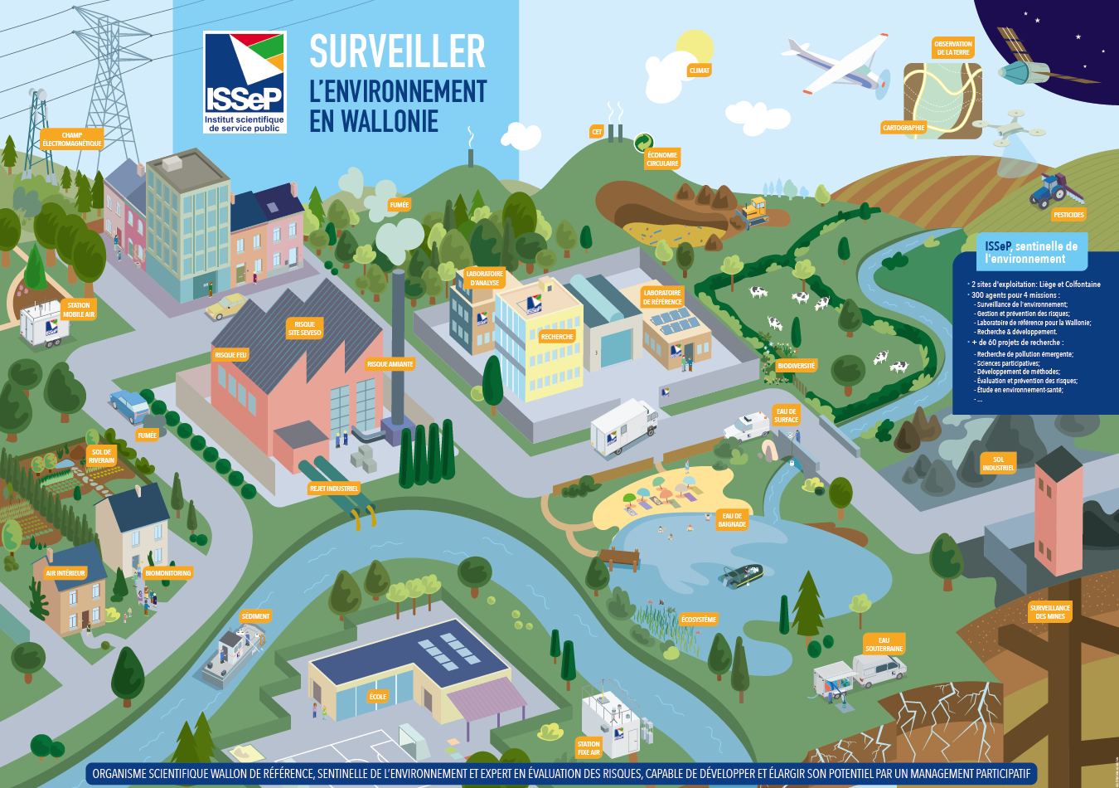
ISSeP
Scientific Institute of Public Service
Environmental sentinel of Wallonia
Notes:
The scientific institute of public service is a public institute under the authority of the Walloon government and the Minister of the Environment .We are located in Liege and in Colfontaine, close to Mons.
ISSeP is the Walloon reference laboratory specialized in environmental monitoring (i.e. water, air, soil, sediments and waste) and risk assessment and prevention. At ISSeP, we have scientific expertise, from field sampling, lab analysis, numerical modelling, data sciene, geostatistical analysis to Earth observation.
ISSeP is the environmental sentinel of the Walloon Region :

Slide 3
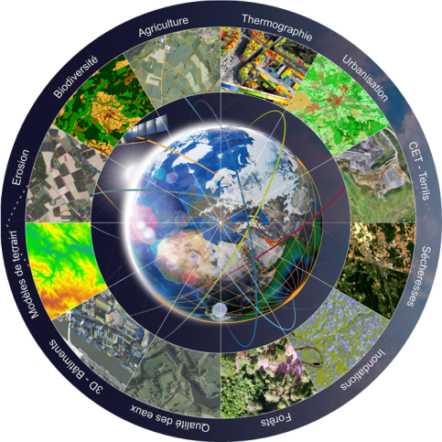
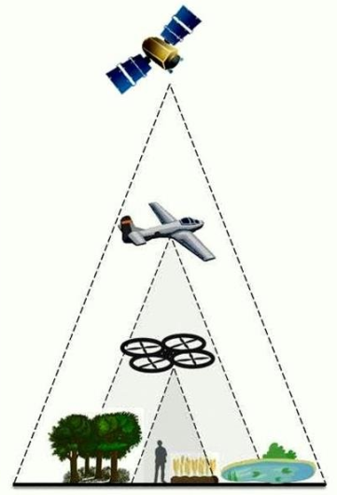
ISSeP - Remote Sensing and Geodata unit
Scientific Institute of Public Service
Acquisition, processing and analysis of EO
data to develop decision support
tools in environmental matters
Land use / Land Cover
Integration of AI
Change detection
Watershed management
Roof material detection
Environmental & Health risks
Development cooperation
Notes:
For EO, there is the Remote Sensing and Geodata unit to which I belong, made up of 6 persons.
We work on the acquisition, processing and analysis of EO data acquired by drone, aircraft or satellite.
Mainly for environmental matters in the frame of various projects, some of them I will present later.
We are also the Walloon relay of the European Copernicus program and we have also some collaborations outside Europe, mainly in development cooperations in Africa.
These projects are with private companies, universities, and with or for public administrations and authorities.
As a public institute, one of our missions is to provide services to public administrations. I would like to share with you some past experience my team had, talk about the challenges we faced and some solutions we found to overcome them

Slide 4
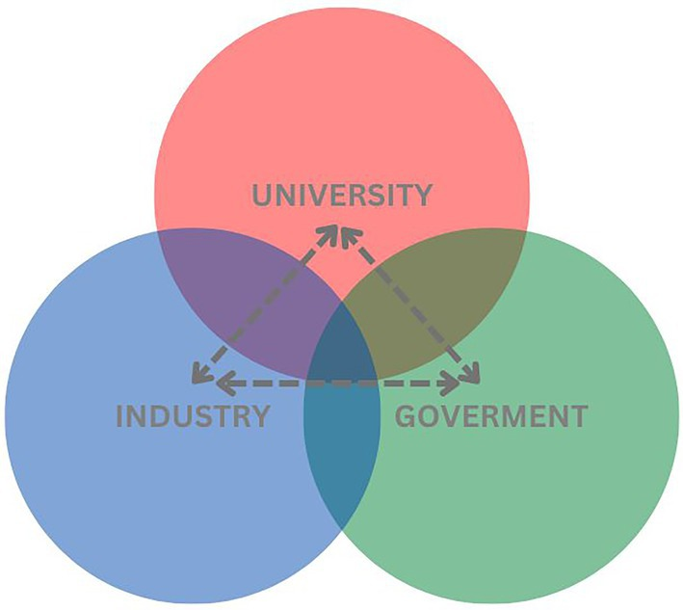
GTEO – EO Working Group
Notes:
Before that, I have to mention two initiatives within the Walloon EO ecosystem.
First, there is th eGTEO, a working group gathering many EO actors in Wallonia covering the triple helix: university and research centers, industry, and public authorities. This group is led by ISSeP and by Skywin, presenting a duality business/research and public/private.
The goal of GTEO is to bring together the skills and knowledge of all Waloon actors working in the field of satellite earth observation

Slide 5
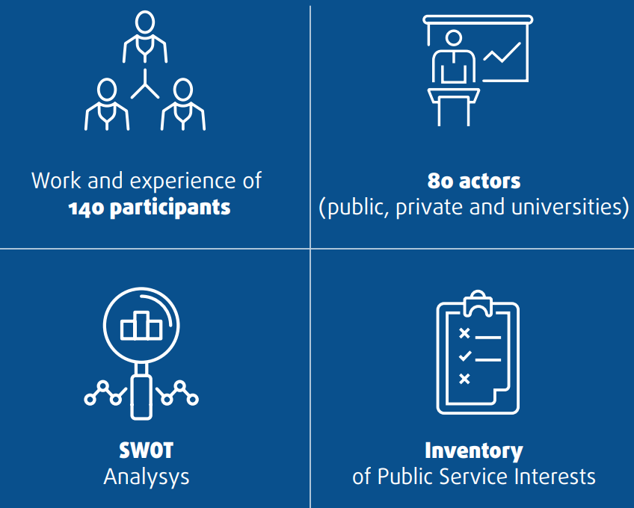
GTEO – EO Working Group
14 RECOMMENDATIONS TO ENHANCE USE OF EO IN WALLONIA
Notes:
In 2019, in the frame of GTEO, a Position paper was published.
It was the result of a 3-year long collective work between 80 actors, with the support of the FPCUP European project
The position paper presents a SWOT analysis of the EO sector and gathers 14 recommendations on the use of Earth Observation data,
TO KEEP AN UPDATED INVENTORY OF EXPERTISE AND NEEDS IN THE PUBLIC SERVICE
STRENGTHEN OUR SCIENTIFIC SKILLS IN THE FIELD OF EO and meet challenges of big data and AI
RAISING AWARENESS AND TRAINING IN OUR PUBLIC SERVICES
INSTITUTIONALISE THE USE OF EARTH OBSERVATION DATA IN PUBLIC SERVICE BODIES
-------------------------
Récolte de manifestations d’intérêts des services publics ainsi qu’une recherche de mutualisation des besoins et de l’offre dans différentes thématiques
Position paper https://www.issep.be/wp-content/uploads/GTEO_PositionPaper2019_EN.pdf
80 acteurs 14 actions
Swot
1. INSTITUTIONALISE THE USE OF EARTH OBSERVATION DATA IN PUBLIC SERVICE BODIES
2. STRENGTHEN AND ENCOURAGE DIALOGUE BETWEEN PUBLIC AND PRIVATE ACTORS
3. TO KEEP AN UPDATED INVENTORY OF EXPERTISE AND NEEDS IN THE PUBLIC SERVICE
6. RAISING AWARENESS AND TRAINING IN OUR PUBLIC SERVICES
7. WIDEN OUR APPROACH AND AUDIENCE
9. TO MAINTAIN INTERNATIONAL COMPARISON AND NETWORKING
12. STRENGTHEN OUR SCIENTIFIC SKILLS IN THE FIELD OF EO and meet challenges of big data and AI
14. POSITION OURSELVES ON THE BELGIAN AND INTERNATIONAL STAGE

Slide 6
GTCoWAL
Joint WG for EO in the Walloon Government
Recognized meeting body
Coordinated actions to pool resources
Facilitate the use of remote sensing in administration: access to data, software, tools,infrastructure, expertise
Coordinate internally and with local authorities
Value achievements
Raise awareness among the hierarchy
Notes:
The second initiative is the GTCowal, a joint WG for EO in the Walloon Government.
Contrary to GTEO, it is internal to the public sector, administrations and public research centers.
All members have the Common objective of increasing the use of Earth Observation data by Walloon public services.
And all members are aware of the constraints and difficulties encountered in the public sector: the bureaucracy, all the procedures to respect like the public procurements, etc.
We talk the same language
https://geoportail.wallonie.be/files/PDF/GT%20COWAL/brochure_GTCowal.pdf
https://www.issep.be/wp-content/uploads/2_GTCOWal_GTEO20210520.pdf

Slide 7
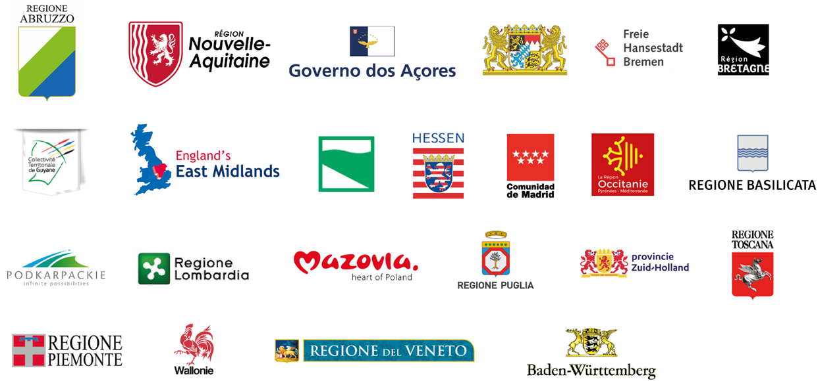
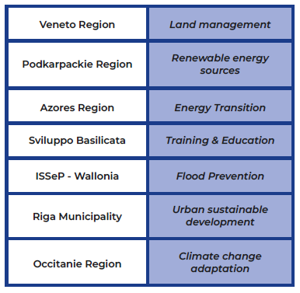
NEREUS – SATSDIFACTION project
Satellite data and Spatial Data lnfrastructures for an evidence-based regional governance
Disaster management, climate change observations, energy transition
Regional stakeholder groups
Exchange of experiences
Improving the regional governance
Notes:
At the European level, I have to mention Nereus, the network…. Which includes 23 members across Europe.
In th efrmae of Nereus, there is an interge project SATSDIFACTION which was launched recently which aims at promoting the exchange and transfer of experiences related to the use of Satellite Data between regions
To improve the performance of regional policy instruments, eventually leading to o better, evidence-based governance of the regional territory.
Each participating regions chose one topic related to disaster management, climate change and , in the case of Wallonia, we chose the flood prevention. Other topics are energy transition, land management.
In each region, there are stakeholders groups who will share their experience at the regional level and then ate the European level.
The SATSDIFACTION project aims at promoting the exchange and transfer of experiences related to the use of Satellite Data in local and regional Spatial Data lnfrastructures as a mean to
improve the performance of regional policy instruments, eventually leading to o better, evidence-based governance of the regional territory.
Aiding government decision-making

Slide 8
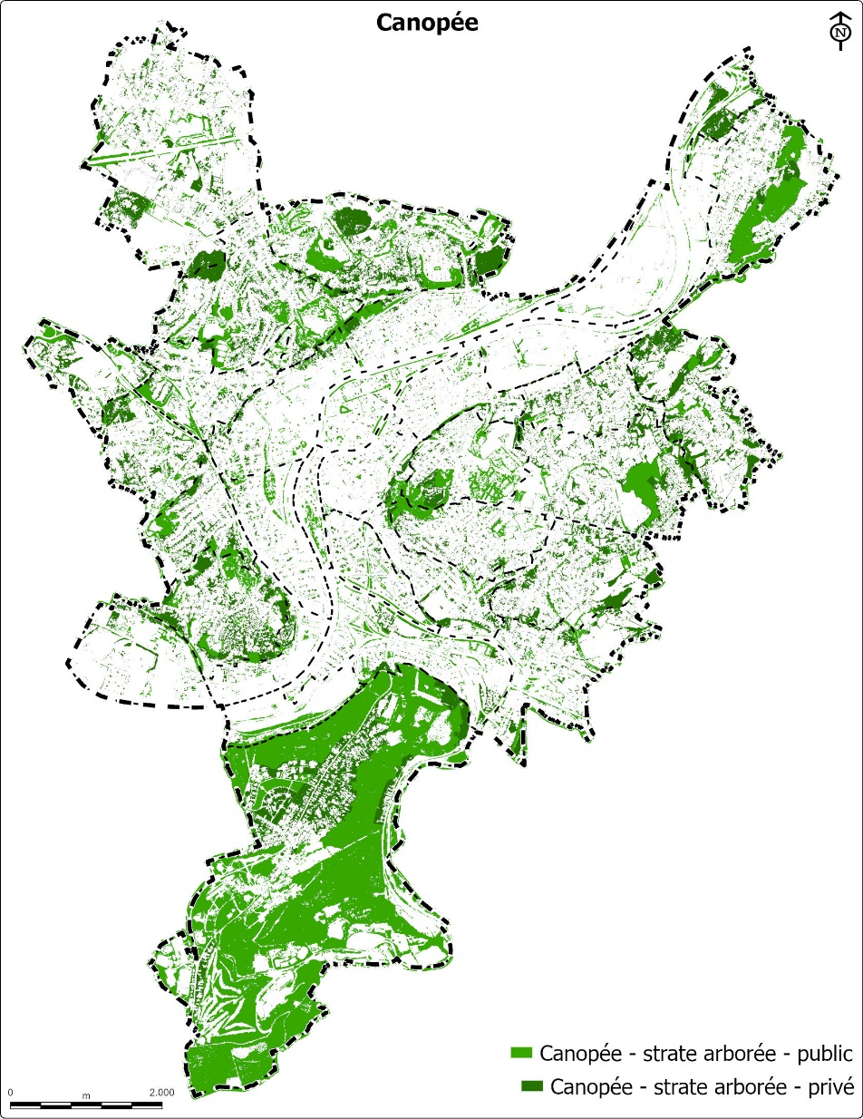
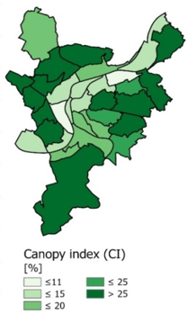
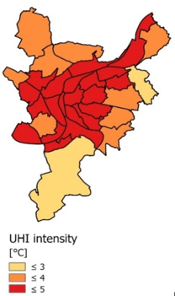
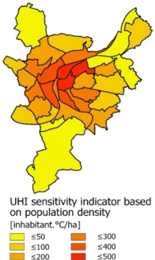
Plan Canopée
Mapping of Liege tree canopy
Comparison with population, population vulnerability
Urban Heat Island (UHI)
Notes:
Let me now present you some concrete examples of projects where we were involved and we worked for public administrations.
A first example is th ePlan Canopée of the city of Liege.
You know that th etemperature in a city depends on the presence of a vegetation. During a heat wave for example, some parts of the cities, where there are less trees, are warmer, constituting a so-called urban heat island (UHI), which can have consequences on the health of vulnerable people.
The municipality wanted to see where are located the UHI, the trees and see where more trees should be planted.
We had to map the tree canopy, looking where are the most vulnerable population and identify where are th eUHI.
For achieving this, we were dependent on some data provided by the municipality. Some calculations had to be done several times because there were mistakes in what was provided.
Plan Canopée (since 2020)
Valider modèle climatique. Pas à l’aise pour appérhender les résultats
La ville ne donne pas les bons fichiers, Calcul à refaire
Trop d’attentes, hautes exigences parfois irréalistes, parfois parce qu’iils sont très bien au courant
Modifications du rapport pour que ça fit avec les discours

Slide 9
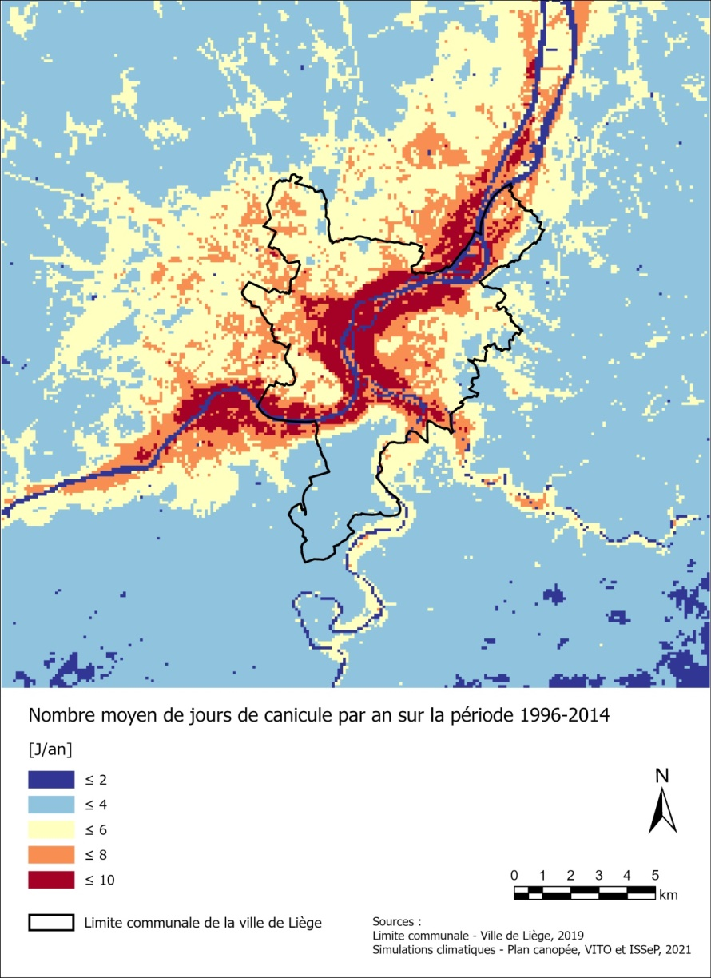
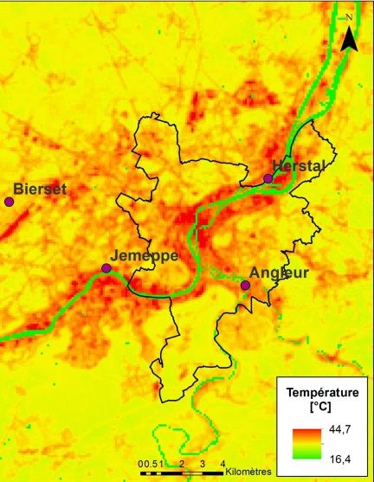
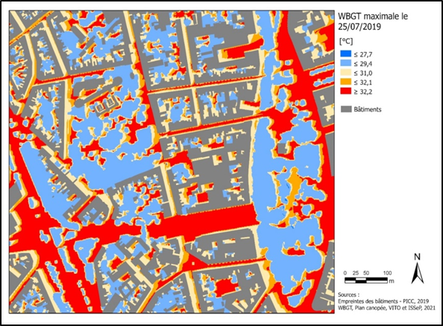
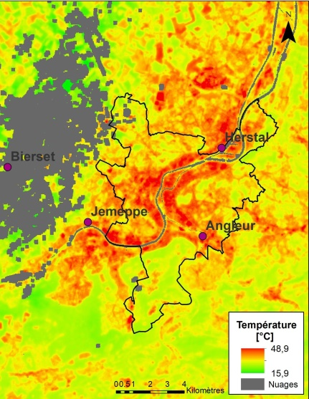
Plan Canopée
T_{surface}
Climate modeling
Necessity to get correct input parameters
Too high demands
Use of additional datasets
Model
Satellite
Notes:
Also to calculate th eUHI, we used climate modelling which required correct input parameters, for example land cover maps, which are not always updated.
General speaking, public administrations have sometimes high expectations because there are very aware of what exists and so what is possible, without thinking the difficulties of the methodology to implement to reach these expectations.
On the contrary, sometimes, they don’t know what exists. For example, in this project, they did not know what could bring the thermal satellite data that we used while it was not planned.
We need very good communication
Also, there is sometimes some mismatch between the scientific results we provide and the political speech the authority wants to deliver.

Slide 10
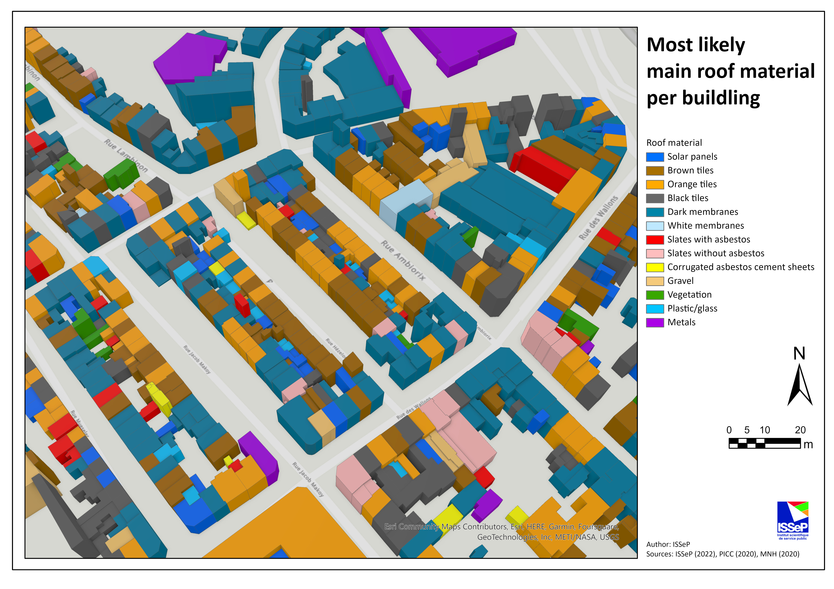
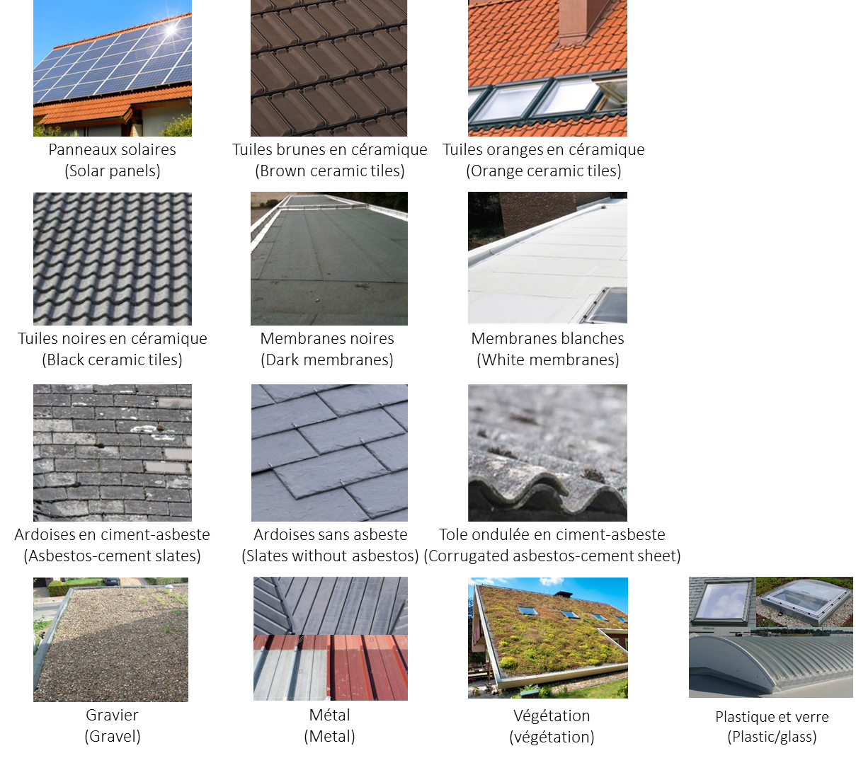
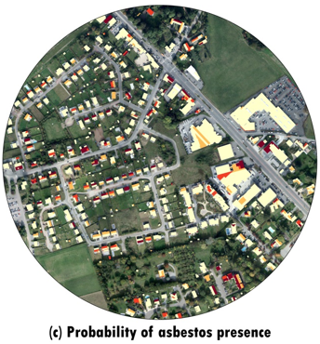
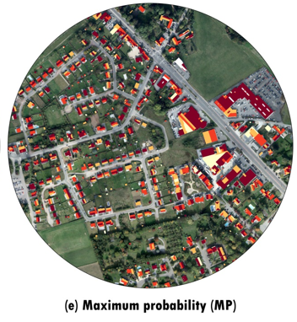
CASMATTELE
Semi-automatic characterization of roofing materials by remote sensing
Simple answer wanted vs scientific complexity and rigor
Identification of the users’ needs to simplify the scientific results
Wyard et al. (2023)
Notes:
Program of the SPW for studiyning some effects of the environment on the people health. In Belgium , many roofs contain asbestos which is bad for the health
Objective was to develop…
Authorities want something black or white but not grey .While we cannot provide a definite and sure answer, but an answer with a certain degree of certainty
We are dealing with staistics which are always understood

Slide 11
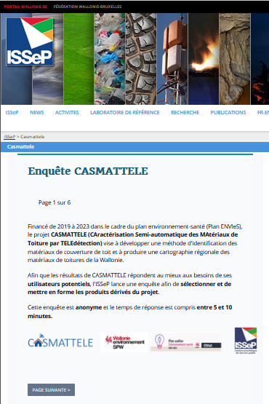
CASMATTELE
Semi-automatic characterization of roofing materials by remote sensing
Wyard et al. (2023)
Notes:
=> survey
Enquête pour connaître les besoins , what is important and what is not (3 classes of ceramic tiles), what is the best way to present the results (most likely class, confidence score), scale of the results (building, neighborhood, municipality), recent information
Very useful to provide the most suitable product
Résultats usage interne, données sensibles, certaine incertitude, notions statistiques qui requierrt une competence poiur être comprise
Veulent carte binaire. On a probabilités
Résultats comme info pour les autroités regionals

Slide 12
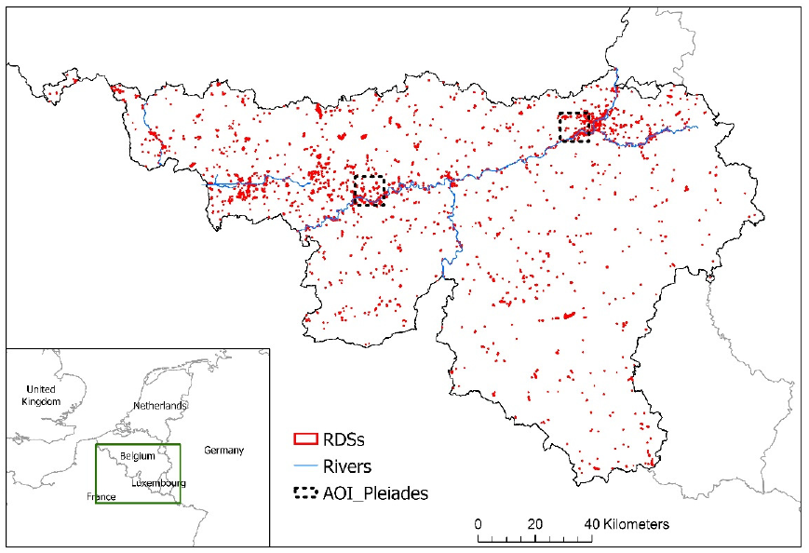
SAR(SAR)
Automated monitoring of redevelopment sites in Wallonia
2200 sites
Selection of the sites to be visited
Difficulty for the administration to appropriate the tool
Dependance on the data
Petit et al. (2022)
Notes:
Brownfields
Sentinel-1 & 2 + orthophotos
Change detection almost automatically detected. One difficulty is to integrate the solution we developed into the technological environment of the public service.
We need some specific data to achieve the mission requested by administrations. Here we are depending on the orthophotos which are acquired only once or twice a year.
We are asked to do sht but we are not sure to get the data, or ot get it on time
In the case of the detection of roofing material, we showed that the best results are obtained with data at 5cm spatial resolution .But these data are available only for two cities in Wallonia.

Slide 13
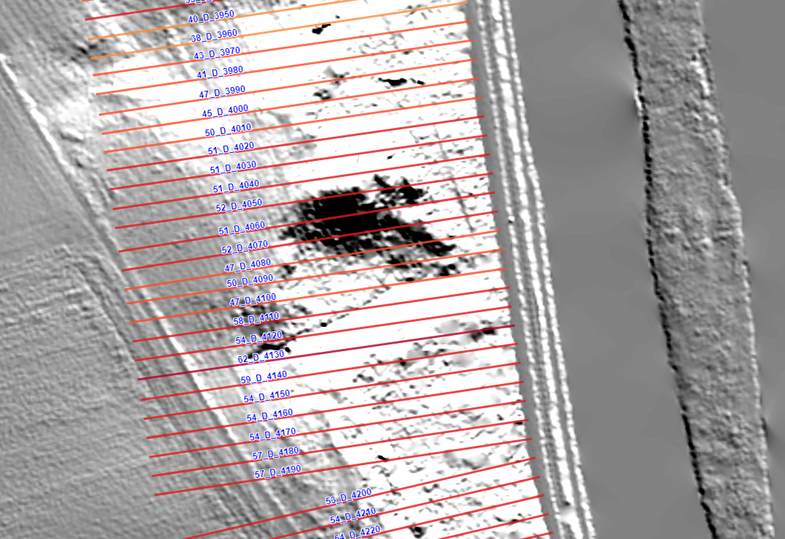
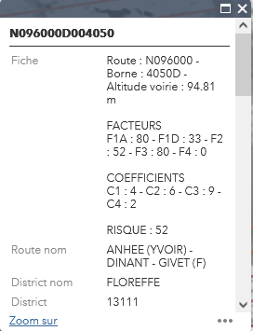
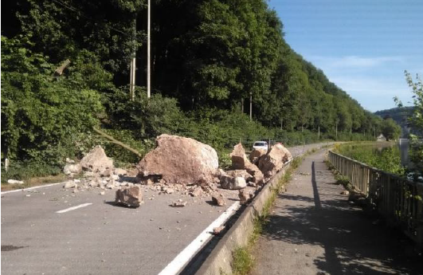
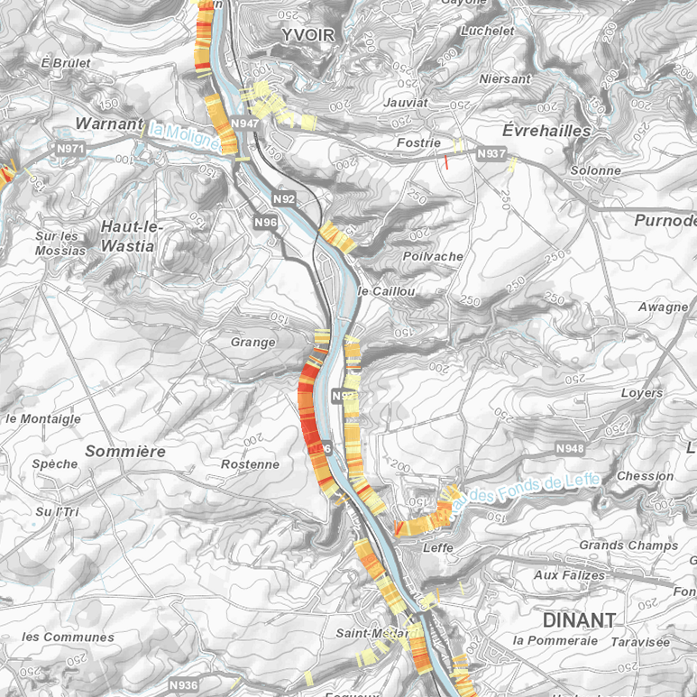
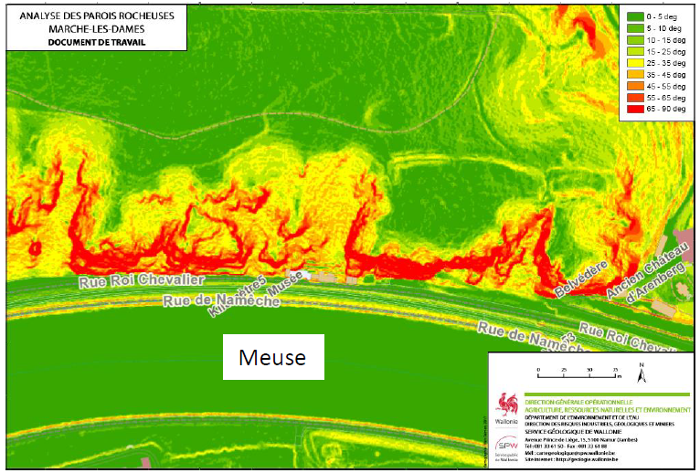
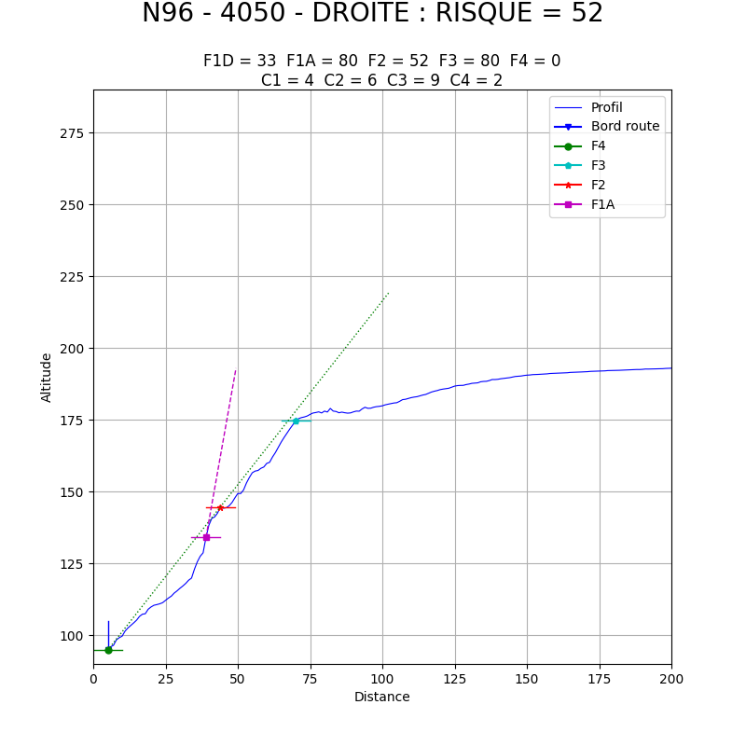
CLADAROC
Identification and classification of the dangerousness of rock walls
ESRI Web App
Notes:
Two last examples.
Teh SPW division for roads and railways wanted to have a tool to identify dangerous rock walls and cliffs with a risk of rock collapse. We developed a tool, a web app, where transects are drawn and, based on the digital terrain model, the slope is calculated, indicating if the is a threat.

Slide 14
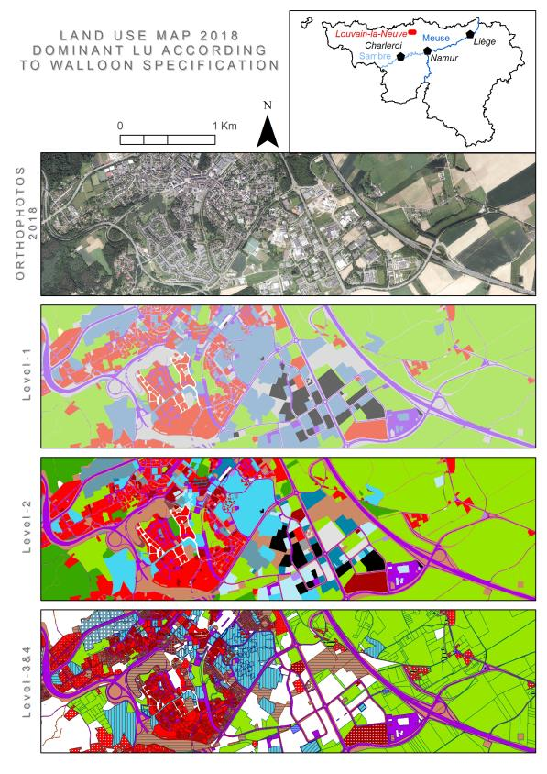
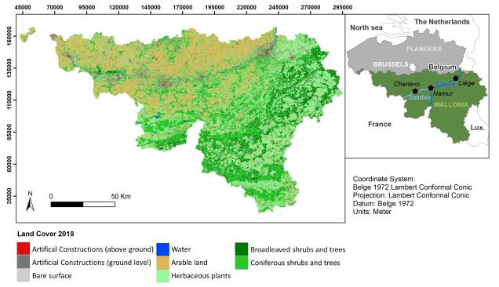
WALOUS
Operational and reproducible methodology for LULC mapping, in compliance with Walloon and European standards
Notes:
Identification des besoins des utilisateurs
S1/S2, orthophotos, DSM
Lack of maintenance because of other public market

Slide 15
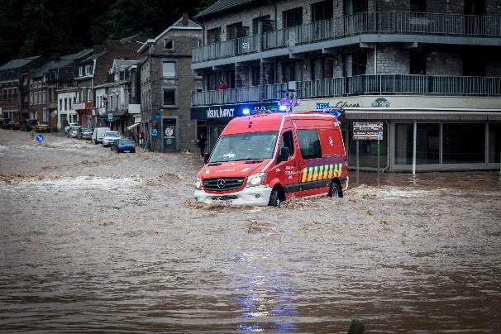
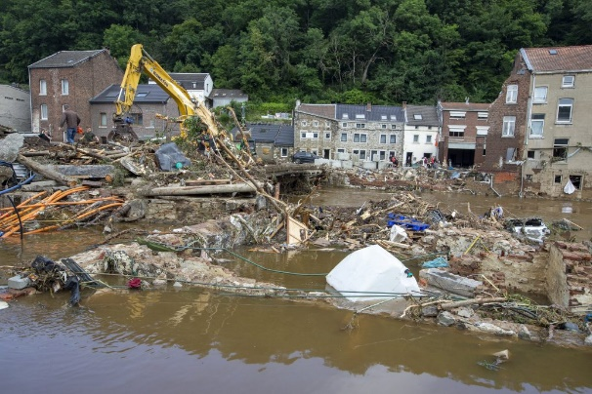
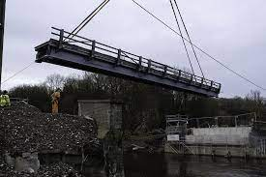
FLOWS
FLOod crisis management With Earth observation Solutions
Crisis
Which EO datasets can meet flood managers’ needs during the crisis, aftermath and reconstruction phases?
Which methods are most efficient to extract the necessary information?
How can advances in AI and user-generated data contribute to operational solutions in the field?
Which EO products are most useful, how can they be integrated into easy-to-use solutions?
Aftermath
Reconstruction

Slide 16
FLOWS
Improved preparedness for future events
EO strategy, processing, knowledge
EO
Ancillary
Population
Field data
Social media
Neural networks
Transformers
SSL & foundation models
Data fusion
Drone
Aerial
Satellite
Optical
Multispectral
SAR
Multi-sensor
multi-resolution
situational awareness
Multi-scale
flood impact assessment
Disaster hot spot mapping
Requirement Identification
Stakeholders’ needs
Agile prototyping with stakeholders
EO
information
Validation
Notes:
[c] To answer these questions, we will use a wide variety of EO and other data as well as innovative methods, such as neural networks, transformers, self-supervised learning & data fusion.
More precisely, we have defined 4 content-related WPs that are all interconnected. [c] A first will focus on the identification of the stakeholders and their needs. Then we have two WPs focusing on the development of methods to retrieve flood information from EO data. Here we make a distinction between [c] situational awareness on the hand and [c] impact assessment on the other hand. Finally, in our [c] fourth WP we will work on harmonizing the created EO products in an integrated whole.
As such, we want to contribute to a better prepared preparedness to future flood events.
Our first work package will be dedicated to the needs of stakeholders. When we say stakeholders, we think of actors involved in both the crisis, aftermath and reconstruction phases; like civil security, the red cross, crisis centers, public service, water managers, insurance companies and so on.
We think this is important to include them because during and after the ‘21 floods, we saw that several EO data & products were ready but remained unused. Yet, several reports from emergency services and expert groups stressed that the fast access to situational geo-information is an urgent need for future flood crisis management.
Unfortunately that’s something that we see a lot in science, namely that valuable knowledge and products are underutilized as they don't reach their potential users.
We want to tackle this differently by including stakeholders from the start. Some of you might know have heard of the term agile prototyping. We are not in the prototyping stage yet, but we want to integrate this concept in our research activities.
More specifically, we will identify stakeholders’ needs through a participatory approach in the beginning of the project. We will organize workshops with each group of stakeholders and identify their needs using the problem tree identification method. We will do at least 4 iterations to refine and validate them interactively, and based on that finetune our research questions where needed. Furthermore, our research results will be validated not only by ground truth data but also with the stakeholders. As such, we aim to ensure the impact of our work.

Slide 17
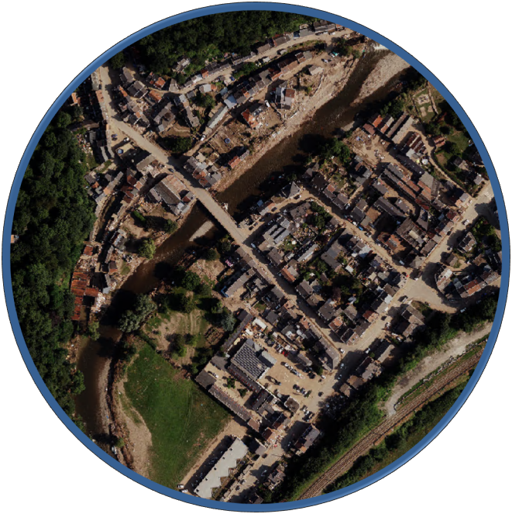
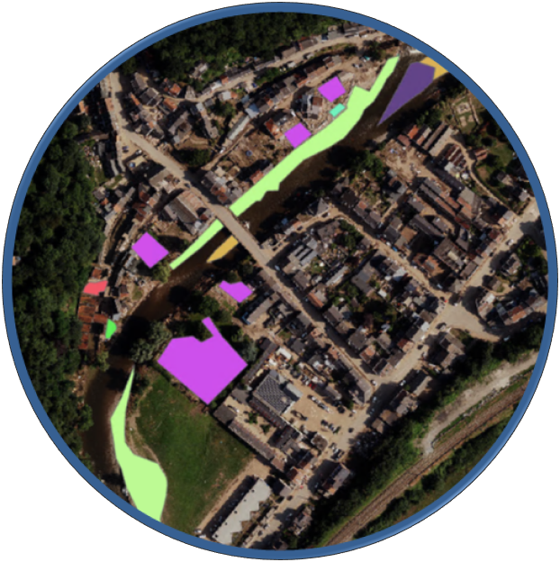
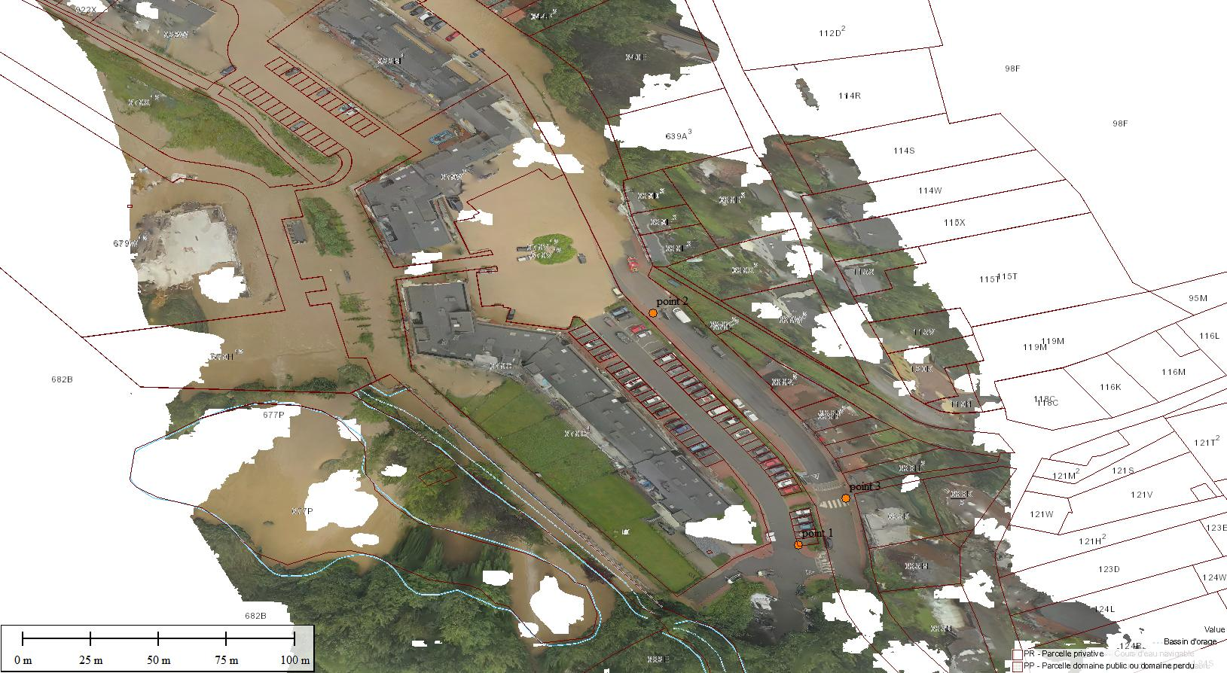
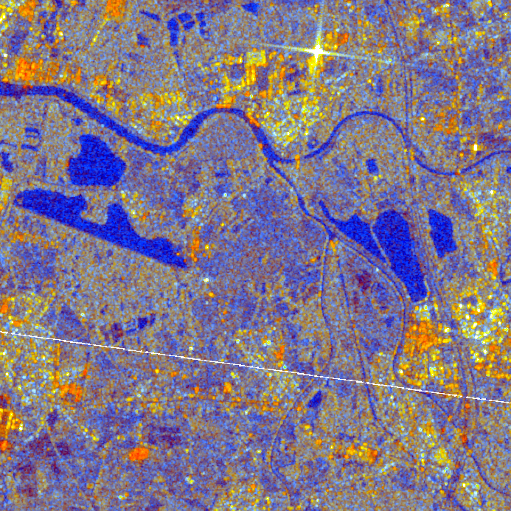
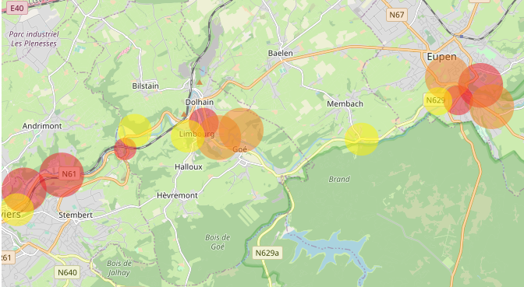
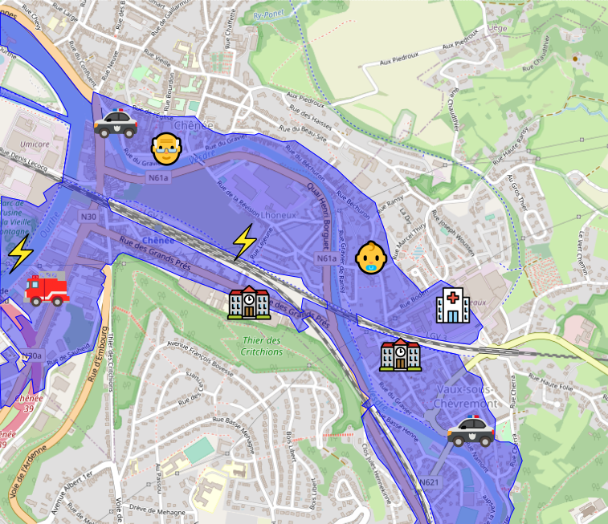
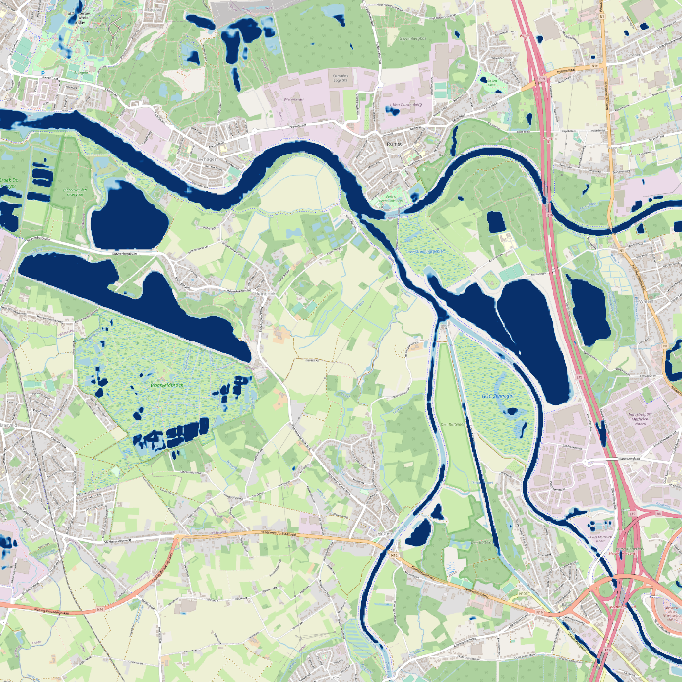
FLOWS
Notes:
Flood extent
Damage assessment
AI
Conversion of oblique drone imagery into orthorectified and georeferenced imagery
Identification of the impacted vulnerable people and facilities
Mapping of the population dynamics
Data fusion into a single map

Slide 18
Conclusions
There are CHALLENGES…
but there are SOLUTIONS to any challenge faced !
Notes:
Inertia, not always open to innovative solutions
Lack of scientific expertise
Depends on policy agenda, depends on the government and on the elections
Real-time policy (e.g. PFAS)
But if we know the reality, if we share the same objectives and talk a common language, it is not difficult to find solutions to

