Slide 1
Galileo Contribution for Disaster “Risk” Management
EUSPA-Galileo Reference Centre (GRC)
Peter BUIST– Peter.Buist@euspa.europa.eu

Slide 2
Content
Galileo Services
Search and Rescue (SAR)
Emergency Warning Satellite Service (EWSS)

Slide 3
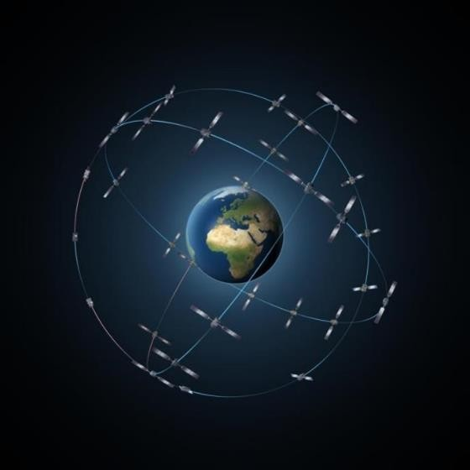
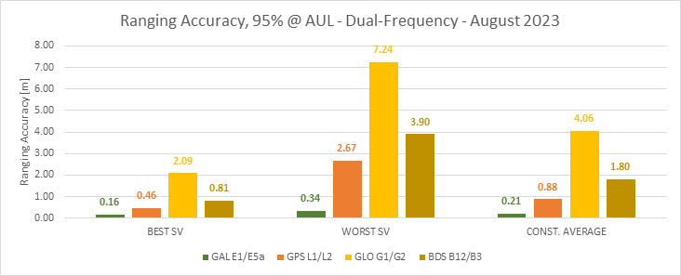
Galileo Today
28 satellites in orbit
Remarkable performance
Operational services, or in roll-out phase
Strong link with users, market and industry
Modernization ongoing
GNSS performance as monitored by the Galileo Reference Centre (GRC)

Slide 4






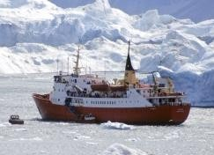




Galileo Services
Available, Ongoing, & Next
Open Service (OS)
Free and Open Positioning Navigation & Timing (3 frequencies + improvements)
Emergency Warning Satellite Service + Advanced timing + SSV
Public Regulated Service (PRS)
Encrypted, more robust, unlimited & uninterrupted access
PRS evolutions
Search and Rescue (SAR) - contribution
Forward link + acknowledgement "return link“ + Remote Beacon Activation
Two Way Communication + Distress Position Service
High Accuracy and Authentication
High accuracy services + OSNMA + Advanced signal authentication services
Safety-of-Life (SoL) - contribution
Multilateral Workplan for aviation adoption (ARAIM+EGNOSv3)
Notes:
Remote Beacon Activation (RBA), Two Way Communication (TWC), Distress Position Sharing (DPS)

Slide 5
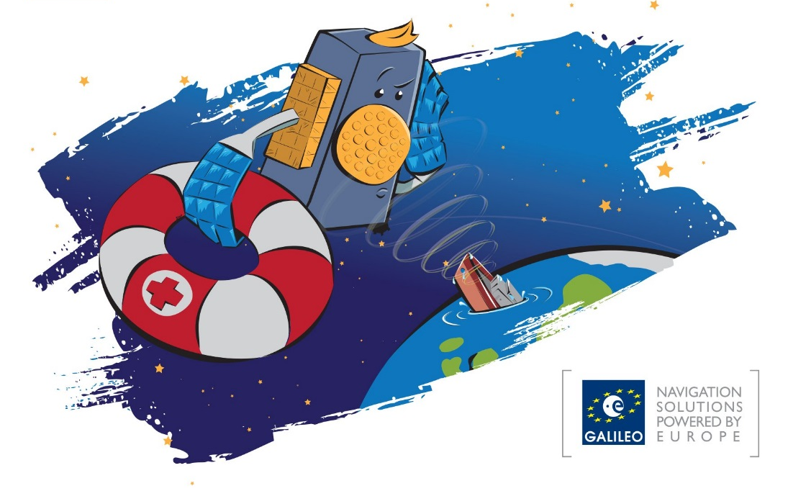
Galileo SAR: Contribution to the
worldwide SAR effort in Cospas-Sarsat
SAR payloads on board of Galileo satellites
Ground Segment for the Forward Link
Ground Segment for the Return Link
The Galileo Contribution is
  the largest Space Segment (L-band) contributor
  the largest Ground Segment contributor: 4 MEOSAR Local User Terminal (MEOLUTs)
  the only Return Link Service Provider

Slide 6
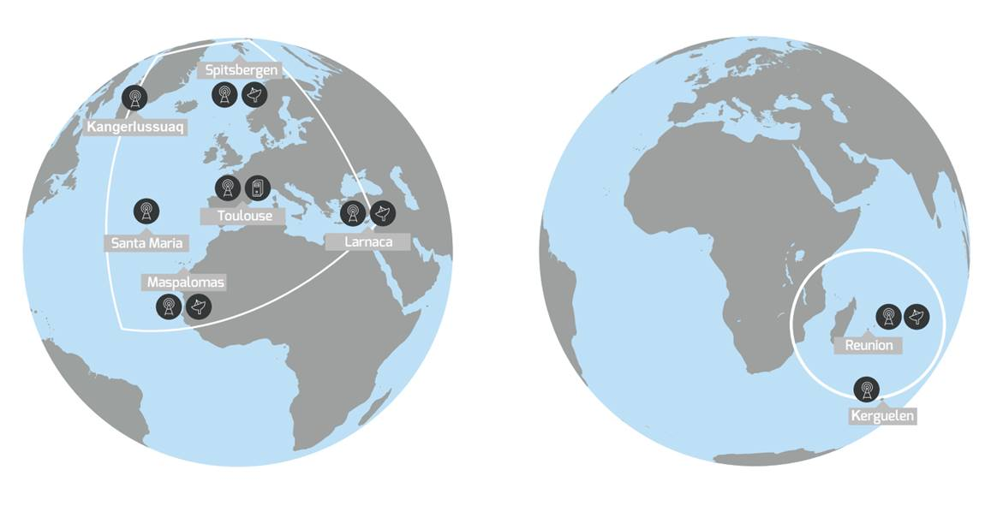
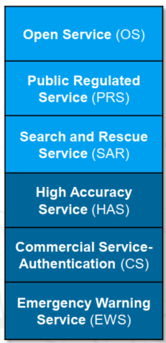
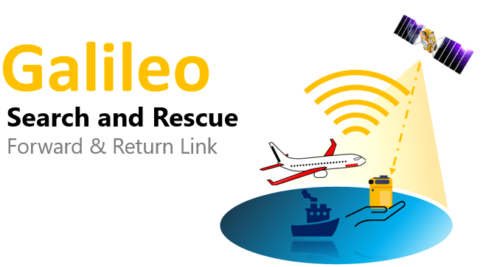

Galileo SAR: Programme Overview
European Coverage Area
2 Forward Link Service Coverage Areas as a contribution to Cospas-Sarsat MEOSAR Programme with:
    4 European MEOLUTs acting as one deployed in: Maspalomas (Spain) , Spitzbergen (Norway), Larnaca (Cyprus), Reunion (France).
    24 SAR L-Band SAR repeaters onboard the Constellation
    1 Coordination and Monitoring Facility deployed in in Toulouse
    7 Reference Beacons spread over the Service Areas for Service Monitoring purposes.
Galileo Services
1
High Accuracy
Service (HAS)
Indian Ocean Coverage Area
2
Return Link Service a global service enabling a communication link back to the originating emergency beacon through the Galileo Navigation Signal in Space (I/NAV E1) sending a confirmation message (RLM) to the user that the distress signal has been localized by the System

Slide 7
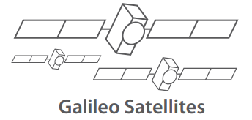


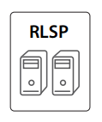


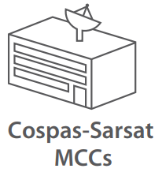

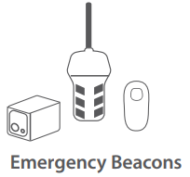


Galileo SAR: Return Link Service Provider (RLSP)
RLM
RLM
C-Band RLM Uplink
1575.42 MHz RLM Downlink
406.1 MHz Distress Uplink
RLM Request
1544 MHz Distress Downlink
RLM Request
RLM
Average of 37seconds
(RLSP to beacon)
RLM
RLM
RLS is the backbone for future Galileo Services
Notes:
Mission Control Centre (MCC), French Mission Control Centre (FMCC), (SPMCC)

Slide 8
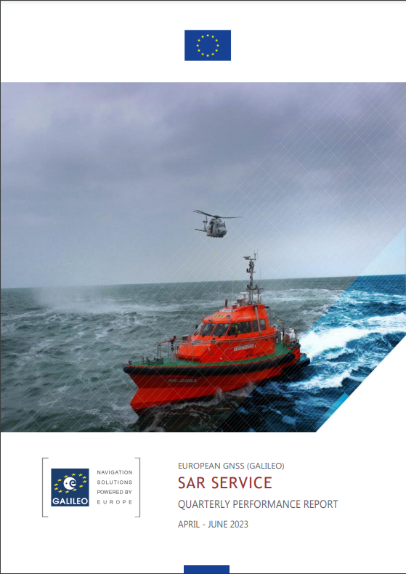
Galileo SAR Service Performance
Excellent Forward and Return Link Availability ≥ 99.9% which contributed to 390 SAR events with approx. 1,389 people rescued within EU territories (2022)
All Service commitments were met
Main Performance Metrics:
  Forward Link Detection Probability constantly at 100%;
  Location Accuracy within 5km ≥ 99.8 %
  Mean Location Accuracy 784m;
  Return Link Delivery Latency <1min
All Galileo SAR commitments are published on a quarterly basis at www.gsc-europa.eu

Slide 9
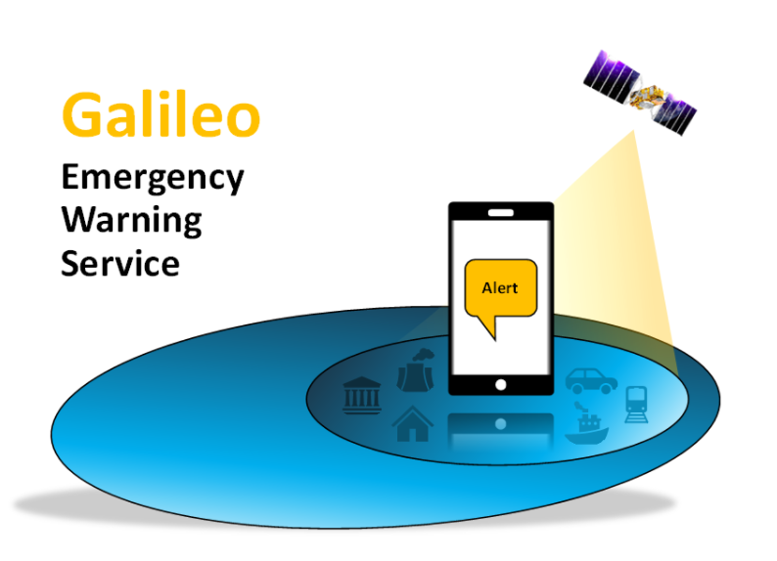

Galileo Future Services:
Enhancing the Galileo Emergency Solutions Porfolio
1
2
Two Way
Communication
2W
The Return Link Channel is the backbone of future evolutions with the following characteristics: Low bit rate (10 bits/s); Short messages (80 or 160 bits) & Global coverage: reliable (multiple satellites, available with no ground infrastructure)
3
4
Distress
Position
Sharing
2WM

Slide 10
EWSS background
Global trend to develop Disaster Risk Reduction technologies:
  United Nations’ Sendai Framework for Disaster Risk Reduction: “Substantially increase the availability of and access to multi-hazard early warning systems and disaster risk information and assessments to people by 2030”
Galileo contribution to this target: Emergency Warning Satellite Service (EWSS)
Use the GNSS satellite capacity for alert dissemination
  Purpose: Alerting the population in case of a looming disaster (fire, storm, floods, tsunamis, volcano, industrial… )
  National Civil Protection entities decide to trigger the alert and request Galileo to broadcast a message
  People receive the alert message on their mobile phone/nav’ device, or public signeage displays the alert message (buildings, billboard, etc)

Slide 11
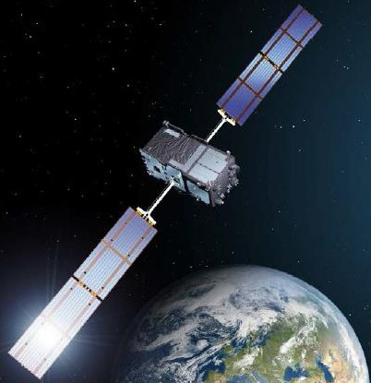
EWSS Service Concept
Example of target area for an alert message, defined by ellipse.
Dissemination of an alert message, including associated instructions to follow
Global coverage
Target area from local to continental scale
Time to disseminate ~ minutes
Available even when terrestrial communication networks are not working
Available with standard personal devices (smartphone, car navigator, handheld…)
Free of charge
Alert message is authenticated
Complementary alert system to those already operated at national level
  ‘the more systems, the better’
Ellipse radius is adjustable
5
DOUBLE notification rule: receiver is located (1) within the country that emits the alert AND (2) within the ellipse encoded in the message
11

Slide 12
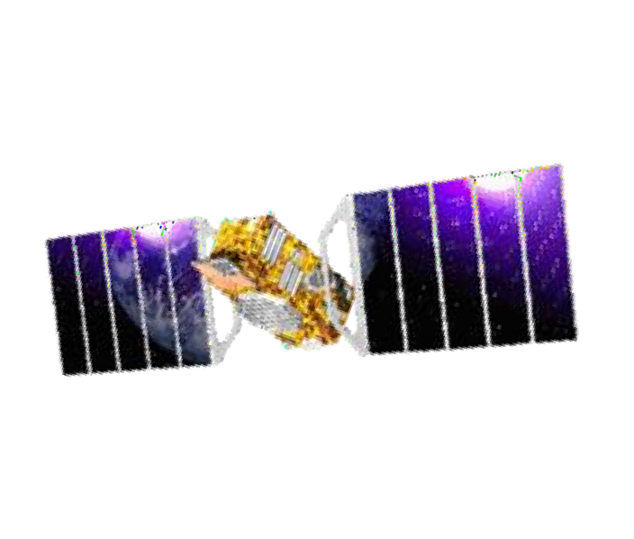
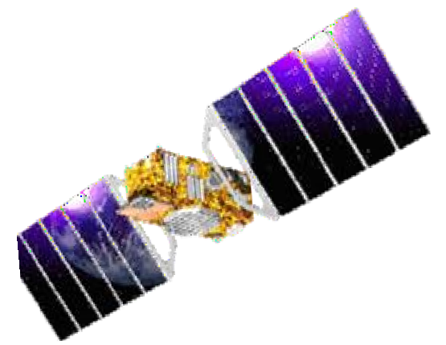


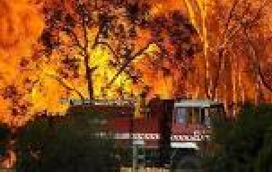

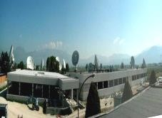
EWSS Operation concept
National Emergency Centre
Decision
Galileo Emergency Service
Interface
CAP / XML
EWS Message
Bit level
ALERT
7
Civil protection
Galileo Ground Segment
Population
(smartphone, car navigator, Handheld, smartwatch, public display, sirens, etc)
The service is realised by three components:
Civil Protection Authorities Galileo infrastructure
End users

Slide 13
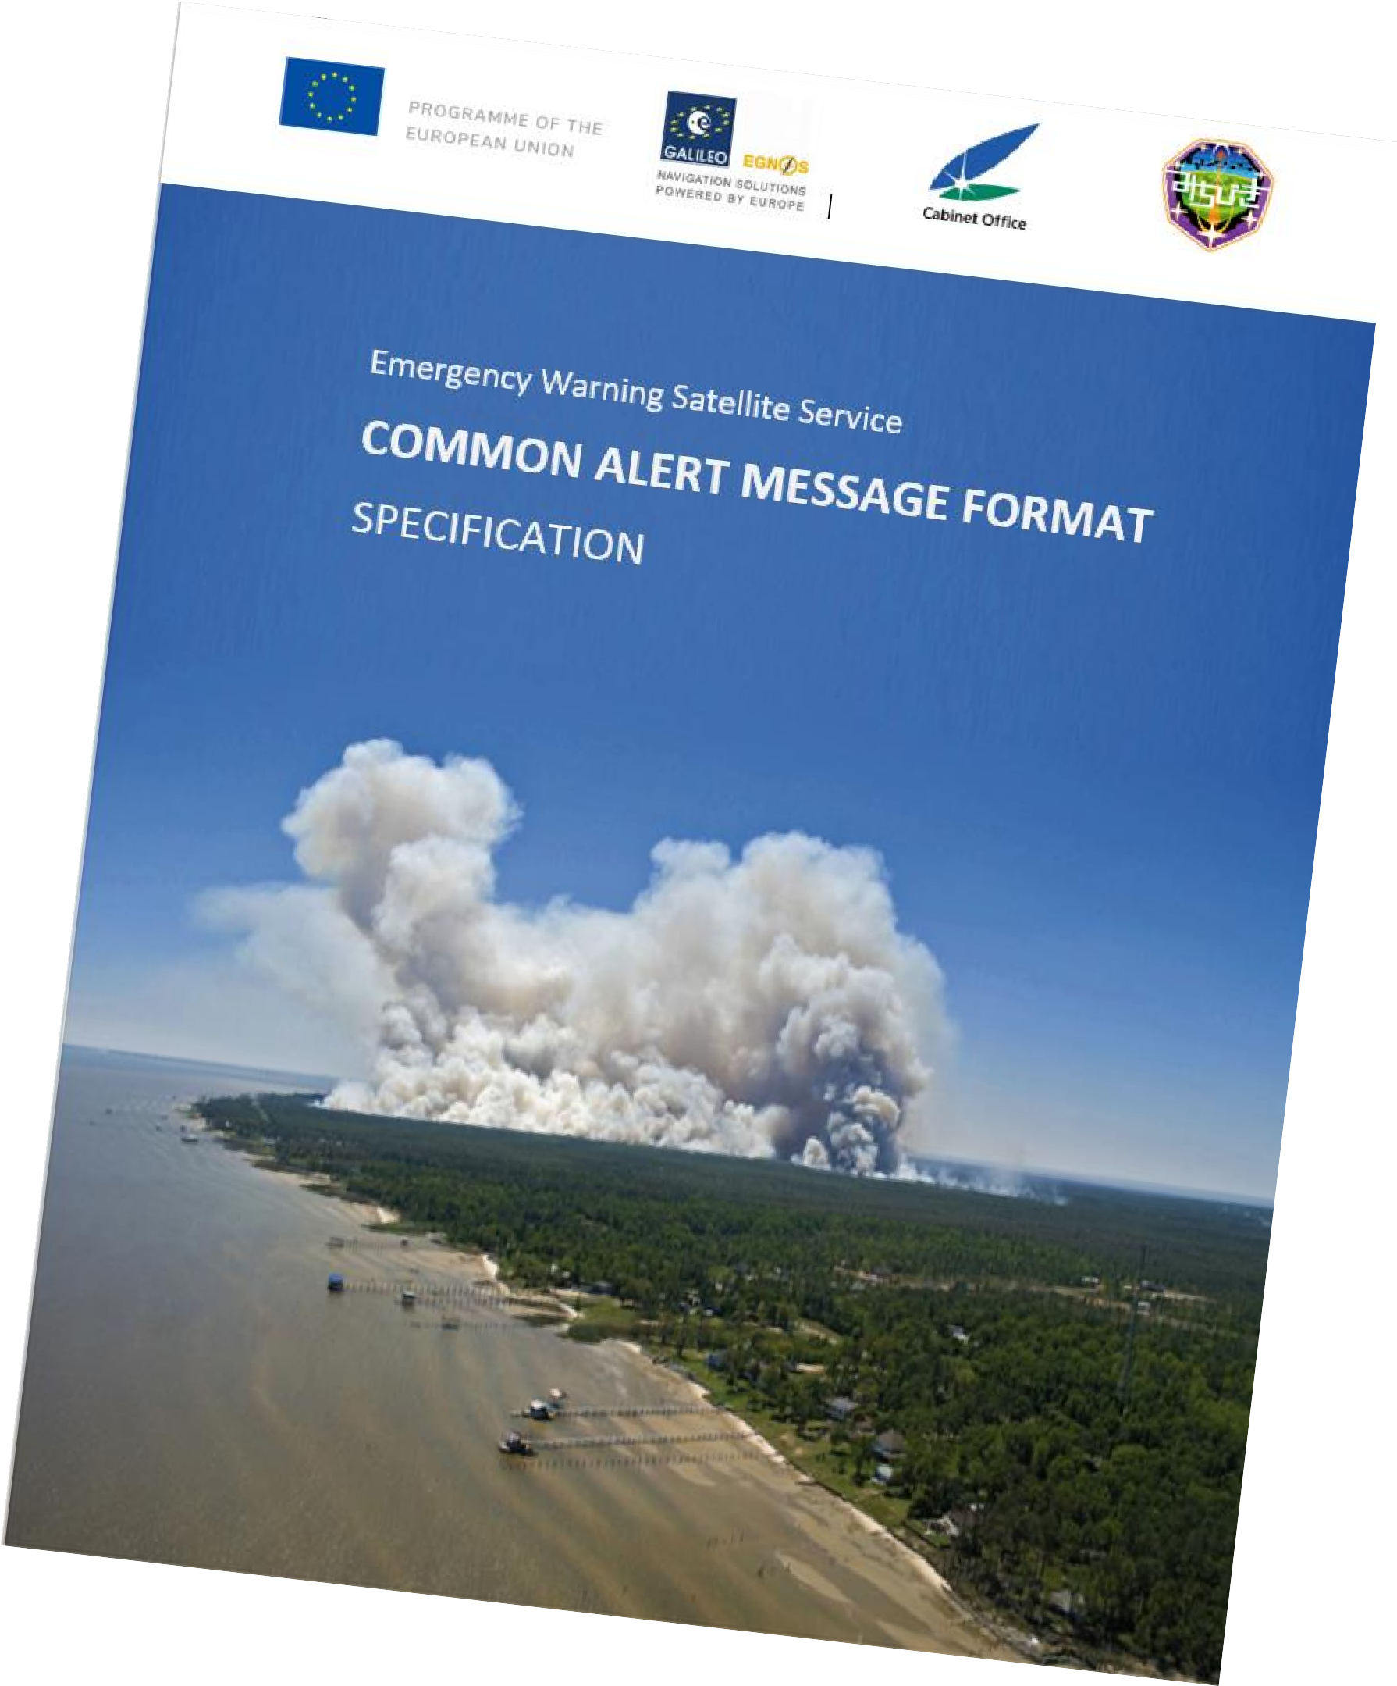
EWSS format
Common EWSS Message format
Message Type: Alert/Update/Test/Cancel
Country ID: ID of the country from which the alert is issued
Provider ID: National agency raising the alert
Event Category: Tsunami, Forest Fire, pandemic, volcano, storm, etc.
Severity: moderate/severe/extreme (or ‘unknown’)
Event Onset: Day/Hour/Minute, 7-to-14 days time horizon
Duration: in hours, from < 0.25 h to 24 h (or ‘unknown’)
Target Area: 2D ellipse, with semi-axis ranging from 200 m to 2500 km
Instructions: Generic instructions to population, taken from a library (combination of two instructions possible, to enrich the message)
Additional information for message customization (magnitude of event, secondary ellipse for indicating safe destination, location of hazard, etc)
Message format full description soon to be published! Joint effort EU-Japan (Galileo-QZSS)

Slide 14
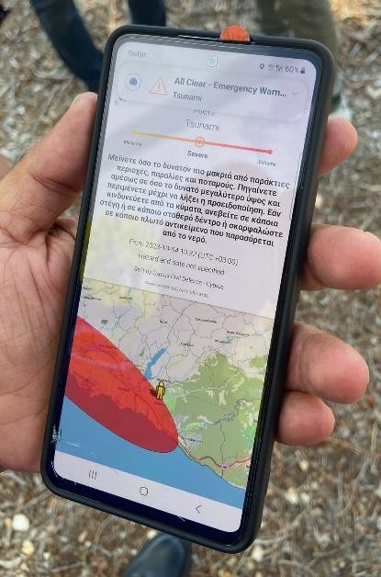
EWSS: next steps
Field demonstrations: 2023
  Purpose: organize end-to-end, in-field demonstrations of alert dissemination using the real Galileo system
Connections to the system: 2024
  MS civil protection agencies
Service declaration: 2025

