Slide 1
GOVSATCOM for Disaster Risk Management
Eurisy Workshop in Brussels, 11 December 2023
Georgios SYNNEFAKIS, GOVSATCOM Programme Manager

Slide 2
Space based solutions and telecommunications for disaster risk management

Slide 3
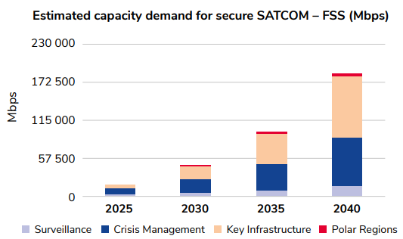
Crisis Management will account for almost half of the total SATCOM demand in 2025
Civil Protection is one of the main contributors
SATCOM is key when terrestrial networks are unavailable
Real-time monitoring of emergency operations, fostering effective communication among response teams and coordination centers
Higher number of expected natural disasters due to climate change
Increase of units equipped with a Communication on the Move capability and the spread of intelligent sensors transmitting valuable data.
Smart emergency response vehicles serve as a critical asset for first responders, such as civil protection, ambulance services, and fire & rescue teams.

Slide 4
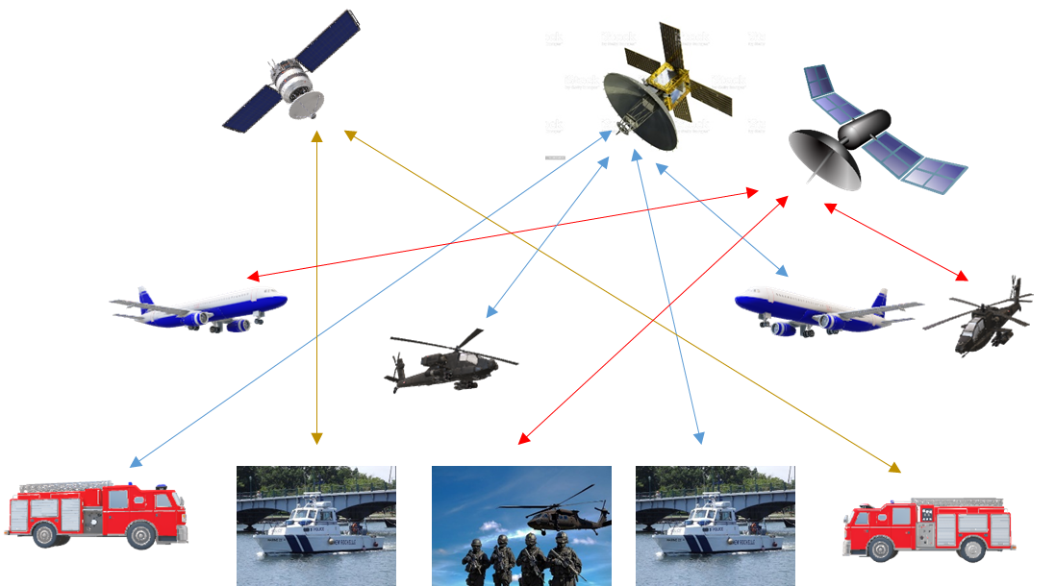
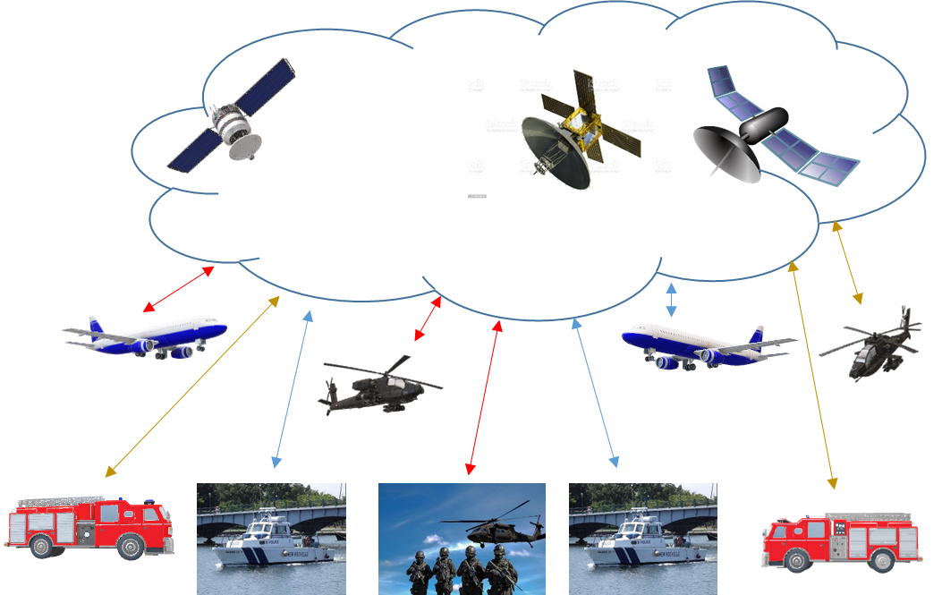
EU GOVSATCOM – Common Union Pool
Common
Union
Pool
GOVSATCOM
GOVSATCOM pools existing satellite communication capacities and services into a common Union pool
Users access capacities and services listed in the service portfolio through the GOVSATCOM Hubs
3 GOVSATCOM Service categories: 1) raw capacity 2) anchored capacity 3) end to end services
4

Slide 5
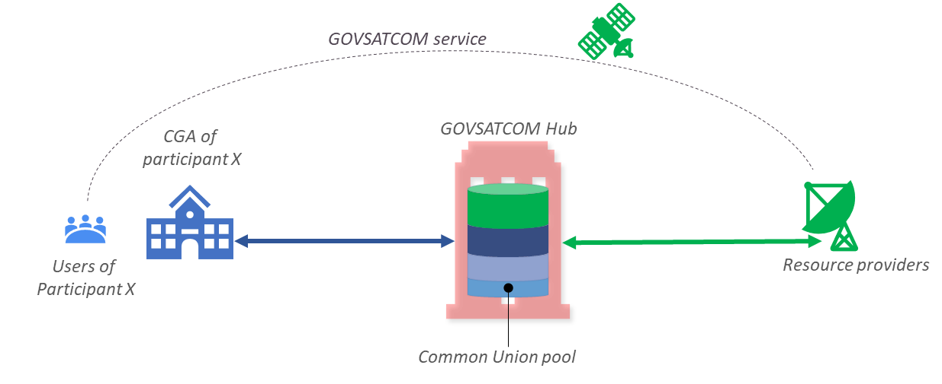
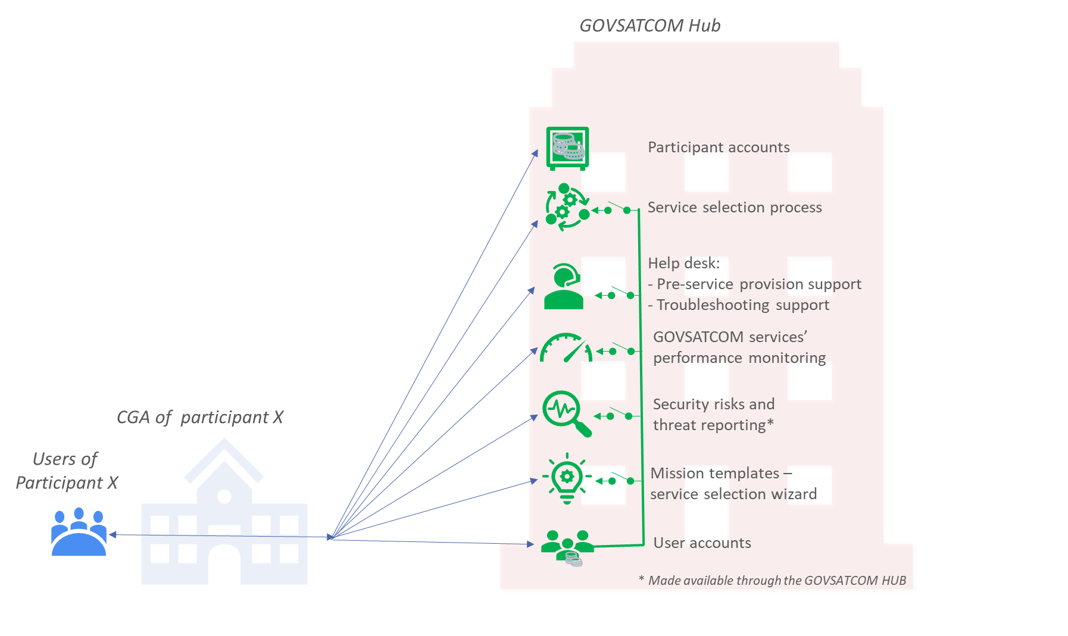
The GOVSATCOM ecosystem – the benefits
Unified satellite communications service catalogue with prices
Easy to compare services
Pre booked resources-services
Easy and fast booking of services
High priority needs served through crisis margin SATCOM resources
Innovative SATCOM services delivered by the EU multi-orbital constellation IRIS²
. . . and many more!

Slide 6
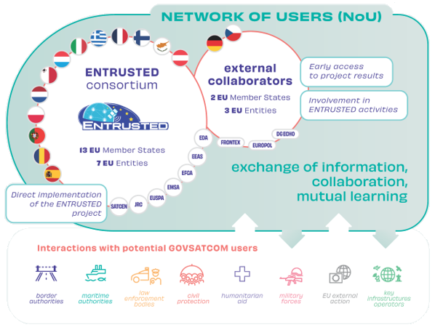
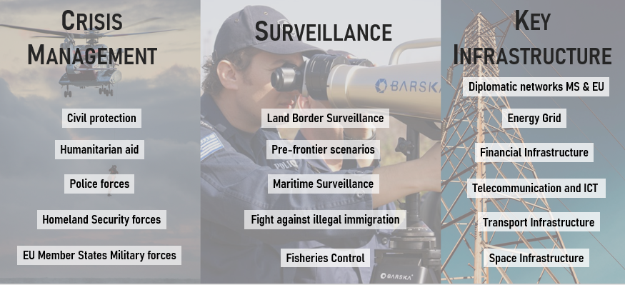
ENTRUSTED: The voice of EU and National secure SATCOM users
Interaction with Potential GOVSATCOM Users
3 months
Secure SatCom Requirements
192 use cases analyzed
Consultation
450 Users
154 responses

Slide 7
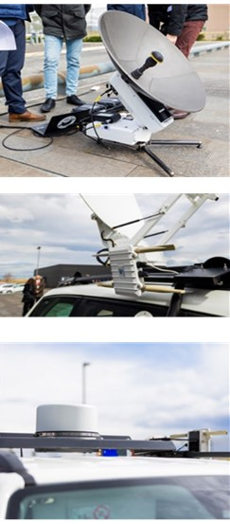
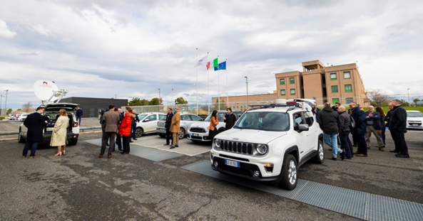
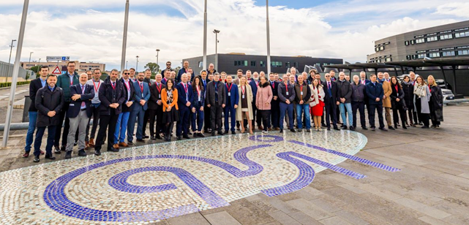
EUSPA is launching a new network of users
Interested to join?
Thematic groups (Emergency Management, Critical Infrastructure, Surveillance…)
Gain access to opportunities and promote share of experience across the communities
Identify, discuss and assess further use cases and requirements, challenges and opportunities for the use of secure SATCOM
Launch pilot activities
Discuss and prioritise technological gaps to be filled
Workshops, Demo events, Training needs …
… and much more..
ENTRUSTED@euspa.europa.eu

Slide 8
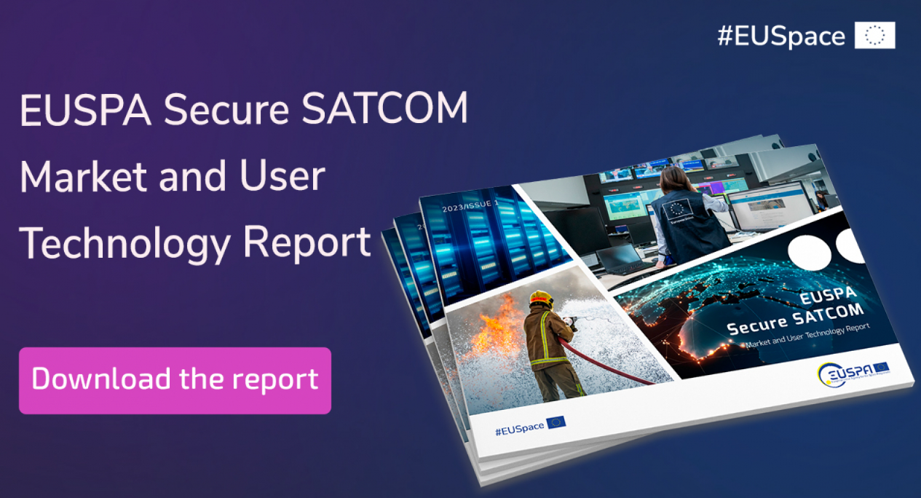
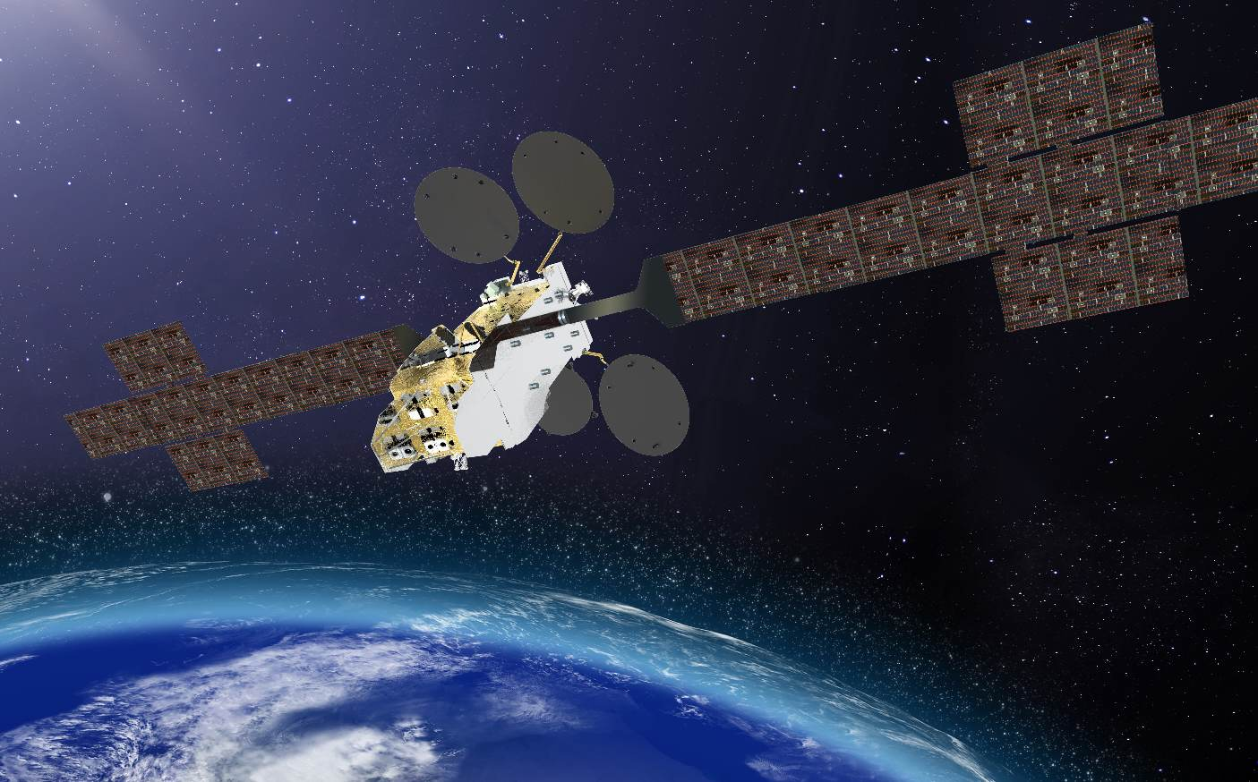
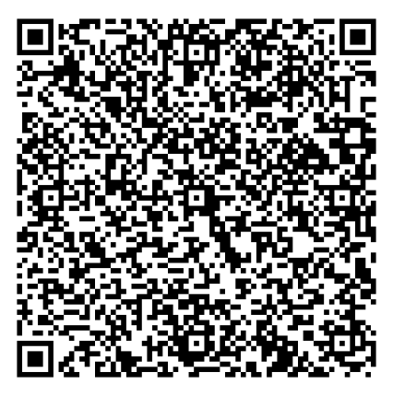
Secure SATCOM in the EU: A Comprehensive Overview
Secure SATCOM
Market
Secure SATCOM
Supply
Secure SATCOM User Technology
Register
here!
Do you want to know more?
Join the online Webinar on 12th December at 10-12h

