Slide 1
TerraFlood
Flood extent mapping
Lisa Landuyt
Jurgen Everaerts
Eurisy Satellite-based Services for Disaster Risk Management
Brussels 11 December 2023

Slide 2
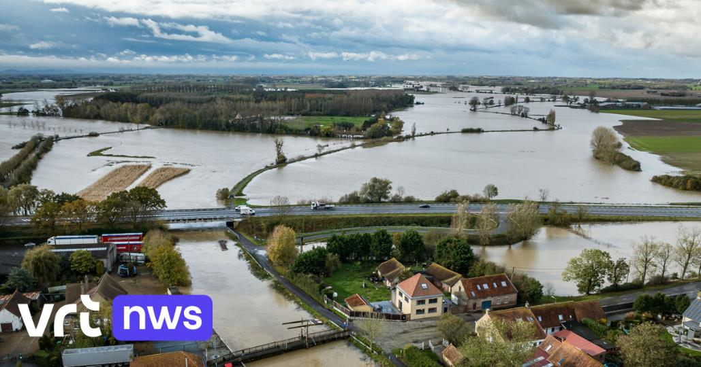

Slide 3
Sentinel-1 RADAR (SAR)
to the rescue

Slide 4
What is so great/bad about Sentinel-1?
RADAR is not much affected by clouds
Active system, does not require sunlight
Systematic coverage (every x days)
Operations to continue for many years to come
Image resolution ~ 10m
Noisy images
Clutter

Slide 5
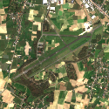
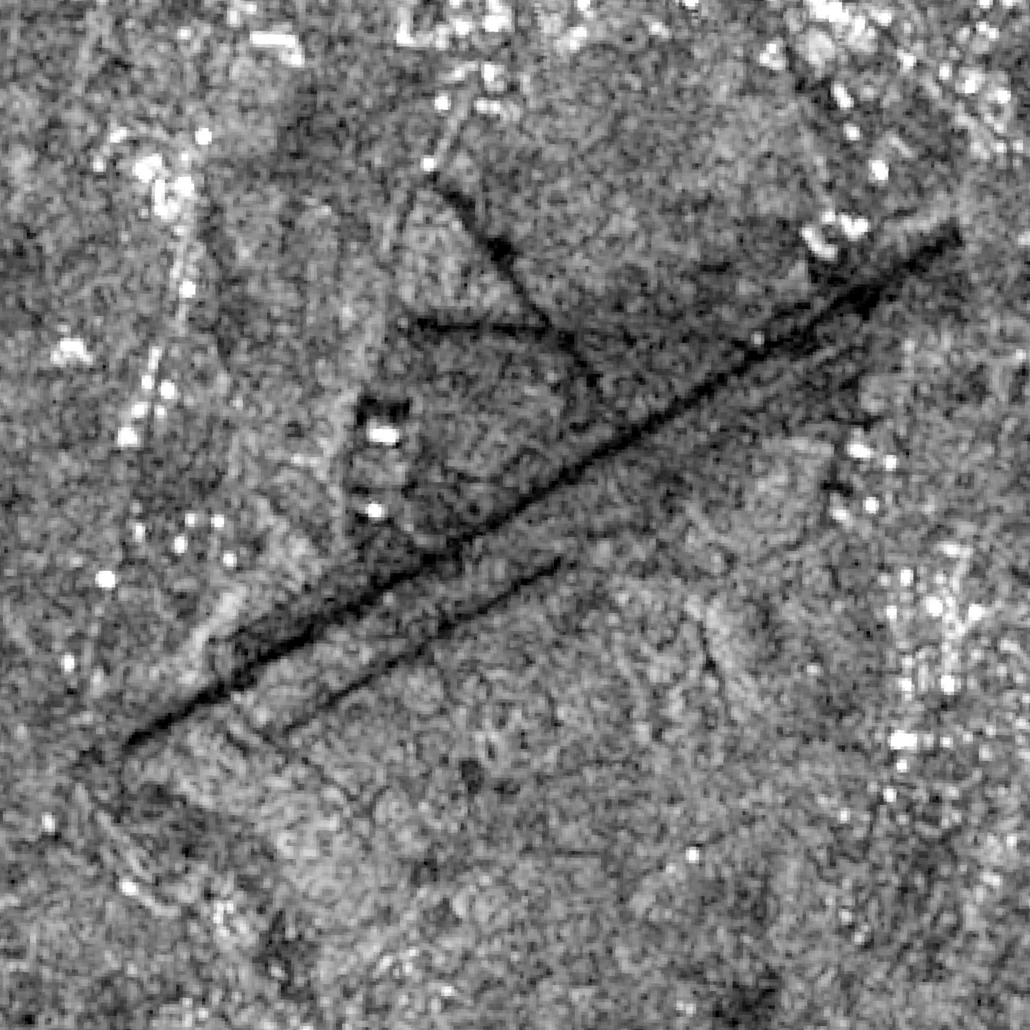
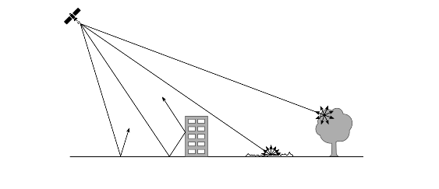
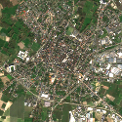
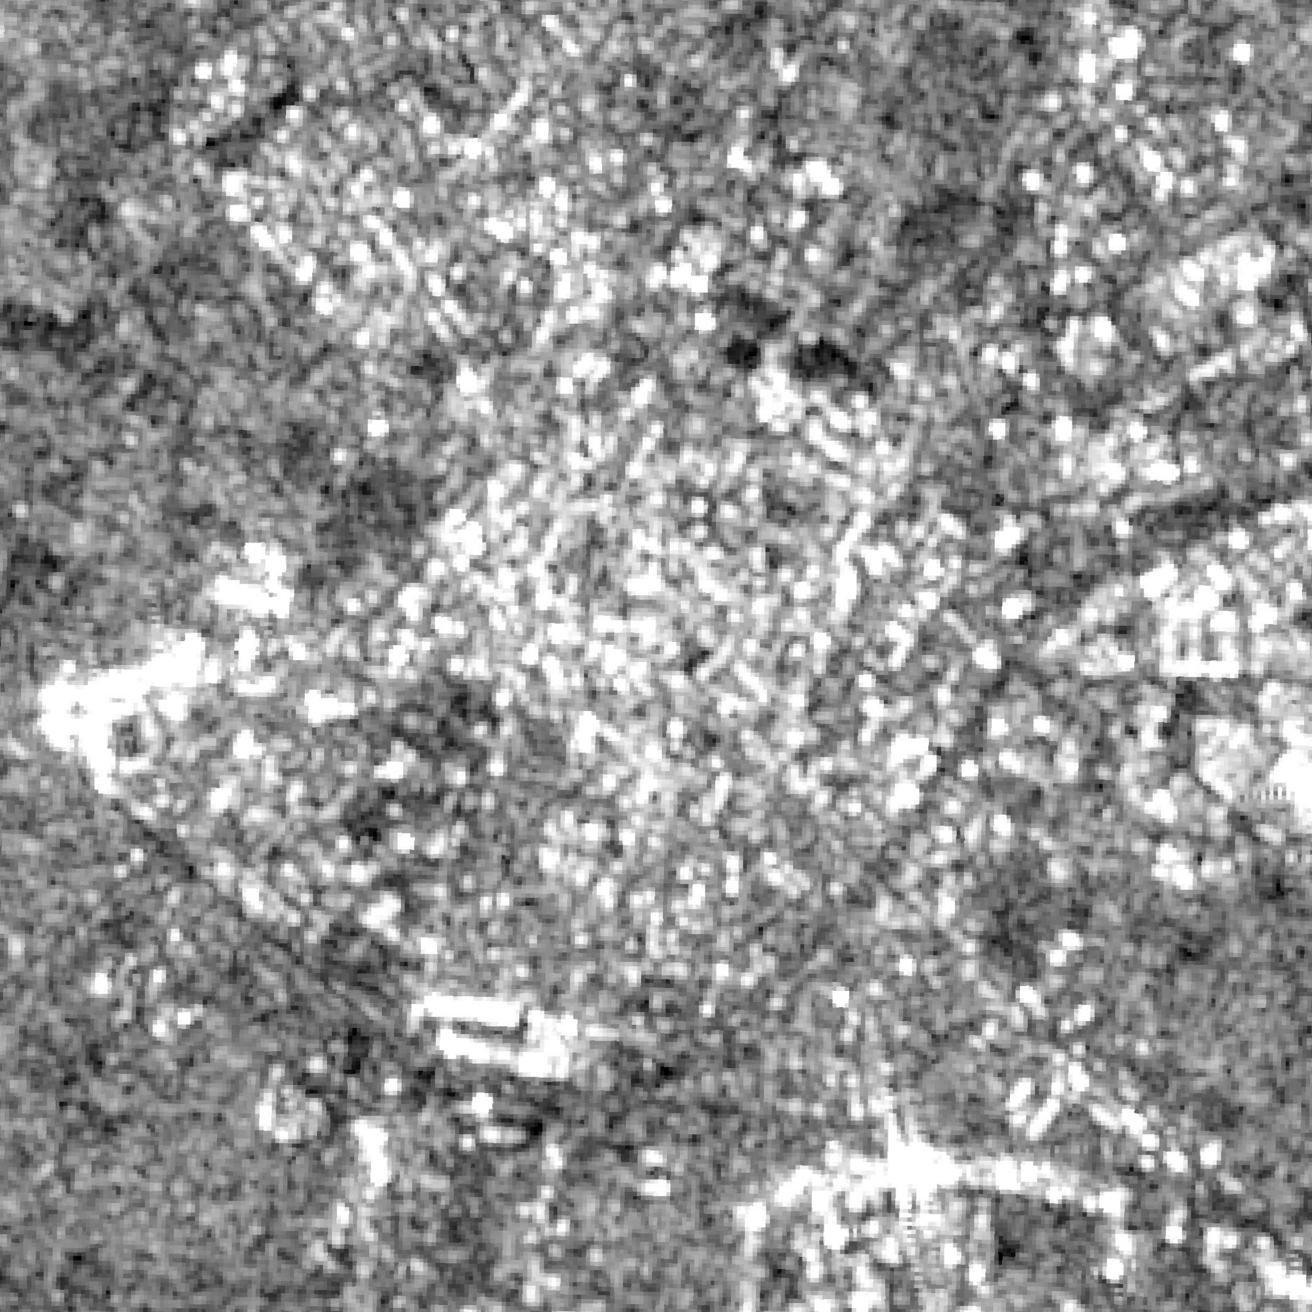
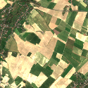
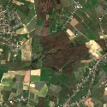
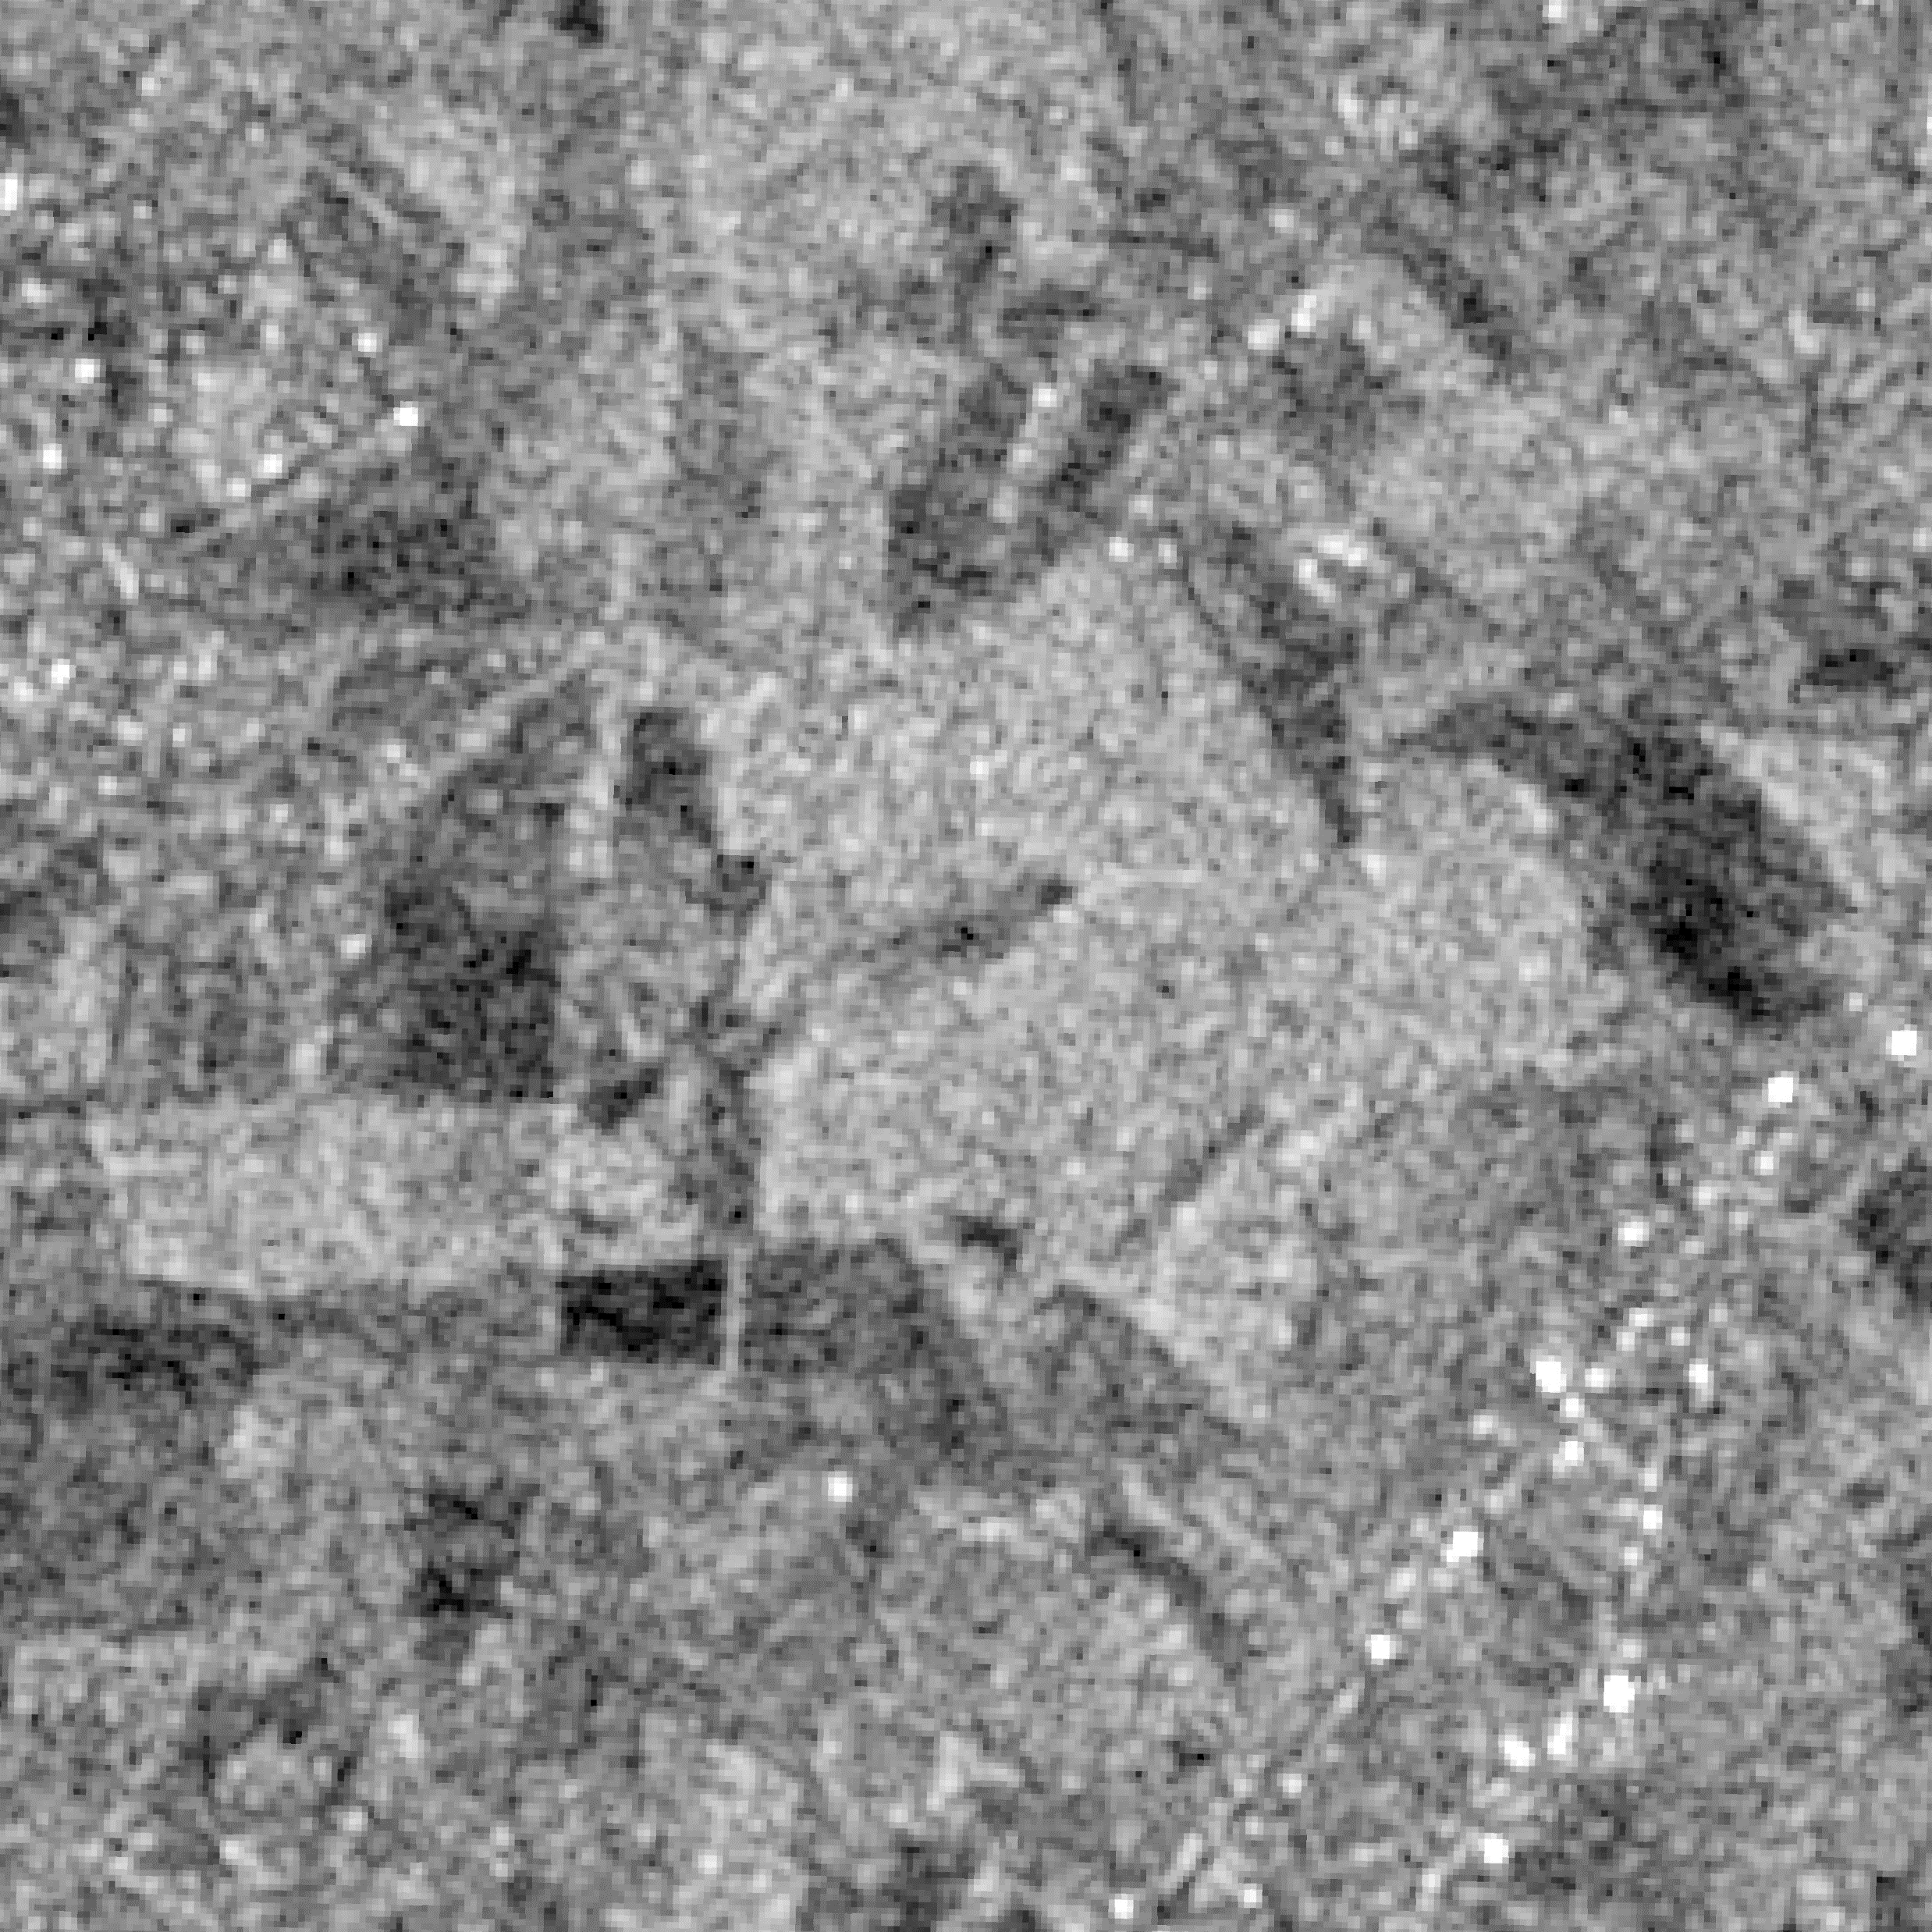
Interpreting a SAR backscatter image
Scattering mechanism
specular
reflection
corner
reflection
diffuse
scattering
volume
scattering
Image tone

Slide 6
All Sentinel-1 observations since 2015

Slide 7
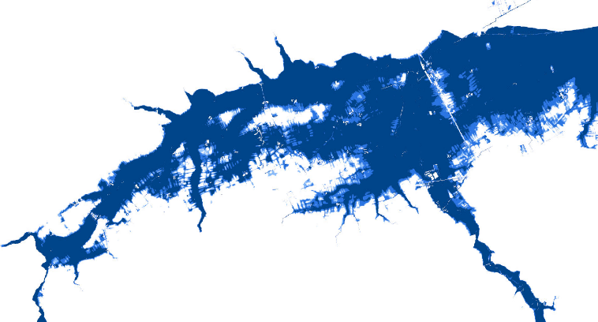
Fluvial flood risk map

Slide 8
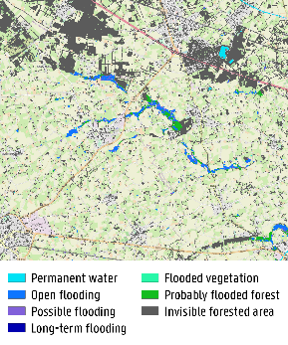
TerraFlood algorithm
More info:
L. Landuyt, F. M. B. Van Coillie, B. Vogels, J. Dewelde and N. E. C. Verhoest, "Towards Operational Flood Monitoring in Flanders Using Sentinel-1," in IEEE Journal of Selected Topics in Applied Earth Observations and Remote Sensing, vol. 14, pp. 11004-11018, 2021, doi: 10.1109/JSTARS.2021.3121992.
SAR
image pair
Pixel-based approach
Thresholding
Region growing
Edge refinement
Land Cover
Combination pixel- and object-based approach
Elevation
Object-based approach
Thresholding
Region growing
Edge refinement
Flood Risk
Flood Depth
Final flood map
(8 classes)
Notes:
We chose for a dual approach, making use of the advantages of both the pixel and the object level. We start from thresholding, as this very fast, but combine it with several refinements based on region growing and edge refinement.
As I said, we chose to fully exploit the local data availability. Besides SAR, we also use land cover, elevation and flood risk elevation.
Moreover, we make use of a SAR pair, in order to discriminate between permanent and temporary water surfaces.
All of this results in an 8-class map, discriminating …
Flood water beneath trees cannot be seen using C-band SAR, but making use of our ancillary data we are able to proved a “probably flooded forest” class.
We tested and validated our approach based on a set of drone images. If you want to know more, we described everything in detail in a paper.

Slide 9
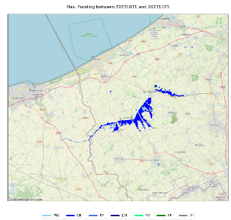
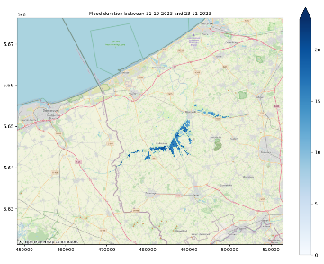
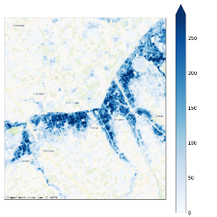
Derived products
Maximum flood extent
Flood duration
Flood recurrence

Slide 10
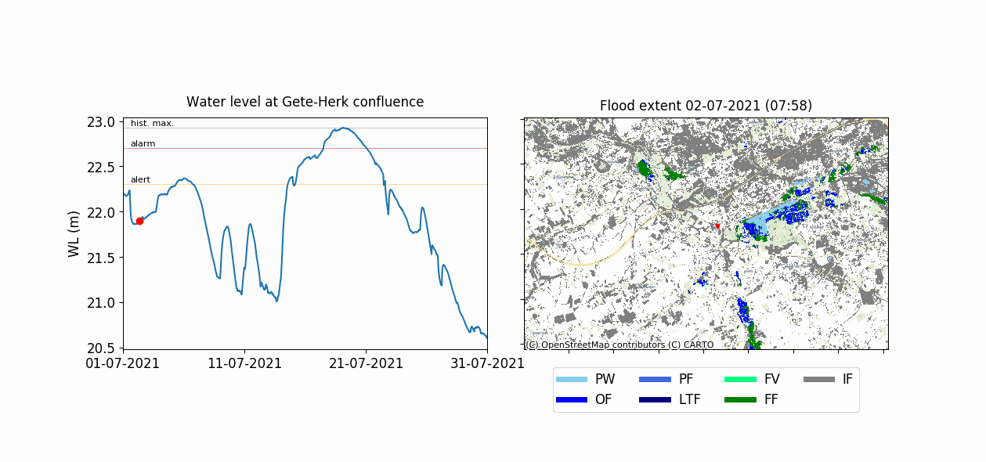
TerraFlood products: NRT maps
Notes:
This algorithm allowed us to translate VMM’s water level time series into spatial maps, as you can see here for the floods in the Demer valley in July 2021.
You can see lake Schulensbroek, a permanent water body.
Its surroundings are used a retention basin to protect the nearby cities from flooding. As you can see, the retention basin was successfully activated in the beginning of the month, and then emptied in time to buffer the mid-July peak. Then also many agricultural areas got flooded.

Slide 11
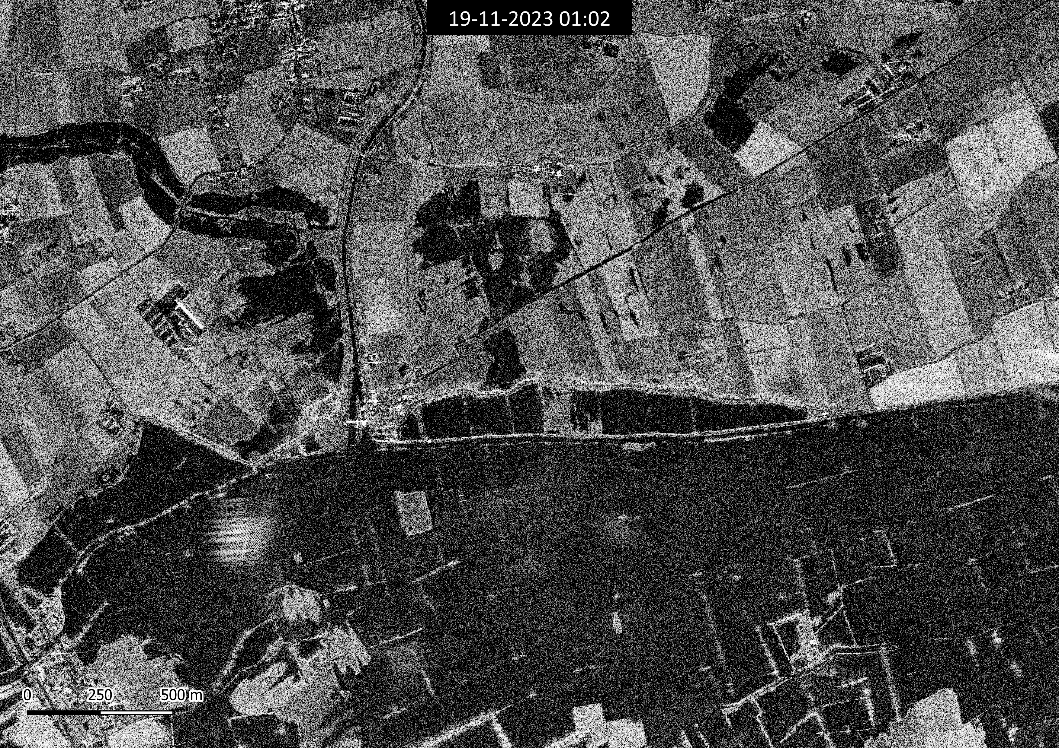
Need more detail? Sentinel-1 vs Capella Space

Slide 12
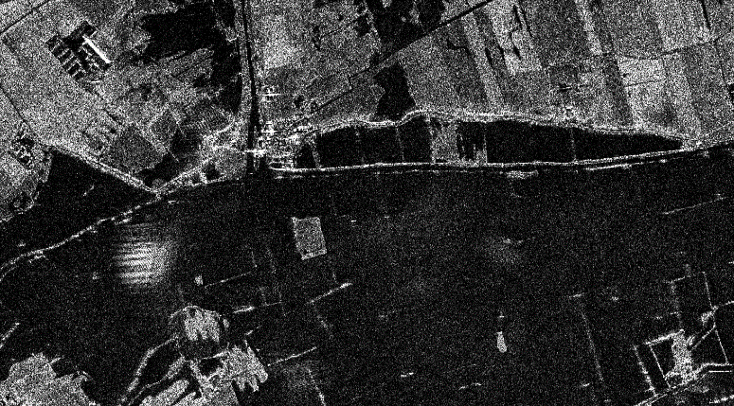
Capella space example

