Slide 1

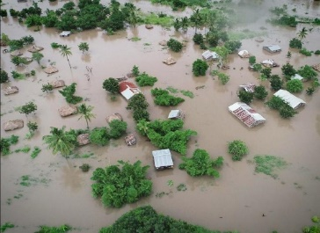
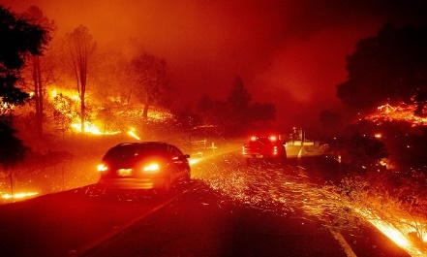
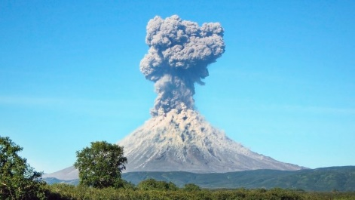
Orbiting Safety – Copernicus and Disaster Risk Management
#EUSpace
Brussels, 11 December 2023
Helmut SPITZL

Slide 2




The EU Space Programme 2021-2027 brings EU space activities under one umbrella
Space data and services are at the heart of a technological revolution
IRIS²
GOVSATCOM
Space Situational Awareness (SSA)
EGNOS
Galileo
Copernicus
Others
Makes navigation signals more accurate and trustworthy for safety-critical applications
Operational in 400+ airports & helipads in 23 countries
Europe’s global satellite navigation system
More than 3 billion Galileo receivers worldwide
10% of EU GDP enabled by satnav
Bringing together satellite and non-space data for Earth Observation
Nr.1 world provider of space data and information (>20TB/day)
Secures satellite communications for EU governmental actors
Rapid support over crisis areas
Monitoring and protecting space assets
Space Surveillance and Tracking (SST), Space Weather Events (SWE), Near-Earth Objects (NEO)
Access to Space
Research & innovation
Entrepreneurship
Certification & standardisation
Capacity building

Slide 3
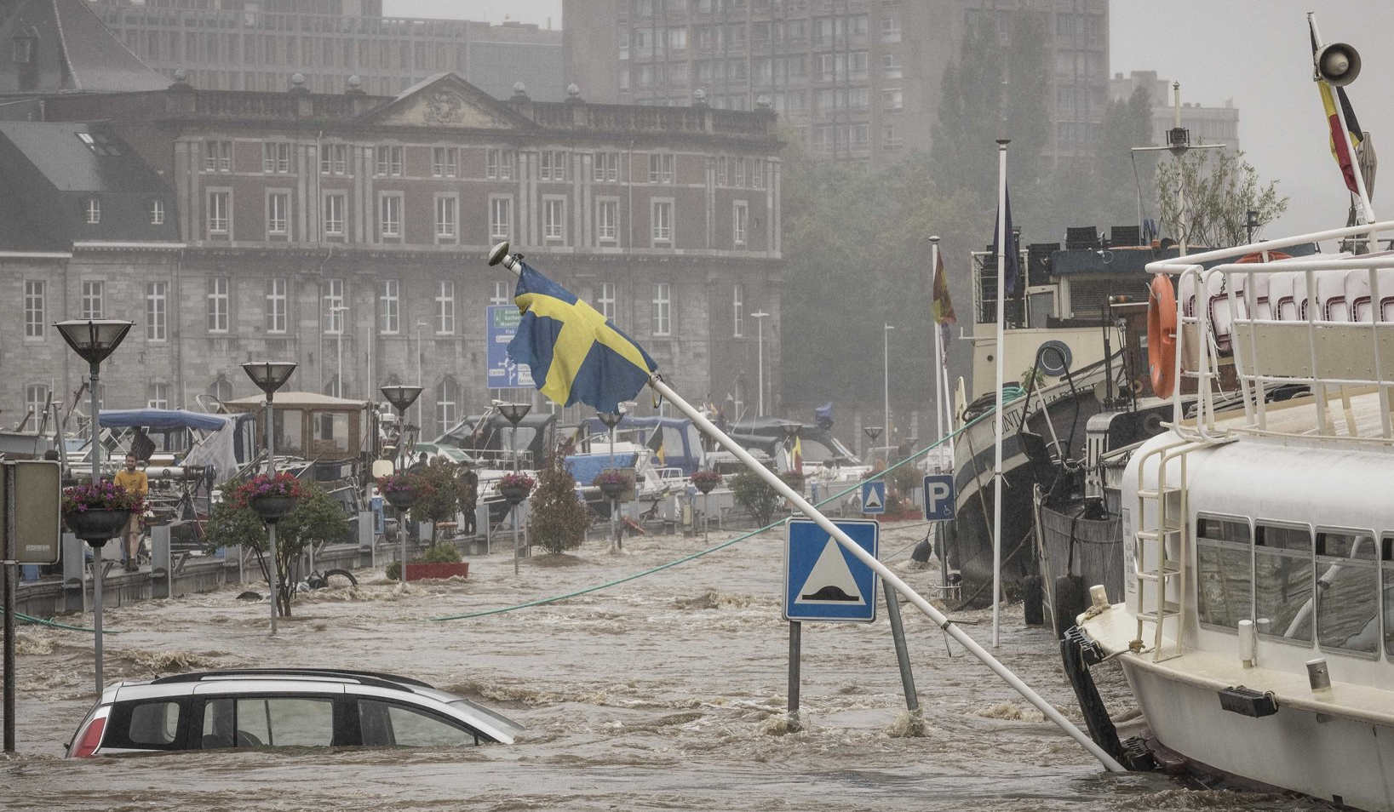
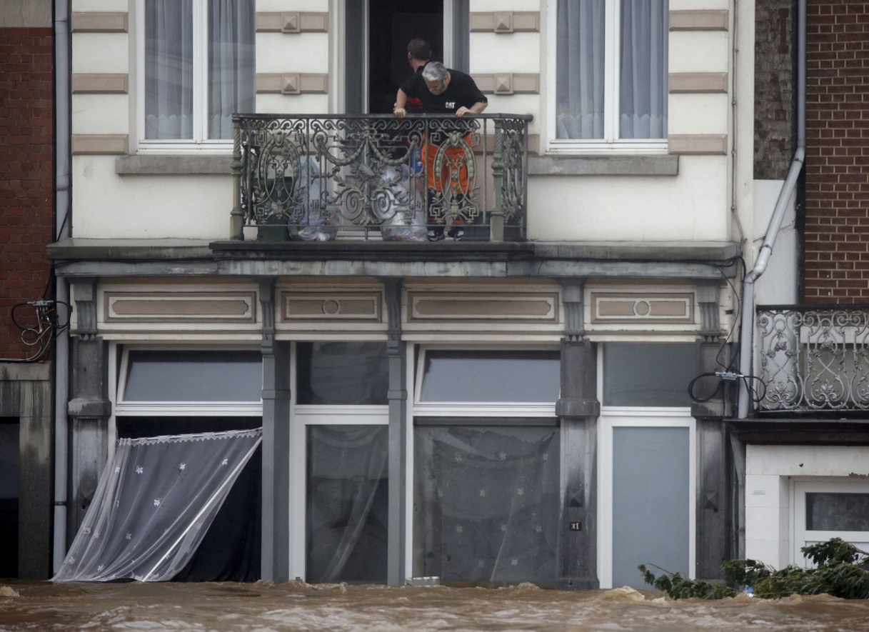
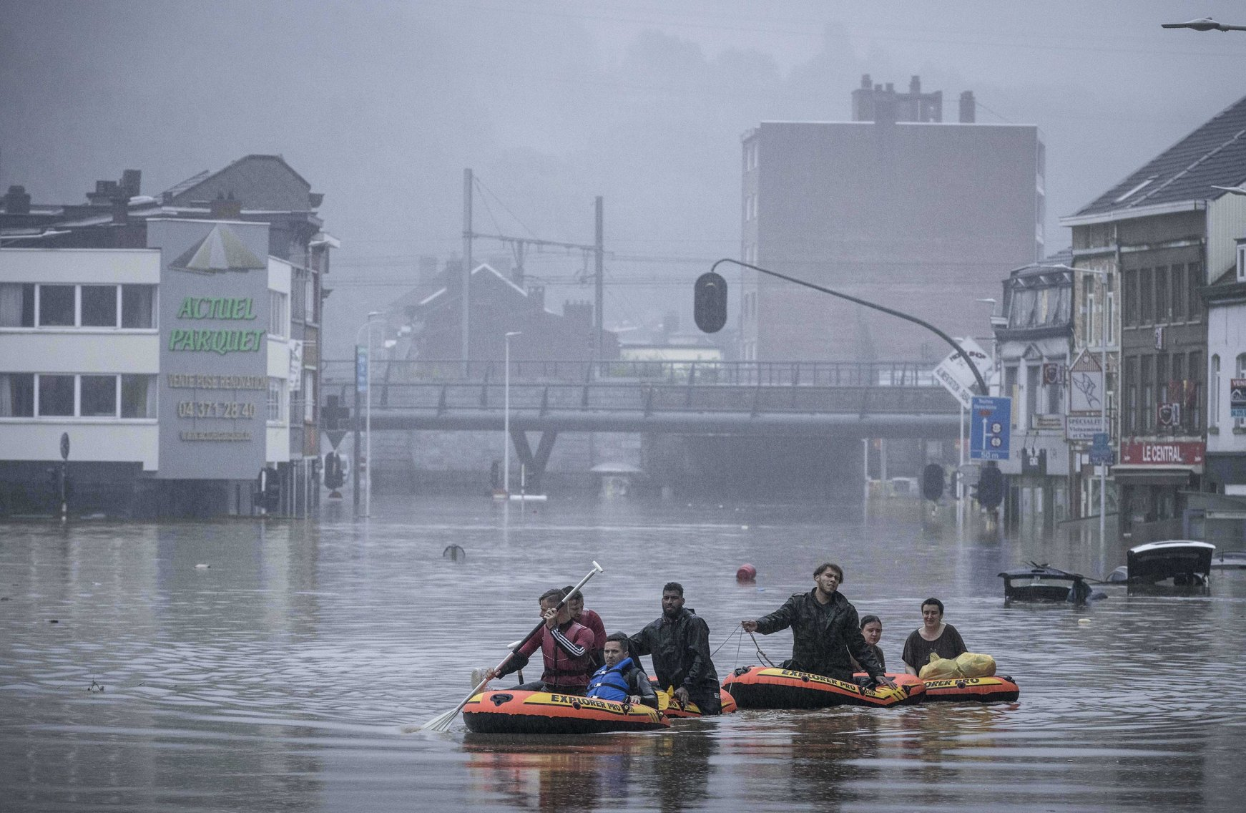
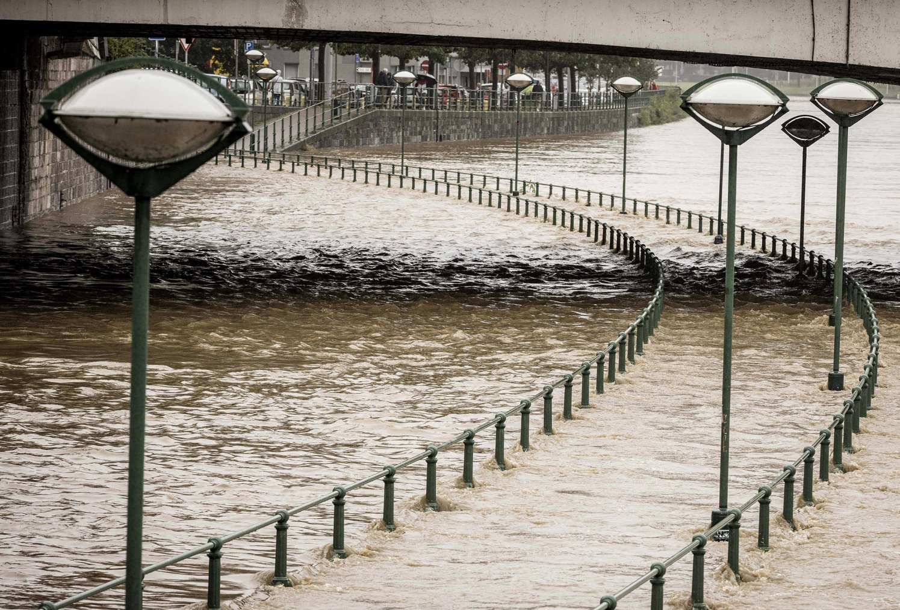
Flooding in July 2021
Liege, July 2021

Slide 4



The EU Space Programme is a key player enabling disaster risk management applications
Copernicus
Services are operational
Galileo and EGNOS
Supports downstream development with cloud-based infrastructure
Assist responders (and vehicles/drones) to navigate in the field
Receivers accurately detect earthquakes, landslides, land deformations
Enable crowdsourcing applications (geo-tagged images)
IRIS² and GOVSATCOM
Provide connectivity to first responders and humanitarian aid actors, enable secure and resilient communication and data transmission services
Provides Earth observation data which helps to understand and quantify risks and to detect and monitor hazards

Slide 5

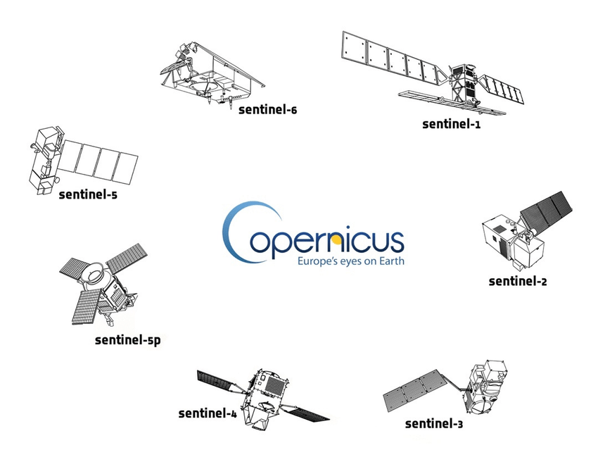








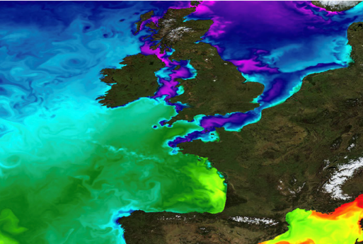
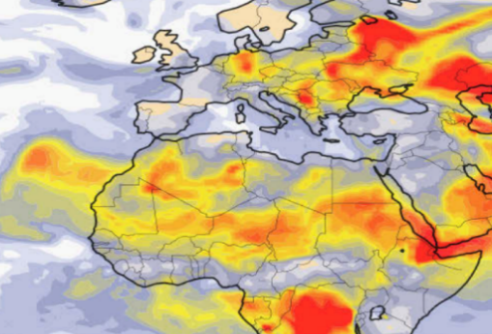
Copernicus data is free and openly accessible to all users around the world
European Union's Earth observation programme looks at our planet and its environment to benefit all European citizens
SPACE
IN SITU
SERVICES
Delivers more than 20TB of Earth observation data each day
Nr. 1 world provider of space data and information

Slide 6






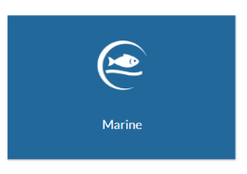
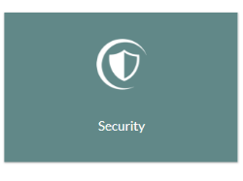
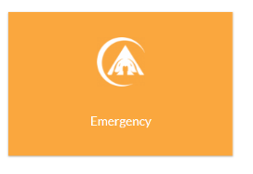





Copernicus provides six specialized services to address Earth observation and monitoring needs
https://atmosphere.copernicus.eu/
https://land.copernicus.eu/en
https://climate.copernicus.eu/
Atmosphere
Land
Climate Change
https://marine.copernicus.eu/
https://www.copernicus.eu/en/copernicus-services/security
https://emergency.copernicus.eu/
Marine
Security
Emergency

Slide 7
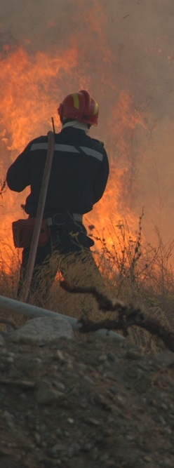

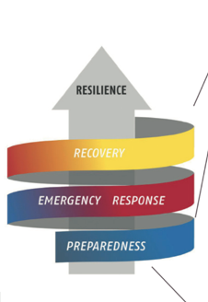
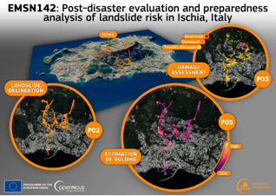
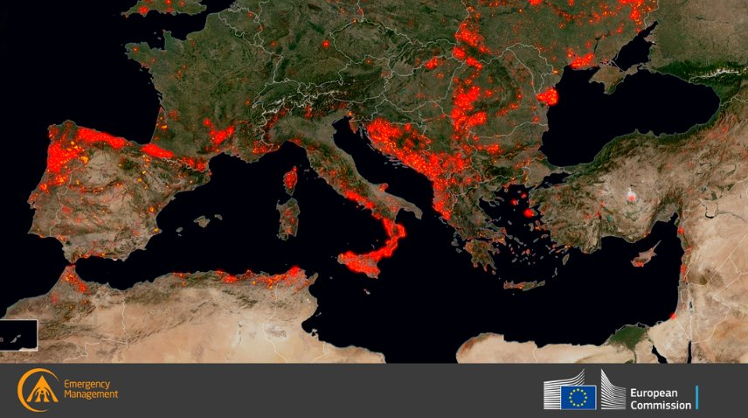
Emergency Management Service
Risk & Recovery Mapping
Reference Maps
Pre-disaster Situation Maps
Post-disaster Situation Maps
Rapid Mapping
Reference Maps
Delineation Maps
Grading Maps
Early Warning
Floods
Forest Fires
Droughts
Notes:
The Copernicus Emergency Management Service (EMS) has three main components, Early Warning andRapid Mapping, /risk and recovery mapping, as well as a dedicated component for the validation of the mapping products.

Slide 8
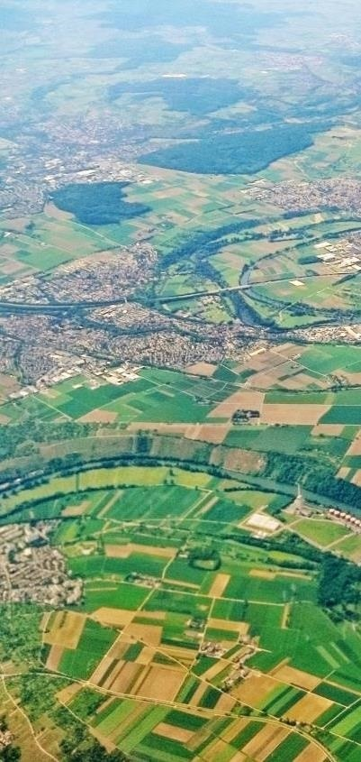




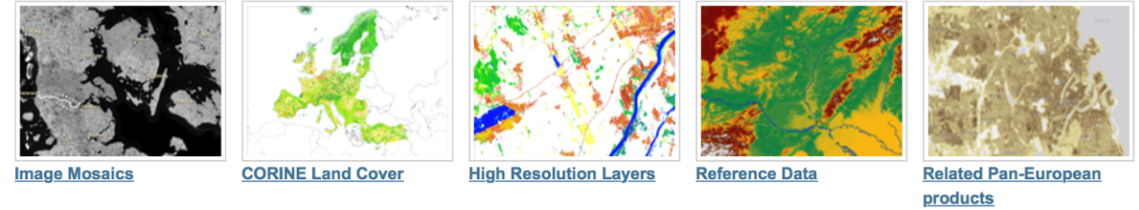
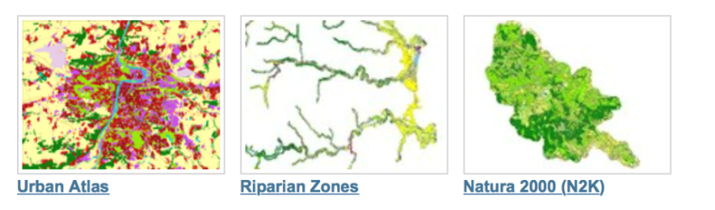
Land Monitoring Service
Ecosystems
Biodiversity
Agriculture
Forestry
Energy
Natural Resources
Water
Urban planning
Global
Pan-European
EU Land Cover
Specific land cover info
Hydrographic and elevation reference maps
% of built-up area
Local
Coming up: Ground Motion products
Notes:
The Land Service is divided into three main components:
Global Land Service (Providing bio-geophysical products of global land surface): is a component of the Copernicus Land service that provides a series of bio-geophysical products on the status and evolution of land surface at global scale at mid and low spatial resolution. Production and delivery of the parameters take place in a timely manner and are complemented by the constitution of long term time series. The products are used to monitor the vegetation, the water cycle and the energy budget.
Pan-European:
The pan-European component provides information about the land cover and land use (LC/LU), land cover and land use changes and land cover characteristics. The latter includes information about imperviousness, forests, natural grasslands, wetlands, and permanent water bodies.
Local:
The local component focuses on different hotspots, i.e. areas that are prone to specific environmental challenges and problems. This includes detailed LC/LU information for the larger EU cities (Urban Atlas), riparian zones along European river networks and NATURA 2000 sites. It will also include maps of coastal area
Note:
The CORINE Land Cover (CLC) inventory was initiated in 1985 (reference year 1990). Updates have been produced in 2000, 2006, and 2012. It consists of an inventory of land cover in 44 classes.

Slide 9



Climate Change Service
Climate monitoring
Weather forecast and extreme weather events
Sea levels and coastal risks
Pollution
Seasonal forecasts and climate projections support the mitigation and adaptation strategies
  Accurate evaluation of the Essential Climate Variables (ECV) such temperature increase, sea level rise, or other climate indices (precipitation, drought event)
  Modelling scenarios based on climate projections
Notes:
The Climate Change Service will provide information aimed at providing:
The Copernicus Climate Change service responds to environmental and societal challenges associated with human-induced climate changes.
The service will give access to information for monitoring and predicting climate change and will, therefore, help to support adaptation and mitigation. It benefits from a sustained network of in situ and satellite-based observations, re-analysis of the Earth climate and modelling scenarios, based on a variety of climate projections.
The service will provide access to several climate indicators (e.g. temperature increase, sea level rise, ice sheet melting, warming up of the ocean) and climate indices (e.g. based on records of temperature, precipitation, drought event) for both the identified climate drivers and the expected climate impacts.
The Copernicus Climate Change service is under implementation
The service will provide information for monitoring and predicting climate change and help to support adaptation and mitigation
It will give access to several Essential Climate Variables e.g. :
temperature increase, sea level rise, ice sheet melting, warming up of the ocean and several climate indices
The Service is currently under implementation

Slide 10


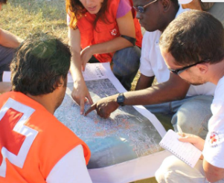
Security Service and Support to EU External Action
Border Surveillance
Maritime Surveillance
Crisis management and humanitarian aid
Support to EU External Action
Road network status assessment
Conflict damage assessment
Critical infrastructure analysis
Reference map
Support to evacuation plans
Crisis situation map
Border map
Camp analysis
Notes:
The Climate Change Service will provide information aimed at providing:
The Copernicus Climate Change service responds to environmental and societal challenges associated with human-induced climate changes.
The service will give access to information for monitoring and predicting climate change and will, therefore, help to support adaptation and mitigation. It benefits from a sustained network of in situ and satellite-based observations, re-analysis of the Earth climate and modelling scenarios, based on a variety of climate projections.
The service will provide access to several climate indicators (e.g. temperature increase, sea level rise, ice sheet melting, warming up of the ocean) and climate indices (e.g. based on records of temperature, precipitation, drought event) for both the identified climate drivers and the expected climate impacts.
The Copernicus Climate Change service is under implementation
The service will provide information for monitoring and predicting climate change and help to support adaptation and mitigation
It will give access to several Essential Climate Variables e.g. :
temperature increase, sea level rise, ice sheet melting, warming up of the ocean and several climate indices
The Service is currently under implementation

Slide 11
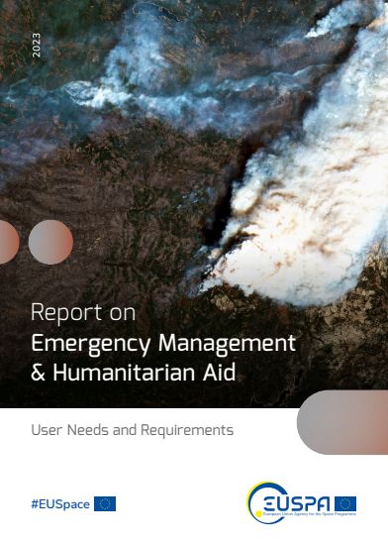
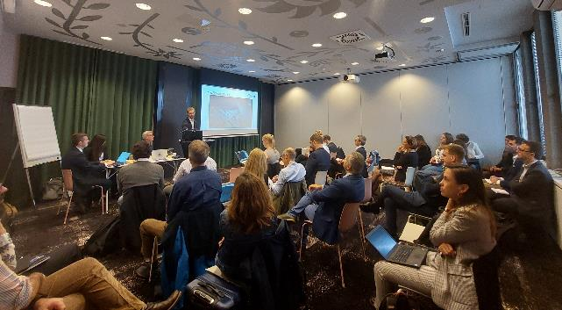
Connecting with user communities –
EUSPA User Consultation Platform
2nd Call
UCP 2022 -> 500 participants
Sessions on Emergency Management & Humanitarian Aid
Critical Infrastructures applications
https://www.euspa.europa.eu/newsroom/news/euspa-releases-user-consultation-platform-2022-reports
https://www.euspa.europa.eu/sites/default/files/report_on_emergency_management_humanitarian_aid_user_needs_and_requirements.pdf

Slide 12


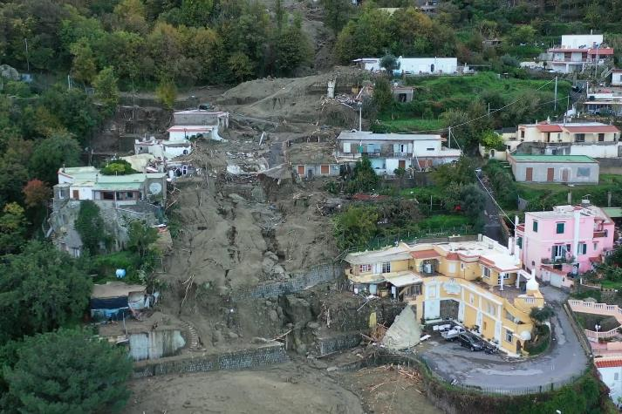
EO user requirements
1) Landslides and terrain deformation monitoring
Two major operational scenarios have been identified by users:
General inventory of landslides, mostly using change detection [Regional to global]
Monitoring landslides in predefined areas, using a variety of technologies [Local to regional]
Need for accurate systems to detect and assess change patterns in the terrain and inform decision-makers and/or communities to be impacted (early-warning systems).
The European Ground Motion Service (EGMS) represents a baseline for ground motion applications at continental, national and local level but it needs to be further valorised in applications.

Slide 13

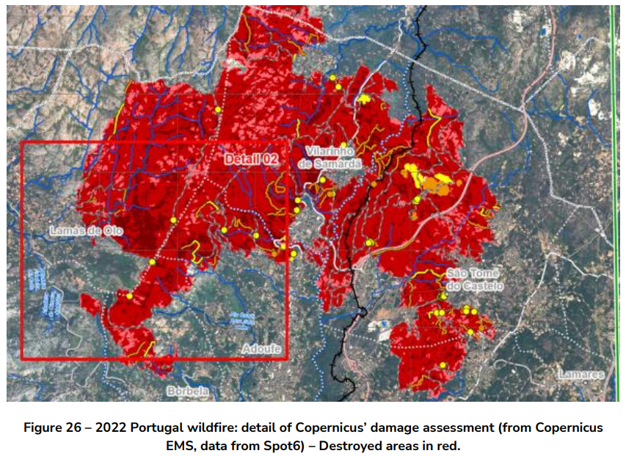
EO user requirements
2) Post-crisis damage assessment and building inspection
Two major operational scenarios have been identified by users:
Overview and large-scale prioritisation
Detailed assessment for rehousing, insurance and reconstruction purposes
Need for authenticated geo-tagged (i.e., GNSS) text, pictures and/or videos with additional AI capabilities to assist quicker inspection.
Need to improve the accuracy and timeliness of EO-based assessments.
The use of drones/swarms is also increasing in the field as they are well suited for quick micro assessments
As shelter is one of the critical needs of communities affected by a disaster, this remains a central part of the response efforts in any given crisis.

Slide 14


EO user requirements
3) Asset monitoring in Humanitarian aid operations
GNSS-enabled telematics allows humanitarian organisations working in crisis zones to track assets and personnel.
Need for panic button that end-users can push in case of an attack or carjacking to alert the local office.
Resilience to attacks or interferences like jamming or spoofing.
Two-way communication, allowing the user to report threats, current location, or for the control room to send alerts.
Identification of goods delivery points, accessibility constraints (e.g., road closures, “access constraints” maps), impossible crossings, or even the mapping of road networks.

Slide 15

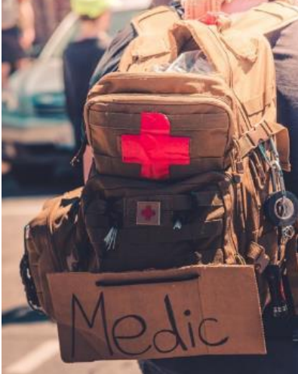
EO user requirements
4) Health and medicine response and coordination
Understanding the needs of the people affected by a humanitarian crisis, support response and coordination operations.
Lack of baseline map data as well as population density statistics is in some places a big limitation.
Deployed personnel shall use GNSS-devices in difficult environments to import field data -> i) robustness is required and ii) battery consumption is a problem.
Need to simplify applications and solutions for non-expert users; making EO products easier to comprehend, aligning them with the “humanitarian language”.
Fit-for-purpose drone solutions need to be operational and easy-to-use.

Slide 16
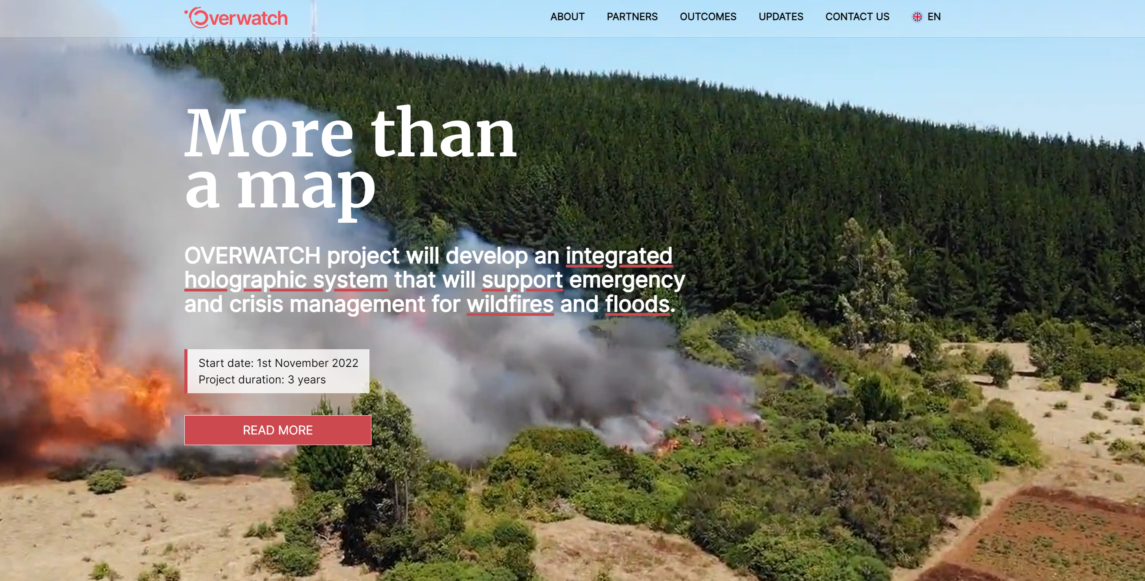

Copernicus Demonstrators – Proof of concept
for emergency and crisis management under way
Source: https://overwatchproject.eu/en/

Slide 17
EUSPA Horizon Europe – Call ongoing
Deadline: 14 Feb 2024
Type of Action | Topic | Indicative budget (million EUR)
IA | EGNSS - Transition towards a green, smart and more secure post-pandemic society | 3.5
IA | EGNSS - Closing the gaps in mature, regulated and long lead markets | 8
RIA | Copernicus-based applications for businesses and policy-making | 7
RIA | Designing space-based downstream applications with international partners | 6
IA | EU GOVSATCOM for a safer and more secure EU | 10
Total budget: |  | 34.5
IA – Innovation Action, RIA – Research and Innovation Action

Slide 18
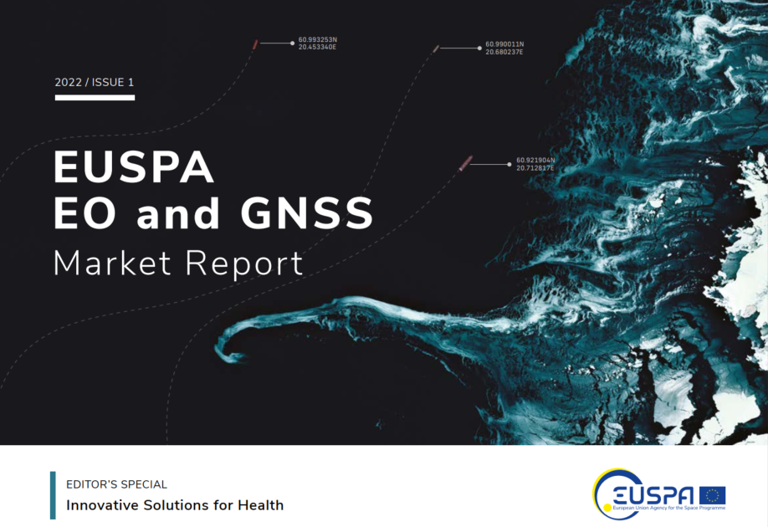
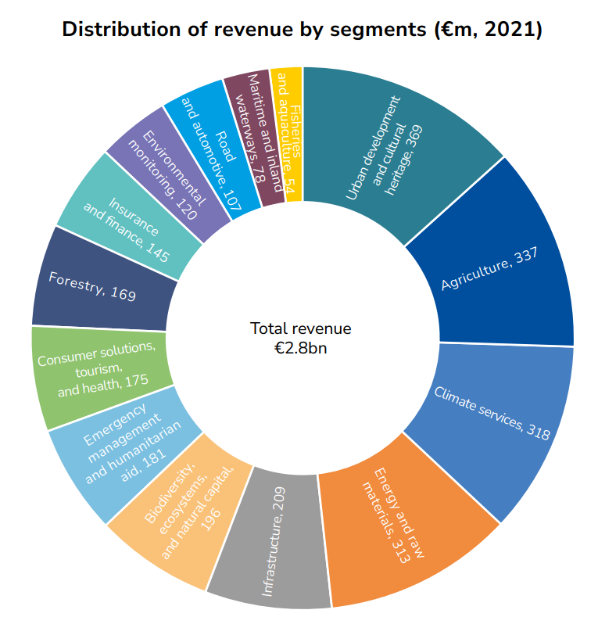
The Market for Space Data has a huge economic potential – EO and GNSS Market Report coming soon
The EO and GNSS Market Report combines the market and application insights into a single report that provides global coverage of the EO and GNSS applications across multiple market segments
New Edition coming soon !

Slide 19
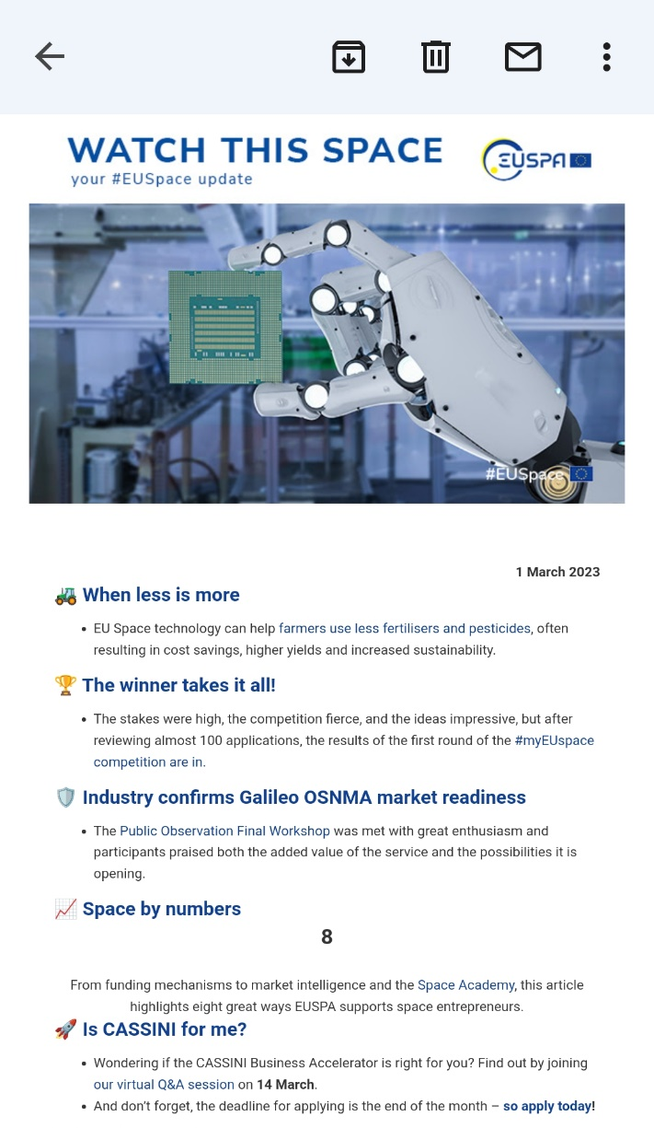
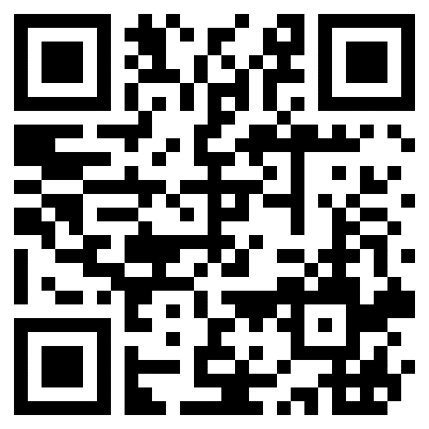
Subscribe to EUSPA newsletter Watch This Space
… and receive the latest #EUSpace news every week in your mailbox.
To subscribe, scan the QR code below:

Slide 20
Watch This Space Newsletter

