Slide 1
Pre-commercial procurement supporting the uptake of EO services: the case of PROTECT
EURISY Member’s Day
12th December 2023
Stefka Domuzova
EIT Climate-KIC

Slide 2
What is PROTECT?
HEurope project aiming at raising awareness and building capacity for the use of pre-commercial procurement schemes in the co-development of climate services.
This is in preparation of a future Pre-Commercial Procurement fully funded by the European Commission and expected to be launched in 2024 with a funding amount of up to EUR 19 million: HORIZON-CL6-2024-GOVERNANCE-01-5: Customisation/pre-operationalisation of prototypes end-user services in the area Climate Change Adaptation and Mitigation
We look for service developers and public procurers – public authorities (regions, cities, national and regional agencies, etc.) that may be interested in exploring innovative procurement for tackling adaptation and mitigation issues in one of the 5 domains below, in order to stimulate the market of (EO-based) climate services
Marine and coastal environments
Energy & Utilities
Sustainable urban communities
Agriculture, Forestry and other land use
Civil security & protection

Slide 3
Climate Services
Climate services are customised solutions that transform climate-related data together with other relevant information to help address a wide range of needs.
They include, for instance projections, forecasts, economic analyses, assessments, counselling on best practices, or any other solution or service in relation to climate that may be of use for the society at large.
Because CS allow all categories of end-users to access and action relevant climate-related data, climate services are essential to support their needs related to climate mitigation and adaptation.
The potential for new, innovative, connected climate services is untapped.
EC 2015 Roadmap of climate services
Notes:
[3min] Definition and scope of climate services- EC 2015 roadmap / Importance of climate services in environmental decision-making (why you can’t do adaptation on scale without data-based services…) / The role of PCP in the context of climate services (market stimulation)- role of taxonomies

Slide 4
Known challenges in stimulating the climate service market:
The market of climate services is growing (EUSPA Market report 2022) but remains scattered, incomplete and not fully mature (H2020 MARCO, H2020 EUMACS)
Lack of clarity on what is a climate service, and what is not. A number of “partial” definitions (EC2015 Roadmap of climate services)
Various involved communities (research, local authorities, service providers) seem to be using very different terms when navigating the same issues as the information that gets provided often does not match the users’ needs (EC2015 Roadmap of climate services)
Difficulty to define the market offer on one side results in difficulty in formulating the demand on the other (H2020 MARCO, HE PROTECT, HE Climateurope2)

Slide 5
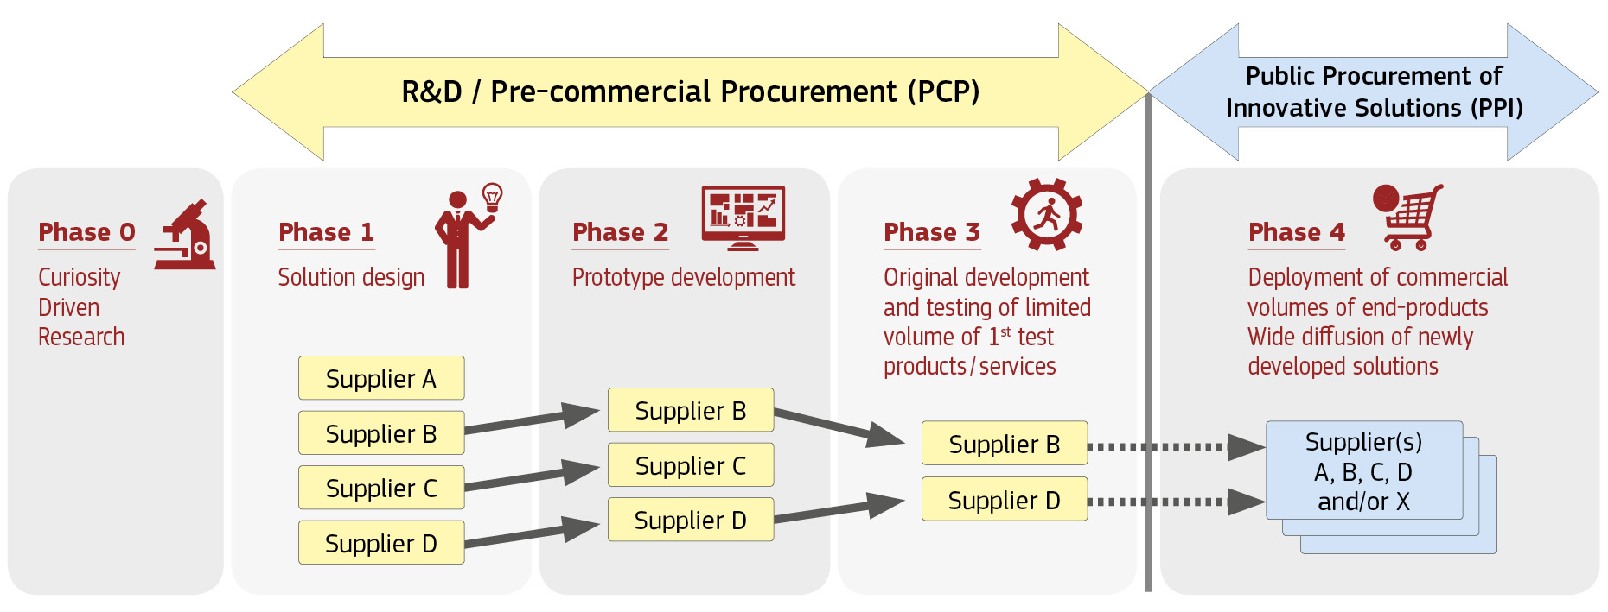
The main principles of a PCP: Competitive development in phases, risk-benefit sharing, separation from market entry
Competitive development in phases
Risk-benefit sharing under market conditions
Separation from the deployment of commercial volumes of end-products / services
Source: EC
Notes:
Competitive development in phases:
In PCP, public procurers buy R&D from several competing suppliers in parallel to compare alternative solution approaches and identify the best value for money solutions that the market can deliver to address their needs. R&D is split into phases (solution design, prototyping, original development and validation/testing of a limited set of first products) with the number of competing R&D providers being reduced after each R&D phase.
Risk-benefit sharing under market conditions:
in PCP, public procurers share the benefits and risks related to the IPRs resulting from the research and development (R&D) with suppliers at market price. Suppliers retain IPR ownership rights, while procurers keep some usage and licensing rights.
Separation from the deployment of commercial volumes of end-products / services:
PCP can go up to the development and the purchase of a limited volume of first products or services developed in the PCP ('limited' because in a services contract like PCP the total value of supplies purchased needs to remain below 50% of the total PCP contract value). As R&D cannot include quantity production (large scale production to produce commercial volumes of end-products), PCP does not cover large scale commercialisation. The deployment of commercial volumes of end-products is the remit of PPI. PCP is thus complementary to Public Procurement of Innovative Solutions (PPI).
Source: EC

Slide 6
How does PCP support the development of (EO-based) climate services - Early-stage funding, co-development, tailored services
Competitive development in phases: Instead of issuing a classical procurement call and choosing the one best provider, in PCP, public procurers buy R&D from several competing suppliers in parallel to compare alternative solution approaches and identify the best value for money solutions that the market as a whole can deliver to address their needs.
Securing fit-for-purpose service for the procurer and early-stage funding for the developer
Co-development processes (rather than buying off the shelf). PCP is traditionally used in high technology settings where there is a need to reducing the information asymmetry between parties.
Data as a key enabling condition: Including local climate and non-climate data in solutions that are very place-specific (also, HEurope VALORADA).
Separation from the development of commercial volumes of end-products and services: PCP can go up to the development and the purchase of a limited volume of first products or services; when the solutions are mature enough to go to more industrial volumes, another instrument can take over, namely PPI (Public Procurement of Innovative solutions).

Slide 7
Why is it important to know about types of climate services and what is important to know about their taxonomies?
It helps to know the structure of the market → knowing where to search for a service provider or for someone with similar needs as your own (e.g. for a PCP)
If the taxonomy categories do not match your needs, it probably means that there is a market gap → and probably the service you are looking for does not exist off-the shelf (i.e. you may need a PCP)
–> Either way, you may need/benefit from PCP
And even if you are not doing a PCP, knowing the market can help formulate your demand, or assess if the climate services you are currently using correspond to your needs
Notes:
what it means for user – traditionally, a lot of taxonomie are supply driven and data driven. This is justified to an extend, but this is also shifting – e.g. the EUPSA taxonomy is user-driven (looking into demand).

Slide 8
Key takeaways
Pre-commercial procurement as a solution offering to leverage and integrate co-development in the dialogue of the creation of climate service
Not the only instrument enhancing co-development
Look out for other tools and schemes aimed at co-development, and look into integrating them in your processes.

Slide 9
The PROTECT “toolkit”

Slide 10
What have we produced to help public procurers (and not only):
The PROTECT taxonomy of climate services
Analysis on the Market of CS/EO services in the 5 PROTECT domains
Analysis of the perceived climate adaptation risks around Europe (per region)
Analysis of national legal frameworks vis-à-vis innovation procurement
Training webinars and materials on PCP, climate services, Earth Observation and the interaction of these
Other awareness-raising material (e.g., policy briefs)
…
All available at https://www.protect-pcp.eu/relevant-resources/ and https://www.protect-pcp.eu/downloads/

Slide 11
Thank you! More information at: https://www.protect-pcp.eu/ For questions: Stefka.Domuzova@climate-kic.org

