Slide 1
How to boost commercialisation of European space solutions:
ESA Scale up Programme
EURISY Members’ Day 2023
Brussels: 12/12/23
Dr Gianluigi Baldesi
Head of Ventures and Financing Office

Slide 2
Global Space Economy Overview 2022
ESA Space Economy Report perspective
Global space economy
Institutional spending
Gov. civil contracts
Gov. spending (not contracted)*
Gov. defence contracts
Commercial markets
Downstream
Upstream
460b€
1
100b€
360b€
2
2
Upstream
40%
3%
60%
*Internal costs & R&D
3
Downstream
97%
Note The overview presents rounded values.
Source Euroconsult, Space Economy Report 2022, Press Release
Notes:
The upstream segment includes: research, space manufacturing and ground systems (fundamental and applied research activities, scientific and engineering support activities, material and components supply, manufacturing of space systems, subsystems and equipment, telemetry, tracking and command stations).
The downstream segment includes: space operations for terrestrial use, and products and services which rely on satellite technology, signal, data to function (e.g. satellite broadcasting, selected GIS, GNSS-enabled devices).

Slide 3
Public investment in space 2022
1
Public investment in space 2022 (civil & military) (%)
€99 billion (+9%) of global public space investment in 2022 (civil and military)
Growth largely driven by defence space budgets
Continuously underestimated Chinese and Russian space budgets due to lack of publicly available data
Source: Euroconsult
99B€
€14 billion (+3%) of European public space investment in 2022
Note Year-over-year variations based on the US dollar values, to avoid misleading evolutions due to the strong variations of the Dollar-Euro exchange rate from 2021 to 2022.
Source Euroconsult, Government Space Programs 2022, Press Release

Slide 4
Private Space Investments - Europe
€8-9B of global private space investment in 2022 (approx. - 30% to 2021)
Decrease largely driven by the US (-33% compared to 2021)
€1B of private investment in European space ventures in 2022 (+66%)
In addition, multiple mega-rounds ( > €250M investments) over the last year years, including OneWeb raising €1.9B across 5 rounds. This included 4 mega-rounds and €165M series-F funding from Eutelsat, which was a precursor to their intended merger announced in 2022.
Mega rounds are less common in Europe than the US.
€1,017M
*Excluding ”mega rounds” ( > €250M) such as OneWeb
Note: preliminary estimates for 2022
Source: ESPI, Space Venture Europe 2022, upcoming in Spring 2023

Slide 5
Challenging Macro Economic Environment
Euro Inflation Rate
6.9%
March 2023
Euro Short-Term Rate
2.9%
March 2023
Global financial markets under highest strain since the 2008 financial crisis.
Failure of Silicon Valley Bank
Acquisition of Credit Suisse by UBS
The COVID-19 pandemic and geo-political tensions put a major strain on the economy.
Rising interest rates to tackle high inflation increasing the cost of debt.
Investors are raising the bar for deploying capital into longer-term, higher-risk ventures, including space.
GDP Volume Growth
0.0%
Q4 2022
Source: European Central Bank

Slide 6
Europe's Space Boom: Invest in Tomorrow
LAUNCH PRICE TO BE DIVIDED BY 3 IN NEXT 10Y
HIGHER PAYLOAD CAPACITY AND LAUNCH RATE
Global Space Economy
€ 460 bn
€ 1 tn
DEORBITING REGULATIONS
in 2022
In 2040
SPACE-AS-A-SERVICE
IN ORBIT SERVICING, MANUFACTURING, ASSEMBLY
TO MAKE EUROPE A SPACE COMMERCIALISATION HUB TO LAUNCH AND GROW GLOBAL SPACE COMPANIES THAT MAKE SENSE FOR OUR FUTURE

Slide 7
ESA AND NEW SPACE
NEW APPROACH TO
PROJECT MANAGEMENT
AND RISK
ACCEPTANCE
CUSTOMER-ORIENTED: GOOD ENOUGH VS BEST IN CLASS
SPEED UP
TIME
TO MARKET
For ESA, there are no “New Space companies”, but a New Space approach which can be observed from large well-established companies to small newcomer entities. This approach implies a business mindset based on private investments leveraging on speed, customer focus and new risk acceptance culture.

Slide 8
The ecosystem
INVESTORS
NON SPACE COMPANIES
STARTUPS
THE ARENAS WE WILL PLAY IN
STARTUPS
INSTITUTIONS
ACADEMIA
SPACE COMPANIES

Slide 9
COMMERCIALISATION@ESA

Slide 10
COMMERCIALISATION IS NOT NEW
Total funding for 1.3 bn €
EARTH OBSERVATION
EXPLORATION
Incubed 2
Ф-Sat
Corpernicus Contributing Missions
• E3P Period 3 (BSGN and commercial mission support services)
D/CIC
COMMERCIALISATION AND COMPETITIVENESS SUPPORT SERVICES AT ESA
SCALEUP & BASS
OPERATIONS
TECHNOLOGY
• S2P (COSMIC – Competitiveness )
• GSTP (Develop, Make, Fly)
NAVIGATION
TELECOMS
• Navisp (Element 2) Third Phase
• FutureNAV
• Space for 5G
• Space Systems for Safety and Security (4S)
• Future Preparation
• Optical Communication
• Partnership Projects
SPACE TRANSPORT
• Boost! 2.0 (Commercial Services; Support to MS; Service Procurement)

Slide 11
ESA CONTRIBUTION ALONG THE COMPANY LIFE-CYCLE
Service Contracts and Anchor Customer Schemes
CASH FLOW
ESA Business Incubation Centres
ScaleUp INVEST
Supporting the development of ScaleUp ventures in new space markets ESA Marketplace
Prepare for Space
Ф-Lab Network
Technology Transfer
Intellectual Property
ESA pre-commercialization / R&D Programmes
ScaleUp INNOVATE
Boosting innovation and commercialization in the European space sector
ScaleUp INNOVATE
Technology Readiness Level (TRL) 1
TRL 7
TRL 9
TIME/TRL
ESA INVESTOR NETWORK
Notes:
Key features:
Twin track/element approach – technology/sector agnostic – complementary to other ESA programmes - end-to-end support to avoid gaps in the development & delivery of commercial services/products through companies
ELEMENT 1. INNOVATE – to boost innovation and commercialisation
To identify and translate high-potential strategic R&D into commercial services/products (Phi labs)
To incubate start-up companies through access to critical business development services - funding, access to technical support, brokers, IP (Tech transfer)
To grow space economy at a local, regional, national and European level through innovation networks (BICs)
ELEMENT 2. INVEST - to support development of companies in commercial space markets
To facilitate access to finance for SMEs and midcaps with demonstrated technology and high growth potential
Live call for IOD/IOV demonstration – ends 1 Oct – valid for companies seeking to test payloads aimed at In Orbit ops
Open call on OSIP

Slide 12
SCALEUP INNOVATE:
ESA BICs
Foster start-up firms that set-up a new and innovative business using space-oriented technology, or data derived from space assets, for products and services in both space and terrestrial markets
Φ-LAB NETWORK
BUSINESS INCUBATION
TECHNOLOGY BROKERS
PARTNERSHIPS
ESA TECHNOLOGY BROKERS
Support technology transfer and application between established industry from the space and non-space sector, and within the space sector
ESA-WIDE COVERAGE IN MULTIPLE MEMBER STATES
29 CENTRES
FOR ENTREPRENEURS, CORPORATES, INSTITUTES, AND BUSINESS SCHOOLS
9 TECHNOLOGY BROKERS
>90 LOCATIONS
GROUND-BREAKING RESEARCH, DIVIDING COMMERCIAL TECHNOLOGIES
SUPPORTS START-UPS, ALUMNI AND NEWCOMERS
ESA Φ-LAB NETWORK
Facilitates research teams to engage in groundbreaking science and technology development that have a potential in high-yield commercialisation
200 NEW STARTUPS P/Y
450 TECHNOLOGY TRANSFERS
1600 STARTUPS SELECTED
CONNECTING TO CURRENT & FUTURE DECISIONMAKERS
FOR PhDs AND RESEARCHERS

Slide 13
SCALEUP INVEST: Marketplace
Mission
How it works
Enabling Aerospace companies
With a vision to scale UP their operations to become the next Big European Player
On the Global Space Market.
Seller
Buyer
B2B DEAL
€€€ to co-finance B2B deal
BUSINESS & TECHNICAL INSIGHT
What companies can benefit from the program:
🗸 Access to Millions of € for B2B deals
🗸 Up to 80% for co-financing of B2B deal
🗸 Support for up to 5 deals

Slide 14
Access to the financial community
EUROPEAN COMMISSION & EUSPA & EIC
EUROPEAN INVESTMENT FUND & EUROPEAN INVESTMENT BANK
INVESTORS
Venture Capital, Private Equity, Institutional investors
ACCELERATORS
Space founders, Seraphim, TakeOff!, CDL Space, Starburst, CASSINI Business Accelerator
1
1
1
Technical and market advisory
Investment opportunities
Dedicated events with the ESA Commercialisation Networks
Network for exploring new strategic initiatives
3
1
3
30+ MEMBERS OF THE ESA INVESTOR NETWORK
3
8
2
1
5
1
Please contact: investor-network@esa.int

Slide 15
ESA CONTRIBUTION ALONG THE COMPANY LIFE-CYCLE
Service Contracts and Anchor Customer Schemes
CASH FLOW
ScaleUp INVEST
ESA pre-commercialization / R&D Programmes
ScaleUp INNOVATE
Technology Readiness Level (TRL) 1
TRL 7
TRL 9
TIME/TRL
ESA INVESTOR NETWORK
Notes:
Key features:
Twin track/element approach – technology/sector agnostic – complementary to other ESA programmes - end-to-end support to avoid gaps in the development & delivery of commercial services/products through companies
ELEMENT 1. INNOVATE – to boost innovation and commercialisation
To identify and translate high-potential strategic R&D into commercial services/products (Phi labs)
To incubate start-up companies through access to critical business development services - funding, access to technical support, brokers, IP (Tech transfer)
To grow space economy at a local, regional, national and European level through innovation networks (BICs)
ELEMENT 2. INVEST - to support development of companies in commercial space markets
To facilitate access to finance for SMEs and midcaps with demonstrated technology and high growth potential
Live call for IOD/IOV demonstration – ends 1 Oct – valid for companies seeking to test payloads aimed at In Orbit ops
Open call on OSIP

Slide 16
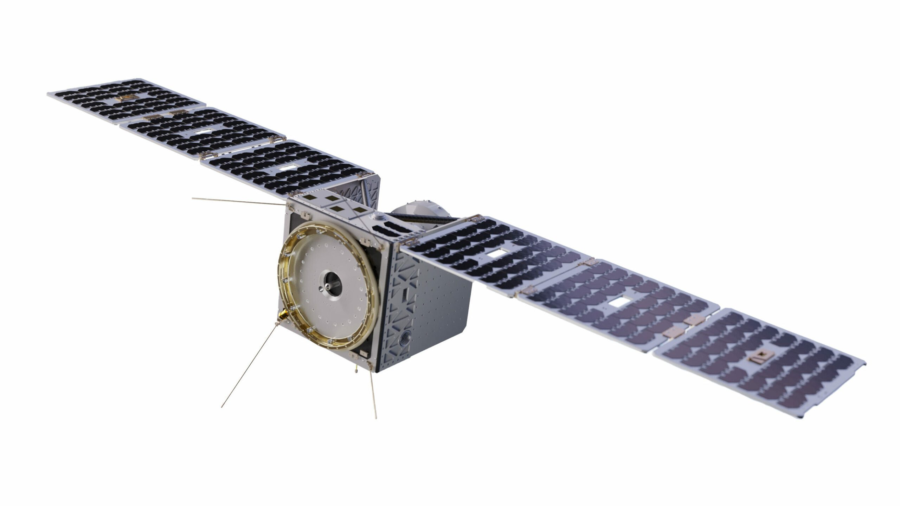
ESA Contribution on ConstellR
Copernicus Contributing Mission 2023
Service Contracts and Anchor Customer Schemes
CASH FLOW
MARKETPLACE 2023
ScaleUp INVEST
INCUBED 2022-2023
ESA pre-commercialization / R&D Programmes
ESA BICs 2020-2022
ScaleUp INNOVATE
Karista 2023
Einstein Industries Ventures 2023
Lakestar 2022
Seraphim space 2021
Technology Readiness Level (TRL) 1
TRL 7
TRL 9
TIME/TRL
ESA INVESTOR NETWORK
Notes:
Key features:
Twin track/element approach – technology/sector agnostic – complementary to other ESA programmes - end-to-end support to avoid gaps in the development & delivery of commercial services/products through companies
ELEMENT 1. INNOVATE – to boost innovation and commercialisation
To identify and translate high-potential strategic R&D into commercial services/products (Phi labs)
To incubate start-up companies through access to critical business development services - funding, access to technical support, brokers, IP (Tech transfer)
To grow space economy at a local, regional, national and European level through innovation networks (BICs)
ELEMENT 2. INVEST - to support development of companies in commercial space markets
To facilitate access to finance for SMEs and midcaps with demonstrated technology and high growth potential
Live call for IOD/IOV demonstration – ends 1 Oct – valid for companies seeking to test payloads aimed at In Orbit ops
Open call on OSIP

Slide 17
TOGETHER WE INVEST AND INNOVATE
YOU SCALE UP!

