Slide 1
From Copernicus Networks towards
EU Space Networks
Stéphane Ourevitch
support@copernicus.eu

Slide 2
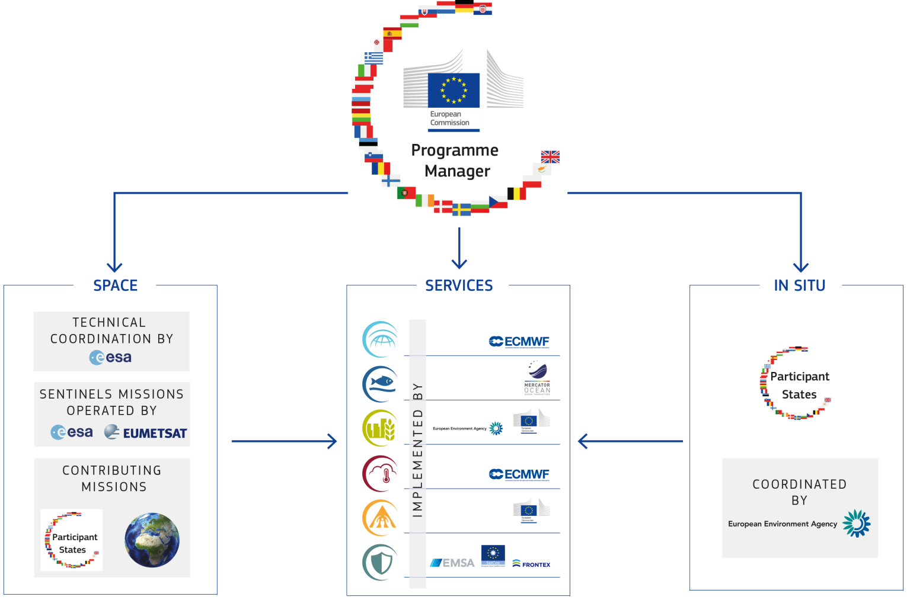
Copernicus in a nutshell
Copernicus is a flagship of the European Union. After 25 years …
It has about 1.5 million users worldwide
> 90% of users are satisfied with the quality of data and services provided by Copernicus
delivers more than 25 TB of Open Data every day

Slide 3
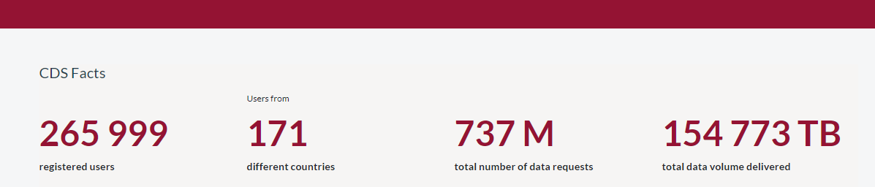
Copernicus facts
In June 2023, the number of users of the Copernicus Climate Data Store reached 200,000.
It passed the 250,000 marker in September and in November….
November 2023

Slide 4
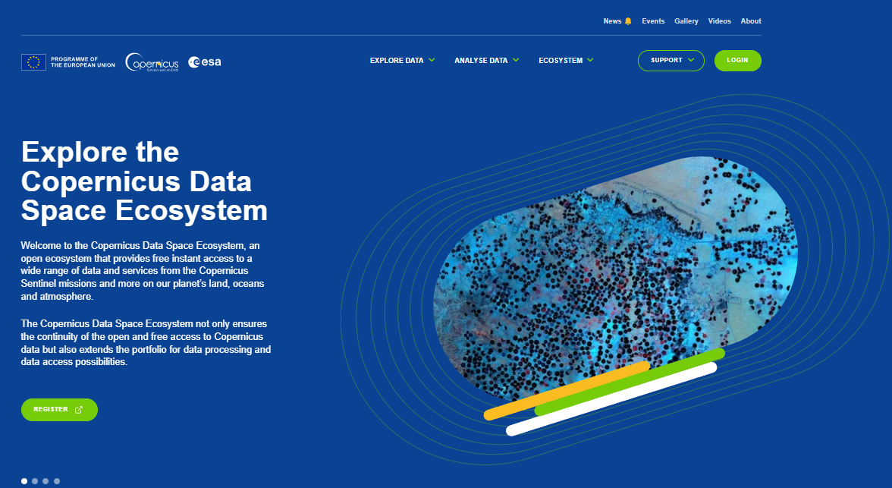
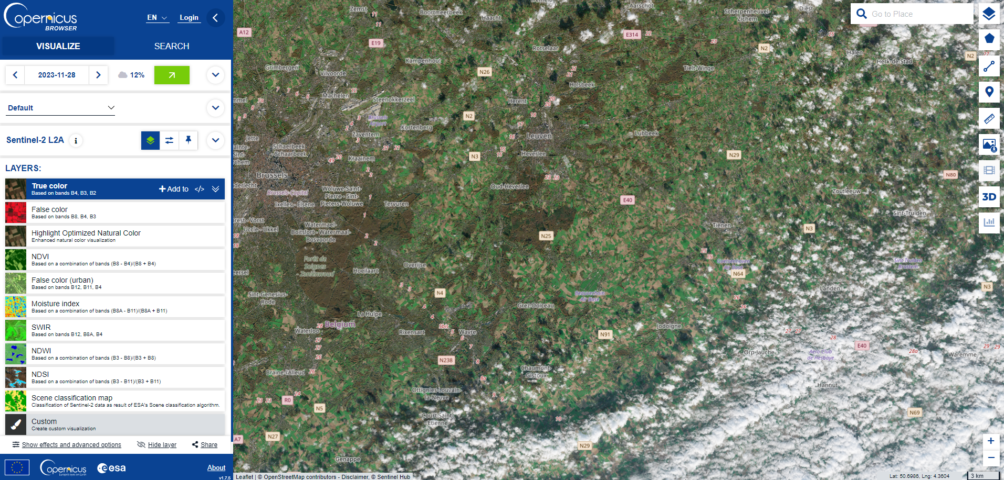
Copernicus Data Space Ecosystem (CDSE)
A new data access platform, the Copernicus Data Space Ecosystem, has been launched in January 2023.

Slide 5
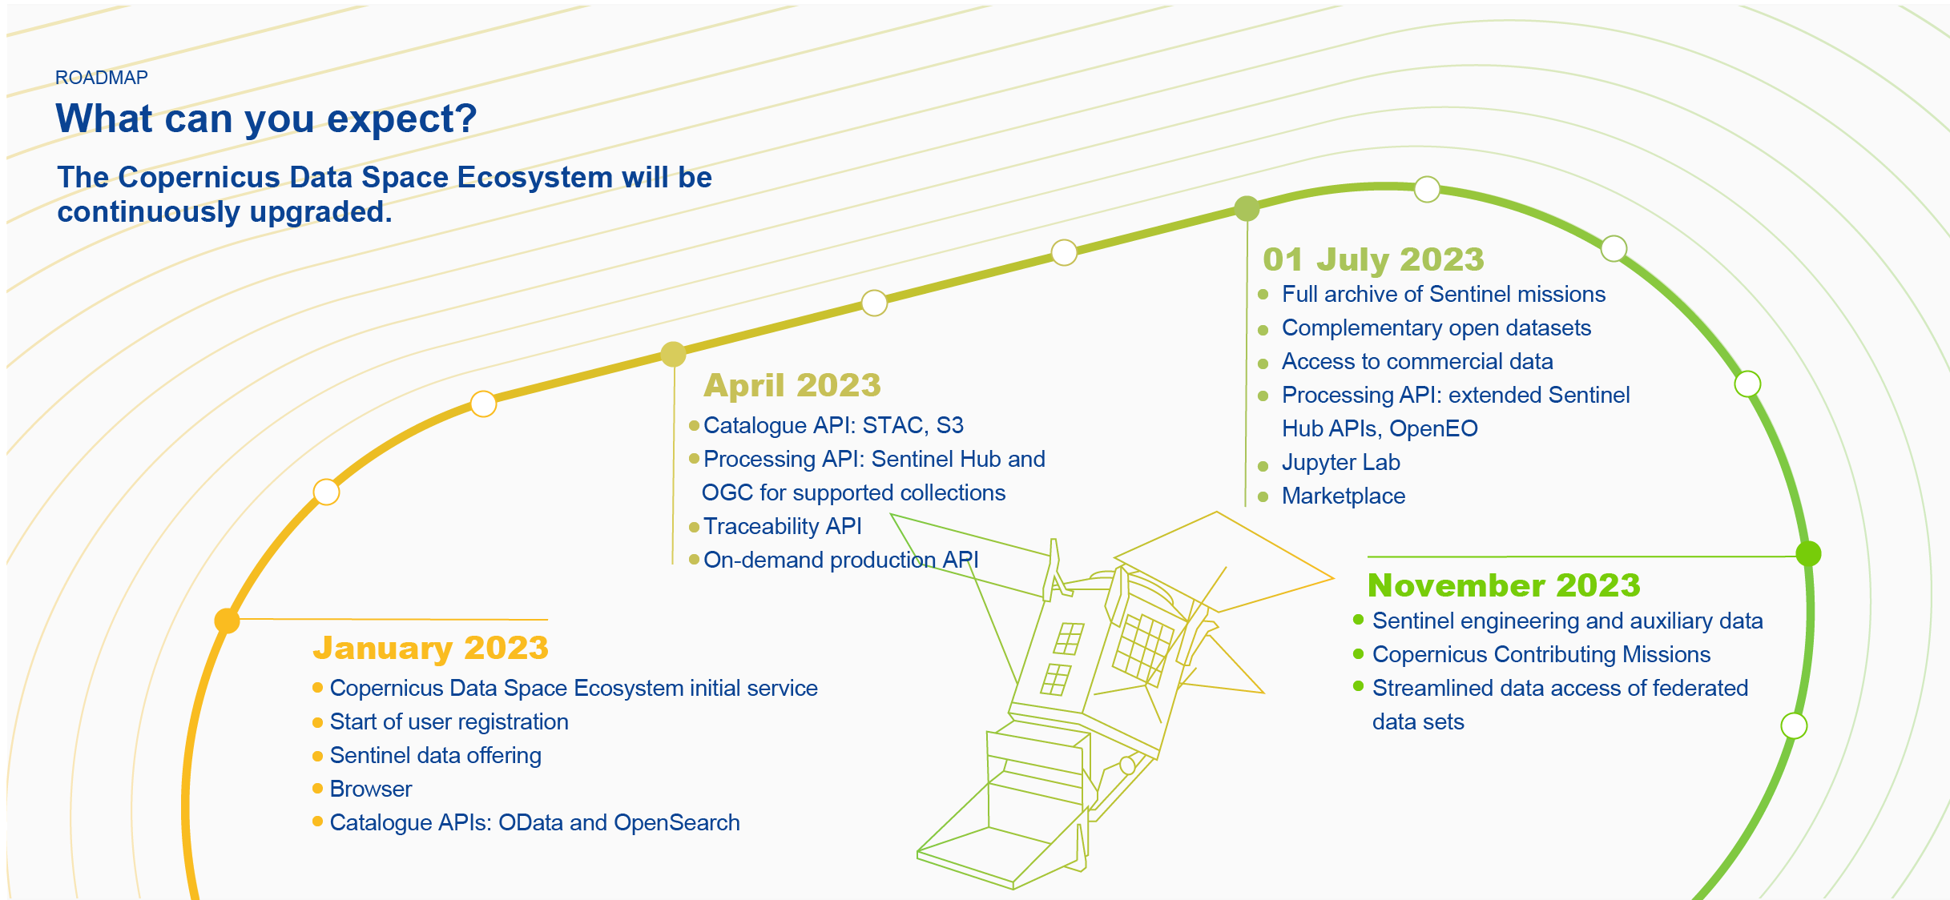
CDSE Facts
75,500 registered users in less than 11 months
+1,500 new users per day
+11,000 active users every day
https://dataspace.copernicus.eu/

Slide 6
CDSE Facts
Updated 01/12/2023
Public release in the next days

Slide 7
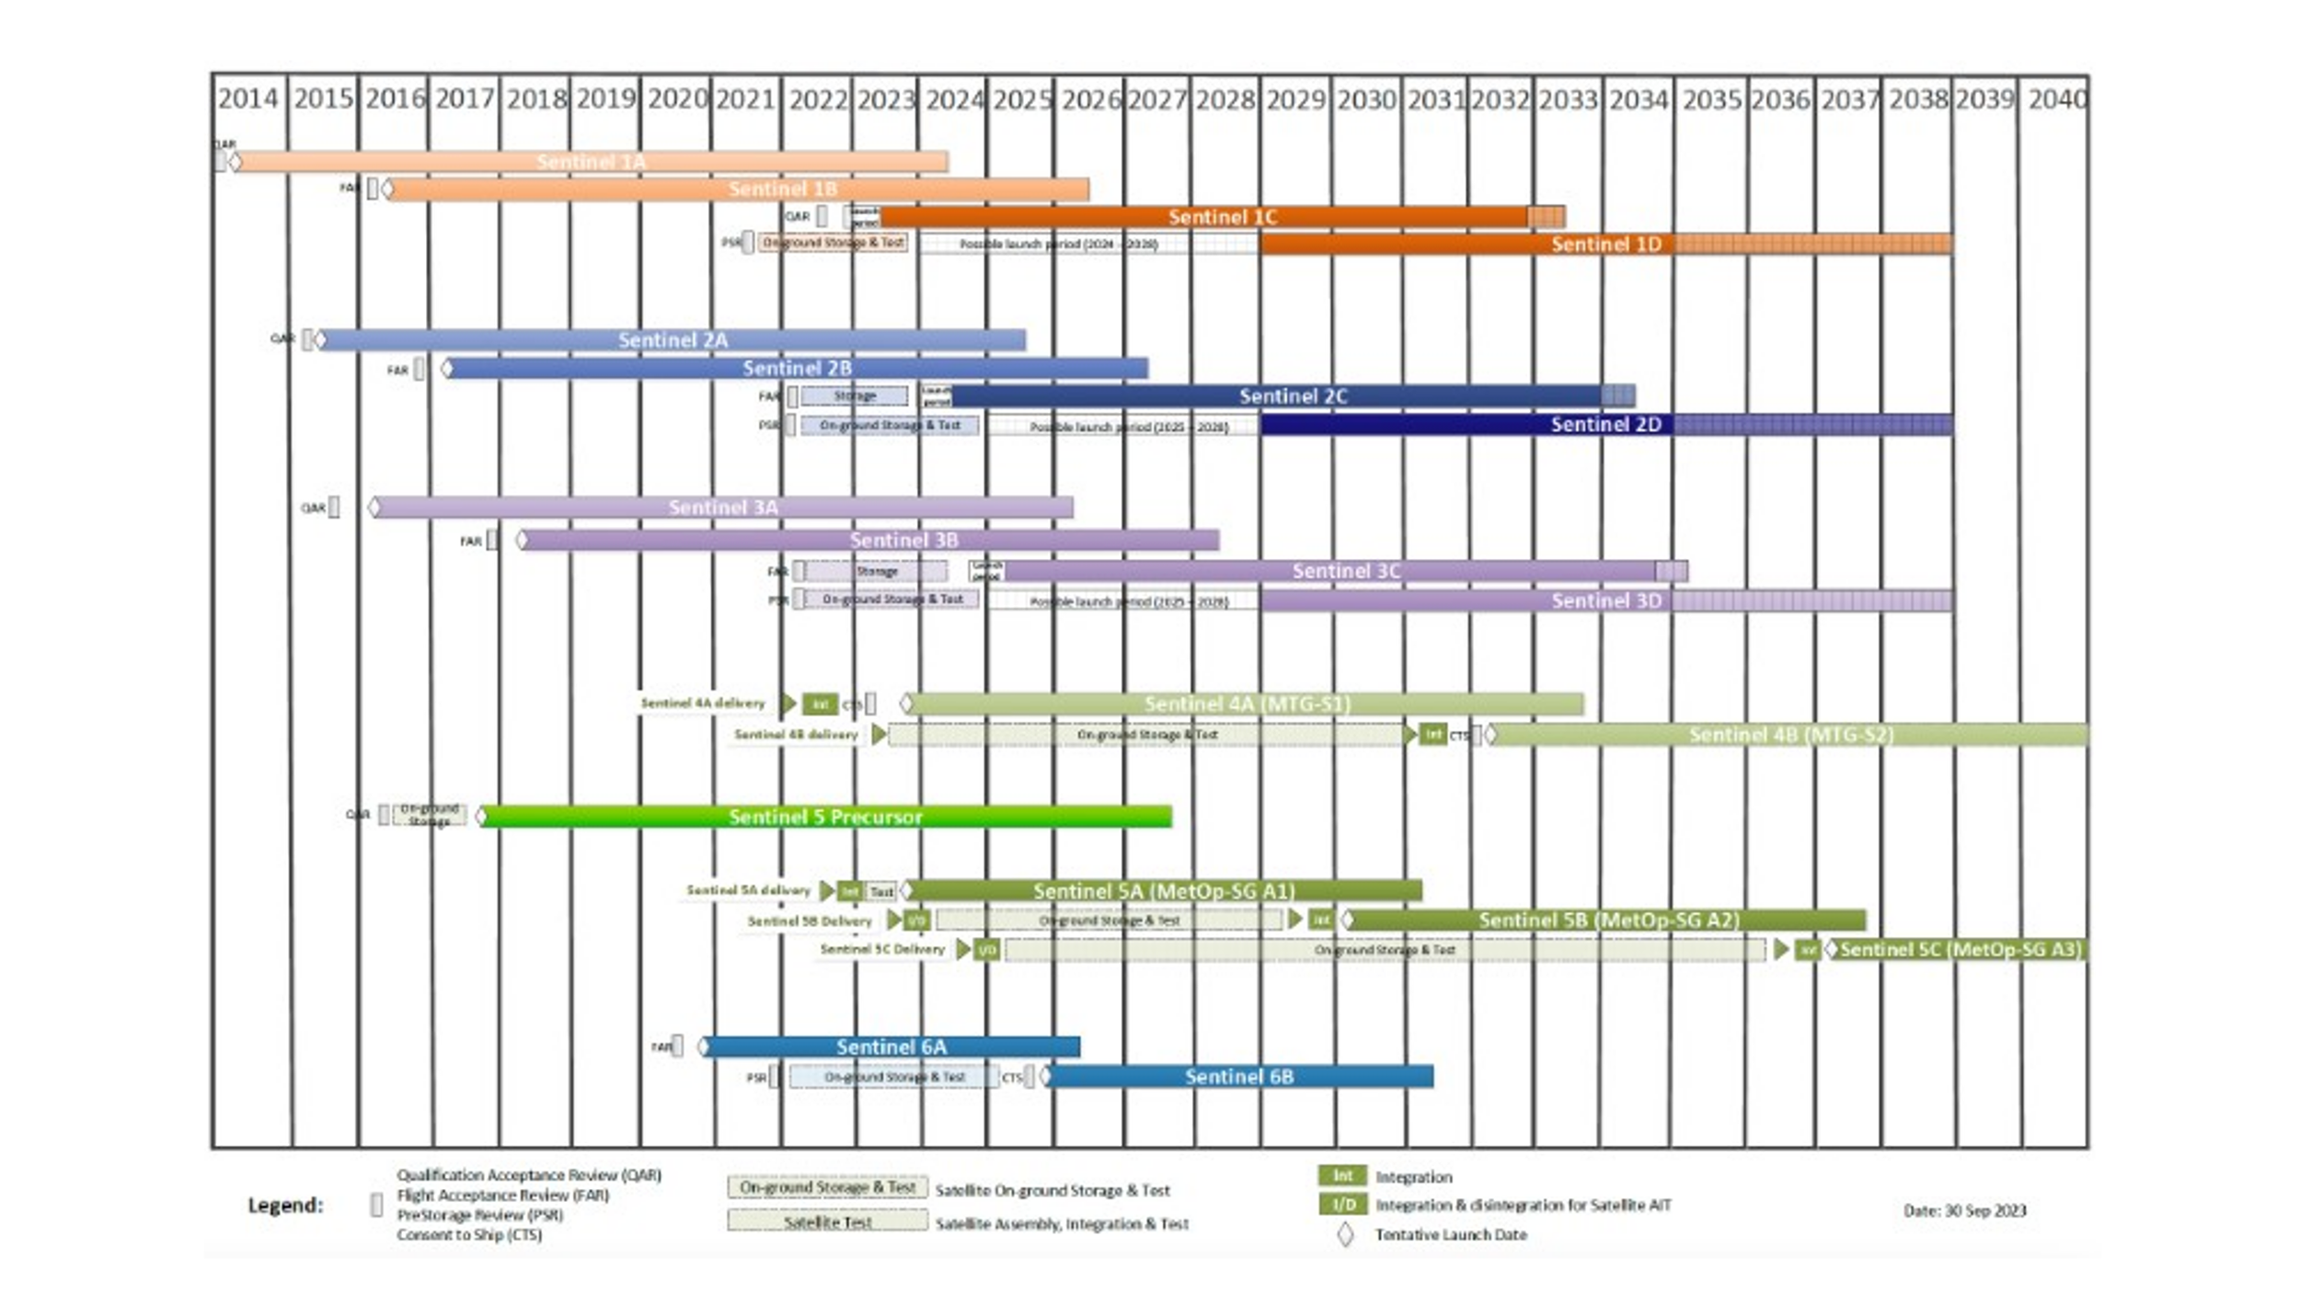
The Copernicus Sentinel missions: a guaranteed flow of open satellite data
Dec. 2023

Slide 8
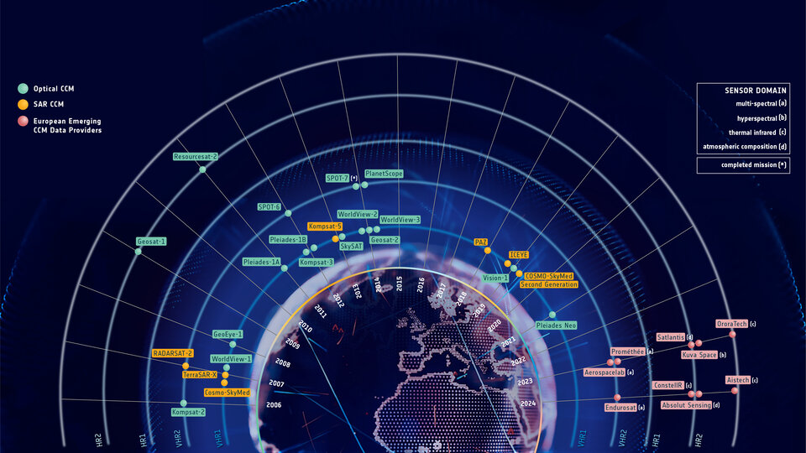
Copernicus Contributing Missions
In addition to data provided by the Sentinel satellites, the Copernicus Contributing Missions play a crucial role, delivering complementary data to ensure that a whole range of observational requirements is satisfied.

Slide 9
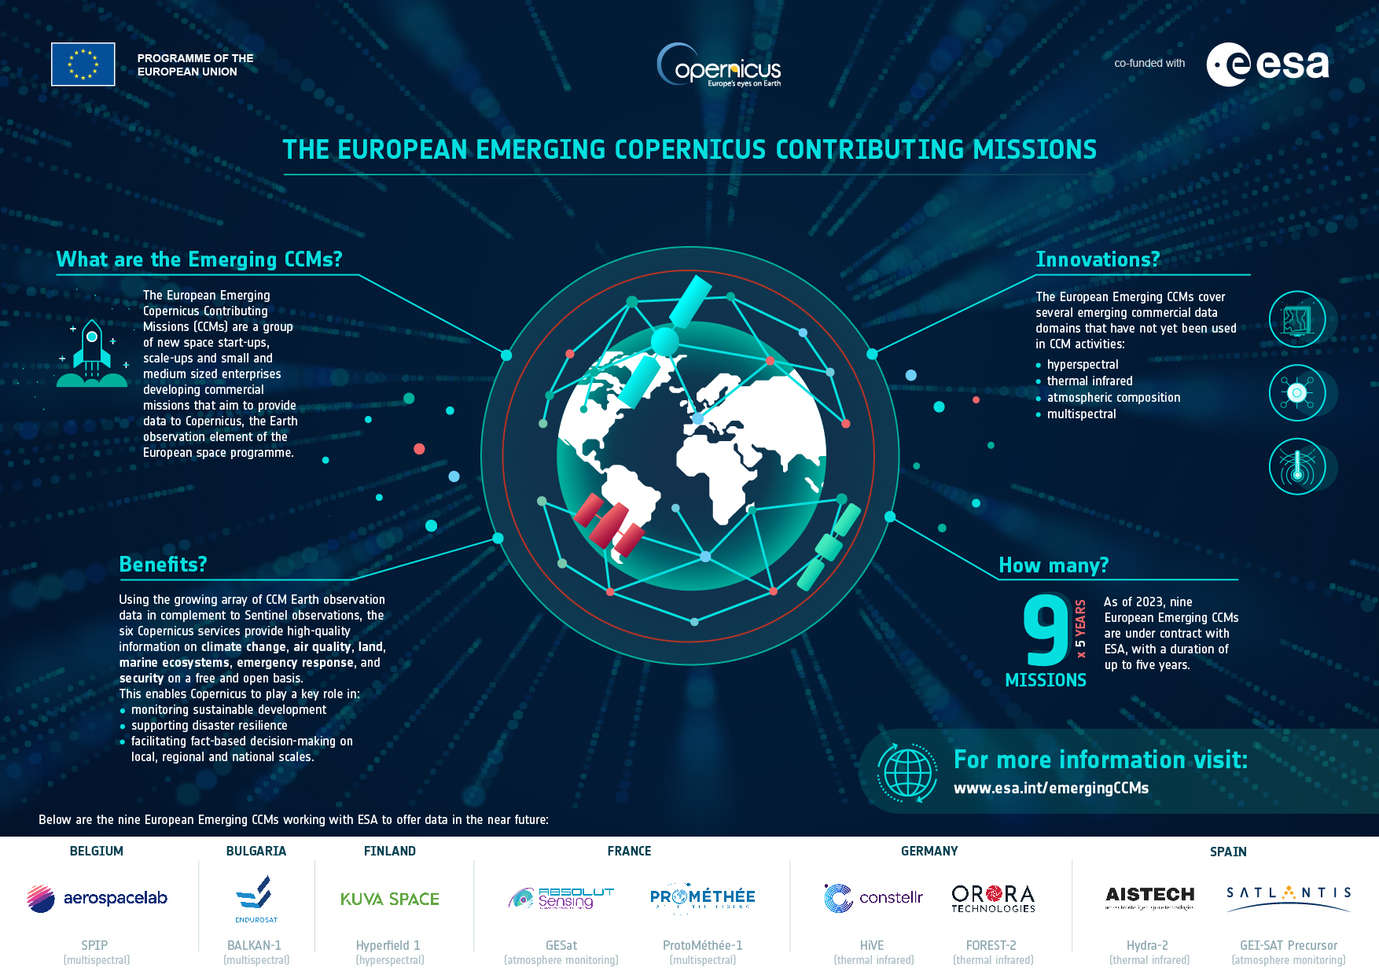
Copernicus Contributing Missions
In 2023:
nine European New Space Satellite data suppliers joined Copernicus as Contributing Missions.
more than 20 operational Copernicus Contributing Mission

Slide 10
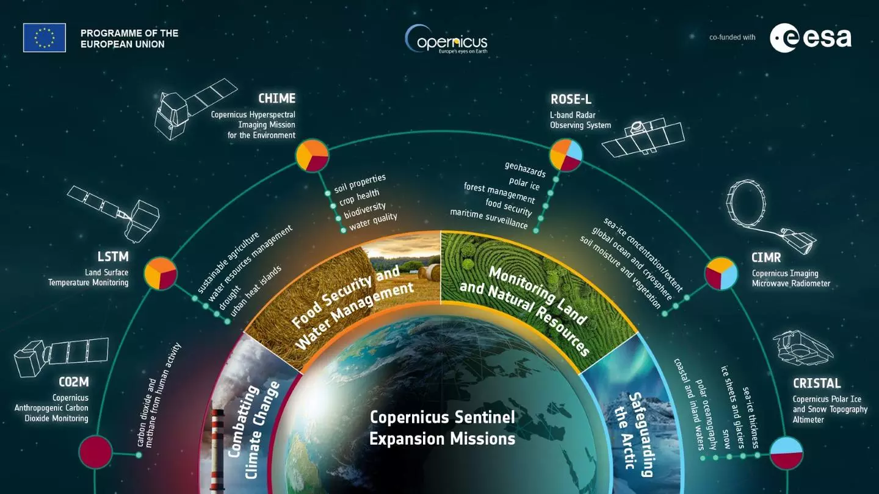
Copernicus Expansion Missions
Copernicus satellites will grow with 6 new missions, the Copernicus Expansion missions. They will help to address challenges such as urbanisation, food security, rising sea levels, diminishing polar ice, natural disasters and climate change.
Credit:ESA
https://sentinels.copernicus.eu/web/sentinel/missions/copernicus-expansion-missions

Slide 11
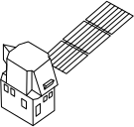
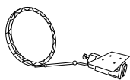
Copernicus Expansion Missions Timeline
CHIME: CHIME-A launch date is in 2028 while CHIME-B is planned to be launched in 2030
CIMR: The CIMR system consists of up to 3 Satellites dedicated to day-and-night monitoring of land, ice and oceans flying in loose convoy with METOP SG satellite B, launched in the frame 2025+
CO2M: CO2M-A is planned to be launched in December 2025 which will be followed by CO2M-B in March 2026 and CO2M-C later in 2026
CRISTAL: Planned to be launched in 2028
LSTM: LSTM-A is planned for launch in 2028, and LSTM-B is planned for launch in 2030
ROSE-L: Planned to be launched in 2028

Slide 12
New «Horizons» with the UK
In September 2023, a political agreement on UK participation in Horizon Europe and Copernicus has been reached between the European Commission and the United Kingdom.
The UK will contribute almost €2.6 billion per year on average for its participation in both Horizon Europe and Copernicus
As of 1 January 2024, researchers and organisations in the UK will be able to participate in Horizon Europe

Slide 13
Copernicus Thematic Hubs
On 8 November 2023, the first four Copernicus Thematic Hubs were launched
Their aim is to improve the user experience and streamline access to key information for different stakeholders, policymakers, and users by leveraging the open data and information available from different Copernicus core services and providing thematic one-stop-shops
The areas of interest of the Hubs launched are health, coastal zones, the Arctic, and energy.
Energy Hub: energy.hub.copernicus.eu/
Health Hub: health.hub.copernicus.eu/

Slide 14
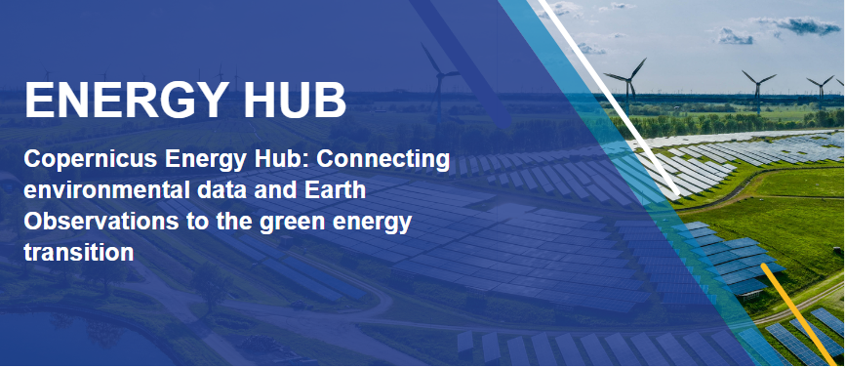
Copernicus Thematic Hubs
The goal of the hub is to support the EU Green Deal.
The Copernicus Energy Hub aims to bring together all the energy-related activities of Copernicus in order to simplify the user journey, facilitate access to key information and data of interest to the energy sector and inspire users with stories and use cases.
https://www.energy.hub.copernicus.eu/
The Copernicus Health Hub collects and provides all the Copernicus environmental information that are pertinent to Health, following WHO definition: Physical, Mental and Well-being.
The Health Hub is also supporting the users in better exploiting and uptake Copernicus data and products (via documentation, access to catalogues, inspirational use case stories, …).
https://www.health.hub.copernicus.eu/

Slide 15
Copernicus Thematic Hubs
The goal of the hub is to support the EU's Arctic Policy.
The Copernicus Arctic Hub focuses on ensuring safety, understanding the impacts of climate change and promoting sustainability in the Arctic, providing data to monitor key variables of climate change (melting sea ice and thawing permafrost) and supporting shipping and fisheries.
https://www.arctic.hub.copernicus.eu/
The Copernicus Coastal Hub supports evidence-based decision-making and sustainable practices for coastal ecosystems.
It aims to protect biodiversity, identify hotspots, monitor water quality, and supports infrastructure planning by providing data for flood risk management on land and maritime spatial planning offshore.
https://www.coastal.hub.copernicus.eu/

Slide 16
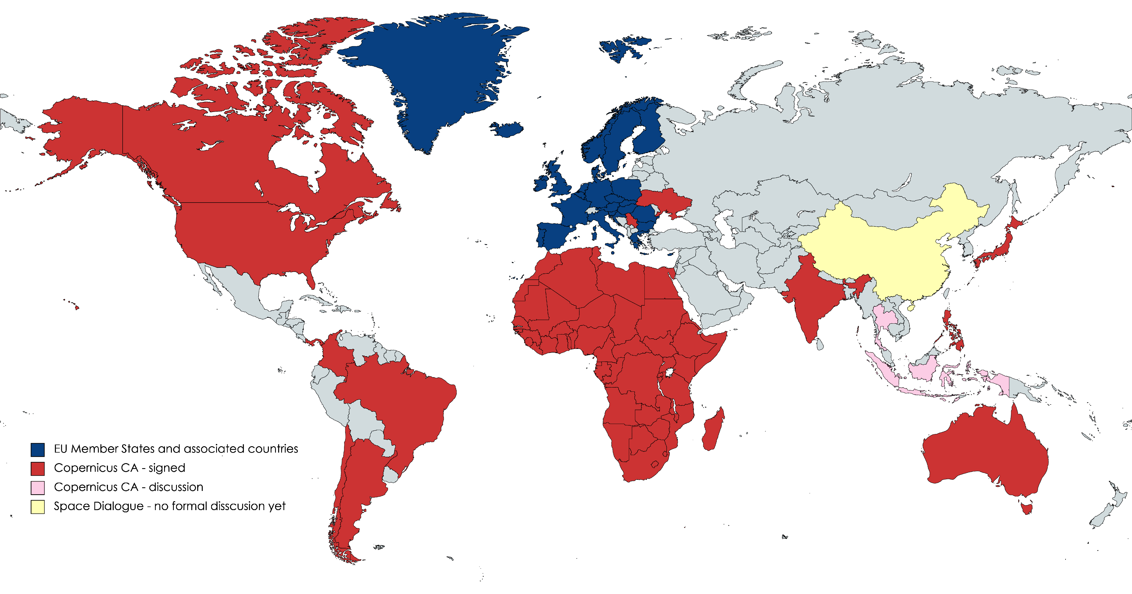
Copernicus International Arrangements
Copernicus is a tool for international cooperation for climate and environmental action, for international partnerships.

Slide 17
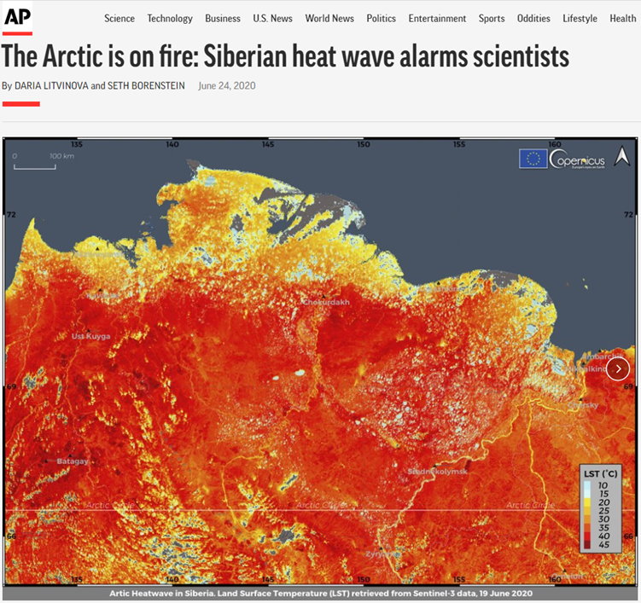
Copernicus in the media
>8,200 results on Google
The Copernicus Image of the Day serves as a bridge between complex satellite data and the general public, making information accessible and understandable.
Since 1 April 2020:
1,234 images published (as of today)
~ 70 million impressions (DG DEFIS and Copernicus Social Media)
~ 60 thousand media mentions on AP, Reuters, BBC, Reuters, CNN, DW, The Times, The Guardian, Sky News etc.
https://www.copernicus.eu/en/media/image-day

Slide 18
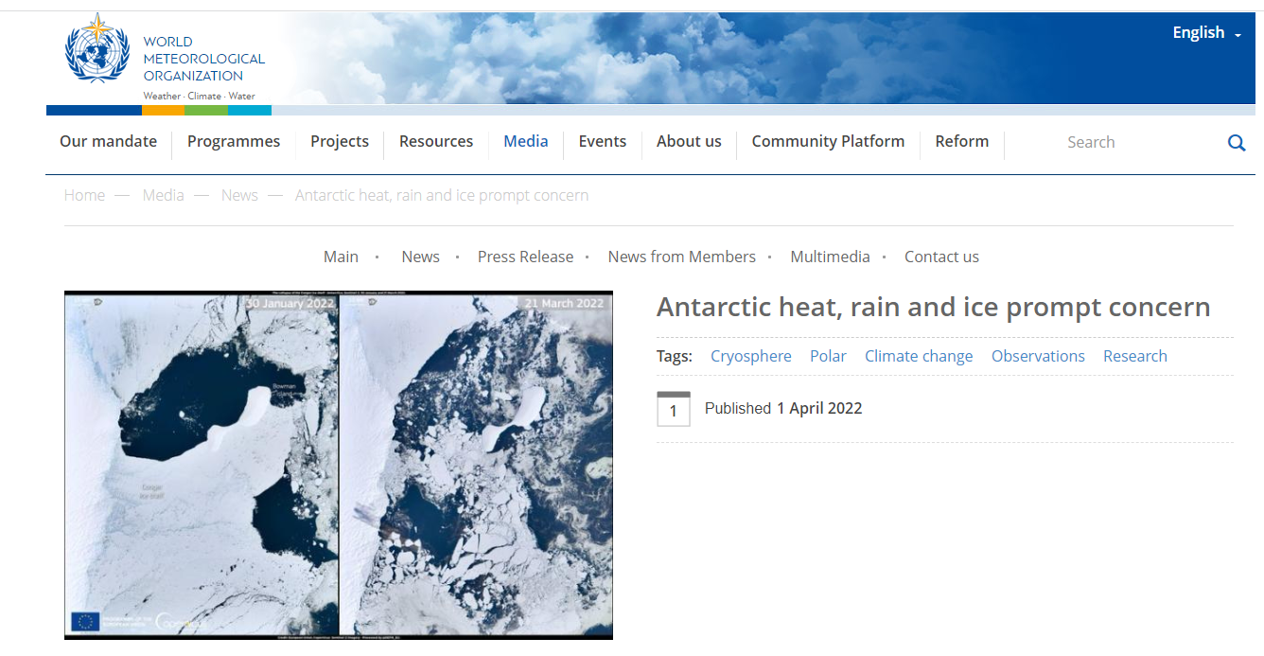
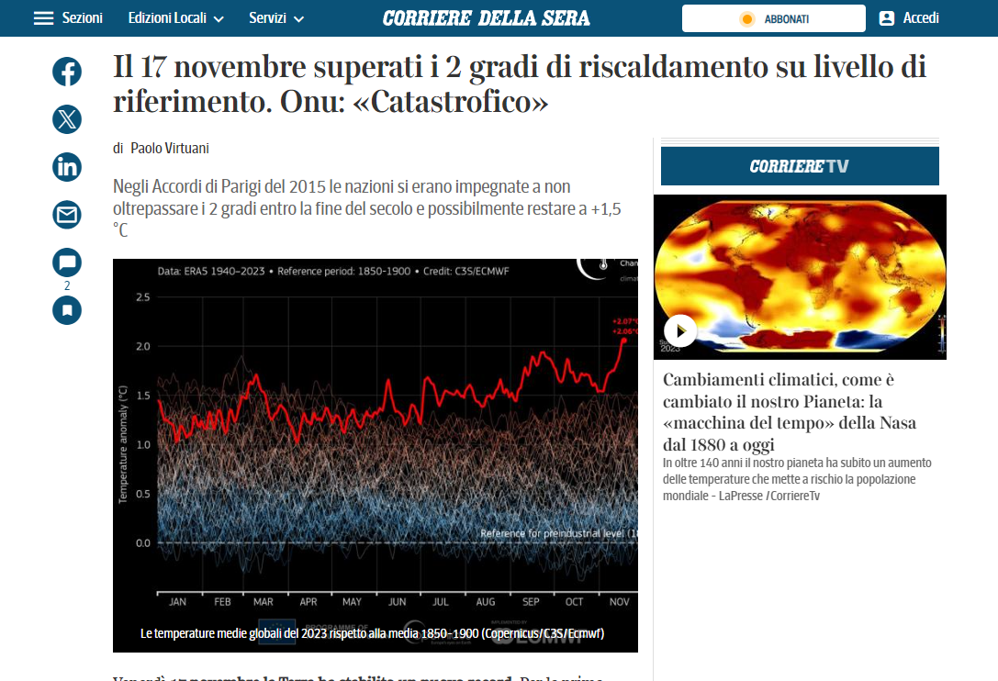
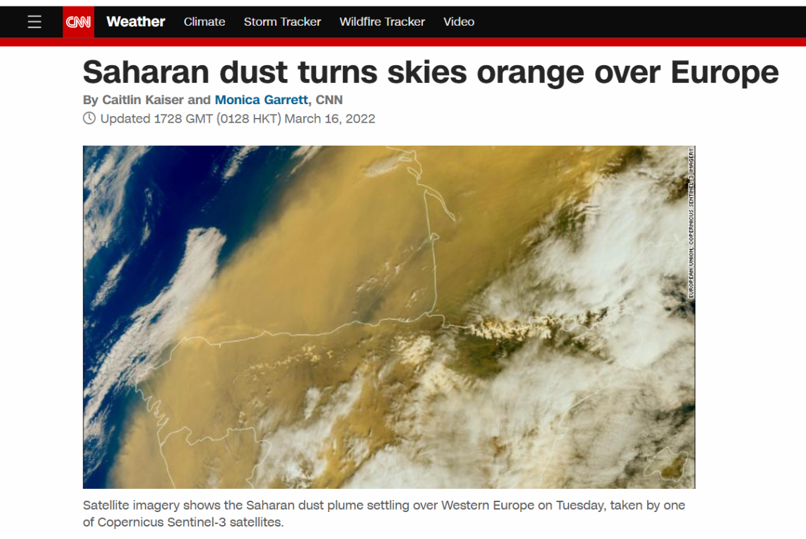
Copernicus in the media

Slide 19
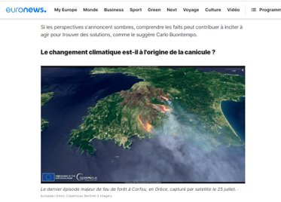
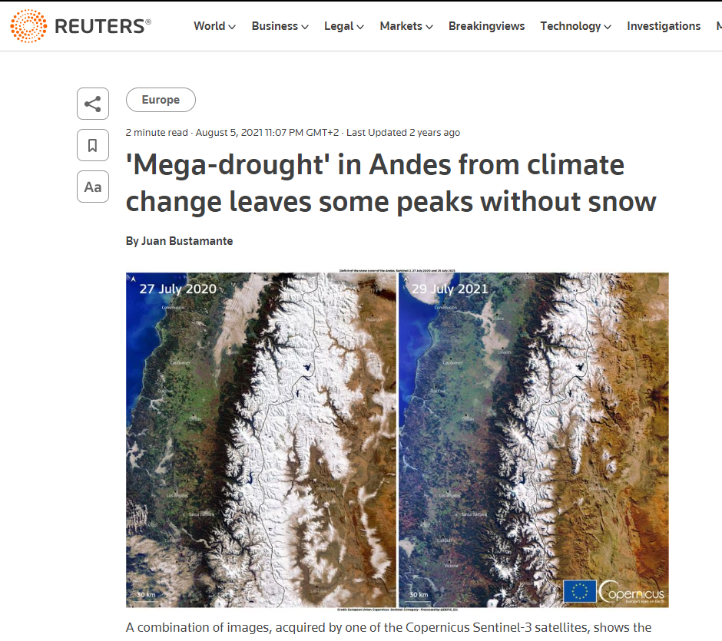
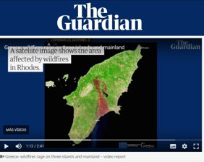
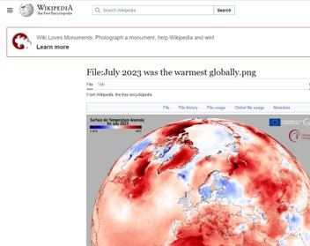
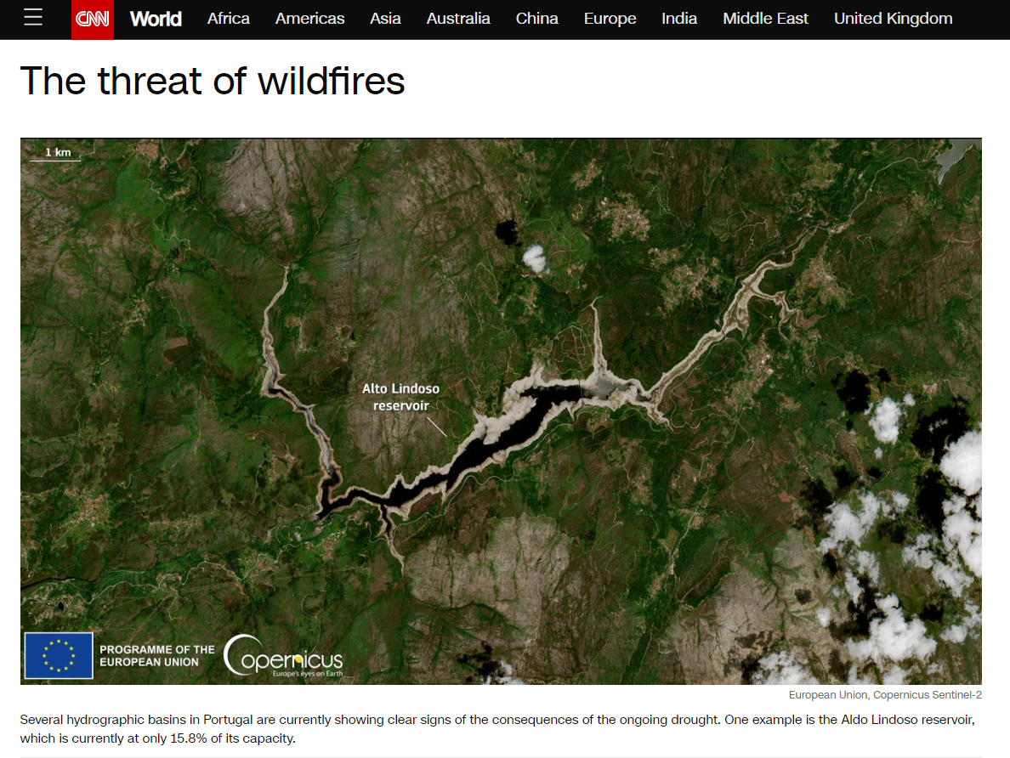
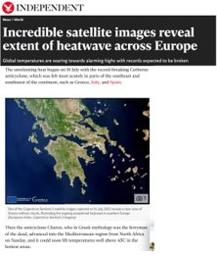
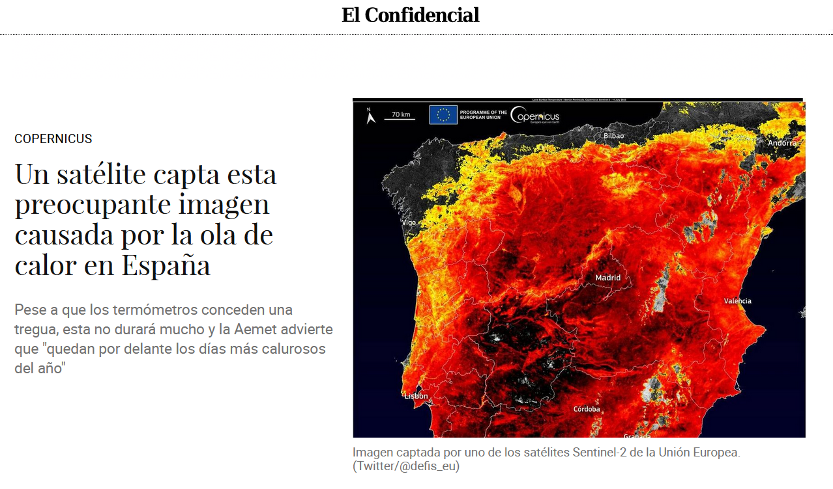
Copernicus in the media

Slide 20
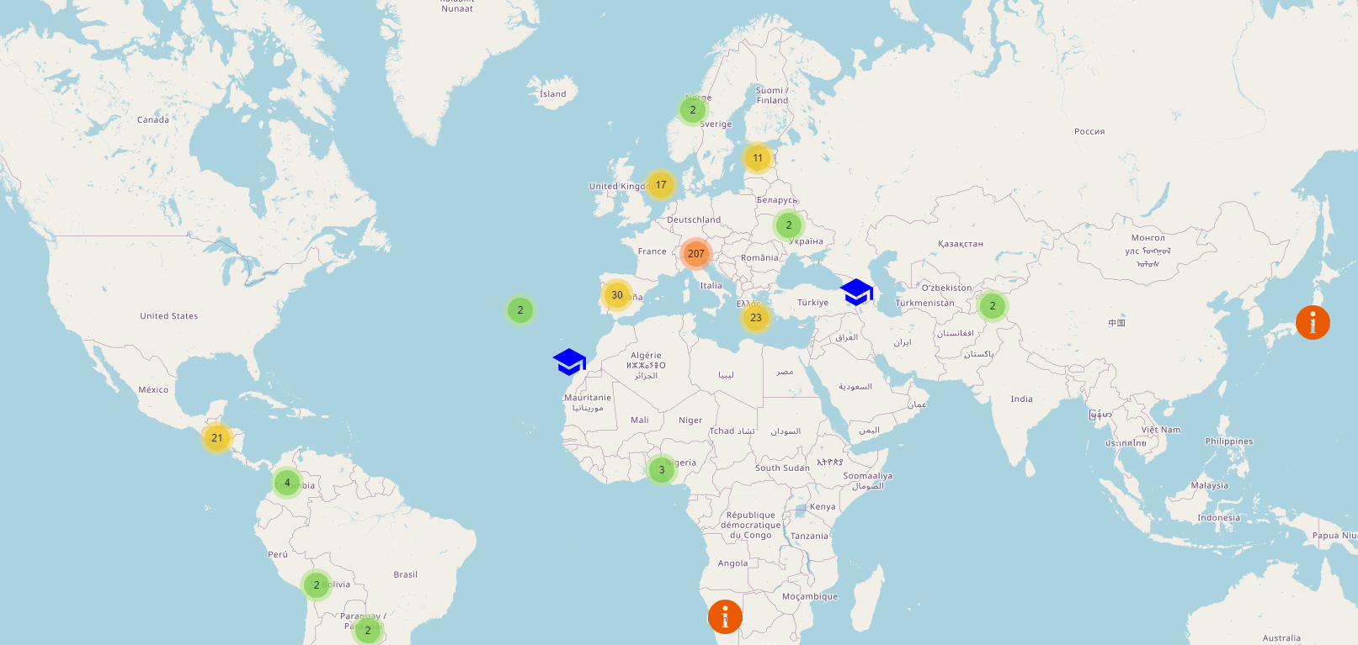
Copernicus Networks
The development of the use of Copernicus open data and information around the world is supported by the networks:
Copernicus Relay and Copernicus Academy
339 Members

Slide 21
Copernicus Support Office (CSO)
Active for over 6 years
Helpdesk
Over 2,000 inquiries answered yearly
Support to networks members
Support and coordination of user uptake
Enhanced global visibility for Copernicus

Slide 22
History of Copernicus
Baveno Manifesto
GMES - EU space policy
EC-ESA Agreement on GMES
Copernicus data policy and regulations
EU Space Regulation
1998
2005
2008
GMES → Copernicus
2013
2021
Copernicus 2.0
2001
2006
2011
2014
EU Summit in Gothenburg
EC - GMES Bureau
GMES GIO start
Start of operations

Slide 23
EU Space
EUSSO active since 1 September 2023

Slide 24
Press & Media
Programme partners
SST/SSA
EUSPACE
STM
European Actors
EU Space
Research
Institutional
Associations

Slide 25
Transition to EU Space Support Office
EU Space
Vision:
Encompassing more than just Copernicus
Promoting and leveraging synergies within the EU Space Programme
Accompanying the transition to EU Space Networks

Slide 26
Purpose
EU Space
Animate the EU Space Networks and level 1 user support
Engaging and educational communication, including the publication of the weekly “Observer” and a podcast
Support career-development initiatives
Help bridge the gap between skills and data use

Slide 27
Purpose
EU Space
Foster the use of data across new sectors, public and private user organisations or industries
Connect stakeholders interested in the various components of the EU Space Programme
Increase the exchange of ideas and best practices across borders and disciplines

Slide 28
How to contact us
EU Space Support Office
support@copernicus.eu
Thank you.

