Slide 1
Annalisa Donati
Acting Secretary General
Eurisy
Annalisa Donati
Secretary General

Slide 2
Members

Slide 3
2023 Members’ requests

Slide 4
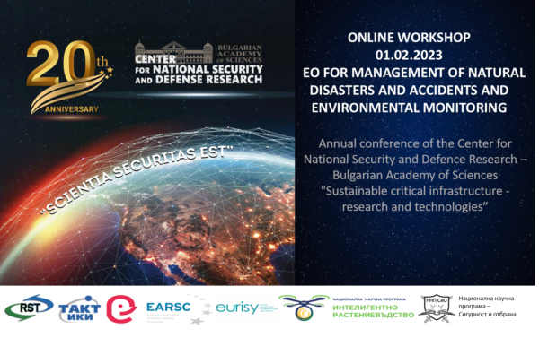
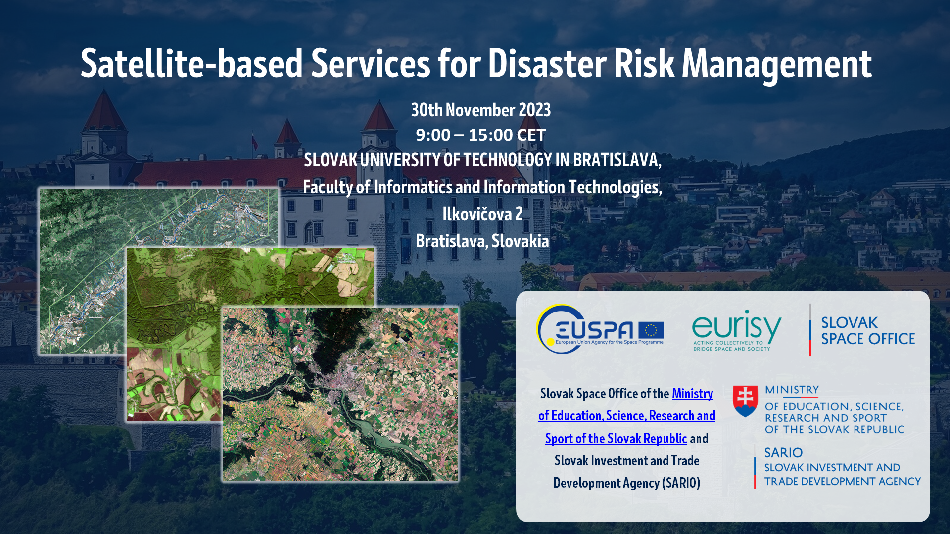
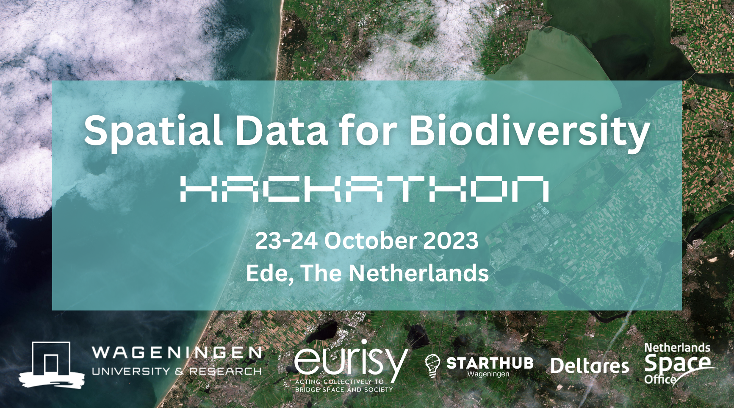
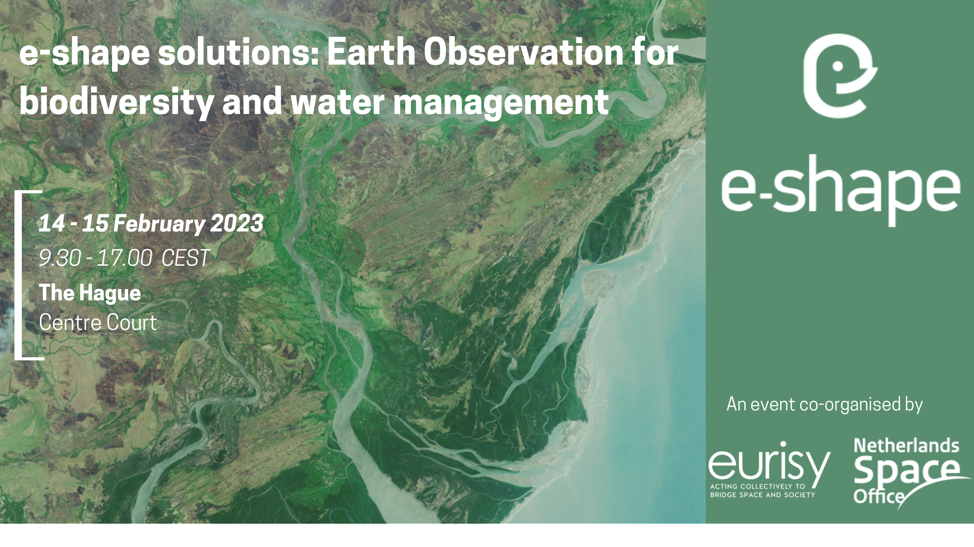
Overview of recent activities
2023 Year in review
7 Eurisy workshops (7 different countries)
2 series of thematic webinar developed with partner association
EURISY MEMBERS CORNER
30+ events supported
4 ongoing projects

Slide 5
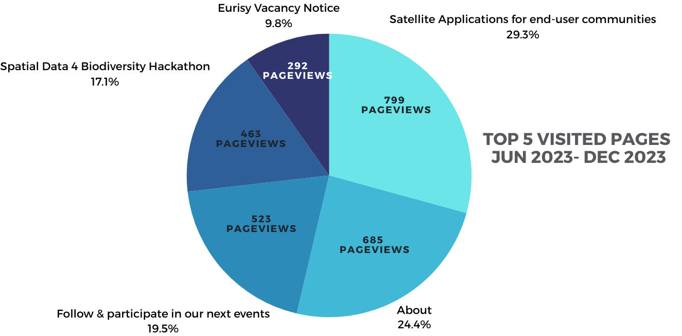
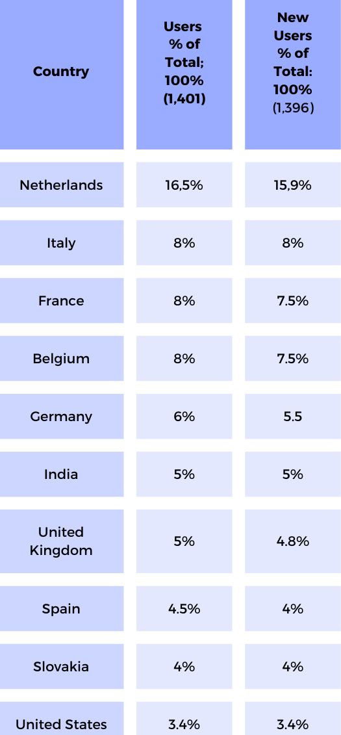
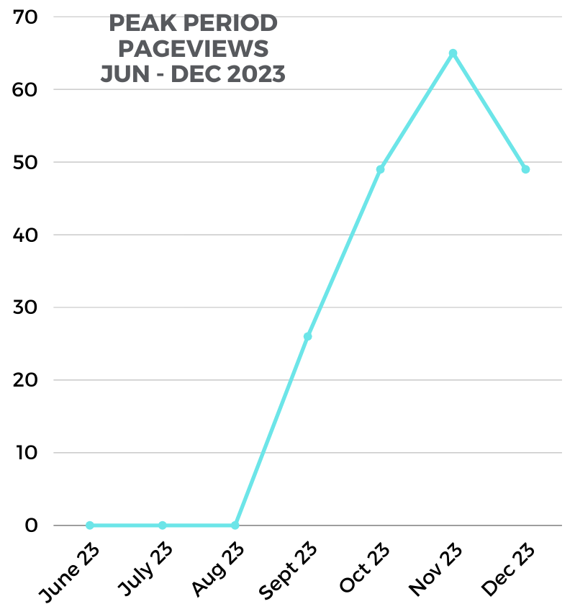
Communication & Outreach
Website Overview
In light of the above, it can be concluded that the value of workshops and partnership even﻿ts in the process of raising awareness about satellite-derived services tailored for the use by national and regional stakeholders is of great importance and represents a powerful outreach tool.
Notes:
Site traffic began to steadily grow starting from Aug 2023 reaching its peak on 23 November 2023 marked by the publication of the article on the outcomes of the Spatial Data for Biodiversity Hackathon and of the Satellite-based services for DRM worskhop in Slovakia. The peak activity in October is linked to the holding of the Spatial Data for Biodiversity Hackathon in Ede.
In light of the above, it can be concluded that the value of workshops and partnership even﻿ts in the process of raising awareness about satellite-derived services tailored for the use by national and regional stakeholders is of great importance and represents a powerful outreach tool.

Slide 6
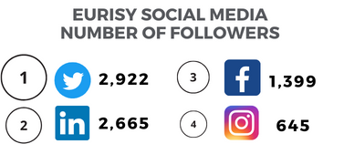
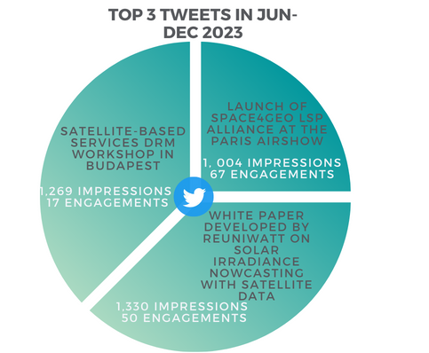
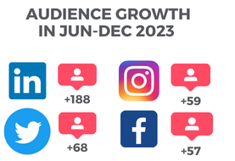
Communication & Outreach

Slide 7
Fulfilling Eurisy Mission
RAISE AWARNESS favour UPTAKE
MATCHMAKING favour ecosystem growth

Slide 8
Members’ engagement
Members’ corner
Members’ day
IAF ACCESS Europe Subcommittee action plan

Slide 9
Copernicus and EO market perspectives
Most significant barriers to growth that your company faces:
1. The biggest obstacle for both established companies (45%) and start ups (18%) is market user acceptance;
2. The second is for both finding new customers (38% EC; 16% Sus)
Most significant barriers related to customer uptake
Notes:
Companies were asked to consider the most significant barriers to their growth. These results are consistent with our previous survey. The most important barriers are related to three main issues: market/user acceptance, finding new customers and lack of development funding.
According to our survey’s respondents, the difficulty for customers to be convinced that EO provides them with a business solution is the most important barrier. The lack of awareness of the utility of EO applied to their business processes also represent an important barrier

Slide 10
Challenges & Opportunities
Users still lack knowledge of the possibilities offered by satellite-based services
Identify effective ways to communicate in a non-technical jargon
Users often lack technical skills
Need for more users’ success stories and business cases and training
Data specialists fail to meet real-world user-specific needs
large amount of open, free data and support opportunities by Copernicus and Galileo programmes;
Increasing technical development and user-centered services and growing offer from service providers
Difficulties in procure/purchase the service
Service sustainability
Established relationships between different stakeholders; decision policy-makers at local level and academia, tech clusters

Slide 11
Space 4 entrepreneurship
Support to Hackathons’ organisation (Bulgaria, Netherlands)
Prizes and Grand Challenges GLOBAL SPACE MARKETS CHALLENGE
Matchmaking events and support to incubation programmes

Slide 12
"Spatial Data for Biodiversity Hackathon"
Services & Products we delivered
Preparation phase
1.Hackathon Planning "Spatial Data for Biodiversity Hackathon"
2.Coordination of the Hackathon’s implementation
3.Coordination of the launch event (webinar) held on 6 October 2023
Implementation phase
4.Coordination of the Hackathon implementation
5.Post-hackathon Communications
Notes:
Hackathon planning
• identification of target audience
• mapping of stakeholders in collaboration with Wageningen University and Research
• identification of experts, tutors/jury members + invitation to join the jury
•setting of the calendar for the implementation of the hackathon
2.Coordination of the Hackathon’s implementation
•design of visuals and banners
•creation, launch and maintenance of the Hackthon webpage hosted by Eurisy website
•creation of a registration webpage
•creation and dissemination of communication materials, incl. a social media campaign
•design and production of a 1,5-minutes teaser video
3.Coordination of the launch event (webinar) held on 6 October 2023
•creation of the webpage of the launch event announcing the hackathon (this webinar aimed at informing potential participants about the objectives of the hackathon, its challenges, the registration criteria, the technical tools to be used, and the scheduled implementation of the hackathon)
•communication about the launch event through social media and direct mailing
•definition of the agenda of the launch event
•coordination of the webinars’ implementation (creation of registration links, dissemination, and setting up of the webinars’ platforms and moderation of the webinar)
publication of the recording of the launch event on Eurisy Youtube channel
4.Coordination of the Hackathon implementation
•proposal of the draft agenda of the hackathon for 2 days
•support during the 2 days of the hackathon – moderation, logistic and animation of the Hackthon
•participation as a jury member
5.Post-hackathon Communications
•conducted interview with the Hackathon winners
•drafted two articles on the outcomes of the challenge and the solutions proposed by the winning teams, published them on the Hackathon webpage
•promoted the article on social media channels

Slide 13
Aftermovie

Slide 14
SPACE SERVICE HUB
CONNECT WITH USER COMMUNITIES ON A WHOLE NEW LEVEL

Slide 15
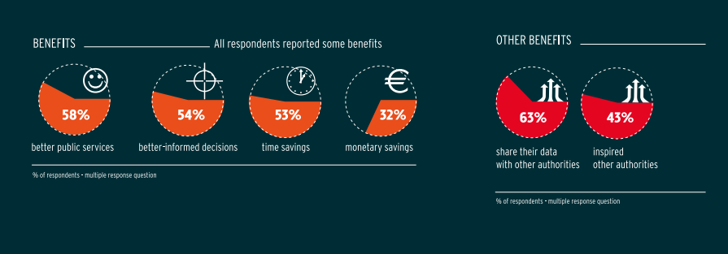
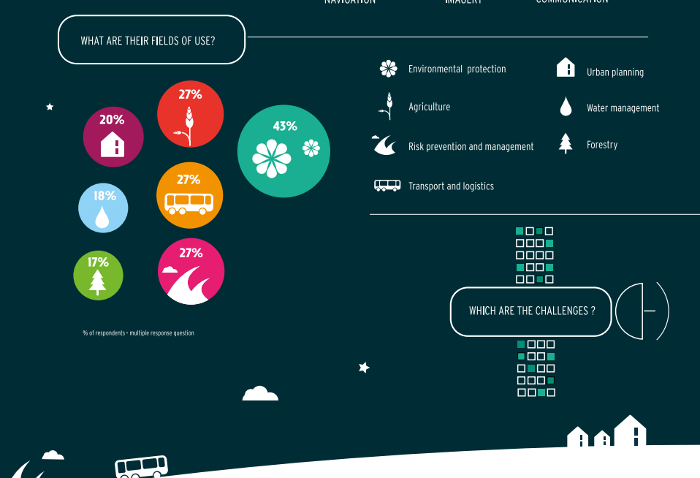
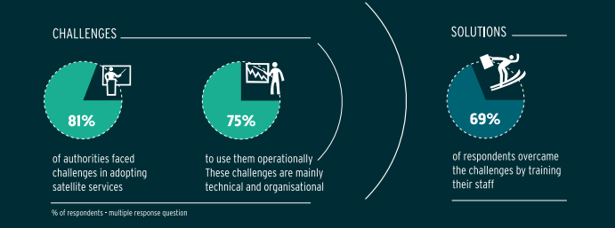
Support to UPTAKE of PA

Slide 16
Support to UPTAKE of PA
Copernicus Connection
Feasibility studies
Stakeholders mapping and analysis
Use Cases
Training, Workshops, Boothcamps, infodays

Slide 17
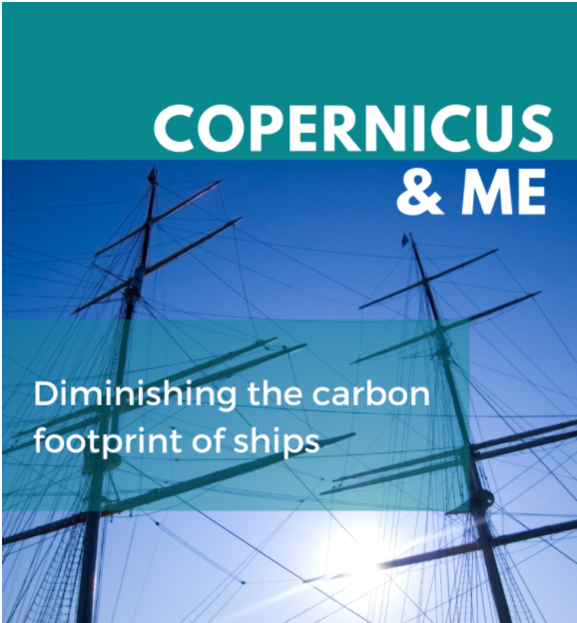
Agenda

Slide 18
GLOBAL CHALLENGES...FRAGMENTED SOLUTIONS
Society is confronted with new global challenges
CLIMATE CHANGE
PANDEMIC
Economy and technology are rapidly evolving
Shortage of specialized workforce in the sci-tech sector
Traditional scientific education is no longer effective
Different education systems and curricula
teachers not consistently supported in their learning
Need for new skills and competencies not
Never has the clock been ticking so fast….
Notes:
The challenges of the 21st century are posing a threat to the achievement of social progress, environmental and social sustainability, and peaceful relations between countries. In this scenario, the recent outbreak of Covid-19 and ongoing climate change have exacerbated social and economic conditions at European and global level, and had a particularly striking impact on the younger generation, whose educational choices have been influenced with regard to transition and orientation to school and university. As a core component of its agenda, the European Union strongly emphasises the importance of forging a resilient generation of young learners who are able to deal with emerging global issues. In this context, STEM (science, technology, engineering and mathematics) education plays a fundamental role in building a more sustainable society. Nontheless, STEM pathways are only taken by a minority of students in Europe.

Slide 19
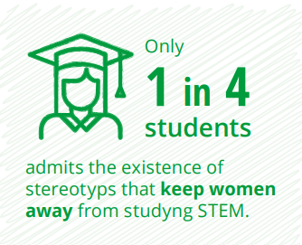
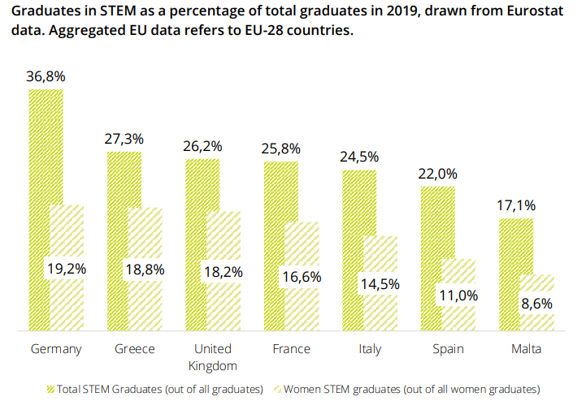
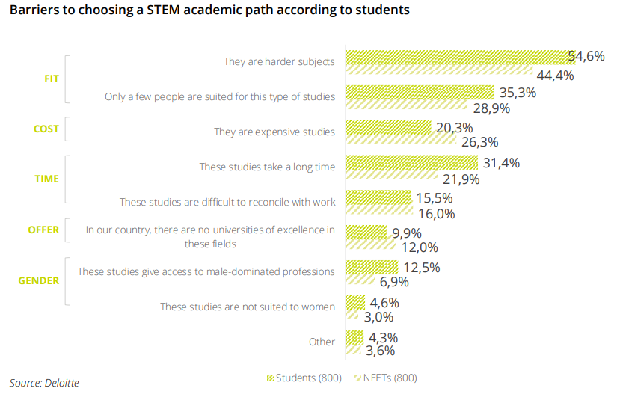
Current scenario
Only 26% of European (EU + UK) is graduated in STEM subjects
Notes:
STEM tertiary educational pathways are embarked on by a minority of European students. A quarter (26%) of total graduates in EU-28 countries (EU-27 + the UK) holds a STEM degree or qualification, with some variations depending on each country. This picture has been largely stable in Europe over the past five years, with virtually no change in the proportion of STEM graduates since 2016. Germany is a leading country for STEM education, where almost four graduates in ten hold a STEM qualification or degree.
Students and NEETs interviewed in Italy and Greece mentioned the lack of guidance from school teachers as a challenge in the transition to the next educational level. Students, NEETs and workers also highly rate the role of family and school in shaping high school students’ decisions about their future educational pathway.
Stereotypes and biased opinions about STEM disciplines shape student’s educational choices. One element is clearly identified as a deterrent to choosing STEM paths: on balance, STEM subjects are perceived as being more difficult than non-STEM subjects, and it is commonly believed that they are only suited to some people. This result does not significantly vary across the countries and targets considered, where students and NEETs believe that these disciplines are not suitable for women, showing the persistence of deeply rooted gender stereotypes, at least among a minority of respondents. In a nutshell, lack of self-awareness, misguided advice, fixed mindsets, and the idea that STEM degrees are too difficult, too long and too expensive for the average student, might deter a substantial number of high-school students from studying STEM subjects in tertiary education.

Slide 20
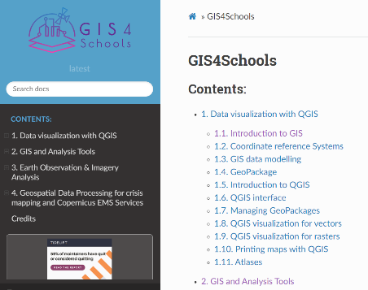
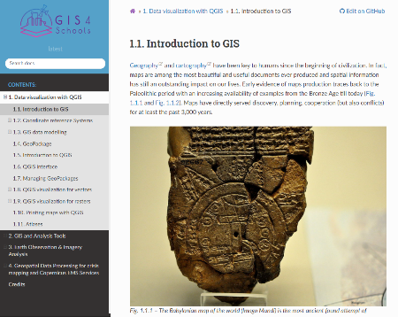
What is next…
Objectives
GIS4Schools
Insert the EO4GEO alliance to capitalize on what others are doing, establish partnership and disseminate material
GEO Academy – train the trainers
Leverage 2023 years of Skills and adhesion to the Pact for Skills
→ ROADMAP for STEM
Meeting and workshops to develop policy guidelines to harmonise scientifc European curricola

Slide 21
Space 4 Skills - SpaceSUITE
From EO4GEO to Space4GEO
25 partners
Focusing on GNSS, communications, emerging EO topics, and small sats
3 core objectives
Assessing the skills mismatch between educational offerings and the downstream sector.
Addressing the skills mismatch through training programmes and co-creating curricula. (HE, VET, and training)
Bridging knowledge and practices exchanges from the downstream sector to industry and government.

Slide 22
Space 4 Skills – GEO-Academy
Innovative digital GEO-Tools for enhancing teachers’ digital green and spatial skills towards an effective STEAM Education for Sustainability Development
12 partners from 7 countries
36 months (June 2023-2026)
Training teachers to develop:
Green
Digital
Spatial skills
Based around 5 core GEO-Concepts
Reaching 2,000+ teachers
www.geoacademy.eu
Notes:
GEO-Academy
Erasmus+ Project
Kicked off June 2023, 36 months until June 2026, with a sustainability plan to ensure continual availability of resources for several years after
Consortium of 12 members from 7 EU countries (France, Portugal, Greece, Sweden, Austria, Bulgaria, Cyprus)
With expertise from across geo-spatial and climate science, pedagogical experts and educators, communications + dissemination, policy
Builds off our experience from GIS4Schools
But this time targeting teachers
Targeting teachers pre- and in-service (from primary to upper secondary)
The problem
Climate change + sustainable development as key societal challenges, core aspects of EU policy, a clear demand for these topics and engagement from young people/ school students. Education for sustainable development is an important pillar of UNESCO
But is inconsistently implemented within national curricula in Europe, both on the national level as well as across subjects
Teachers lack both the knowledge and skills to be able to teach these effectively within their subject
Knowledge in terms of e.g. what is the greenhouse effect
Skills in terms of how to effectively convey this to students (e.g. using satellite-data, GIS, map storytelling) – access, analyse, convey/present
One hindrance to both these issues is a lack of accessible training, that fits within their schedules, that fits within their curricula, that is designed by and with teachers to be incorporated by teachers, and that is based on proven pedagogical models
Enter GEO-Academy
GEO-Academy aims to offer a comprehensive teacher training and development program for pre- and in-service teachers
Based around providing resources and training activities to support teachers professional development in their green, spatial, and digital in a range of key tools such as:
Geographic Information Systems (GIS),
Remote Sensing (RS),
Earth Observation (EO),
Geospatial Storytelling technologies within Education for Sustainable Development
5 GEO-Concepts (of which Eurisy is directly involved in 3?)
Cartography and spatial skills
Visualisation and map storytelling
GIS for Earth Sciences
Satellite applications
STEAM education, robotic, coding with a focus on urban sustainability
Using evidence based-pedagogical approach
Specific outcomes
Training activities, both national in 7 countries and international (and eligible for KA1 funding!)
Summer and Winter schools, the first of which is in Greece in June 2024
Developing e-learning resources hosted on the GEOBSERVE Platform
A central hub hosting learning and professional development resources, activities, and acting as a community of practice
Schools as GEO-Hubs, establishing national networks of participating schools based around national needs
Local ambassadors for education for sustainable development
Supplied with kits including digital resources and sensor kits for Arduino, Raspberry Pi etc.
Where are we now
Developing the tools, resources,
Developing a network of stakeholders and mapping out interested parties
Soon be reaching out teachers
Understand their needs in more depth
Inviting to participate
2 step approaches
Small scale, co-creation with teachers, testing implementation and incorporating feedback
Go big, scale up
By June 2026 we want to have reached 2,000 teachers

Slide 24
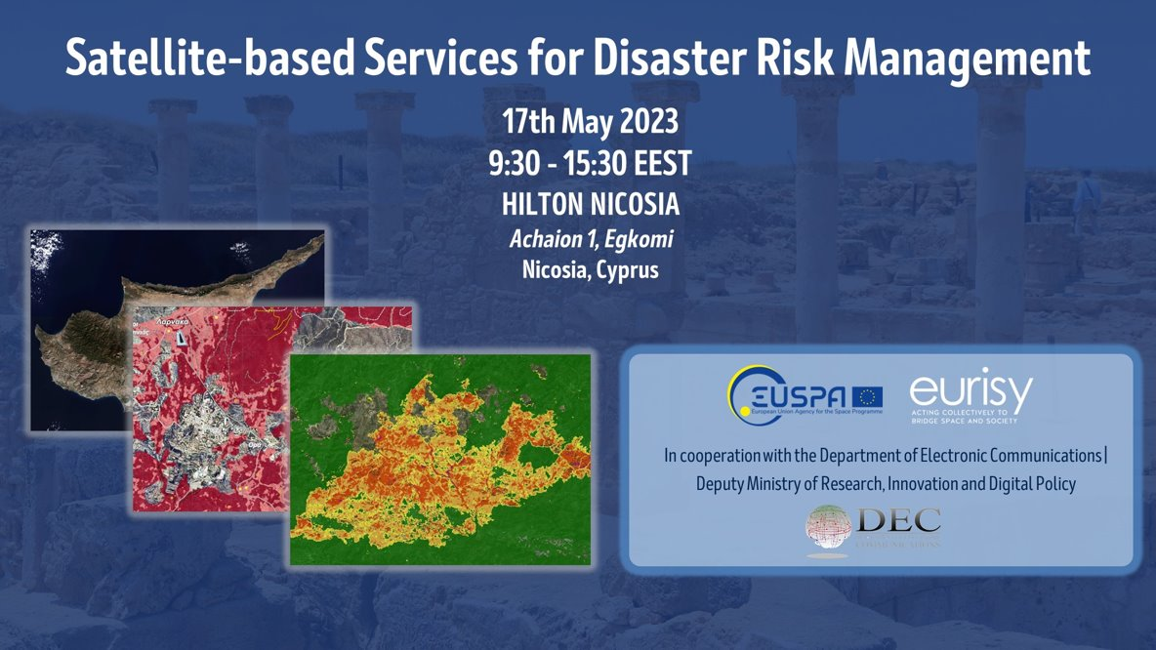
Satellite based services for DRM

Slide 25
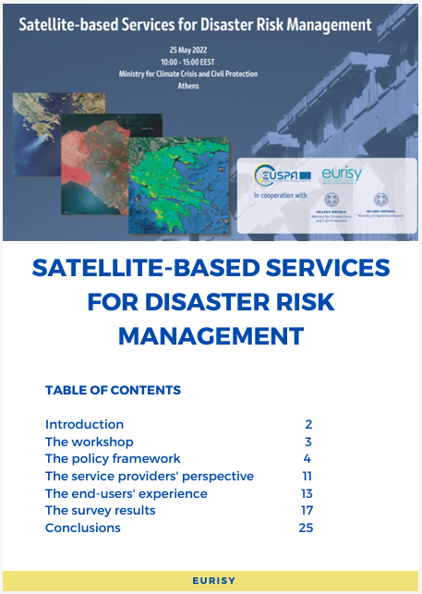
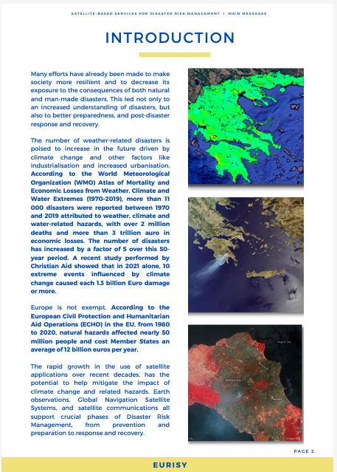
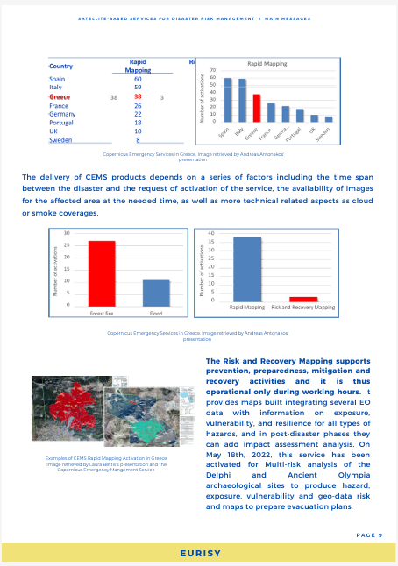
Methodology
Close cooperation with national authorities
Identification of current/interested/potential stakeholders
Questionnaire
Objectives
To get quantitative and comparable data
Allow for an easy sampling
In-depth interviews
Objectives
To get qualitative data from individual stakeholders/users
To specify the sampled categories

Slide 26
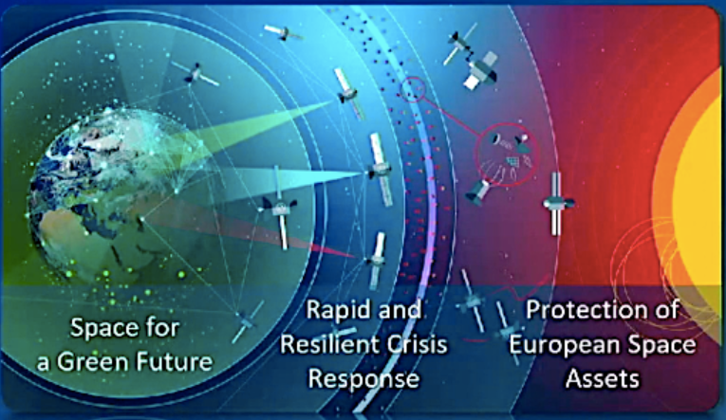
ESA Accelerators
→ stakeholders engagement, needs analysis, promotion of European capabilities

Slide 28
THETIDA
May 2023 – October 2026.​
17 European partners from Italy, Portugal, Greece, Cyprus, France, the Netherlands and Norway. ​
Multidisciplinary team & Holistic approach.​
Combined environmental and pollution analysis of cultural heritage sites and damage assessment.​
7 Pilot sites. ​
Spatial data (Sentinel 2 and Landsat 5) & InSAR, complemented by in-situ sensors.​
Living Labs: diversity and inclusivity. ​
Scaling-up!

Slide 30
UDENE
The UDENE Project aims to use large amounts EO data from Copernicus to support evidence-based decision making for urban development.
Support to UN SDG 11 creating a virtual laboratory for urban planners to test their multi-dimensional models of urban areas across time and countries.
Project outcomes will be embodied by an exploration tool for natural experiments and a matchmaking tool.

Slide 32
Webinar series before the olimpic games
Three webinar to highlight three relevant aspects of Space4Sport
Infrastructure
Performance
Entertainment

Slide 34
Identification of relevant good practices
Stakeholder engagement and capacity building
User needs analysis
Liaising with local, national, European institutions involved
Communication and dissemination
Support for potential training courses and workshops
Policy recommendations development

Slide 35
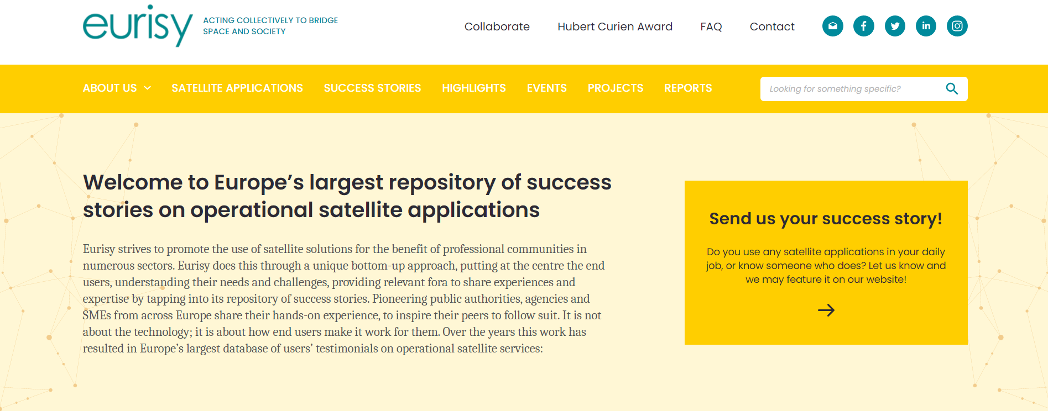
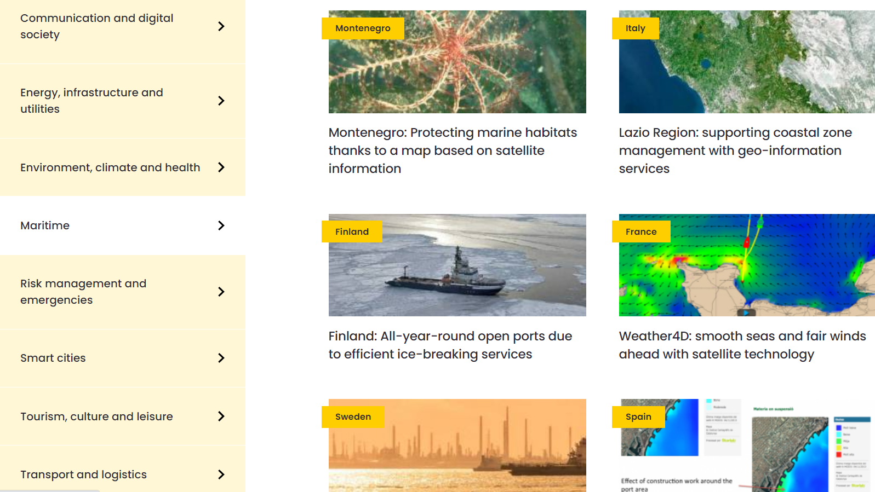
Success stories will foster the relations between service providers and end users.
The Success Stories aim at addressing communities outside the space sector and offer them the opportunity to express their needs and to present their challenges.
The objective is to favour the integration of satellite-based solutions in their workflow.

Slide 36
Thank you!
Do you want to partner with Eurisy or know more about satellite applications?
CONTACT US!
Follow us:
https://www.facebook.com/eurisy1
@Eurisy1
linkedin.com/company/eurisy
www.eurisy.eu

