Slide 1
Space assets supporting the disaster risk management cycle
Satellite-based Services for Disaster Risk Management Workshop
Alfeite, May 13th, 2024

Slide 2
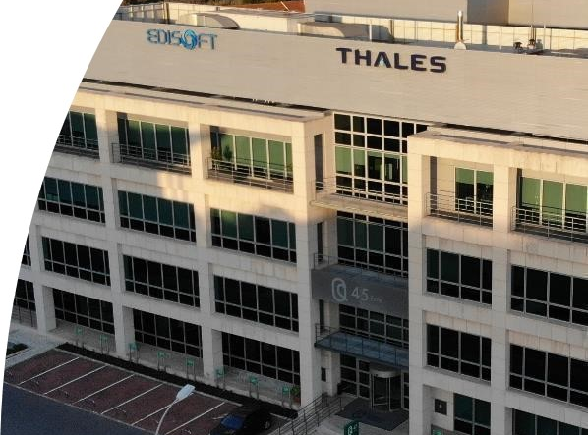
Thales Portugal Presentation

Slide 3



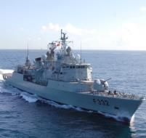
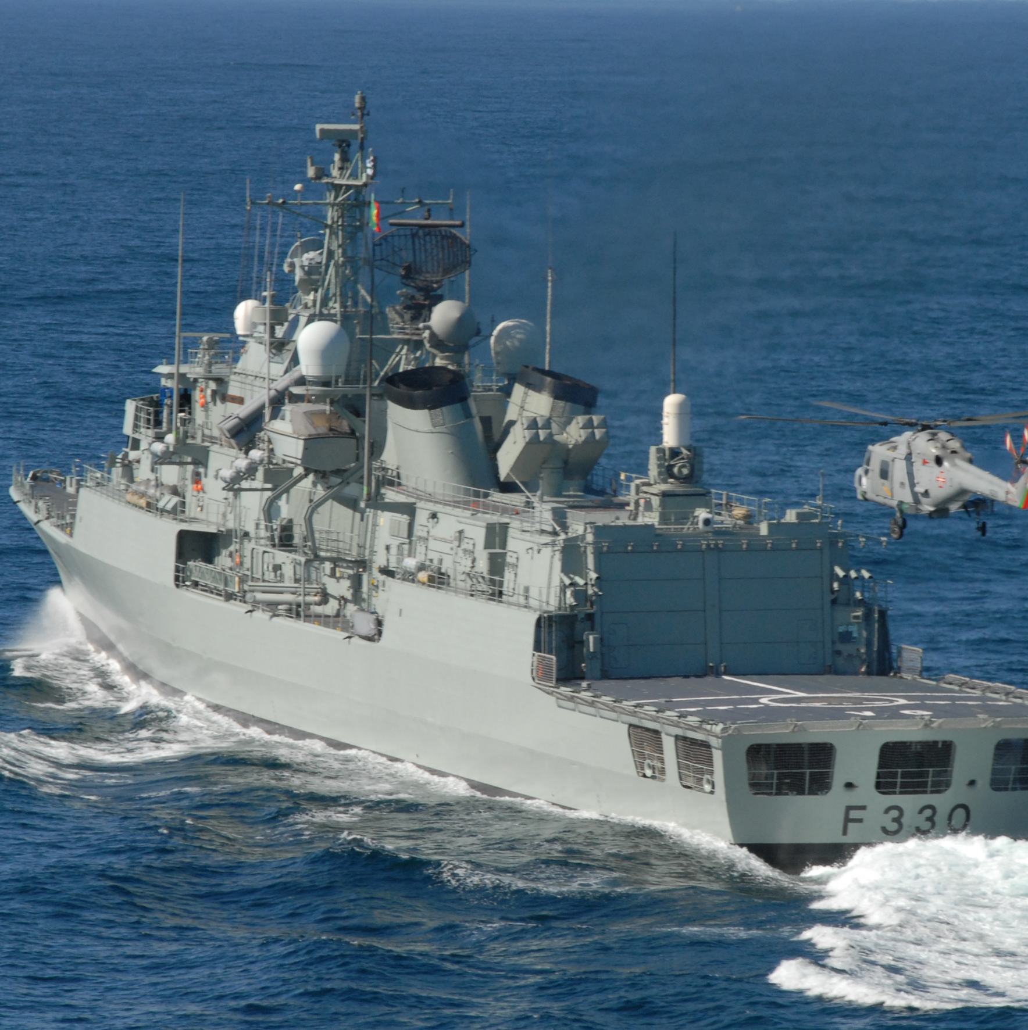


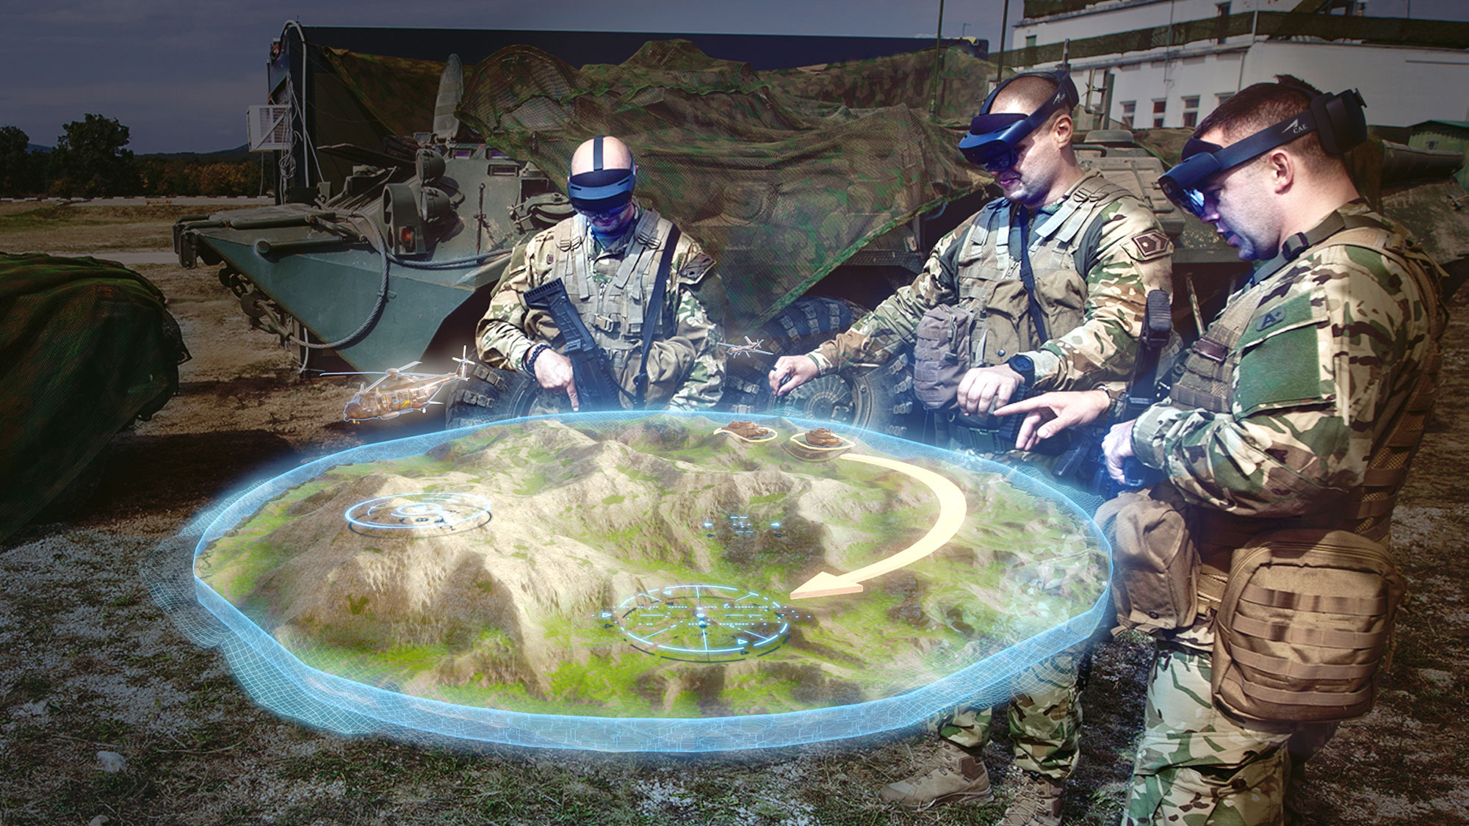
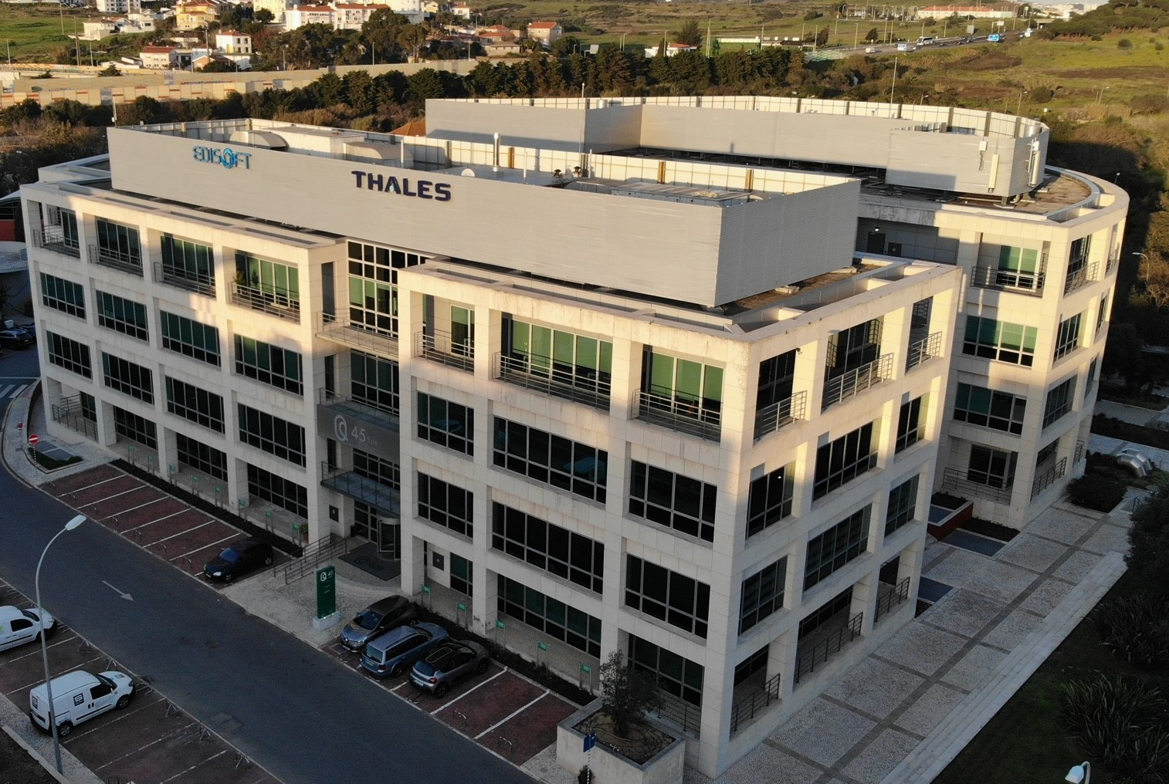
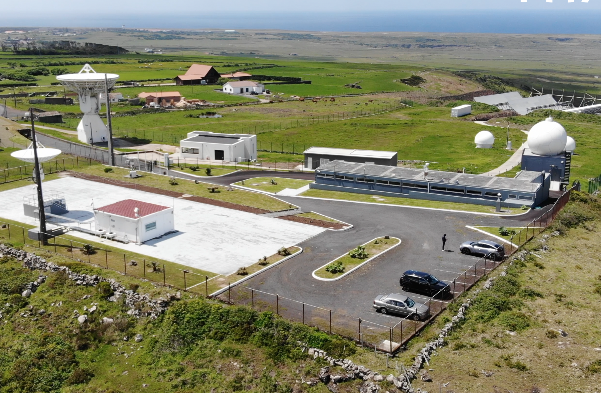




Thales Edisoft Portugal Overview
Naval Defence Systems
Naval Systems & Sensors, Combat
Management System. Integrated Bridge,
Platform Systems Integration, Automation & Logistics
Aerospace
Software & Embedded Systems, RTEMS by Thales Edisoft RTOS Licence & qualification
Space Ground Segment activities with major EU Agencies, Copernicus collab station & ESA (GALILEO, EGNOS, EDRS)
NAVAL Engineering Center
AIRSPACE Mobility Solutions Engineering Center
Airspace Mobility Solutions
Software development for Air traffic management systems.
Product & Services development in the segments of Tower Automation, Aeronautical Communications & Digital Services
Land Defence Systems
Tactical Deployable Communications,
GEOINT & Military Equipment maintenance
Shareholders
Cyber & Identity Security
Cybersecurity & Identity Security Systems to Government, Critical Infrastructures & Security authorities
65%
170 Employers
14 Employers
HQ Oeiras Valley
SMA Teleport, Azores
17,5%
17,5%

Slide 4
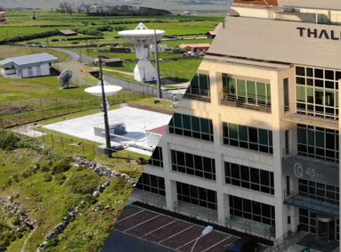
Satellite Data Processing Tool

Slide 5
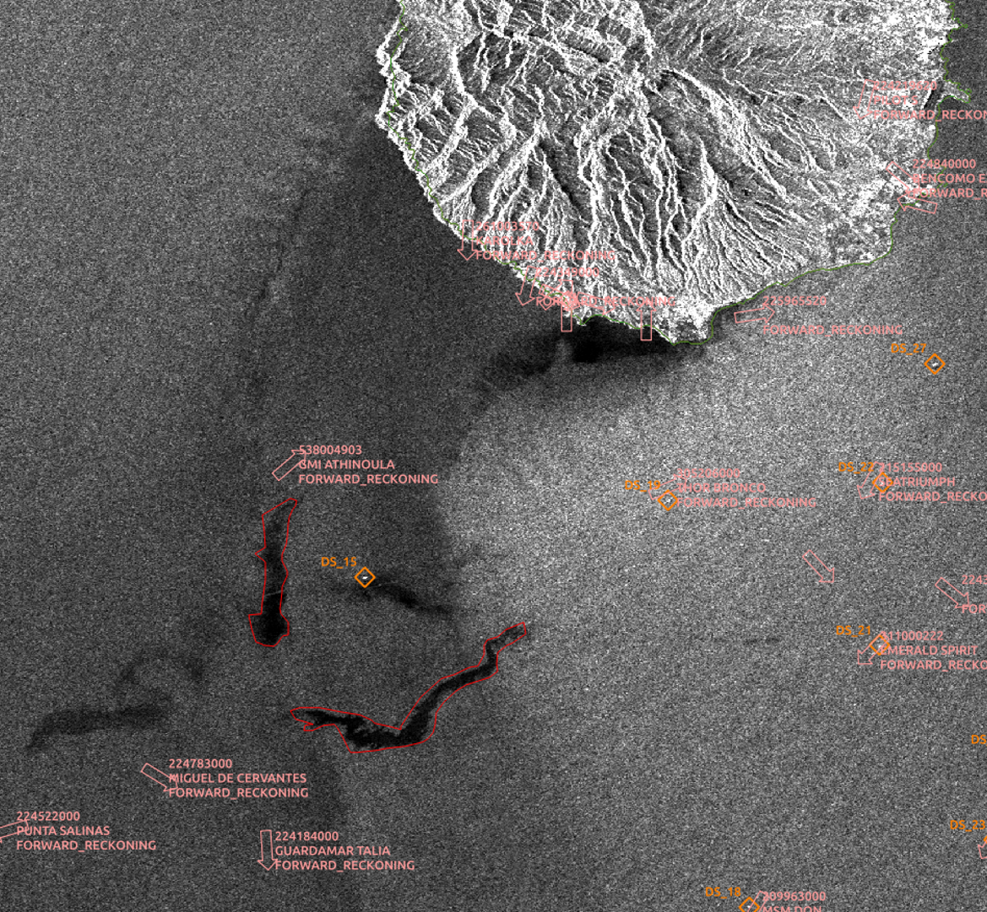
EO and GeoInteligence
Space based info
  Acquire from sensors, process and deliver added value information to customers
Processing Chain technology Development
Data acquisition
Data Processing
Data storage & transmission
EO Value added products
Demonstration of Innovative concepts
Data Science
Business analysis – Vertical Maritime

Slide 6
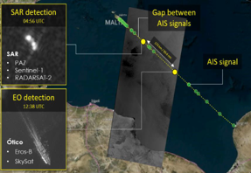
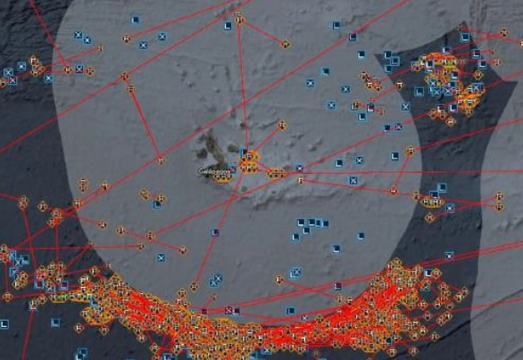
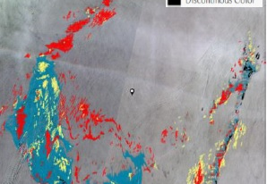
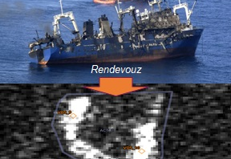
OceanEye
Platform for Daily basis Operation in Near-Real Time:
  Ship detection and AIS Correlation
  Illegal activities
  Maritime pollution monitoring
  Environmental conditions monitoring
  Support to navigation and maritime operations
  Customizable products for a wide range of maritime surveillance tasks
  Guarantee of confidentiality, integrity and availability
  Satellite based processing, both from SAR and Optical sensors, for 24/7 operations, all-weather operation

Slide 7
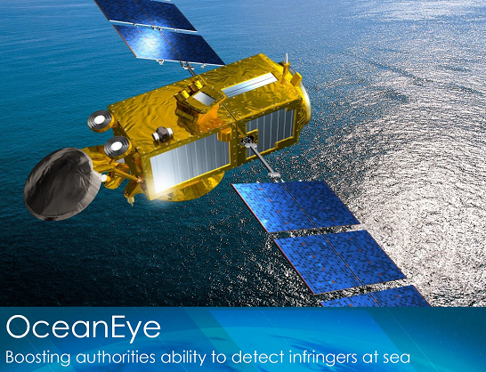
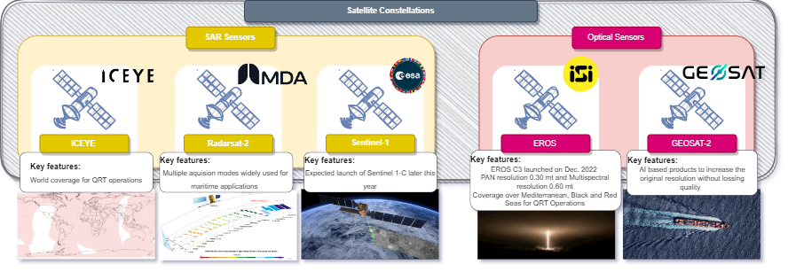
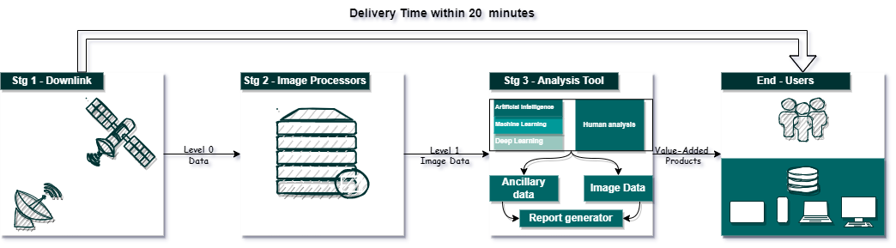
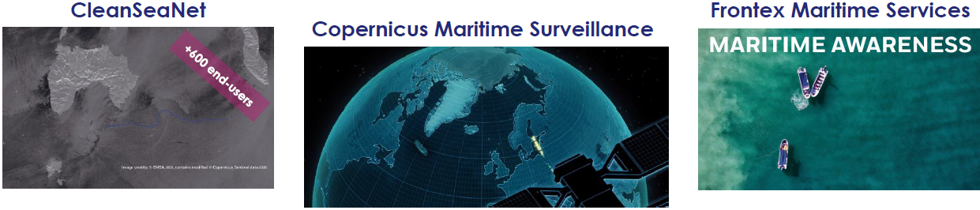
OceanEye Payload Processing Platform
Platforms
  xxx
  xxx
xxx

Slide 8
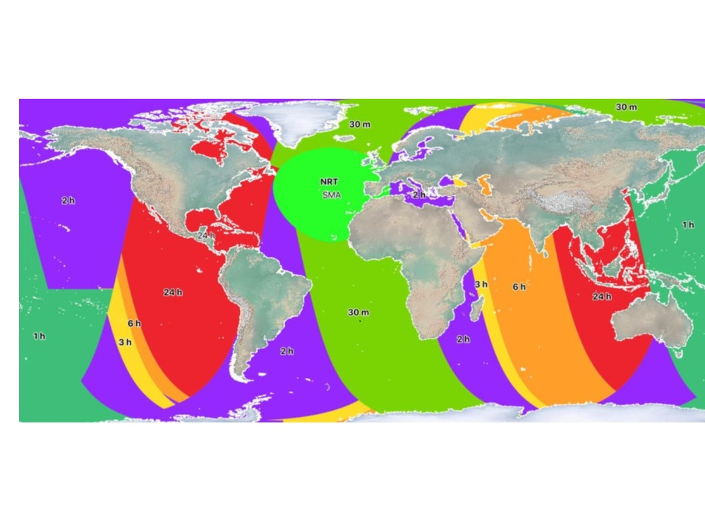
Risk Disasters Support

Slide 9
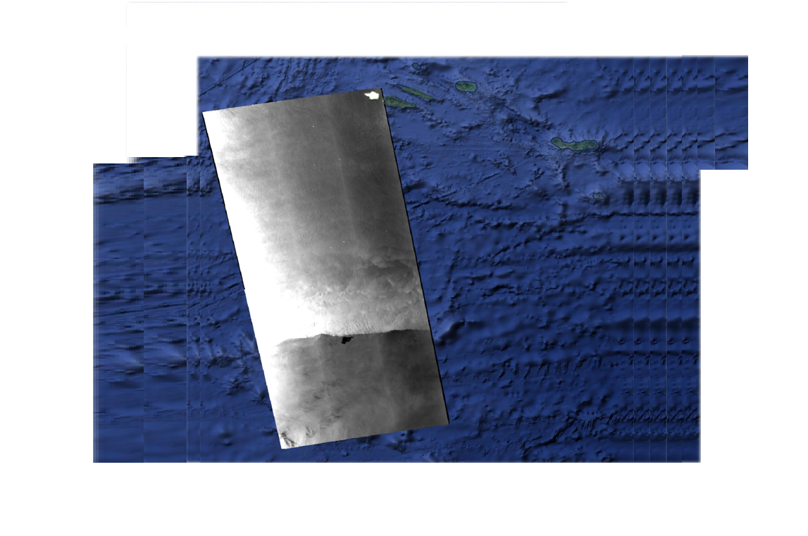
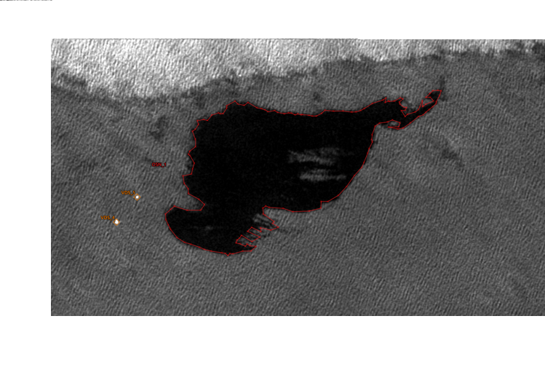

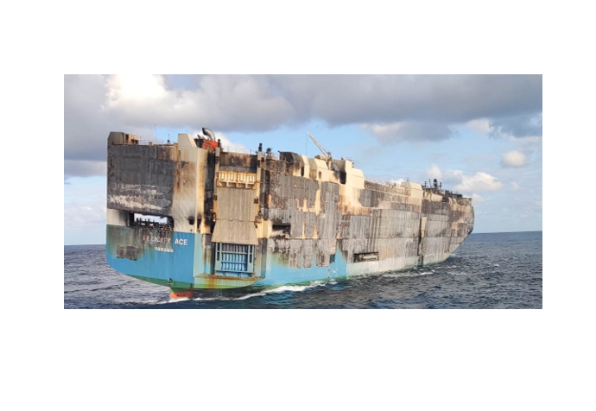

Use Case: Oil Spill Emergency Response
Mid-term monitoring of
Oil Spill evolution
  RO-RO Felicity Ace sank on March 1st, 2022
  Thales Edisoft Portugal contributed to the pollution monitoring from late February, when the ship was evacuated, until early April
    In addition to routine monitoring, additional images were tasked specifically
Photo of Felicity Ace prior to sinking
© Marinha Portuguesa

Slide 10
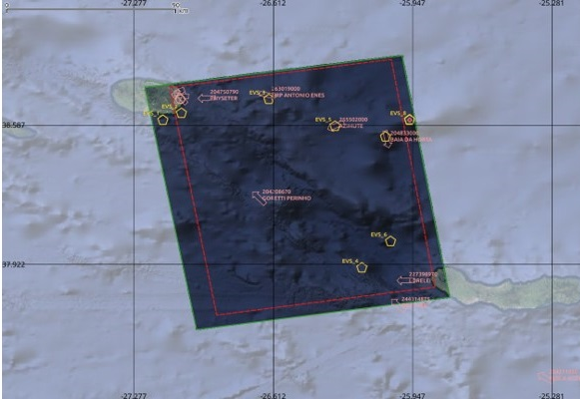
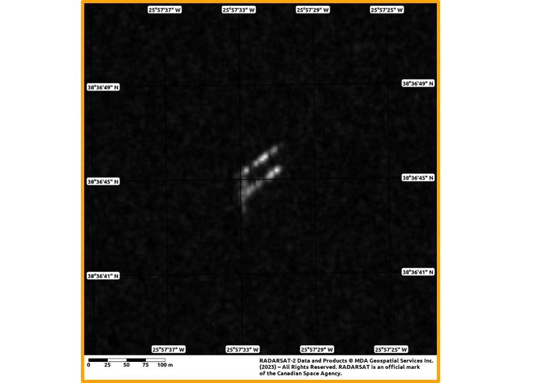
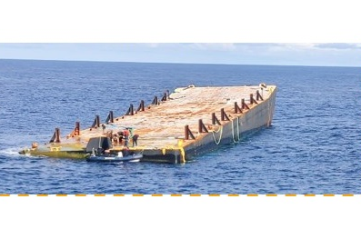
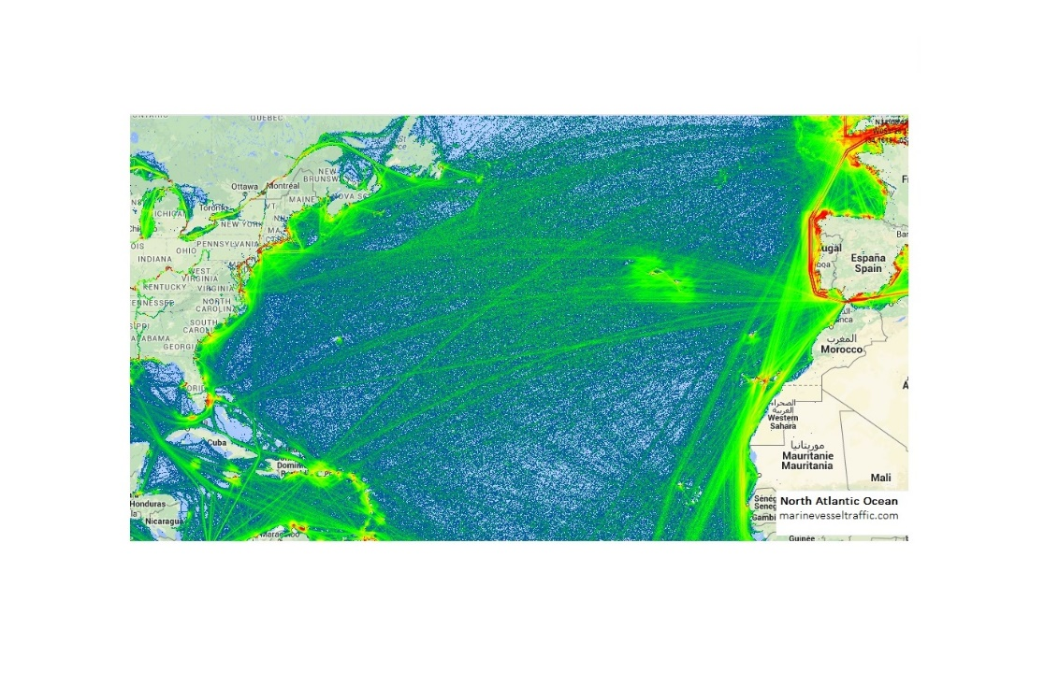
Use Case: Vessels and object detection
Emergency activation over Azores
  Target of Interest: 60 m x 15 m barge adrift
  East of Terceira (hazard to navigation)
  Azores 2023-07-23 19:50Z
  RADARSAT-2 XF SAR image:
  ~100 km x 100 km @ <5 meter resolution
  Delivery deadline: 30 minutes
  Result:
    9 vessels detected at sea
    Barge clearly visible, SAR signature matches configuration of TOI
Photo of Target of Interest (TOI)
© Marinha Portuguesa

Slide 11
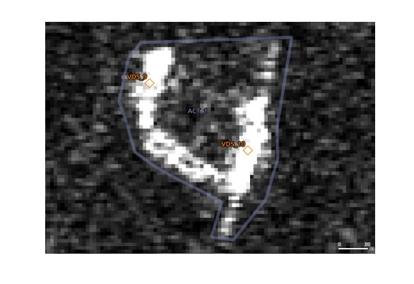
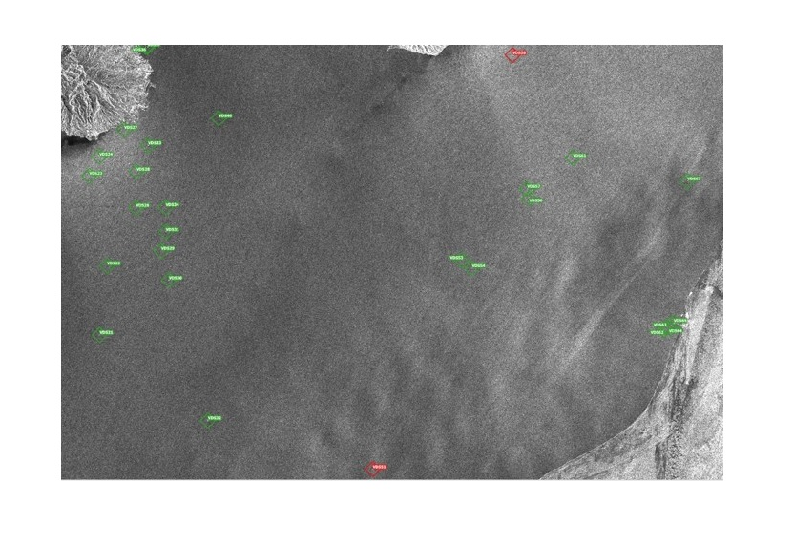
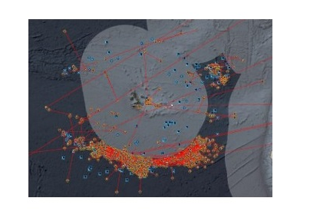
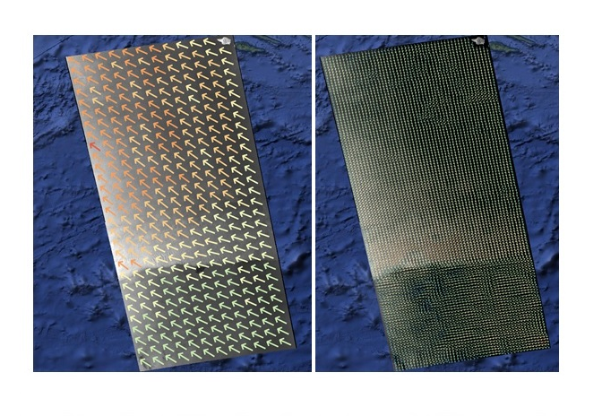
Use Case: Monitoring of (illegal) activities
Felixible and advanced monitoring
  If we can see it, we can monitor it
  All services include an analyst
  Typical use cases:
    Illegal migration
    Trafficking and smuggling
    Piracy and terrorism
    Illegal fishing
    Environmental conditions monitoring
  Intel correlation can be a paramount
Rendez-vous at sea
AIS correlation
RF Detection
SAR wind and waves

Slide 12
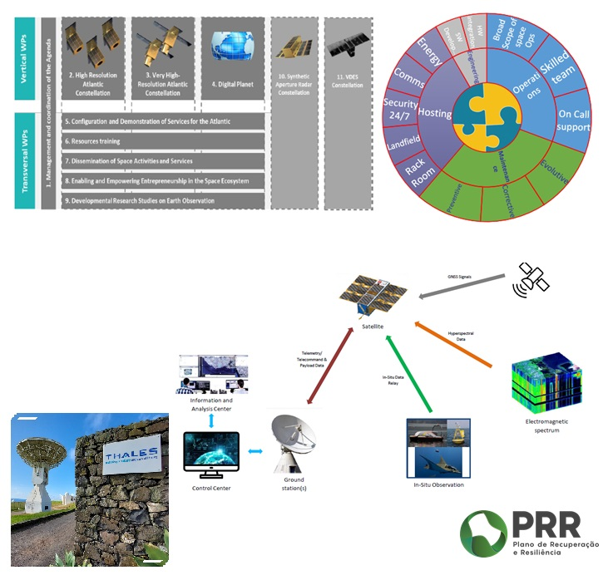
Future activities for national capabilities in support to disaster risk management
Recovery & Resilience Program
  Development of satellite constellations in support to national capabilities
  Ground-Segment support activities to ensure confidentiality, integrity and availability – Santa Maria Teleport plays a pivotal role
  Development of added-value services – benefit from 15 years of operational experience
  Integration with other EU Atlantic constellations capabilities for wider coverage

Slide 13
Contact
João Fidalgo Neves
Aerospace Manager
+351 923120911
joao.neves@thalesgroup.com

