Slide 1

CGEOMETOC
Rúben Santiago
Satellite-Derived Bathymetry
for Disaster Risk Management

Slide 2
Agenda
Maritime Geospatial, Meteorological, and Oceanographic Centre
Satellite-Derived Bathymetry (SDB): An Overview
Applications of SDB in disaster risk management

Slide 3
Maritime Geospatial, Meteorological, and Oceanographic Center
MISSION
Ensure the production and availability of meteorological, oceanographic, and geospatial information essential for the Planning, Command, and Control of national maritime operations and allied forces.
Promote Innovation, Scientific Research, and Technological Development in the fields of Maritime Situational Awareness and military GEOMETOC support products and systems.

Slide 4

Maritime Geospatial, Meteorological, and Oceanographic Center
PILLARS
Geoespatial
acquisition, processing, analysis, and representation of georeferenced information
Meteorology
forecasting, analysis, and monitoring of atmospheric dynamics and sea state
Technology
sensors, software engineering, scientific computing, databases, information infrastructure, and web services
Oceanography
forecasting, analysis, and monitoring of ocean circulation, coastal dynamics, and underwater acoustics
Operational Support
use of GEOMETOC knowledge and intelligence to support the planning and execution of military operations
Data science
involves transforming GEOMETOC information into operational knowledge and intelligence

Slide 5
Agenda
Maritime Geospatial, Meteorological, and Oceanographic Center
Satellite-Derived Bathymetry (SDB): An Overview
Applications of SDB in disaster risk management

Slide 6
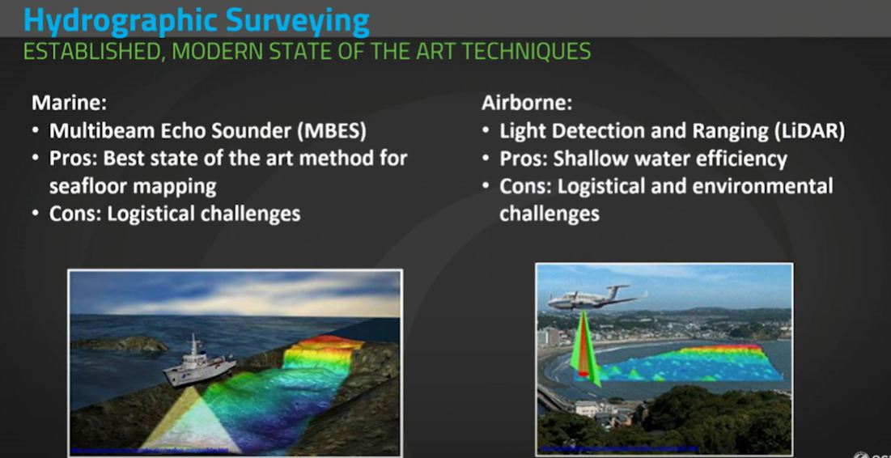
Satellite-Derived Bathymetry (SDB): An Overview
Traditional survey methods
Marine - Multibeam Echo Sounder (MBES)
Technology: Remote Sensing - acoustics
Pros: Best state of the art method for seafloor mapping
Cons: Logistical challenges and short swath in coastal areas
Airborne – Light Detection and Ranging (LiDAR)
Technology: Remote Sensing - laser
Pros: Shallow water efficiency
Cons: Logistical and environmental challenges

Slide 7
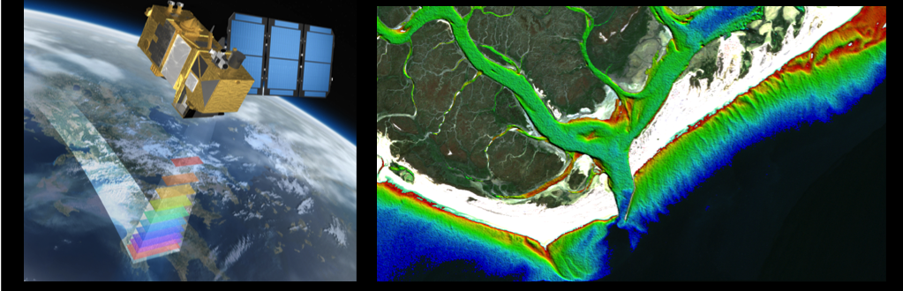
Satellite-Derived Bathymetry (SDB): An Overview
What is SDB?
Satellite-Derived Bathymetry (SDB) utilizes satellite data to estimate water depth in bodies of water such as oceans, lakes, and rivers.
The accuracy of SDB data varies and requires careful validation for use in navigation safety products.
SDB is important to identify areas that require a new hydrographic survey (for planning future surveys).
It's a complementary tool to traditional hydrographic survey methods.

Slide 8
Satellite-Derived Bathymetry (SDB): An Overview
Pros and Cons
PROS
Regional Coverage
Data often accessible (and free)
Multi-temporal coverage
Produced quickly on desktop
Often high resolution is not required
Cheap
Choice of satellite imagery input
No environmental impact or danger to personnel
Frequent data updates
CONS
Requires clear water
Cloud cover issues
Limitation in vertical accuracy
Empirical methodology
Low resolution comparing to MBES or LIDAR (m vs cm)

Slide 9
Agenda
Maritime Geospatial, Meteorological, and Oceanographic Center
Satellite-Derived Bathymetry (SDB): An Overview
Applications of SDB in disaster risk management

Slide 10
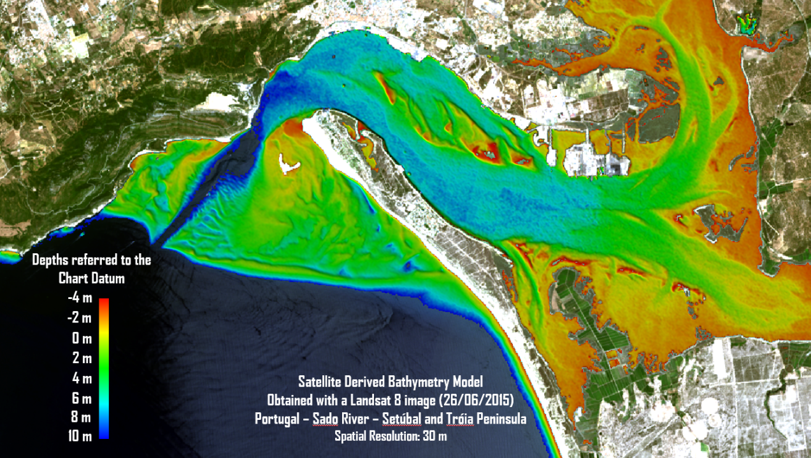
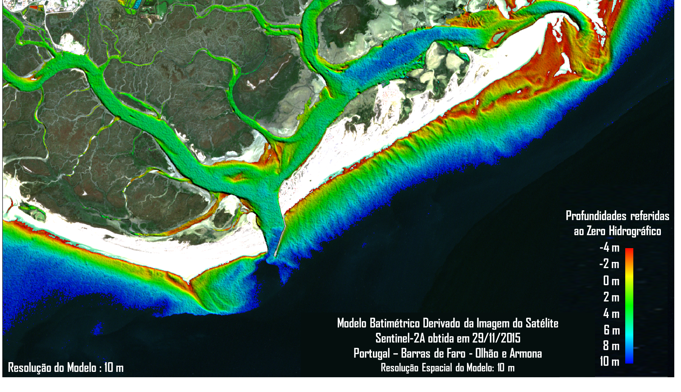
Applications of SDB in disaster risk management
Plan Safe Navigation Routes
SDB is used to map submarine obstacles, such as submerged rocks or shipwrecks, which pose navigation risks. This information is vital to ensure the safety of navigation routes and avoid maritime accidents.

Slide 11
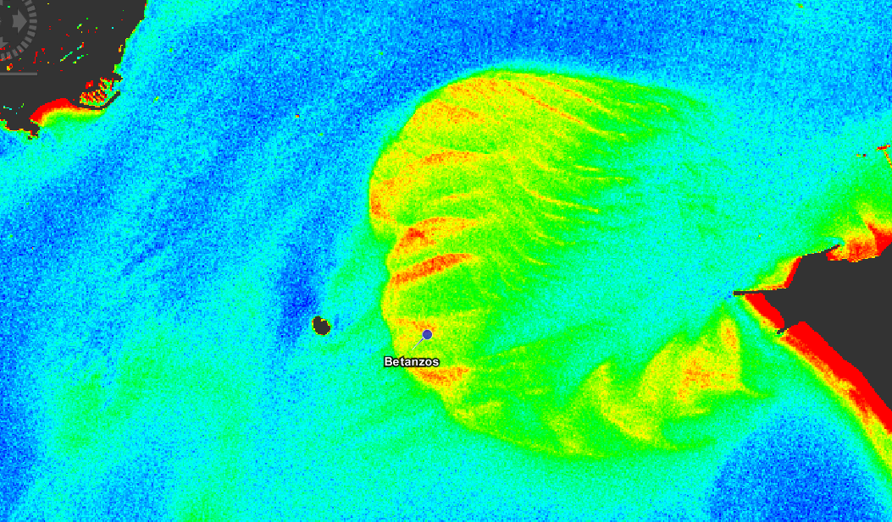
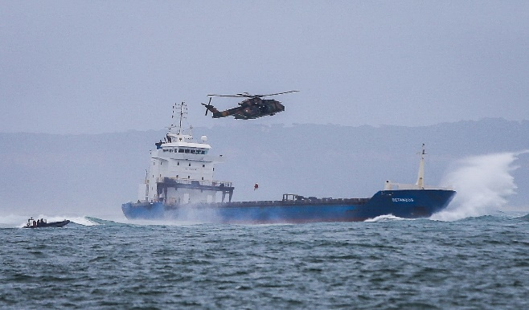
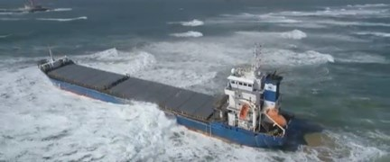
Applications of SDB in disaster risk management
Maritime Emergency Management
In March 2018, the cargo vessel Betanzos grounded, prompting ship removal operations. The Hydrographic Institute supported these efforts by supplying updated meteo-oceanographic information and bathymetric data.

Slide 12
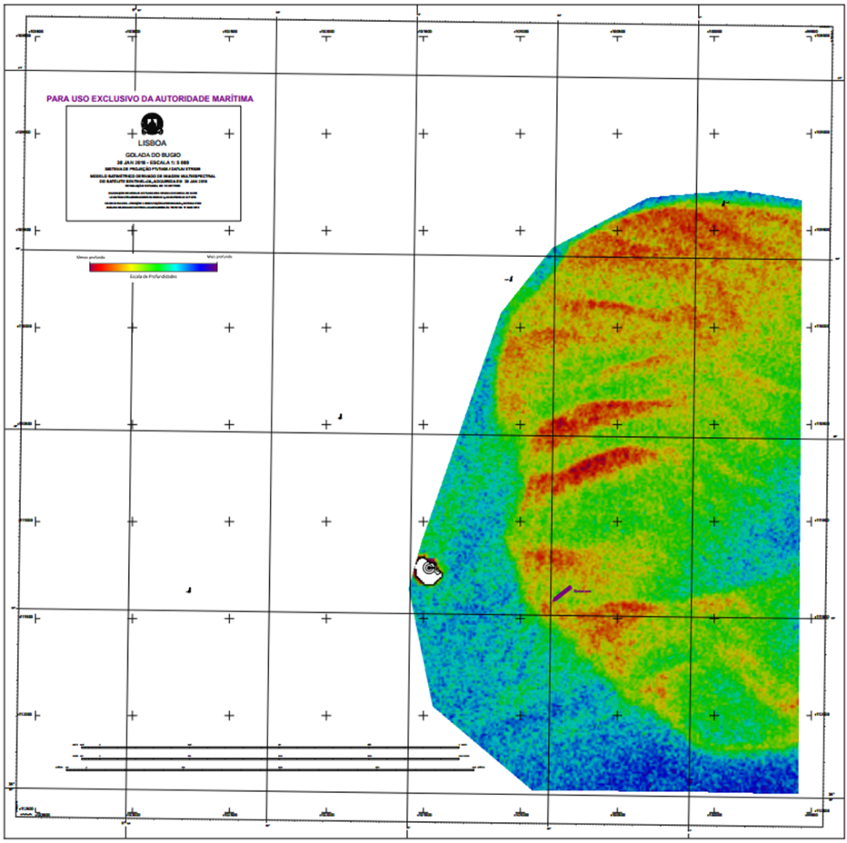
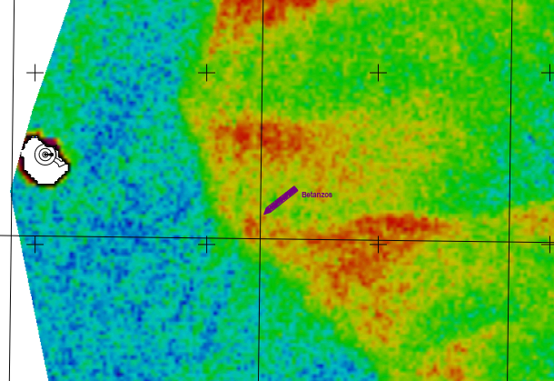
Applications of SDB in disaster risk management
Maritime Emergency Management
With SDB's detailed information, we can improve safety at sea and get ready for emergencies better. This means finding dangers in advance, making plans for emergencies, and having what we need to react quickly to unexpected events

Slide 13
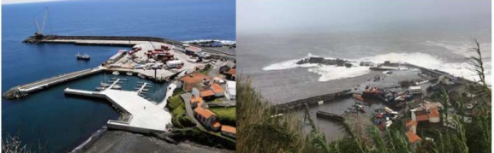
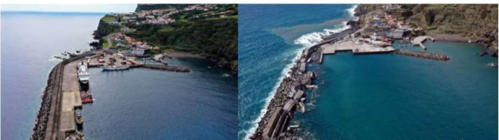
Applications of SDB in disaster risk management
Post-Disaster Response and Civilian Support
Hurricane Lorenzo in October 2019 devastated the port of Lajes on Flores Island, leaving it inoperable for months.
Before
After
Before
After

Slide 14
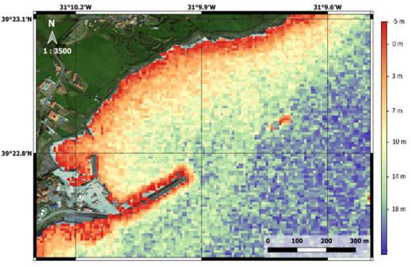
Applications of SDB in disaster risk management
Post-Disaster Response and Civilian Support
Bathymetric models with a 10-meter resolution were quickly generated to assess the damage and aid in relief efforts.
These models supported the projection of civilian and military forces into affected areas, ensuring effective support for the affected population.

Slide 15
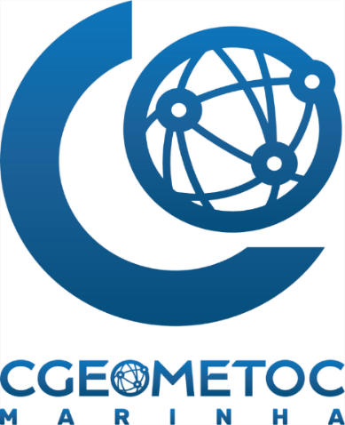
CONTACTS – MARITIME GEOMETOC CENTRE
Rua das Trinas 49, 1249-093 Lisboa, Portugal | map
Operational Support Section
  Phone: +351 213 217 541 | RTM 304 341
General Contacts
  Phone: +351 213 217 500 | RTM 304 300
  E-mail: cgeometoc@hidrografico.pt

