Slide 1
European Union Agency for the Space Programme
Rodrigo da Costa, Executive Director
14/05/2025

Slide 2




EU Space 2021-2027
GOVSATCOM
IRIS²
IRIS²
Infrastructure for Resilience, Interconnection &
Security by Satellites
EGNOS
Galileo
Copernicus
GOVSATCOM
Space Situational Awareness (SSA)
EGNOS “Makes navigation signals more accurate and trustable for Safety-critical applications”
Operational in 480+ airports & helipads in 26 countries
97% of new tractors with GNSS in Europe equipped with EGNOS
Global satellite navigation and positioning system (GNSS)
More than 4 billion Galileo receivers worldwide
Earth Observation (EO) and monitoring based on satellite & non-space data
Nr. 1 world provider of space data and information (16TB/day)
Secure satellite communications for EU governmental actors
Rapid support over crisis areas
Space Surveillance and Tracking (SST)
Space Weather Events (SWE)
Near-Earth Objects (NEO)
Sovereign multi-orbit constellation
Cutting-edge technologies focused on government service

Slide 3


EUSPA’s mission
Exploitation
Galileo and EGNOS services provision and 24/7 operations – including management, operation, maintenance, improvement, evolution & protection of infrastructure
GOVSATCOM hub and IRIS² preparation
Space Surveillance and Tracking Front Desk
Security
Security Accreditation
Security Monitoring Center operations (GSMC)
Governmental Service Provision
Key contributor in the implementation EU Space Strategy for Security and Defence
Utilization
Market development, communications, user uptake, applications, innovation
For Galileo, EGNOS, commercial use of Copernicus, GOVSATCOM, SST, and soon IRIS²

Slide 4
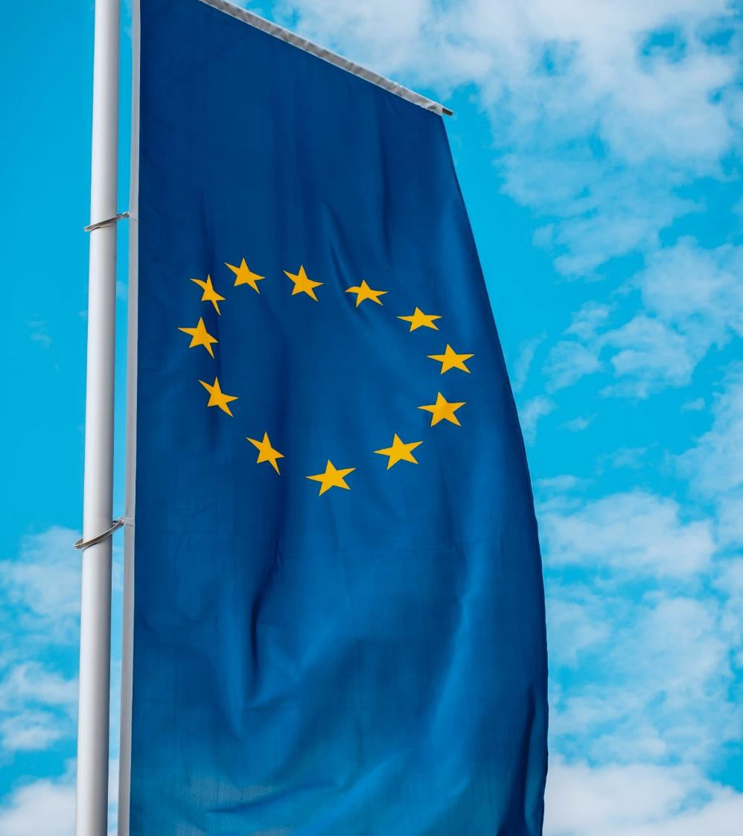
EUSPA contributes to the EU Agenda
  Stronger Europe
  Strategic autonomy and non-dependence of Europe in space
  Green Deal
  EU-space-based applications for sustainable economy, transport, agriculture, biodiversity, energy, smart cities, etc.
  Digital
  Security of EU Space, uninterrupted high capacity connectivity everywhere, IoT
  Resilience
  Innovative space downstream sector

Slide 5
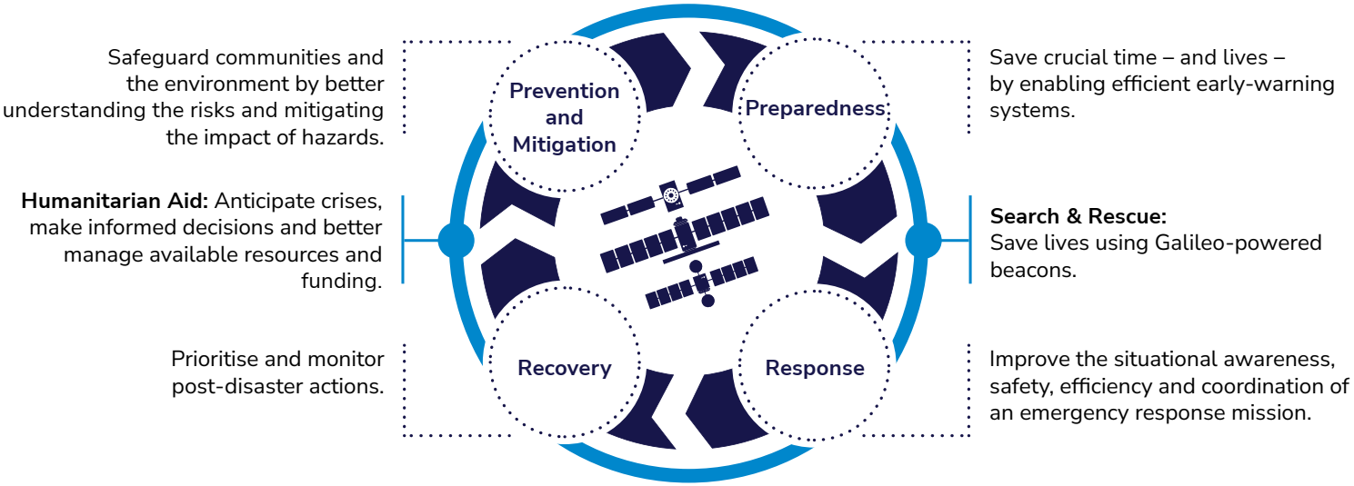
Space and disaster management in natural and man-made disasters
Availability
Resilience
Stability
Accuracy
Example applications
Impact exposure analysis
Hazard monitoring
Asset management
Crisis area assessment
Health and medicine response & coordination
Post-crisis damage assessment
Restoration of supply chains
Management of refugee camps etc….

Slide 6



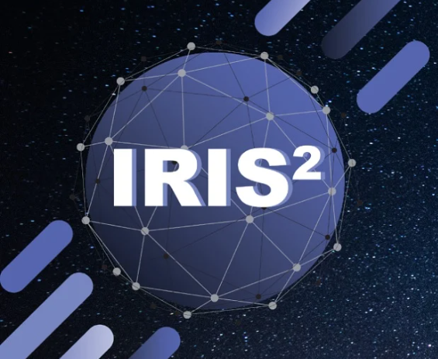

EU Space and disaster management in natural and man-made disasters
Copernicus
Galileo/EGNOS
Supporting downstream development with cloud-based infrastructure – see DIAS
Navigating responders (and autonomous vehicles/drones) on the field
Receivers accurately detect earthquakes, landslides, land deformations & tsunamis
Enable asset management applications for more efficient response
GOVSATCOM/IRIS²
Secure Connectivity to first responders and humanitarian aid actors, enabling secure and resilient communication and data transmission services
Delivering a treasure of free, open and accessible Copernicus data to assess, detect and monitor hazards
Galileo Early-Warning Satellite Service (EWSS) and Search-And-Rescue Service (SAR)
Operational Copernicus Services -> Emergency Management Service, Security etc.
EU Space Surveillance and Tracking
Coordination with civil protection and maritime authorities for uncontrolled re-entries

Slide 7
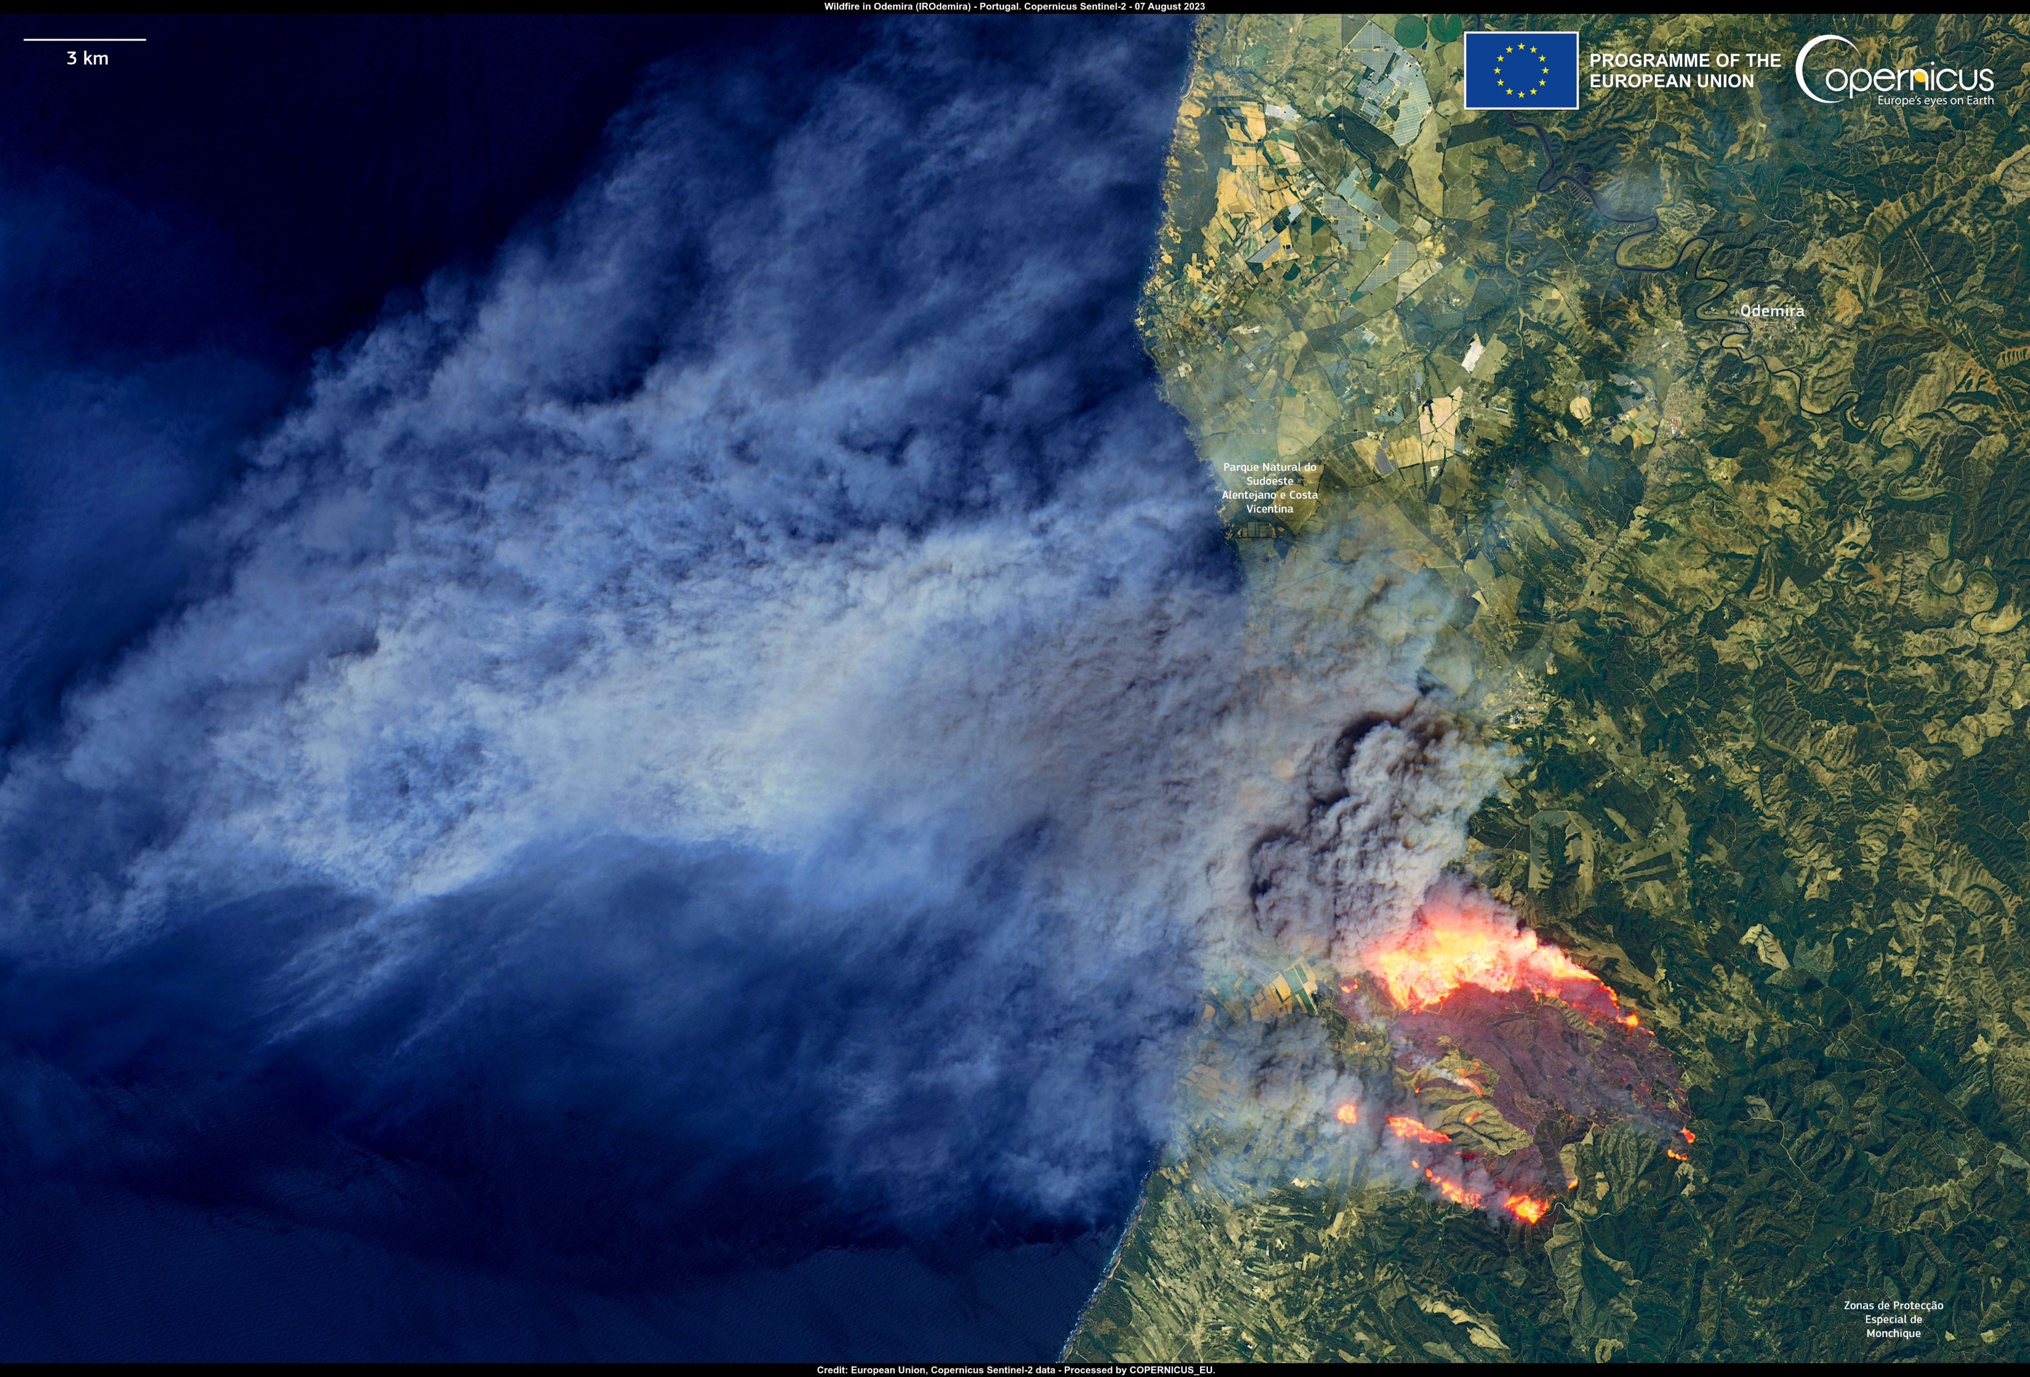
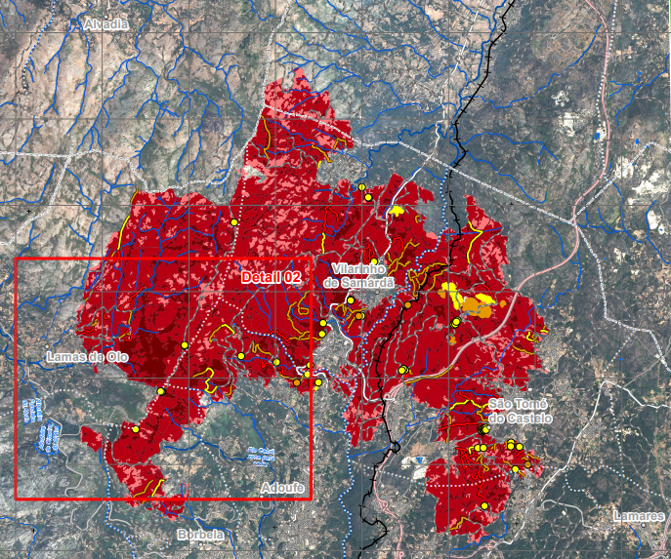
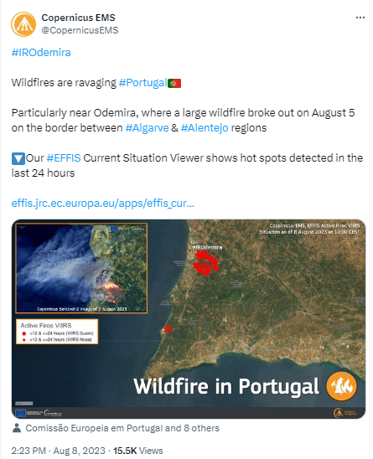
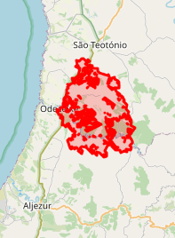
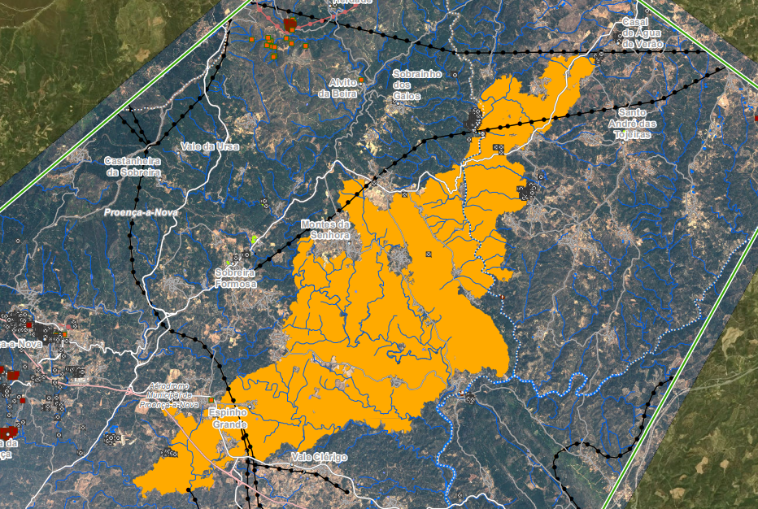
Burnt area delineation
24/08/2022 - VILARINHO DE SAMARDA
Burnt area delineation
06/08/2023 - CARRASCAL

Slide 8

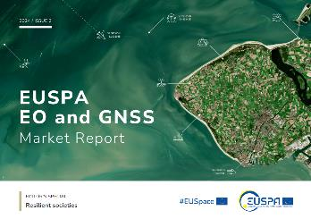
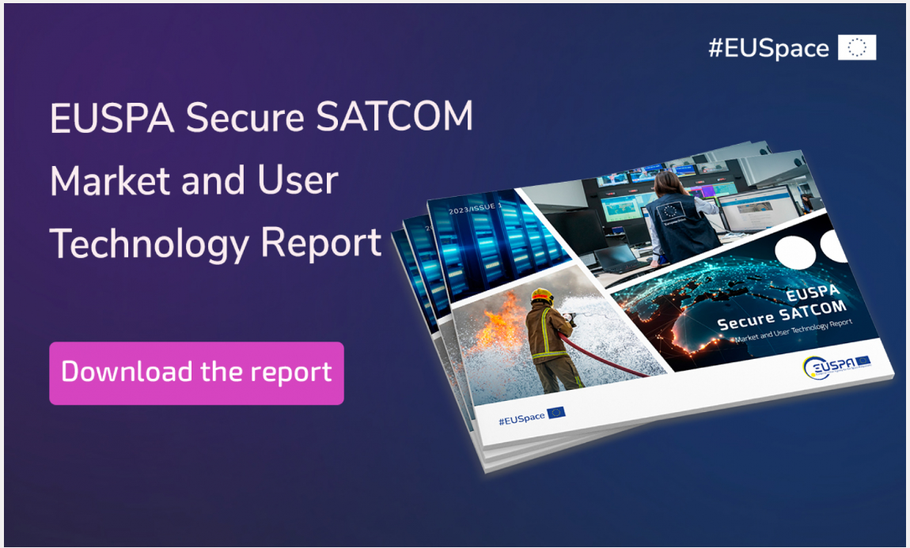

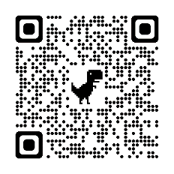
EUSPA Market and User Reports
EO and GNSS and Secure SATCOM
Synergies of >180 specific applications fully analysed and categorised

