Slide 1
Space for Arctic
Laurent Jaffart
Directorate of Connectivity and Secure Communications (D/CSC)
ESA Space for Arctic workshop:
Accelerating the use of Space for climate action & Civil Protection,
Policy Panel, 3 July 2024
V03
ESA UNCLASSIFIED – Releasable to the public

Slide 2
The Arctic: A rapidly changing landscape of strategic importance
Arctic = Laboratory to quantify/monitor rapid changes in our climate
Arctic = Strategic Geopolitical Environment
Opening of Maritime Transport routes + Natural resources
-> Need More Space for a changing Arctic
(e.g. real-time situational awareness from space
for safer tactical/autonomous navigation)
Notes:
A unique Laboratory to quantify our Planet climate
Acceleration of Climate Change in Polar regions
Melting of sea-ice + Permafrost + Ecosystems change, see Essential Climate Variables (ECVs)
Regional Change - Global Impact: what Happens in the Arctic does not stay in the Arctic (teleconnections)
A Strategic Geo-political Environment
Opening of shorter global shipping routes (due to melting)
Enhanced exploitation of Natural Resources (e.g. fishery, Oil&Gas, Minerals)
Growing maritime transport + tourism - safety of navigation, need for situational awareness and connectivity.
Geopolitical environment / Regional Security
The Arctic is an emerging theater of strategic importance. Opening sea lines of communication and increased access to Arctic resources are forcing decision makers to address regional challenges. The reemergence of polar power competition, coupled with rapid climate change, is changing the strategic demand for space capabilities within the region.
Space = unique role to securely monitor and connect such a vast and remote environment,
-> Space tech supports EU / Arctic policies on climate change, SDGs and Int Cooperation
-> More Space needed due to changing Arctic landscape (e.g. safer tactical / autonomous navigation)

Slide 3
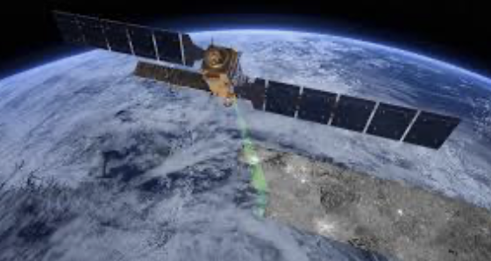
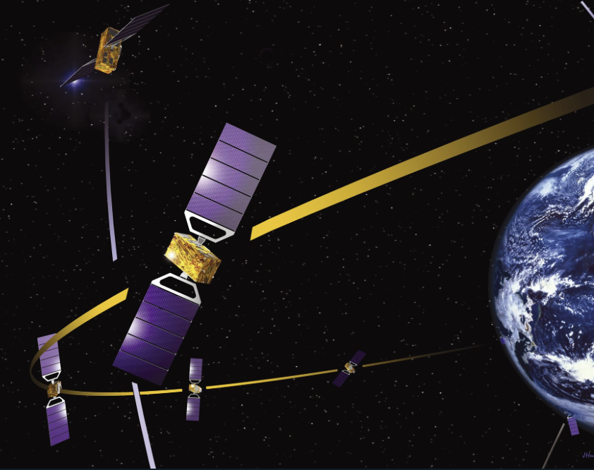
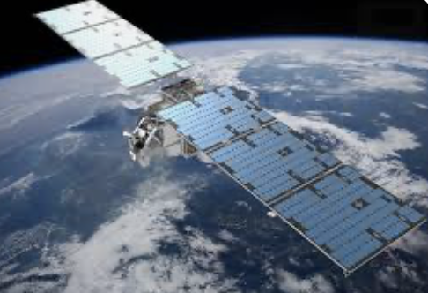
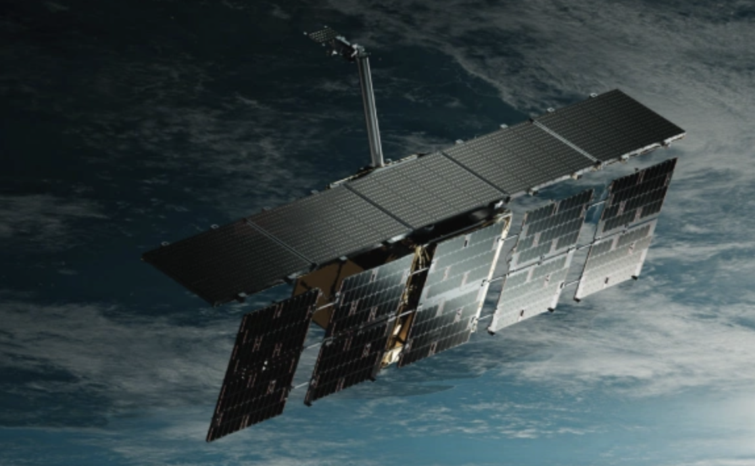
Space for the Arctic - Key European capabilities
Earth Observation (EO)
High-speed Broadband secure Connectivity
Accurate timing, positioning, Nav
Global Monitoring
Copernicus
Arctic Weather Sat
SatCom + GovSatCom + 5G/6G Direct2Device + Inter-sat Links
Arctic Sat Broadband Mission
High-precision GNSS + Emergency Warning
New Space
ICEYE
-> Need for end2end space solutions with ultra-low latency
-> Need to ensure European sovereignty in the Arctic
Notes:
SatCom Connectivity
Need for secure connectivity
EU GovSatCom initiative for “pulling & sharing"
From low to high bandwidth e.g. Arctic Sat Broadband Mission (ASBM) -> https://www.eoportal.org/satellite-missions/asbm#missioncapabilities
Emergence of “Direct2Device” connecting local communities
+ Intersat optical links
Earth Observation (EO)
Global Monitoring
EU capabilities: Copernicus (Sentinels) + Contributing missions + Met missions + Earth Explorers (e.g. CryoSat2, Swarm)
Commercial - New Space (e.g. IceEye, Spire, Planet, Ororatech)
Arctic Weather Satellite! https://www.esa.int/Applications/Observing_the_Earth/Meteorological_missions/Arctic_Weather_Satellite
SatNav
Positioning. Navigation and timing
Galileo
Search & Rescue
Emergency warning service – payload that sends messages directly to devices.
-> Need for integration of space capabilities to capitalise on synergies and develop the next generation of space-based solutions, services and business opportunities
-> Need to ensure European sovereignty in the Arctic, e.g. avoid relying exclusively on non-European solutions (e.g. Starlink, GPS, US new Space)
Antennas, jamming resilience, Dual Use technology are needed even if the may have commercial usage first

Slide 4
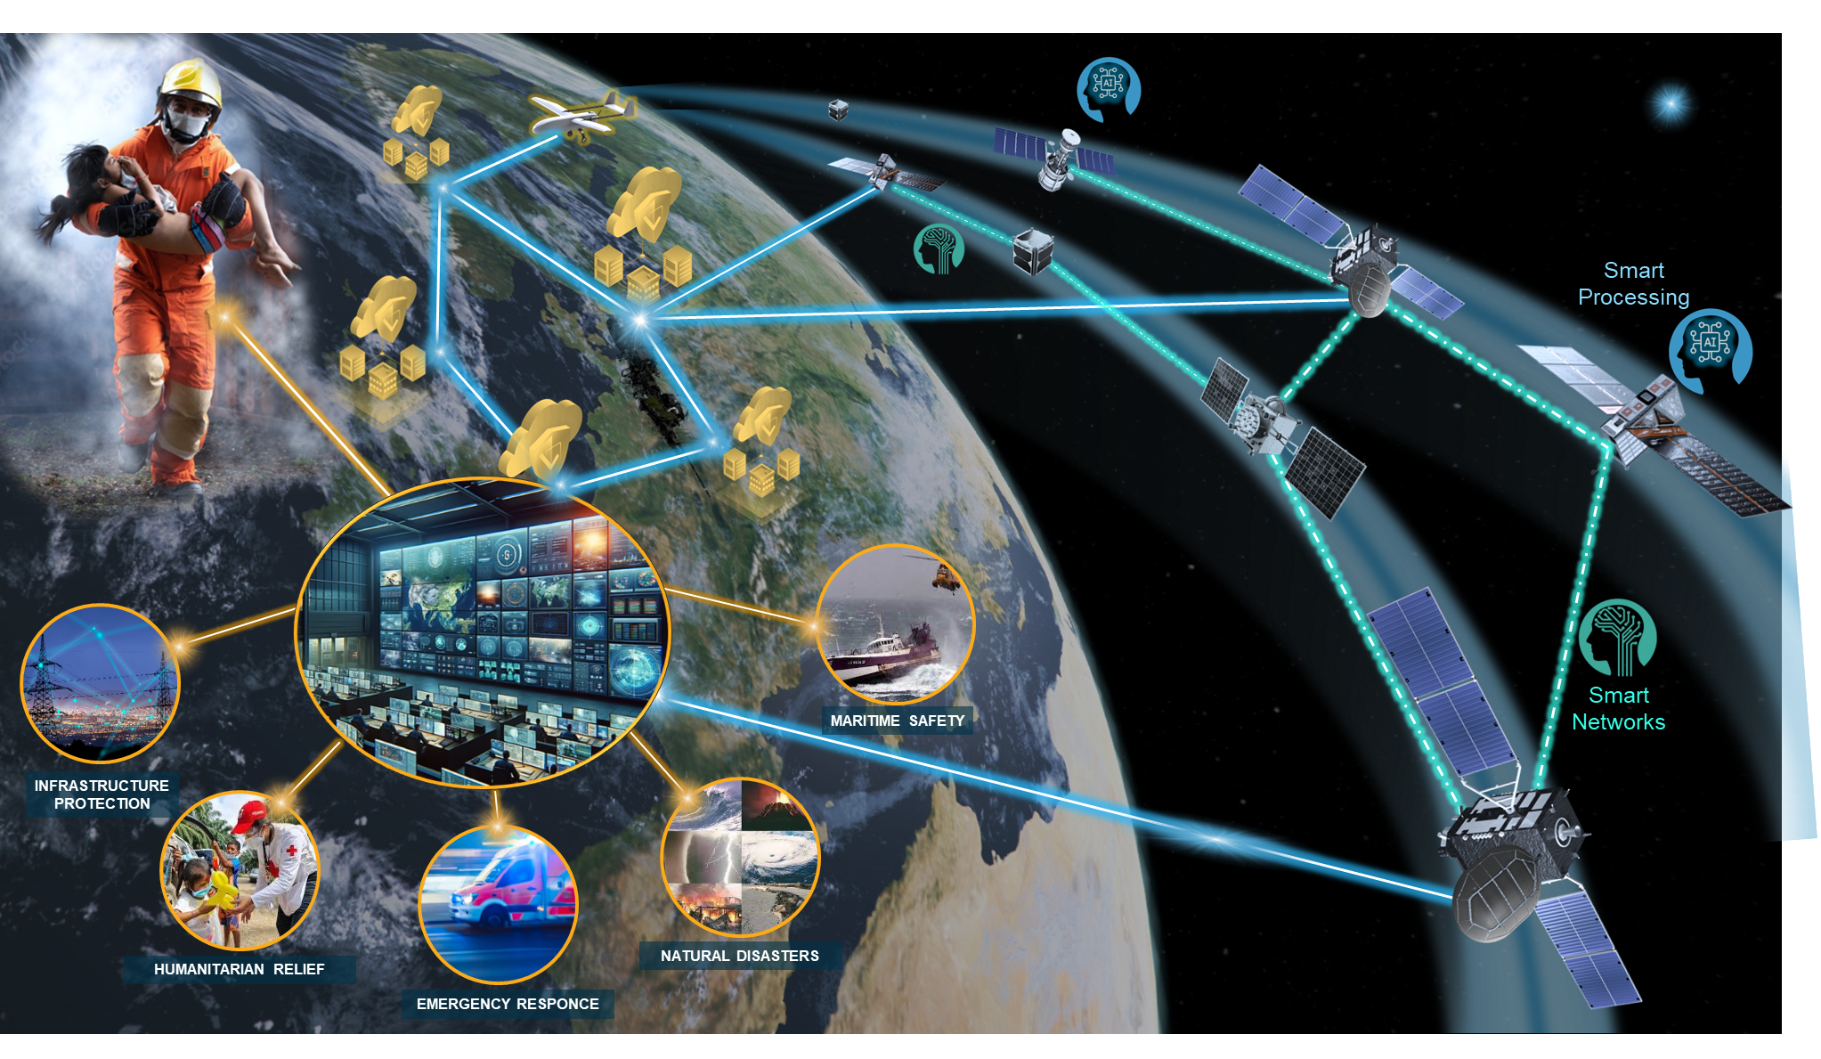
Towards an integrated system for space-based rapid response
Civil Security from Space (CSS) Hub
Orchestrating observing systems, e.g. EO, drones, IoT
Deliver situational awareness to users
Fostering a “digital market place”
AI factory for Big Data mining
Notes:
Civil Security from Space (CSS) Hub
Connecting / Orchestrating a suite of observing systems, such as EO, drones, IoT
Rapidly mining big data to extract “actionable” information with AI with real-time information
Deliver information & augmented situational awareness to the users, even within the field (e.g. bridging the last-mile gap)
Fostering a “digital market place” to access new generation of space services (e.g EO, SatCom, Nav, …)
Building New Partnership with user communities, int organisations and industry

Slide 5
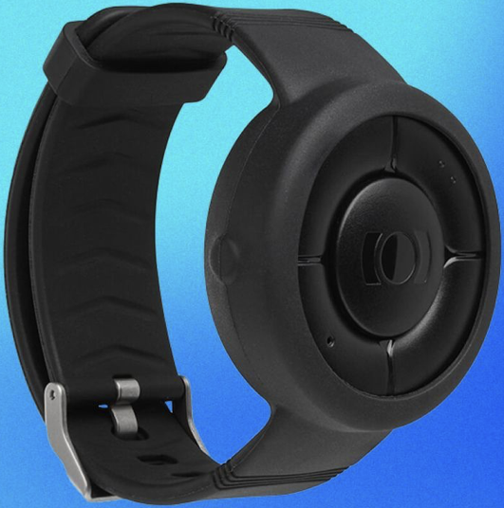
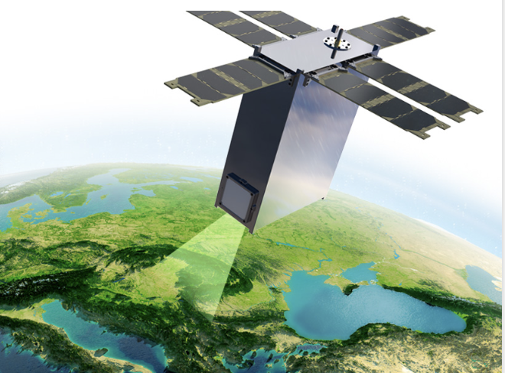
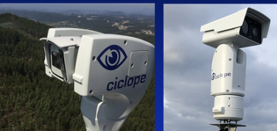
Example of Civil Security from Space (CSS) partnership projects
SatNav - Wearable indoor & outdoor positioning (Epic Blue)
CSS System (Hub) Integrating/ orchestrating
EO New Space
Hyper spectral (KuvaSpace)
SAR (ICEEYE)
Broadband
Connectivity
IoT - Video Surveillance to detect fire (CICLOPE)
Notes:
Smart Connect
Cosmos
Norway could join
KuvaSpace - Finland
Polish Hub - IceEye
Epic Blue – Belgium
Wearable for triangulations
Pb of bandwidth in the middle of fires

Slide 6
Part 2:
Focus on New Disruptive Tech
in Connectivity
ESA UNCLASSIFIED - For ESA Official Use Only – ESA Delegations

Slide 7
Disruptive New tech have been triggered and maturing over the last years thanks to ESA and its Member States
Software Defined Satellites: density of coverage, ability to dynamically change coverage (e.g. Novacoms I & II)
Focus on the ground segment for multi-orbit applications and usage (e.g. 5G-EMERGE)
AESA for User Terminals (single/multi orbit reach, single/multi frequencies) (e.g. AIDAN, Sunrise)
Optical technologies (e.g. EDRS, OISLs, QKD, Hydron)
Direct to Device, the “holy grail”, is becoming a reality and creates a new growth avenue(s):
Some existing infrastructure (Iridium, Lynk Global, Globalstar, Inmarsat, Starlink): Safety services, Tracking, IoT
Clear link with terrestrial operators
Clear link with the chipset manufacturers

Slide 8
CM25 Response to Europe’s Connectivity Needs
MOBILE CONVERGENCE
Direct to Device*
IRIS^{2 (tbc)}
QUANTUM NETWORKING
INDUSTRIAL COMPETITIVENESS
QUASAR*
SAGA*, QKD*
STELLARIS*
Core Competitiveness*
INTERPLANETARY CONNECTIVITY
SPECTRUM SUSTAINABILITY
Moonlight
SolarNET / Assign*
CleanWaves*
GOVERNMENTAL CONNECTIVITY
IRIS²
Civil Security from Space
Mix of New & Continuation
* ARTES Programme
Directorate of Connectivity and Secure Communications
Notes:
IRIS2 is a game changer and will impact the whole EU Industry European and Future leadership through Interplanetary connectivity (Moonlight / SolarNet

Slide 9
Key Takeaways
The satcom market is experiencing a deep, disruptive, and extremely fast transformation
European industry is lagging behind – in particular for low TRL / low MRL
The 6 Connectivity Pillars are established to answer to satcom needs, with a clear focus to
Support European industry competitiveness worldwide
Address growing societal needs for resilient terrestrial-integrated connectivity, secure communications and increased European sovereignty
Regain European leadership
ESA as an inter-governmental agency can link intitatives in Europe.
The unique geographical position of the artic nation calls for adapted solutions
Common needs calling for joint answers.
Could we imagine a joint CSS Hub federating artic nations?
Bringing Vision → Near-Ready → Ready Now

Slide 10
Thank you

