Slide 1
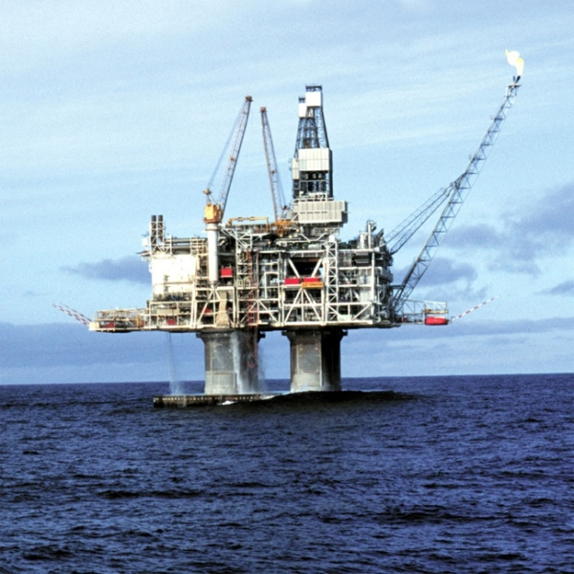
Maritime Surveillance for Civil Security
Presented to: ESA Space for the Arctic
July 2, 2024

Slide 2
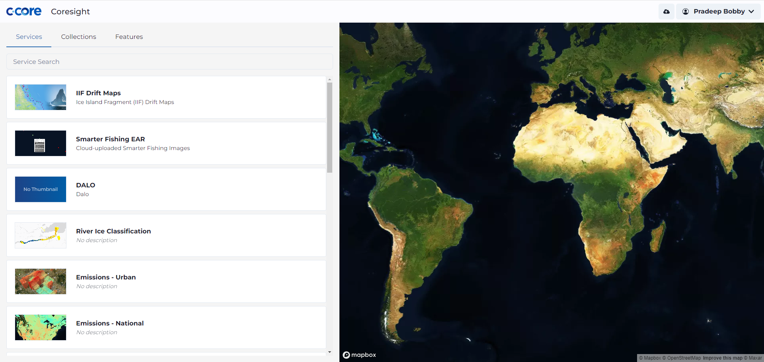
C-CORE Approach
Partnerships
Architecture
R&D + Services
Data Agnostic

Slide 3
>60 satellites
12 constellations
8 providers
Demonstration programs in 2021, 2022 & 2024
Marketing vs reality
International collaboration for maritime surveillance
Situational awareness platform
Mission control centre

Slide 4
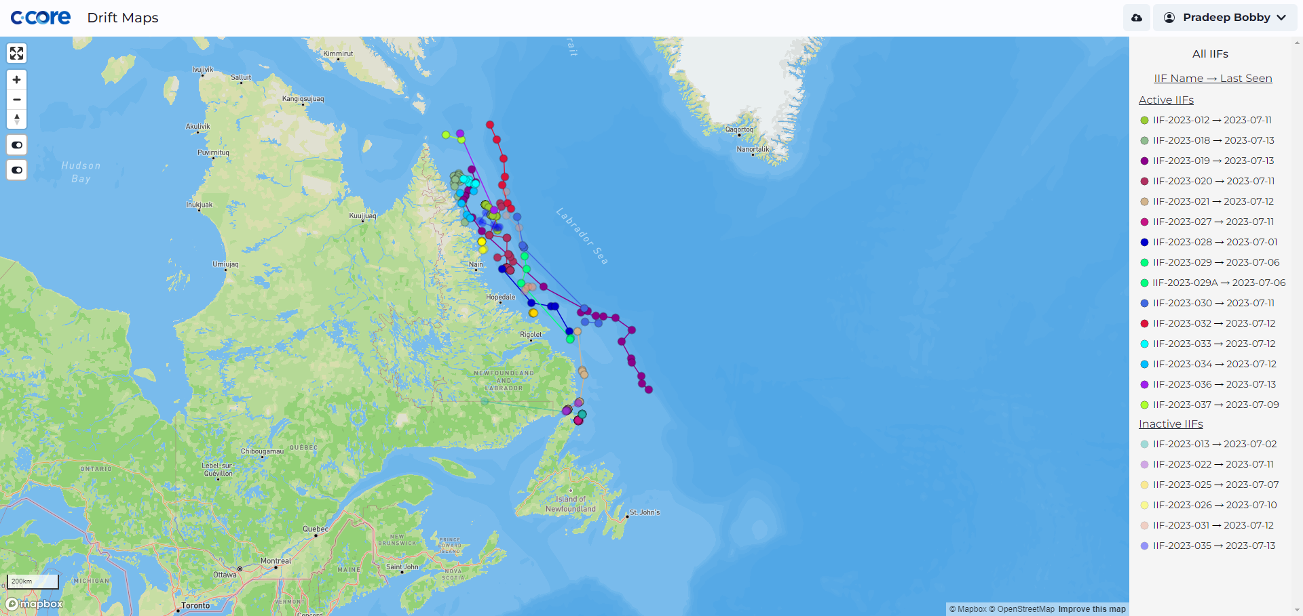
Situational Awareness
Research and services delivered through in-house Coresight platform
Data management
Product creation (processing pipeline)
Product delivery
Data curation
Algorithm environment for code sharing and rapid development

Slide 5
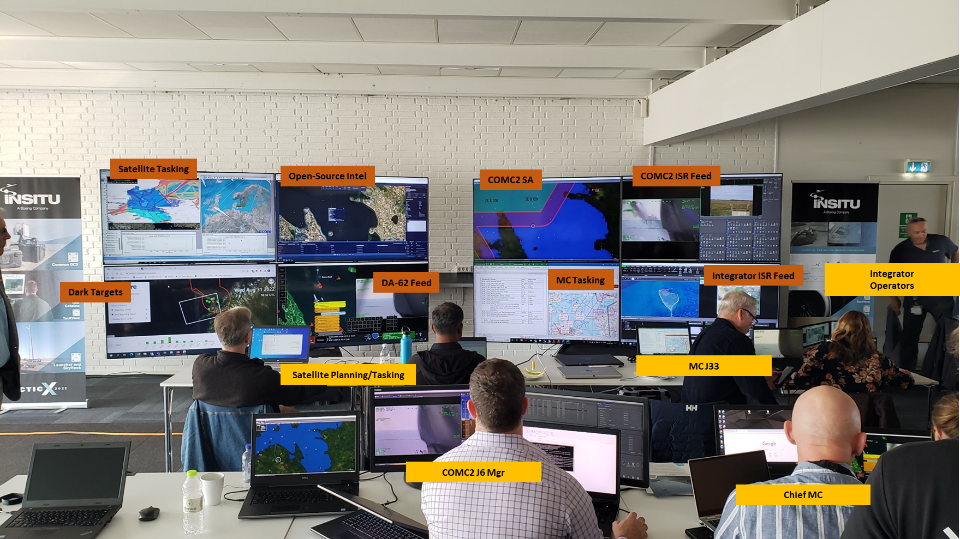
Mission Control Centre

Slide 6
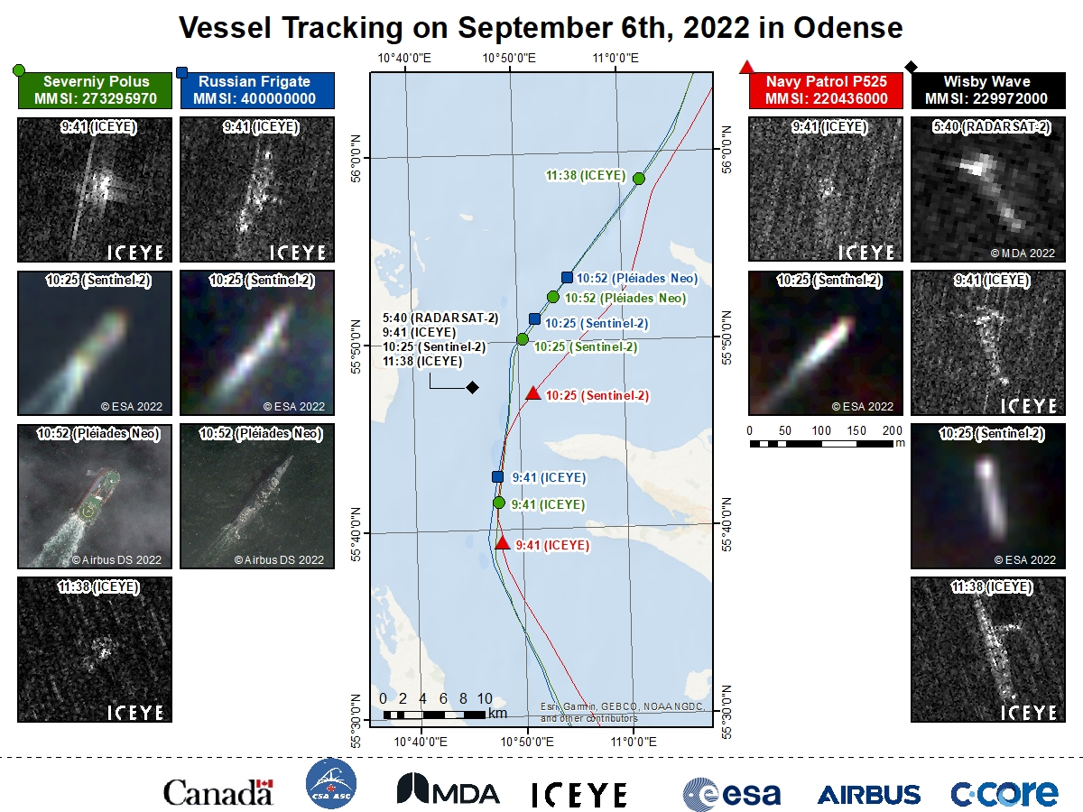
Maritime surveillance uses freely available and commercial data
Free/public data useful for baseline surveillance
Commercial data for higher resolution/gap filling
Taskable commercial data for follow up on suspicious activity

Slide 7
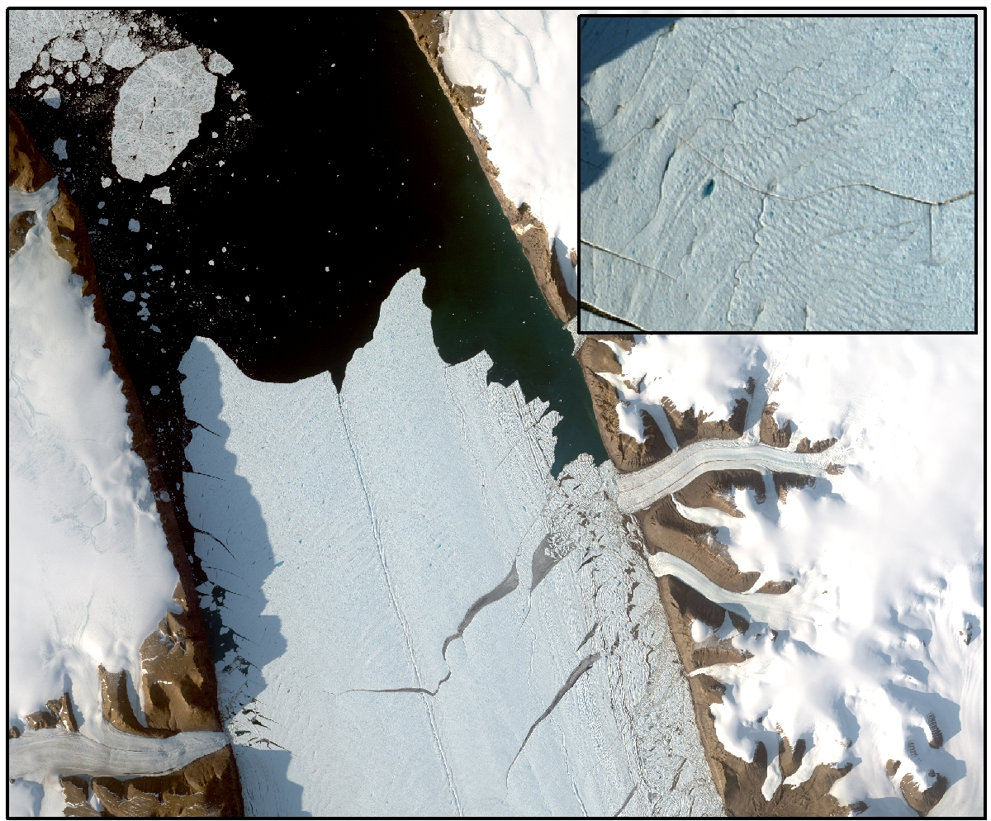
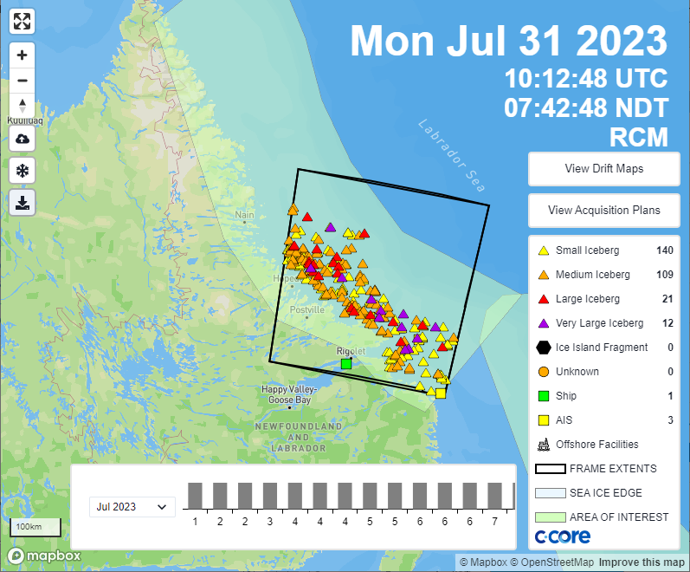
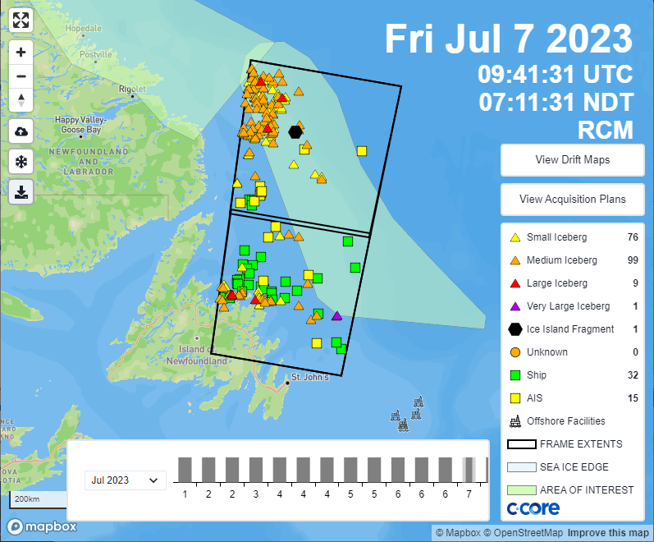
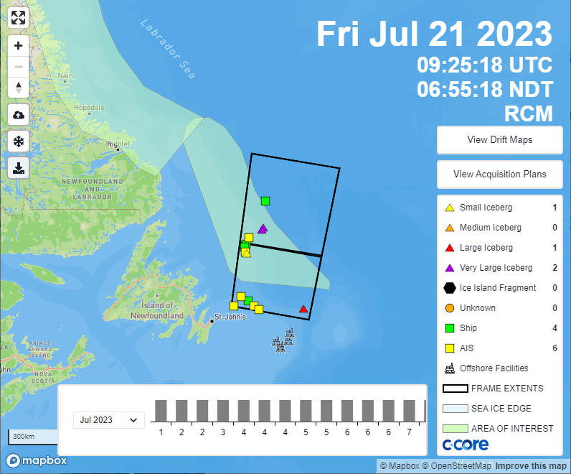
Infrastructure Protection – Ice Management
Newfoundland offshore
25% of provincial revenues
1687 personnel offshore, 2836 offshore
~205,000 Barrels production/day
Satellites provide advance knowledge of ice conditions and are used to coordinate other assets
Satellite reports integrated with vessels/aircraft surveillance

Slide 8
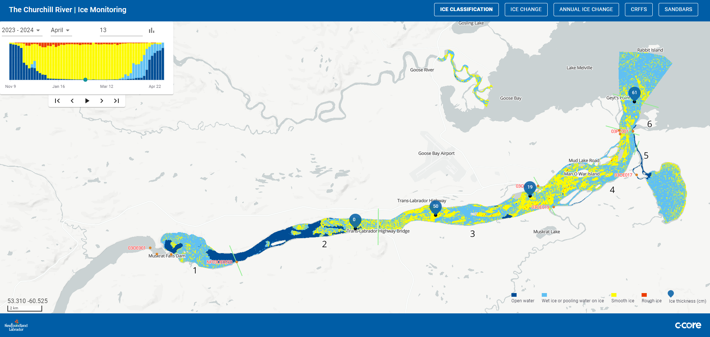
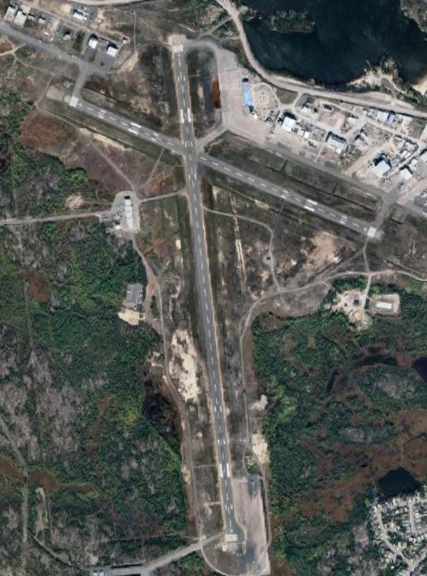
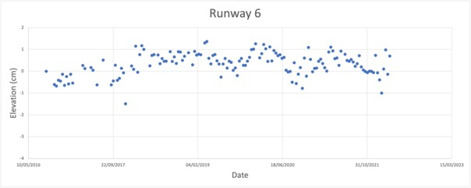
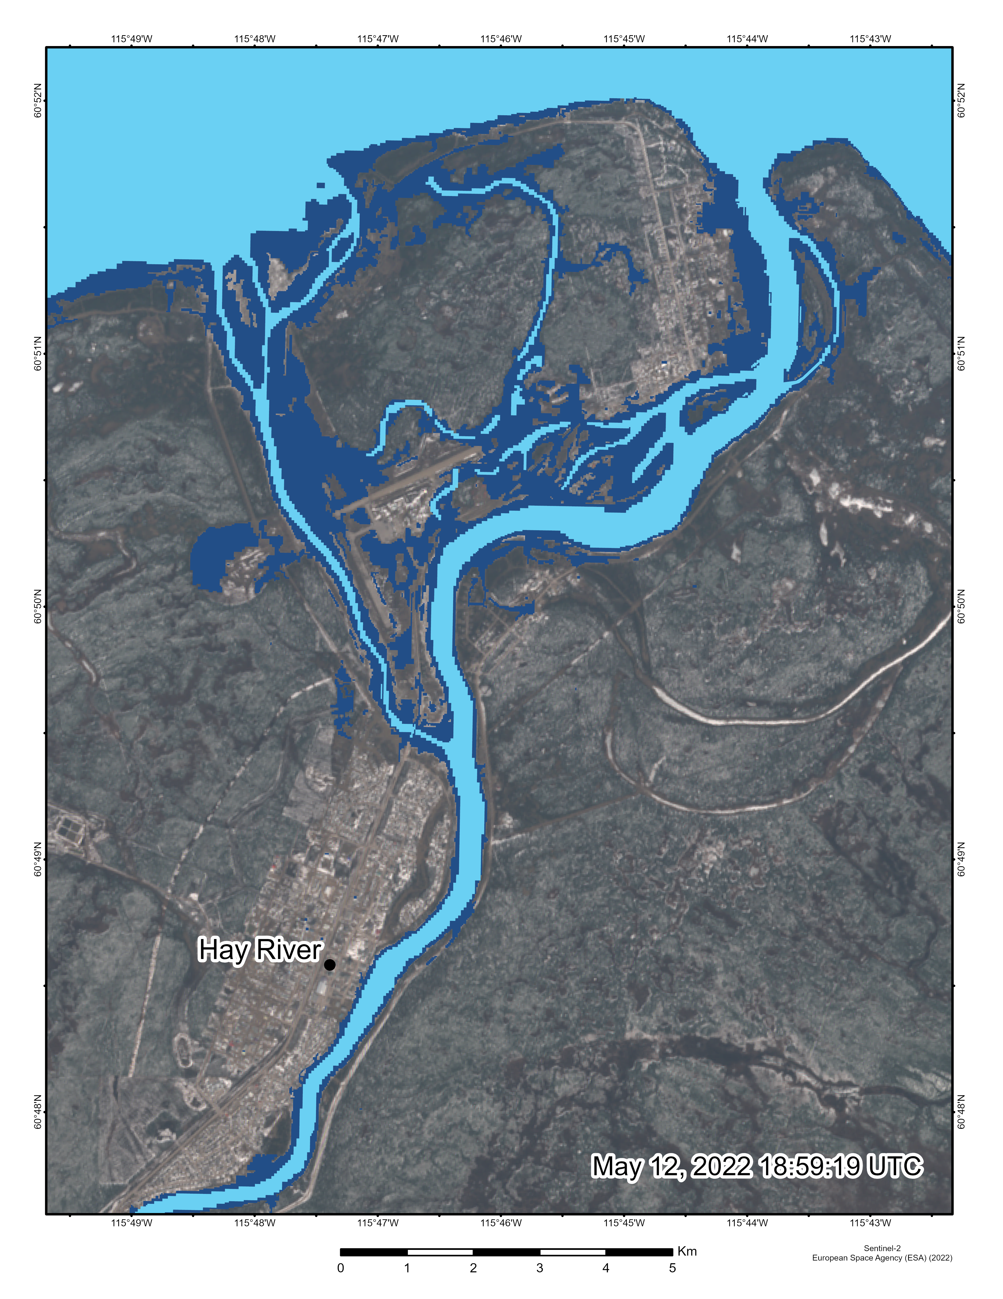
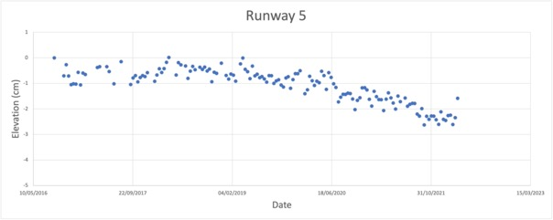
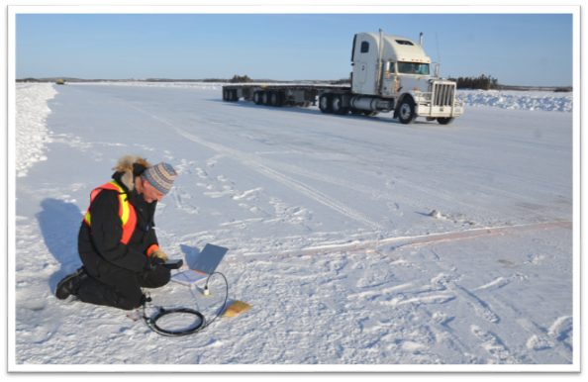
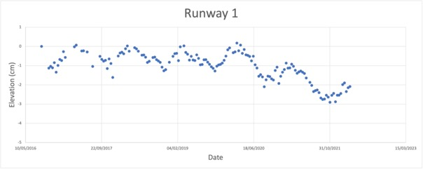
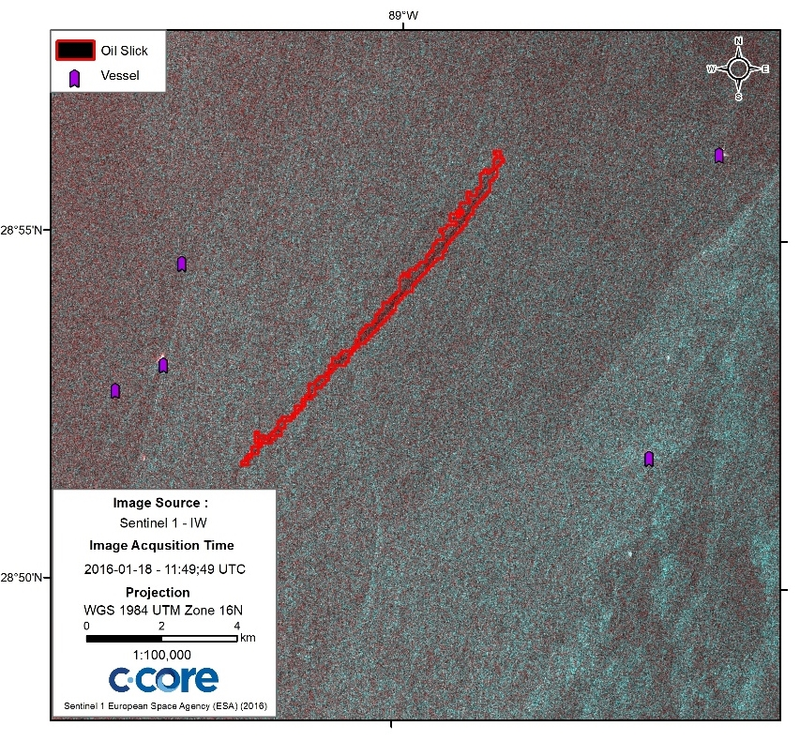
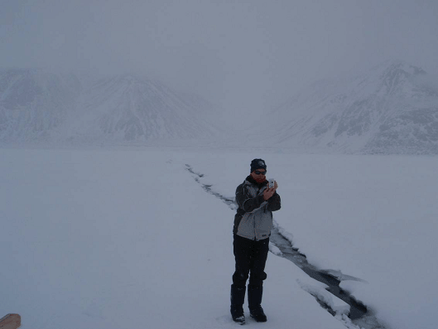
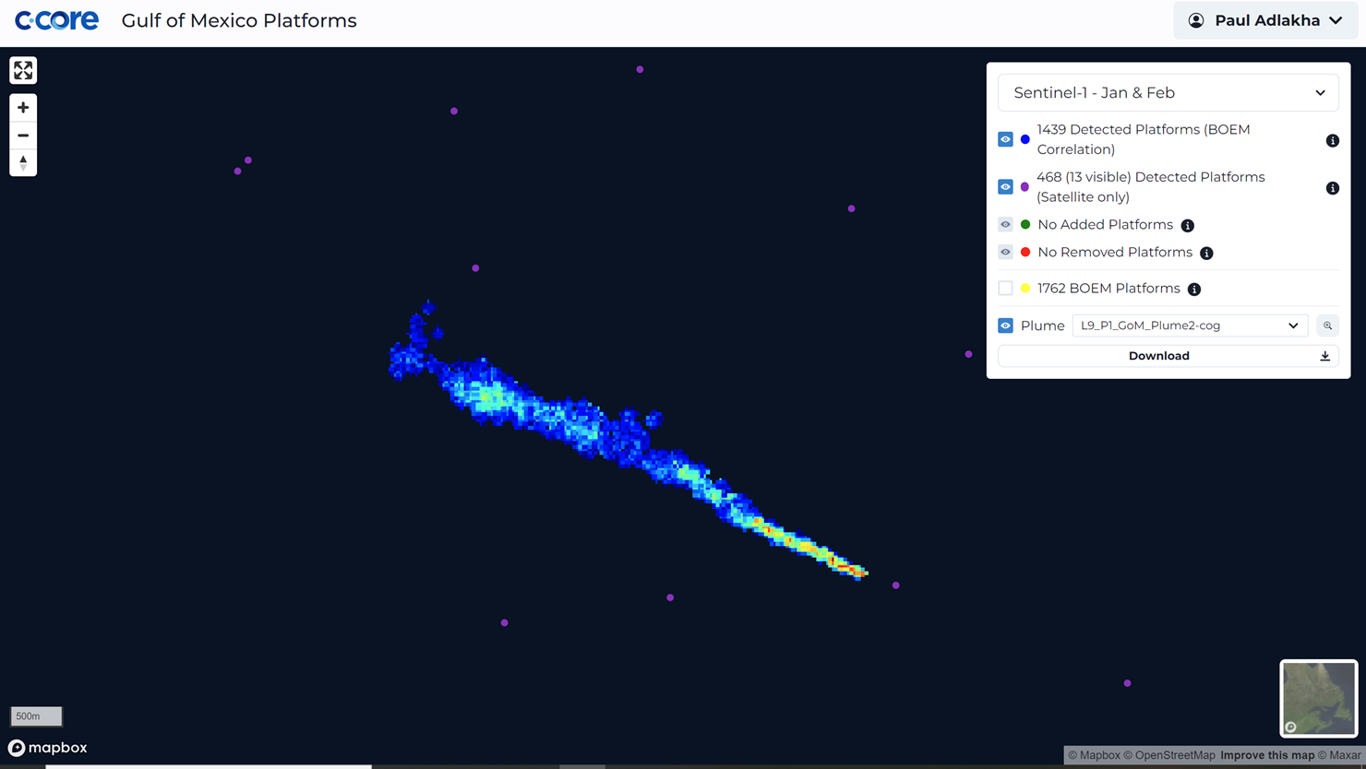
Maritime surveillance is just the beginning…
Anything is possible when you have the right partners, architecture, data and development
River ice/flood prediction
Flooding
Ice roads
Northern roads and runways
Emissions
Sea ice transportation
Oil spills

