Slide 1
Space for weather, ocean and climate
Roar Skålin, Director General, Norwegian Meteorological Institute

Slide 2
The importance of ‘Space’ for monitoring and forecasting in the Arctic
The Arctic is among the most challenging places to monitor, due to the vast, remote area.
Space-based observations are essential to monitor the Arctic, specifically given the rapid changes through climate change.
Weather and ocean forecasting in the Arctic heavily depends on the space-based datasets.
Several new satellites will become available soon
Arctic Weather Satellite and EUMETSAT Polar System – Sterna (TBD 2025 by EUMETSAT)
Three Copernicus Polar Expansion missions:
CIMR, Copernicus Imaging Microwave Radiometer, sea ice and sst
ROSE-L, L-band SAR, For the Arctic: sea ice types, ice sheets and glacier velocities and snow water
CRISTAL, altimetry for the ocean and Cryosphere, snow and ice
EUMETSAT

Slide 3
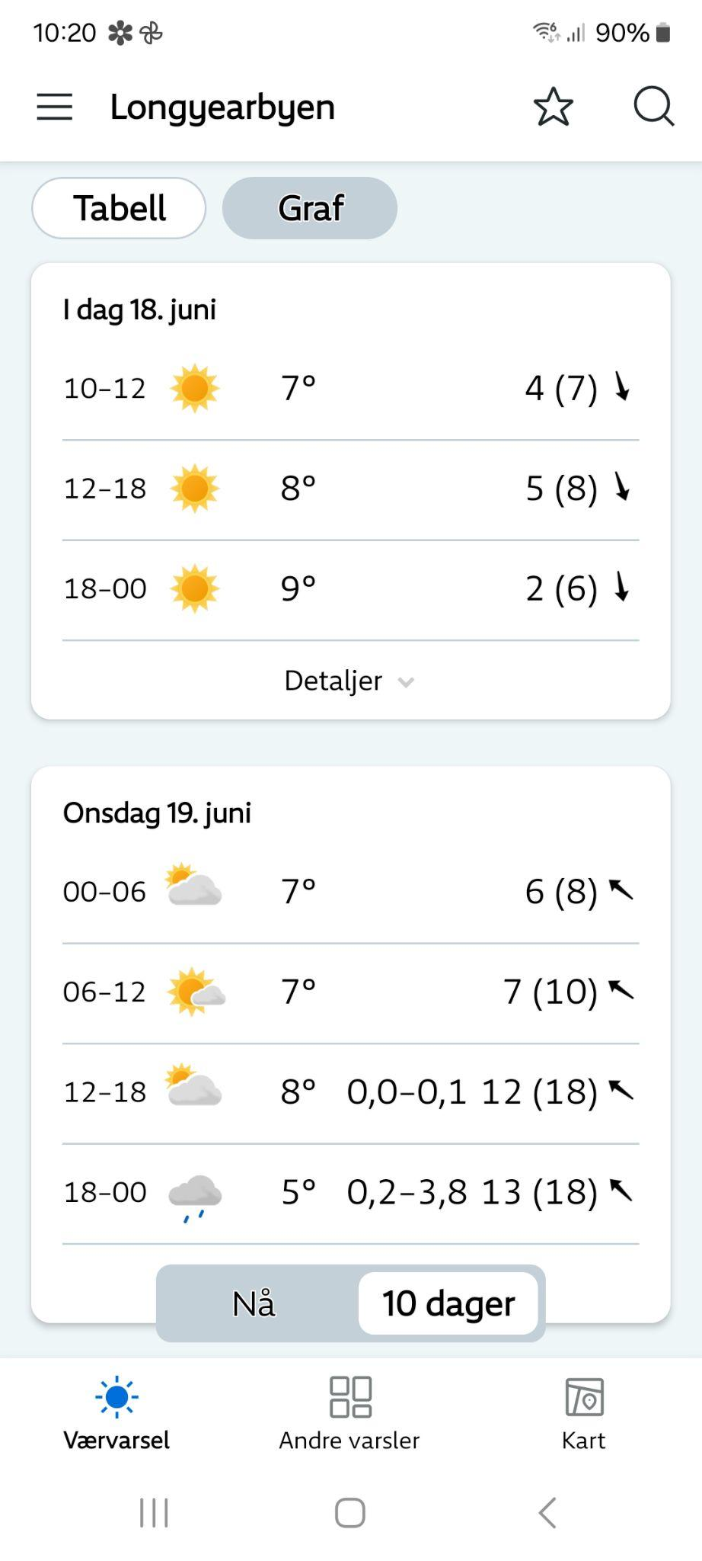
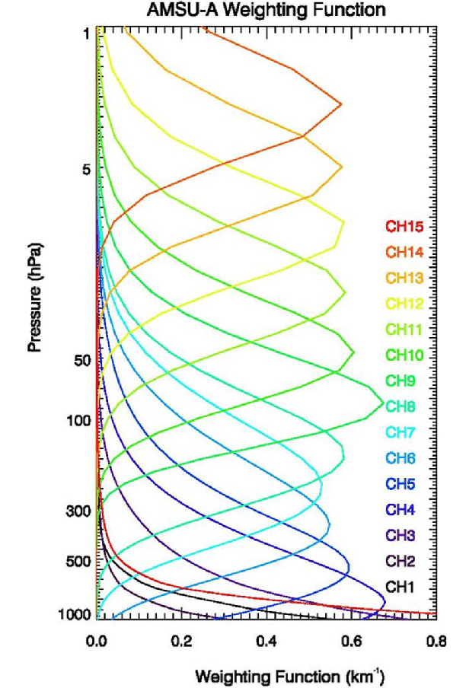
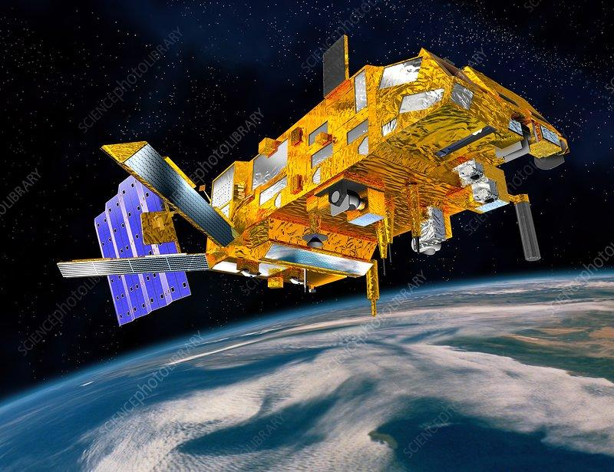
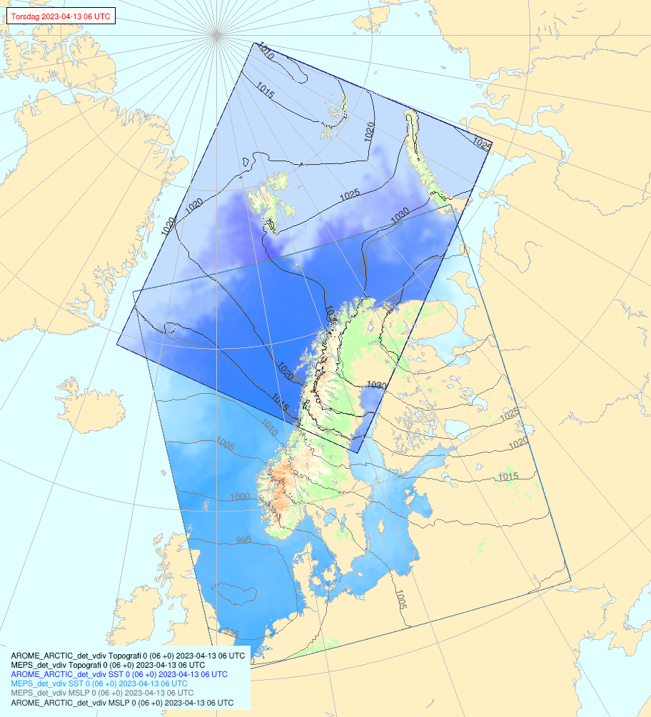
Satellite data for weather forecasting
Assimilation of satellite microwave sounding profiles is the backbone of numerical weather prediction, in particular over the Arctic

Slide 4
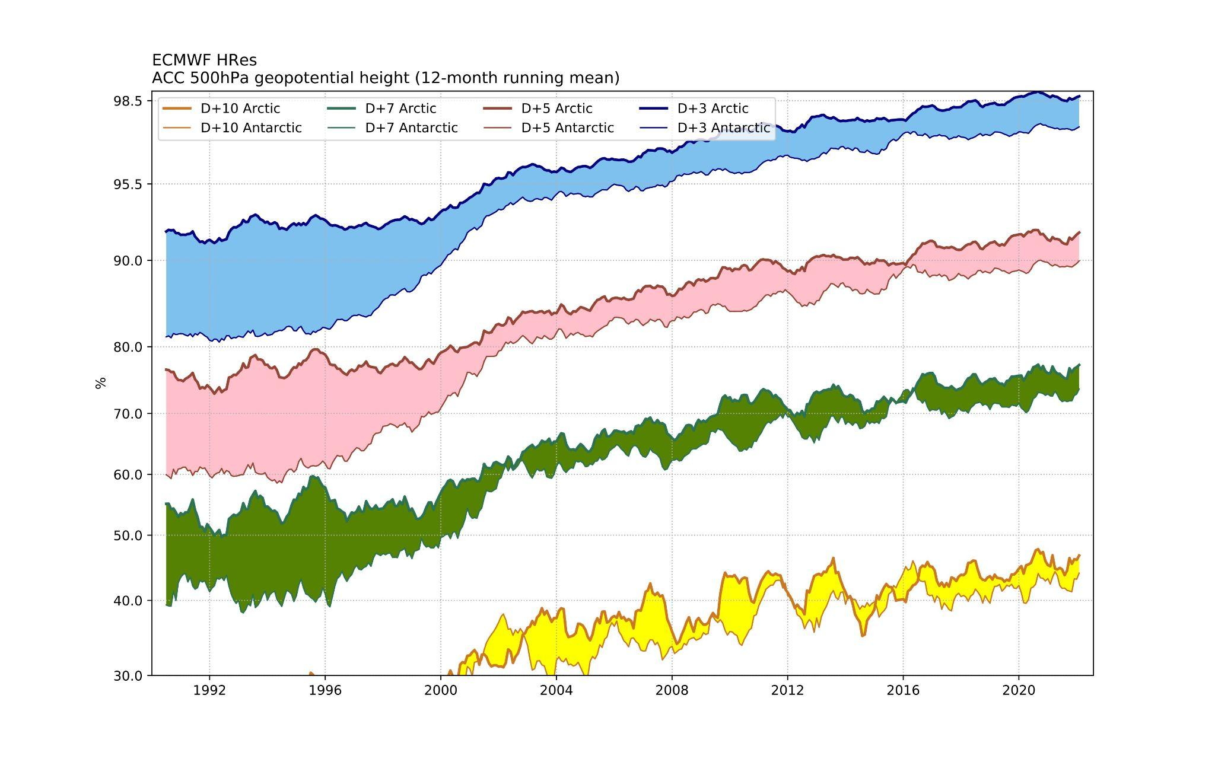
How good are the forecasts for the Arctic and Antarctica?

Slide 5
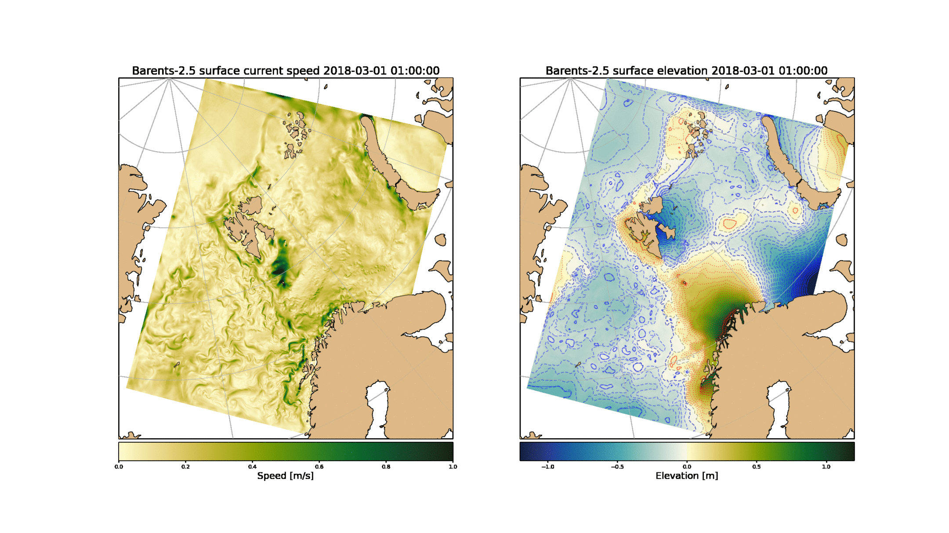
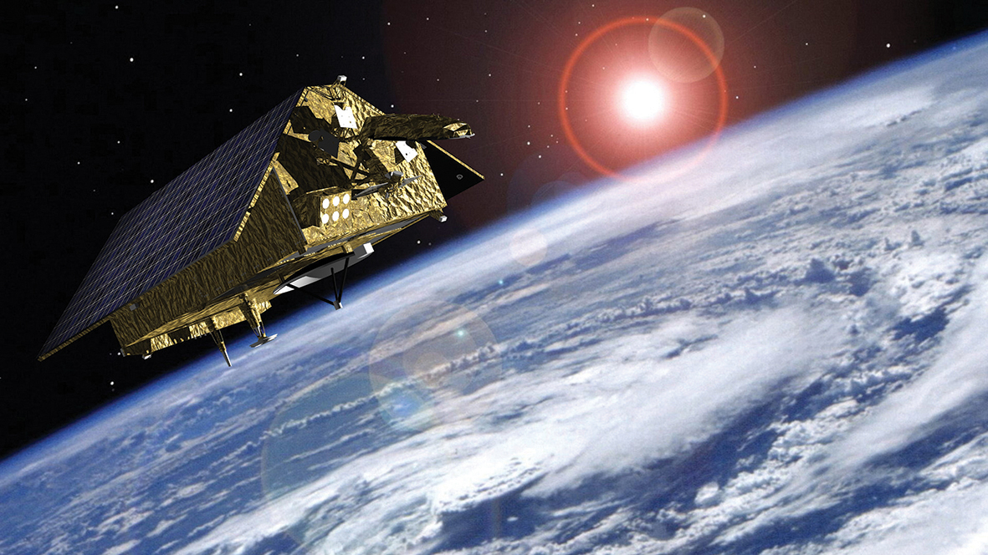
Satellite data for ocean forecasting
Assimilation of altimeter (Sentinel 6)

Slide 6
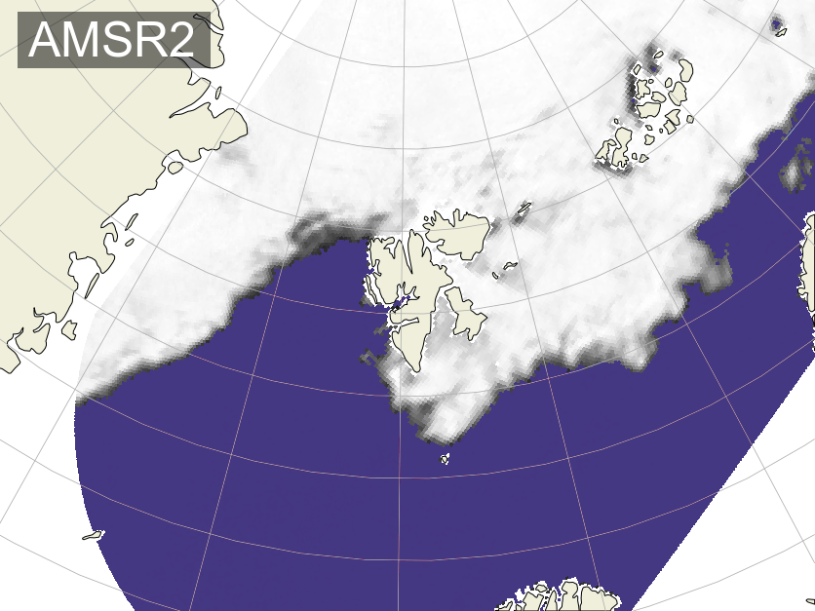
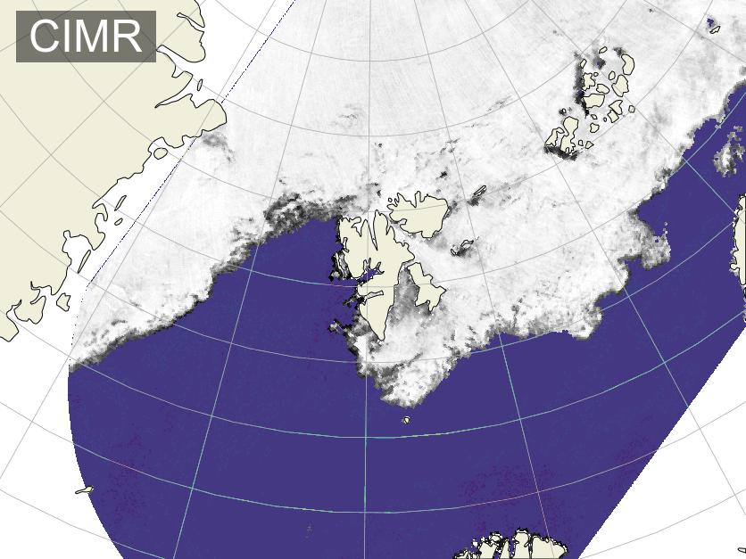
Copernicus Imaging Microwave Radiometer (CIMR)
Will be a game-changer for the operational weather, ocean, and sea-ice forecasts at the Norwegian Meteorological Institute (including the forecasts we produce for Copernicus)
Highlights:
More accurate ~5km sea-ice concentration;
More accurate sea-ice motion vectors;
More SSTs (through cloud cover);
Better timeliness (NRT1H) for better data assimilation, and synergistic use combined with e.g. S1 SAR.
Thomas Lavergne
Senior Scientist @ MET Norway

Slide 7
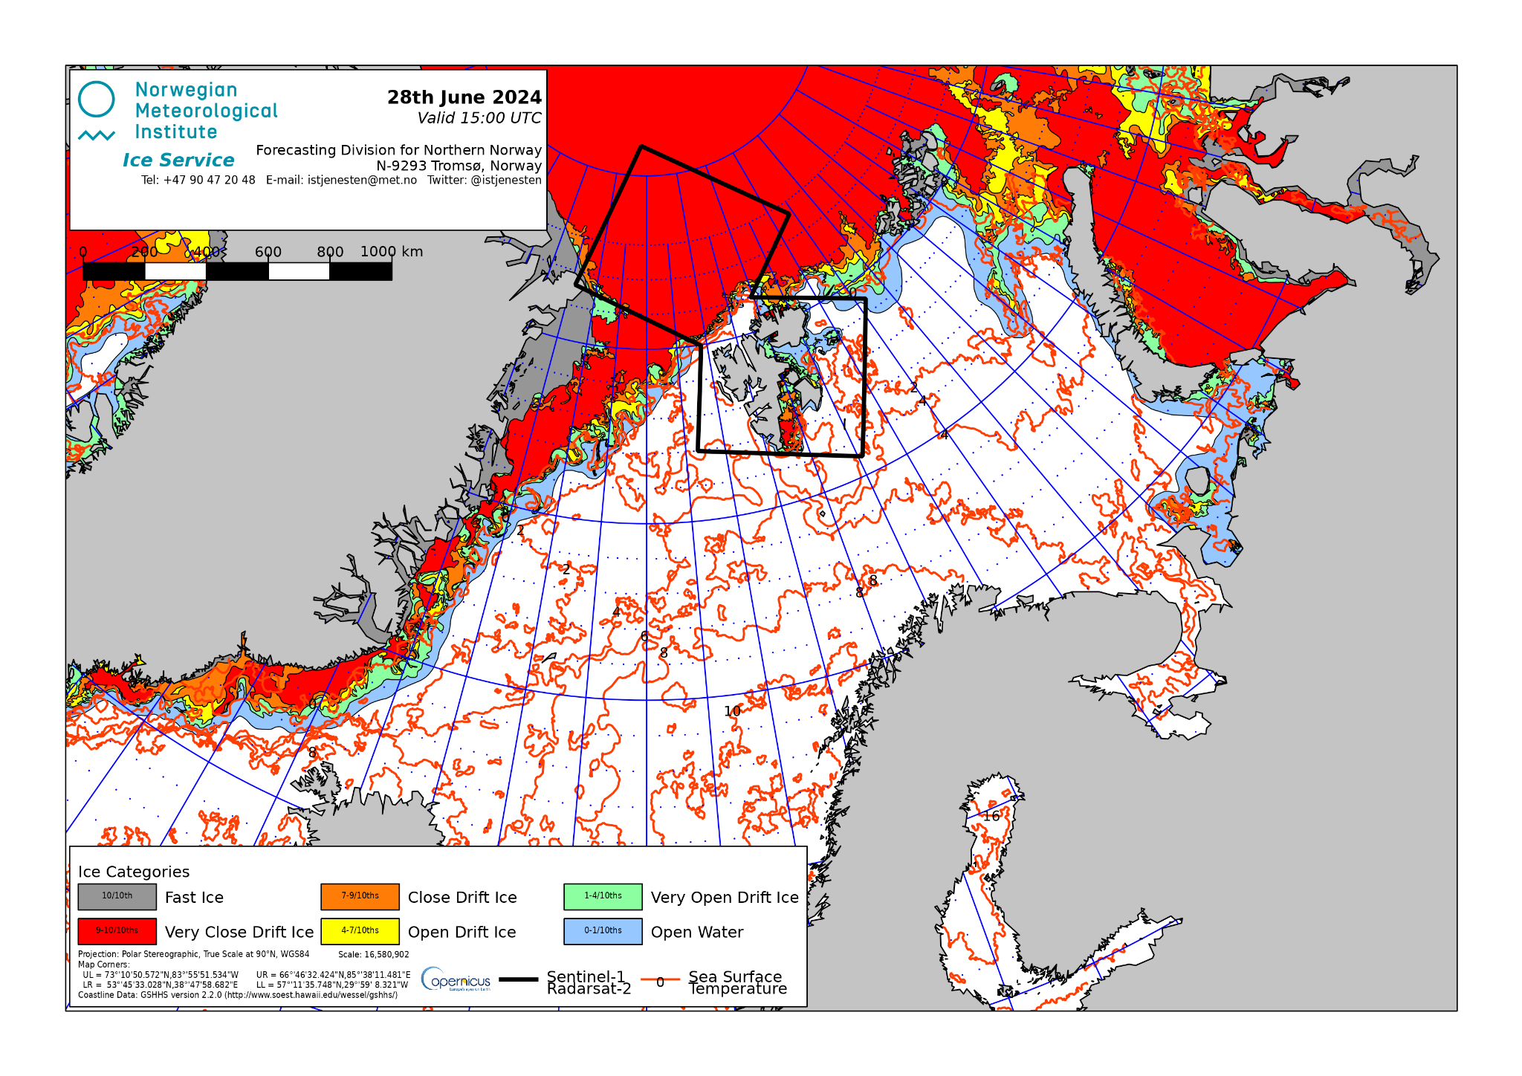
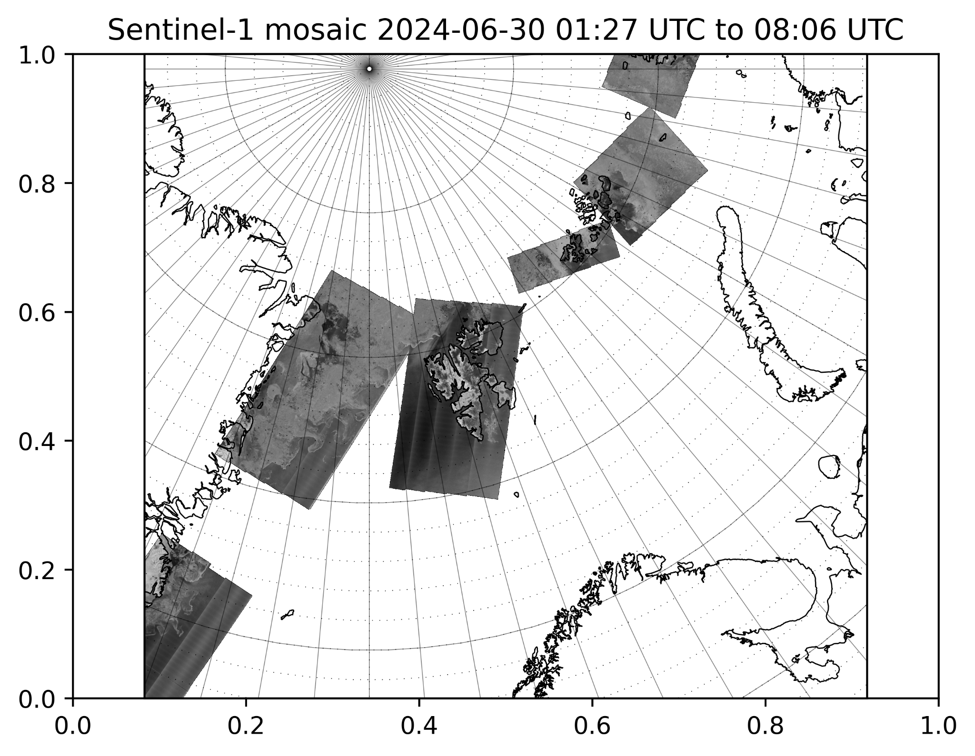
MET Norway Ice Charts for the Arctic

Slide 8
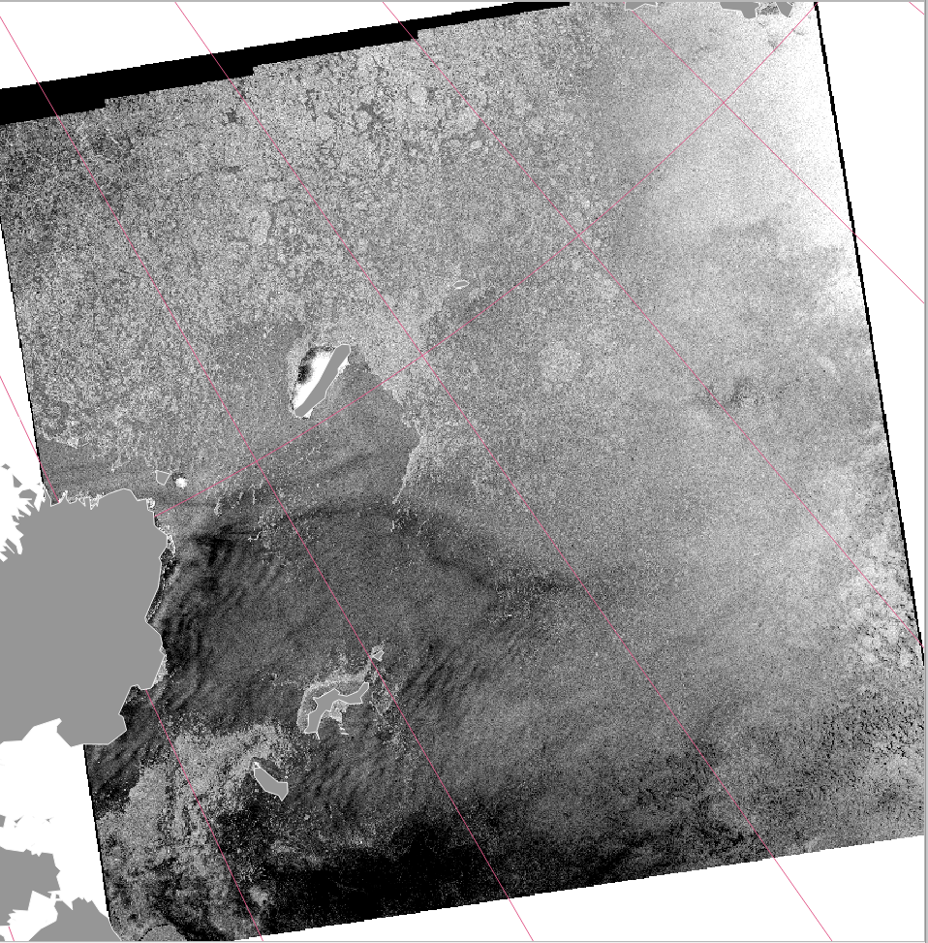
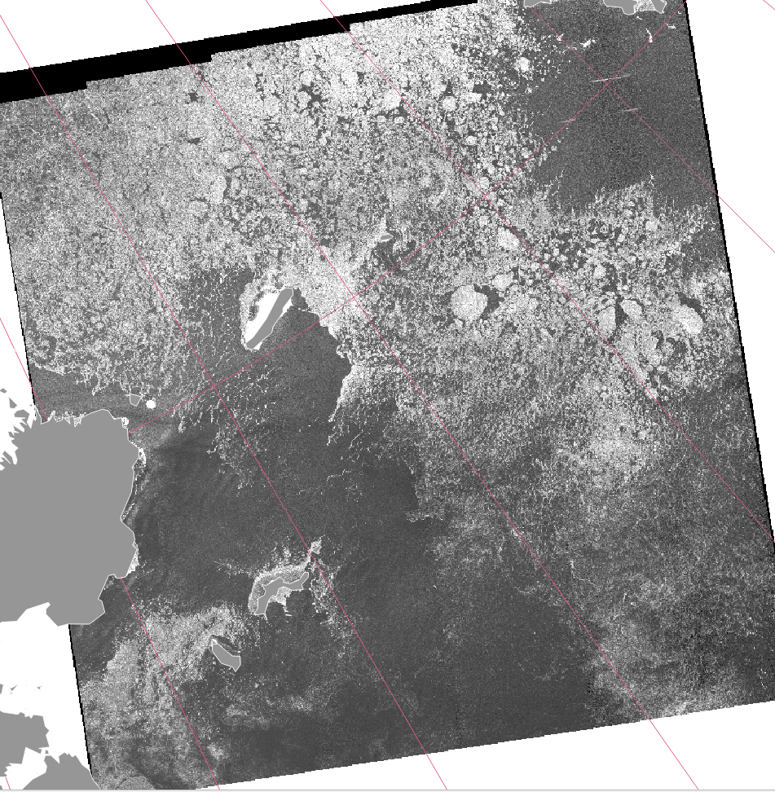
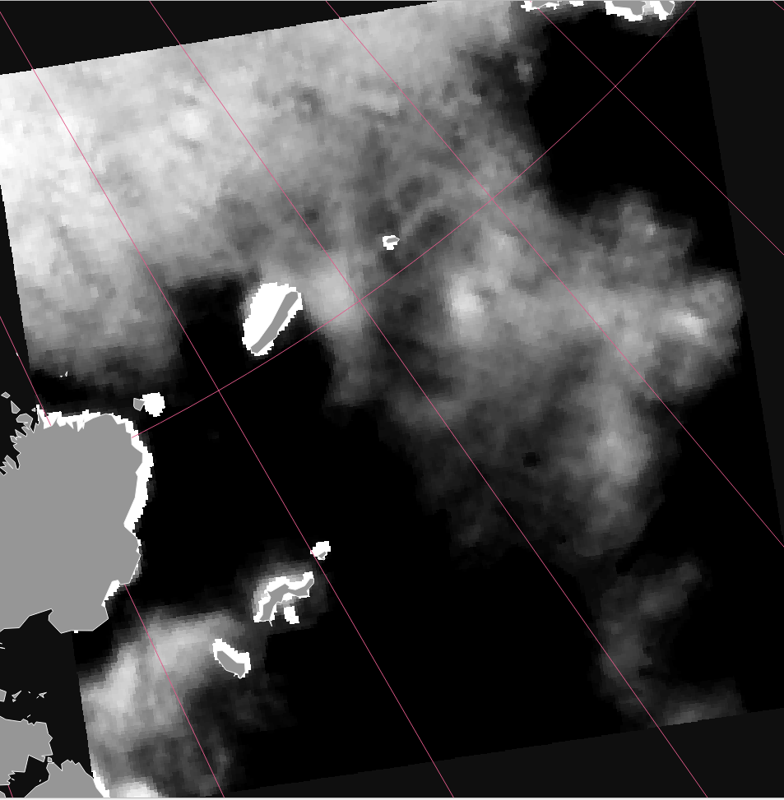
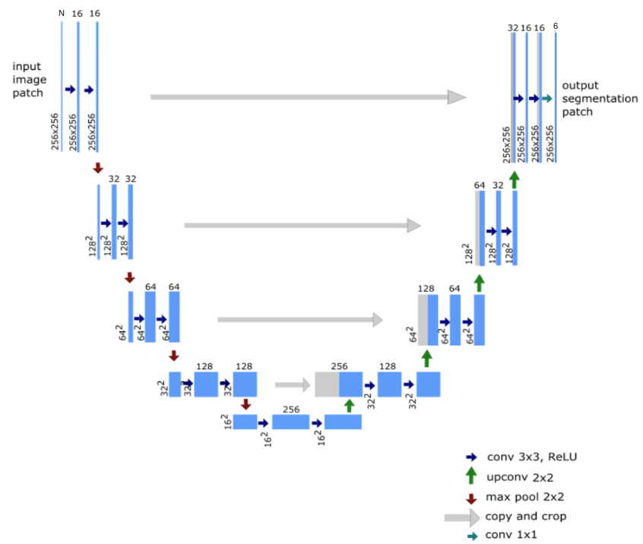
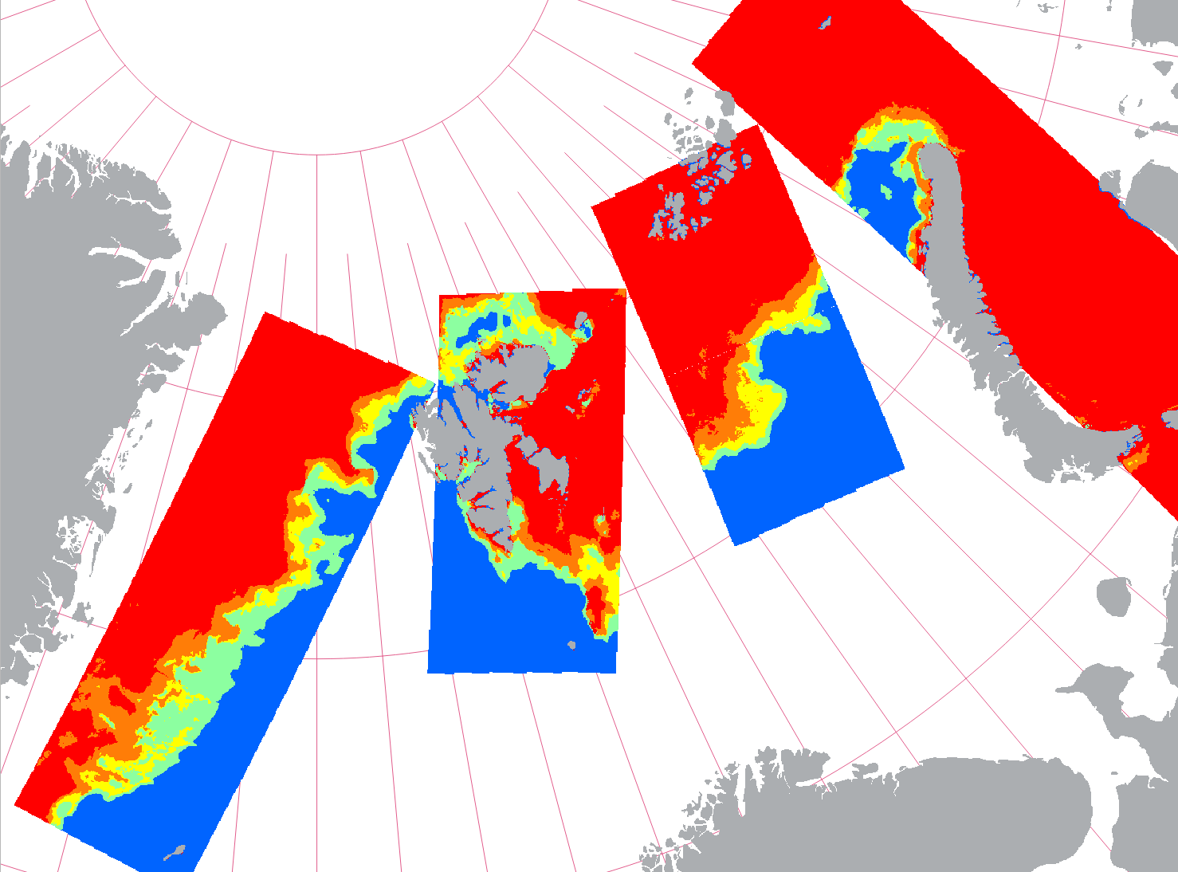
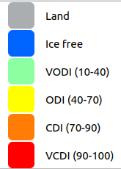
Sea ice from Sentinel Synthetic Aperture Radar (SAR) based on ML
S1 HH S1 HV S1 IA AMSR2 SIC
A new SAR based automatic sea ice concentration product has been developed to offer detailed and timely sea ice information to Arctic users.
A Deep Learning (DL) U-Net model is trained on satellite data from Sentinel-1 and AMSR2.
A daily mosaic is continuously updated when new Sentinel-1 data becomes available within the area of interest.
Sea ice concentration are provided according to the sea ice concentration classes:
OpenWater (0-10%),
Very Open Drift Ice (10-40%),
Open Drift Ice (40-70%),
Close Drift Ice (70-90%),
Very Close Drift Ice (90-100%)
The new Sentinel-1C will be an important contribution to the Arctic coverage

Slide 9
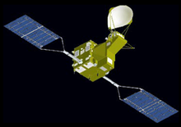
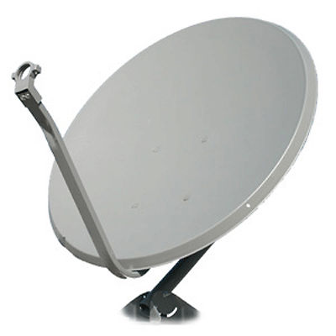
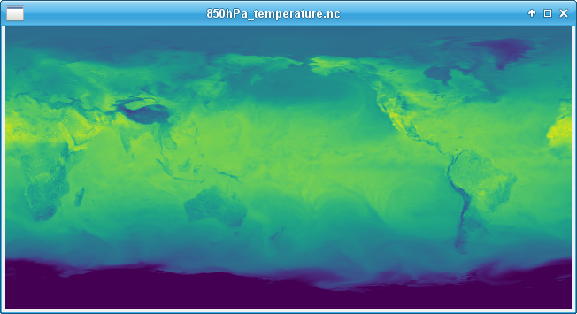
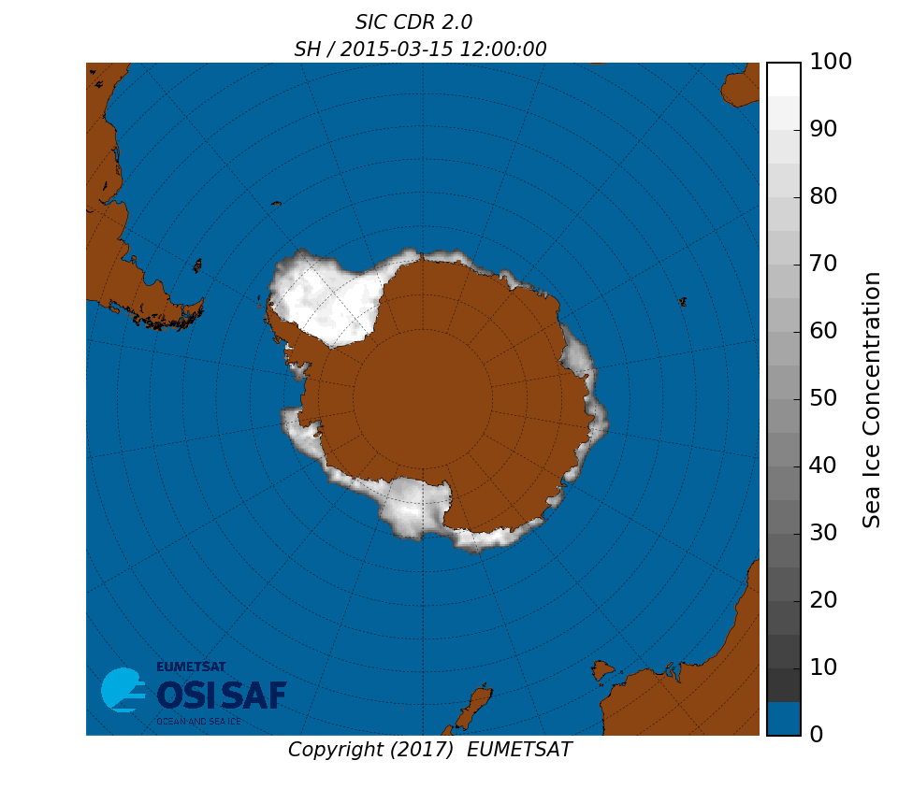
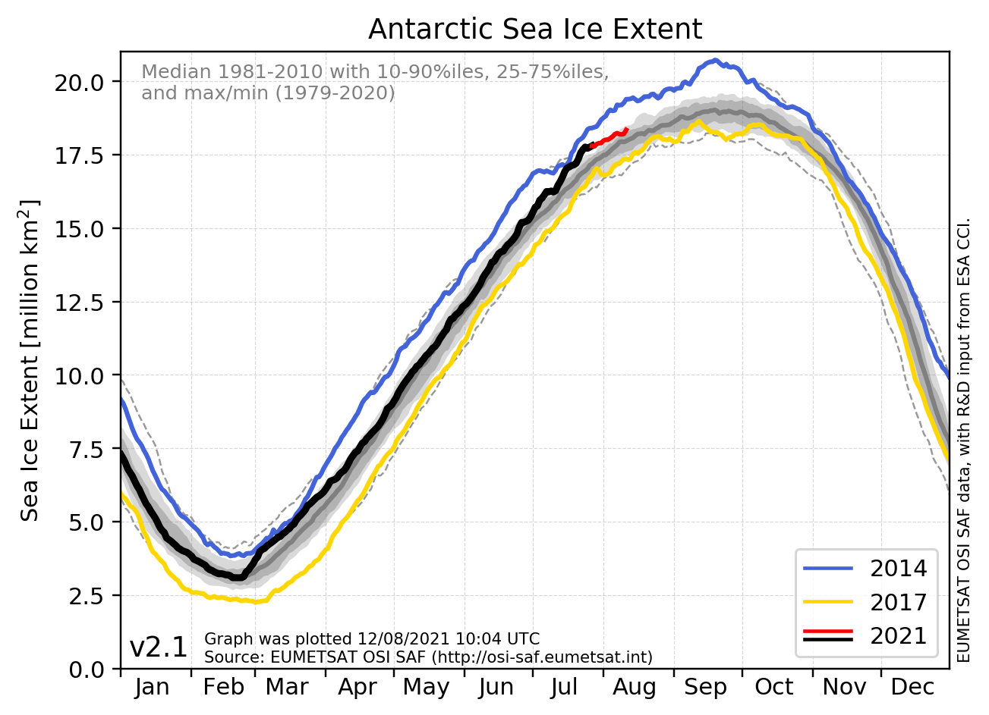
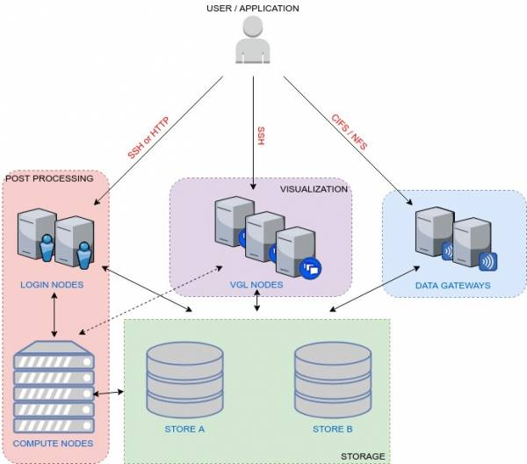
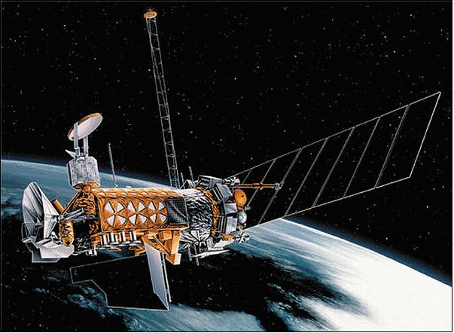
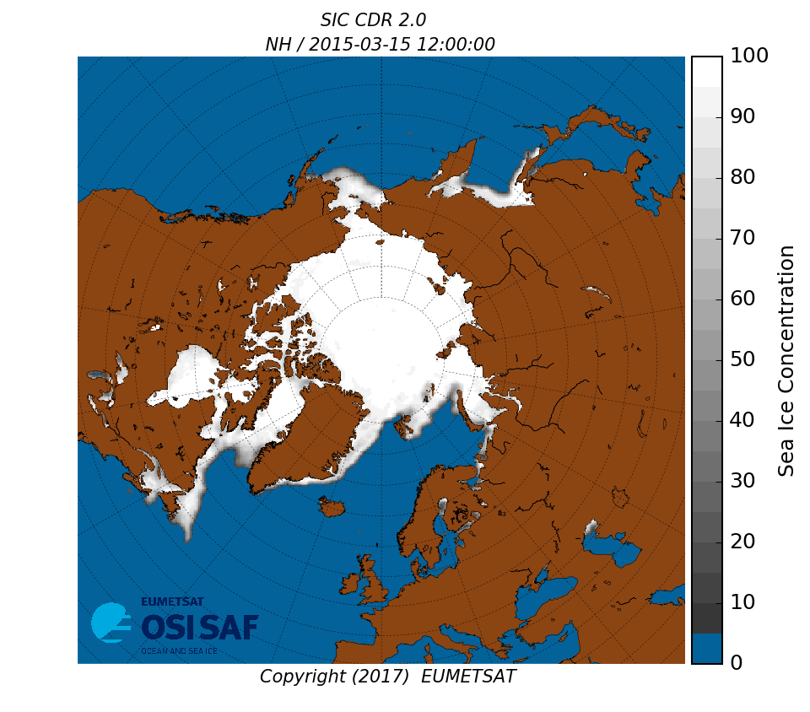
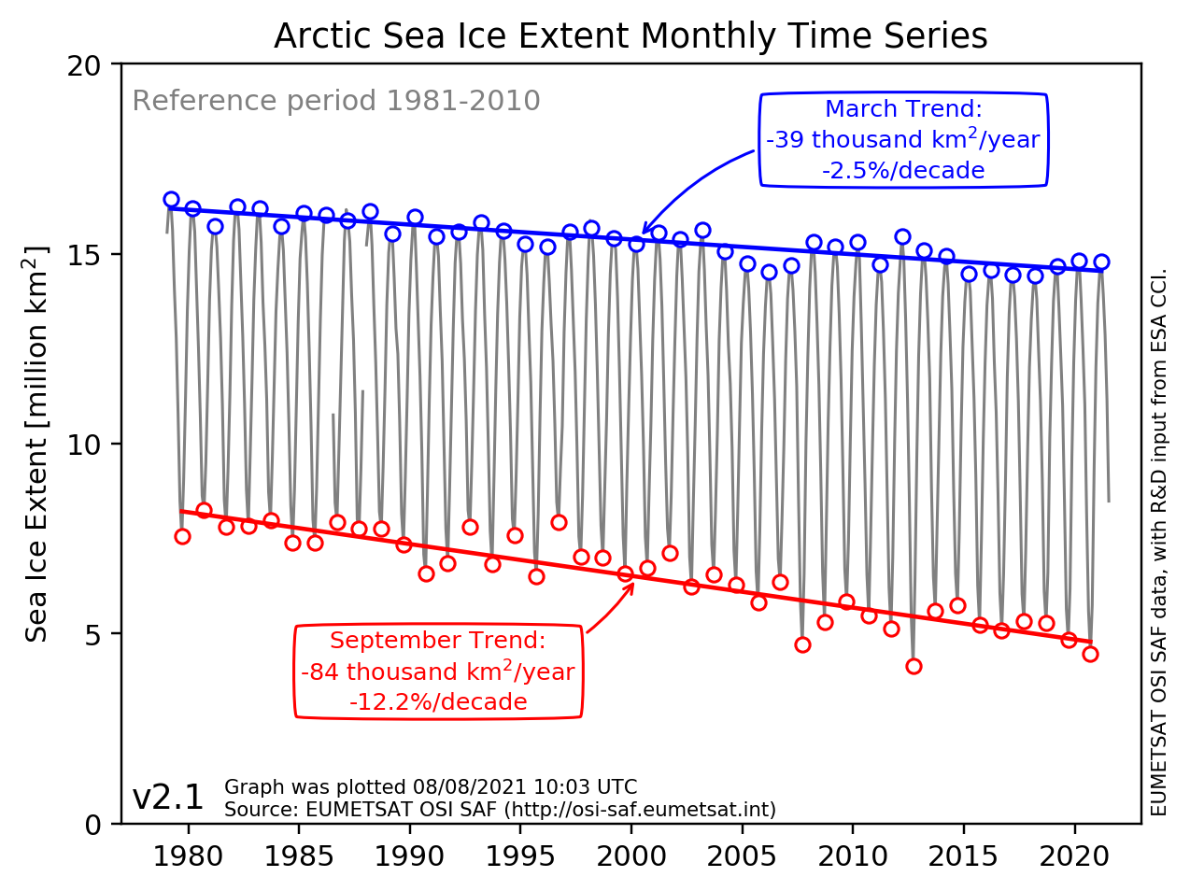
MET Norway’s value chain for Sea Ice Essential Climate Variables
Satellites in orbit
Climate data
(40+ years of daily maps)
Climate Information
(trends, anomalies, indicators)
Algorithms
Processing chains
Dissemination and Outreach
NWP fields
THREDDS,
FAIR
feedback & validation
PPI & Lustre
Archived missions

Slide 10
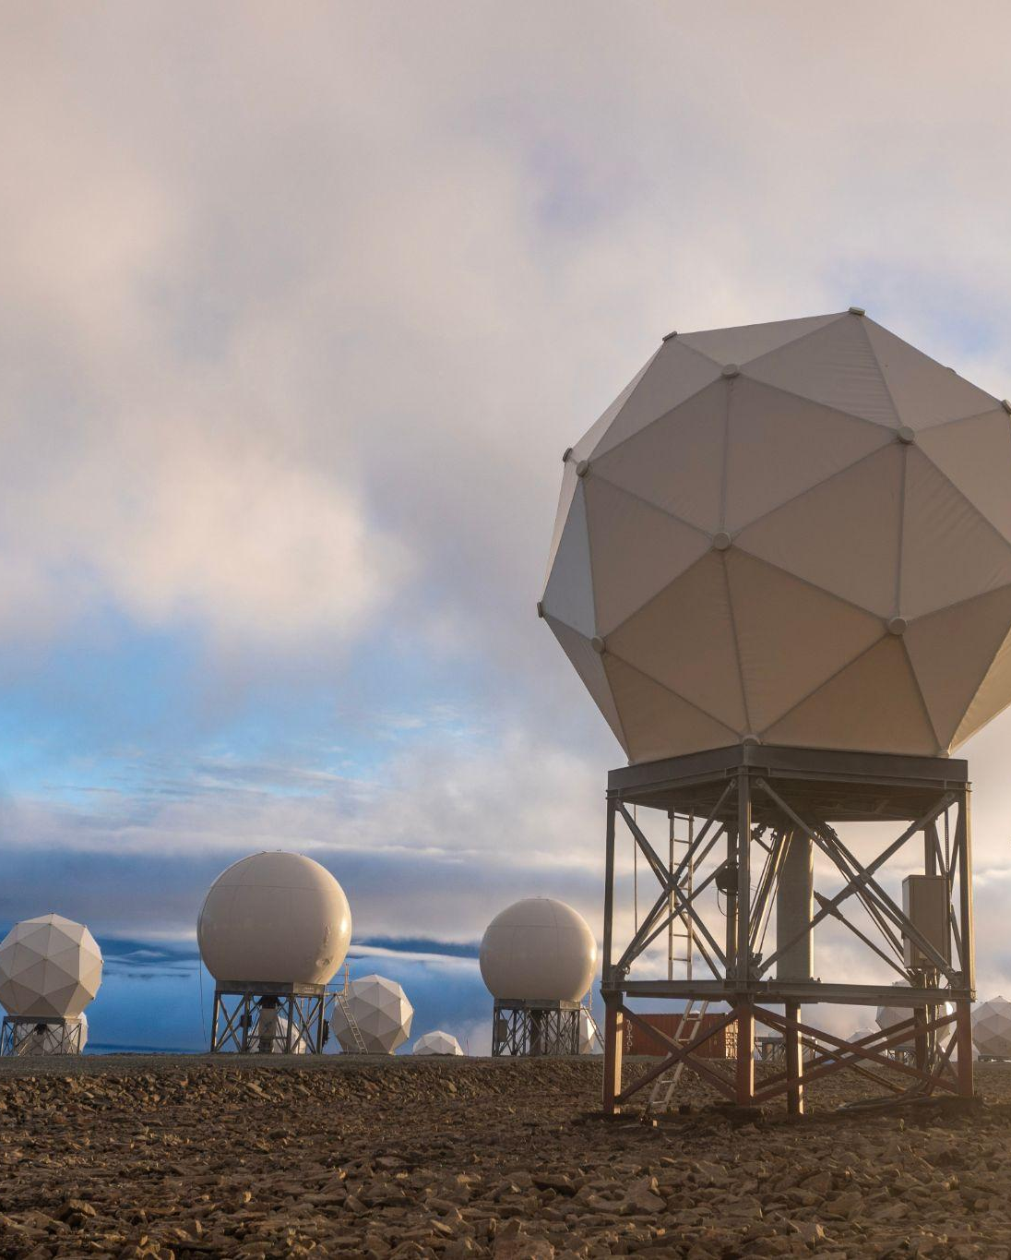
Future outlook
Richards/ Shutterstock
‘Space’ is essential for forecasting and monitoring in the Arctic.
These remote observations are resilient to geopolitical uncertainties.
New technologies/artificial intelligence may provide options
to extract more information from existing datasets.
to use the data in new ways that have not been explored yet.
to take advantage of microsatellites (such as AWS and EPS-Sterna).
The ongoing climate change is leading to devastating impacts in the Arctic and more generally in the cryosphere.
We have a responsibility to protect our populations through enhanced understanding, mitigation and adaptation.

Slide 11
Photo Abstract51 / Shutterstock

