Slide 1





Critical infrastructure High accuracy and Robustness increase Integrated Synchronization Solutions
Satellite-based Services for Disaster Risk Management in Romania
Panel 1: Space assets supporting the Disaster Risk Management Cycle
What can space data contribute to prevention, preparedness , response, and recovery ?
Politehnica University of Bucharest 26/11/2024
Bucharest, Romania CHRISS - BEIA Team
Eng. Mari-Anais SACHIAN
Assoc. Prof. Eng. Petrică CIOTÎRNAE Ph.D.
This project is funded by the European Union under the call Horizon_EUSPA-2021-SPACE NR:101082440

Slide 2

Summary
01
The Chriss project
Problem Outline
Objectives of the CHRISS project
Specific Use case
Innovation and Added Value
Synchronization supply for disaster communication network
Disaster Management Risk Use case

Slide 3


The CHRISS Project
02
Critical infrastructure High accuracy and Robustness increase Integrated Synchronization Solutions
November 2022 – October 2025
HORIZON Innovation Action, funded by the European Union under the call Horizon_EUSPA-2021-SPACE NR:101082440
Project partners:
More information: chriss-project.eu

Slide 4
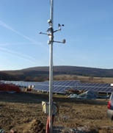
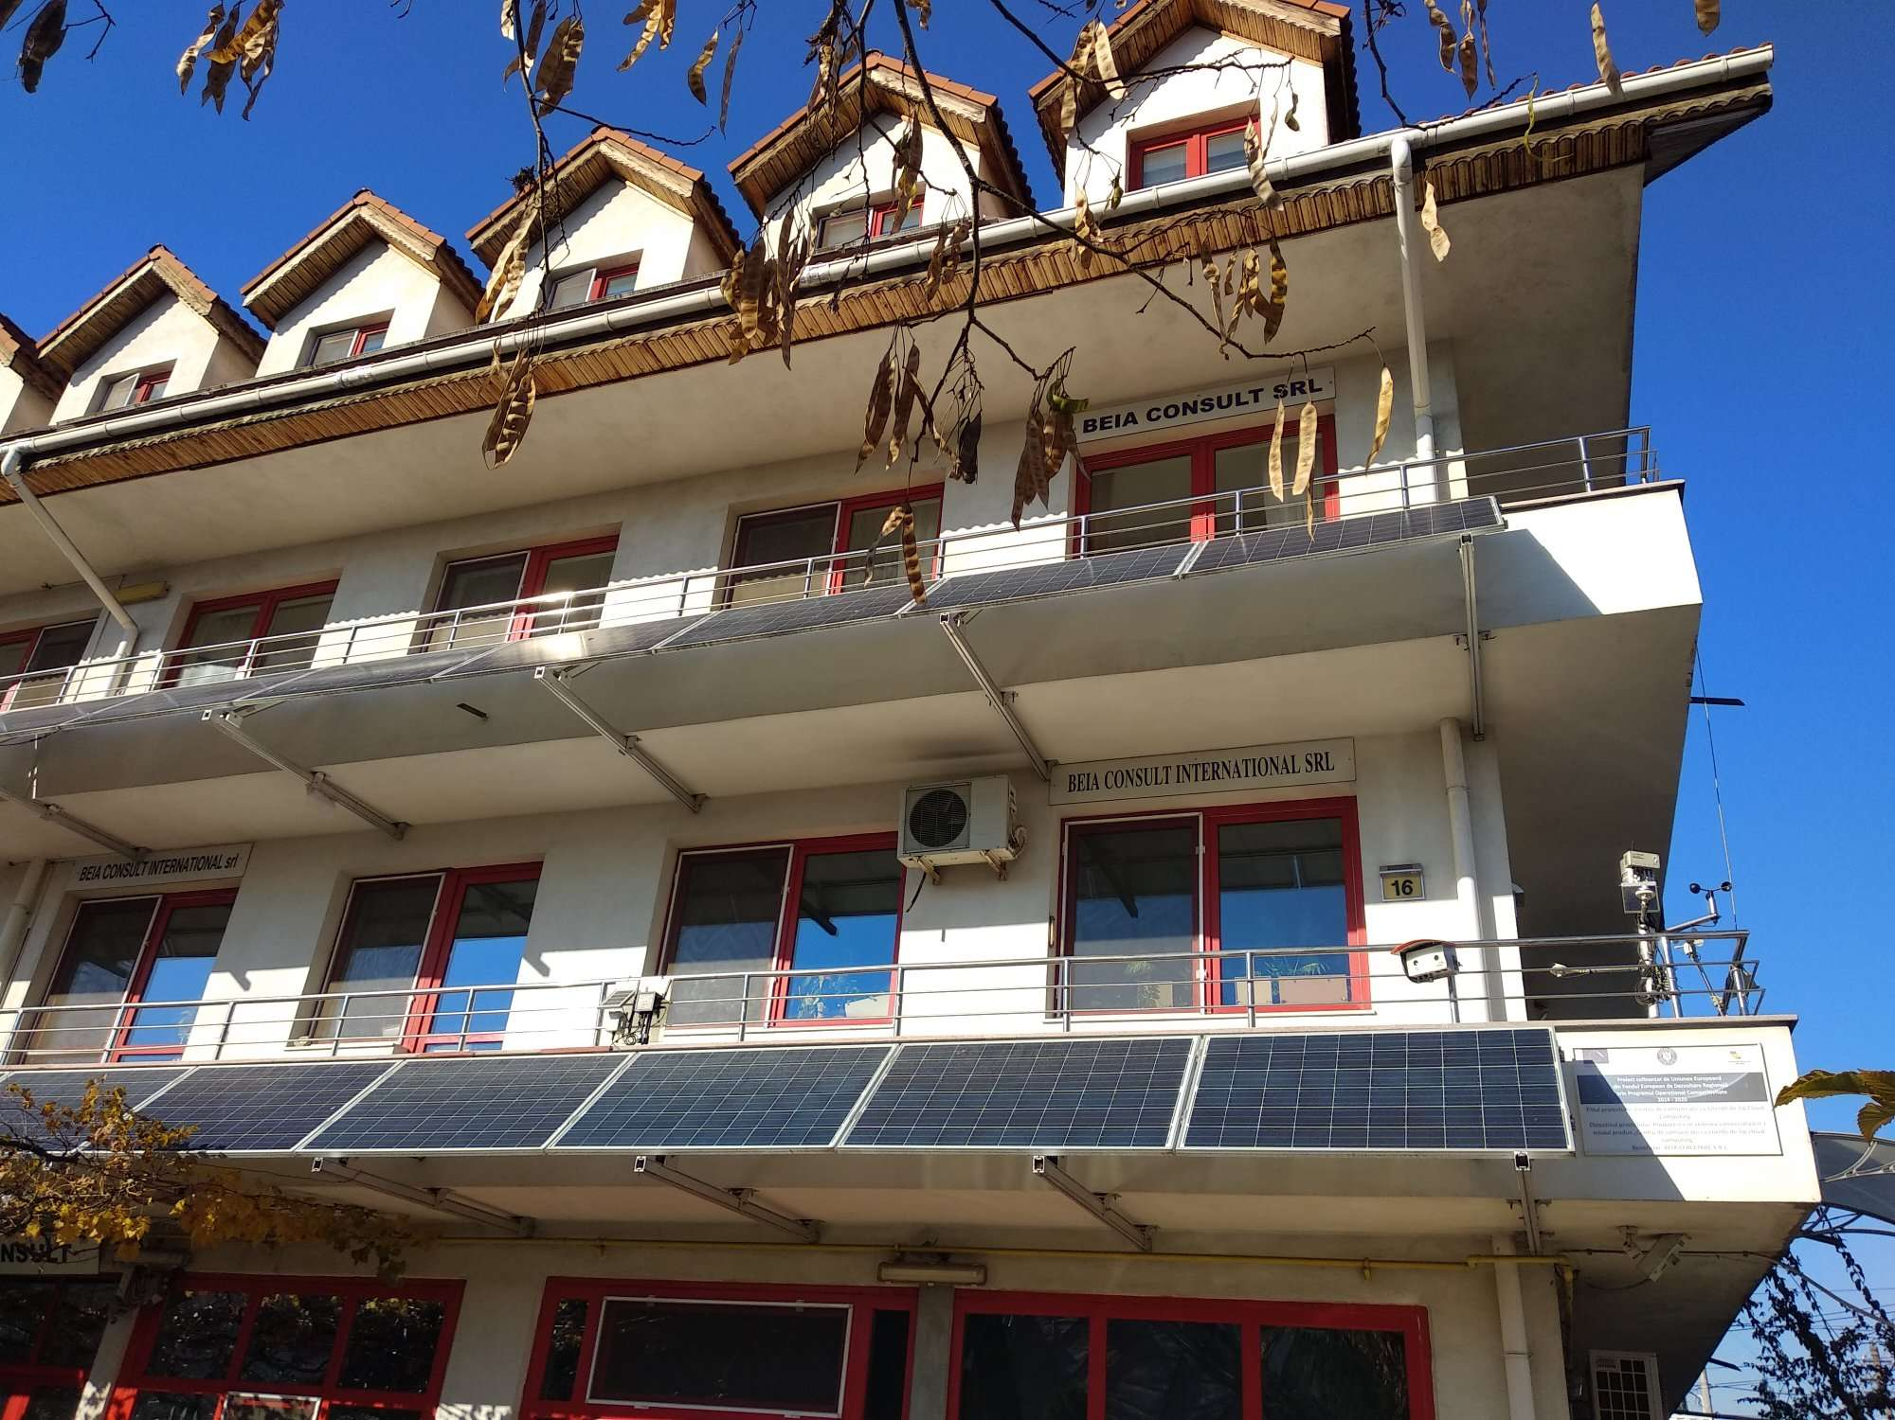

Company presentation - BEIA
03
George Suciu, R&D and Innovation Manager, george@beia.eu
BEIA (SME) founded in 1991
Offices in: Austria, Belgium, Romania www.beia.eu
One of the leading providers of ICT solutions and services in Romania for cloud communications and IoT telemetry
  critical infrastructure operators' "CI"
    telecom, finance, food, energy (DSO, SG/RES/ESS, EV/PV, nuclear), water (ports, shipping), transport (metro/railway), chemical industry, RI, etc.
  first responder organizations "FRO"
    firefighters, ambulance, red cross, volunteer organizations, SMURD, forensic investigators, crime scene investigators, CERT/CSIRT, etc.
  law enforcement agencies "LEA"
    police, border guard, customs, environmental guard, coast guard, ports administration, STS, SPP, SRI, other authorities from the Ministry of Interior, Ministry of Defense, etc.
Team of 90 people with experience in various Programme Eureka/Eurostars, ITEA, Celtic, Eurostars, ERA-Net, Horizon, LIFE+, ESA/ROSA, etc., like TESTBED2, SAFECARE, FLEXI-CROSS, SEALEDGRID, MOBILISE, RITHMS
Notes:
TESTBED2: Testing and Evaluating Sophisticated information and communication Technologies for enaBling scalablE smart griD Deployment (H2020 MSCA RISE)
SealedGRID: Scalable, trustEd, and interoperAble pLatform for sEcureD smart GRID (H2020 MSCA RISE)
A-WEAR: A network for dynamic WEarable Applications with pRivacy constraints (H2020 MSCA ITN)
HUBCAP: Digital Innovation Hubs and Collaborative Platform for Cyber-physical Systems (H2020 DT-ICT-01-2019)
S4AllCities: Smart Spaces Safety and Security for All Cities (H2020 INFRA)
STAMINA: Demonstration of intelligent decision support for pandemic crisis prediction and management within and across European borders (H2020 DRS)
MOBILISE: A novel and green mobile One Health laboratory for (re-) emerging infectious disease outbreaks (HORIZON EUROPE CL3 DRS)
FLEXI-CROSS: Flexible and Improved Border-Crossing Experience for Passengers and Authorities (HORIZON EUROPE CL3 BM)
RITHMS: Research, Intelligence and Technology for Heritage and Market Security (HORIZON EUROPE CL3 FCT)
SOLID-B5G: A Massive MIMO Enabled IoT Platform with Networking Slicing for Beyond 5G IoV/V2X and Maritime Services (EEA)
VITAL-5G: Vertical Innovations in Transport And Logistics over 5G experimentation facilities (H2020 ICT-41)
5G-SAFE-PLUS: 5G Enabled Road Safety Services (Eureka Celtic)
SARWS/FLEXNET/IMMINENCE: Intelligent Management of next generation MobIle NEtworks aNd serviCEs (Eureka Celtic labelled running)
CyberSec2SME/SecureIT - CONTINUOUS CYBER SECURITY AUDIT (H2020 open call)
SCRATCh: SeCuRe and Agile Connected Things (Eureka ITEA)
PARFAIT: Personal dAta pRotection FrAmework for IoT (Eureka ITEA)
DEFRAUDify: Detect Fraudulent Activities in dark web and clear web to protect your business (Eureka ITEA)
ENTA: Encrypted Network Traffic Analysis for Cyber Security (Eureka ITEA labelled running)
STACK: Smart, Attack-Resistant Internet of Things Networks (Eureka ITEA labelled running)
CHRISS: Critical infrastructure High accuracy and Robustness increase Integrated Synchronization Solutions (HORIZON CL4 EUSPA-2021-S

Slide 5
Problem Outline
04
Critical infrastructure, e.g. telecommunication networks, rely on precise timing sources for synchronization and improved performance.
These networks connect society and the economy, enabling telecommunications, energy distribution, finance operations, and more.
Current timing and synchronization solutions use GNSS signals, but they are vulnerable to interference and cyber-attacks, posing risks to network reliability and security.

Slide 6
Objectives of the CHRISS project
05
Objective 1
Increased GNSS receiver resilience to interference and cyber attacks
Objective 2
Significantly improving robustness of the time reference system
Objective 3
Increasing time distribution accuracy
Objective 4
Objective 5
Secure and trusted source of reference time
Awareness raising of using EGNSS-based source of reference time
Notes:
The main objective is to provide a solution increasing time distribution service availability to prevent telecommunication network blackouts or service failures in case of jamming or spoofing attacks on GNSS radio signals transmitting PNT service.

Slide 7
Innovation and Added Value
06
Better receiver resilience to strong interference and cyber attacks, maintaining Timing reference information accuracy.
High Precision Timing distribution with nanosecond accuracy using PTP protocol.
Enhanced authenticity operation using OS-NMA protocol.
Streamlined synchronization process with a compact casing TSU solution.

Slide 8
Synchronization supply for disaster communication network
07
Equipment special features:
  High Resilient GNSS receiver – detection of the jamming, spoofing and meaconing.
  TSU equipment – physical intrusions detection and secure remote access.
  PTP protocol – with security mechanism implementation.
Notes:
Primul slide prezintă structura internă a echipamentului, generică. Receptorul GNSS primește semnalul de la satelit, iar un element suplimentar realizează o prelucrare în interiorul echipamentului – permite o extragere a semnalului de foarte bună calitate. Funcționează chiar și în condiții de propagare scăzută. OSNMA este o tehnologie recent introdusă care permite autentificarea pe receptoarele satelitare. Dacă OSNMA este implementat, nu există riscuri de jamming, spoofing sau meaconing, deoarece nu sunt chei care să poată fi modificate.
Generatorul din mijloc este un oscilator standard, cu porturi electrice și optice. Are doar porturi electrice de tip TSU. Modulul de securitate procesează mai multe informații, iar ceea ce furnizează la ieșire este autentic. Orice element suspect este blocat la ieșire, iar furnizarea semnalului autentic (lock-ului) împiedică inducerea în eroare a consumatorului.
Consumatorii:
În situații de criză sau război, există rețele de comunicații care funcționează izolat și asigură semnal unui număr de utilizatori numiți first responders. Aceste rețele au nevoie de un semnal de sincronizare, care poate fi furnizat doar de sateliți. Se verifică autenticitatea semnalului; dacă acesta este valid, atunci se furnizează mai departe.

Slide 9
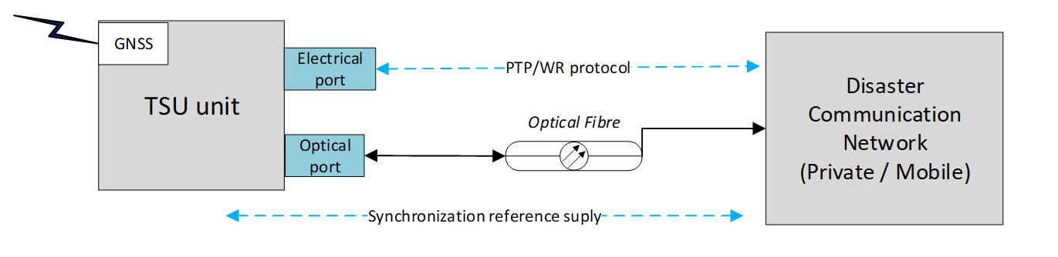
Specific Use case
08
Security components:
  Highly sensitive and resilient GNSS receiver, based on proprietary signal processing algorithm.
  Satellite authentication based on OS-NMA protocol implementation.
  Security protocols implementation for remote user access to the equipment configuration menu and physical protection of the equipment.
Notes:
In stanga este echipamentul , ansambulu retelei nou instalate care vine in sprijinul.

Slide 10
Disaster Management Risk Use case
09
In the event of disasters, in a very short time, special communication networks are installed in the affected area to ensure the necessary communication for intervention teams and supply chains.
Special communication networks operating in isolation mode requires a precise clock time reference for their operation. Classical solutions generates local clock reference with non adequate accuracy and stability.
The new equipment developed within the CHRISS project can generate a very high-quality synchronization signal, based on the extraction of synchronization information from the satellite.
The equipment implements multiple security solutions, such as OS-NMA, the PTP protocol and secure access for equipment users.

Slide 11


Thank you for your attention!
BEIA Consult International
Eng. Mari-Anais SACHIAN , Assoc. Prof. Eng. Petrică CIOTÎRNAE Ph.D.
anais.sachian@beia.ro , petrica.ciotirnae@beia.ro
www.beia.eu

