Slide 1

UDENE Project
TUNisian Space Association
EURISY members day
16 December 2024, European Space Agency, Paris, France
Presented by:
Eng. Syrine Souissi, PhD student
The project has received funding from the European Commission's Horizon Europe Research and
Innovation Programme under grant agreement No 101131190

Slide 2
Outline
Tunisia’s use case
UDENE’s Exploration tool

Slide 3
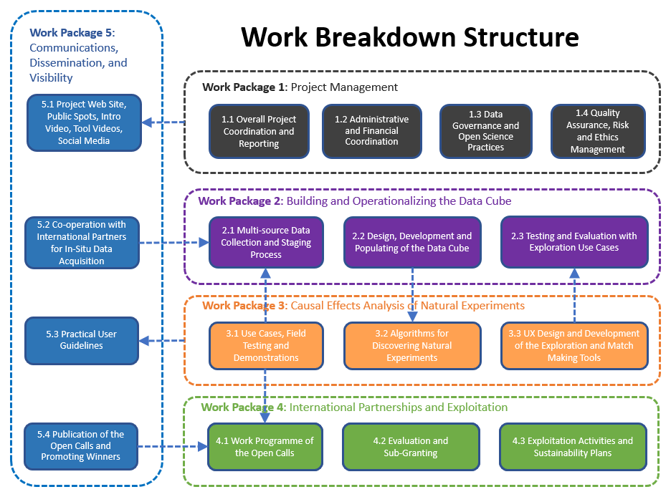
Opening
Use case
Exploration tool

Slide 4
Tunisia’s use case
Effect of a linked park system on heat load
“The urban development idea revolves around the creation and enhancement of a linked park system within the city to mitigate urban heat islands (UHI)”.
Urban Development Idea
Revolves
Involves
Creation and enhancement of a linked urban park system to mitigate urban heat islands.
The strategic design and expansion, of green spaces, parks, and urban forests.

Slide 5
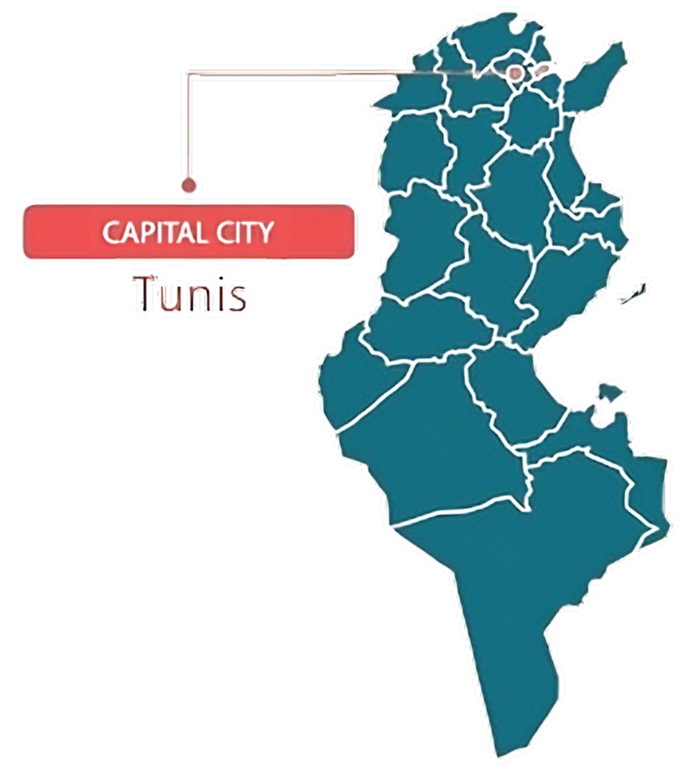


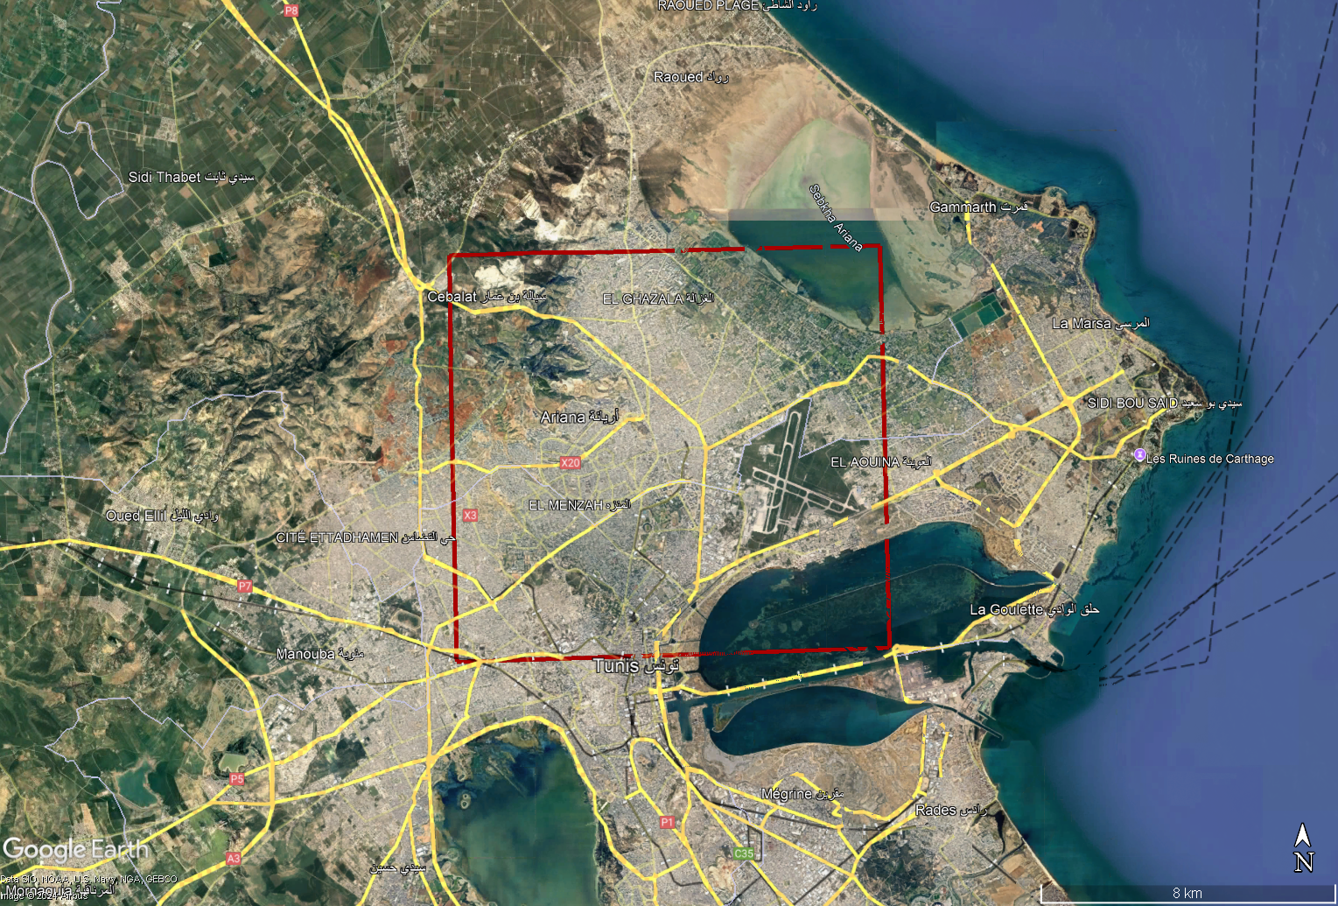

Tunisia’s use case
Location:
Greater Tunis is positioned in northern Tunisia, bordering the Mediterranean Sea.
CAPITAL CITY
Tunis
Coordinates:
Northeast (NE) Corner: 36°54'58.5"N latitude, 10°19'07.6"E longitude
Northwest (NW) Corner: 36°54'39.6"N latitude, 10°00'35.7"E longitude
Southeast (SE) Corner: 36°41'59.3"N latitude, 10:22'35.8"E longitude
Southwest (SW) Corner: 36°40'32.9"N latitude, 10°06'30.3"E longitude
Region Name:
The study area known as "Greater Tunis" and includes the following municipalities:
Tunis
Ariana
La Manouba
Ben Arous

Slide 6





Tunisia’s use case
Surface Area:
The study area covers a surface area of approximately 256,000 hectares (2,560 square kilometers).
Population:
Greater Tunis is home to a population of about 2.6 million inhabitants.
Urbanization:
Highly urbanized, with dense residential, commercial, industrial, and institutional areas.
Geographical Extent and Characteristics:
The region presents a diverse land use land cover classes, including the following features:
wetlands
Urban green spaces
Lakes
Built-up
airport
Temporal scope
Seasonal change in 2023

Slide 7
Tunisia’s use case
Methodology
Earth Observation datasets and products
SUHI prediction model
SUHI maps
In situ data
Inputs
Processing
Outcome

Slide 8





Tunisia’s use case
Digital Earth Africa data cube:
spectral indices from annual geo-composites of ARD
Google Earth Engine Cloud-based computational service:
Urban Green spaces maps from Sentinel 2 images with pixel-based classification
Copernicus:
Global Human Settelmnet layer
European Space Agency:
Land cover
WUDAPT:
Local Climate Zones

Slide 9
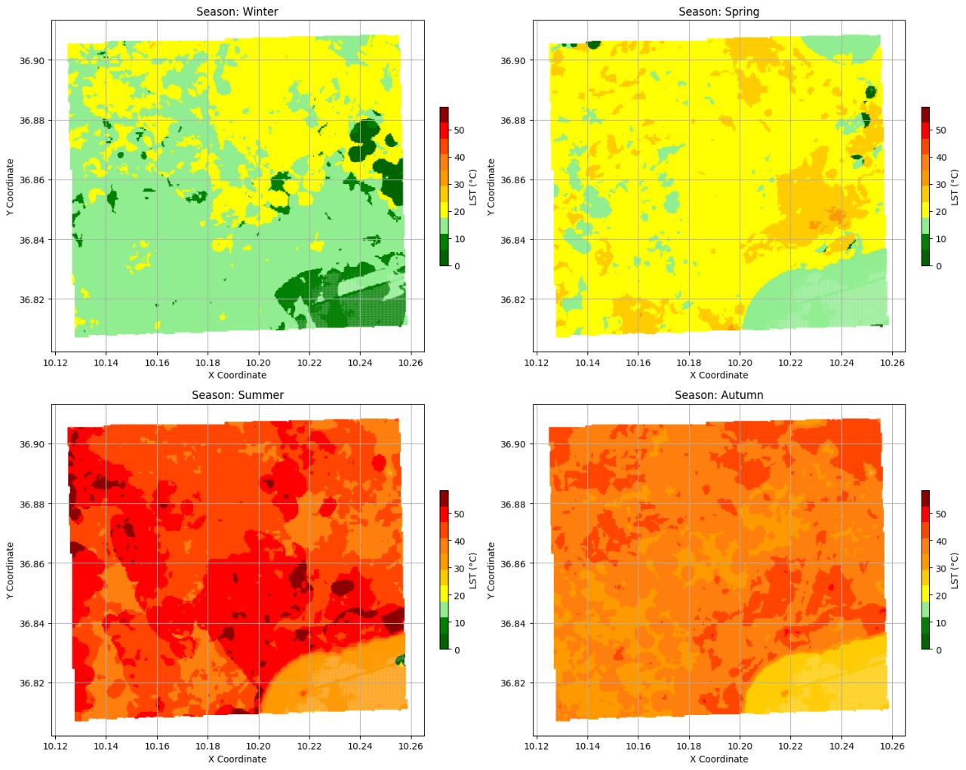
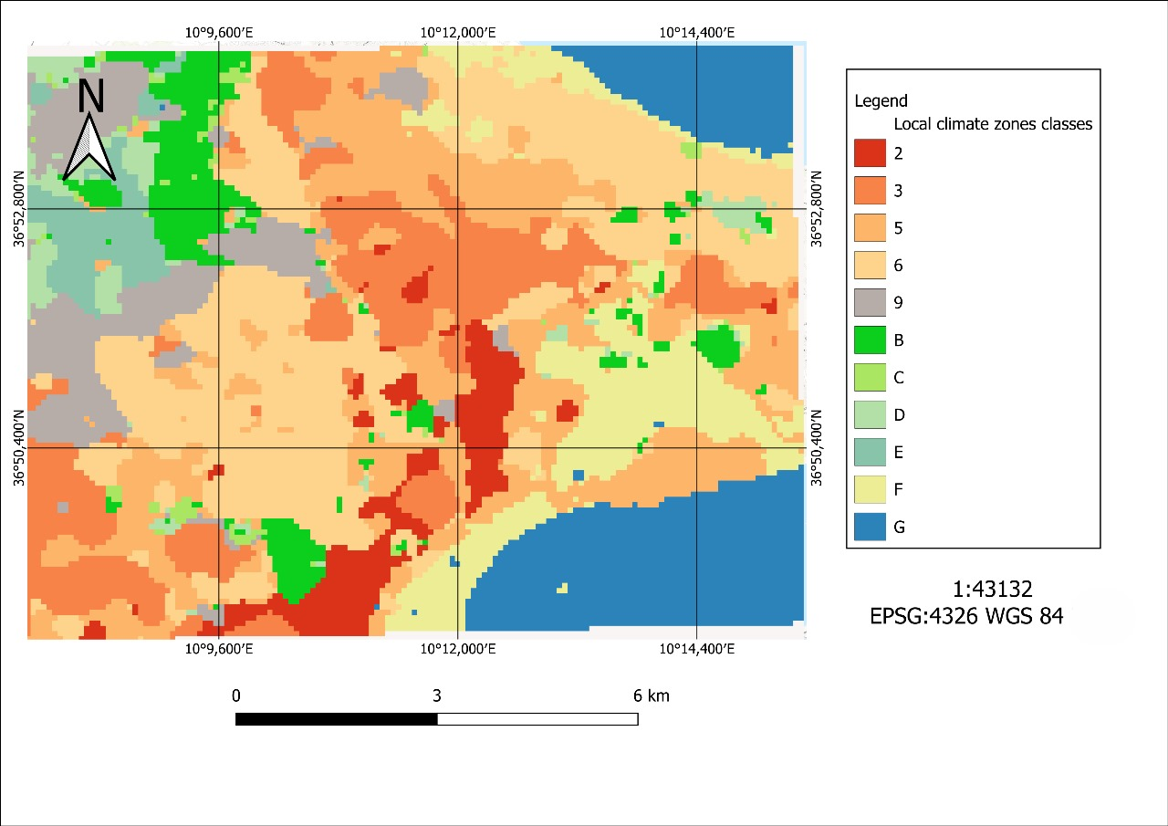
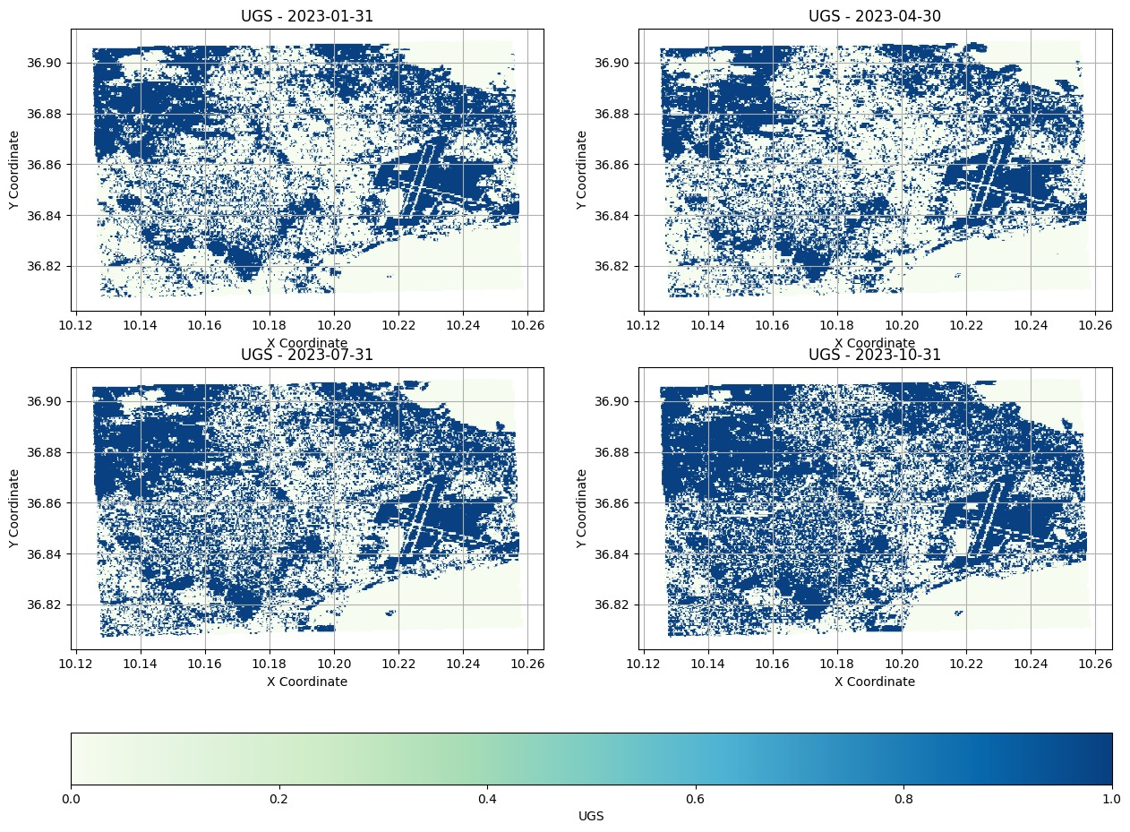
Tunisia’s use case
LST
LCZ
UGS

Slide 10
Exploration Tool
Description
The Exploration Tool will use the models to filter similar locations in terms of input variables to the urban region that the user intends to develop.
The input variables that are used for modelling will also be subjects of the user’s judgement about the change that the development concept may induce.

Slide 11
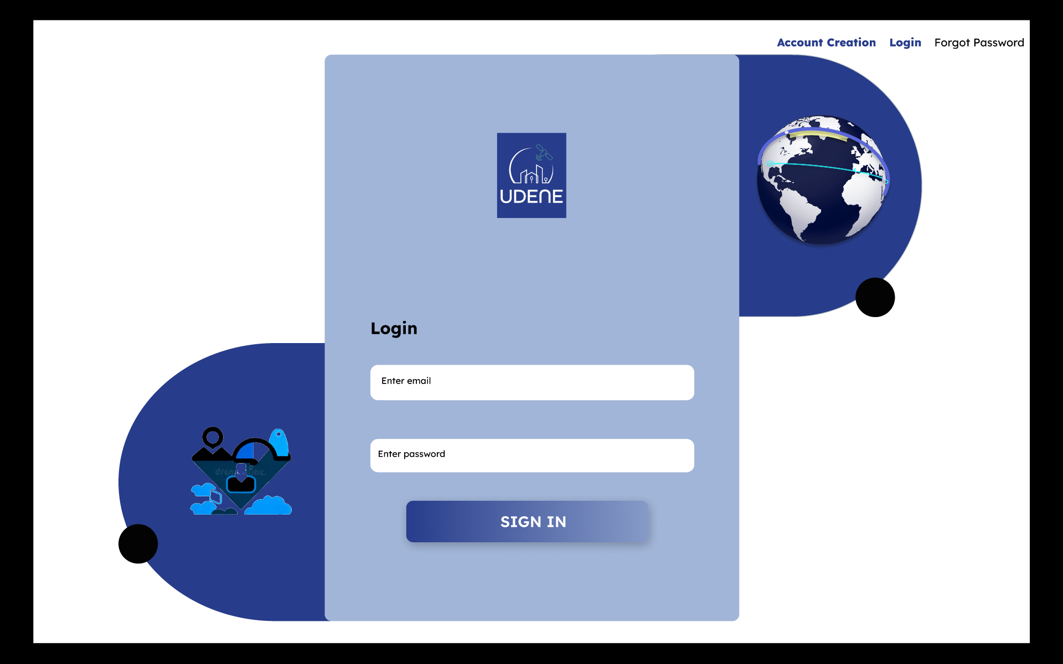
Exploration Tool
xxxx.xxxx@gmail.com
************

Slide 12
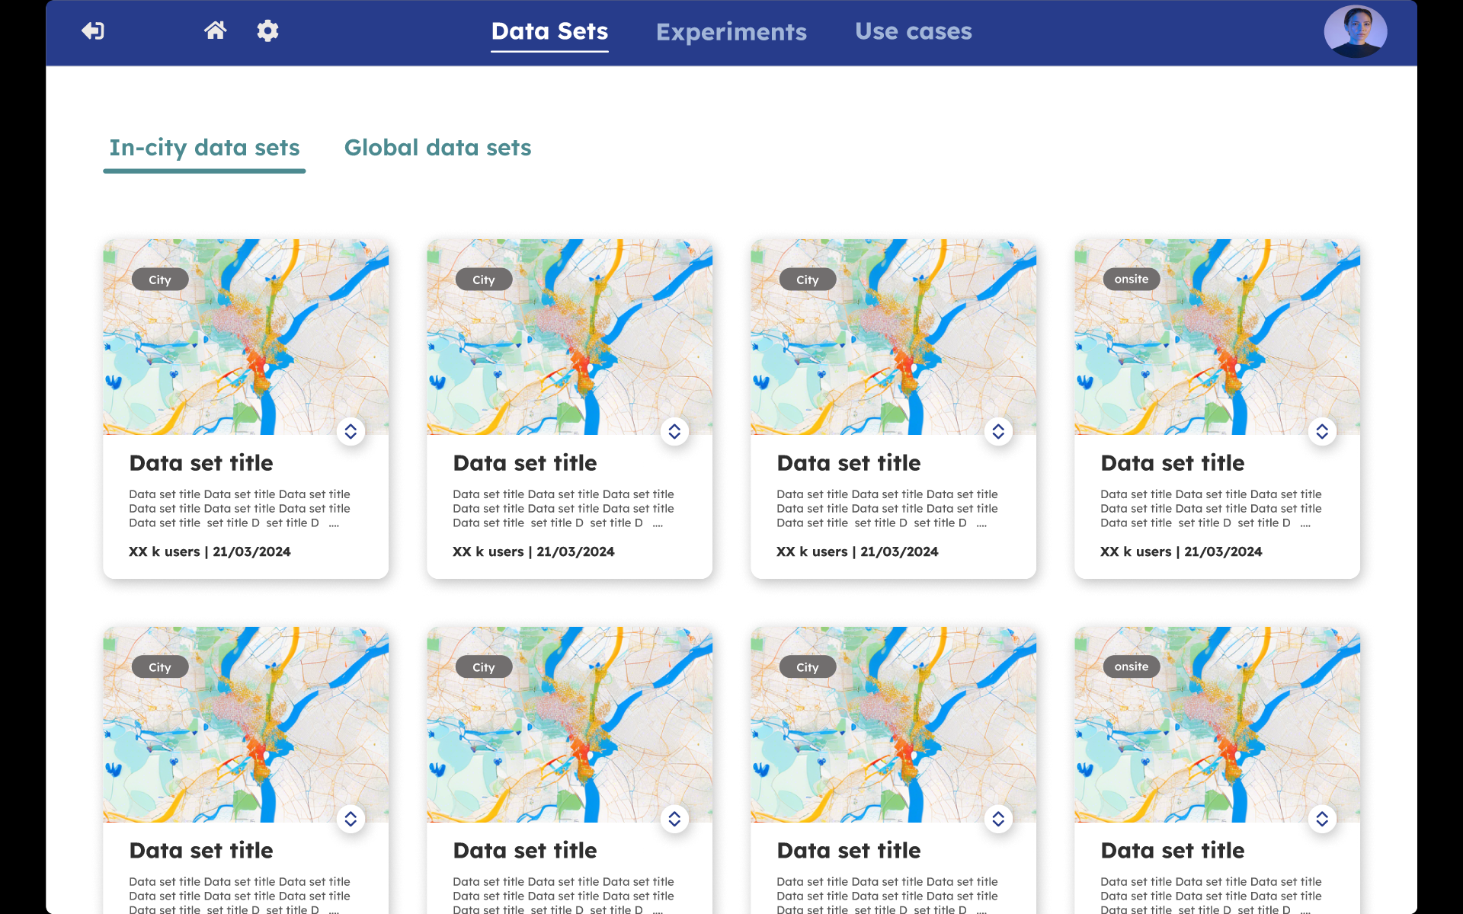
Exploration Tool

Slide 13
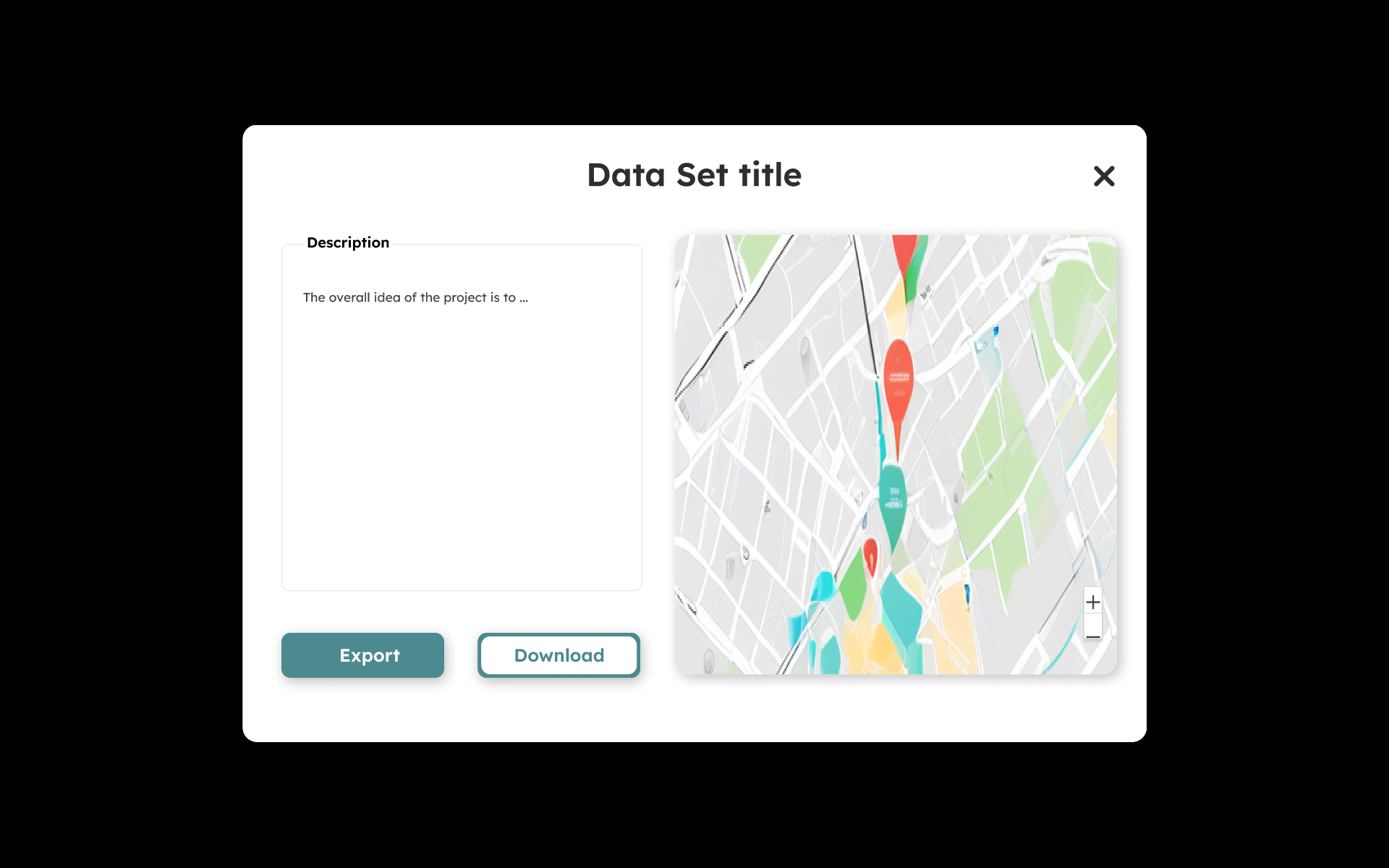
Exploration Tool

Slide 14
Exploration Tool

Slide 15
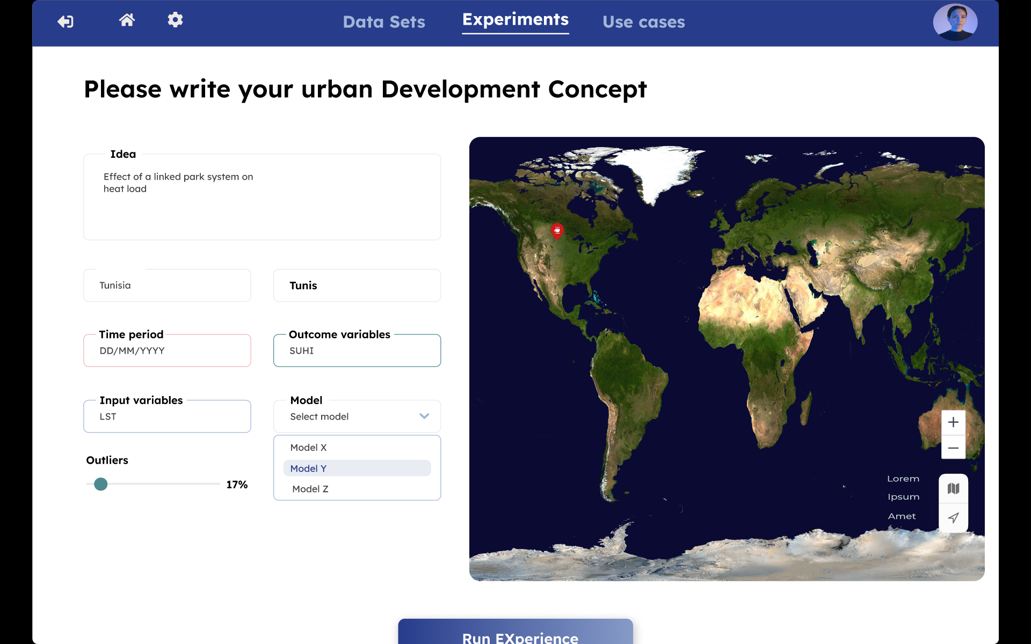
Exploration Tool

Slide 16
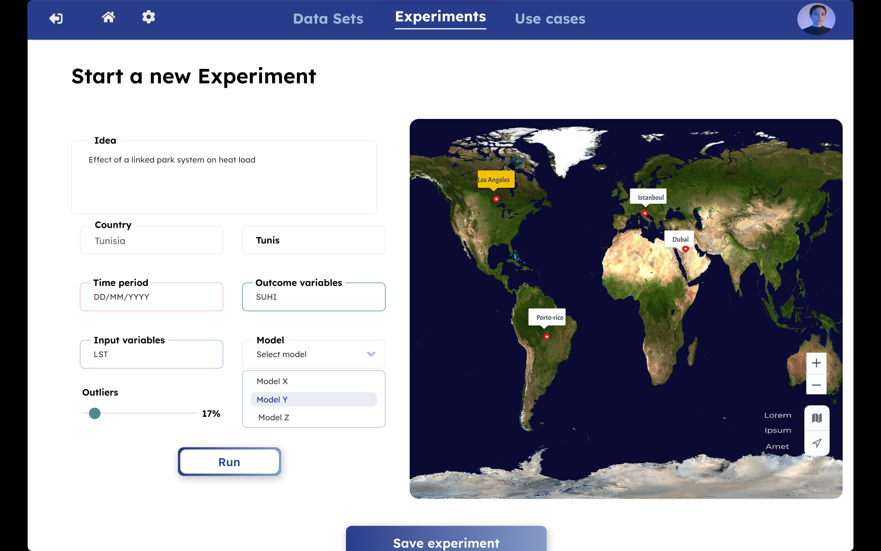
Exploration Tool

Slide 17
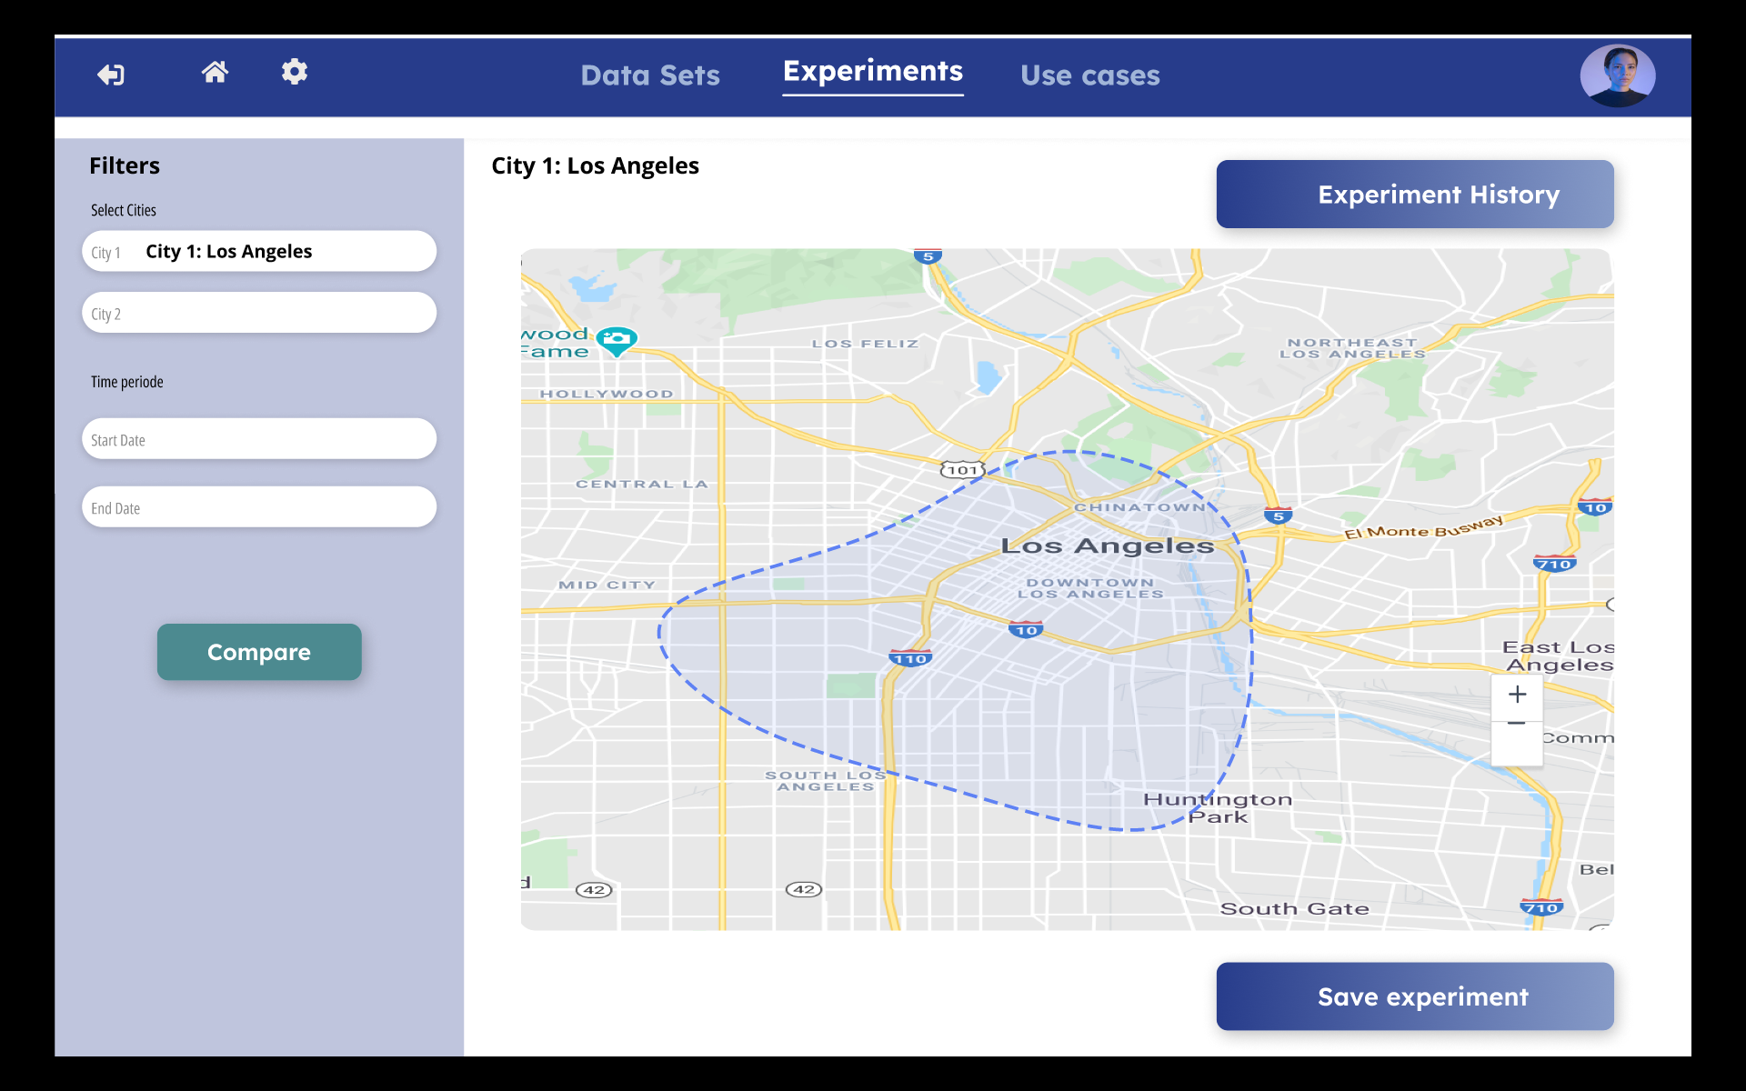
Exploration Tool

Slide 18

Exploration Tool

Slide 19
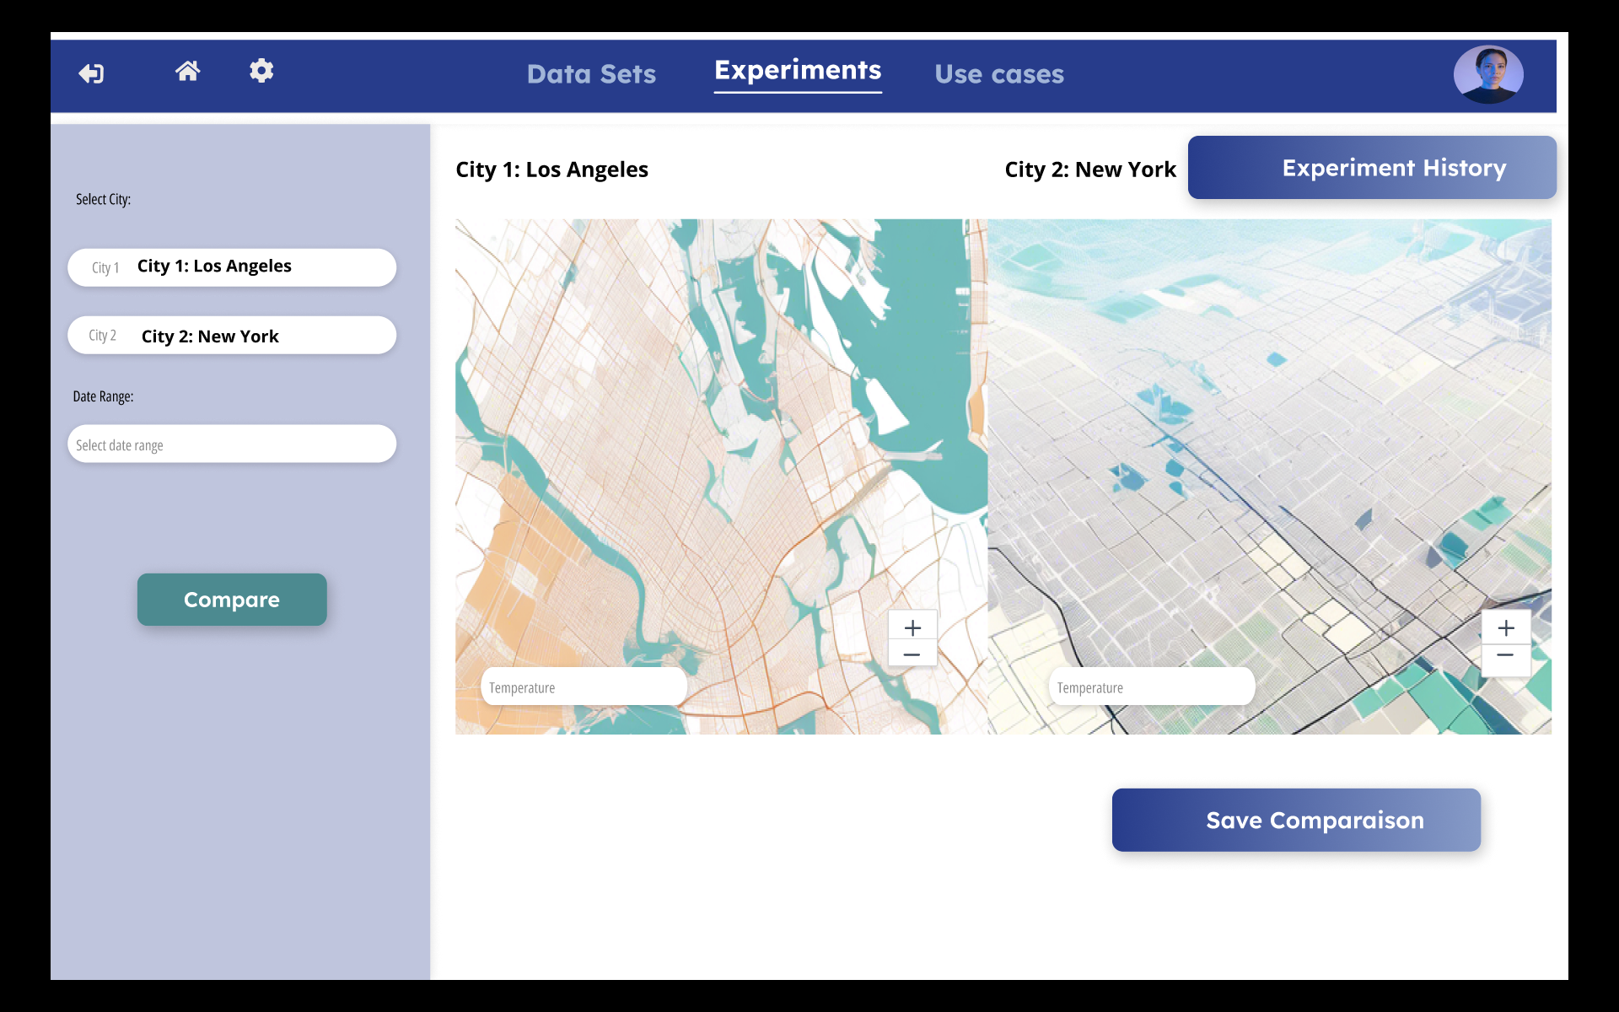
Exploration Tool

Slide 20
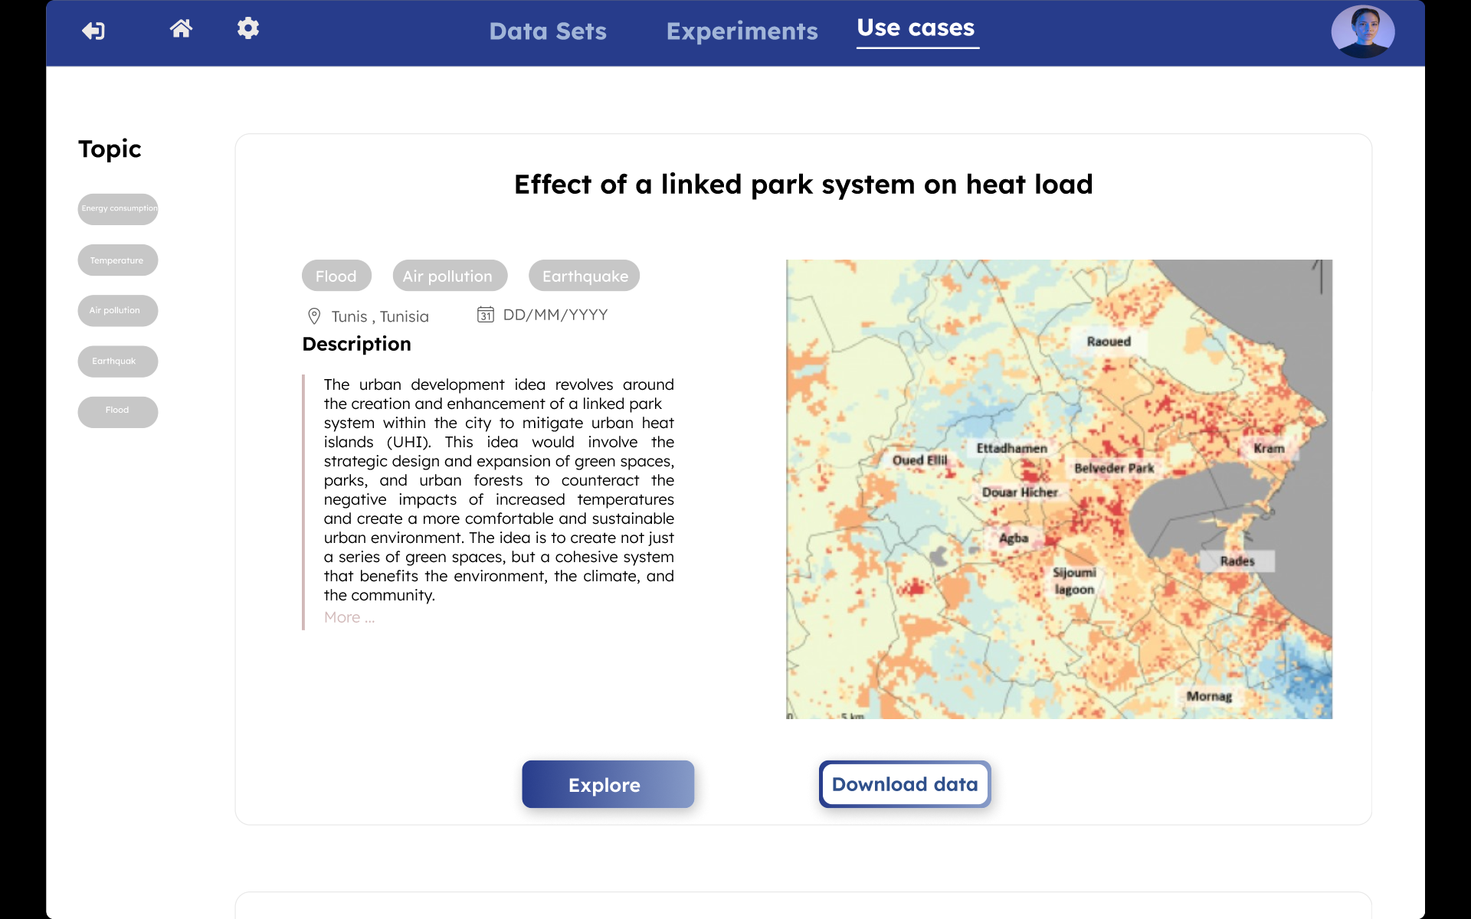
Exploration Tool

Slide 21
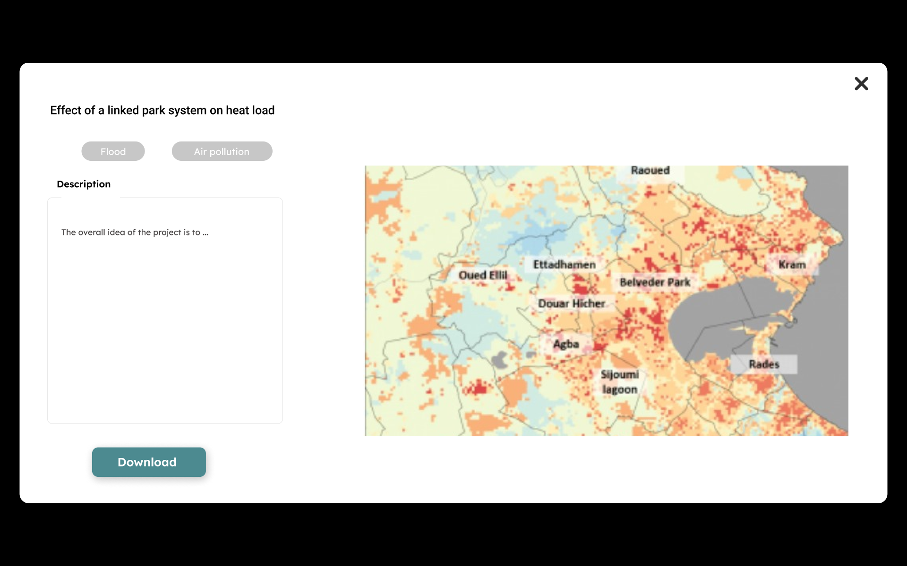
Exploration Tool

Slide 22
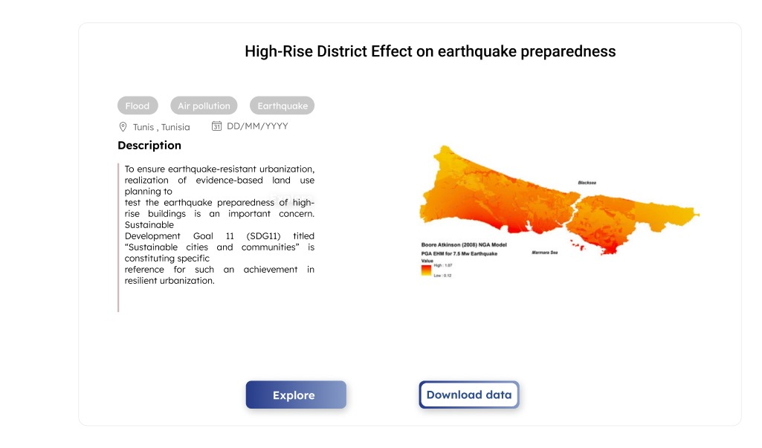
Exploration Tool

Slide 23
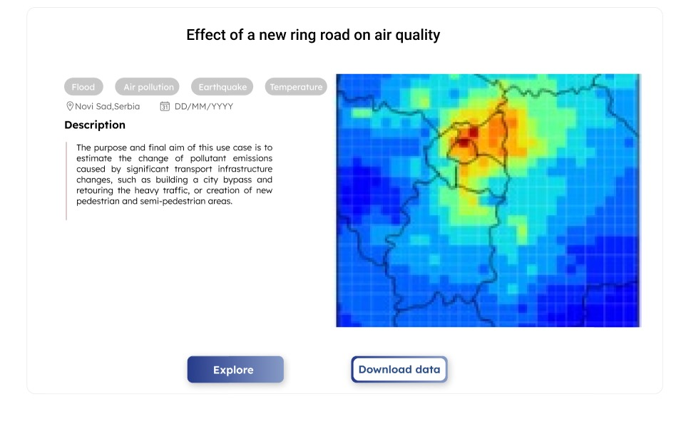
Exploration Tool

Slide 24
UDENE Project
TUNisian Space Association
Thank you for your attention ☺
Contact
Syrine Souissi : syrine.souissi@etu.Sorbonne-universite.fr
TUNSA: direction@tunsa.tn
UDENE: info@udene.eu
The project has received funding from the European Commission's Horizon Europe Research and
Innovation Programme under grant agreement No 101131190

