Slide 1
EO Sectors perspectives and opportunities,
Emmanuel PAJOT, Secretary General
Big Data: Space Solution for society Government of Malta, Eurisy, Xjenza Malta
July 01, 2025

Slide 2
What is EARSC?
Membership-based, non-profit, Brussels-based, European organization which coordinates & promotes the activities of European companies engaged in delivering EO geo-information services.
Enabler: Connect , Facilitate a structured dialog, Support Awareness & Develop the market

Slide 3
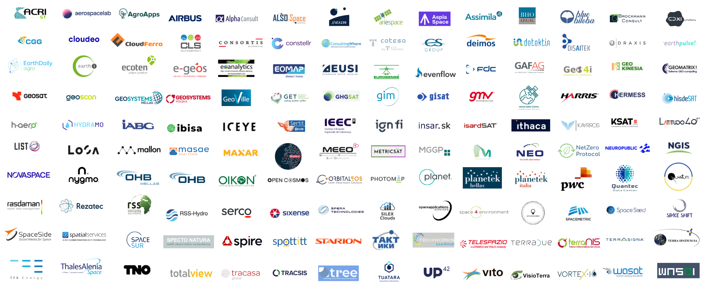
EARSC Members
140
Companies
24
Countries
covering the whole Earth Observation value chain.

Slide 4
A Developing Industry - EARSC Industry Survey 2023
796
Companies
Up from 772 (+3%)
year on year
14928
Employees
Up from 13796 (+8%)
year on year
2.27b EUR
Revenues
Up from 1.79b EUR (+27%)
year on year
10.7%
Growth Rate
Over the last five years
A collective success but …

Slide 5
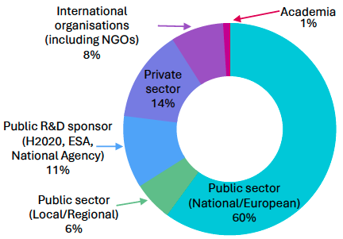
Market & User trends
Public sector share reaches a total of 66% (vs 52% in 2021)
➔ Uptake at National/European
Established and growing markets
➔ “global” uptake

Slide 6
EO in a changing world
Defence
Security
Climate Adaptation
Call to exploit existing capabilities and THEN develop what is needed
Solutions exist and are used, significant potential if activities are implemented to support compliancy
Numerous capabilities and market development in the making: policy as a driver, innovative procurement, …
EU Sovereignty
International Collaboration
Access to Infrastructure, Data, Platforms, Services and Information

Slide 7
Conclusions
SMEs developed cutting edge solutions for local/regional authorities and need support to connect with new customers
Engagement of local and regional public organizations should be a shared goal that aligns with digitalization efforts and climate adaptation initiatives.
New commercial data opens avenues for new solutions (new payload, revisit, AI onboard, …)
National constellations should be instrumental in the user uptake approach, identifying need for services and could play a role to define standards and ensure interoperability.
Platforms are powerful tools to facilitate the use of new processing technics (cloud, AI, …), scale up and access diverse type of data inc. non EO data and support defragmentation
Security can serve as a catalyst for interested SMEs to improve their operations and allow Defence entities to access various solutions provided by the private sector “Purchase what you can, Build what you need”
International collaboration is a powerful vector as CC/CA is global and European companies have the expertise.

Slide 8
A first action?
Support the dissemination of the Industry survey in your country/community !
Thank you for your support

Slide 9
26, Rue de la Loi, Brussels info@earsc.org
www.earsc.org www.eopages.eu https://africa.eopages.eu www.earsc-portal.eu www.eoMALL.eu www.earsc.org/sebs

