Slide 1
Requirements Gathering Exercise: The Use of Satellite Data in Public Sector Departments

Slide 2
Interviews with the Public Sector
14 Public Sector Entities
1 Private Sector Entity (Meteorological Department MIA)
Interviews semi-structured (Method used in UI design)
In person and recorded
Results have been transcribed
Data analysis uses Grounded Theory as analysis method

Slide 3
Key points for Discussion
Satellite-Data Use
Education
Sustainable Satellite-Data Infrastructure
The Function of a Centralised Hub
ESA PECS or Horizon Europe as a Mechanism to Develop a Satellite Data Ecosystem

Slide 4
Satellite-Data Use
Satellite data use is being perceived within a limited scope
Knowledge about data stitching is limited
Satellite data use is only being perceived as provision for basemaps
Satellite data compared to drone data and standards for satellite data resolution are being made on-par with drone imaging standards
Frequency of satellite fly-overs allows for constant data updates
Use of satellite data fosters collaboration between researchers and organisations encourages global data-sharing which influence large scale decision making
Long-Term observation and pattern recognition are used to identify trends
Use of various bandwidths allows for wide range data collection and the use of various analysis methods

Slide 5
Education
Education about satellite data does not necessarily have to be about being able to process it
A good understanding of Satellite data use is required to be able to deliver effective requirements gathering
Better understanding of the variety of satellite data products allows broader manipulation of the data and being able to adapt it to broader needs
Degrees in GIS education and remote sensing are lacking locally
ESA PECS used as a means to create university modules and degrees to teach about satellite data, its use, how it can be accessed, data manipulation
Lack of personnel proficient in GIS
Lack of interested workers who aspire to work with GIS
Education and awareness campaigns have to start from a lower level than university

Slide 6
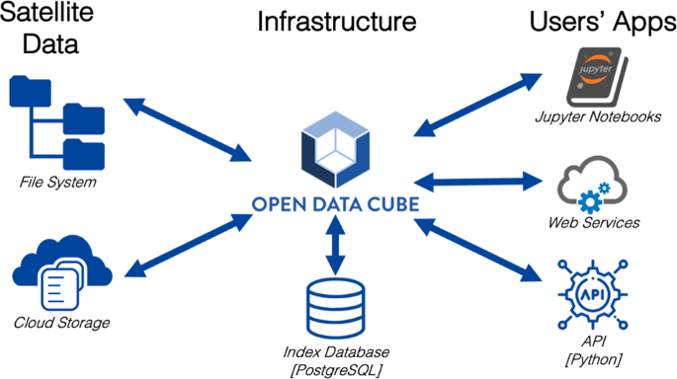
Sustainable Satellite-data Infrastructure
The creation of GIS professionals with competitive wages and scales created purposely for these roles
Satellite data integration will increase and infrastructural changes and adaptation to a new modus operandi will be needed at government level
Ongoing training is required to ensure personnel’s knowledge is on-par with technological developments
The creation of a central datahub that can purchase commercial satellite data is needed
The formation of an Action Committee is needed to establish a central datahub
With an organised government ecosystem academia and the private sector will be able to produce specific services and products based on government sector needs

Slide 7
The Function of a Centralised Data Hub
A centralised data hub forms a focal point where data is collected from multiple sources and applications
Data can be organised and distributed amongst its different users
Facilitates data collection, integration and data-efficiency management between organisations
Acts as a repository that can store large volumes of data and distribution
Responsible for collecting, organising and harmonising data for redistribution
Improves data quality and security reducing redundancy and replication
Handles the purchasing, compiling and processing based on end-user requirements
Democratises data through easy access fostering collaboration

Slide 8
ESA PECS as a Mechanism to Develop a Satellite Data Echo System
PECS – Plan for European Cooperating States acts as an incubator that allows domestic stakeholders to compete for ESA Tenders
PECS calls are issued every year calls can be designed to suit a country’s needs
PECS allows for the development and creation of satellite products
Consortiums can be formed between private companies, academic institutions and public institutions
Through a Type A criterion stakeholders can start fundamental research (€125,000)
Through a Type F criterion stakeholders can develop their product to be ready for Market (€200,000, 25% must be co-funded)
Criteria specifically dedicated to Space Education (Types G1 and G2) cater for the development of university degrees, Bachelors and Masters. G2 is for PhD’s
ESA PECS brings lots of training opportunities in the form of webinars and in-person training.

Slide 9
Horizon Europe as a Mechanism to Develop National & pan-European Satellite Data Echo Systems
National Potential
Horizon Europe as a platform to develop a national satellite infrastructure
Large scale projects that could be used to develop various smaller scale infrastructures
________________________________________________________________________________________
International Potential
Horizon Europe as a platform to develop a pan-European Satellite data infrastructure
Common data systems between European Countries

Slide 10
Thank You

