Slide 1
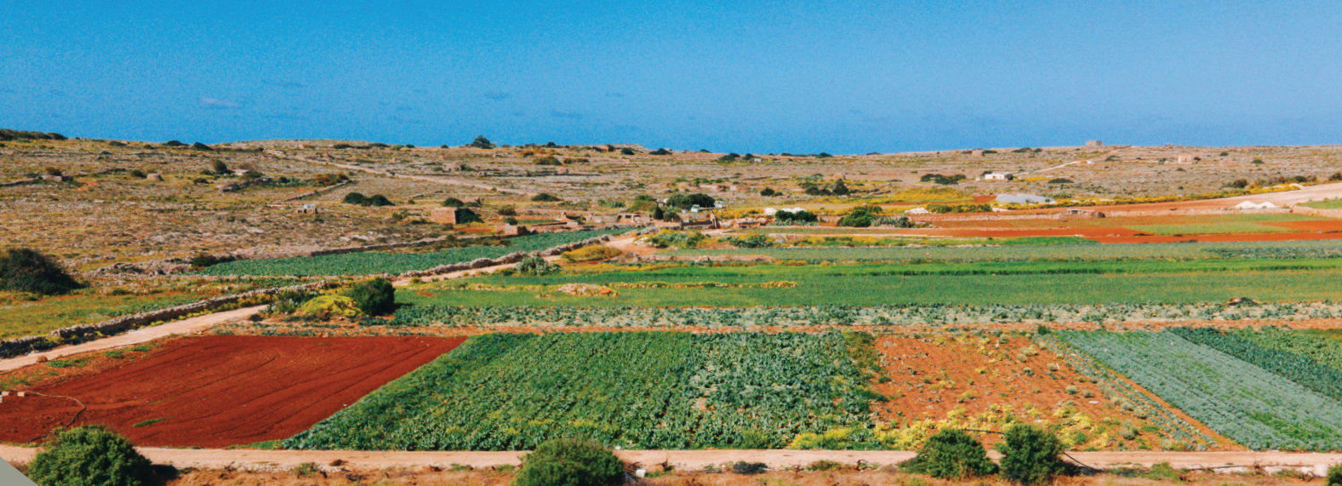
Empowering Farmers
CAP Support From Space
Emanuel Azzopardi
Senior Manager
ARPA
emanuel.b.azzopardi@gov.mt
Johan Zammit
Founder & CEO
Smart Studios
johan@smartstudios.io

Slide 2
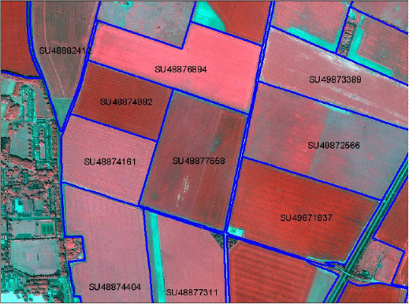
(CAP) Common Agricultural Policy - System for Agricultural Subsidies by the EU
✅ Food supply
✅ Sustainable farming
Land Parcel Identification System (LPIS)
Notes:
CAP - CAP SP - TARGETS + eligibility conditions e.g. production of specific crop | crop diversification |

Slide 3
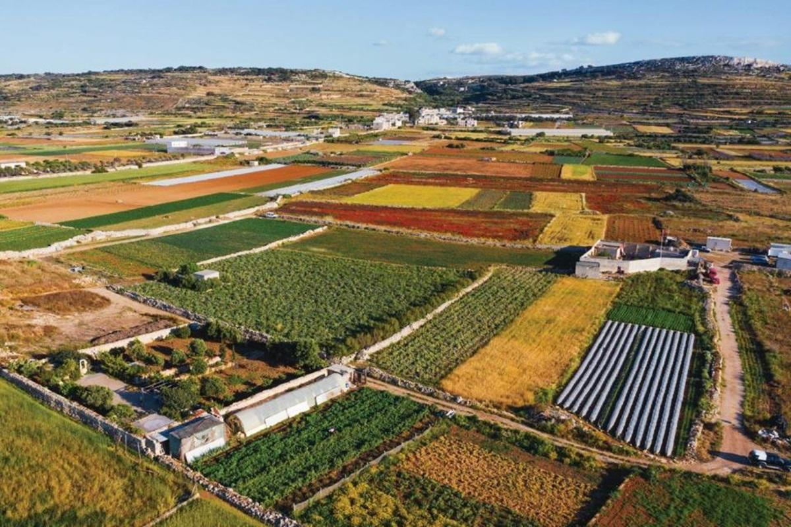
(CAP) Common Agricultural Policy - System for Agricultural Subsidies by the EU - HOW do farmers receive subsidies - HOW GIS and EO help?
1. Real world - Aerial Shot
2. Farmer declare their parcels to quantify DIRECT support
3. Controls - Land cover updates
4. Farmer declare crops or commit to environmental agric. Practices - RD Support
5. Controls - Declared practices
Potato
Abandoned land
Wheat
Strawberries
Notes:
CAP - CAP SP - TARGETS + eligibility conditions e.g. production of specific crop | crop diversification |

Slide 4
(CAP) Common Agricultural Policy - System for Agricultural Subsidies by the EU
HOW are farmers declaration checked?
Checks and Controls:
✅ Old methods
Sample based (1-5%) - On the spot inspection
Rule based - High financial penalty rates
✅ New methods
Area Monitoring System (100%) - Satellite
No financial penalty rates
Notes:
CAP - CAP SP - TARGETS + eligibility conditions e.g. production of specific crop | crop diversification |

Slide 5
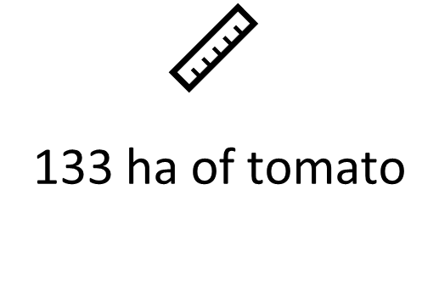
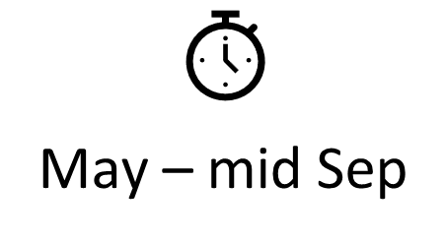
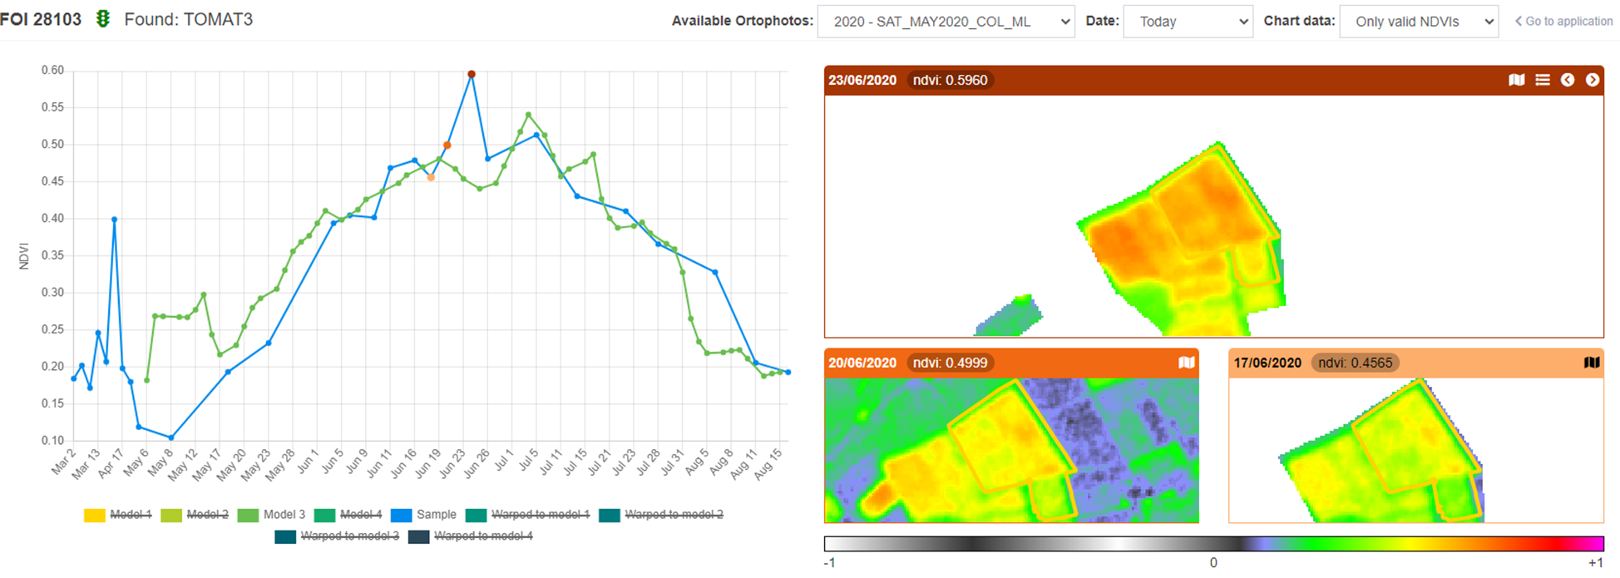
USE CASE 1: Monitoring of Tomato crop - ‘Markers’

Slide 6
USE CASE 1: Monitoring of Tomato crop - ‘Traffic Light’

Slide 7
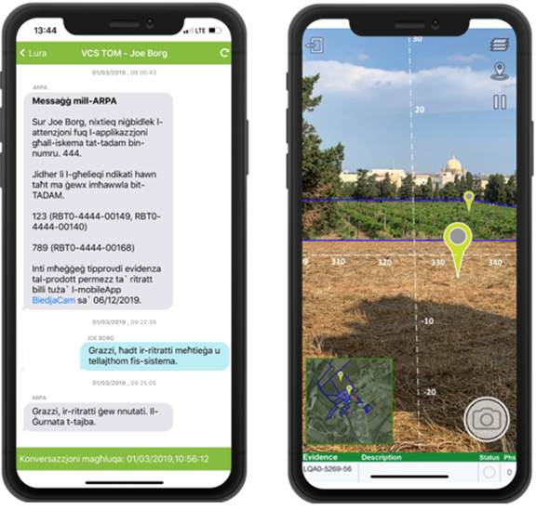
USE CASE 1: Monitoring of Tomato crop - ‘Success Stories’
✅Farmers active players in the Monitoring process
✅Can provide GeoTagged photos
✅Can amend their original aid application
✅ZERO aid application with penalties

Slide 8
USE CASE 2: Monitoring Agricultural Activities
✅Baseline Condition: Avoidance of land abandonment
Sep Yn-1 - Sep Yn
9,000ha
Bare Soil = Blue
✅Top up payments: 7% of holding left as fallow land
May - October

Slide 9
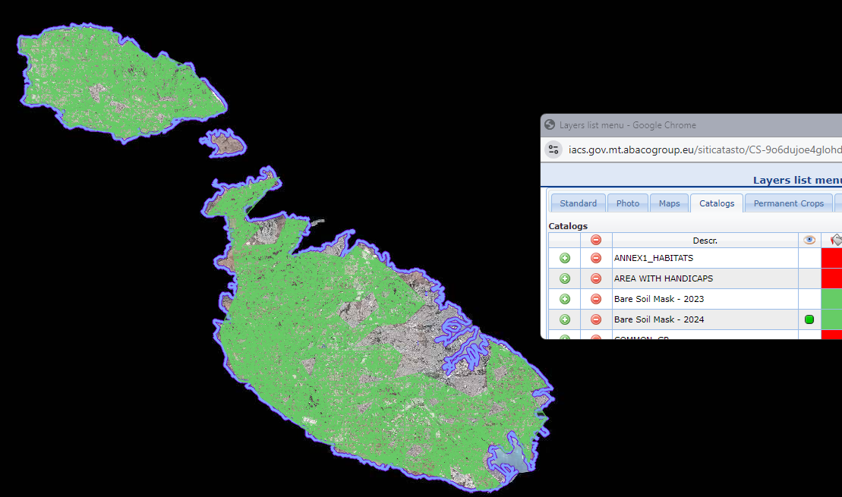
USE CASE 2: Monitoring Agricultural Activities
Nationwide maps
Useful for policy makers
When, How much?

Slide 10
Why Is AI-Based Land Use Identification From Satellite Images Needed?

Slide 11
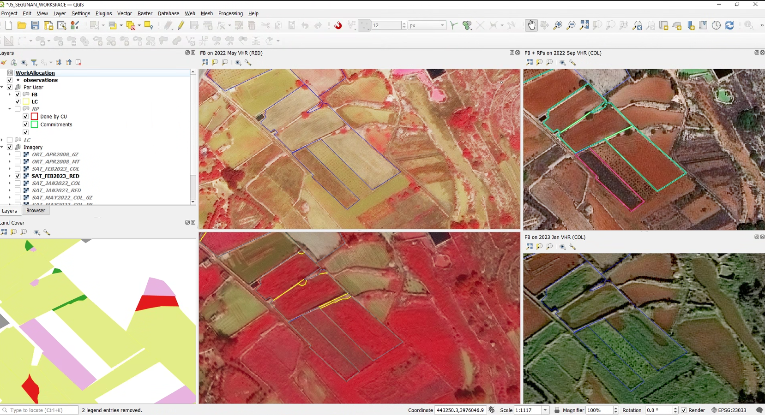
The only way ARPA can feasibly check land use nationwide is through satellite images.

Slide 12
And the only feasible
way of processing
huge satellite images
is through AI.

Slide 13
Why Not Procure An Off The Shelf AI Geospatial Analytics System Instead?

Slide 14
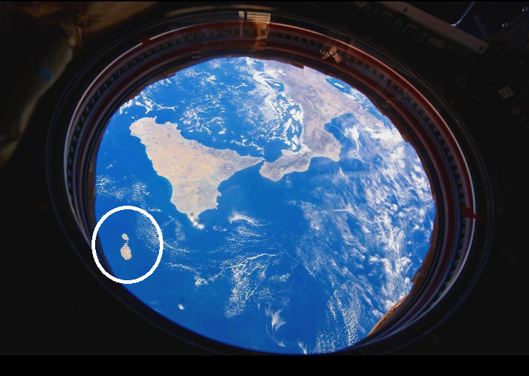
Malta’s vegetation is different!
Custom
AI models built specifically for Malta’s land surface.
ESA

Slide 15
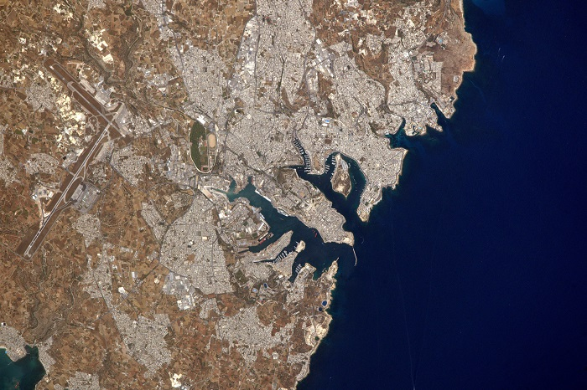
X Data is abundant
X AI is abundant
? Custom AI models are scarce

Slide 16
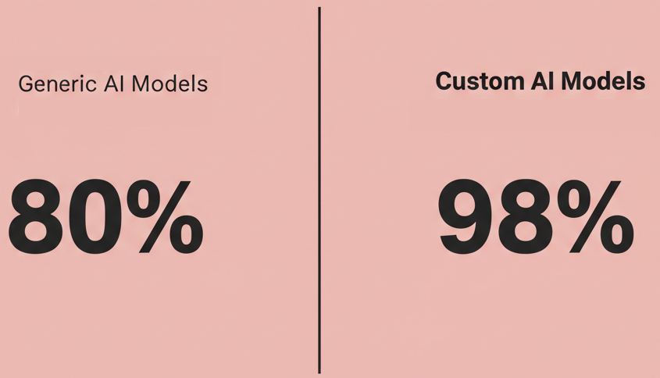
The answer is AI Accuracy

Slide 18
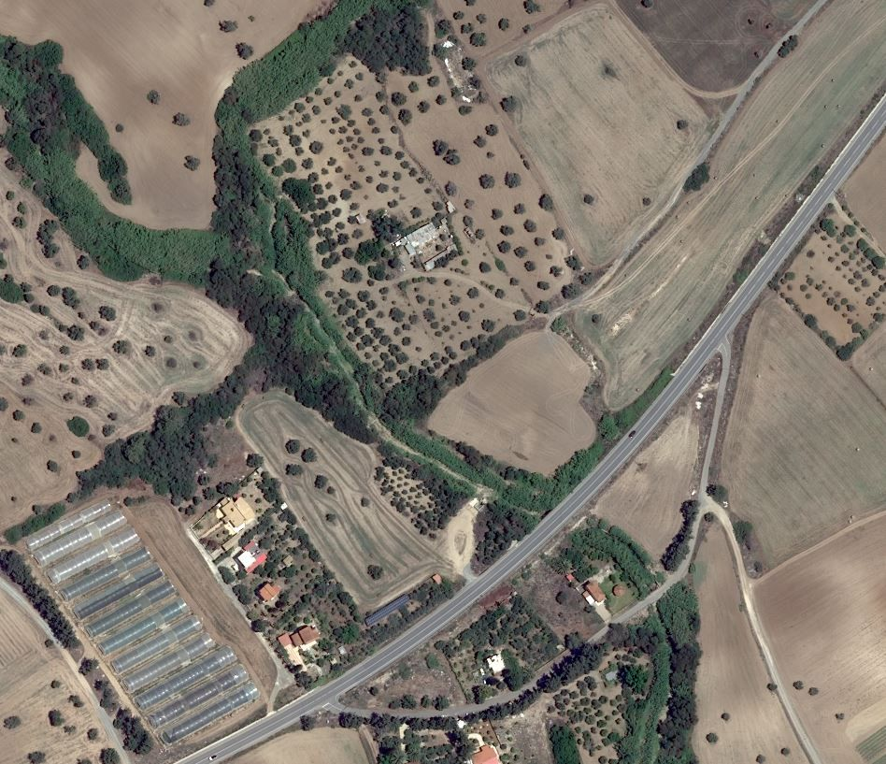
For ARPA
Skeye identifies
✅Arable Land
✅Trees
✅Greenhouses
✅Water Reservoirs
with high precision from VHR satellite images.
Airbus

Slide 19
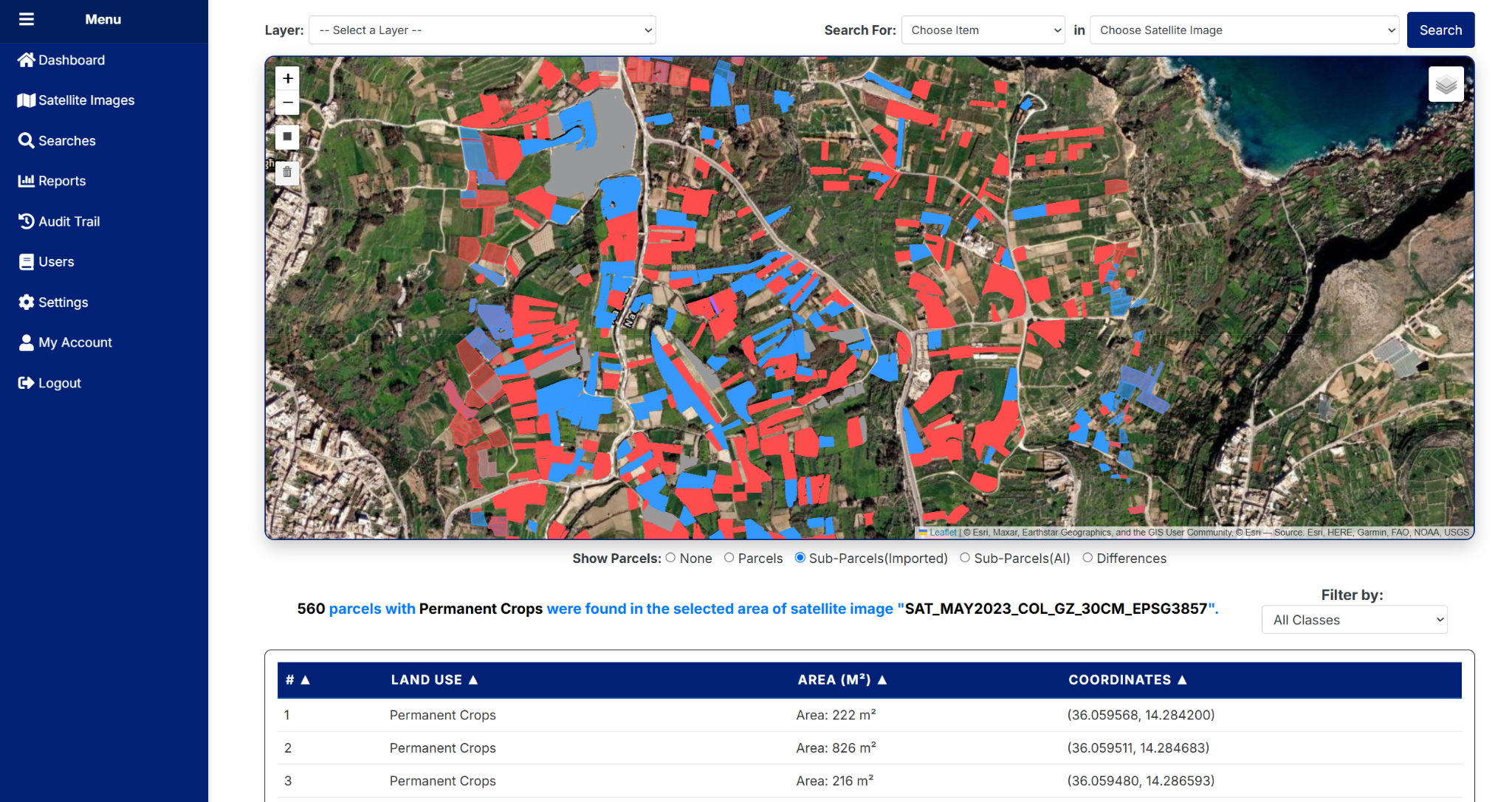
Select 1 an area, 2 an object & 3 a sat image.

Slide 20
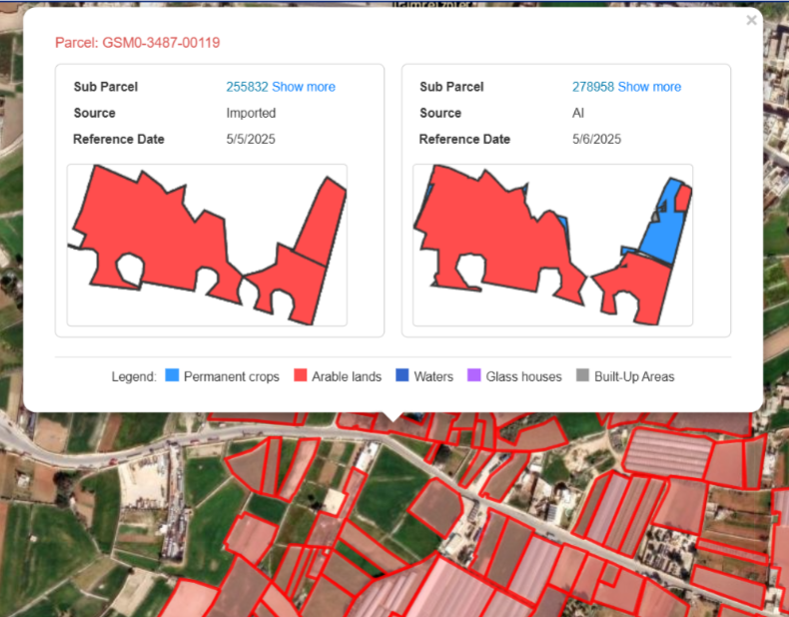
Actionable Intelligence
✅All insights are available on screen & also via API.
✅ You can build active alerts when certain criteria are met.

Slide 21
Why SKEYE?
All the benefits of a SaaS product
✅ An easy-to-use web-based user interface.
✅ Advanced search, filter and alert capabilities.
✅ Long list of identified objects & and land use.
✅ Supports Sentinel-2, VHR etc.
✅ No technical/geospatial/AI knowledge required.
✅ Actionable intelligence & insights.
✅ Cloud-based scalability to process large images.
✅ Seamless integration with sat & GIS platforms.
Plus the accuracy of custom
AI models.

Slide 22
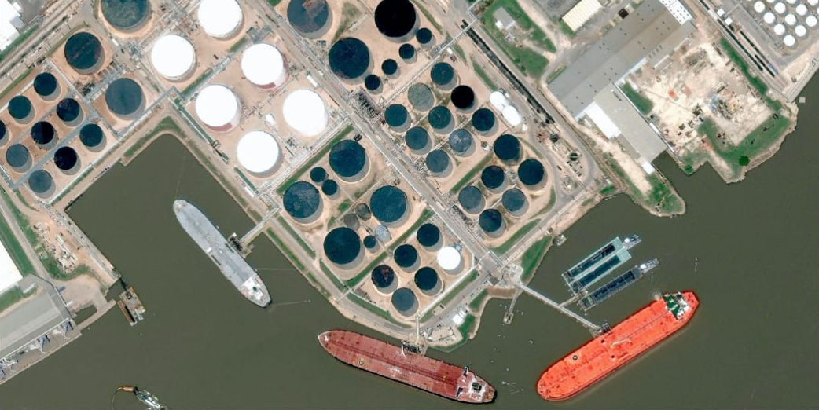
The same technology can be used to identify
✅buildings
✅ships
✅planes
✅solar panels
and much more.

Slide 23
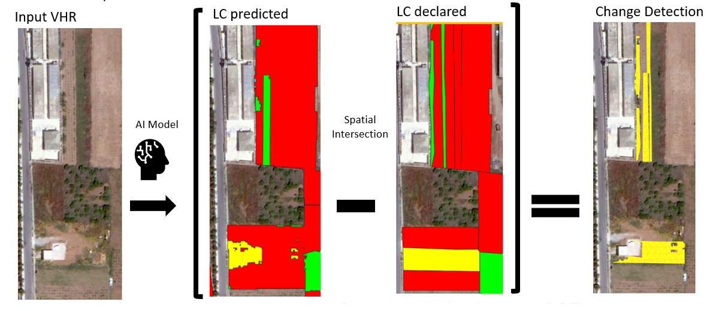
Before using custom AI models built specifically for Malta ARPA did a lot of
❌slow
❌costly
❌error-prone
manual analysis.
Now the AI does 90% of the work.

Slide 24
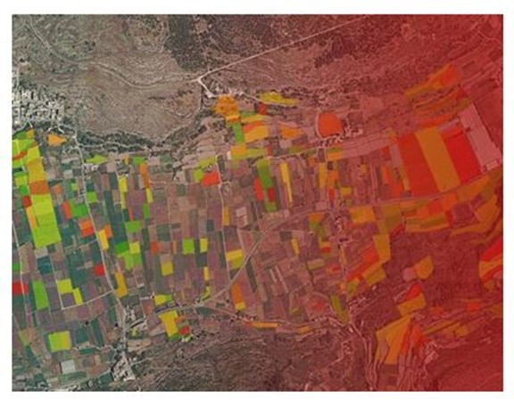
Benefits For ARPA
✅Reduced manual
errors
✅Freed up staff
from manual checks
✅Better help farmers and reduce fraudulent claims
✅ Non-technical staff can use geospatial analytics

Slide 25
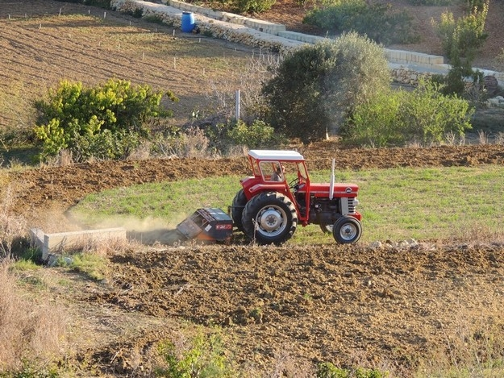
Benefits For Farmers
✅Simplification - Instead of listing parcels in advance, eligible parcels can be identified directly from satellite data
✅Faster Payment
✅Fairer system - amendment possibility
✅ Higher absorption of EU funds through these innovative methods
Emanuel Azzopardi
Senior Manager
ARPA
emanuel.b.azzopardi@gov.mt
Johan Zammit
Founder & CEO
Smart Studios
johan@smartstudios.io

Slide 26
Ideas? Questions? Comments?
Come speak to us after this presentation or send us an email on
emanuel.b.azzopardi@gov.mt
johan@smartstudios.io
Emanuel Azzopardi
Senior Manager
ARPA
emanuel.b.azzopardi@gov.mt
Johan Zammit
Founder & CEO
Smart Studios
johan@smartstudios.io

