Slide 1

Supporting application builders in Earth sciences
Pedro Gonçalves
1 July 2025
Big Data: Space
Solutions for Society

Slide 2
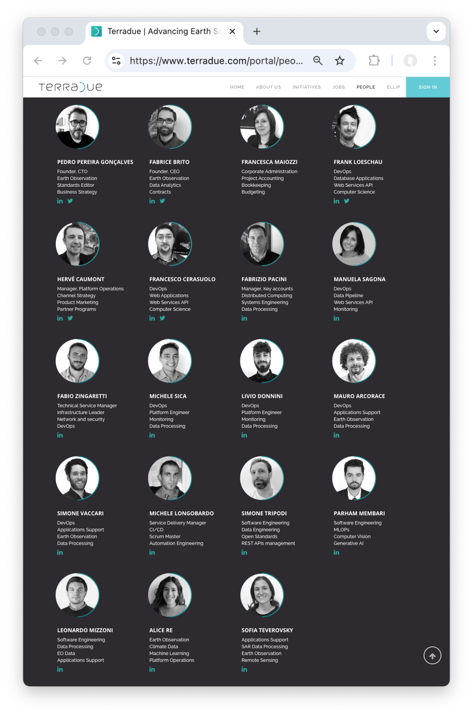


Who we are ?
Founded by ESA researchers (2006)
  Team of 19 (+1) from 6 (+1) nationalities
  Turnover of ~€3M (2024)
  Main office in Rome at The Hub (Termini)
  1st incubatee of ESA BIC Lazio
Notes:
https://business.esa.int/news/meet-esa-bic-lazio

Slide 3
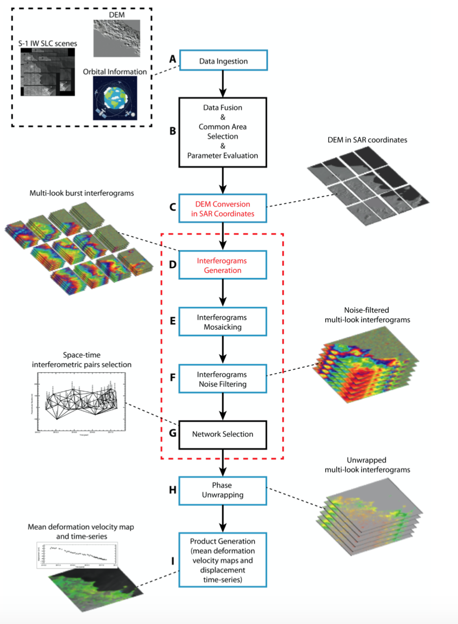
What we do ?
Support to application builders in Earth sciences, to use satellite data as their information source
  Algorithms in different data programming models and languages
  Producing Analysis Ready Data and Added Value Products

Slide 4










Where we do it ?
Support to application builders in Earth sciences to use satellite data as their information source
  Algorithms in different data programming models and languages
  Producing Analysis Ready Data and Added Value Products
Deploy & operate Earth observation data processing applications in multiple Clouds without lock-in
  Processed near the EO data holdings
  Fixed time period or continuous operations

Slide 5

Who are our users ?
Support to application builders in Earth sciences, to use satellite data as their information source
  Algorithms in different data programming models and languages
  Producing Analysis Ready Data and Added Value Products
Deploy & operate Earth observation data processing applications in multiple Clouds without lock-in
  Processed near the EO data holdings
  Fixed time period or continuous operations
Service Providers, Analysis and Decision Ready Data Consumers
  Universities, Research Institutes

Slide 6
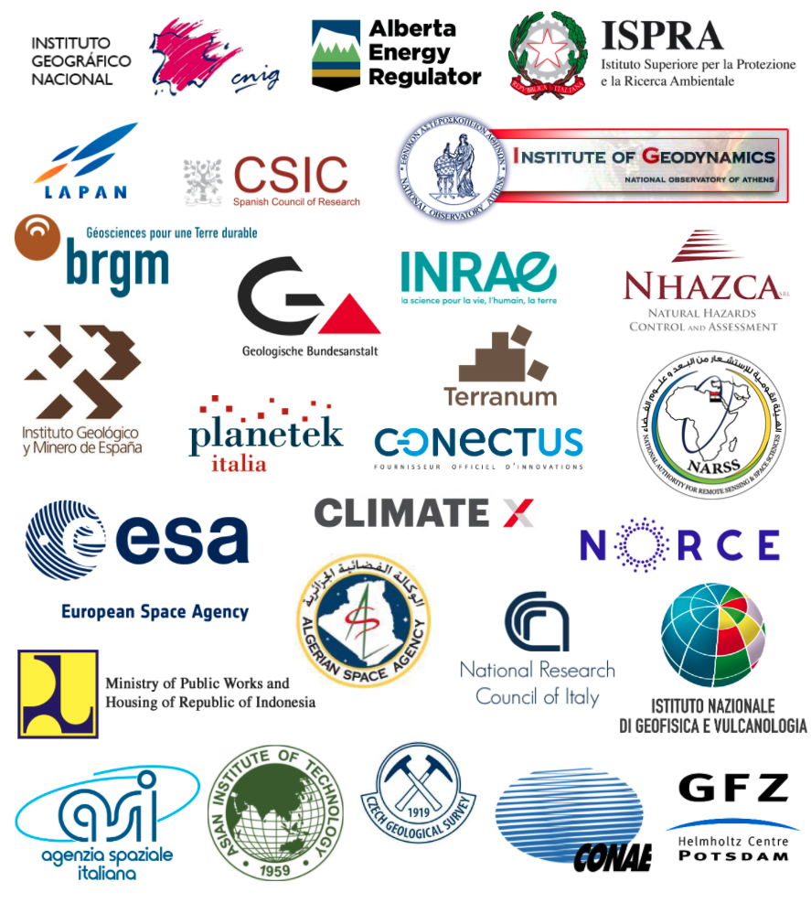
Who are our users ?
Support to application builders in Earth sciences, to use satellite data as their information source
  Algorithms in different data programming models and languages
  Producing Analysis Ready Data and Added Value Products
Deploy & operate Earth observation data processing applications in multiple Clouds without lock-in
  Processed near the EO data holdings
  Fixed time period or continuous operations
Service Providers, Analysis and Decision Ready Data Consumers
  Universities, Research Institutes
  Governmental Agencies, Companies

Slide 7




Portfolio
Geohazards
Exploitation Platform
Disaster Charter
Processing Environment
Cloud-based processing
platform with services
for monitoring terrain motion and critical infrastructures providing data screening, event response and area monitoring
International Charter ‘Space
and Major Disasters’:
  space agencies agreement
  supporting the immediate
  disaster response with
  satellite data and information
Copernicus LAC Platform
FLuorescence EXplorer Data Innovation and Science Cluster
Provides Copernicus Sentinel
data and services to the Latin American region and the Caribbean
Capacity building for full operations of the Centre to Panamanian Government
Collaborative platform to support
the development, testing, and
validation of data processors
for the upcoming ESA FLEX mission
Notes:
https://business.esa.int/news/meet-esa-bic-lazio

Slide 8




Portfolio
Geohazards
Digital Twin
Iliad Digital Twins
of the Oceans
Digital Twin Component for
geohazards (earthquakes, volcanoes, and other natural events)
Monitoring and managing geohazards with real-time information and models
Supporting the packaging of models and data processing chains for creating virtual representations of the sea to integrate Earth observation, modelling, and digital infrastructures
IRIDE Data Lake
Terravision
Satellite constellation financed
by the Italian PNRR
Data management functions
to gather, archive, transform,
to multi-mission datasets
Enhancing EO services for sustainable mining practices, focusing on the raw materials value chain.
Providing services for monitoring terrain motion and critical infrastructures
Notes:
https://business.esa.int/news/meet-esa-bic-lazio

Slide 9
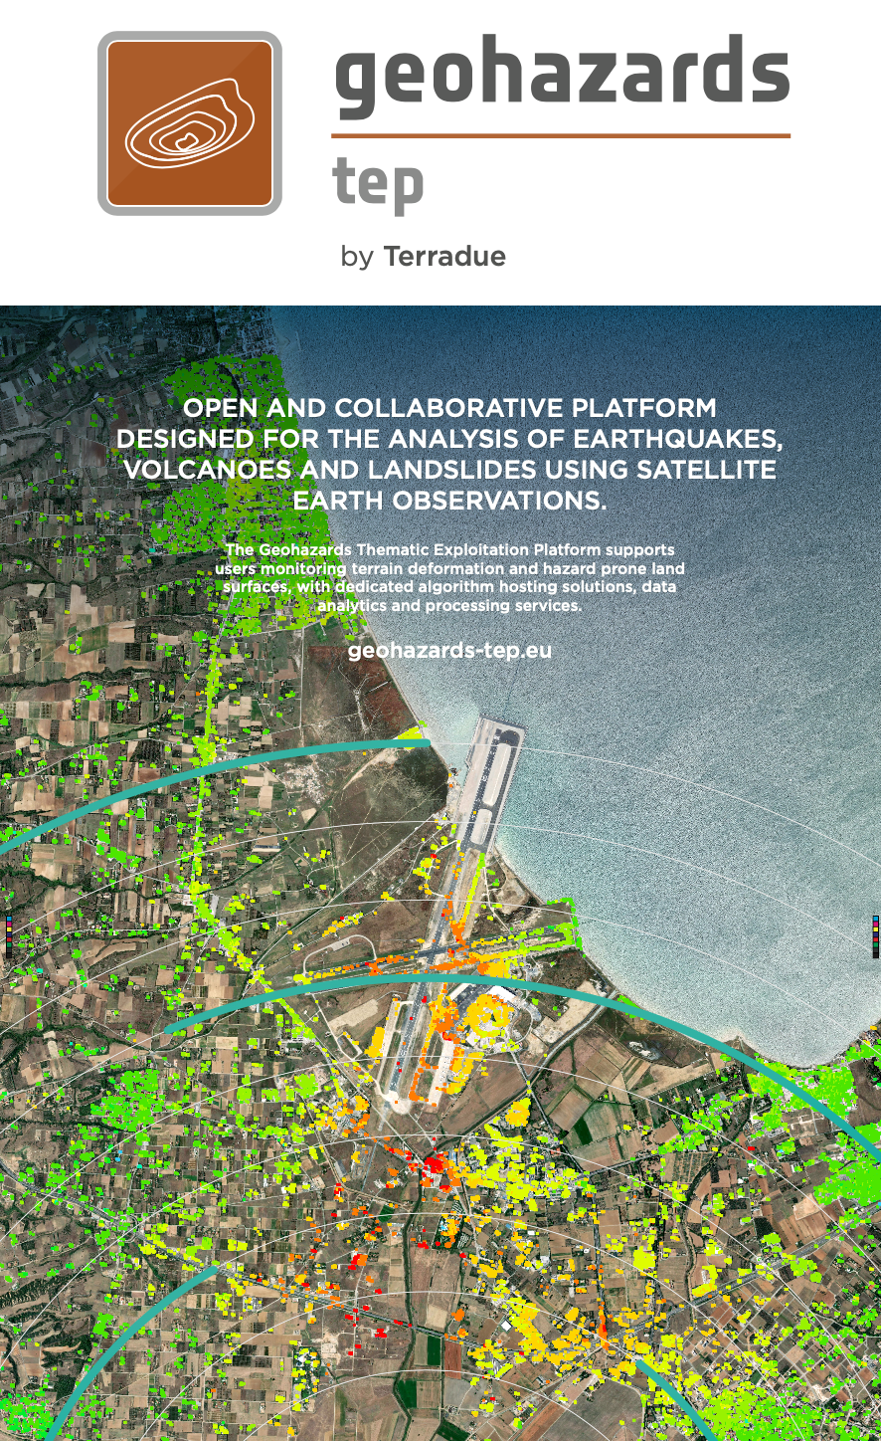

Slide 10
Platform: Geohazards
Terradue operates the Geohazards Exploitation
Platform, a cloud-based processing environment
to support disaster risk reduction & mitigation
  +25 services for monitoring terrain motion and
  critical infrastructures providing data screening,
  event response and area monitoring capabilities
  EO missions, in-situ & community derived products
  +3.500 registered users, ~350 creating new content
Hosts systematic and event-triggered services
from several providers with revenue sharing
Solid sponsored and direct purchase revenue
  Pay-as-you-go or Subscription packages
Notes:
We are the operators of GEP ...

Slide 11
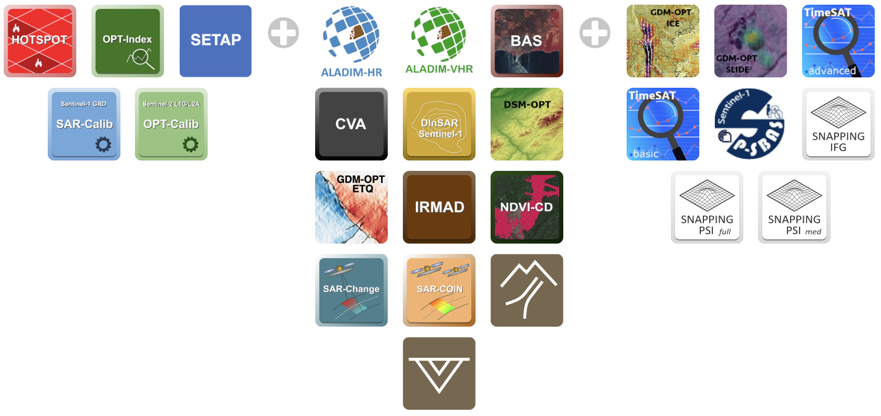













GEP Service Offering
A wide service portfolio for multi-hazard applications
GEP Service Owners
https://geohazards-tep.eu/#!web_store
Notes:
The data processing services are divided into 3 categories:
Data Screening: Optical and SAR services for rapid EO data screening and combination
Event Response: Conventional InSAR/Optical services for earthquake response, land subsidence and volcanoes monitoring
Area monitoring: Advanced Terrain Motion services for time series analysis ranging from Multiple Pairwise Image Correlation of OPtical images to InSAR techniques such as SBAS and PSI
GEP Service Owners
CNR IREA (Italy)
Aristotle University of Thessaloniki (Greece)
Universidad de Jaén (Spain)
TRE Altamira (Italy)
CNES (France)
CNRS EOST (France)
INGV (Italy)
DLR (Germany)
NHAZCA (Italy)
Terranum (Switzerland)
NORCE (Norway)

Slide 12
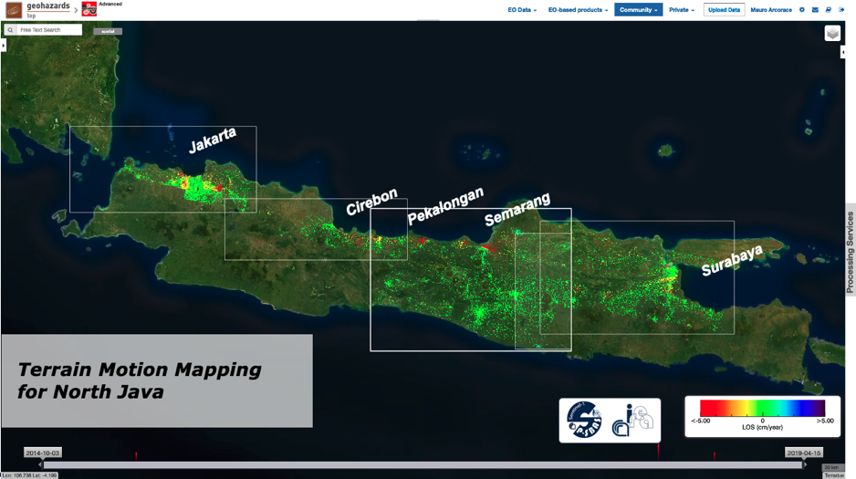
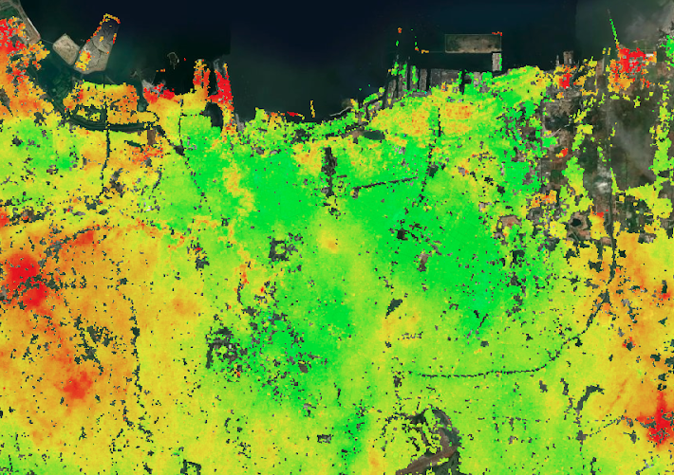
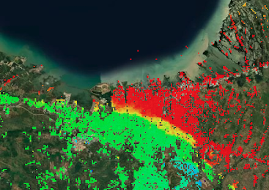

Terrain Motion
Terrain Motion Maps with Sentinel-1 P-SBAS
LOS mean velocity maps over the North of Java derived from Sentinel-1 (2015-2021)
CNR-IREA P-SBAS Sentinel-1 - P-SBAS stands for Parallel Small BAseline Subset and it is a DInSAR processing chain for the generation of Earth deformation time series and mean velocity maps. Input: SLC (Level-1) Sentinel-1 data.
Contains modified Copernicus Sentinel-1 data (2015-2021)
Notes:
The authorized users of the service have access to the Platform and are able to select EO data, define processing parameters and trigger data processing jobs or setup systematic processing requests. They are also able to establish the data pipelines for the retrieval of the information produced from several products from satellites.
In this example, you have the Italian National Research Center that integrated their well known DInSAR processing chain, based on the Parallel Small BAseline Subset algorithm, for the generation of Earth deformation time series and mean velocity maps. Here a user processed more than one hundred Sentinel one products to obtain a ground deformation map of Jakarta (Indonesia).

Slide 13

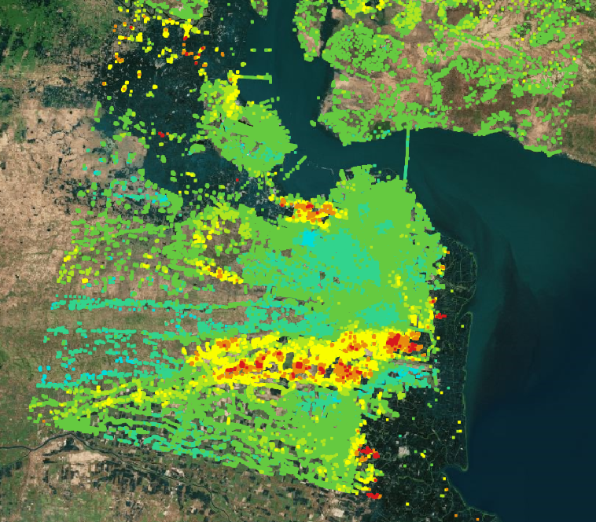
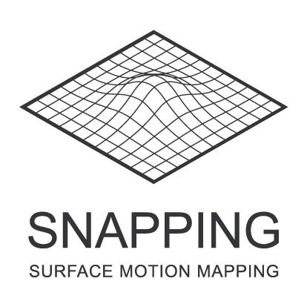
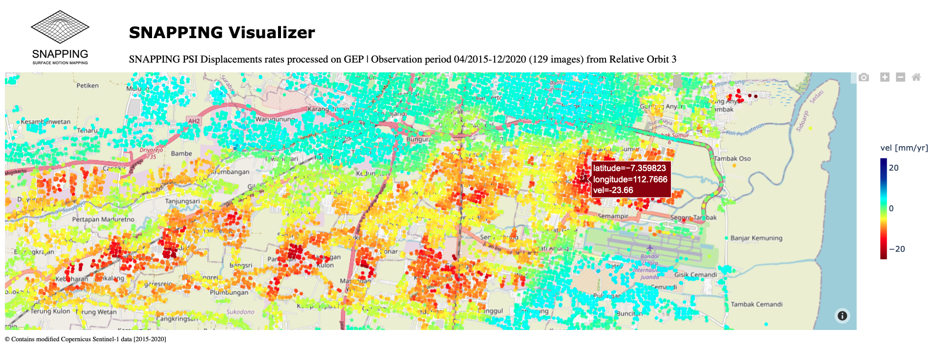
Terrain Motion
Terrain Motion Maps with SNAPPING Medium and Full Resolution
LOS mean velocity maps over Surabaya in Java derived from Sentinel-1 (2015-2020)
SNAPPING - Surface motioN mAPPING is a multi-temporal interferometric service developed by AUTh (GR), MJaen (ES), with the support of Terradue (IT), that produces measurements of surface displacements based on open source ESA SNAP and StaMPS software packages.
Contains modified Copernicus Sentinel-1 data (2015-2020)
Notes:
In this other example, you have the the Aristotle University of Thessaloniki and the Microgeodesia Jaen that integrated a PSI Multi-Temporal DInSAR processing service based on SNAP and StaMPS chains for the generation of Earth deformation time series and mean velocity maps.
Here a 6-years Sentinel-1 products stack was processed to obtain a ground deformation map of Surabaya in Java (Indonesia).
We will see later a demo of the service.

Slide 14
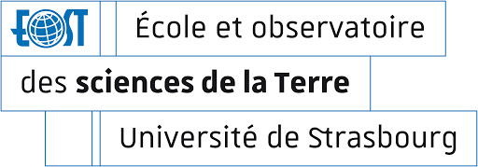
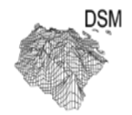
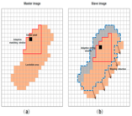
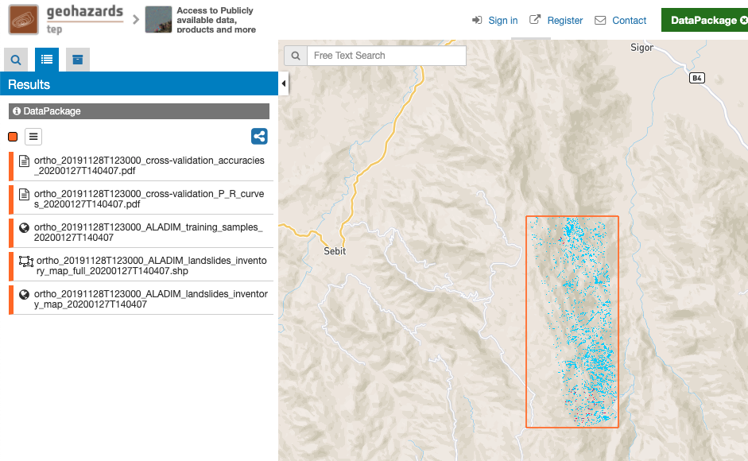
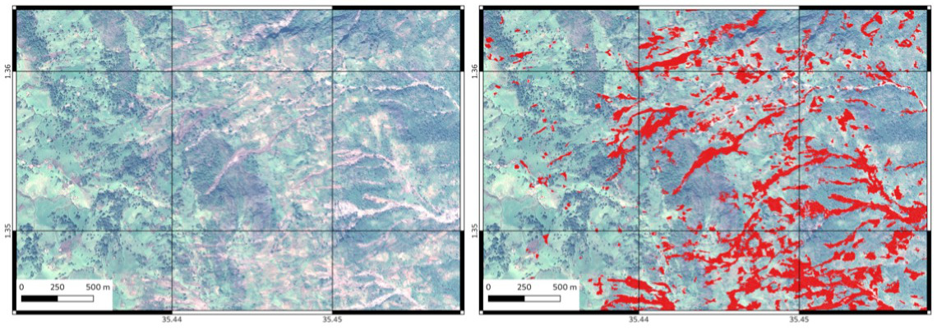

Landslides
CNRS-EOST Strasbourg developed 3 services
running on A2S HPC for landslide monitoring
using Sentinel-2 and Pléiades data
measuring:
  Earth surface deformation
  Digital surface Model
  Automatic landslide detection
  based on Machine Learning
Notes:
GEP supports organisation integrating their algorithms and accessing distributed data repositories and dedicated computing and storage resources.
The CNRS-EOST (The French School and Observatory of Earth Sciences) Strasbourg developed services for landslide monitoring using Sentinel-2, Pléiades and Planescope data
In the example shown here they use this service for automated landslide detection after the heavy rains of November 2019 in Kenya with the ALADIM change detection algorithm.

Slide 15
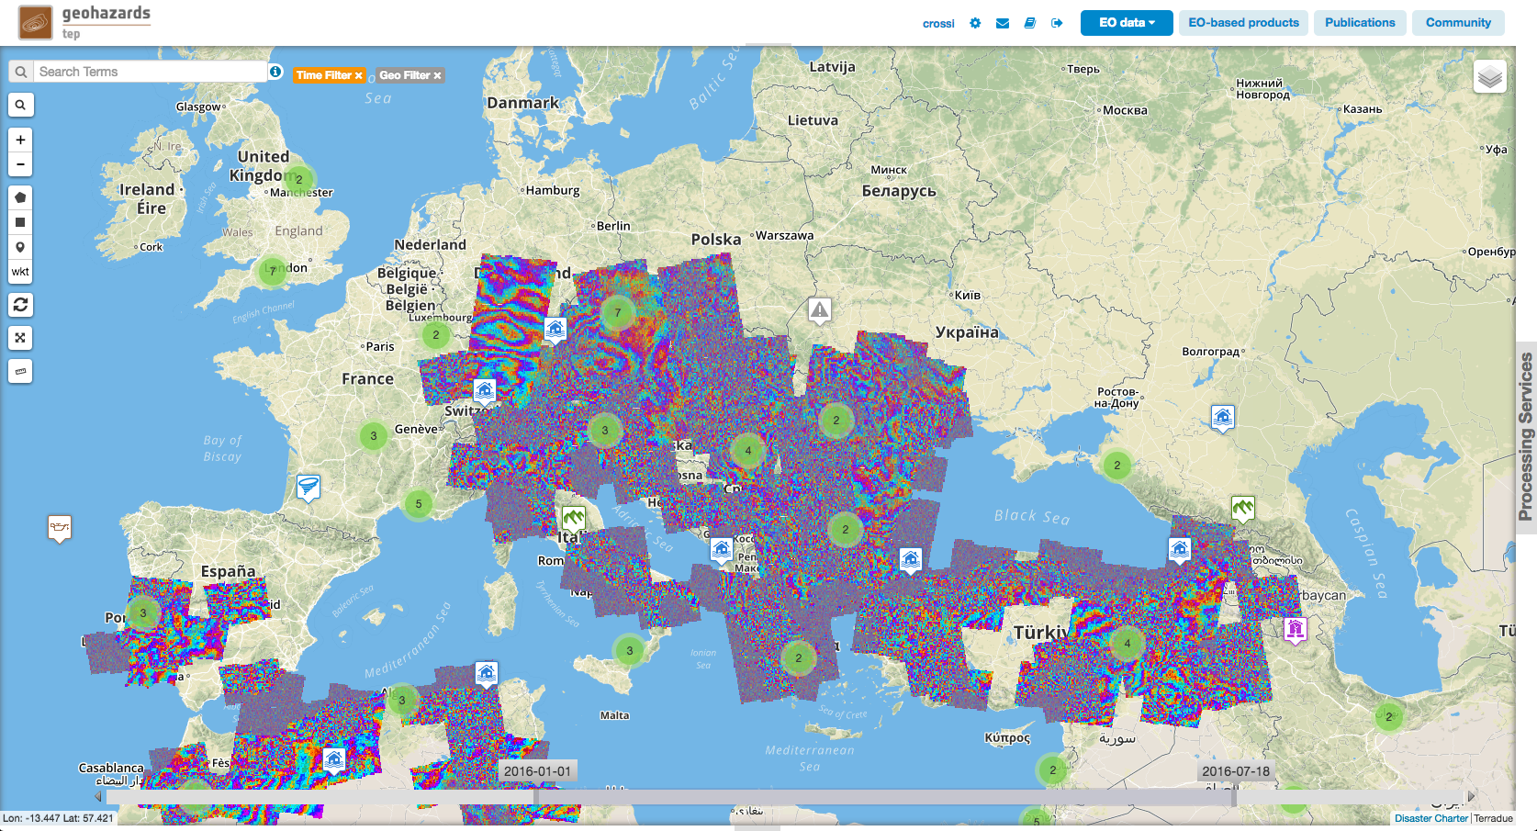
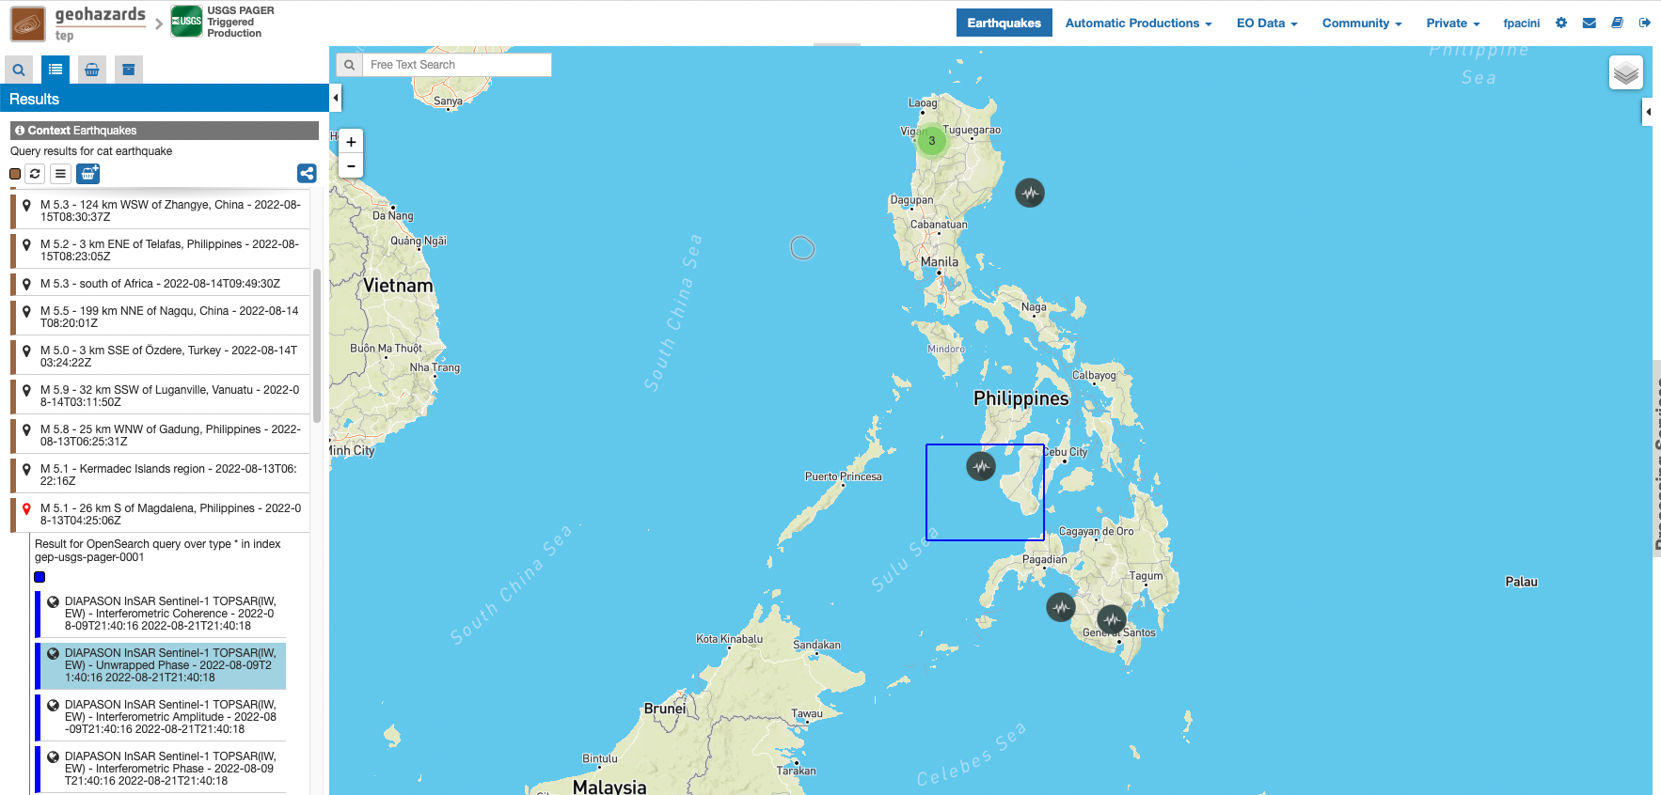
Systematic Processing
Event driven systematic processing
CNES DIAPASON TOPSAR Service
Automatic InSAR production triggered by earthquakes alerts collected from the USGS PAGER system
Data driven systematic processing
DLR InSAR Browse Service
40% of World tectonic area
150+ Sentinel-1 SLC pairs processed per day

Slide 16
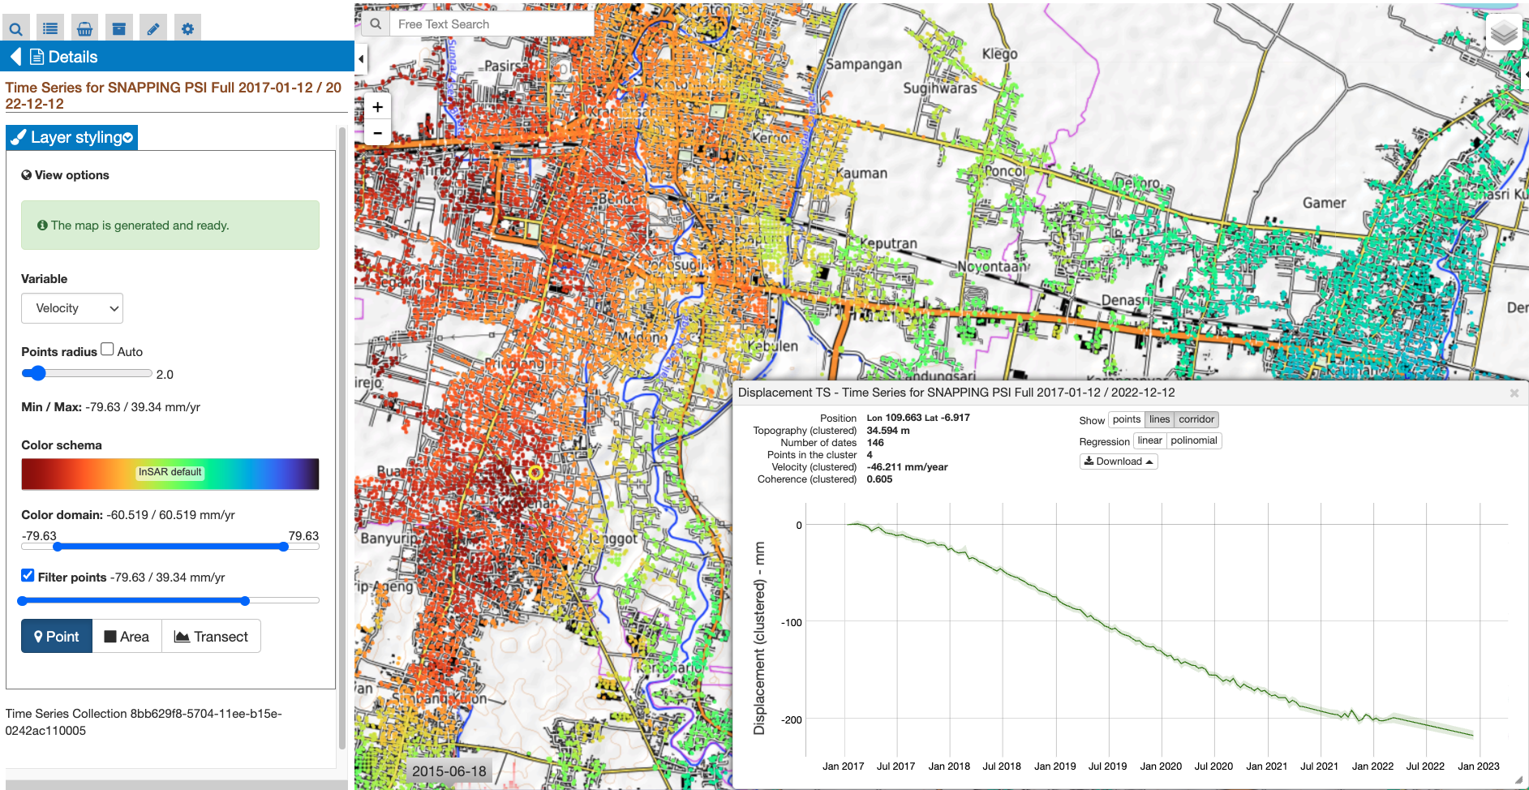
Thematic Apps
​User Interfaces for Ground Motion data visualization and analysis

Slide 17
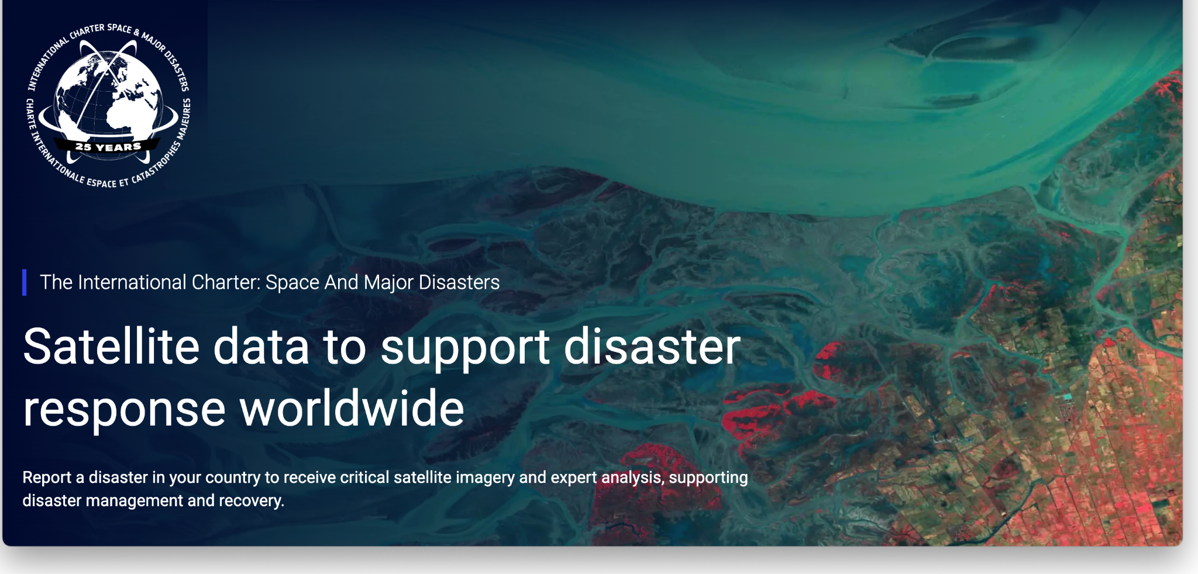

Slide 18

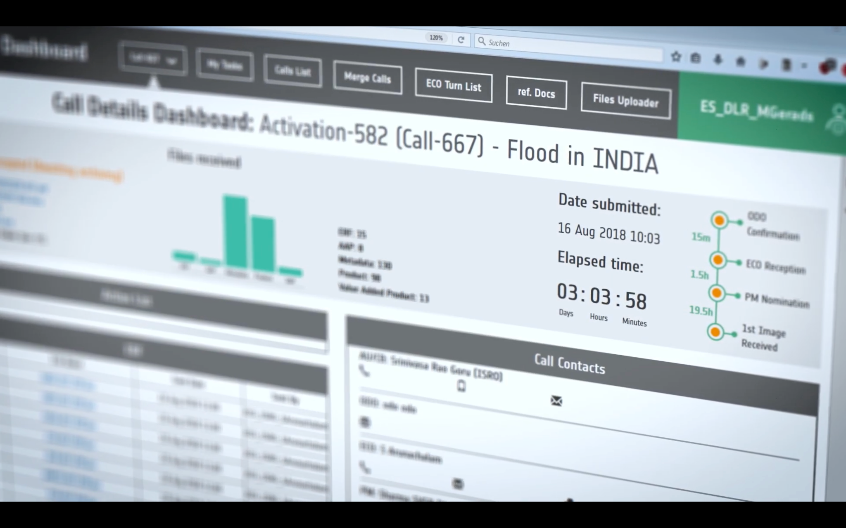
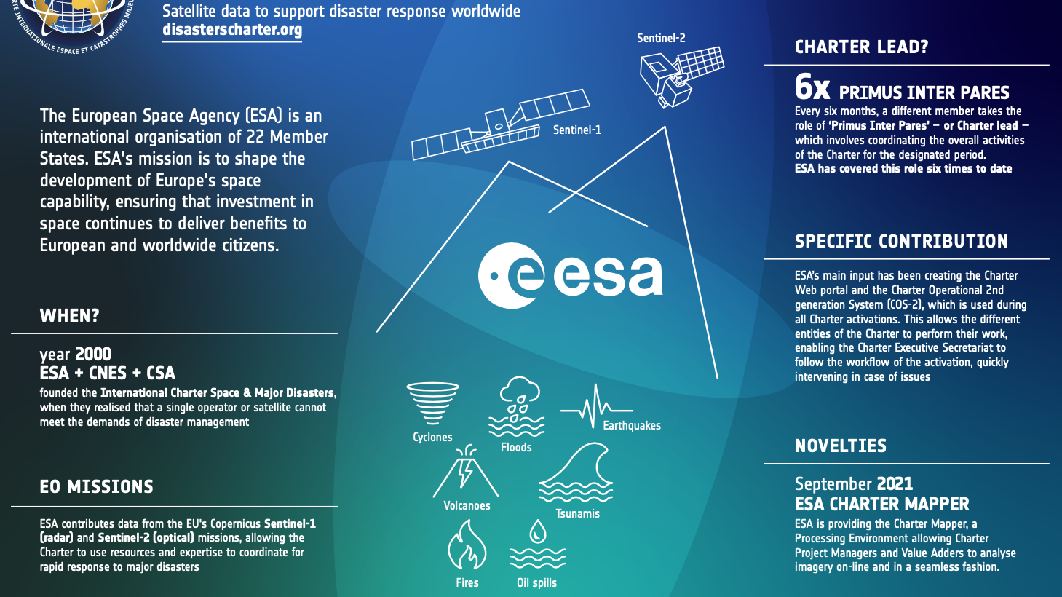
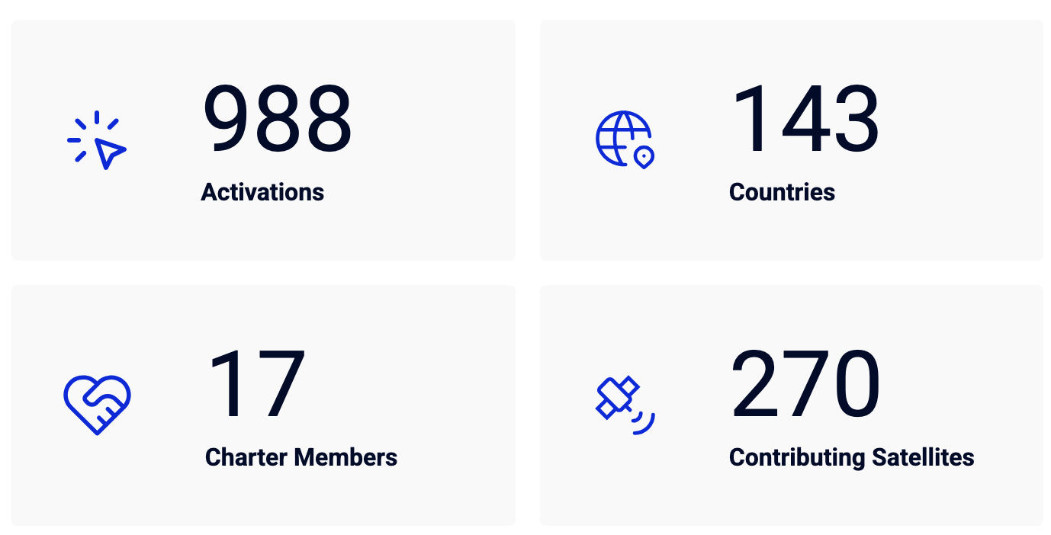
Context
Since 2000 the
International
Charter Space and
Major Disasters
is supporting
disaster
relief operations.
COS-2 improved
the efficiency and
timeliness of
satellite EO data
management
Notes:
The effective use of Earth Observation (EO) data during disasters is critical for timely response and recovery efforts.
Since 2000, the International Charter Space and Major Disasters has provided at no-cost for the final user satellite imagery to global EO experts, empowering them to deliver information products essential for disaster relief operations, such as delineation maps providing an assessment of the impact and extent of a disaster event.
Thanks to the commitment of 17 space agencies and space system operators, in 25 years of operation, the International Charter has been activated more than 988 times to provide satellite data for disasters in 143 countries.
The workflow of Charter activations is managed by the Charter Operational 2nd generation System 2 (COS-2), a software developed by ESA.
Since 2014 of operations COS-2 has improved the efficiency and timeliness of satellite data management, utilizing a Web interface to facilitate the work of the different Charter operational staff members.

Slide 19
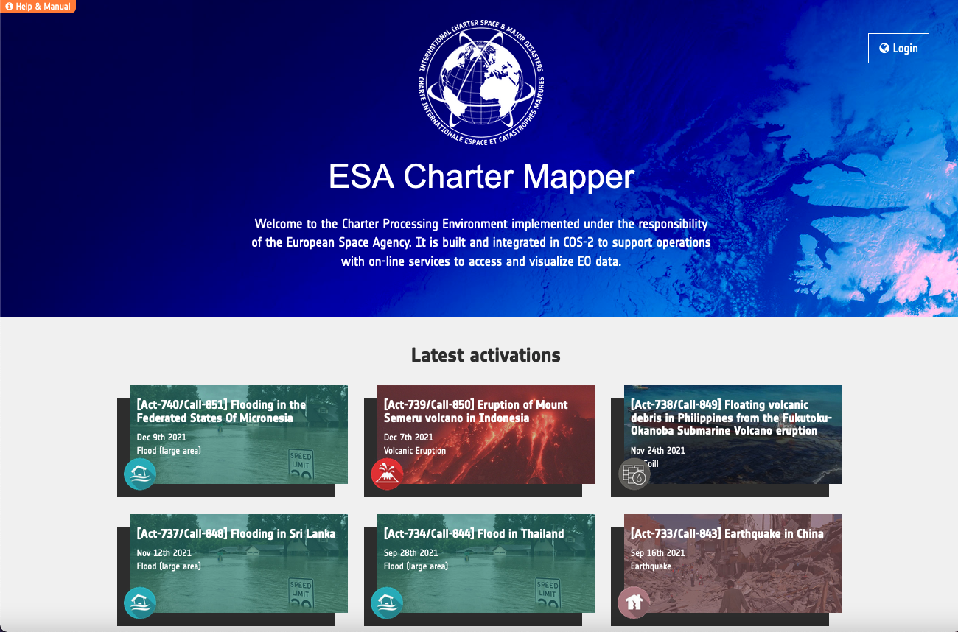
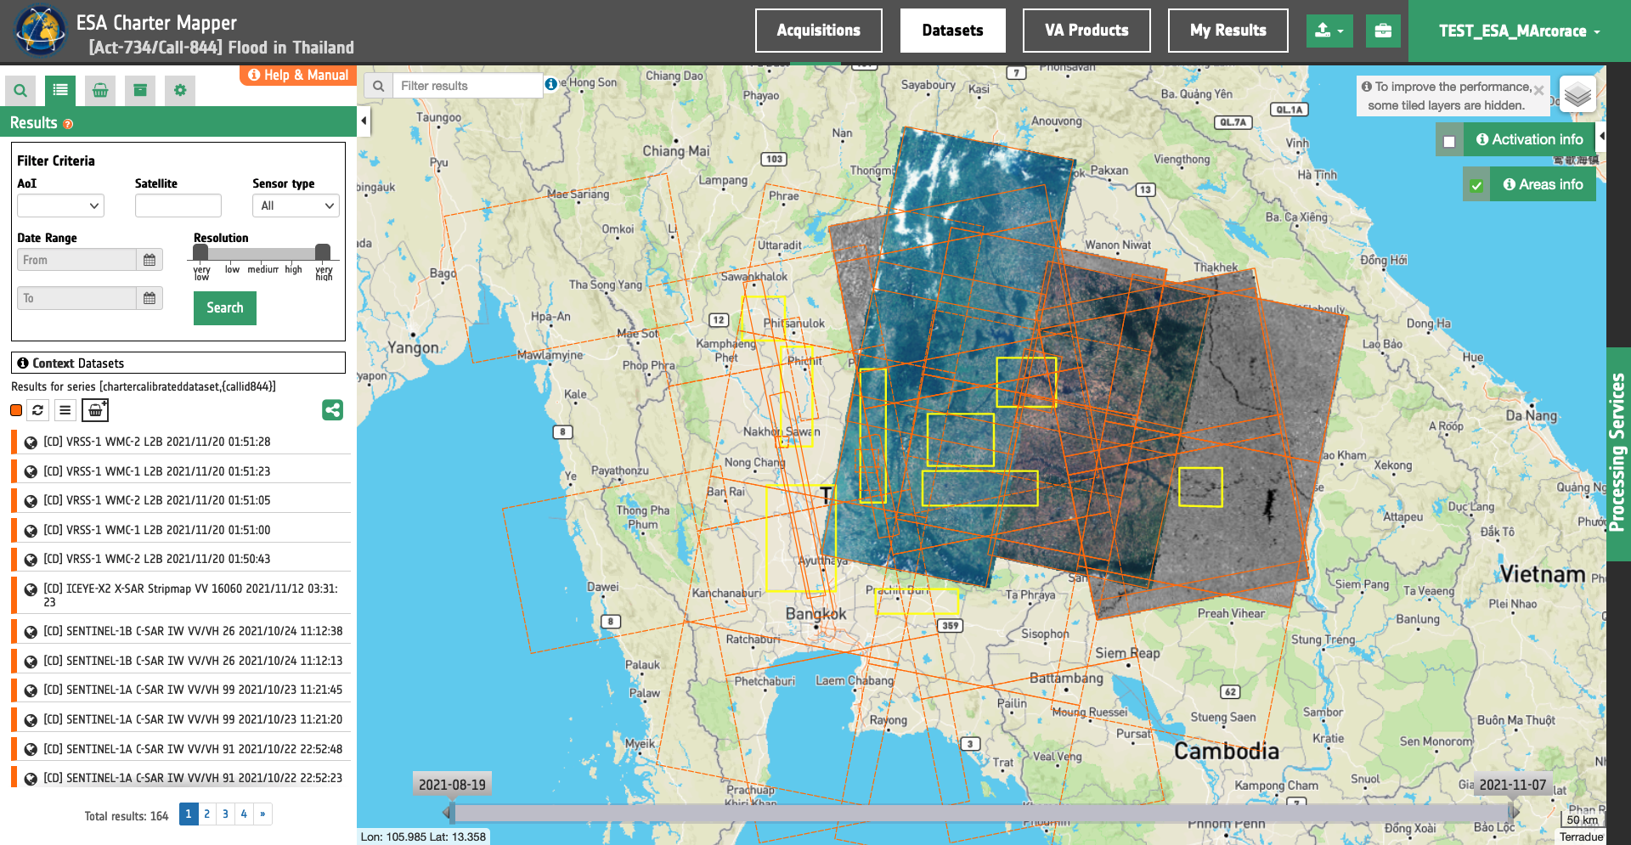
Platform: Disaster Charter
A space agencies agreement supporting immediate disaster response via satellite data and information delivery
Charter Processing Environment: a geospatial data analysis and EO data processing platform
  Purpose: routinely ingest and calibrate cloud-optimized file formats, for a broad range of radar and optical satellite remote sensing imagery
Built on a cloud native software architecture, supporting multiple data providers
Notes:
And we also developed and operates the ...

Slide 20

Multi mission
The ESA Charter Mapper supports a broad range of radar and optical satellite remote sensing imagery products of 41 EO missions from 24 space agencies and data distributors.
ALOS-2
AlSat-1B
Amazonia-1
BKA
Cartosat-2
CBERS-4/4A
Gaofen-1, 2, 3, 4
GeoEye-1
Global (BlackSky)
KANOPUS-V, V-IK
KOMPSAT-3, 3A, 5
ICEYE constellation
Landsat-8, 9
NewSat (Satellogic)
Perusat-1
PlanetScope
Pleiades-1A, 1B
Pléiades NEO
RCM-1, 2, 3
ResourceSat-2, 2A
SAOCOM-1A, 1B
Sentinel-1A, 1B, 1C
Sentinel-2A, 2B, 2C
SPOT-6, 7
TerraSAR-X/TanDEM-X
UK-DMC-2
Vision-1
VRSS-1, 2
Worldview-1, 2, 3
More info at:
https://docs.disasterscharter.org/missions/supported-missions/
Notes:
The ESA Charter Mapper supports a broad range of EO data products from a constellation of 41 EO missions managed by 24 international space agencies and data distributors.
The platform supports optical and radar products with dedicated calibration processing one for optical and one for SAR data.
The ESA Charter Mapper ensures proper dataset access authorization according to the EULA management set in COS-2.

Slide 21
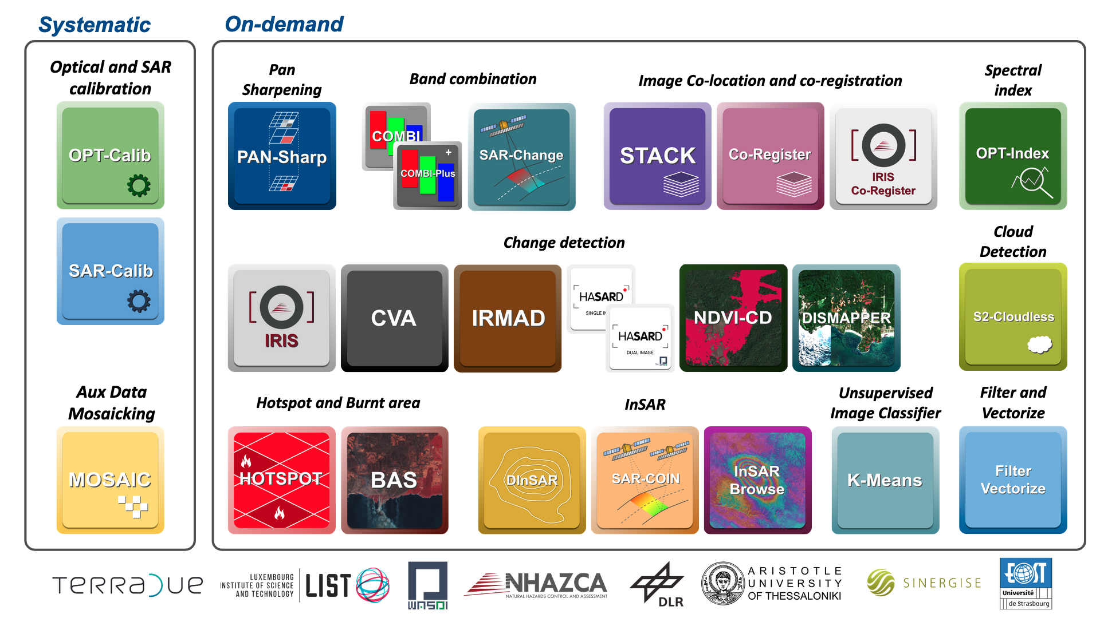

Multi-mission Data Processing
Find an introduction about EO processing services at:
https://docs.disasterscharter.org/services/intro/
Notes:
Beyond visualization, the ESA Charter Mapper offers a robust suite of EO processing services designed to meet diverse analytical needs during disaster response and recovery.
Accessible through an intuitive interface, the platform’s portfolio includes 26 processing services that support both systematic and on-demand workflows.
These services empower users to perform advanced data operations such as pan sharpening, band combination, image co-location and co-registration, change detection, cloud masking, and hotspot and burned area mapping.

Slide 22

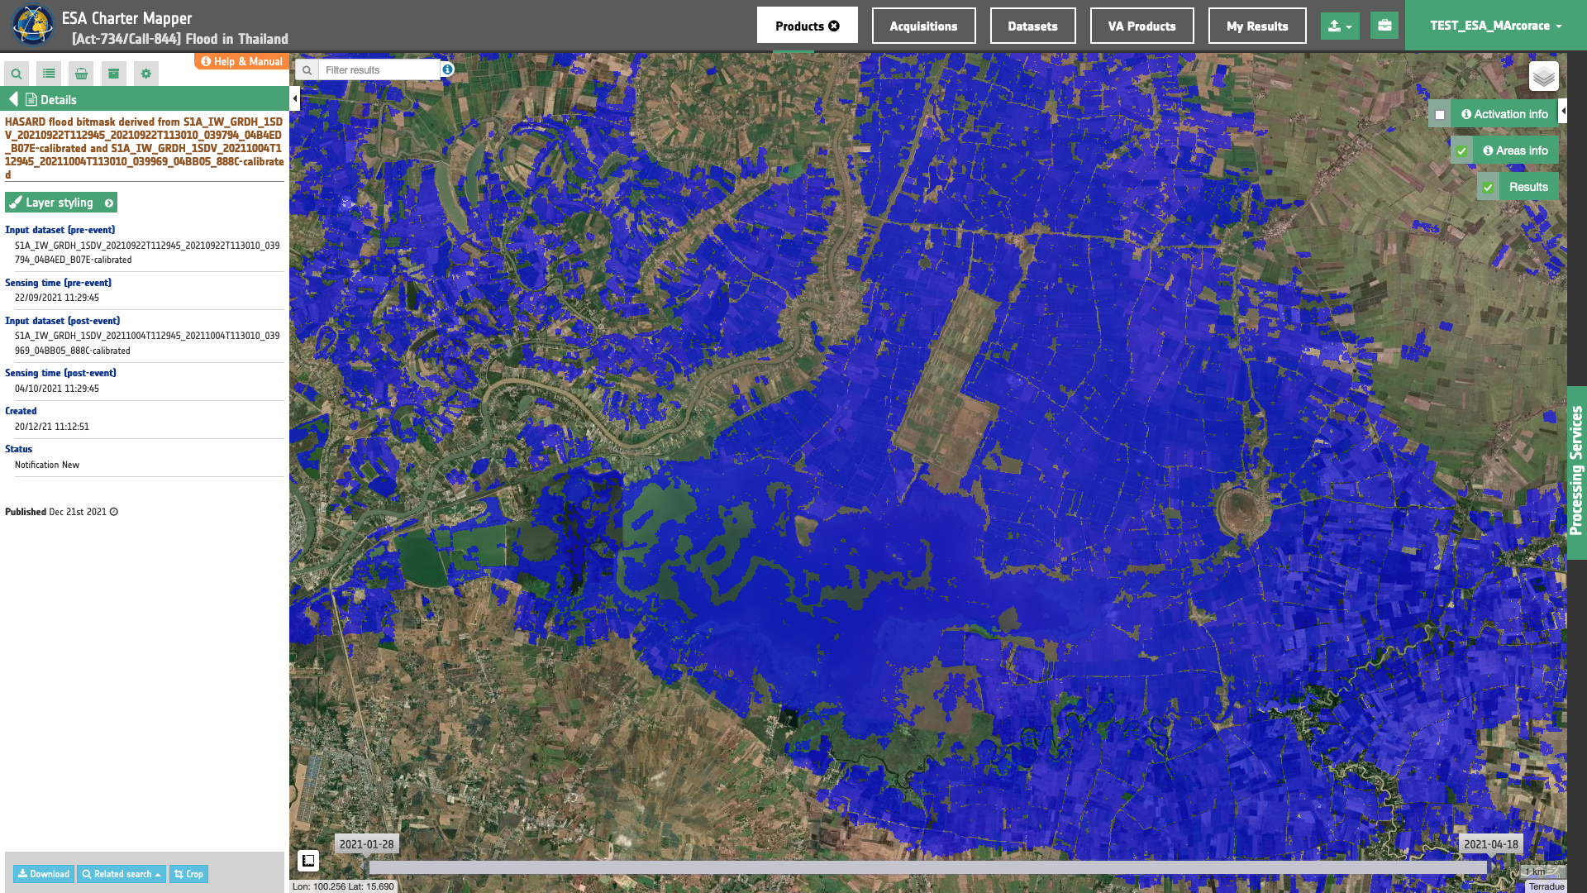

Radar based flood mapping
Automatic change detection algorithm between a pair of pre- and post-event Sentinel-1 datasets
Satellite detected water derived from HASARD over Thailand in Oct 2021 (Image credit: ESA, Copernicus).
ESA Living Planet Symposium 2025

Slide 23
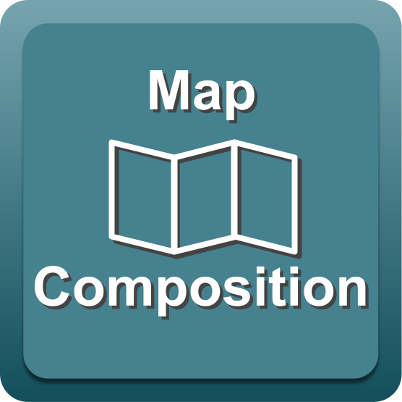
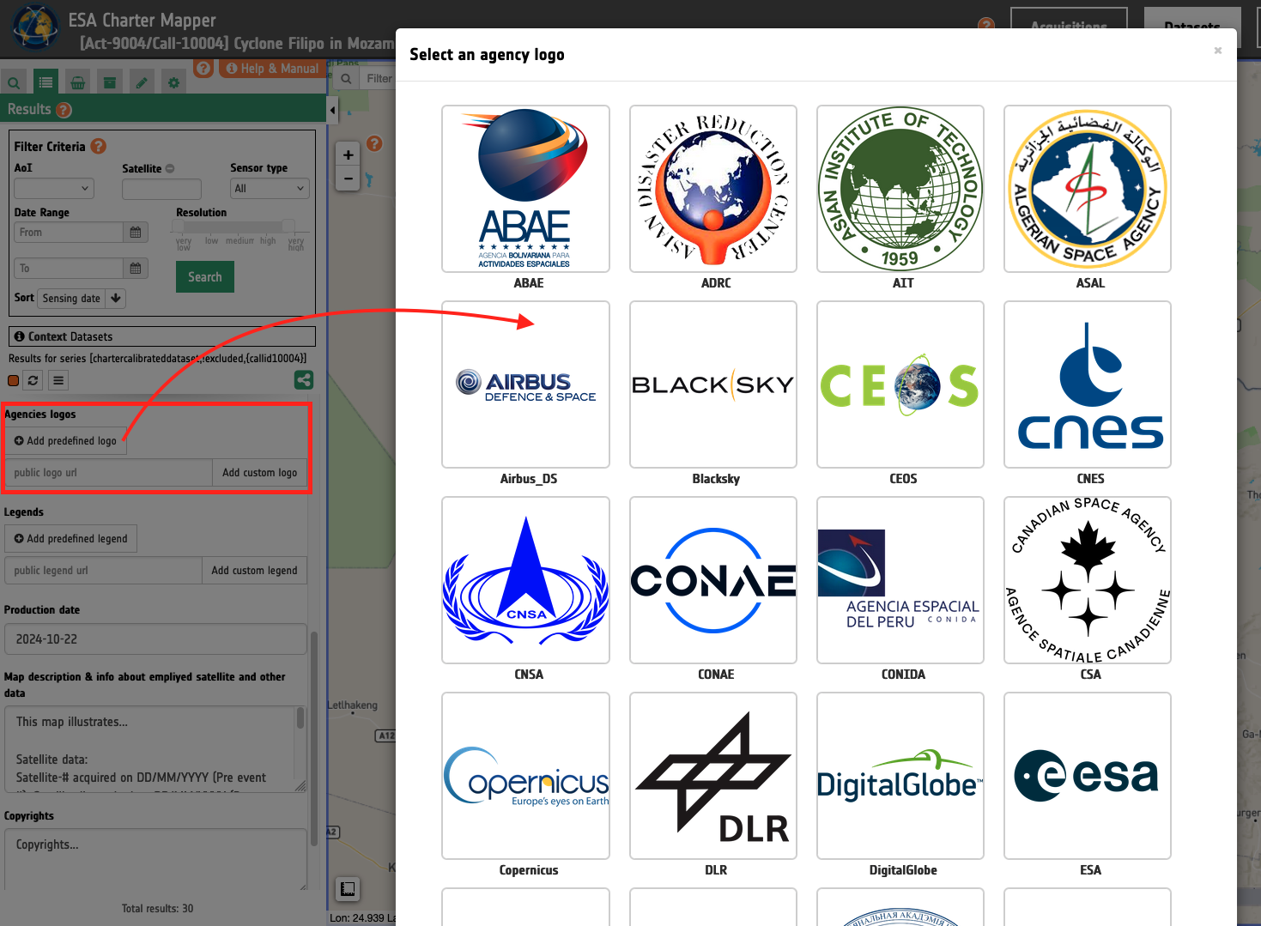
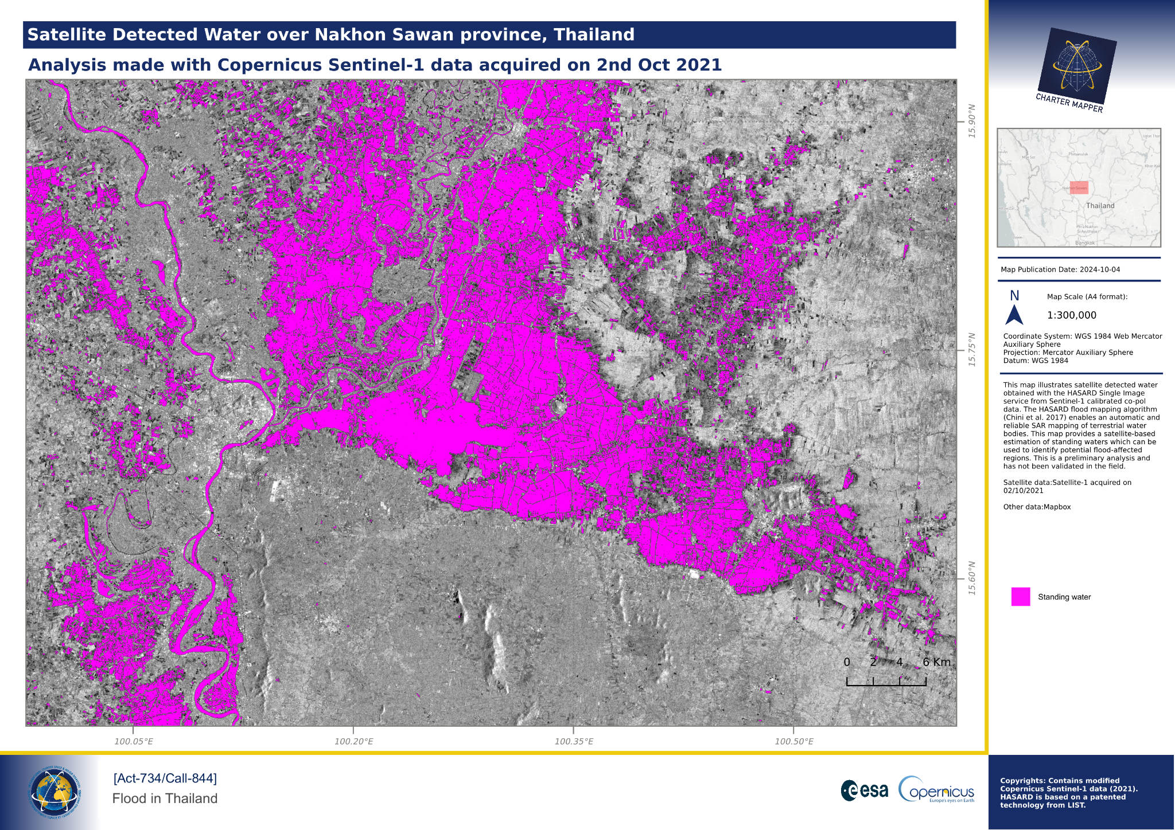
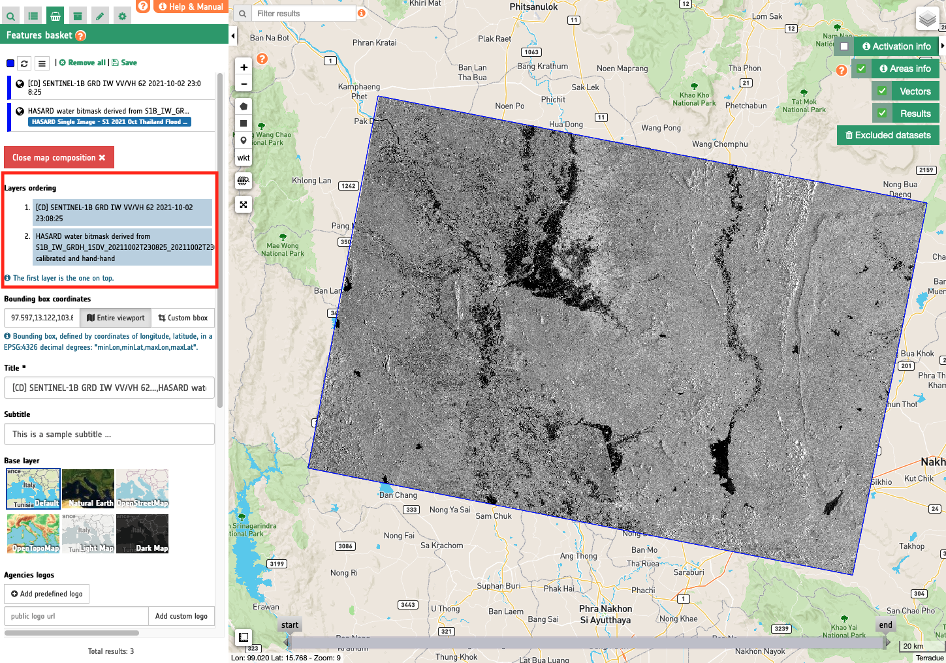
Map Composition
Example of Value Added Product (VAP) derived
with the Map Composition service
A service
that generates
a cartographic
product from a
map composition
using Datasets
or results from EO processing
ESA Living Planet Symposium 2025
Notes:
Recent developments introduced advanced functionalities to facilitate the generation of Value Added Products (VAP) such as the GIS functions panel where users can work with vector files, and the Map Composition functionality to generate a professional cartographic product as PDF or PNG file.

Slide 24



Scalable Solutions for EO
We provide technology and services to host and
scale EO-based solutions, including algorithms
& models from our business partners
We contribute to open standards with ESA and
OGC, enabling portable, reproducible EO services
We design platforms which are portable across
trusted cloud providers
Our platforms are targeted for operational use, supported by transparent and sustainable cost models thru their life cycle (from pilots to long-term assets)

Slide 25
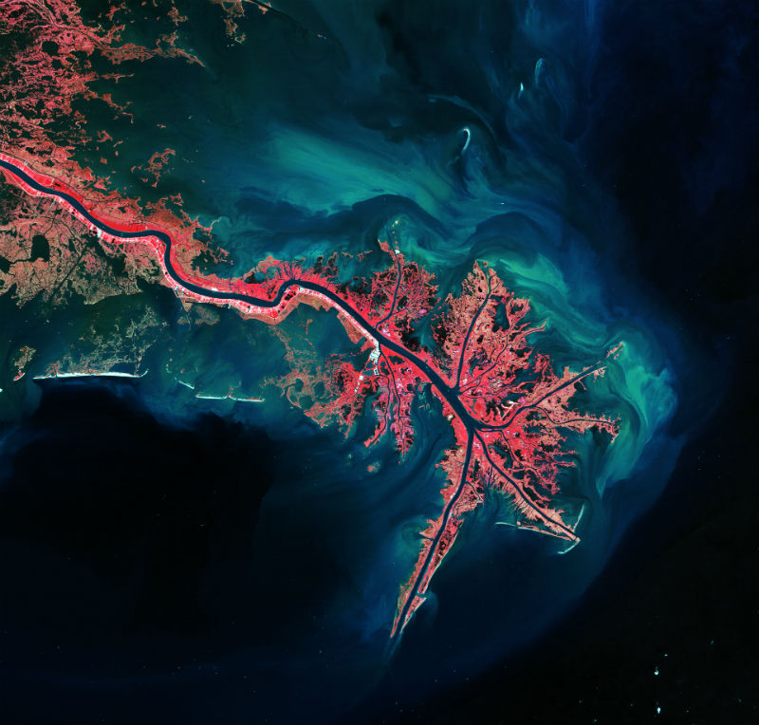

Looking forward hearing from you!
https://www.terradue.com
connect@terradue.com

