Slide 1
- AI4EO - Harnessing AI techniques and models to enhance remote sensing data
Prof. Ing. Gianluca Valentino
Director, Semablu Limited
Big Data: Space Solutions for Society
30 June – 1 July 2025, Kalkara, Malta

Slide 2
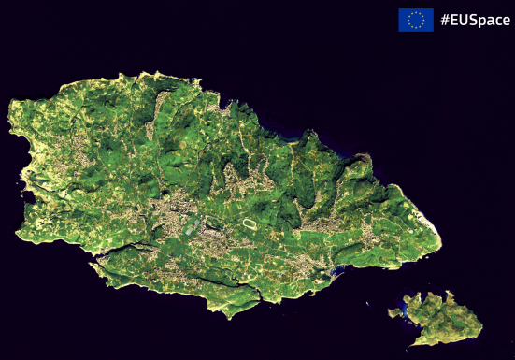
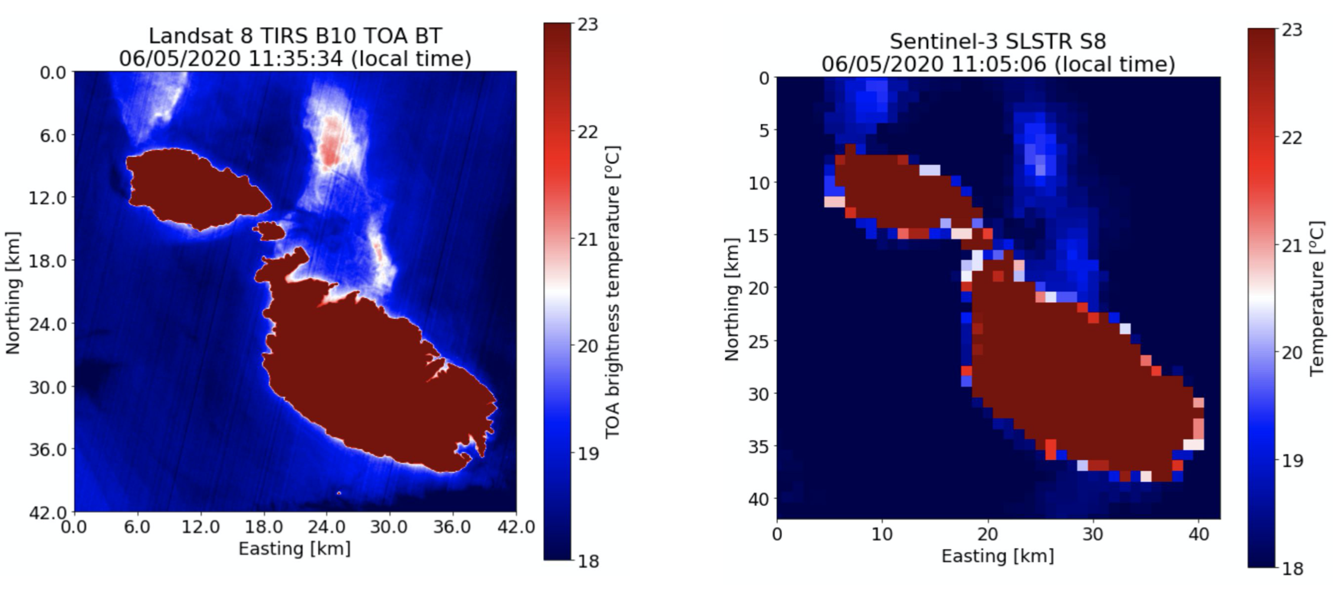
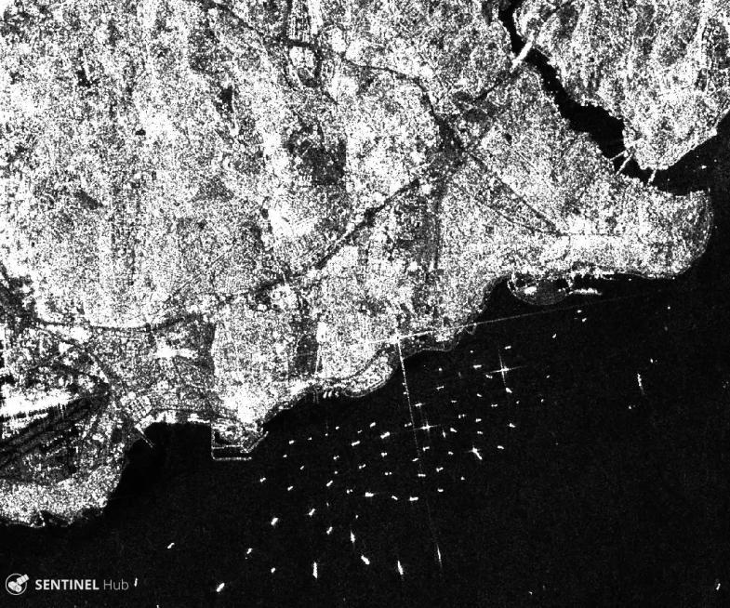
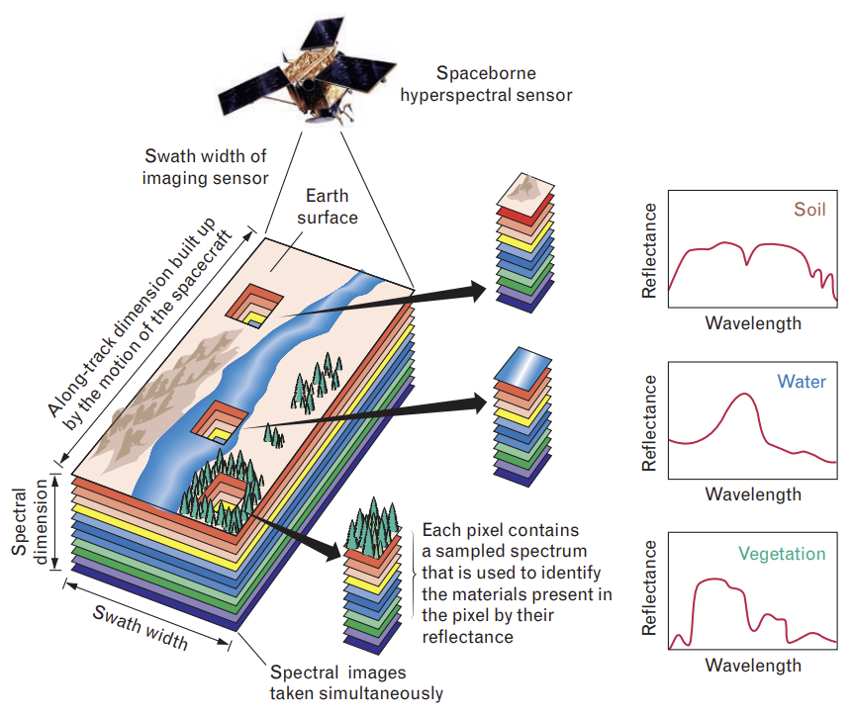
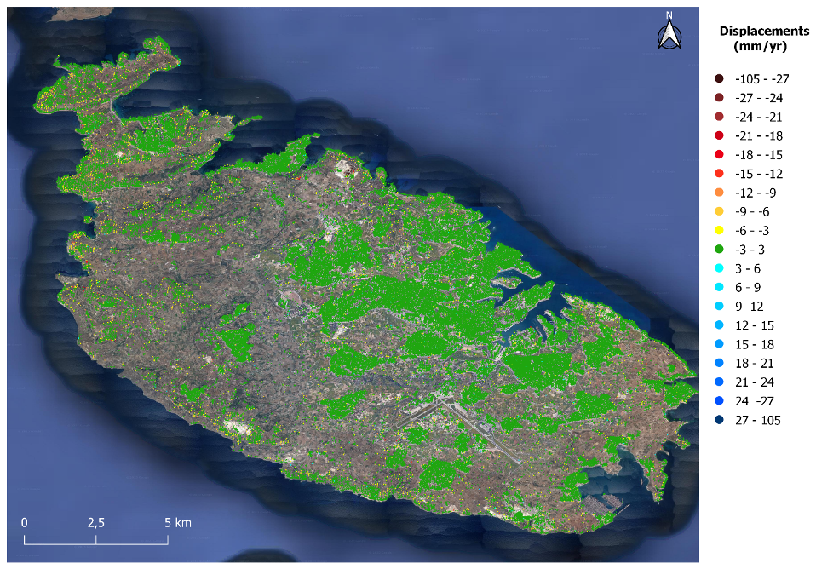
Types of remote sensing data
Infrared bands
Radar (active sensing)
Optical bands
SAR amplitude
Hyperspectral sensing
InSAR displacement estimation

Slide 3
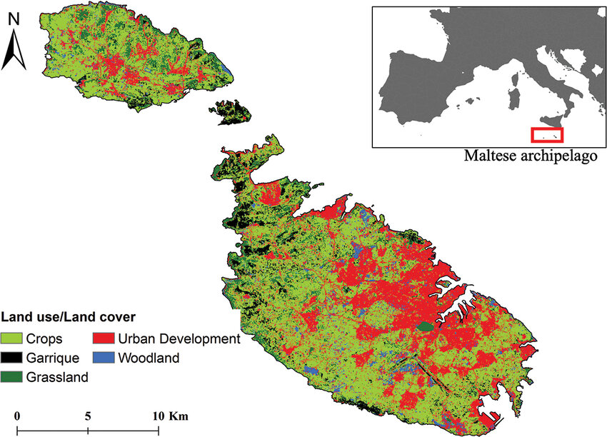
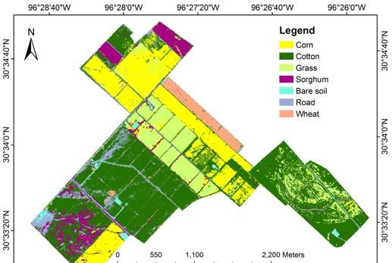
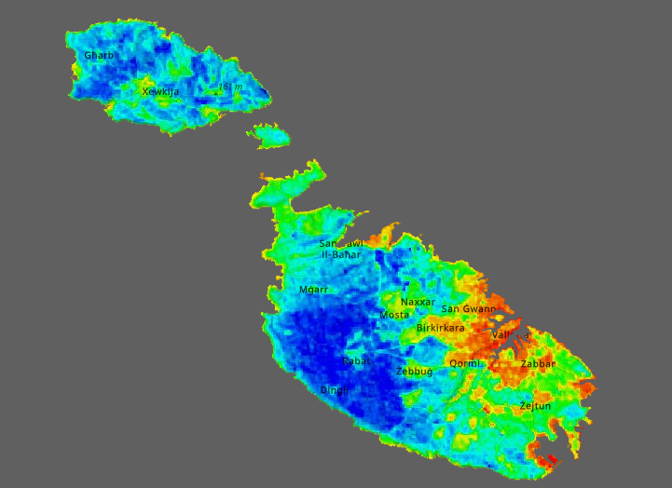
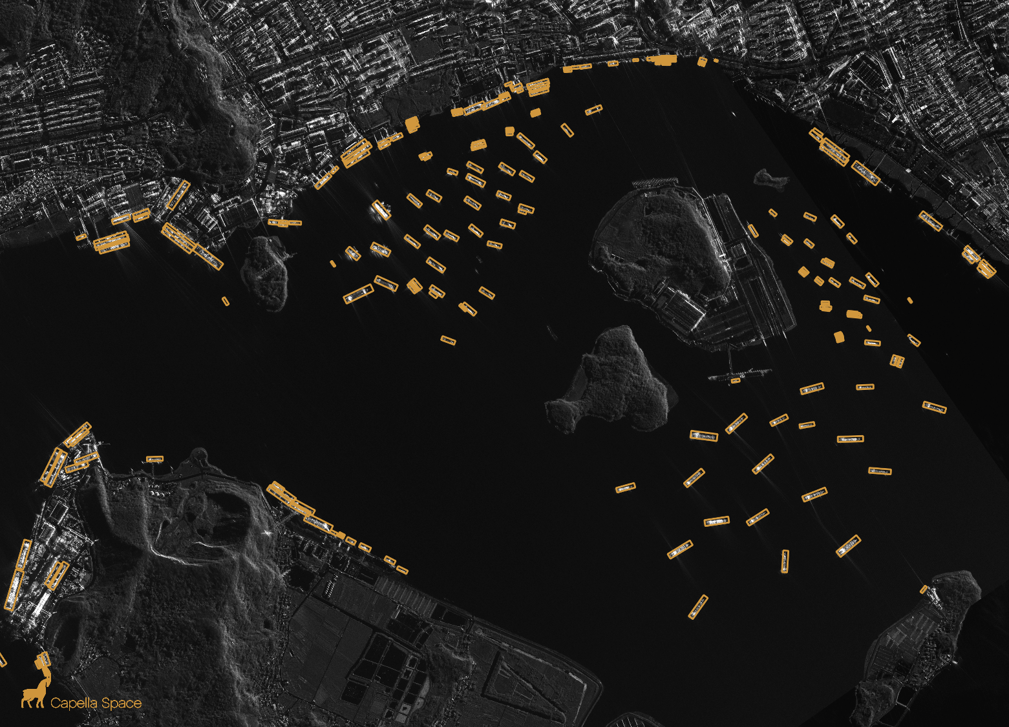
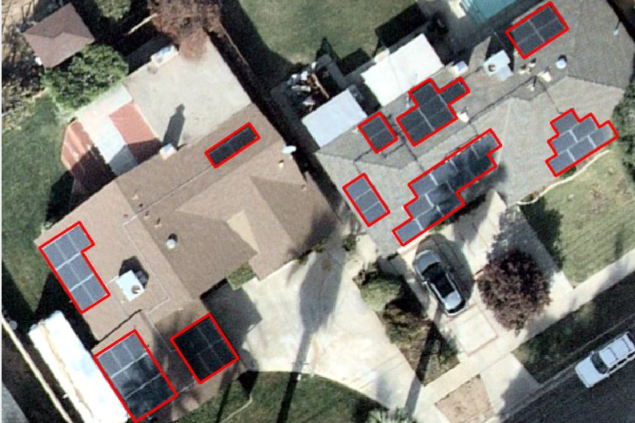
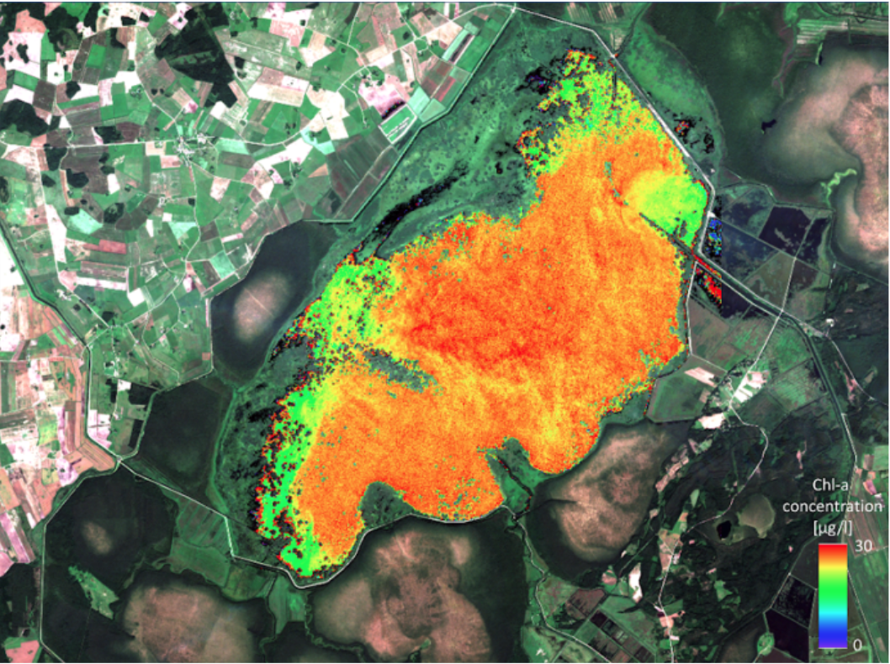
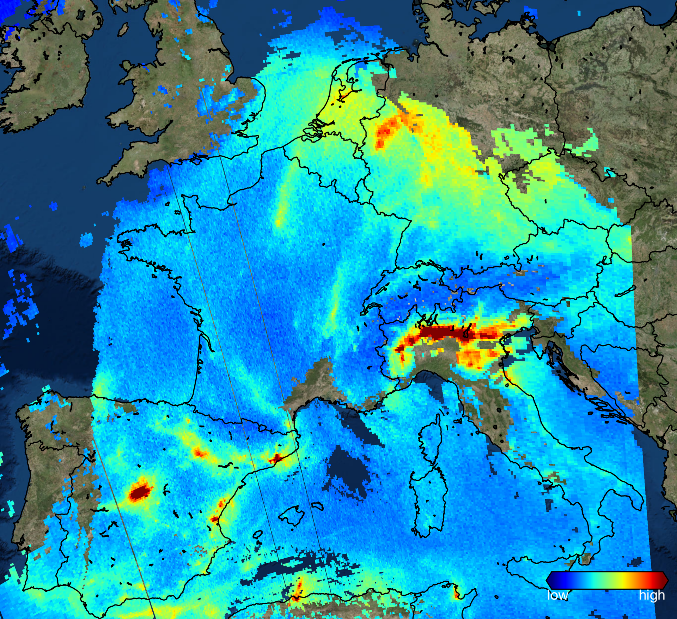
Applications of remote sensing data
Land cover mapping
Crop mapping
Urban Heat Island monitoring
Ship detection and tracking
Object detection / count
Water quality monitoring
Air pollution monitoring

Slide 4
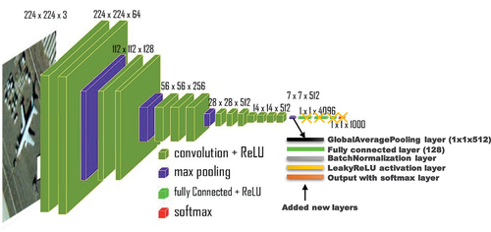
Why AI techniques?
Earth Observation data is essentially 2D (or 3D in time) – can apply computer vision and time-series techniques!
These techniques are now the state-of-the-art in many EO applications:
Super-resolution
Cloud cover removal
Change / anomaly detection
Object detection (e.g. vessels, aircraft, buildings, roads, PV panels, …)
Multi-sensor (optical and/or infrared and/or SAR) data fusion
Segmentation (land cover mapping etc)
Inference / prediction of ground parameters (e.g. crop yield, evapotranspiration, air pollution at ground level, road damage)
…
Not only data-driven..
But also physics-informed models!

Slide 5
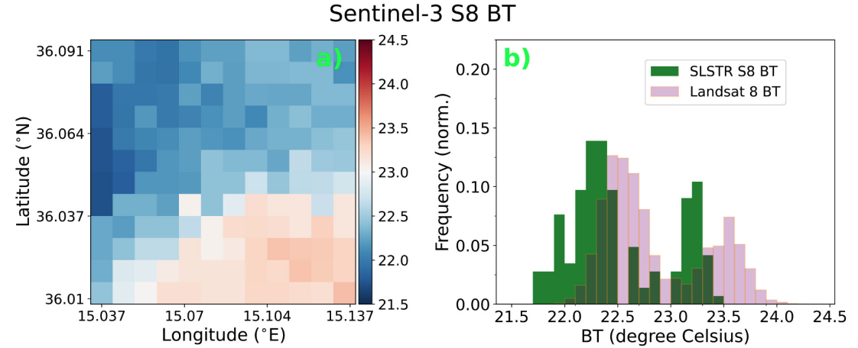
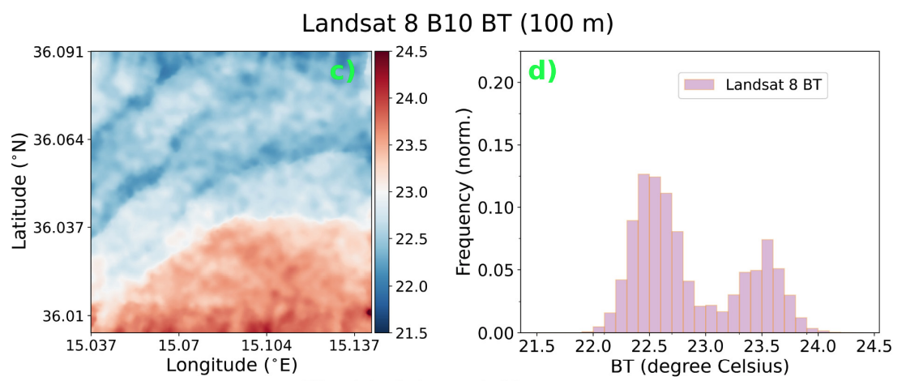
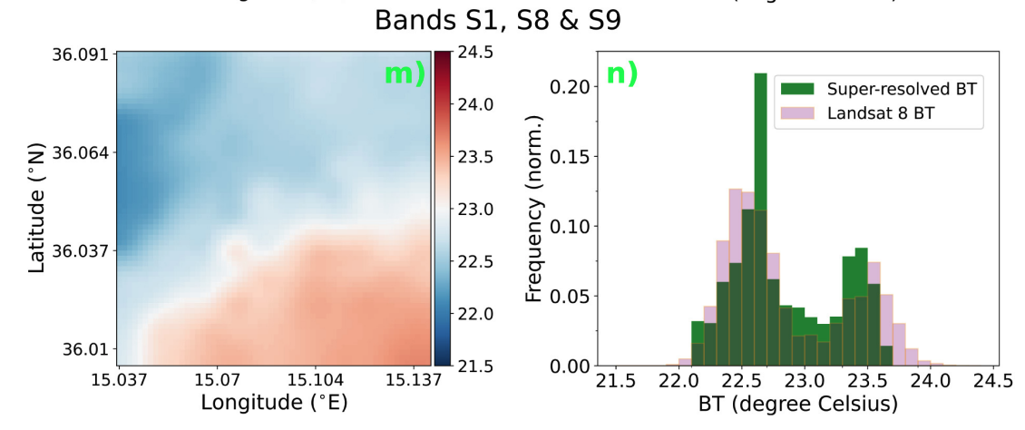
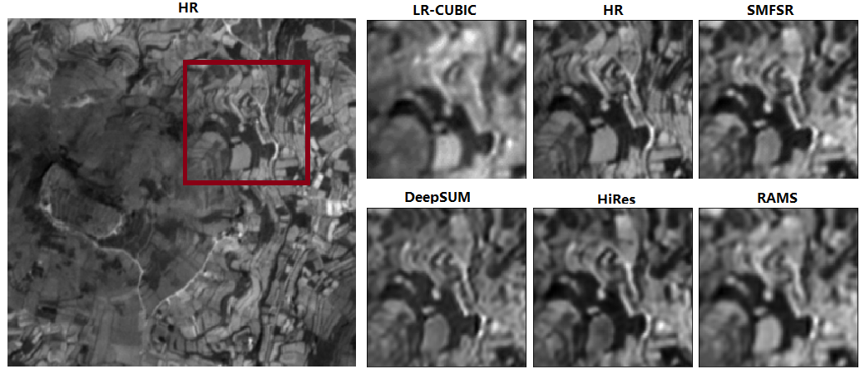
Background and past projects (1)
MCST Space Research Fund
SAT-FIRE (2018-2020)
SATellite data Fusion and Imaging Resolution Enhancement for coastal areas
WARM-EO (2020-2022) with Energy & Water Agency
Water Resource Management platform using Earth Observation

Slide 6
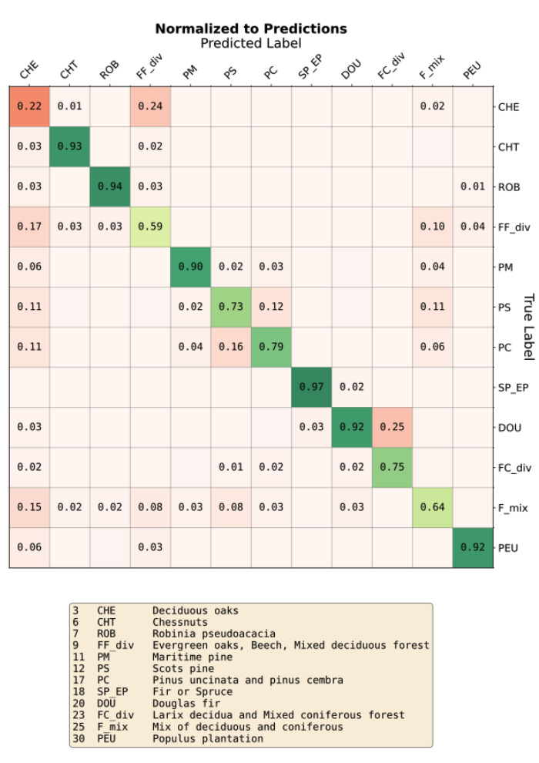
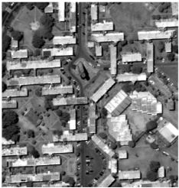
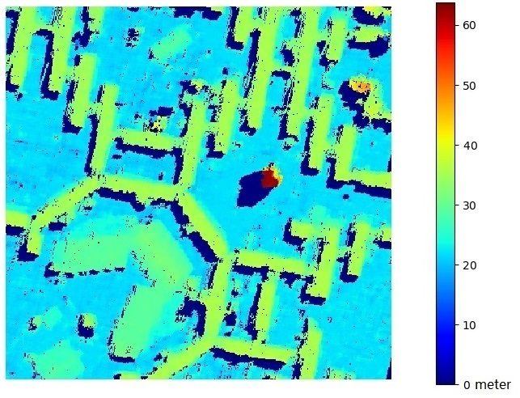
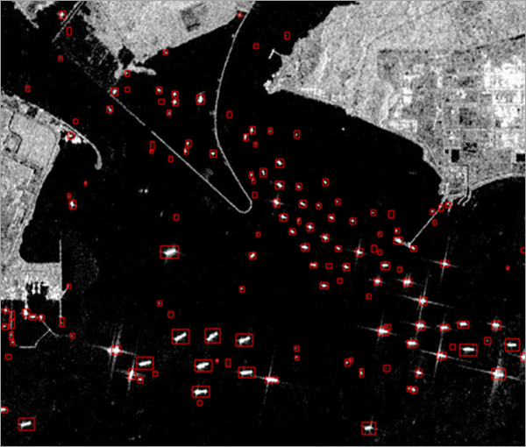
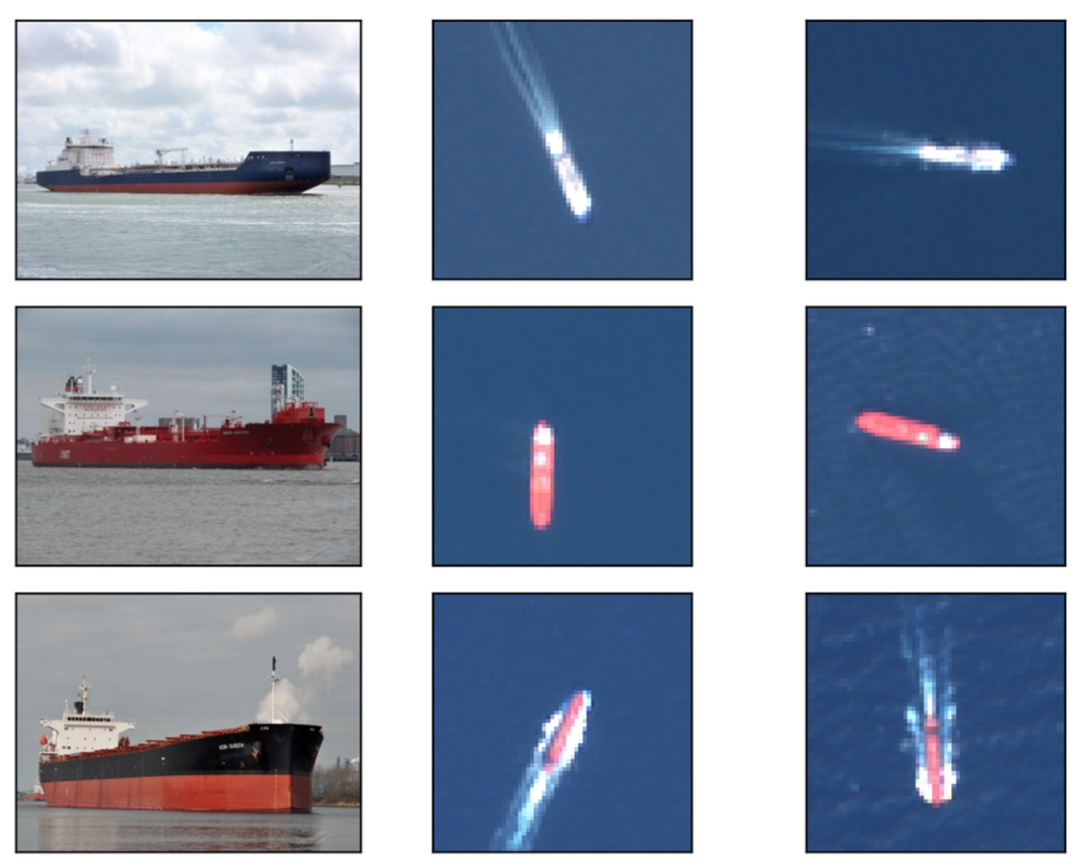
Background and past projects (2)
MCST-CNES
SATINET (2019-2020)
SATellite TraIning and NETworking
3D reconstruction of urban areas from stereo
Sentinel-2 based forest cover mapping
XM Techology Development Programme
ADVISER (2023-2026) with Ministry for Home Affairs, Security and Employment and TrustStamp Malta
Anomaly Detection of Vessel activity using Intelligent SERvices
Sentinel-1
Sentinel-2

Slide 8
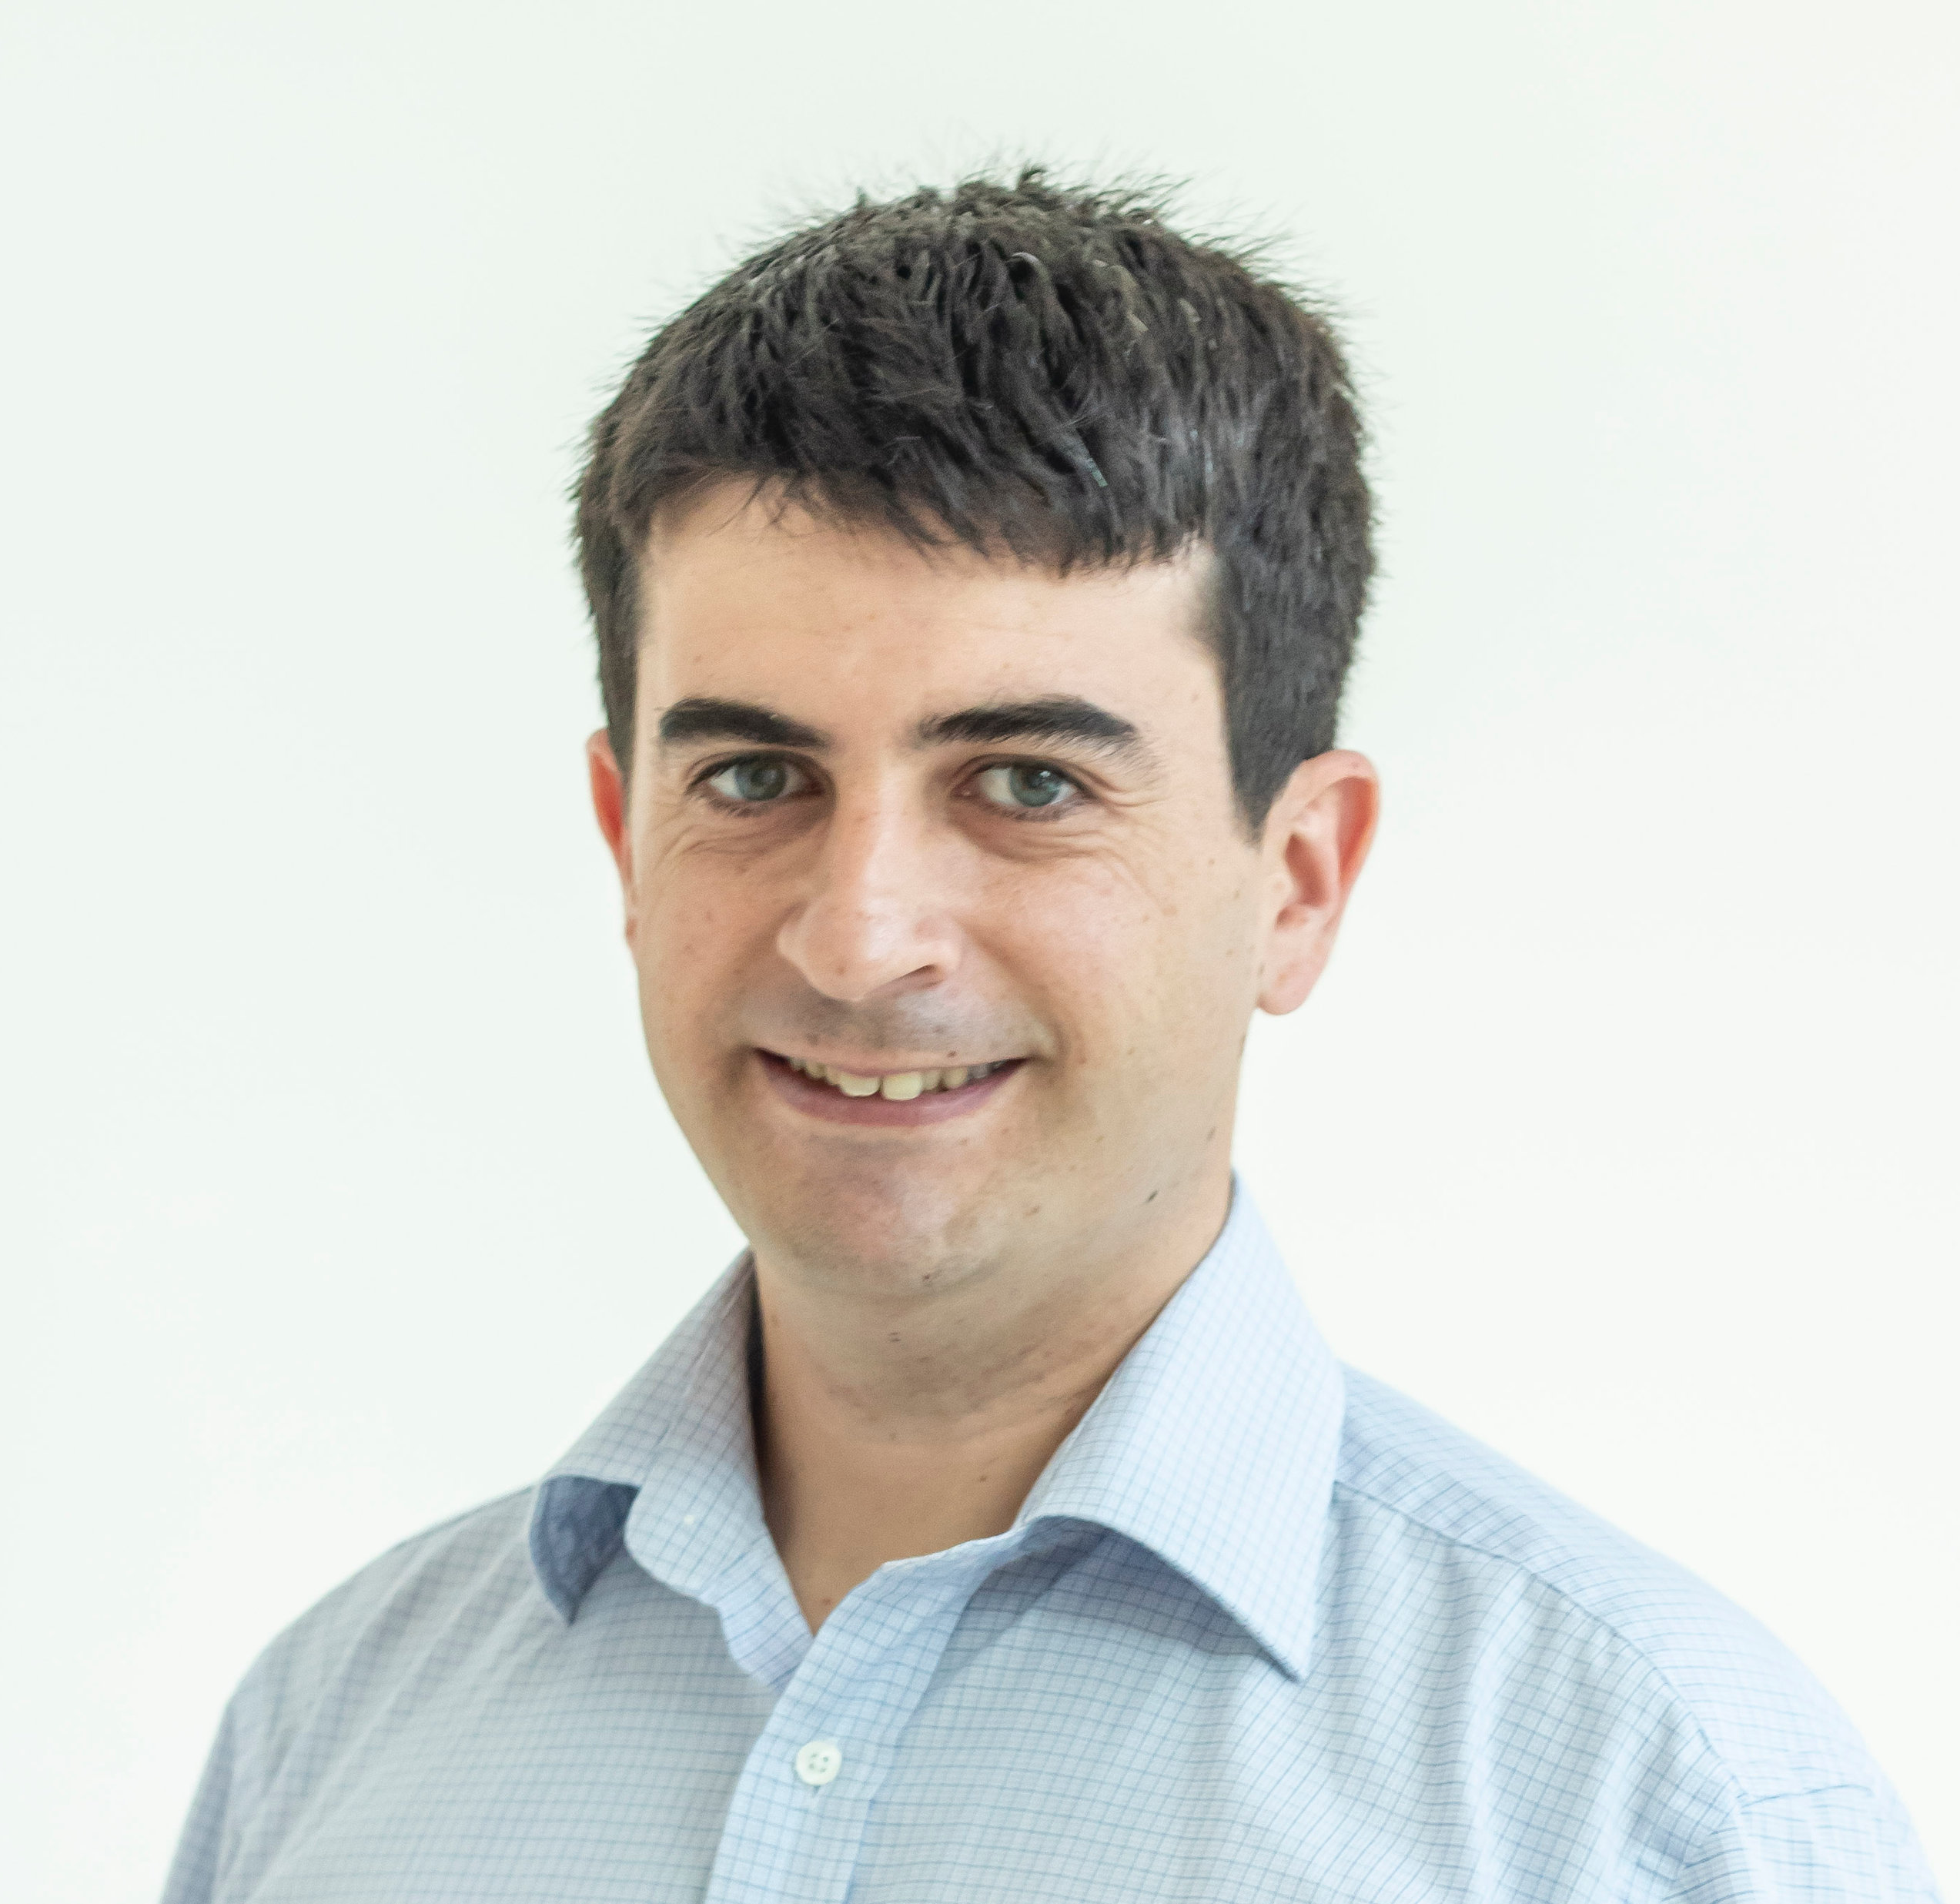
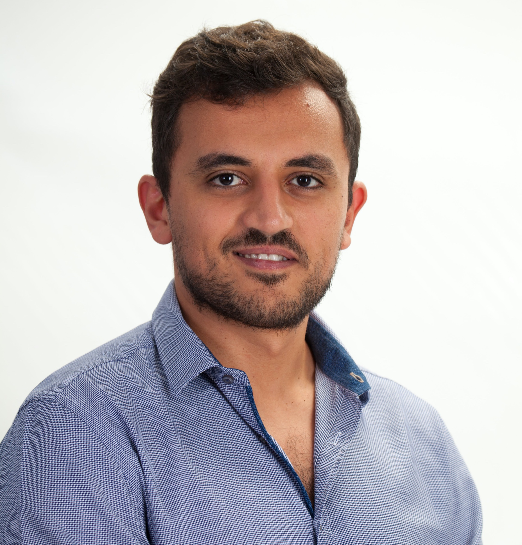
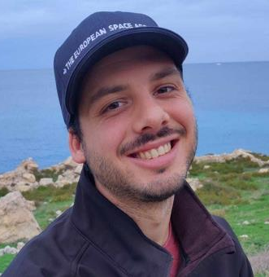
Company overview
Semablu is an AI4EO start-up which develops AI models and techniques to provide knowledge and insights from Earth Observation data.
Founded in 2023, with 5 remote sensing and AI researchers engineers and developers.
Core competences and expertise:
Remote sensing data and related processing (optical, thermal, SAR)
Bespoke AI models (resolution enhancement, object detection, anomaly/change detection etc)
GIS product development
Main product: deep learning based resolution enhancement of optical data

Slide 9
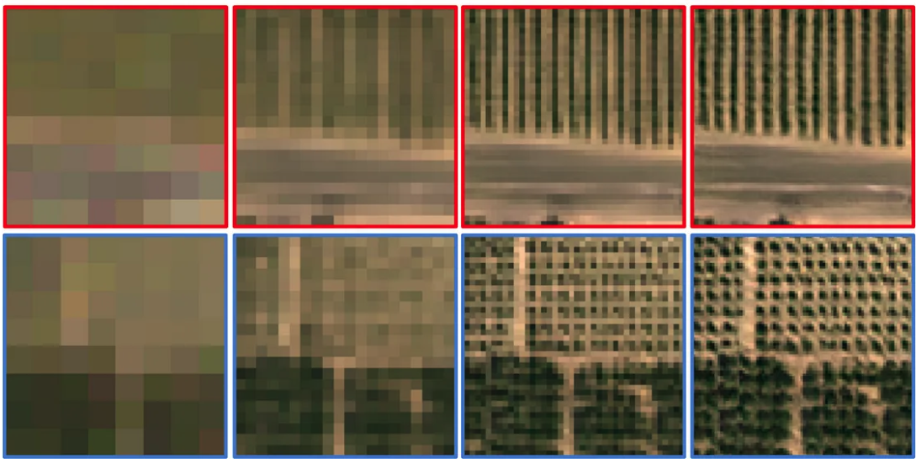
Super-resolution of EO data
5-3 m (Planet, Maxar, Airbus)
Price: $100-500 per sq km
50-30 cm (Maxar, BlackSky, Cappella)
Price: $3,000-10,000 per sq km
Spatial resolution
10 m (Sentinel-2)
Price: free
2-1 m (Maxar)
Price: $800-3,000 per sq km
S2 10m SR 4m SR 2m GT 2m
Deep learning super-resolution techniques can achieve a factor 4-5 resolution enhancement with excellent image quality and preserving spectral information and spatial features
E.g. obtain 2 m imagery which would cost $800 / sq km from free Sentinel-2 data

Slide 10
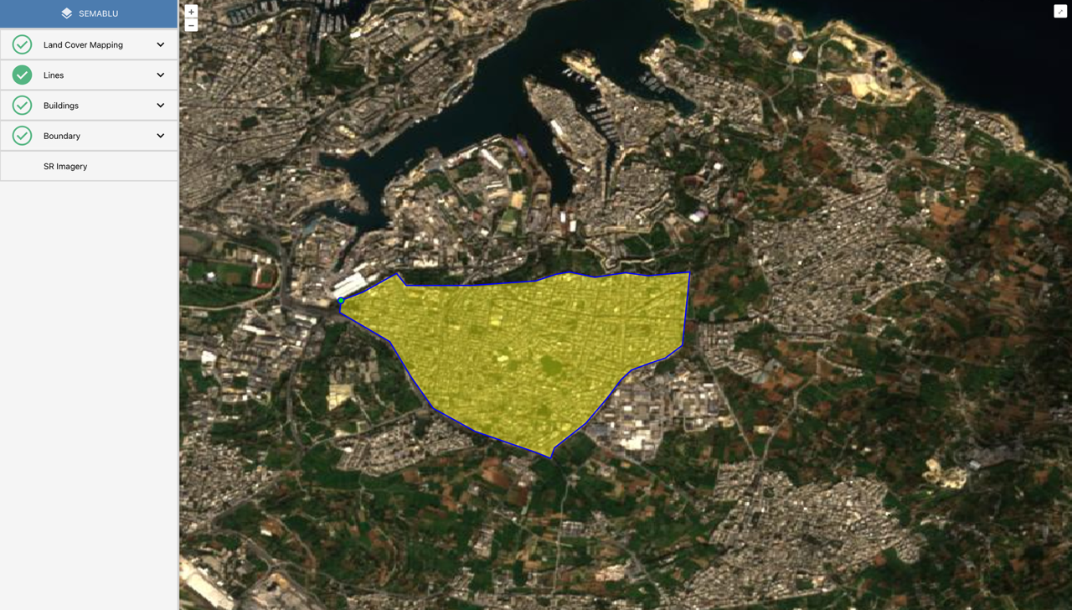
Our product – enhanced resolution for EO
Access via API and/or GIS client
Similar workflow to most EO data providers:
Time period
AOI
Resolution
Target: deploy first resolution-enhanced data products by Q3 2025
Get in touch for more details:
info@semablu.com

Slide 11
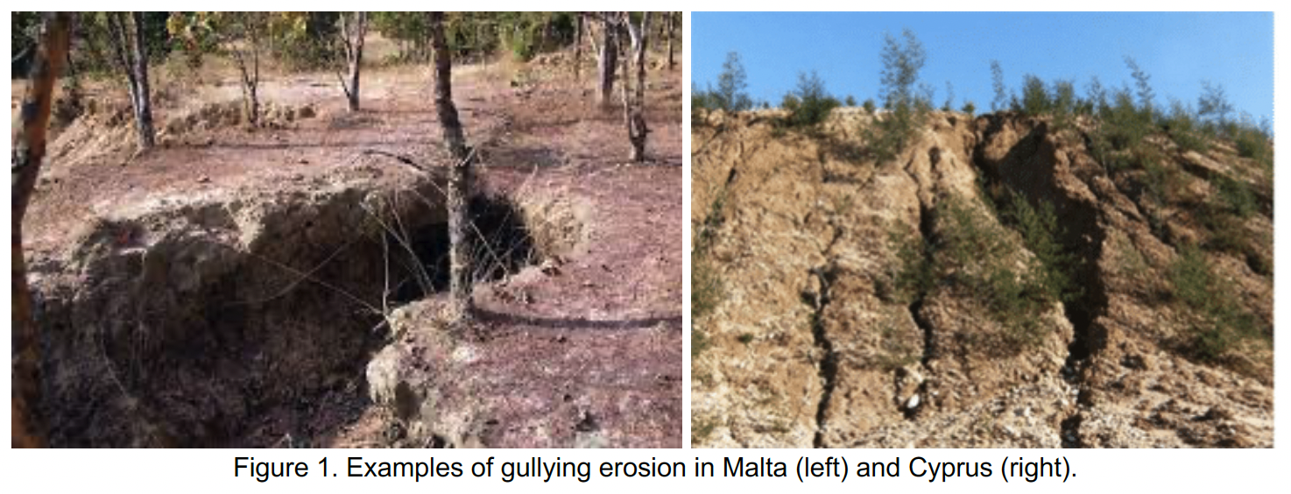
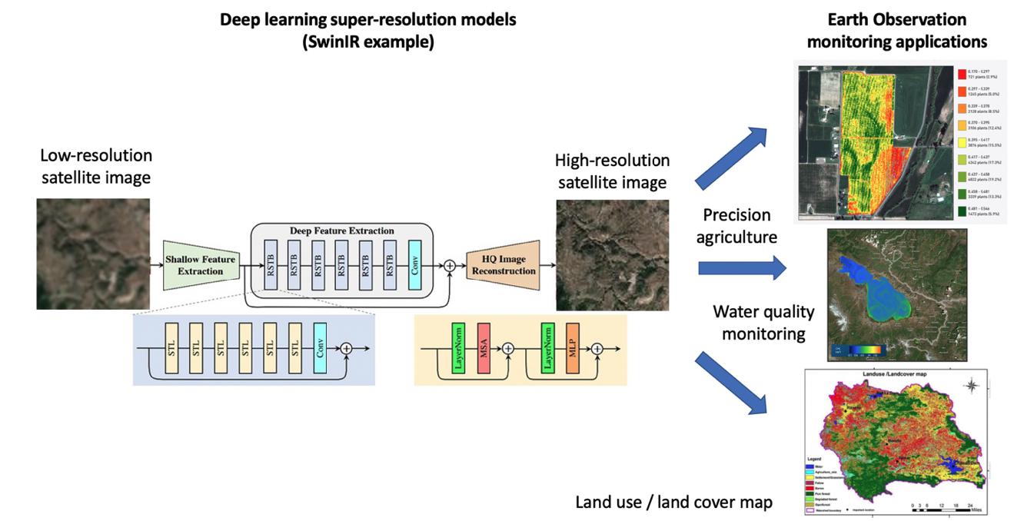
Current projects
Soil Erosion Monitoring using Super-Resolved Sentinel-2 Data (SEMS-2D)
Funded through 1st Malta ESA PECS call
Performance Improvement of Earth Observation monitoring applications using Super-Resolution (PI-EOS)
Funded through Xjenza Malta Research Excellence Programme 2024
Semablu has also submitted 2 further proposals for the 2nd Malta ESA PECS call (awaiting results)

Slide 12
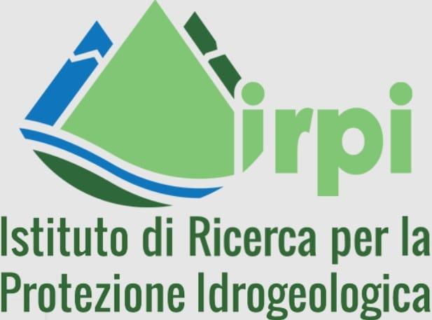
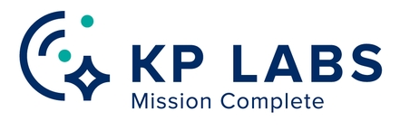
Our partners

