Slide 1
Earth Observation in service of Nature Protection and Sustainable Development
Big Data: space solutions for society
Ivan Tekić, Oikon Ltd – Institute for Applied Ecology
1st July 2025

Slide 2
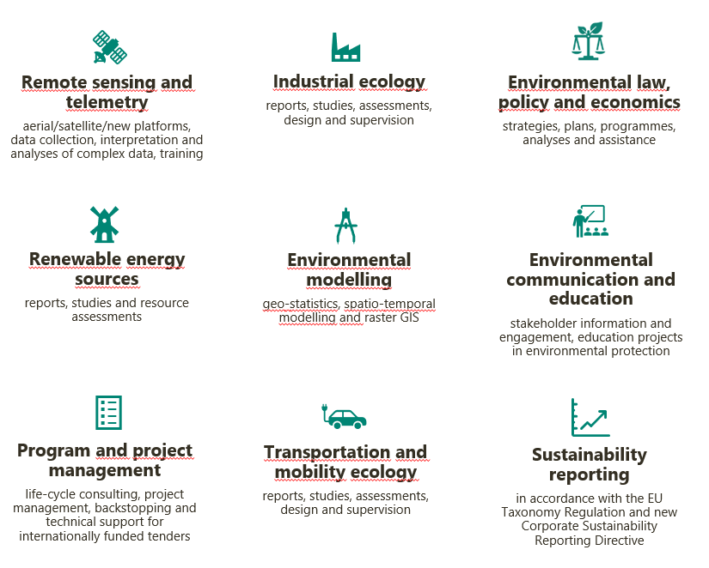
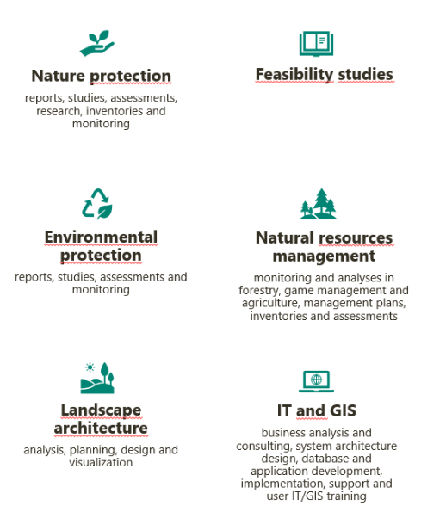
Company information
leading licensed and accredited environmental consultancy / research organisation in Croatia and region.
27 years of experience, over 550 satisfied clients, and more than 1.700 contracts.
practical, pragmatic, feasible and cost-effective development solutions.
excellent business and research system that enables the creation of knowledge necessary for environmental protection, sustainable natural resource management, and the preservation of natural and cultural heritage.

Slide 3
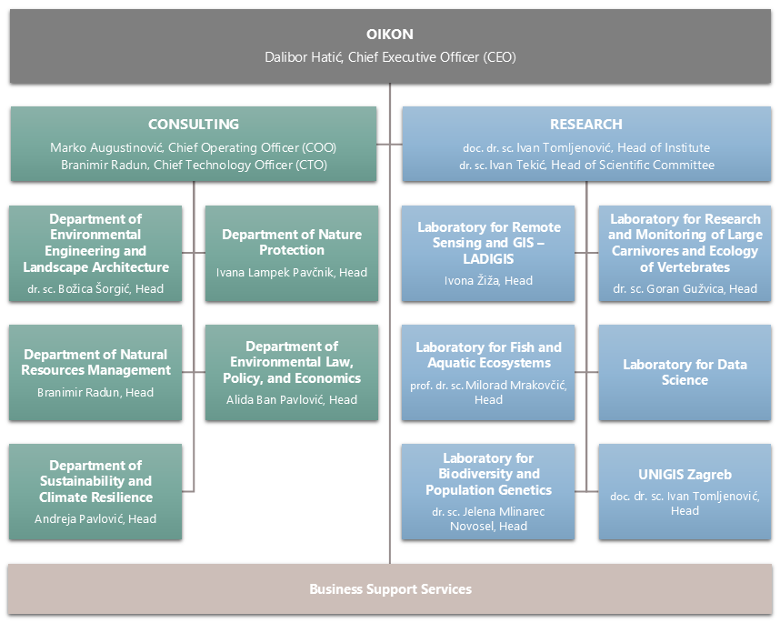
70+ employees | 11 doctors of science
12 certified engineers | 3 PMP certified experts
200+ external associates
Our experts cover many professions (22)
Ecology
Environmental Management
Nature Protection
Agronomy
Biology
Chemistry
Civil Engineering
Forestry
Geodesy
Geoinformatics
Geological Engineering
Geography
Mechanical engineering
IT
Landscape Architecture
Meteorology
Physics / Geophysics
Economy
Law
Journalism
Public Relations
Sociology
We can confidently state that WITH US, DEVELOPMENT IS NATURAL.

Slide 4
Earth Observation projects
Our Earth Observation initiatives span a wide range of environments, from coastal and marine ecosystems to forests and agricultural habitats.
We are leveraging cutting-edge EO technologies to address pressing challenges in environmental monitoring, biodiversity conservation, and sustainable resource management.
By integrating Earth Observation data with traditional methods since the start of our firm, we have built a strong legacy of enhancing the effectiveness of environmental protection and management
Strong cooperation with ESA – in total 11 completed, ongoing and upcoming projects.

Slide 5
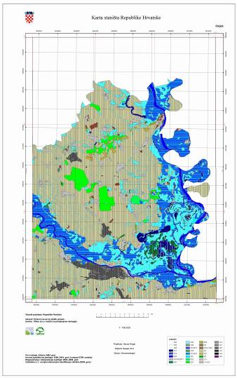
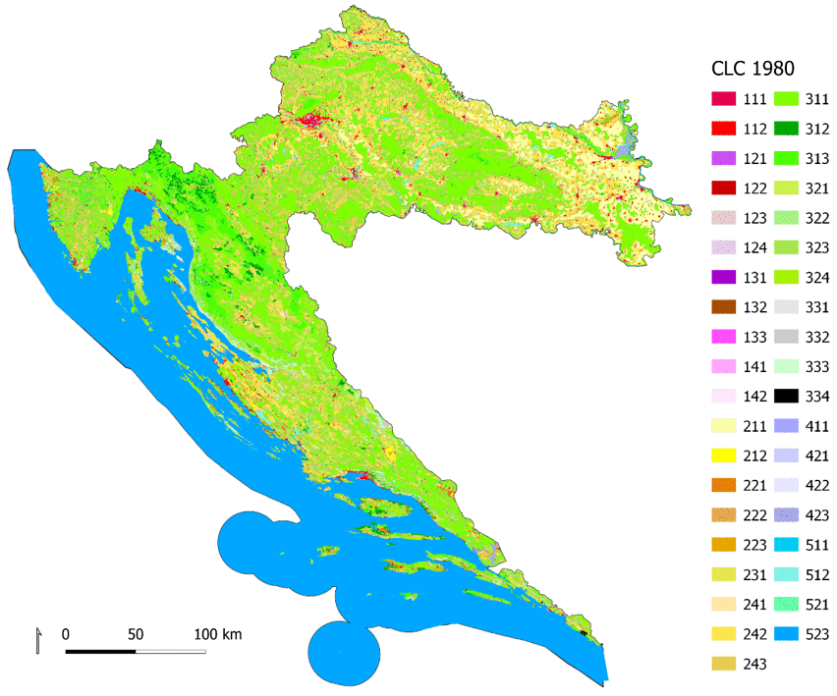
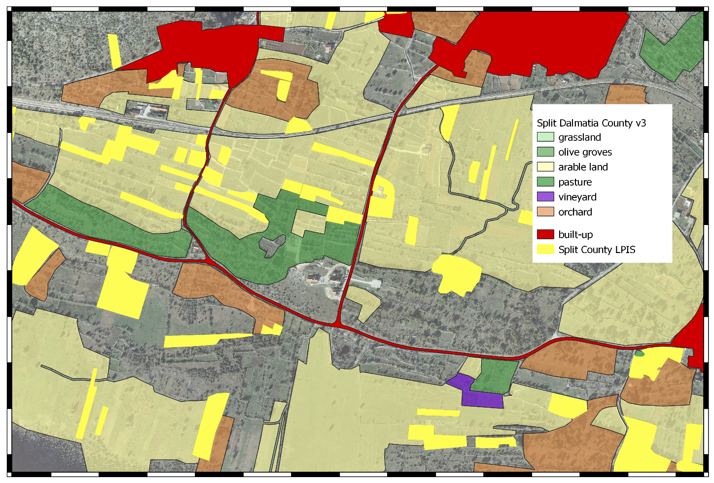
Extensive experience in terrestrial habitat mapping
Agricultural land monitoring and crop type classification – 16 crop types for all Croatia
Habitat mapping – official input for nature conservation for the whole territory of Croatia
All iterations of CORINE Land Cover mapping and change detection

Slide 6
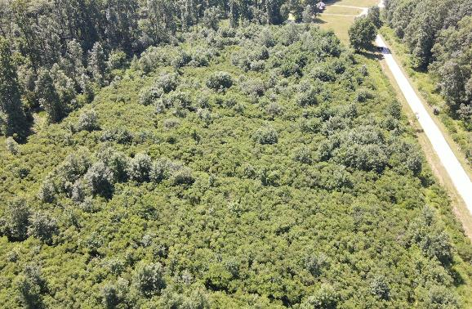
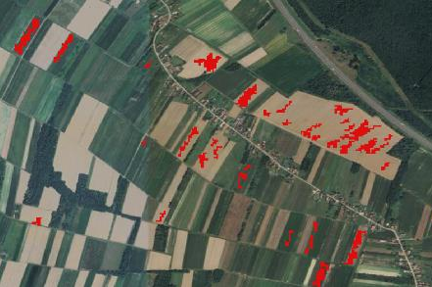
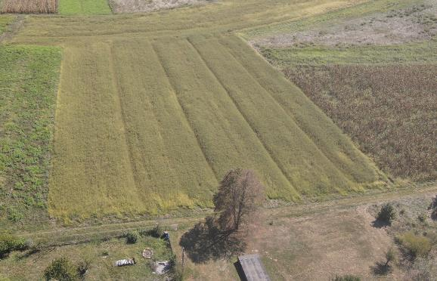
ESA projects: Terrestrial environment
Development of detection method for invasive plant species using Sentinel data
WebGIS application for automated invasive plant species detection using Sentinel data
Amorpha fruticosa
Ambrosia artemisiifolia

Slide 8
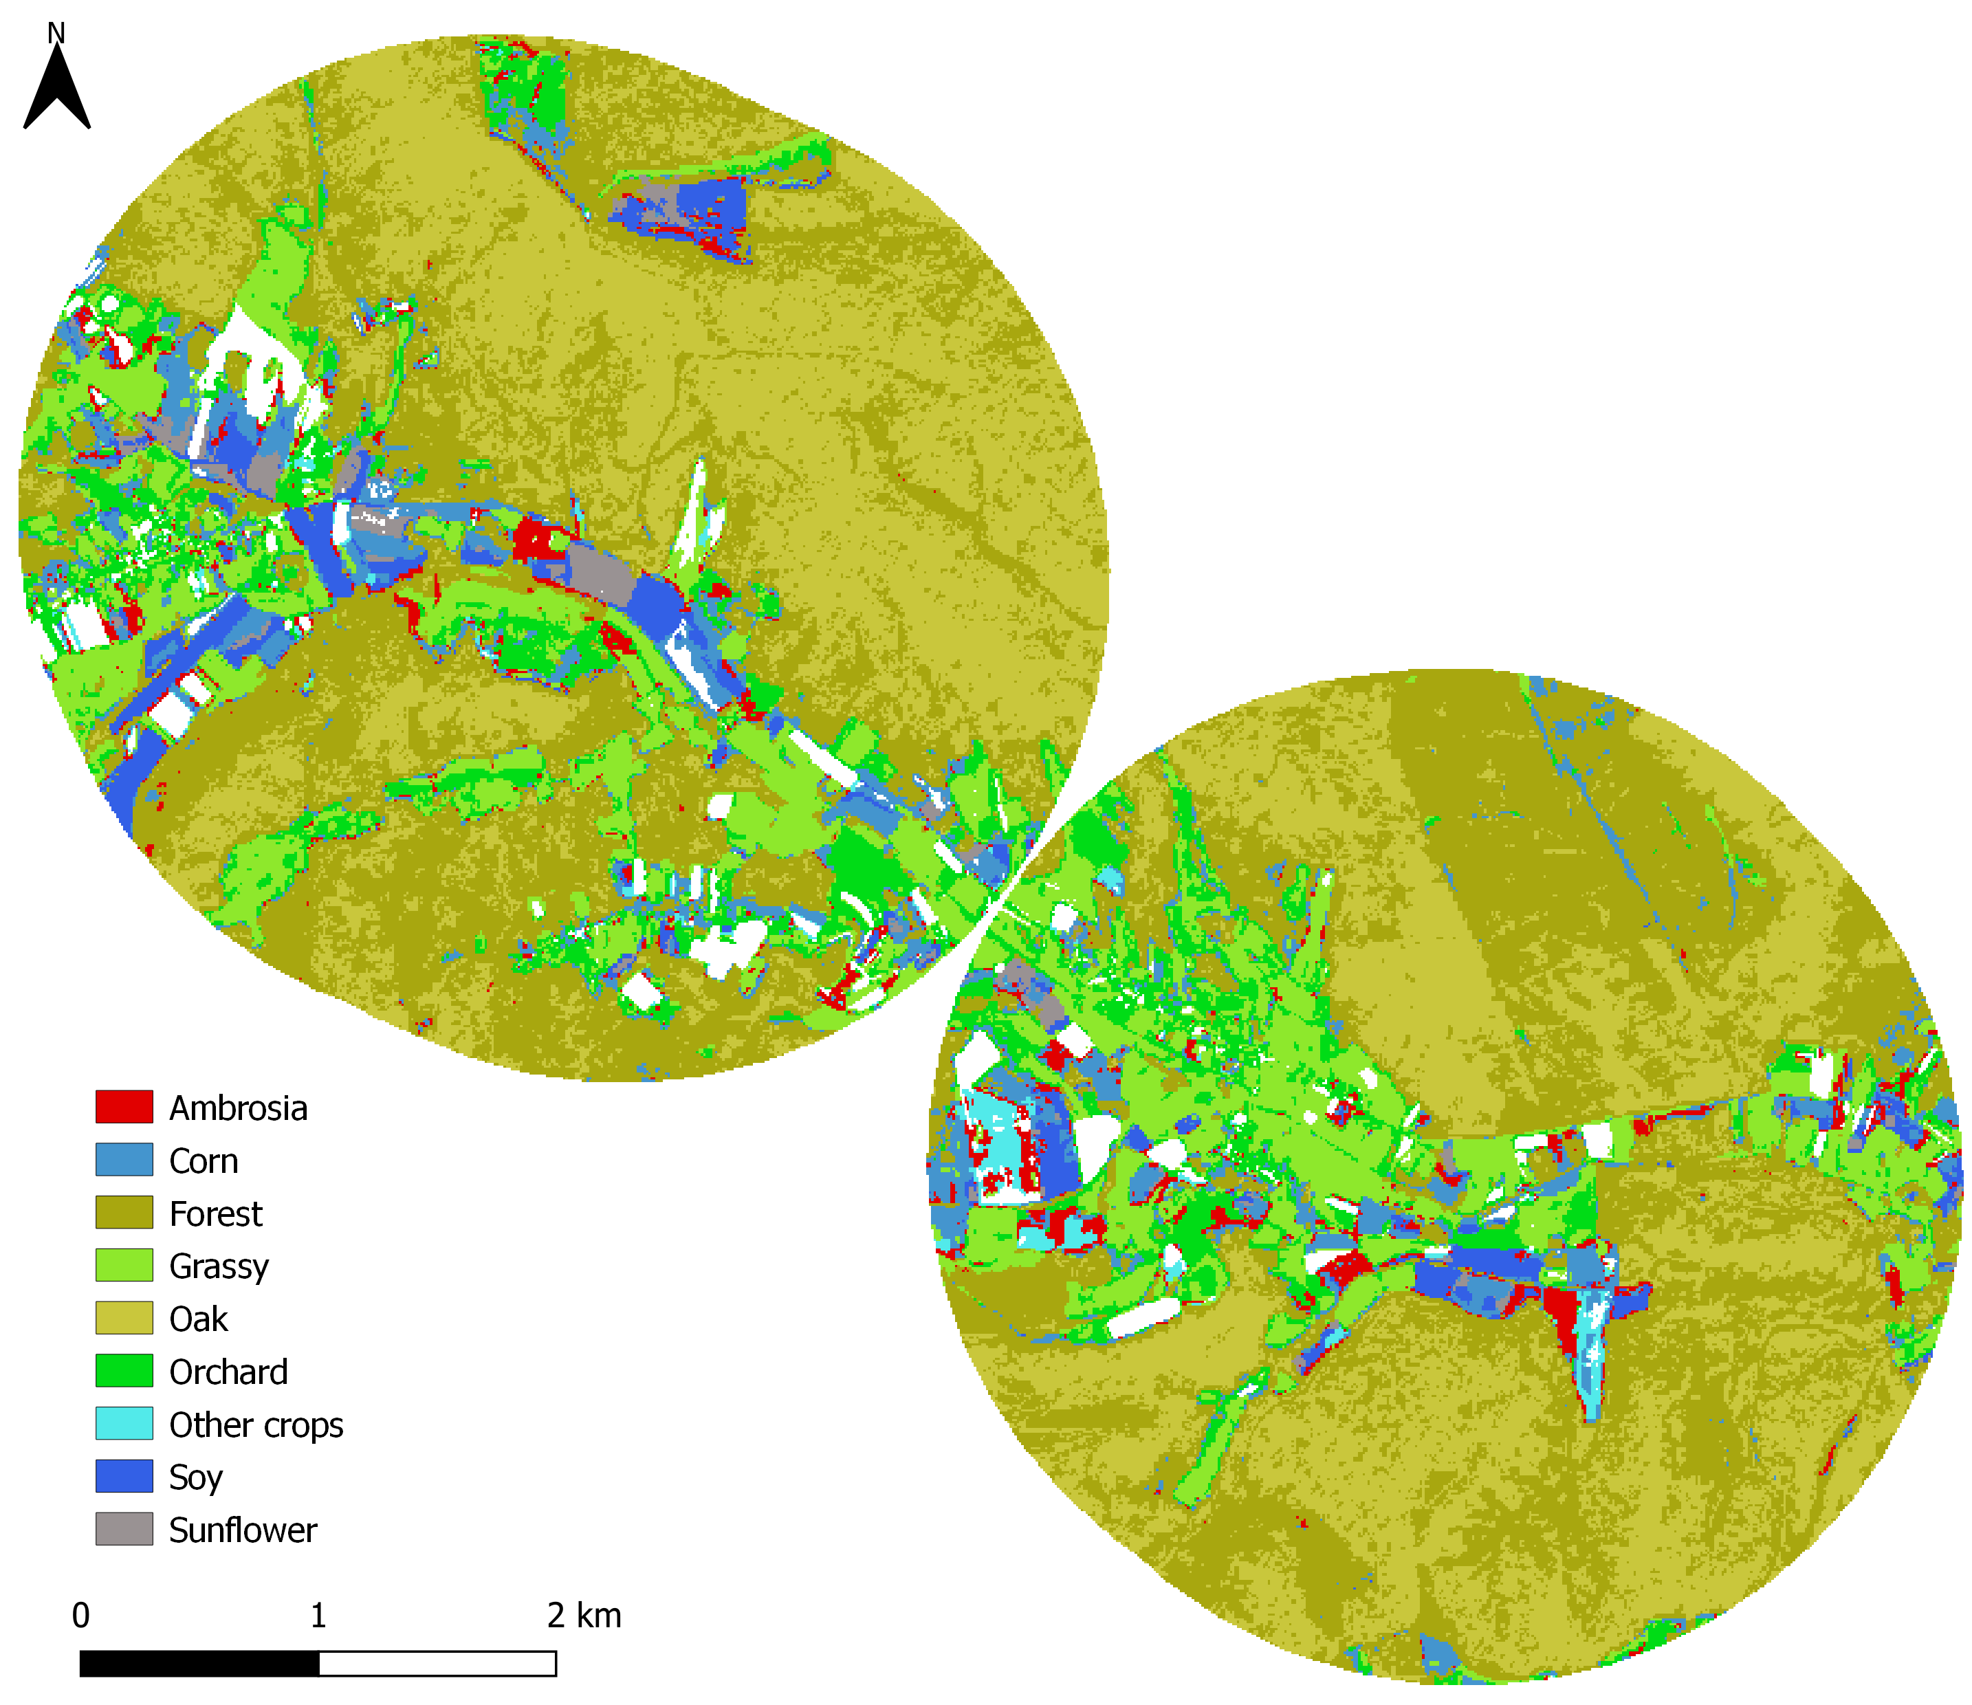
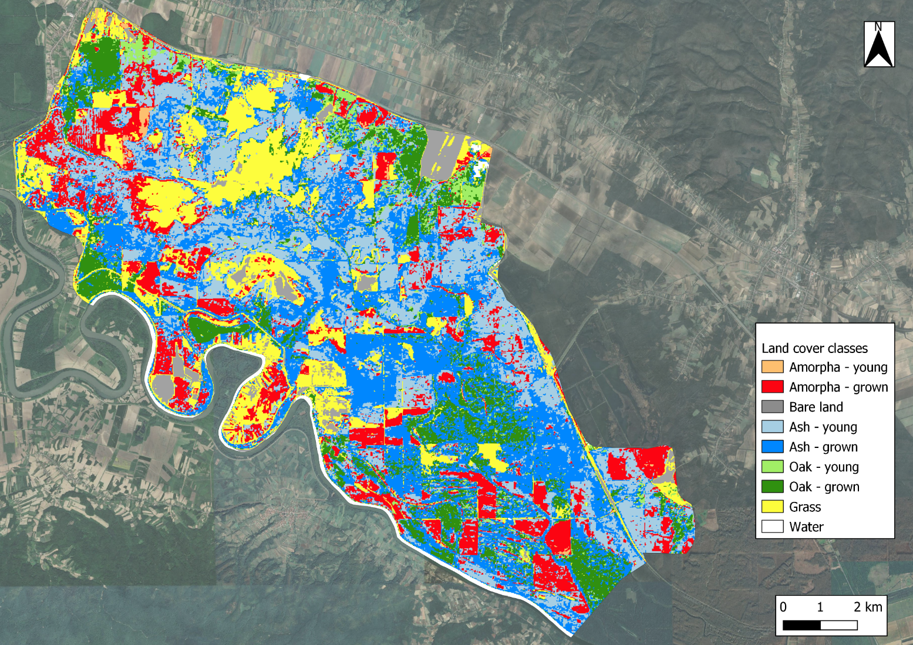
Replaces labor-intensive field surveys with automated detection
Forestry, water and biodiversity management, public health
WebGIS application capable of automated detection → continental Croatia ( 25.000 km2)

Slide 9
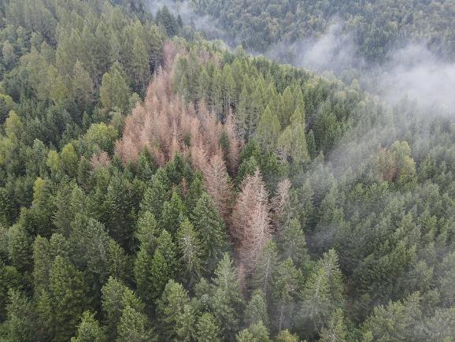
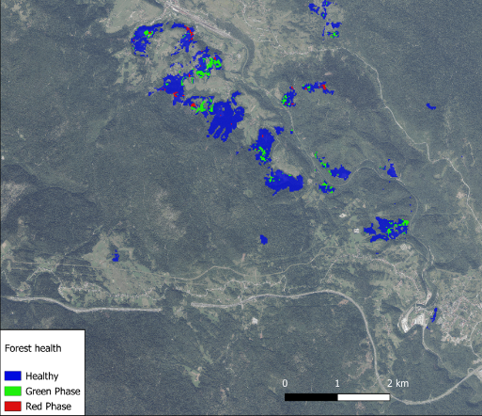
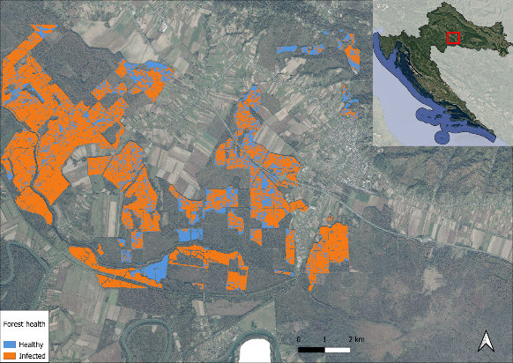
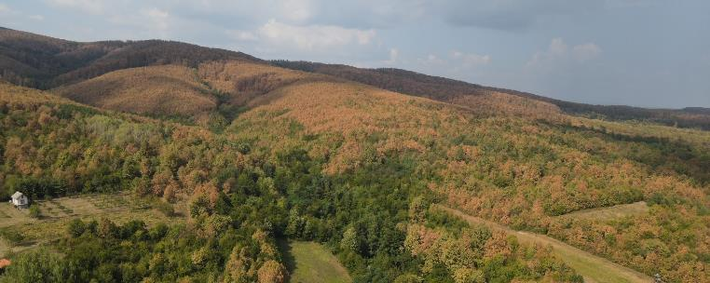
Forest Pests and Diseases - Sentinel-based Early Detection and Monitoring
Time series approach – sequence of 5 images, Machine Learning and Deep Learning algorithms.
European spruce bark beetle
Oak lace bug

Slide 10
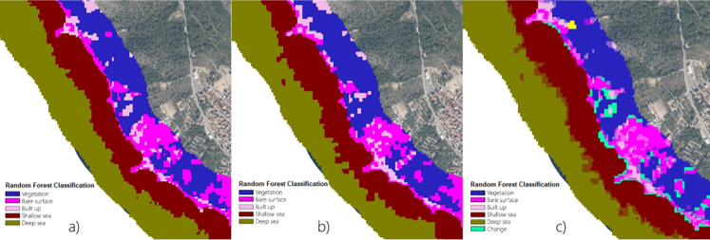
ESA projects: Coastal and maritime environment
Human Induced Coastal Change Monitoring
Development of a Coastal Monitoring System in Croatia

Slide 11
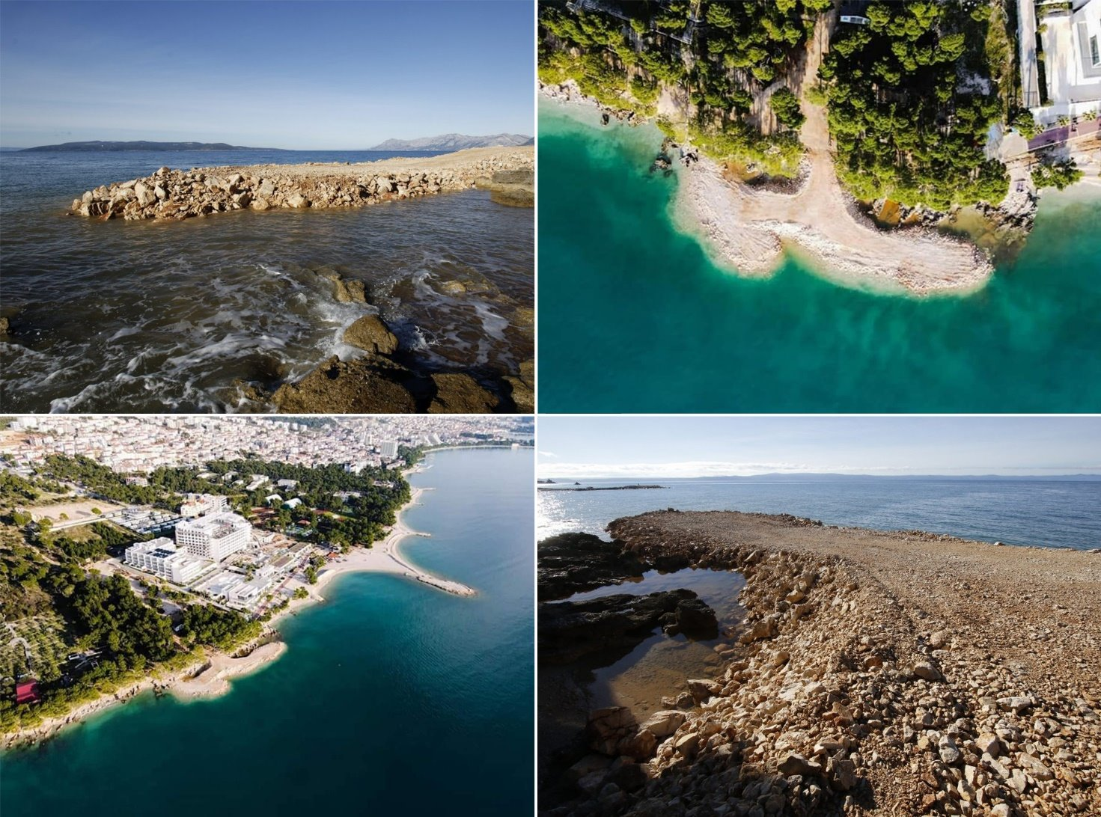
Unauthorized Construction: Land transformed into built structures, changing classification to "Built."
Grinding Rocky Shores: Converts "Rock" to "Gravel" by creating gravel beaches.
Illegal Mooring Areas: Changes "Water" to "Built" or "Rock" based on construction type.
Embanking: Alters "Sand," "Gravel," or "Water" to "Built" or "Rock" through embankment construction.
Unapproved Gravel Replenishment: Adds gravel to karst coastlines, changing "Water" to "Gravel„ or “Baren”.
Excessive Vegetation Removal: Reduces vegetation, changing "Vegetation“ to another land use type, primarily “Grass” or “Baren”.

Slide 12
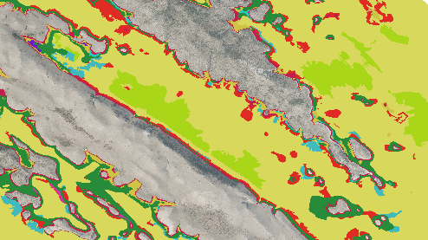
Sentinel based infralittoral sea habitat type mapping
Pixel based detection of sea habitats up to 30 m depth
Differentiaton of infralittoral habitat types up to the 3rd level of the Croatian National Classification of marine habitat types

Slide 13
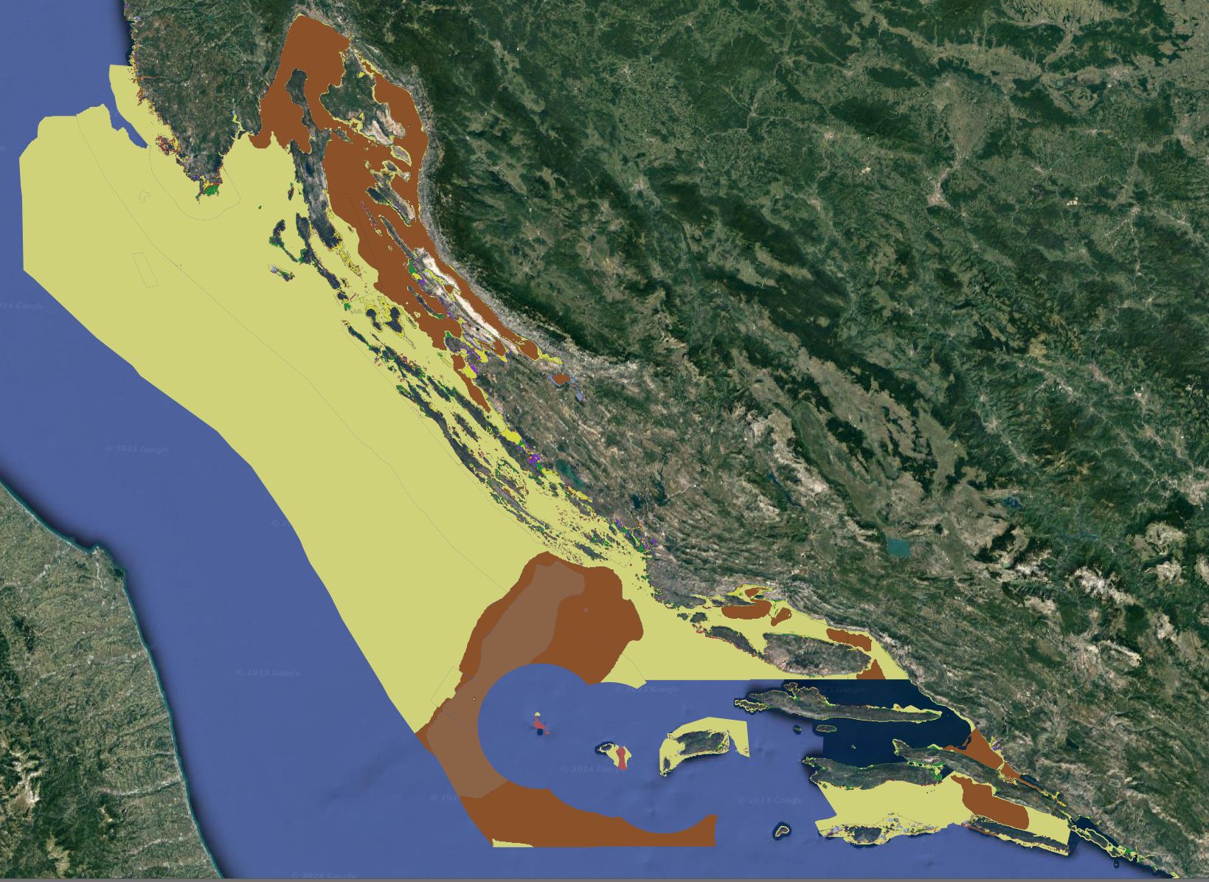
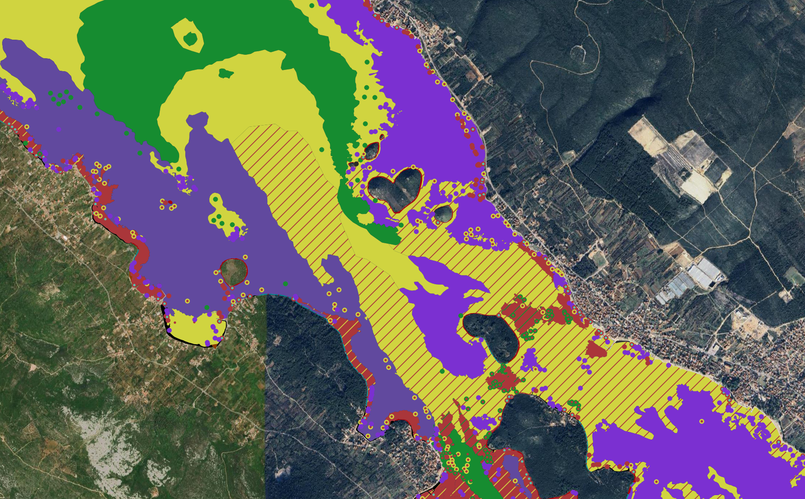

Slide 14
Upcoming ESA projects:
EO-based Coastal and Marine Ecosystem Accounting for Sustainable Management
Remote sensing for marine environment monitoring
EU-based habitat monitoring for large carnivores
Multi-Frequency Synthetic Aperture Radar for Infrastructure, Geohazard and Environmental Monitoring (“MFSAR-IGEM”)

Slide 15
THANK YOU
itekic@oikon.hr
Oikon Ltd. – Institute of Applied Ecology
Trg senjskih uskoka 1-2
HR – 10020 Zagreb
T +385 1 5507 100
F +385 1 5507 101
E oikon@oikon.hr
W www.oikon.hr
We support and contribute to the Sustainable Development Goals

