Slide 1
BIG DATA MEETS OCEAN HEALTH
Toward trusted, globe-ready ocean carbonate intel—at 4 km, every day
Charles Galdies, Institute of Earth Systems, University of Malta
charles.galdies@um.edu.mt

Slide 2
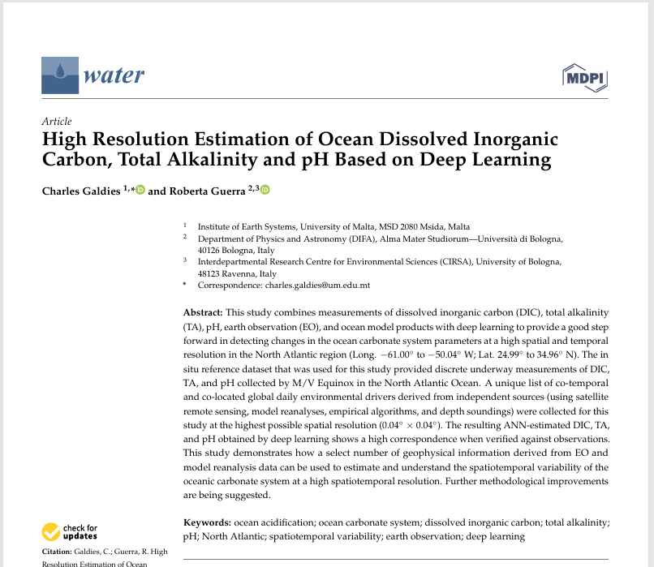
Why care about Carbonate Chemistry
Surface pH ↓ 0.1 since 1860 – acidification accelerating
Shellfish, reefs, €-billion aquaculture industries at stake
Ship surveys cover < 0.01 % of the ocean each month
Big-Earth Data + AI can fill the gap:
Case Study: AI-Driven Estimation of Ocean Carbonate Chemistry from Big Earth Data

Slide 3
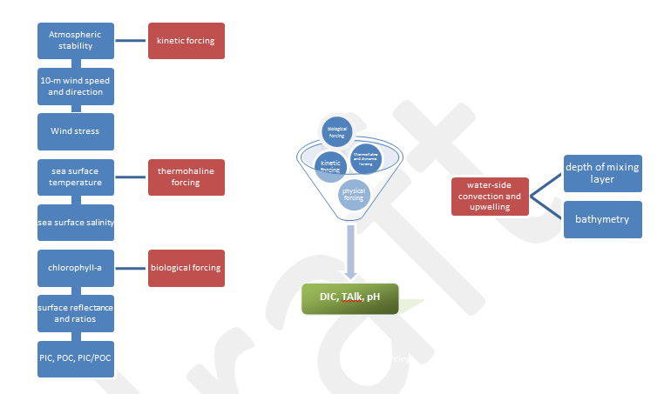
From Data Deluge to Insight
f(DIC, TA, pH) = (U₁₀, DD, wind stress, transfer velocity, depth, SSS, chlorophyll-a, SST, R_{rs} 412, R_{rs} 443/555, R_{rs} 531/555, R_{rs} 443/48, PIC, POC, MLD)
Notes:
Lots of raw data ≠ knowledge. We must blend kinetic, thermohaline, bio-optical and bathymetric drivers quickly enough for decision-makers.” Plant the ‘trust’ question: “Does the model earn its keep?” (1 min)

Slide 4
Parameter | Code | Source | Resolution
Biological drivers
Water-leaving surface reflectance (Rrs) at 412, … 555nm) | BD 1 | MODIS (Aqua, Terra) | 0.042º, daily, global
Rrs 443/555 | BD 2 | MODIS (Aqua, Terra) | 0.042º, daily, global
Rrs 531/555 | BD 3 | MODIS (Aqua, Terra) | 0.042º, daily, global
Rrs 443/488 | BD 4 | MODIS (Aqua, Terra) | 0.042º, daily, global
Chlorophyll a | BD 5 | MODIS (Aqua, Terra) | 0.042º, daily, global
Particulate Inorganic Carbon (PIC) | BD 6 | VIIRS | 0.042º, daily, global
Particulate Organic carbon (POC) | BD 7 | VIIRS | 0.042º, daily, global
Physical drivers
Sea surface salinity | PD 1 | SMOS | 0.05º, daily, global
Sea surface temperature | PD 2 | OISST | 0.25º, daily, global
Wind speed | PD 3 | ASCAT | 0.25º, daily, global
Wind direction | PD 4 | ASCAT | 0.25º, daily, global
Wind stress | PD 5 | ASCAT | 0.25º, daily, global
Transfer velocity_{W} | PD 6 | Based on ASCAT | 0.25º, daily, global
Transfer velocity | PD 7 | Based on ASCAT | 0.25º, daily, global
Transfer velocity | PD 8 | Based on ASCAT | 0.25º, daily, global
Bathymetry | PD 9 | GEBCO | 0.083º, global
Mean layer depth | PD 10 | Global ocean 1/12° physics analysis and forecast updated daily. Copernicus Marine environment monitoring service | 0.083º, daily mean, global analyses, 50 depth levels

Slide 5
Testbed
Toward trusted, globe-ready ocean carbonate intel—at 4 km, every day
Atlantic region ● Research cruise ships ● ROI: 25–35 °N, 61–50 °W

Slide 6
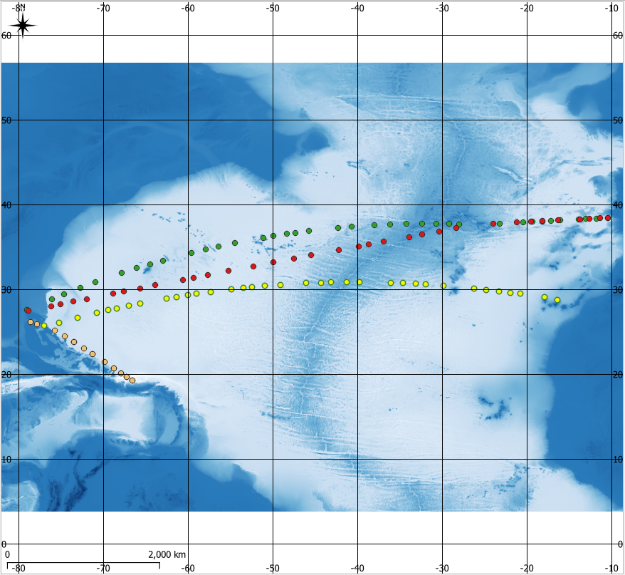
North Atlantic test bed
Sampling periods of in-situ discrete underway samples of DIC, TA and pH measured by M/V Equinox (Source: NCEI Accession 0154382) overlaid over bathymetry (Source: GEBCO).
Winter 2015: Validation dataset 1;
Autumn 2016: Validation dataset 2;
Spring 2015: Validation dataset 3;
Spring 2016: ANN Training dataset for the prediction of DIC, TA and pH.
“Toward trusted, globe-ready carbonate intel—at 4 km, every day”
Notes:
Why here: strong gradients, frequent cruises for ground-truth, remote-sensing clear water. Data: 2015-16 Equinox DIC/TA/pH sets; 17 daily drivers. (1 min)

Slide 7
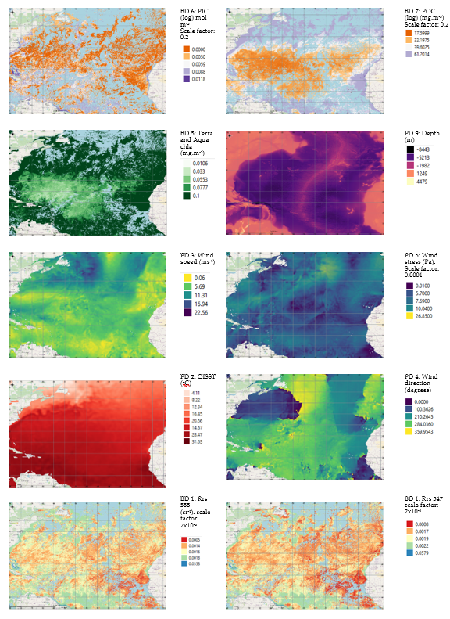
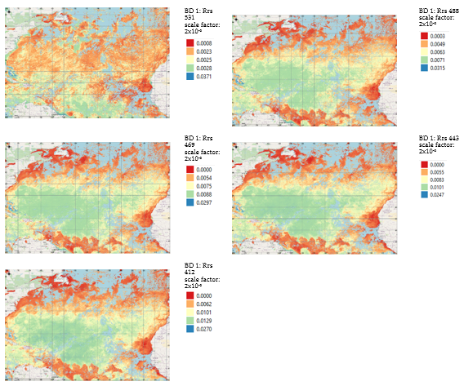
Notes:
Lots of raw data ≠ knowledge. We must blend kinetic, thermohaline, bio-optical and bathymetric drivers quickly enough for decision-makers.” Plant the ‘trust’ question: “Does the model earn its keep?” (1 min)

Slide 8
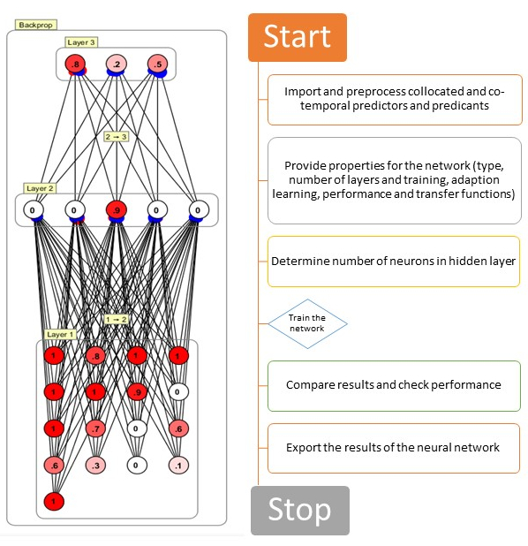
Neural network architecture
BPN model used consisted of 5 hidden neurons and the respective weights (in red and blue) of each connection.
The values in each of the neuron is a scaled down value (1 decimal place) of the input, hidden and output neurons, corresponding to one possible solution between the proxy environmental drivers (predictors) and the values for DIC, TA and pH (predictands).
Layer 1 (input): 17 neurons.
Layer 2: Hidden; 5 neurons.
Layer 3 (output): 3 neurons: DIC, TA, and pH. (b) Steps involved in the development of BPN model.
f(DIC, TA, pH) = (U₁₀, DD, wind stress, transfer velocity, depth, SSS, chlorophyll-a, SST, R_{rs} 412, R_{rs} 443/555, R_{rs} 531/555, R_{rs} 443/48, PIC, POC, MLD)
Notes:
17 satellite & model inputs in, three carbonate outputs out. Five hidden neurons was the sweet spot—anything bigger over-fitted.” Counter scepticism: stress simplicity & interpretability. (1 min)

Slide 9
Independent validation
Training → three reserved cruise transects; metrics table
Toward trusted, globe-ready ocean carbonate intel—at 4 km, every day
9

Slide 10
How well does it work?
Mean bias for DIC, TA and pH are -2.5 μmol kg⁻¹, -3.2 μmol kg⁻¹ and 0.0048 respectively
Median and variability of ANN-estimated values fall within those shown by discrete underway measurements (Winter 2015 cruise transect). The means of the two datasets are similar at the 99% C.L.
Notes:
“Biases are an order of magnitude smaller than natural variability; RMSE < 0.02 for pH.” Address error bars frankly; relate to Fourrier et al. med-sea benchmark

Slide 11
How well does it work?
Median and variability of ANN-estimated values fall within those shown by discrete underway measurements (Autumn 2016 cruise transect). The means of the two datasets are similar at the 99% C.L.
Notes:
“Biases are an order of magnitude smaller than natural variability; RMSE < 0.02 for pH.” Address error bars frankly; relate to Fourrier et al. med-sea benchmark

Slide 12
How well does it work?
 | Discrete underway measurements |  |  | ANN estimation |  |  | Mean bias
StationID | DIC (μmol kg⁻¹) | TA (μmol kg⁻¹) | pH | DIC (μmol kg⁻¹) | TA (μmol kg⁻¹) | pH | DIC (μmol kg⁻¹) | TA (μmol kg⁻¹) | pH
1120000 | 2074 | 2387 | - | 2064 | 2385 | 8.111 | 10 | 2 | -
1130000 | 2078 | 2397 | - | 2066 | 2378 | 8.105 | 12 | 19 | -
1140000 | 2076 | 2404 | - | 2071 | 2368 | 8.099 | 5 | 36 | -
1150000 | 2081 | 2400 | - | 2066 | 2375 | 8.104 | 15 | 25 | -
1160000 | 2083 | 2392 | - | 2062 | 2384 | 8.112 | 21 | 7 | -
1200000 | 2078 | 2382 | 8.073 | 2075 | 2378 | 8.096 | 3 | 4 | -0.023
1330000 | 2095 | 2390 | 8.073 | 2073 | 2388 | 8.099 | 21 | 1 | -0.025
Sampling period | Pearson correlation R - Sea Surface Temperature | Pearson correlation R - Sea Surface Salinity
Mar 07-08, 2015 | 0.78 | 0.93
Apr 28- May 6, 2015 | 0.99 | 0.69
Apr 16-24, 2016 | 0.98 | 0.90
Oct 30 – Nov 06, 2016 | 0.97 | 0.63
Notes:
“Biases are an order of magnitude smaller than natural variability; RMSE < 0.02 for pH.” Address error bars frankly; relate to Fourrier et al. med-sea benchmark

Slide 13
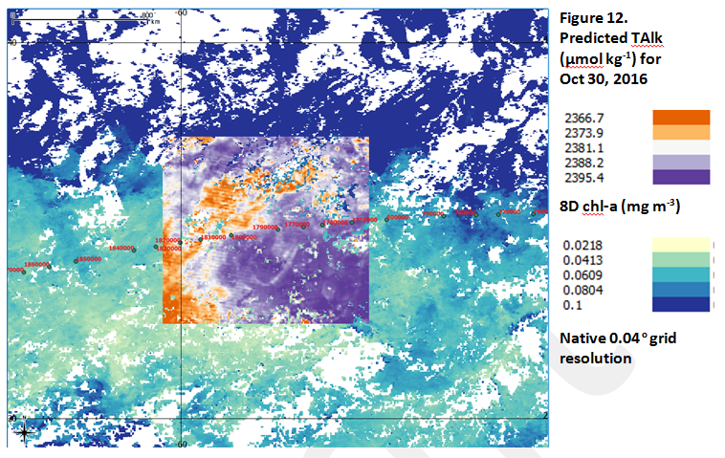
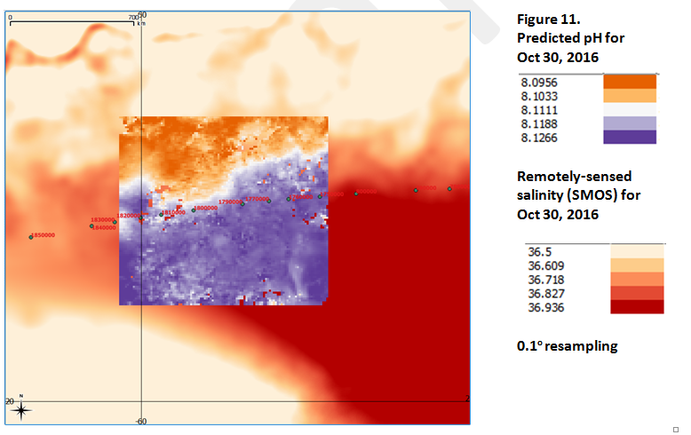
Daily 4-km ocean carbonate chemistry maps: >1 million pH data points
more than 1 million data points to derive rasterised maps of pH
Notes:
zoom into eddies, highlight east-west pH gradient tracking pCO₂ tongue. (1 min)

Slide 14
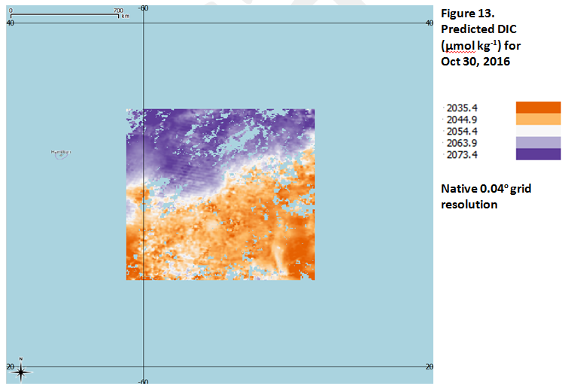
Daily 4-km ocean carbonate Maps
Notes:
zoom into eddies, highlight east-west pH gradient tracking pCO₂ tongue. (1 min)

Slide 15
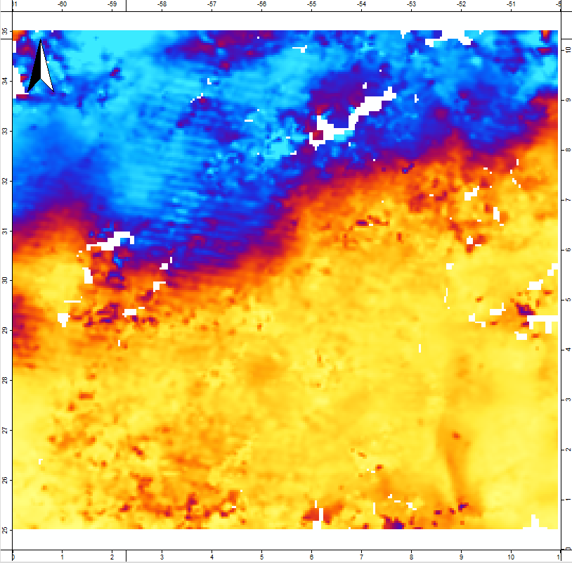
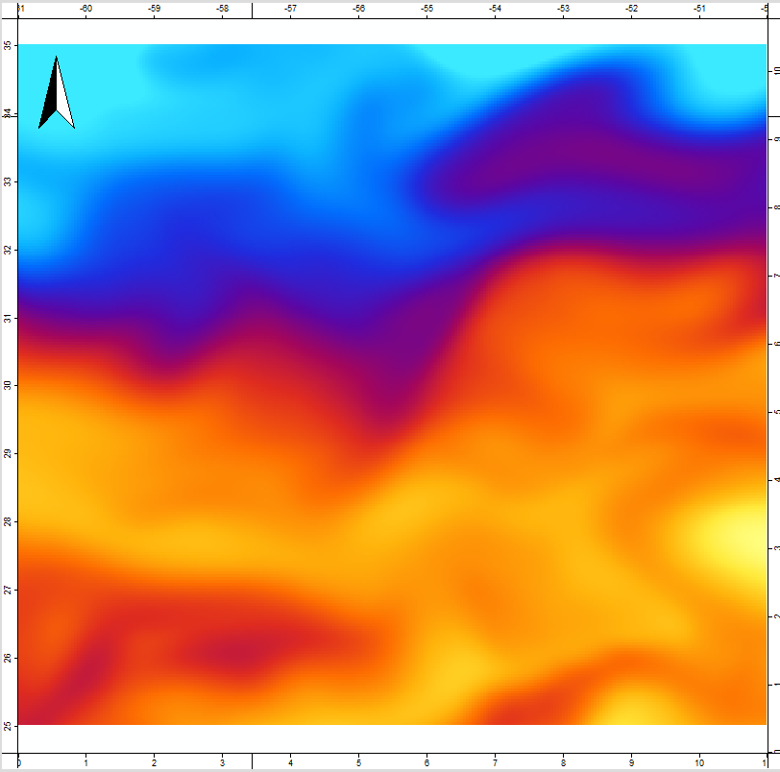
Novel insights into spatial distribution of surface ocean pH
pH (ANN-estimated over ROI)
(October 30, 2016)
pH (Global Ocean Biochemistry Hindcast
(October 16th - November 15th, 2016)
scatterplot R²=0.81

Slide 16
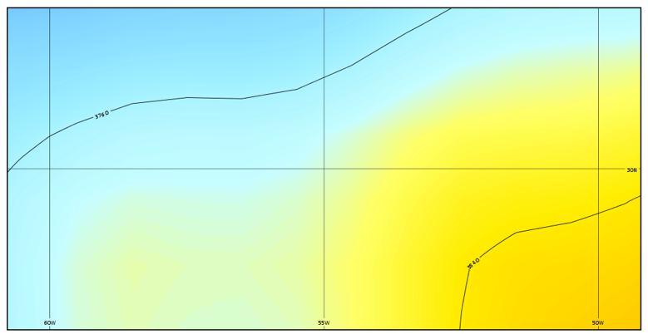
Novel insights into spatial distribution of surface ocean pH
pH (ANN-estimated over ROI)
(October 30, 2016)
Sea surface pCO2

Slide 17
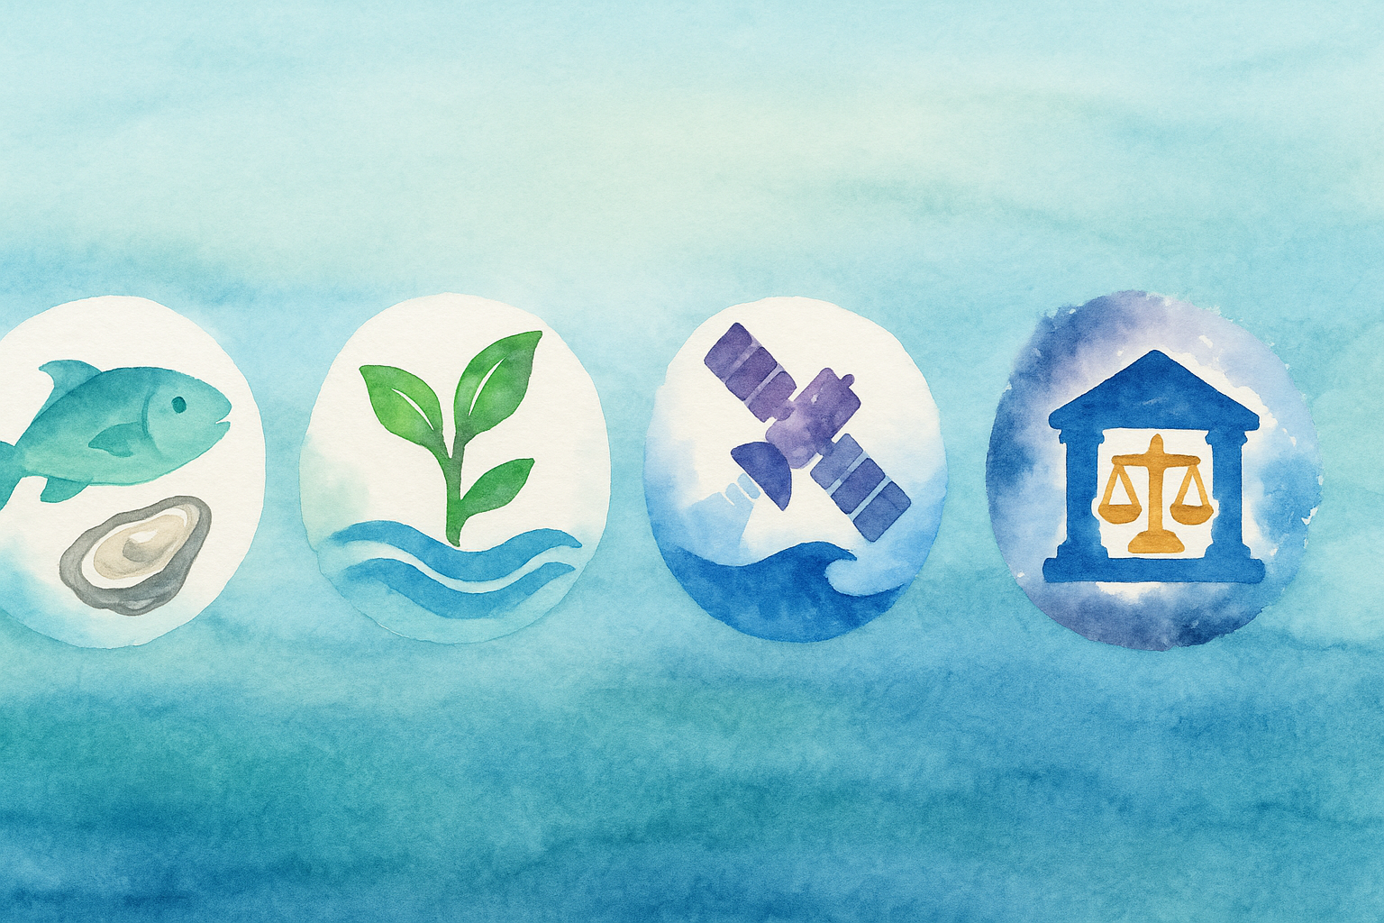
Who uses these maps?
Hatcheries & wild capture fisheries
Blue carbon and coastal restoration projects; monitoring of OA-refugia
Operational oceanography and Research centres
Policy makers & environmental regulators
Notes:
Use OA-refugia example—pH metrics for site management

Slide 18
Limitations and next steps
Current caveats
Roadmap forward
North Atlantic only – model trained on 2015-16 mid-latitude data; transferability to other basins/regions untested
Optical cloud gaps – predictions are nulled where cloud block key EO drivers, leaving spatial holes in daily maps
Unknown in situ error budget –
Driver set still narrow – no air sea heat fluxes, pressure, precipitation or freshwater inputs yet included
Coastal/high productivity bias risk – algorithm may mis-estimate in chlorophyll-rich waters; further learning required
Broaden training matrix with global, seasonally diverse samples and finer scale variability of existing drivers
Add new drivers
Predict pCO2 next (reaching the full carbonate quartet (DIC, TA, pH, pCO₂)
Physics-based adjustments from numerical ocean models to reduce bias
Cloud-scale automation – exploit EO data cubes on cloud servers to deliver global daily 4km maps on demand.
Assimilate model dynamics - Use of AI to fill in spatial holes

Slide 19
Take-home messages
AI + Big Earth Data → daily 4 km maps of DIC, TA & pH
Bias < ±0.02 pH units; RMSE within natural variability
Outputs inform aquaculture, blue-carbon, SDG 14.3 indicators
Open data + open code = transparency & trust
Facility of a National Data Hub will democratise and scale this workflow
“Ocean-health intelligence at cloud speed”
Notes:
Close: recap, invite collaboration, thank organisers. Leave URL/QR to code repo & email. (0.5 min)

Slide 20
THANK YOU
Insert Image

