Slide 1
Unifying Big Data Analytics for Earth Observation using Apache Wayang
Alexander Alten PMC Apache Wayang

Slide 2
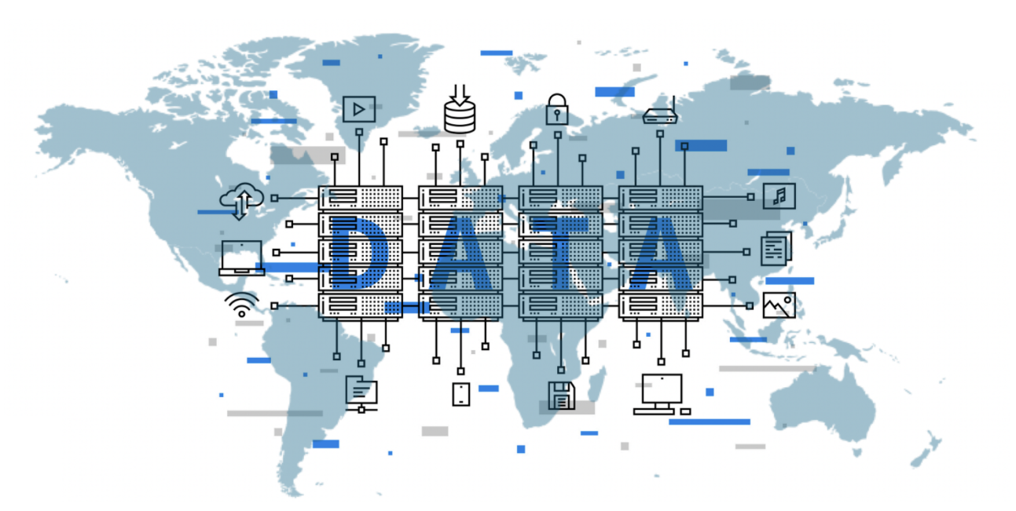
Data-centric World

Slide 3
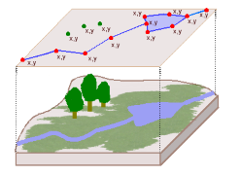
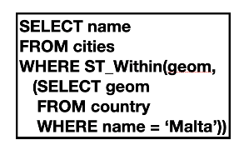
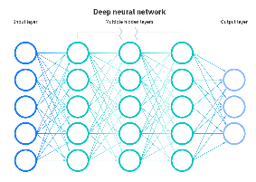
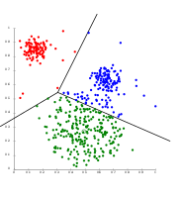
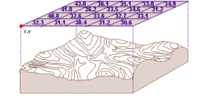
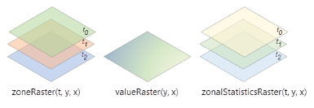
Spatial Data Analytics in 2025
Vector Data
Text Data
SQL Queries
Deep Learning
Streaming Data
Clustering
Raster Data
Image Data
Zonal Statistics

Slide 4
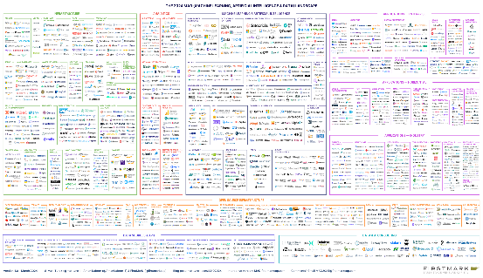
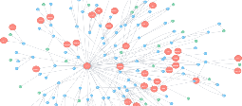
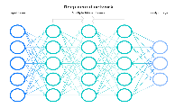
Users/Developers overwhelmed
2024
Complex Analytics
Zoo of Systems

Slide 5
Current Approaches
Custom Systems & ETL/ELT Processes
Hybrid Systems
Complex Data Architectures and Infrastructures
Extract
Transform
Load
Extract
Load
Transform
HadoopDB, SystemDS, FlumeJava
Not maintainable
Not optimal
Costly

Slide 6
Current Approaches
Custom Systems & ETL/ELT Processes
Hybrid Systems
Complex Data Architectures and Infrastructures
Corporate developers spend approximately 65% of their effort building bridges between applications (Gartner)
Extract
Transform
Load
Extract
Load
Transform
HadoopDB, SystemDS, FlumeJava
Not maintainable
Not optimal
Costly

Slide 7
Need: Framework that seamlessly integrates Data Systems
Data Platform Integration Layer
Code once, run anywhere
Optimize applications

Slide 8
Idea behind Apache Wayang
Applications
Scala
Wayang Job
Python
SQL
Java
Apache Wayang
- Optimization & Coordination -
Data Processing Engines
- Data Processing -
Plug your own platform?
Data Sources
- Data Extraction -
Plug your own data source?

Slide 9
How does Wayang work?
Applications
Wayang plan
Scala
Wayang Job
Python
SQL
Natural Language
Java
Platform-agnostic
Apache Wayang
- Optimization & Coordination -
Spark
Data Processing Engines
- Data Processing -
Plug your own platform?
Java runtime
Java runtime
Execution plan
Data Sources
- Data Extraction -
Plug your own data source?
Platform-specific

Slide 10
How does Wayang work?
Applications
Wayang plan
Wayang Job
Natural Language
*Cost:
Runtime
Monetary cost
Energy consumption
...
Scala
Python
SQL
Platform-agnostic
Java
Query Optimizer*
- Optimization & Coordination -
Coordinator
Java Driver
JDBC Driver
Flink Driver
Spark Driver
Giraph Driver
Tensorflow Driver
Java Driver
Spark
Data Processing Engines
- Data Processing -
Plug your own platform?
Java runtime
Java runtime
Execution plan
Data Sources
- Data Extraction -
Plug your own data source?
Platform-specific

Slide 11
Benefits of seamless Data Platform Integration
Data Platform Integration
Data Platform Integration
Optimize ETL Pipelines
Simplify Data Architectures
Federated Data Processing
Privacy-preserved ML Models (Federated Learning)
Data cost reduction
Runtime speedup
Energy savings
Data compliance
Privacy

Slide 12
Earth Observation with Wayang
Train
Train a model for anomaly detection
Tensorflow
Aggregate
Zonal statistics (mean NDVI per region)
Spark
Join
Spatial join
Spark Beast
Preprocess
Preprocess
Mask clouds
Compute NDVI, mask clouds
Spark
PostGIS
Load vector data
Load raster data
PostGIS
Read vector AOI
Read satellite images
Spark

Slide 13
Summary
Wayang: a middleware for integrating data processing engines
Easy platform migration: Code once, run anywhere
Optimized ETL processes, without materialising intermediate results
Simplified data architectures
Optimized performance & cost
Spatial analytics (coming up!)
wayang.apache.org
github.com/apache/incubator-wayang

Slide 14
Research behind Wayang
Apache Wayang: A Unified Data Analytics Framework. SIGMOD Record 52(3): 30-35 (2023)
RHEEM: Enabling Cross-Platform Data Processing – May The Big Data Be With You! -. PVLDB 11(11): 1414-1427 (2018)
RHEEMix in the data jungle: a cost-based optimizer for cross-platform systems. VLDB J. 29(6): 1287-1310 (2020)
Optimizing Cross-Platform Data Movement. ICDE 2019: 1642-1645
ML-based Cross-Platform Query Optimization. ICDE 2020: 1489-1500
Expand your Training Limits! Generating Training Data for ML-based Data Management. SIGMOD 2021: 1865-1878
Farming your ML-based Query Optimizer‘s Food. ICDE 2022: 3186-3189 (Best demo award)
DataFarm: Farm Your ML-based Query Optimizer‘s Food! – Human-Guided Training Data Generation -. CIDR 2022

Slide 15
Thank You!
Alexander Alten PMC Apache Wayang
alo.alt@apache.org alo@scalytics.io

