Slide 1








Eurisy and ICLEI Europe present:
THE SPACE BETWEEN US:
BRIDGING SATELLITES AND SMART CITIES
Thursday, 6 November| 11:30-12:00|
European Commission Booth
EU Stand, Hall 2, Level 0, Street D, Stand 101

Slide 2




MATCHMAKER
WEBSITE
Fostering dialogue between space and non-space communities
FACILITATOR
ADVISER
Raising awareness about the uses and benefits of space applications and data.
Offering insights into user needs and challenges in using and integrating satellite data.

Slide 3


Free-of-charge technical assistance to support making your project bankable or investment-ready.
Knowledge sharing and generation around smart cities. Knowledge repository and focus groups.
Global network of 1000+ cities.
Areas of work include green digital transformation, mobility, energy, nature-based solutions, sustainable food systems, governance innovation, just transition or public procurement.
Supporting local governments towards sustainable development

Slide 4
Agenda
11:30-11:35
Introduction, Eurisy & ICLEI Europe on the Focus Group activities
11:35-11:50
Use Case: Geospatial, AI-powered Urban Digital Platform: CityNexusPro with MindEarth
Use Case: Project Oracles with Meteo France, supporting decision makers during coastal flooding events with Keyros
11:50-12:00
Open Discussion and Q&A
12:00-12:10
Meet the speakers and the community of the Geospatial Tools for Cities Focus Group.

Slide 5

USE CASE PRESENTATIONS
INTRO
CHALLENGE
SOLUTION
RESULTS

Slide 6


Anika Ruess
Growth & Project Manager
anika.ruess@mindearth.ai

Slide 7


Specializing at the leading edge of Geospatial Technology, advanced Artificial Intelligence, and Earth Observation.
Our engine is to stay at the forefront of technology. We collect, process, and fuse high-granular mobility and sensor data, and next-gen satellite EO by leveraging frontier AI to support decision-making across the public and private sectors.

Slide 8

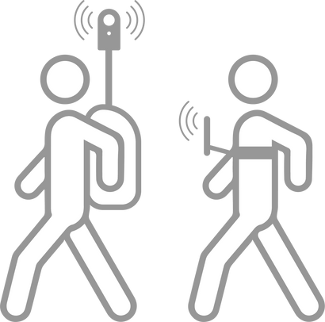


Mobile Mapping for Territorial Intelligence
Field surveys to collect high-frequency sequences of optical and sensor data. Extraction of valuable information on customer behavior, consumer goods, public spaces, and built environments.
In-situ street-level data
Earth Observation data
Earth Observation data and advanced AI methods to develop customized services and solutions for emergency management, spatial planning, environmental monitoring and humanitarian aid.
Earth Observation data
GNSS-based
mobility data
Mobility Data Analysis
Combination of large-scale, high-frequency location based data with POIs and road networks to obtain a dynamic population insights.
ML / AI

Slide 9
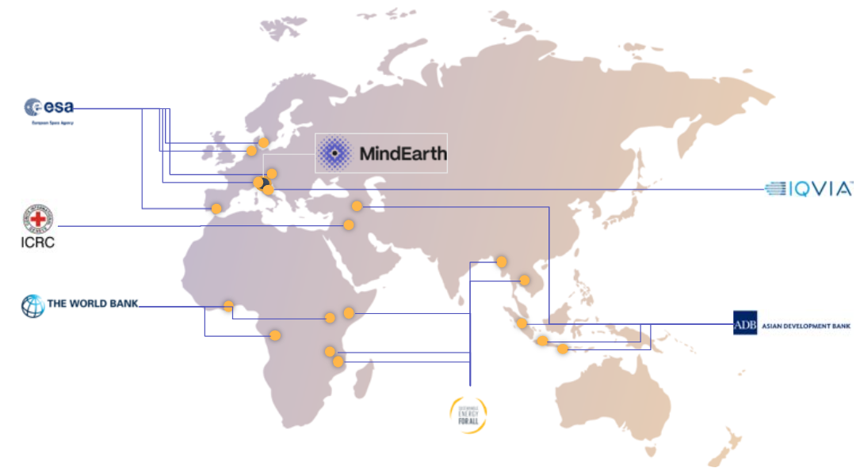







Swiss-based: the global hub of precision, innovation and technological excellence.
Operating globally.
Driven by top-tier technological experts and front-running visionary strategists.

Slide 10



CITYNEXUS PRO
Empowering Sustainable Urban Development through Digital Twin Technology

Slide 11
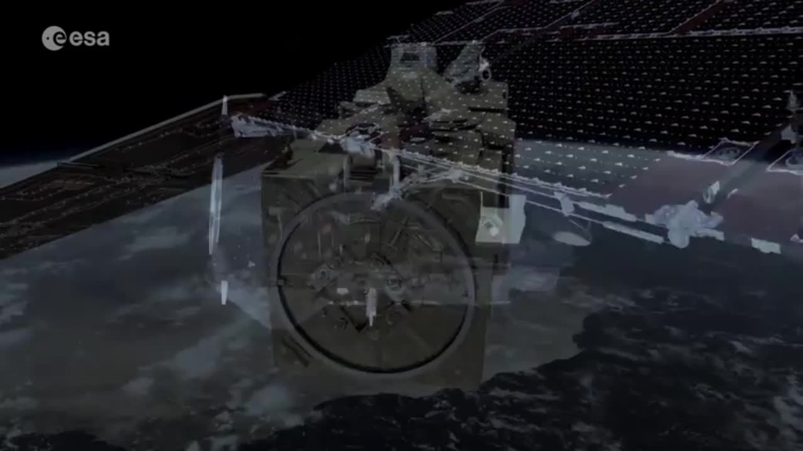
‹#›

Slide 12
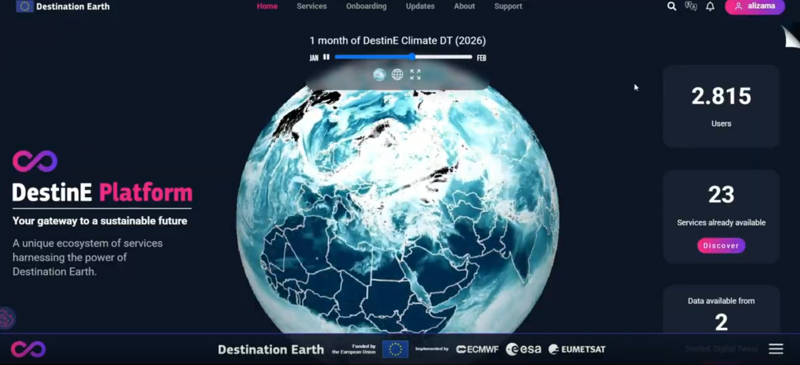
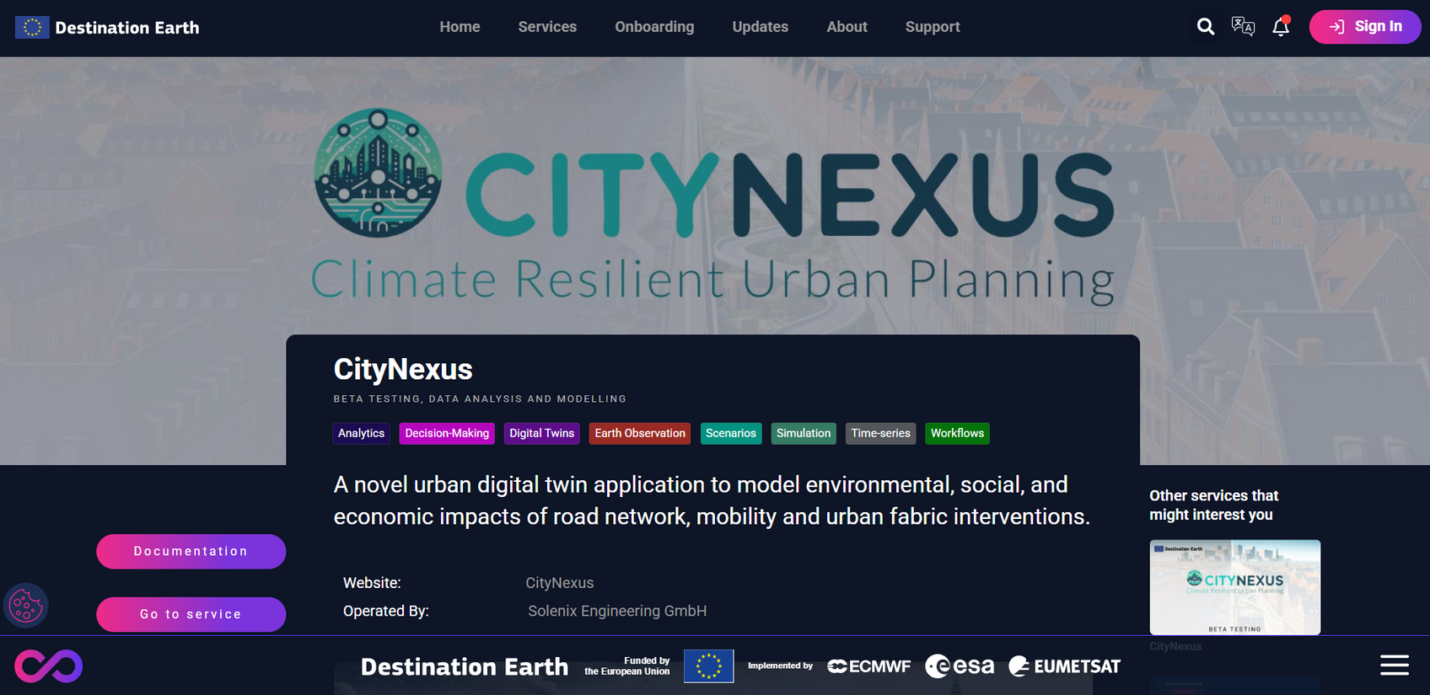

citynexus.destine.eu
Test the platform here!

Slide 13
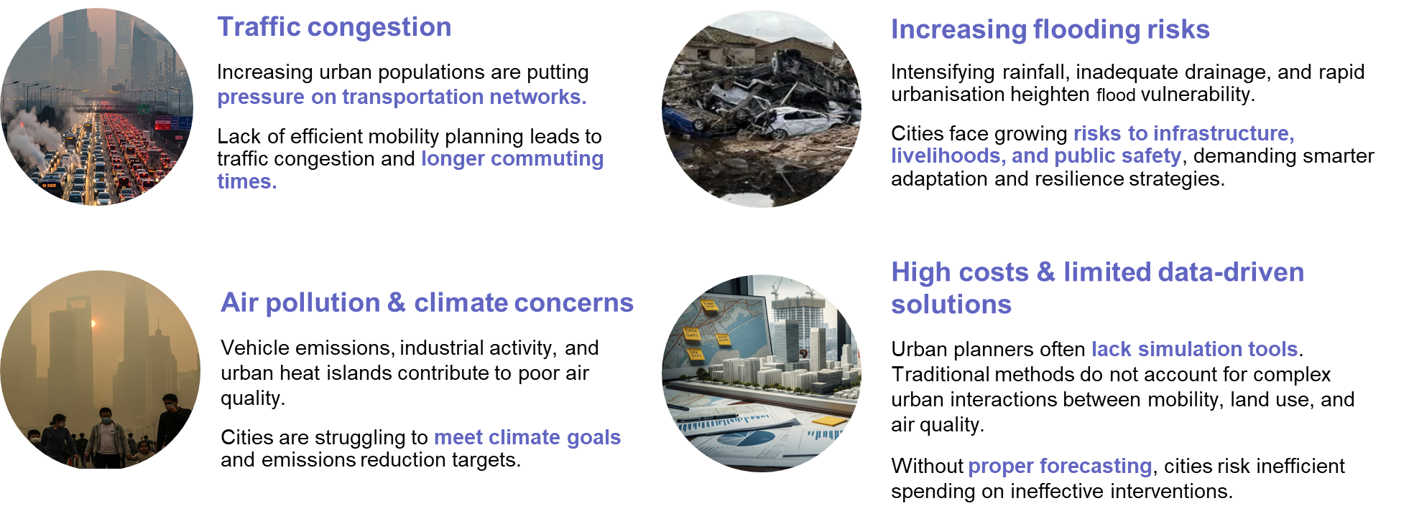
With 70% of people predicted to live in cities by 2050, city authorities are under pressure

Slide 14
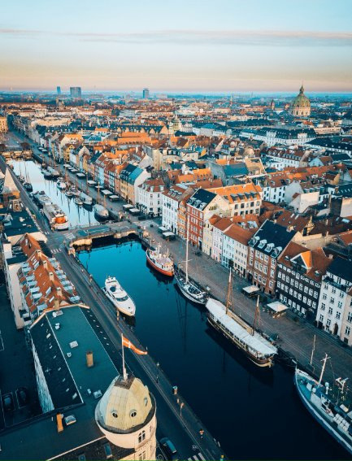
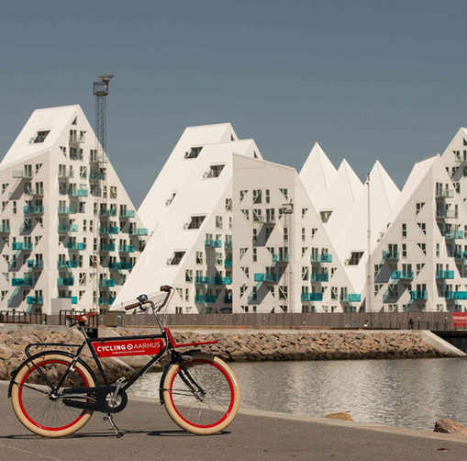

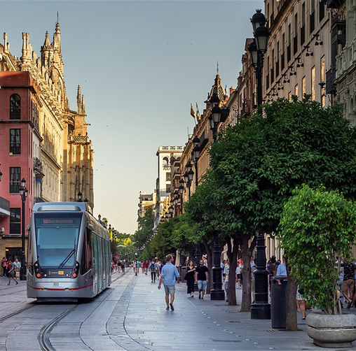
Demonstration cities
Copenhagen (Denmark)​
Aarhus (Denmark)​
Bologna (Italy)
Sevilla (Spain)
Common commitment to achieving climate neutrality and driving sustainable urban development​.
Active pursuit of smarter, more sustainable urban policies through innovation and digitalization.
Diverse urban contexts to test scalable solutions for mobility and air quality.

Slide 15
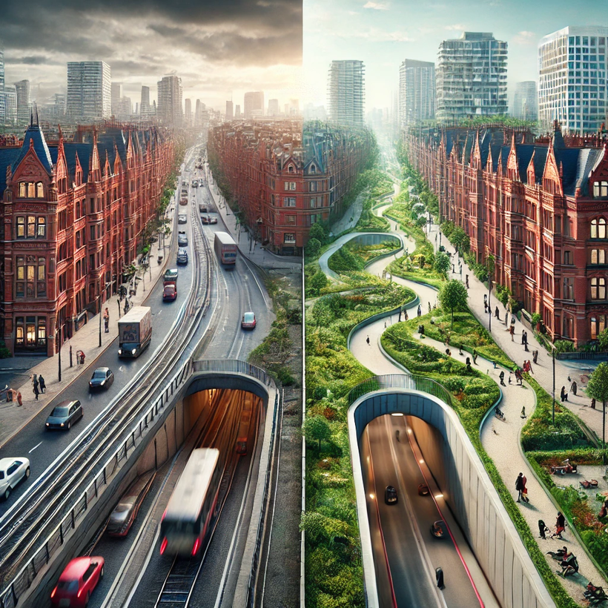

CityNexus is an AI-driven digital twin that helps policymakers, urban planners, and researchers make data-driven decisions to tackle challenges like traffic congestion and air pollution.
It integrates mobility, environmental, and socio-economic information to analyze the effects of urban transformations, infrastructure changes, and transportation policies.
It combines Earth Observation data with empirical mobility data to create "what-if" scenarios and test sustainable mobility interventions and policies, enabling a proactive approach to urban planning and policy design.

Slide 16




End user benefits
Simulate before building
Evaluate new city projects before major investments
Reduce risks
Understand side effects and impacts of potential policy implementation
Enable collaboration
Shared platform oriented to multiple user profiles: policymakers, technicians, researchers, etc.
Drive sustainability
Foster urban development aligned with sustainability goals

Slide 17
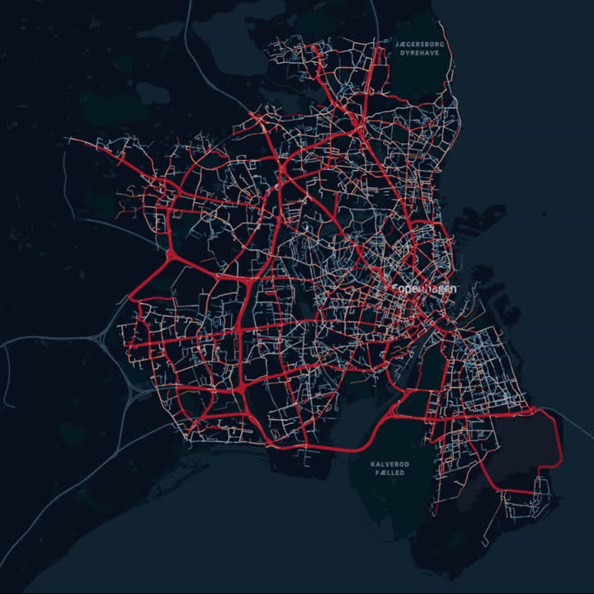
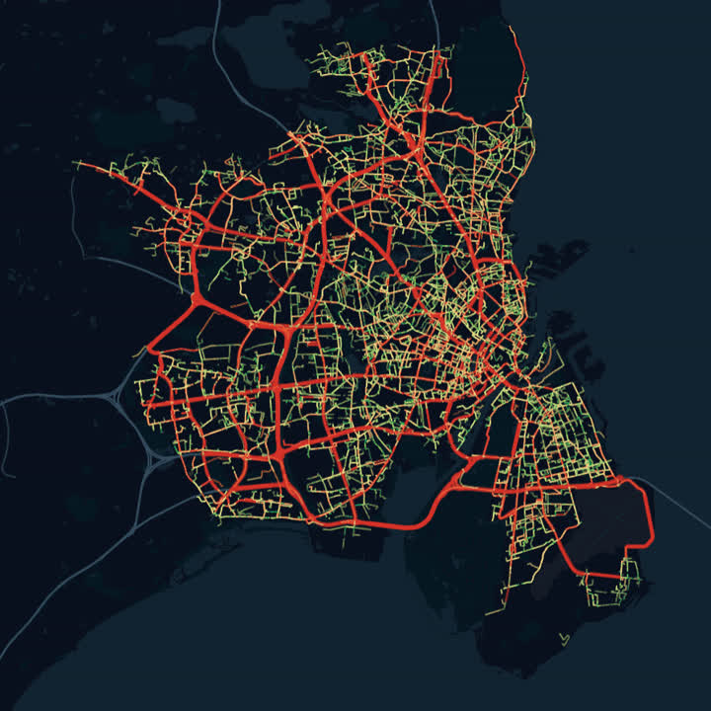
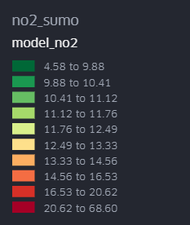
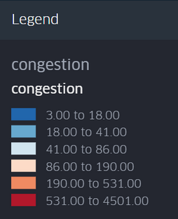
Number of vehicles per road segment
NO2 concentration
NO2 [μg/m3]
N. of vehicles
‹#›

Slide 18
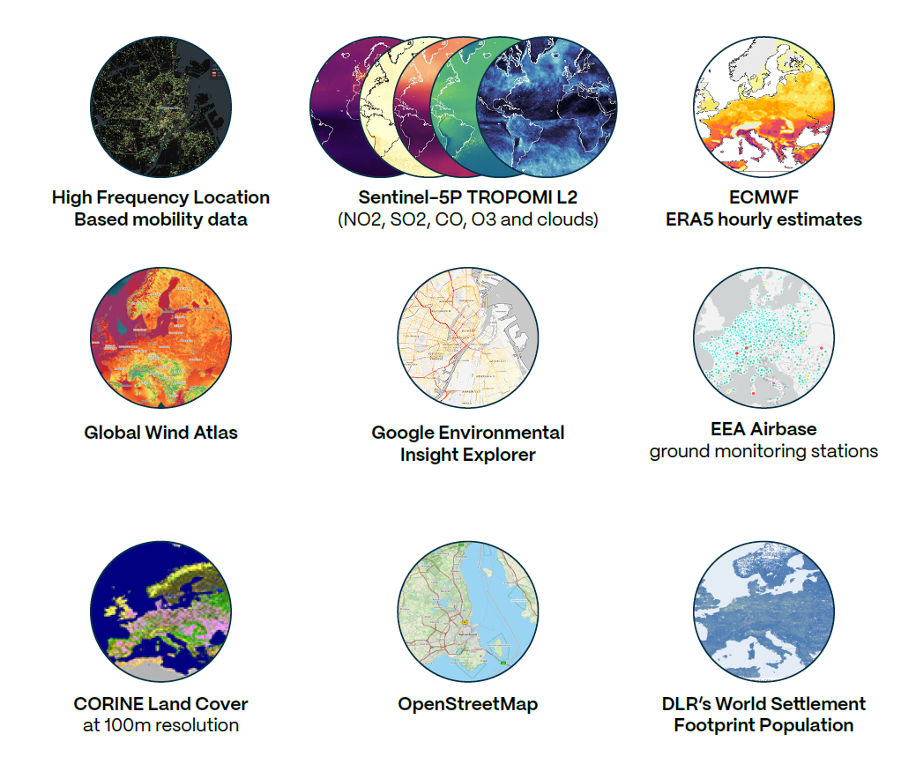
Data sources powering CITYNEXUS
‹#›

Slide 19
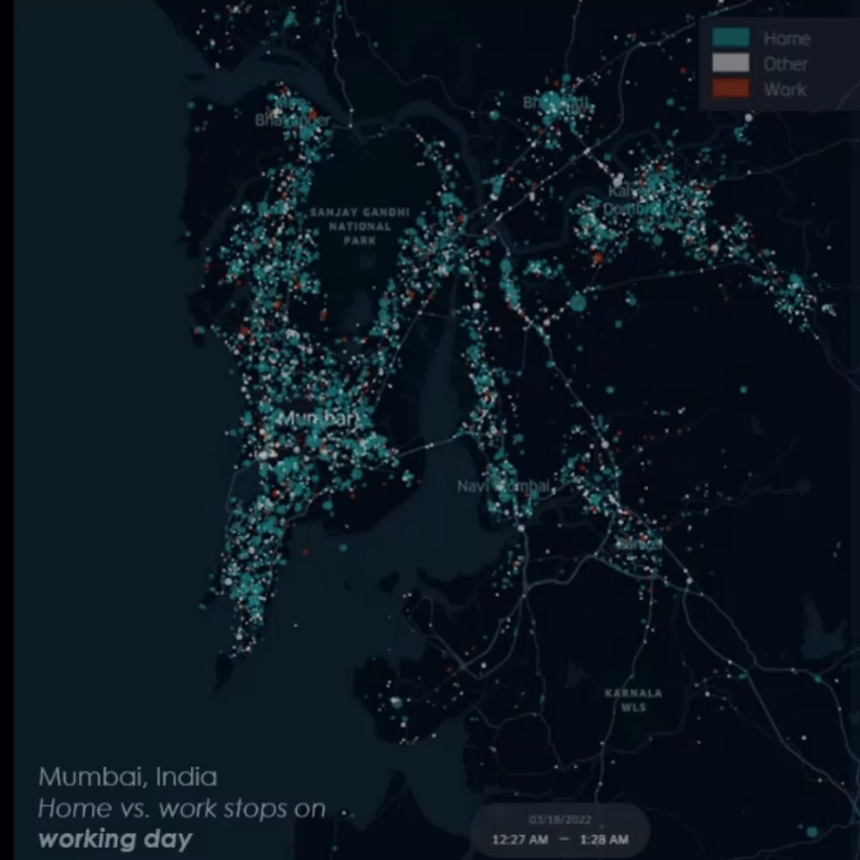




Data sources powering CITYNEXUS
Location traces collected from GNSS-based devices (smartphones), enabling detailed analysis of mobility patterns, travel behavior, and real-time population dynamics across space and time.
User ID
anonymous
Location
(latitude and longitude)
Timestamp
(date and time)
‹#›

Slide 20
Local Mobility & Pollutant Concentration Model
‹#›

Slide 21
Local Mobility & Pollutant Concentration Model
Regional Air Quality Model
‹#›

Slide 22




What-if Scenarios
Users can assess the effects of different intervention, namely:
Road Redesign
Simulate the tunneling of any existing road segment, while repurposing the reclaimed ground for other urban uses.
Low Emission Zone Creation
Convert specific areas to LEZ, where motorized circulation is prohibited or limited to specific types of vehicles.
E-vehicles and Active Mobility
Customize the proportion of these vehicles and modes within the traffic fleet.
Road Speed Adjustment
Adjust to speed limits for specific road segments or entire categories of roads.
‹#›

Slide 23
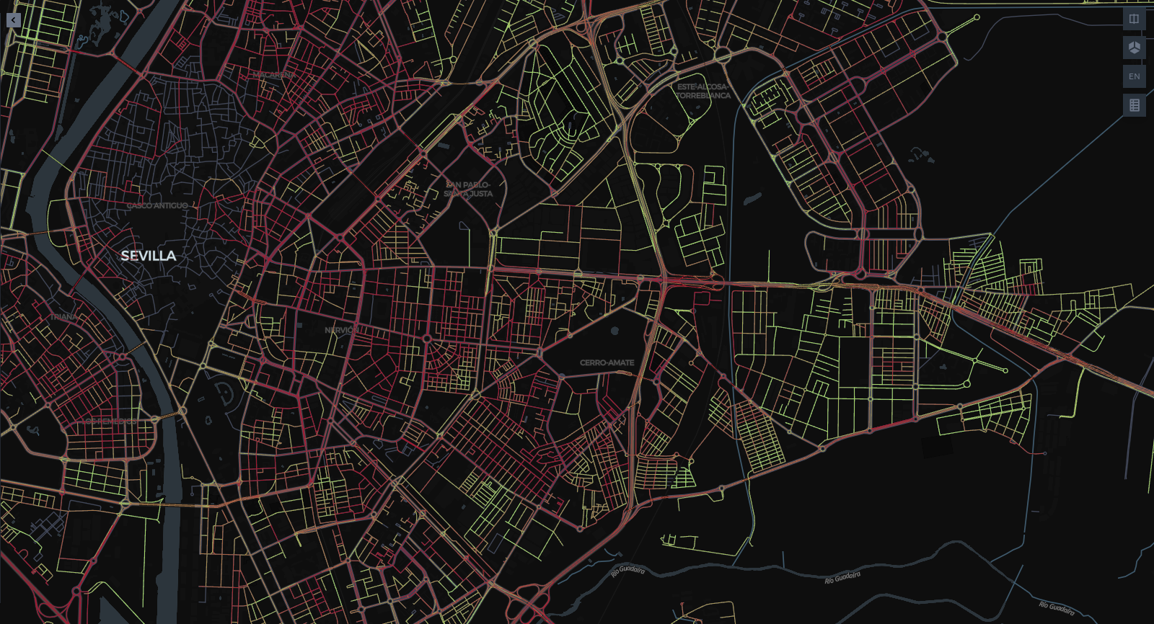
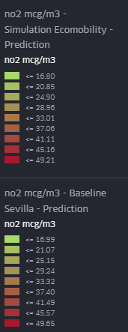
Sevilla – Baseline scenario: NO2 emissions [ug/m3] [g] - 9:00 - weekday
‹#›

Slide 24
Sevilla – Baseline scenario: NO2 emissions [ug/m3] [g] - 9:00 - weekday
LEZ, +20% bike mobility
‹#›

Slide 25
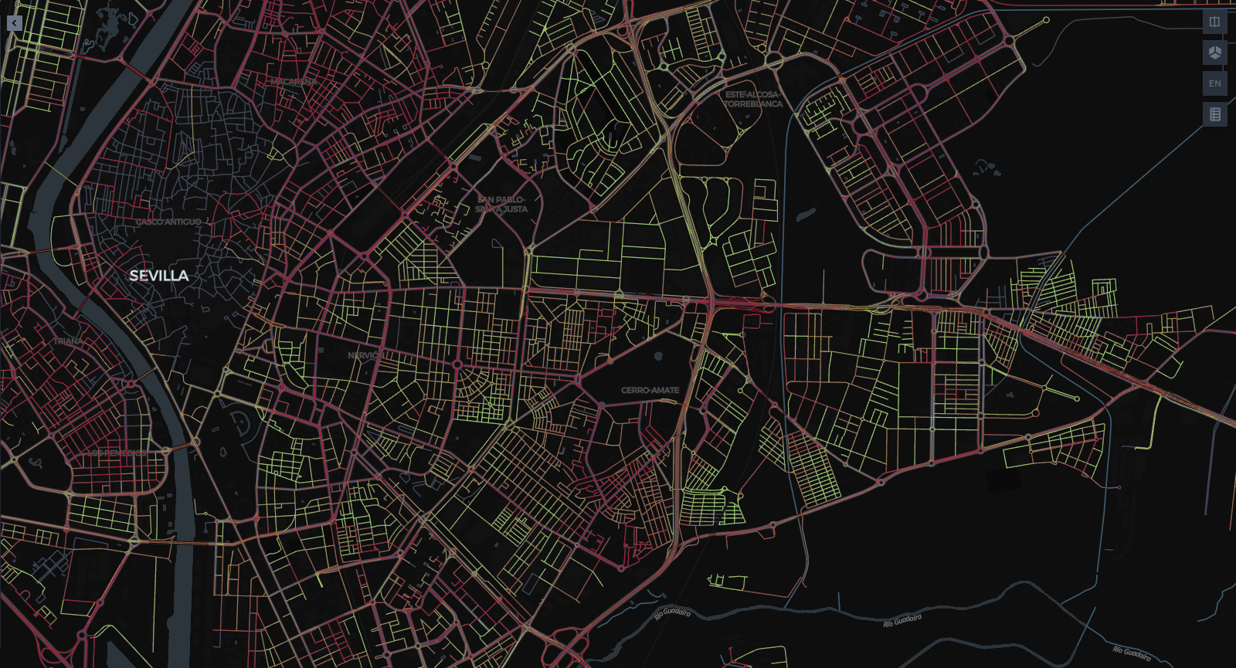
Sevilla – Ecomobility scenario: NO2 emissions [ug/m3] [g] - 9:00 - weekday
LEZ, +20% bike mobility
‹#›

Slide 26

Enhanced scenario definition
Provide users with more interactive tools for defining and customizing urban planning scenarios
Differential NO2 Simulation
Simulate NO₂ concentrations relative to a regional model
Improved visualization tools
Enable better visualization and comparison of scenarios, user experience under the latest version of Kepler.gl
Flood-Mobility Analyses
Integrate flood risk into mobility analyses for better urban resilience planning.
‹#›

Slide 27
Join our upcoming Webinar in November
Test the platform here
citynexus.destine.eu
‹#›

Slide 28



Probabilistic representation of marine submersion forecasts
to support decision-making in crises management

Slide 29
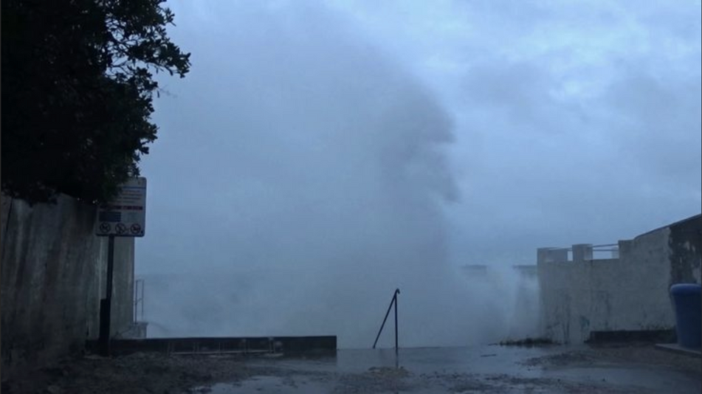
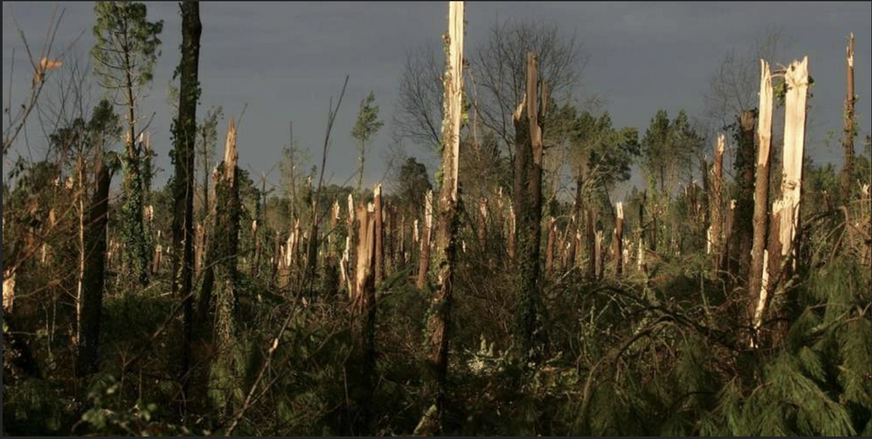
MOTIVATIONS
Marine submersion timings are usually well defined and predicted (high tide)
Phenomenon are very sudden and possibly violent
Storm events are subjects to important meteorological uncertainities due to the unstable nature of atmospheric development
Weather modeller now how to quantify the uncertainities but
They are really hard to intergrate for decision makers

Slide 30
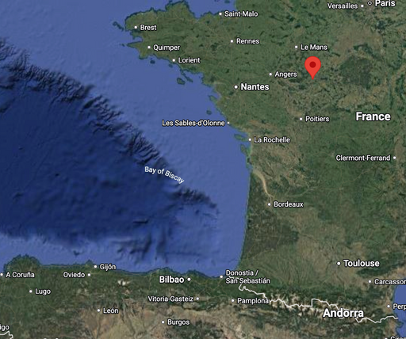
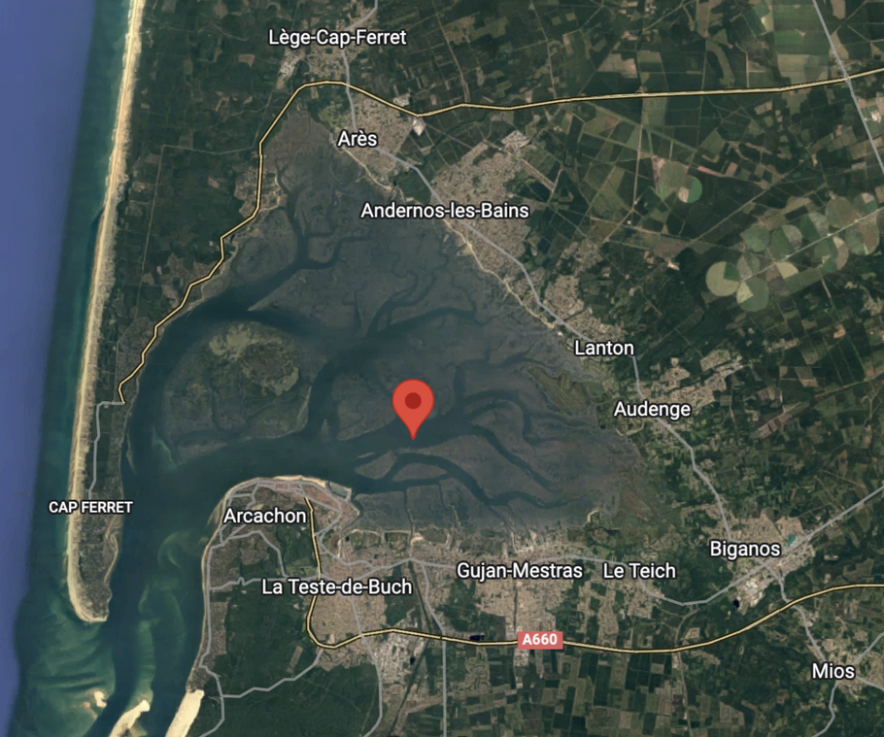
AREA AND SCOPE OF THE EXPERIMENTATION
Arcachon bay
Basin in South West of France,
West of Bordeaux
Celine, Domingos, Kiaran
→ 3 consecutive storms in fall 2023
Local authorities and Network operators
10 municipalities
Regional authority (Préfecture)
Enedis (Electrical DSO)
SIBA (Water operator)
Orange (Telecom operator)

Slide 31
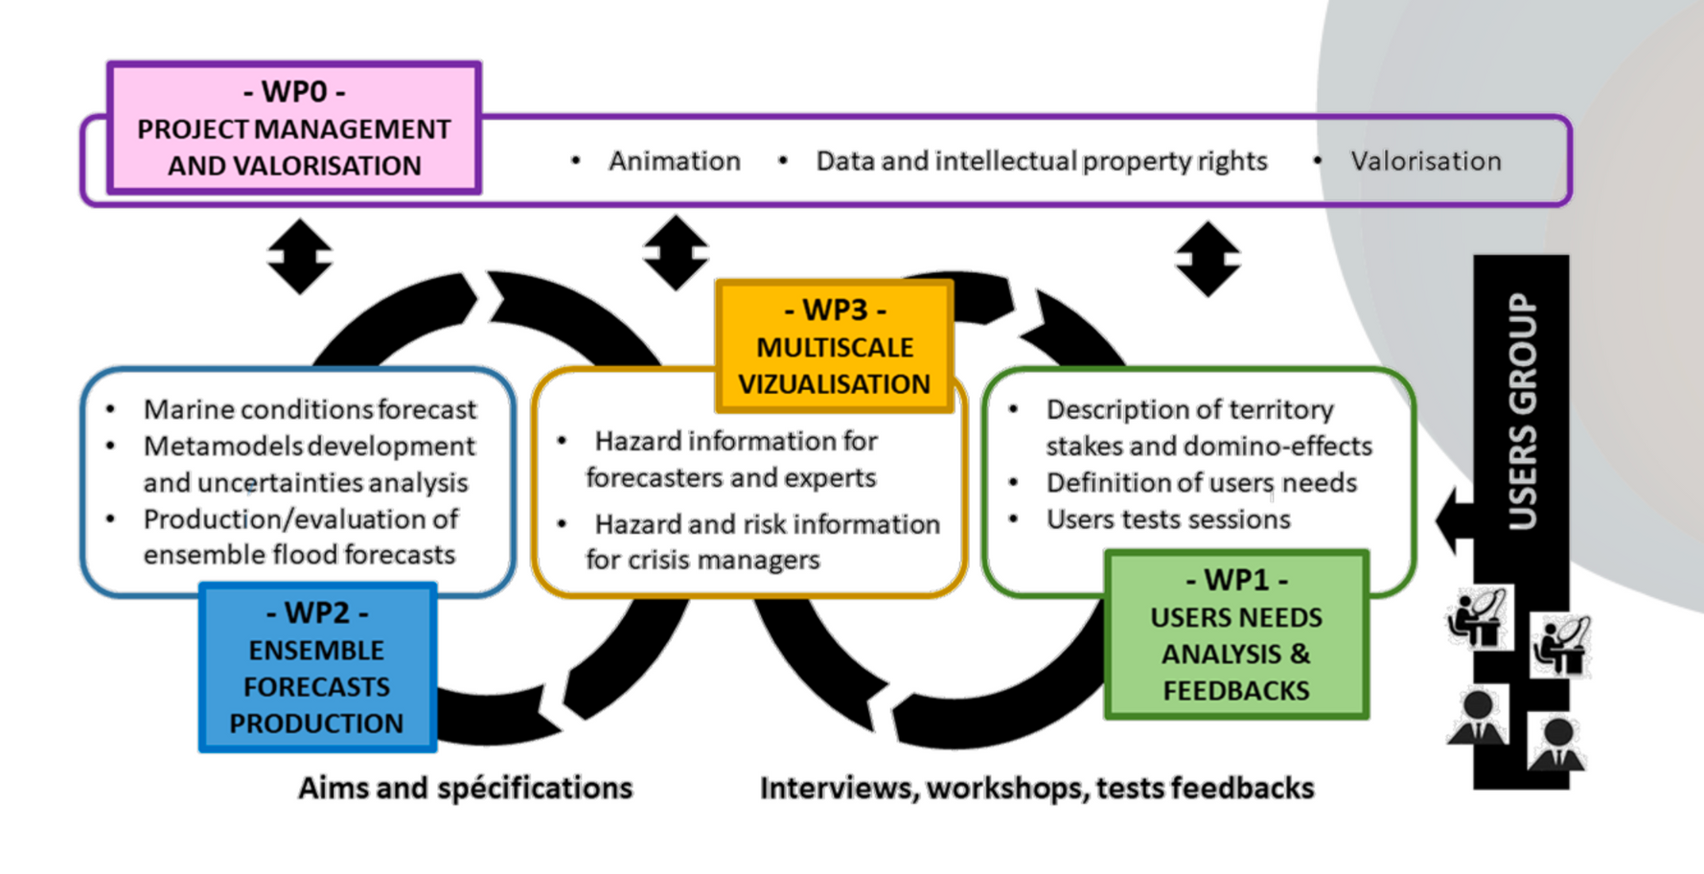
3 WORK PACKAGES
The Phased approach

Slide 32
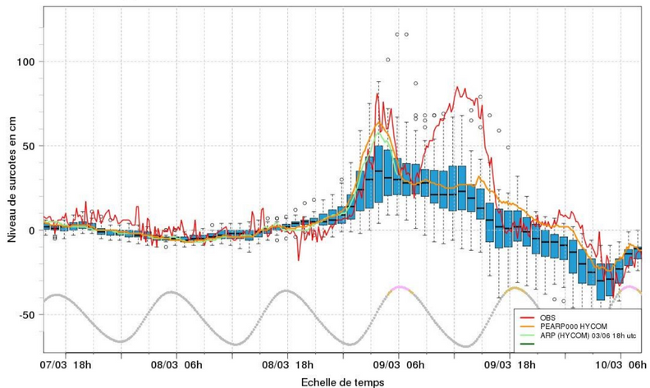
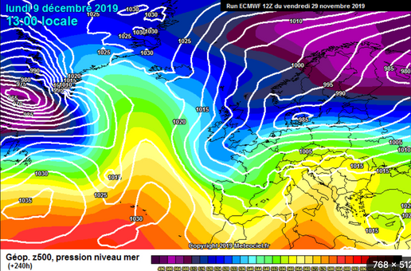
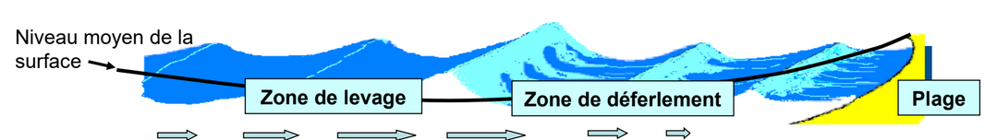
ENSEMBLE FORCASTS
Marine submersion bulletins rely on various parameters
Tide heights
DEFINITE
Wind speeds, direction, wave heights, direction, period
SUBJECT TO UNCERTAINITIES
To quantify forecast uncertainties, weather models compute 35 realisations of oceano-atmospheric state evolution from the current measured state by introducing different set of perturbations (members)

Slide 33
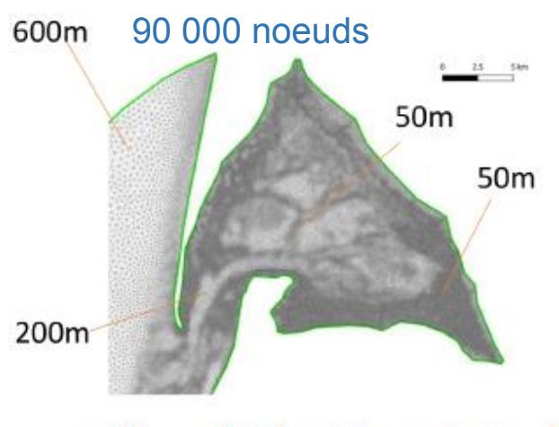
PHYSICAL MODELLING AND META-MODELS
Weather forecast output 6 forcing variables at a point at the entry of the bay
Costal hydrological model is then needed.
Simulations are time-intensive
A collection of reference computations (Atlas) have been built based on the variability of input variables and the sensitivity of the models to each of them
This atlas is then used as a training dataset for a Machine-Learning algorithm in order to quickly associate a submersion simulation to every set of input parameter (Meta-model)

Slide 34
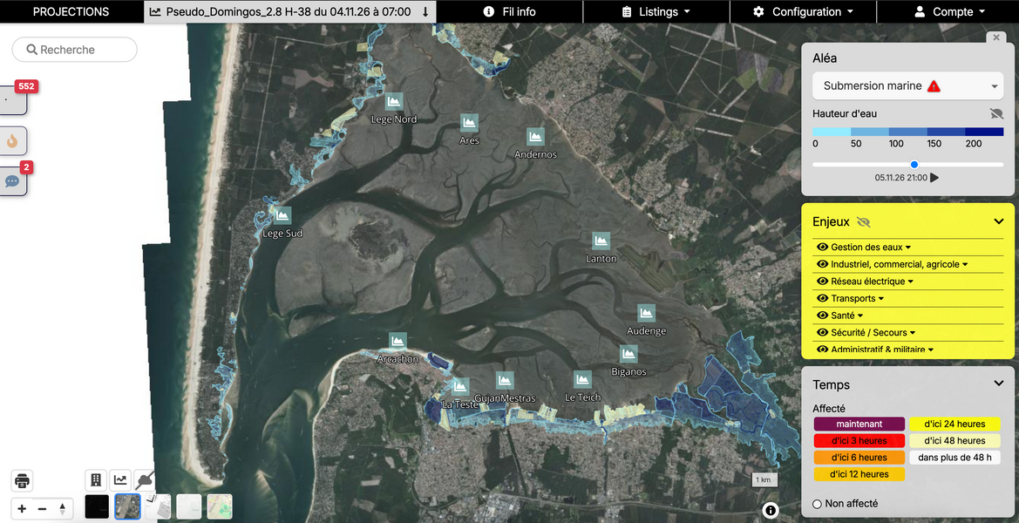
INTERVIEW, USER NEEDS, VULNERABILITIES STUDY
A virtual buoy have been defined at the perpendicular of each city
10 submersion chart associated to each buoy
3 storms were reproduced with its correspondings forecast every 12h up to 3 days before
5 virtual storms were added with higher tide coefficient resultings in 8 total scenarii to be analyzed by decision-makers
15 Interviews conducted:
Presenting the scenarii to each municipality and network operator
Analyze the impacts of the various submersion frames on their infrastructure
Define with them alert categories theresholds

Slide 35
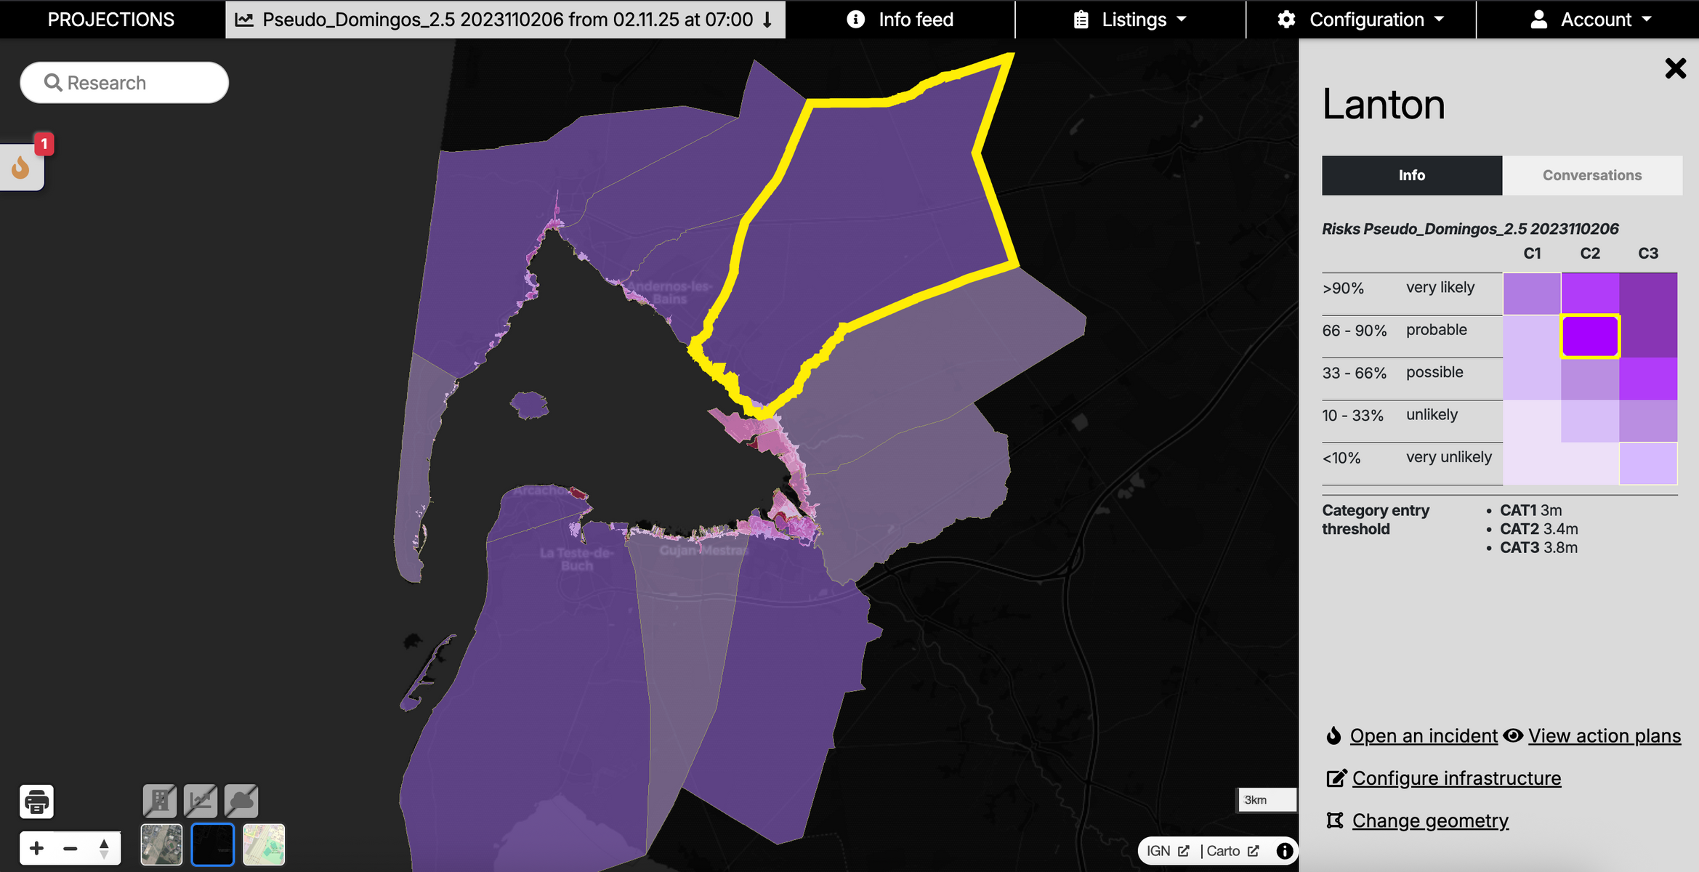
SOLUTION: FROM WEATHER PHYSICIAN VISUALISATIONS TO REGIONAL SCALE

Slide 36
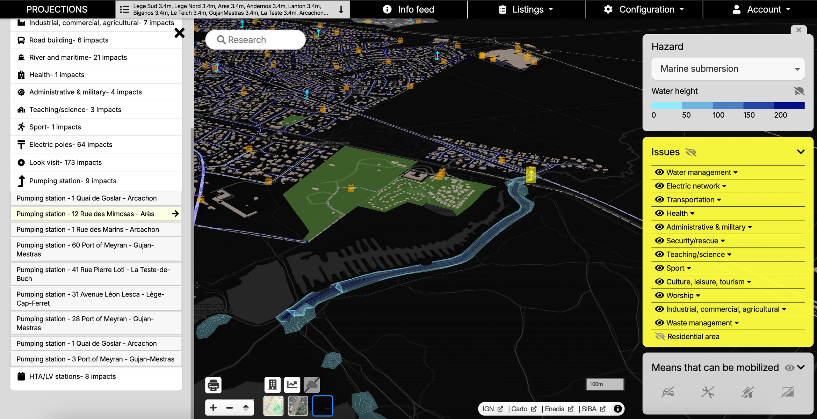
NAVIGATING IMPACTED STAKES AND SCENARII USING PROJECTIONS

Slide 37
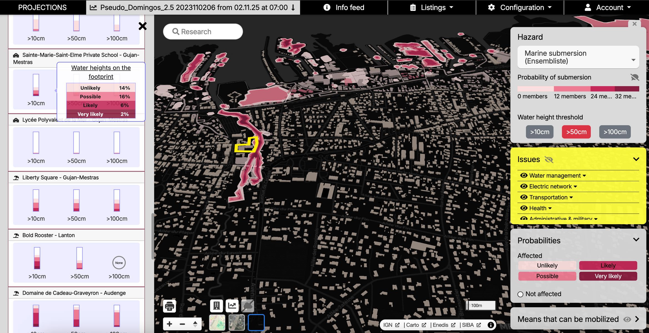
REPRESENTING UNCERTAINTIES FOR NON PHYSICIAN DECISION-MAKERS

Slide 38
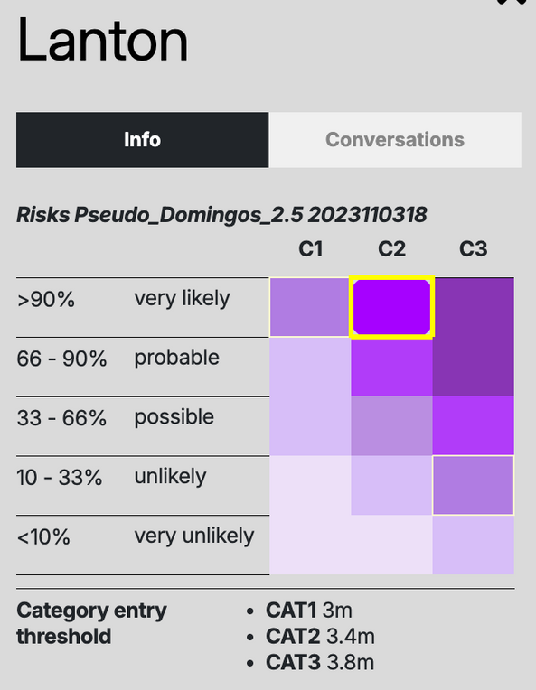
DEFINE ALERT THERESHOLD, A COMMON FRAMEWORK THAT EVERYBODY CAN REFERS TO
Purpose:
Create a shared framework for multi-scale collaboration (municipalities, prefectures, network operators).
Align response efforts despite differing spatial/operational levels.
Impact Categories (Municipal Focus):
C1 – Routine FloodingNear-annual, minor consequences → Municipality self-sufficient.
C2 – Severe ImpactsPopulation/ activities/ property affected
→ Municipality still autonomous.
C3 – Major CrisisWidespread damage
→ External support required.

Slide 39
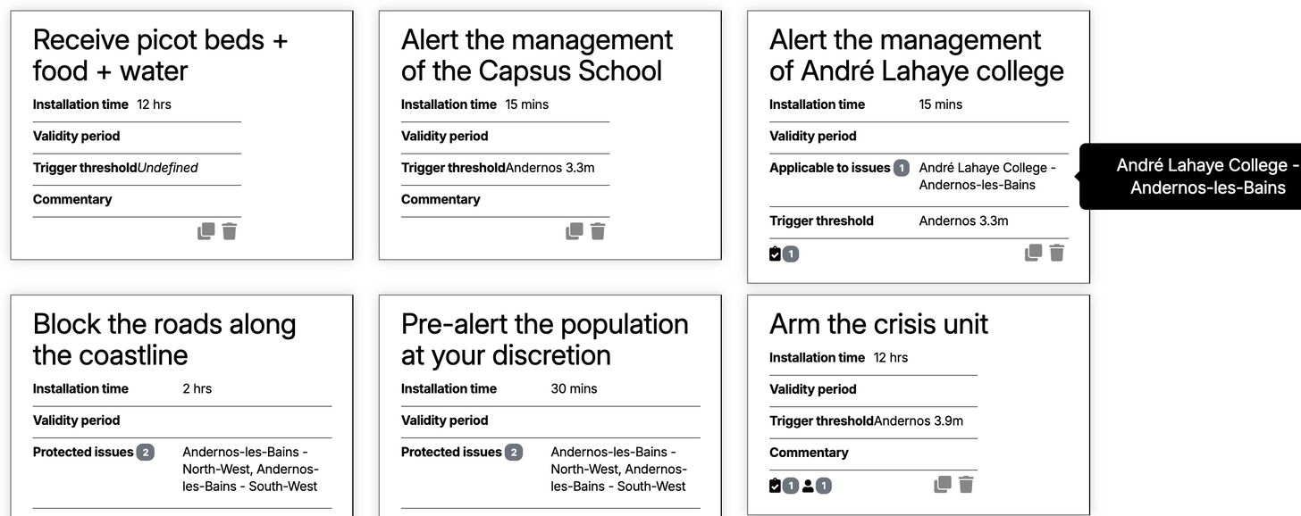
DESIGN RESPONSES PLANS TO PROBABILISTIC MARINE SUBMERSION FORECASTS
Key Mechanisms:
Thresholds: Clear triggers to shift between categories (tailored to local risks).
Probability Integration:
Avoid false alarms and missed critical events.
Enable gradual, timely escalation (prevent "too late" scenarios).
Outcome: Smarter Graduated Intervention Plans—balanced, adaptive, and territory-specific.

Slide 40

THE SPACE BETWEEN US:
BRIDGING SATELLITES AND SMART CITIES
GEOSPATIAL TOOLS FOR CITIES FOCUS GROUP
Are you a city representative or do you work with a local administration?
How much do you know about satellites and space solutions and their role in urban contexts?
We want to learn more from you!
Complete our survey and help us gain more insights on the topic!
If you are interested in joining the Focus Group and for any question contact us:
xavier.casanova@iclei.org
gabriella.quattropanetti@eurisy.eu
fanni.torok@eurisy.eu

